Slide 1
Imbalanced MC Timeseries Study
Exploratory Data Analysis and Modeling Summary

Slide 2
Project Goal
Analyze class imbalance in door_type
Summarize EDA insights for data quality and risk
Compare data transformation, imputation, sampling, and multiclass strategies

Slide 3
Datasets
Registry rows: 504
Catalog rows: 18
Maintenance history rows: 504
Sources: registry.csv, catalog.csv, history.csv

Slide 4
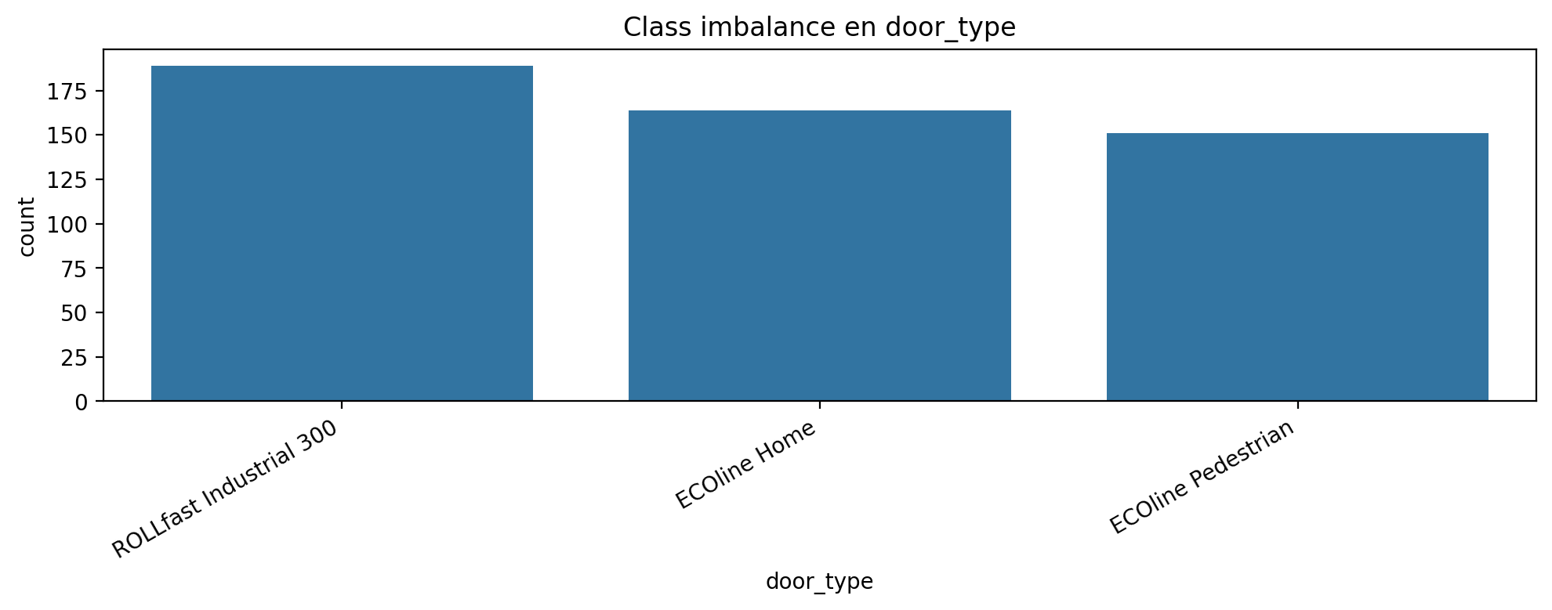
Class Imbalance (door_type)

Slide 5
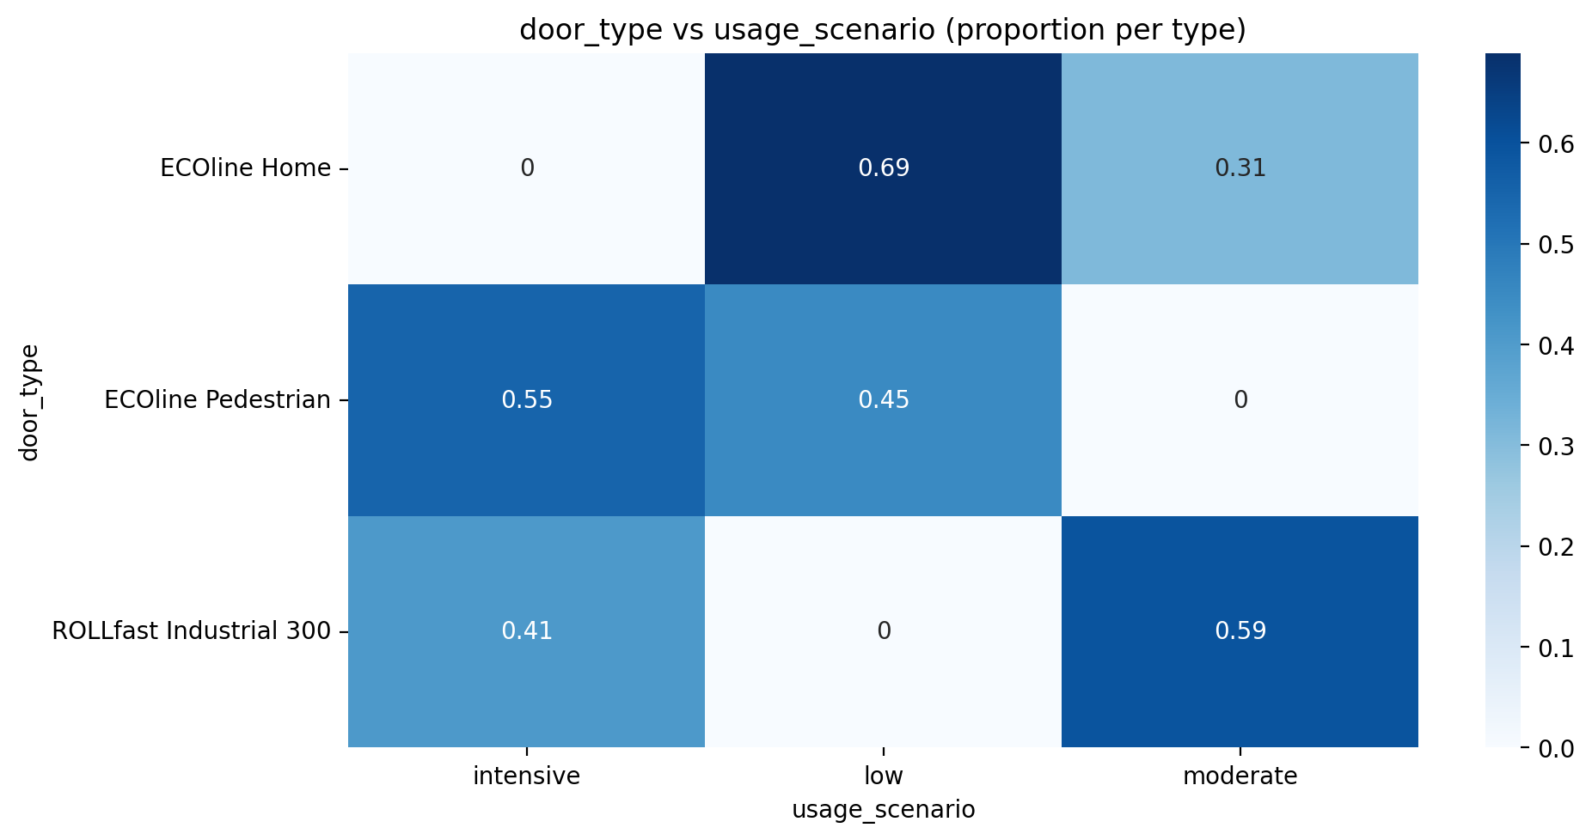
Usage Scenario Mix by Door Type

Slide 6
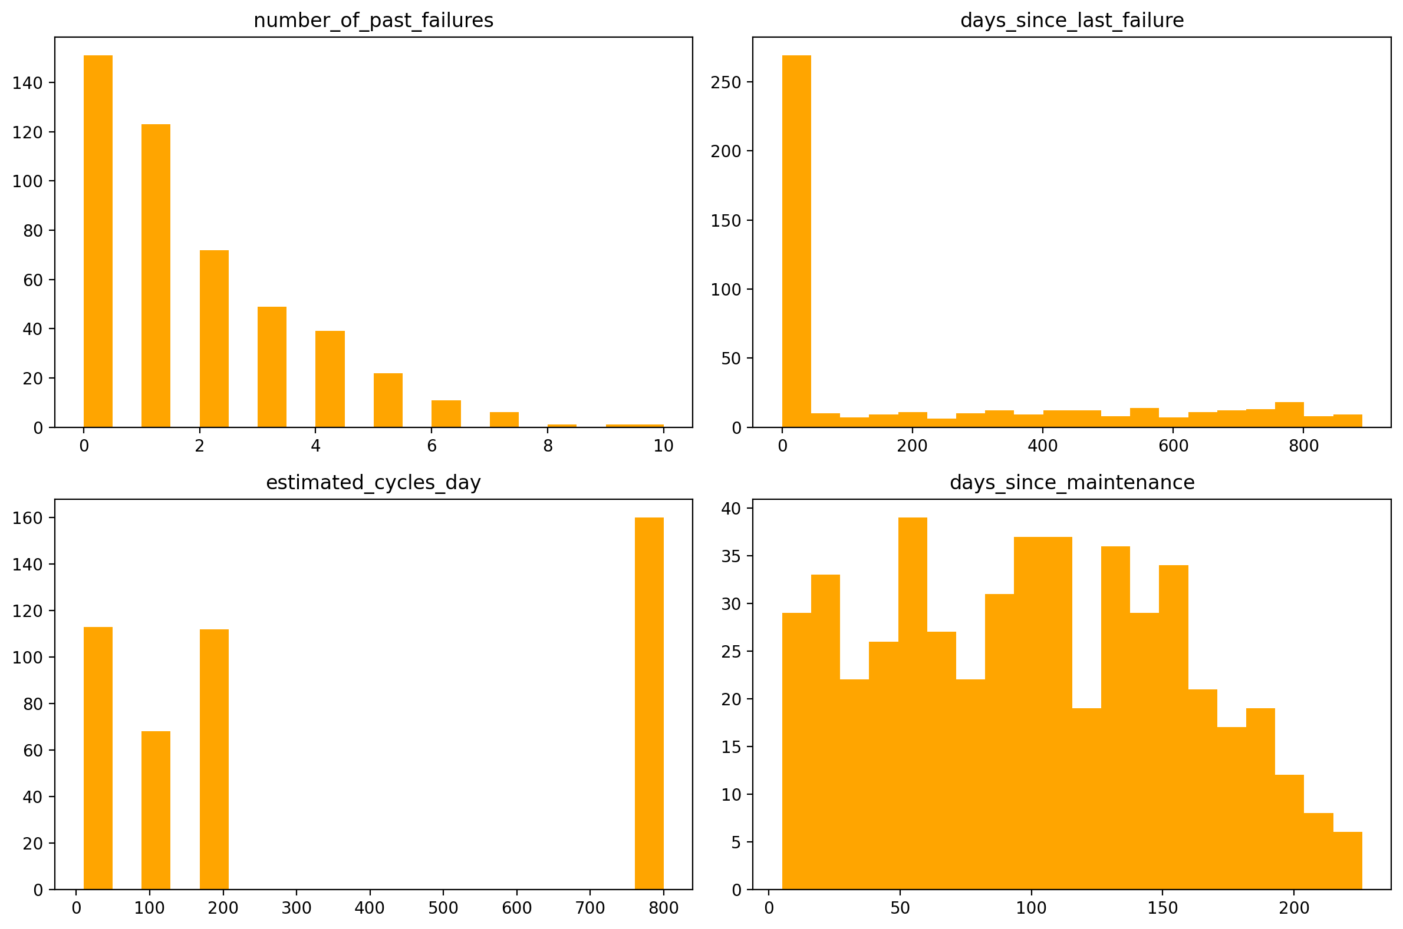
Numeric Distributions

Slide 7
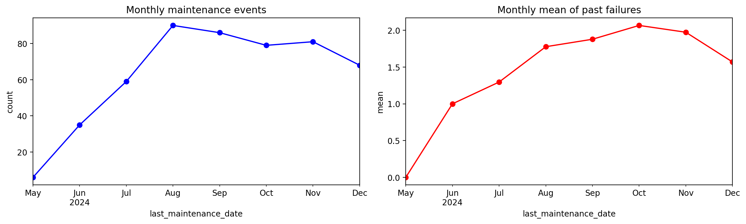
Monthly Maintenance Time Series

Slide 8
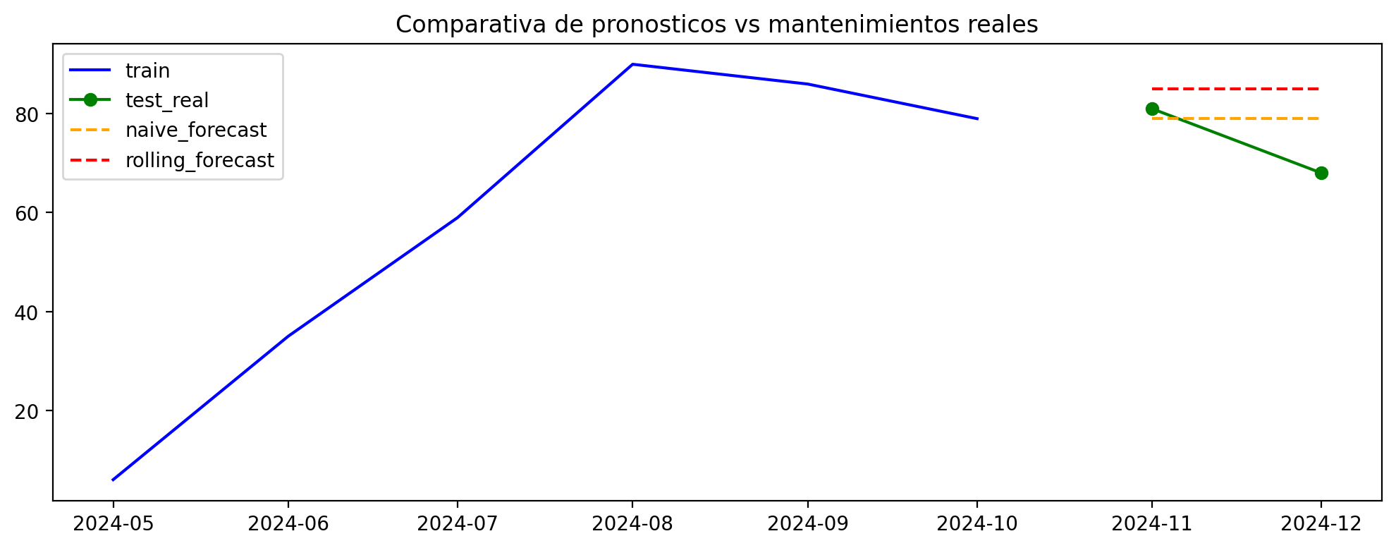
Forecast Baseline Comparison

Slide 9
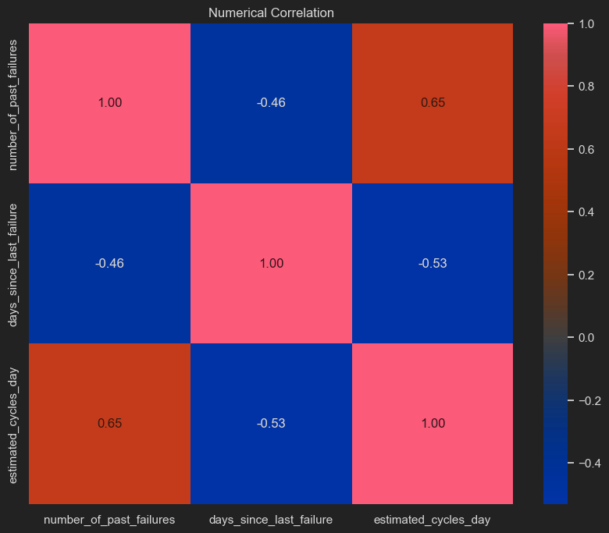
Numeric Correlation

Slide 10
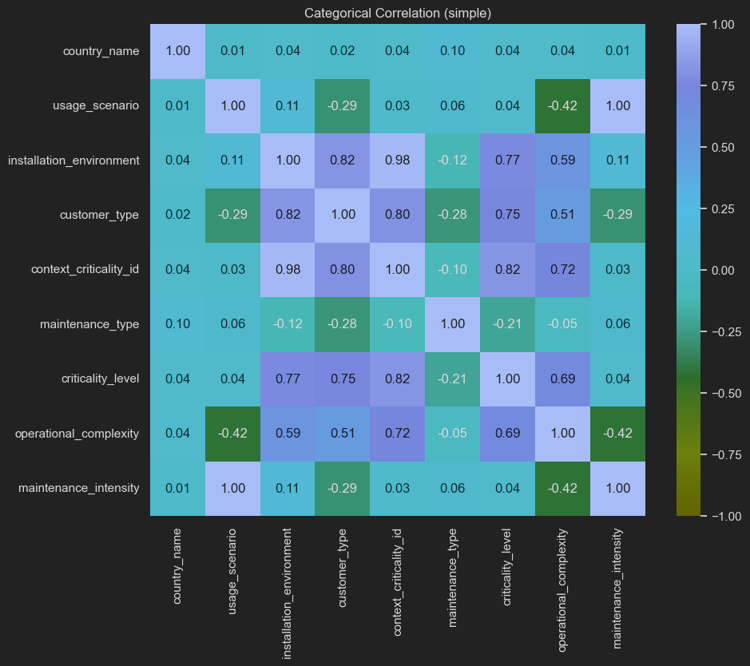
Categorical Correlation

Slide 11
Data Transformation
Normalize installation_environment labels
Join registry + history + catalog on door_id and context columns
Drop high-missing columns: days_to_next_failure, failed_next_30_days
One-hot encode categorical variables before modeling

Slide 12
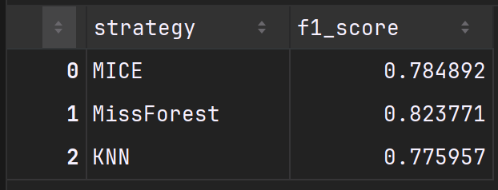
Imputation Techniques
Compared MICE, KNN, and MissForest
Metrics below use RandomForest + macro F1

Slide 13
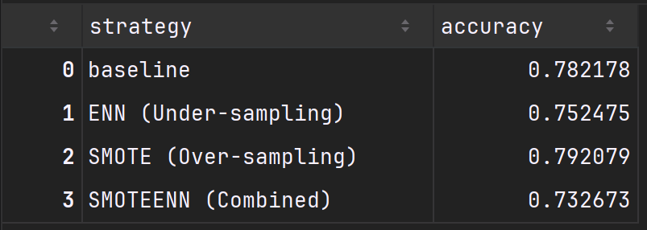
Sampling: Under vs Over
Compared baseline, ENN, SMOTE, SMOTEENN

Slide 14
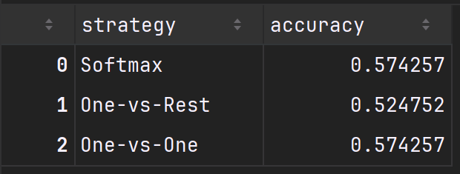
Multiclass Classification
Softmax Logistic Regression vs One-vs-Rest vs One-vs-One

Slide 15
Next Steps
Tune hyperparameters and evaluate with cross-validation
Add feature selection or dimensionality reduction
Extend forecasting with more advanced time-series models

