Slide 1
Explainability and Interpretability
Applied to Cirrhosis Patient Survival Prediction

Slide 2
Project Goal
Evaluate imputation strategies on missing clinical data
Address class imbalance in the target variable (Status)
Compare multiclass classification approaches
Explain model predictions using SHAP, LIME, PDP, ALE and DiCE

Slide 3
Dataset
Rows: 418 patients
Target: Status (C | CL | D)
Class imbalance: CL = 6%, C = 55%, D = 39%
Missing values: 106 non-trial patients
Source: cirrhosis.csv

Slide 4
Preprocessing Pipeline
1
Drop ID + Convert Age
Remove ID column. Convert Age from days to years (Age/365.25
2
Log transformation
log(1+x) applied to Bilirubin, Cholesterol, Copper, Alk_Phos, SGOT, Tryglicerides
3
Encode Categorical
get_dummies on Drug, Sex, Ascites, Hepatomegaly, Spiders, Edema
4
Train/Test Split
80/20 stratified split. Imputation fitted only on X_train to avoid data leakage

Slide 5
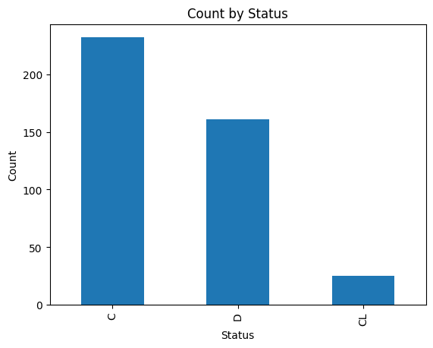
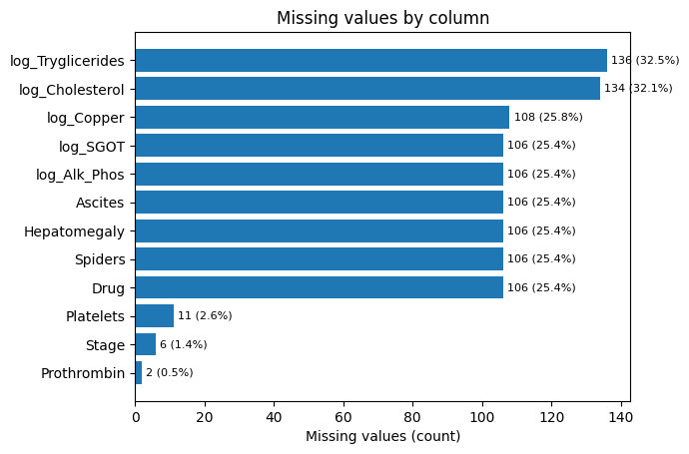
EDA: Status Distribution and Missing Values Analysis

Slide 6
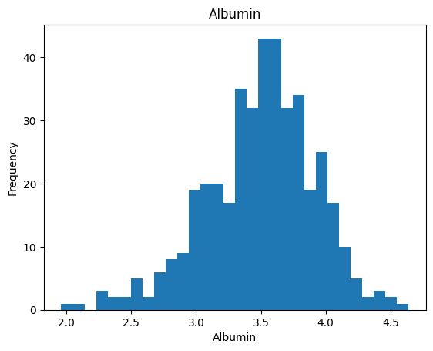
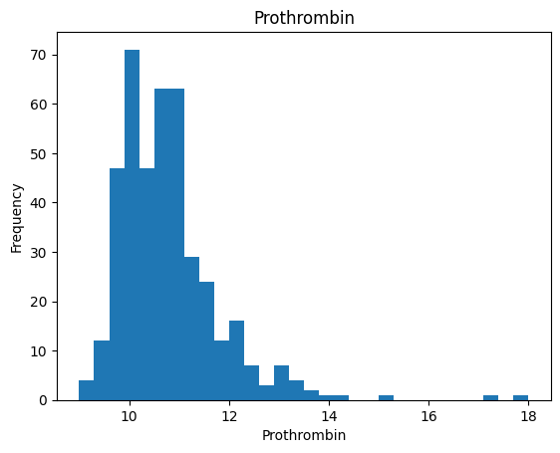
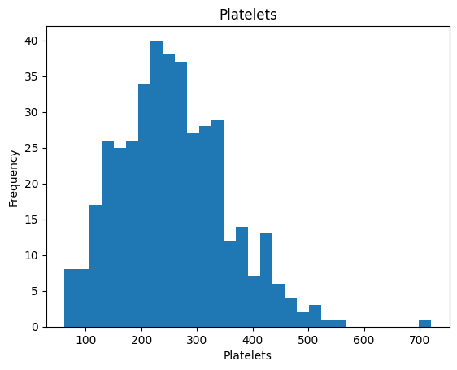
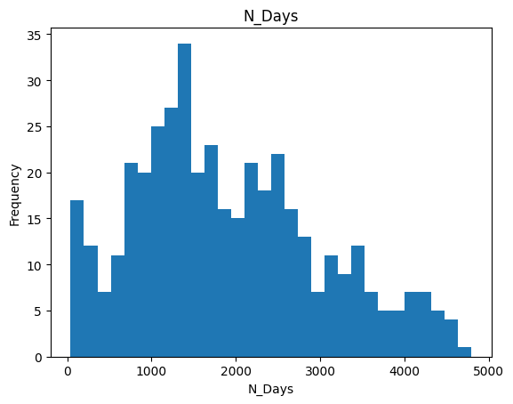
EDA: Numeric Distributions

Slide 7
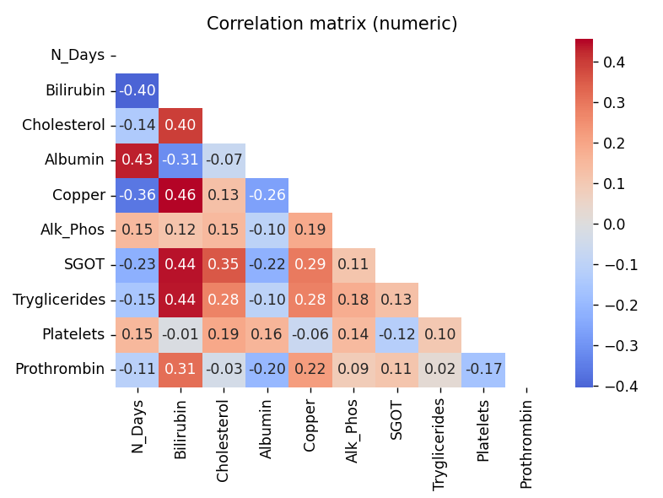
EDA: Correlation between variables

Slide 8
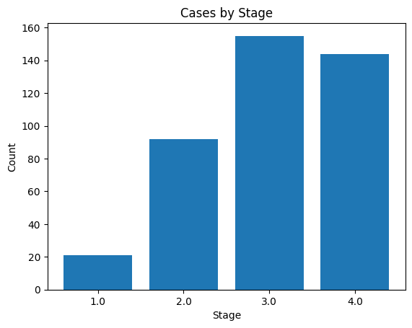
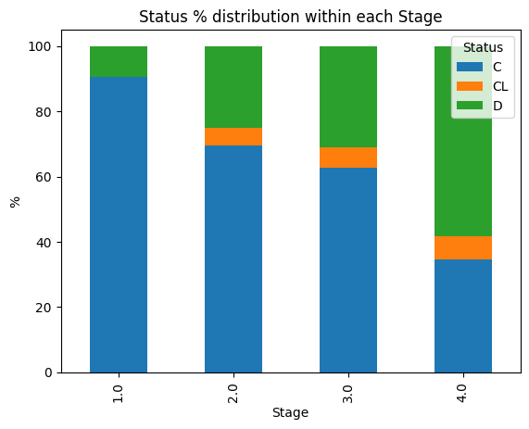
EDA: Case Distribution and Clinical Status by Disease Stage

Slide 9
Imputation and Class Imbalance
Imputation Strategy Comparison
Sampling Strategy Comparison
Strategy | Macro F1
MICE ✓ (selected) | 0.537
MissForest | 0.526
KNN | 0.526
Strategy | Accuracy
Baseline ✓ (selected) | 0.810
SMOTE | 0.774
ENN | 0.750
SMOTEENN | 0.750

Slide 10
Multiclass Strategies and Model Selection
Multiclass Strategy Comparison
Random Forest - Classification Report
Strategy | Accuracy
Softmax ✓ | 0.738
One-vs-One | 0.726
One-vs-Rest | 0.726
Class | Precision | Recall | F1
C | 0.79 | 0.96 | 0.87
CL | 0.00 | 0.00 | 0.00
D | 0.85 | 0.72 | 0.78
Macro avg | 0.55 | 0.56 | 0.55

Slide 11
Deep Learning Model for Cirrhosis Prediction
Neural Network Architecture & Optimization

Slide 12
Project Overview
Dataset: Cirrhosis Patient Survival Prediction
Task: Multiclass Classification (3 classes: C, D, CL)
Input Features: 19 numerical features
Output: Patient status classification
Framework: PyTorch + Optuna for hyperparameter tuning

Slide 13
Dataset Characteristics
Aspect | Details
Input Dimension | 19 features
Output Classes | 3 (C, D, CL)
Target Variable | Status (Cirrhosis outcome)
Main Features | Age, Bilirubin, Albumin, Prothrombin, Platelets, etc.
Preprocessing | Log transformation on skewed columns

Slide 14
Neural Network Architecture
Layer 1: Input (19) → Hidden Layer 1 (h1 neurons) + ReLU
Layer 2: Hidden Layer 1 (h1) → Hidden Layer 2 (h2 neurons) + ReLU
Layer 3: Hidden Layer 2 (h2) → Hidden Layer 3 (h3 neurons) + ReLU
Layer 4: Hidden Layer 3 (h3) → Output (3 classes)
Total Parameters: Dynamically tuned via Optuna
Activation Function: ReLU (hidden layers)
Output Activation: None (raw logits for CrossEntropyLoss)

Slide 15
Optuna Hyperparameter Space
Hyperparameter | Range | Type
h1 (Layer 1 neurons) | 16 - 128 | Integer
h2 (Layer 2 neurons) | 16 - 128 | Integer
h3 (Layer 3 neurons) | 16 - 128 | Integer
Learning Rate (lr) | 1e-5 - 1e-2 | Float (log)
Momentum (beta_1) | 0.8 - 1.0 | Float
Weight Decay | 1e-5 - 1e-1 | Float (log)
Scaling (beta_2) | 0.9 - 1.0 | Float

Slide 16
Training Configuration
Optimizer: Adam with dynamic hyperparameters
Loss Function: CrossEntropyLoss (multiclass classification)
Train/Validation/Test Split: 60% / 20% / 20%
Batch Size: 64
Scaling: StandardScaler for input features
Target Encoding: LabelEncoder (C→0, D→1, CL→2)

Slide 17
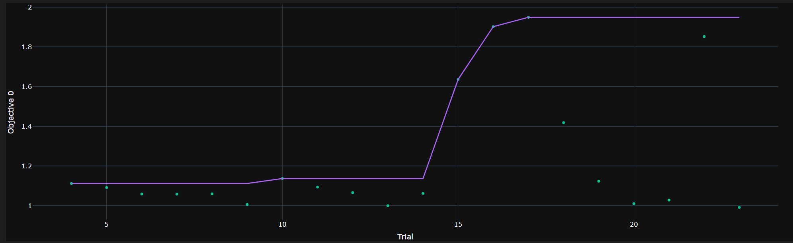
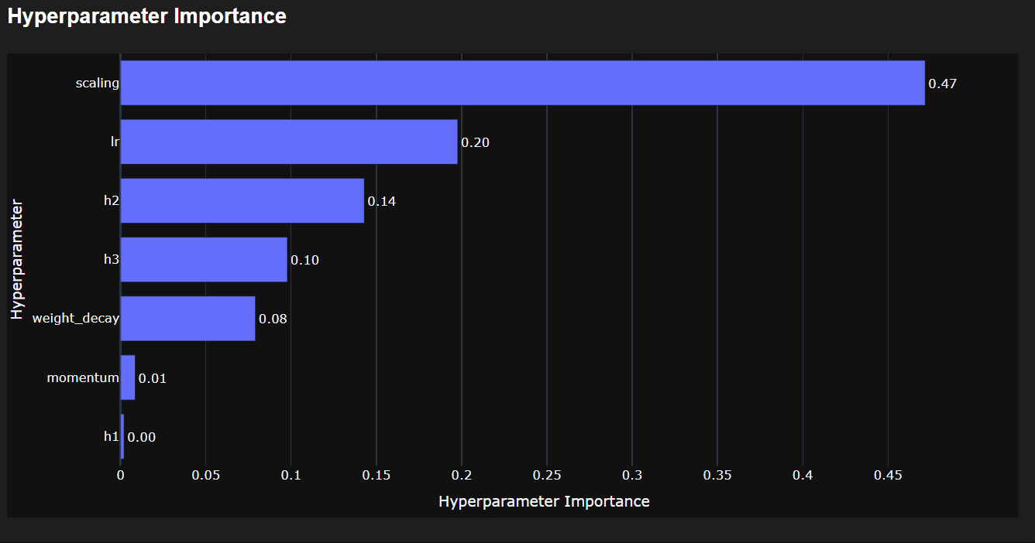
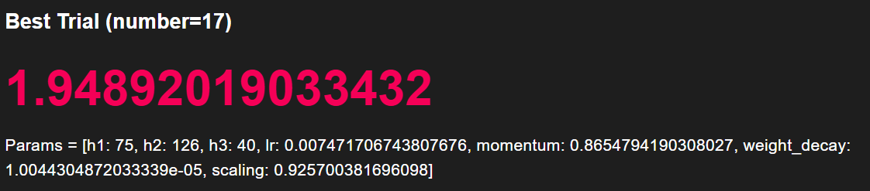
Optuna Results

Slide 18
Hyper Parametters
H1 : 75
H2 : 126
H3 : 40
lr : 0.0075
Momentum : 0.86
Weigh decay : 1.004e-05
Scaling : 0.92

Slide 19
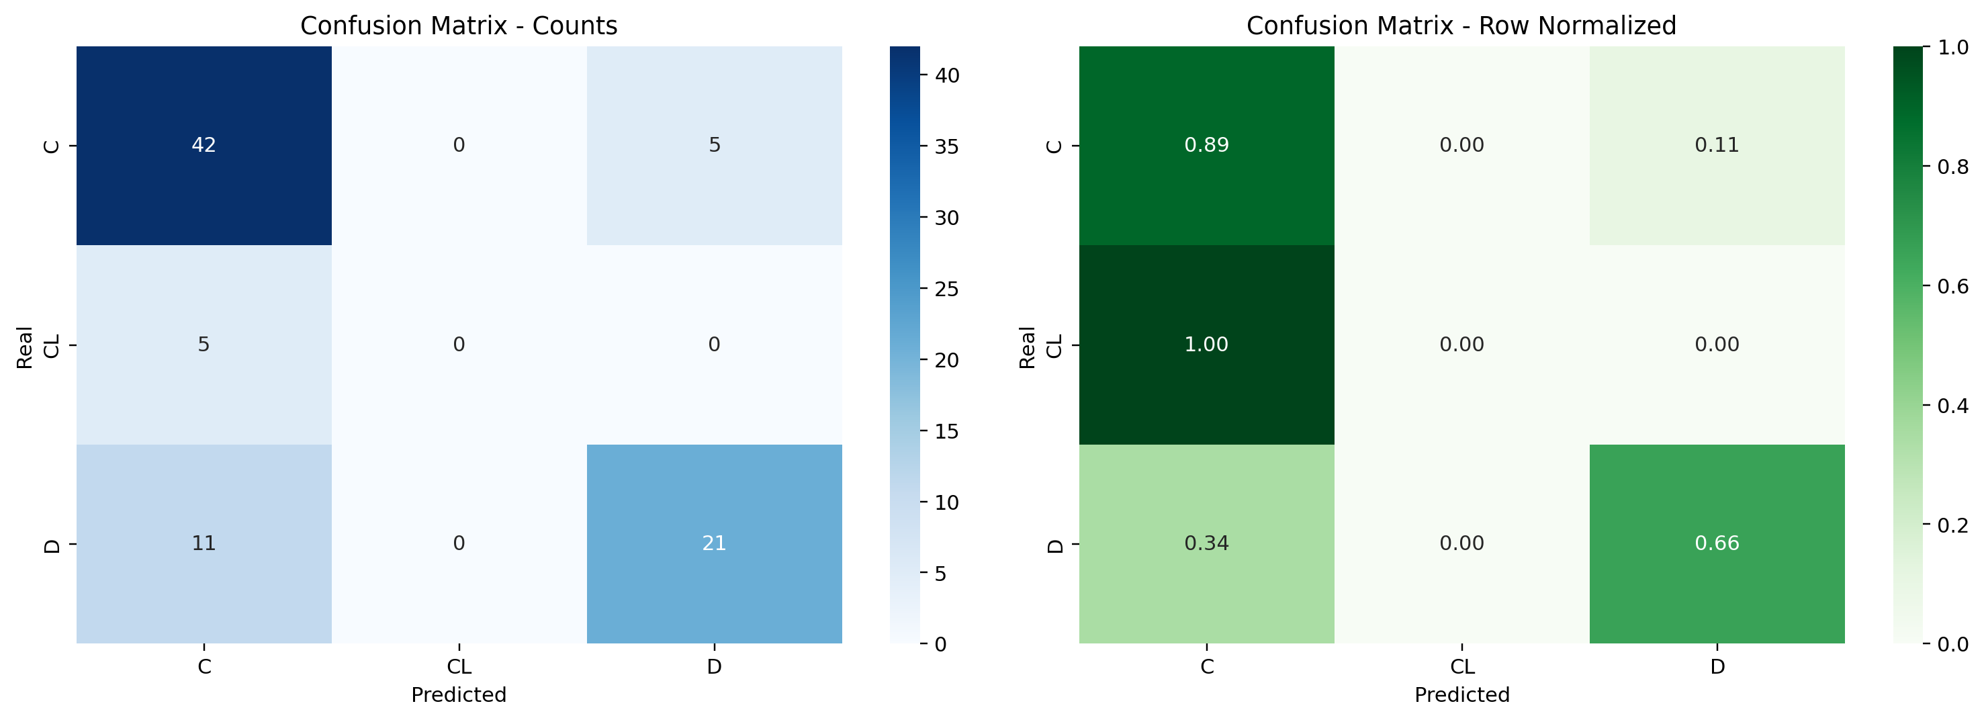
Results

Slide 20
Explainability

Slide 21
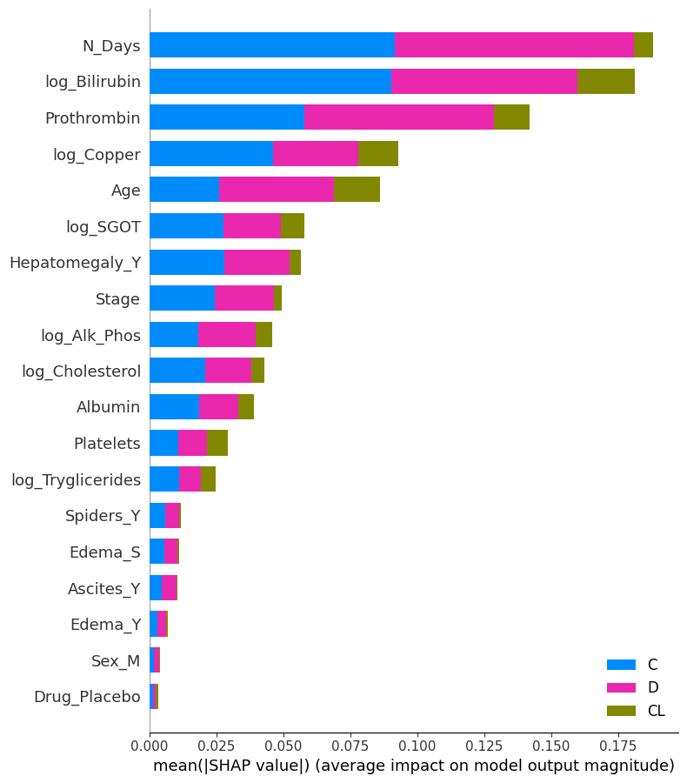
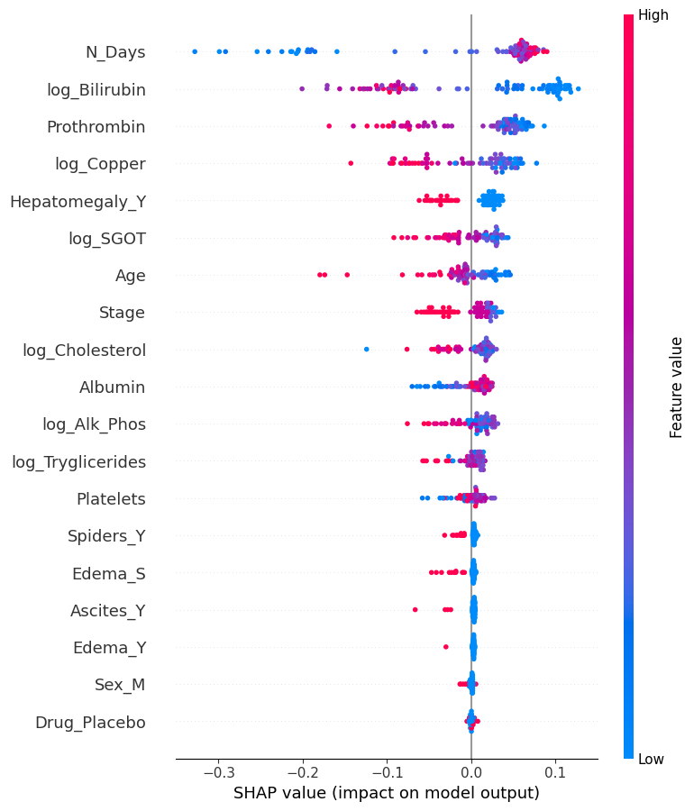
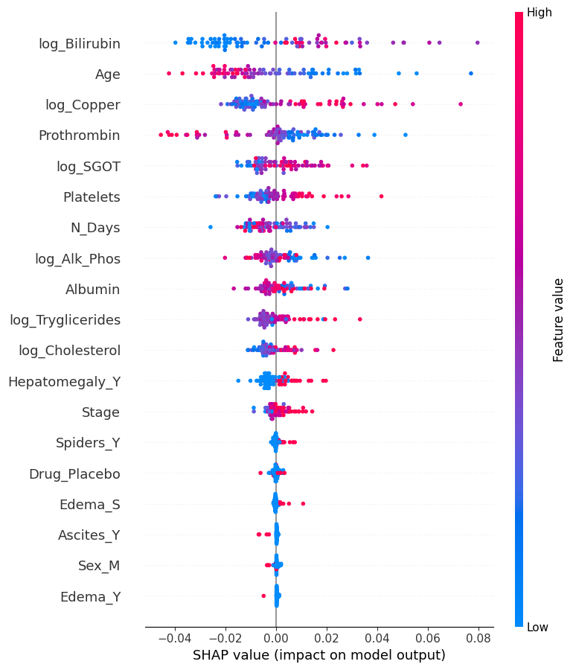
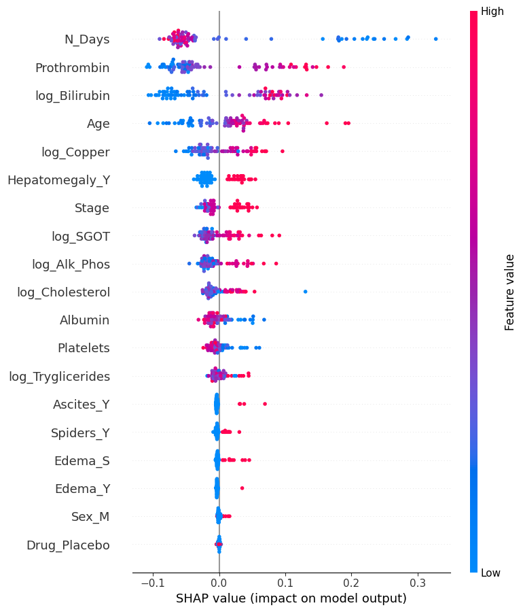
Explainability: SHAP

Slide 22
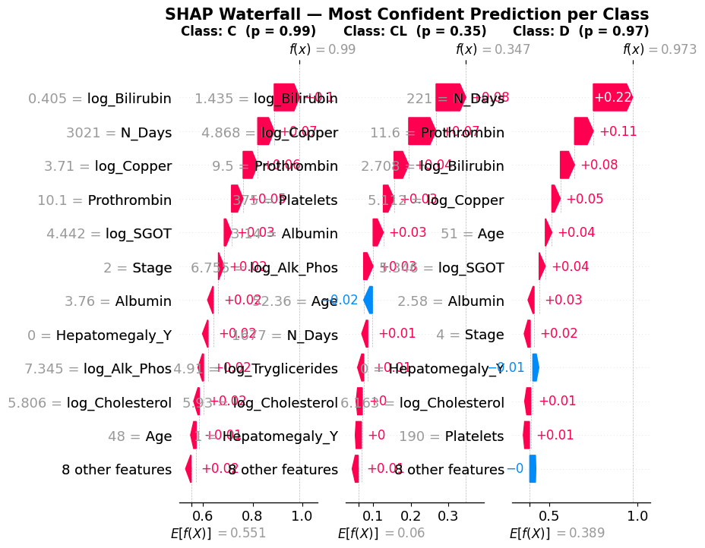
Local explainability: SHAP

Slide 23
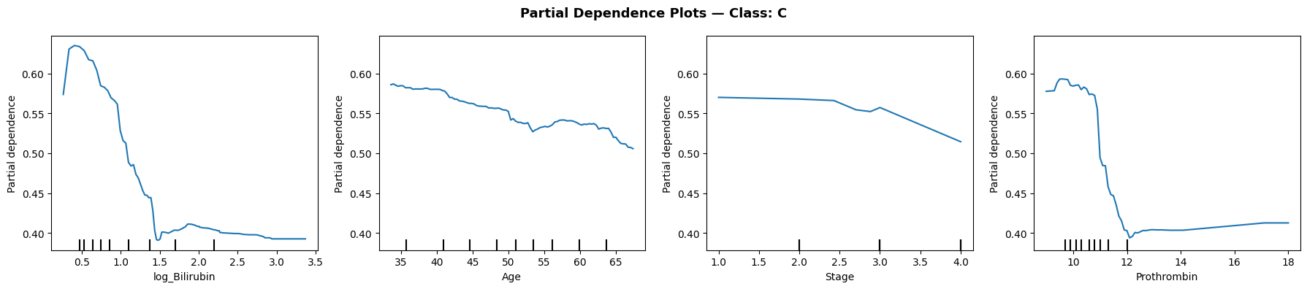
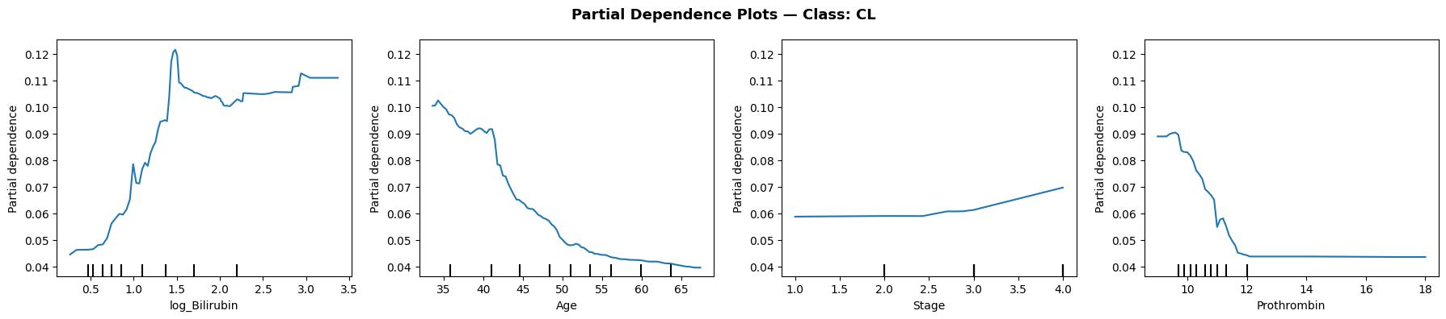
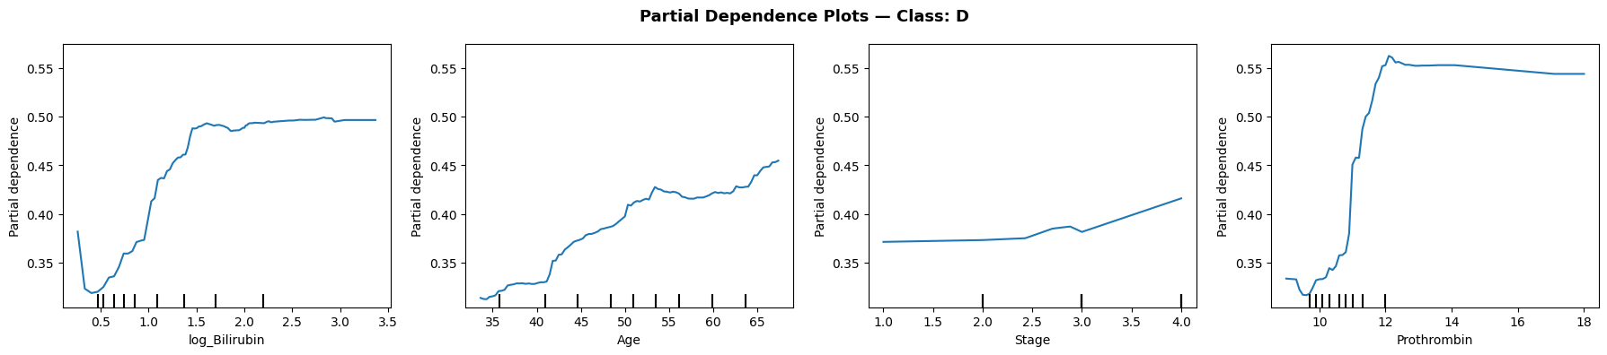
PDP (Partial Dependence Plots)

Slide 24
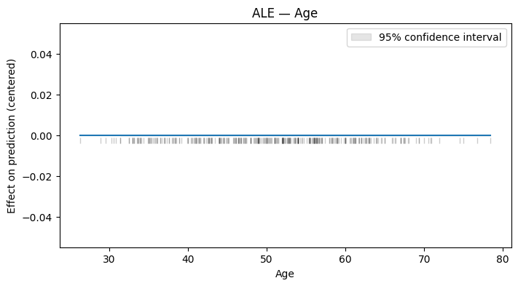
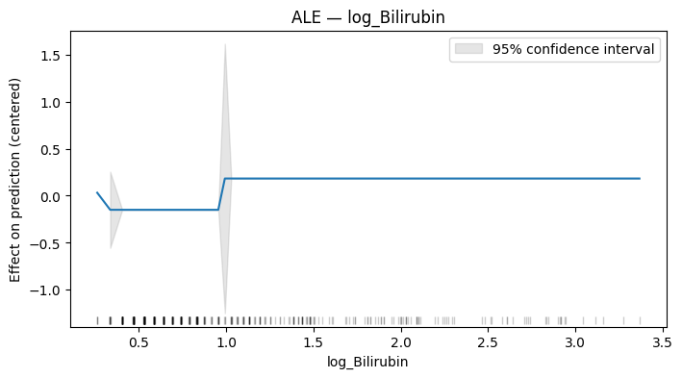
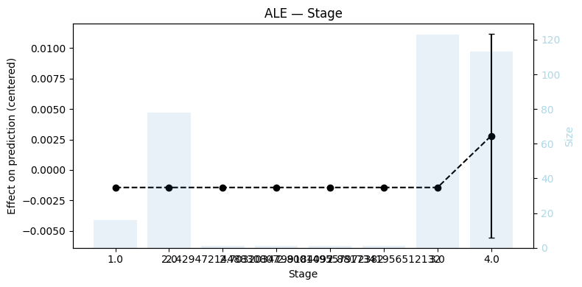
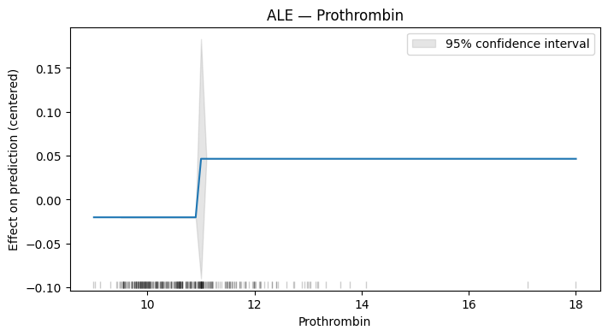
ALE (Accumulated Local Effects)

Slide 25
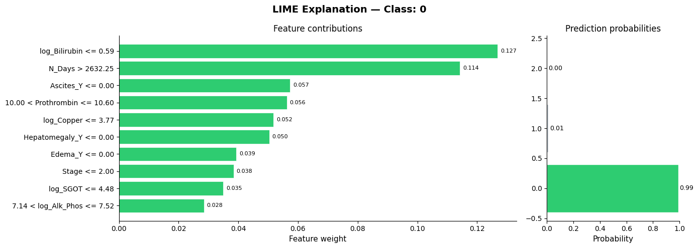
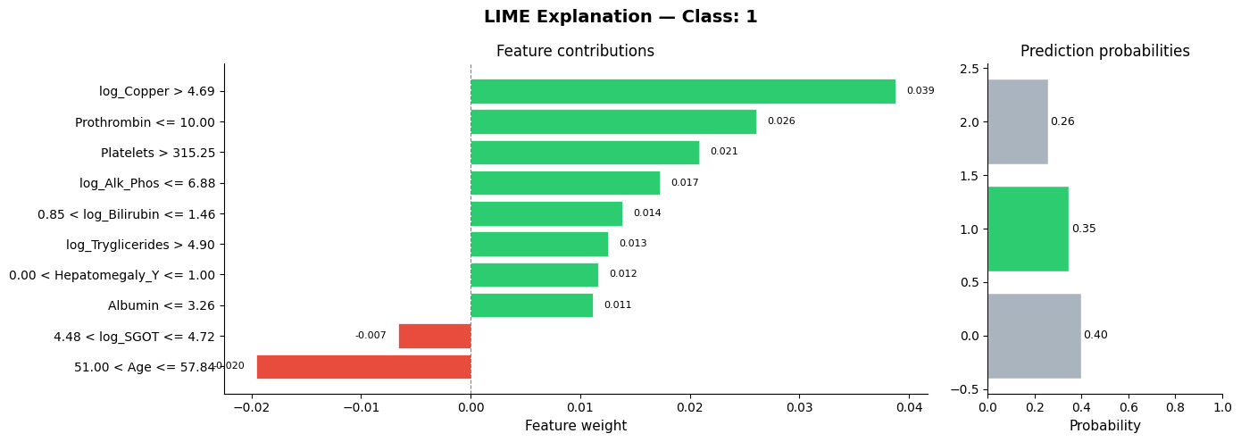
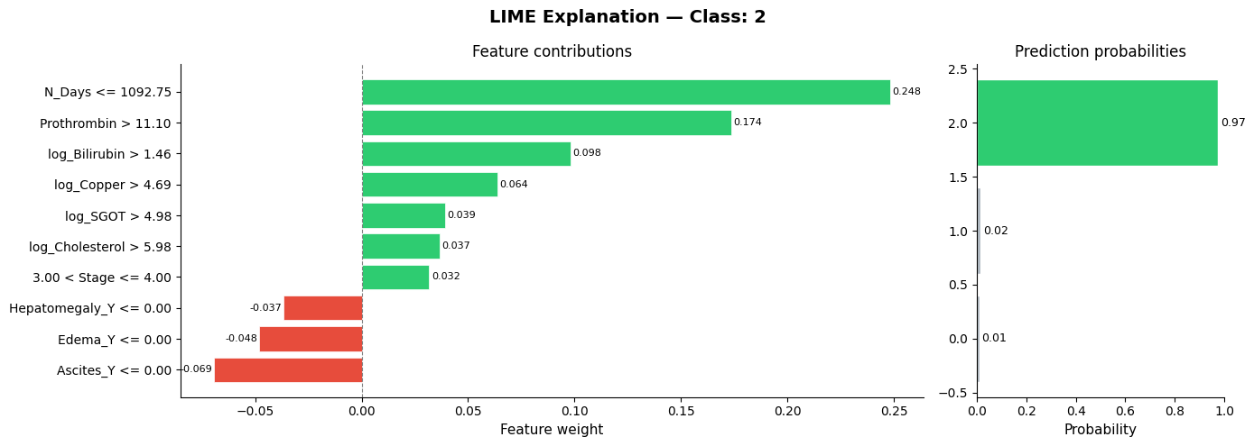
Explainability with LIME

Slide 26
Counterfactual (DiCE)
Original Patient
Feature | Value
N_Days | 221
Prothrombin | 11.6
Stage | 4.0
log_Bilirubin | 2.708
log_Copper | 6.16
Albumin | 2.58
Counterfactual 0 |  | Counterfactual 1 |  | Counterfactual 2
N_Days | 221 → 2514.5 | N_Days | 221 → 3738.6 | N_Days | 221 → 2515.5
Prothrombin | 11.6 → 10.2 | Prothrombin | 11.6 → 10.4 | Prothrombin | 11.6 → 10.2
Albumin | 2.58 → 3.49 | log_Copper | 6.16 → 4.82 | log_Bilirubin | 2.708 → 1.367
log_SGOT | 5.34 → 4.37 | log_SGOT | 5.34 → 4.65 | log_SGOT | 5.34 → 4.62
Platelets | 190 → 68.5 | Sex_M | changes to 0.9 | Platelets | 190 → 272.5

Slide 27
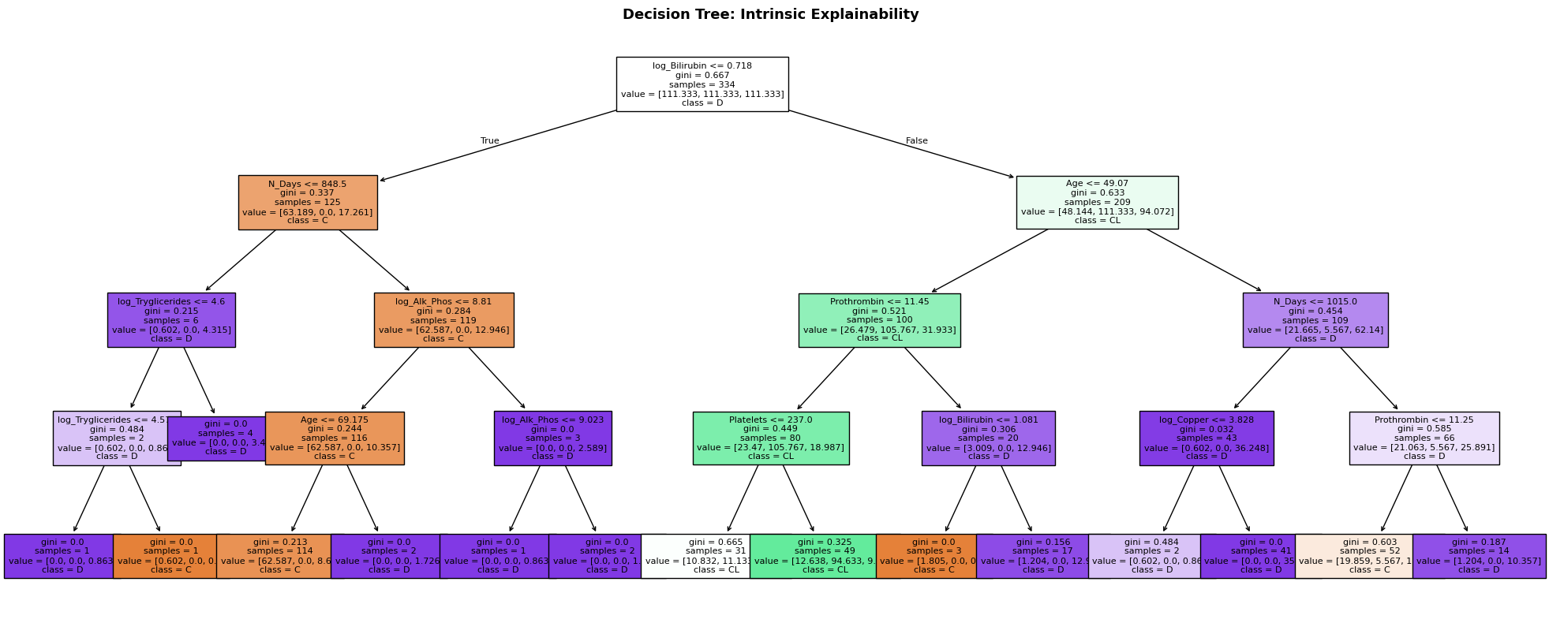
Intrinsic Explainability: Decision Tree
Bilirubin
N_Days
Age

Slide 28
Conclusions
Imputation: MICE marginally best (F1 0.537); structural missingness more limiting than method choice
Class Imbalance: Accuracy misleading on imbalance data; CL class unpredictable at current size, macro-F1 is the correct metric
Multiclass: Softmax LR (acc 0.738) slightly ahead of OvR and OvO; RF (macro F1 0.55) outperforms DT (0.49)
Explainability: SHAP, LIME, PDP, ALE and DT converge on same top features (log_Bilirubin, Prothrombin, Stage, Albumin), clinically meaningful and consistent with MELD/Child-Pugh
Limitation: N_Days is a leaky feature (shorter follow-up for deceased patients); CL class should be merged with C in production.

Slide 29
Next Steps
Merge CL class with C or apply cost-sensitive learning for the rare class
Tune hyperparameters with stratified k-fold cross-validation
Apply feature selection / dimensionality reduction to reduce noise
Evaluate calibration of probability outputs (Brier score, reliability diagrams)
Explore gradient boosting models (XGBoost, LightGBM) for performance gains

