Slide 1

Insurance Charges Prediction with Neural Networks
Deep Learning Assignment 1
Bernardo Llata , Daniel Sanchez , Lucas Stille

Slide 2
1) Problem Statement
Objective: Predict insurance charges from tabular patient features.
Task type: Supervised learning (regression).
Output: One continuous value (charges) per sample.
Business impact: Better pricing estimation and risk analysis.
Notes:
Explain why this is regression and not classification.

Slide 3
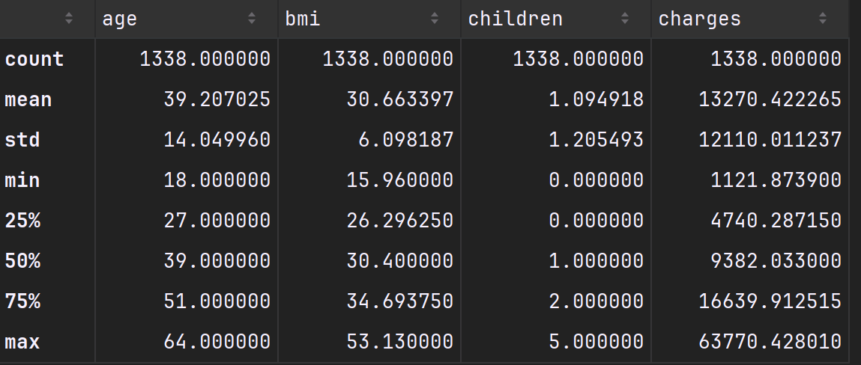
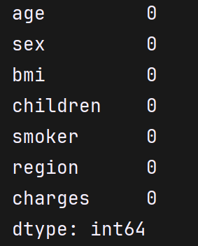
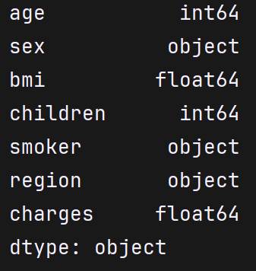
2) Dataset Overview
Dataset loaded from insurance.csv.
Input features include age, sex, bmi, children, smoker, region.
Target variable: charges.
Initial checks: data types, summary statistics, missing values.
Notes:
Mention that no missing-value strategy was needed if nulls are zero.

Slide 4
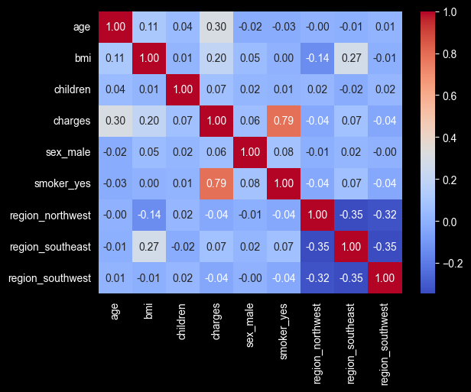
3) Preprocessing Pipeline
Categorical encoding with pd.get_dummies(..., drop_first=True, dtype=int).
drop_first=True avoids redundant dummy columns (multicollinearity).
Correlation matrix (seaborn heatmap) used for feature understanding.
Prepared data for model consumption.
Notes:
Point out that one-hot encoding is necessary before tensor conversion.

Slide 5
4) Data Split Strategy
Train/Test split: 80/20.
Then Train/Validation split from training subset.
Validation data used for hyperparameter search (Optuna).
Test data kept untouched until final evaluation.
Notes:
Stress that test set should not influence tuning.

Slide 6
5) Normalization
StandardScaler fitted ONLY on training data for X.
The same scaler transforms validation and test features.
Target Y is also standardized for stable optimization.
Predictions are denormalized using inverse_transform for interpretation in USD.
Notes:
This is key to avoid very large MSE magnitudes.

Slide 7
6) Tensor Conversion and DataLoaders
Converted arrays to torch.float32 tensors.
Wrapped into TensorDataset(X, y) for paired samples.
DataLoader creates mini-batches (batch_size=64).
shuffle=True for train, shuffle=False for val/test.
Notes:
Mention batch shape: X [batch, 8], y [batch].

Slide 8

7) Neural Network Architecture
Model: InsuranceNN(8 -> h1 -> h2 -> h3 -> 1).
ReLU activations between hidden layers.
Final layer has 1 neuron (single regression prediction).
Hyperparameters h1, h2, h3 tuned with Optuna.
Notes:
Explain output shape [batch_size, 1], then squeeze to [batch_size].

Slide 9
8) Training Loop Logic
model.train() enables training behavior.
Forward pass: prediction = model(data).squeeze().
Loss: MSE(prediction, target).
Backprop: loss.backward(); update: optimizer.step().
Optimizer (ADAM) : optimizer.zero_grad() prevents gradient accumulation across batches.
Notes:
Clarify where gradients are computed and where weights are updated.

Slide 10
9) Hyperparameter Tuning (Optuna)
Objective function trains model and returns validation loss.
Search space: h1, h2, h3 in [16, 128], lr in [1e-5, 1e-2] log-scale.
study.optimize(...) runs multiple trials (exmpl: 30).
Best params used in final full training.
Notes:
Mention functools.partial to pass loaders/device into objective.

Slide 11

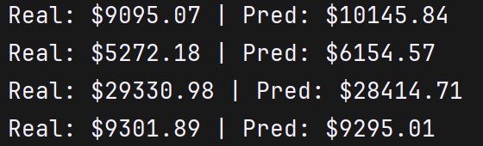
10) Evaluation and Inference
model.eval() switches to inference behavior.
torch.no_grad() disables gradient tracking (faster, less memory).
Predictions collected from test_loader.
Denormalize y_pred and y_true for real-scale comparison.
Notes:
Explain reshape(-1,1) needed by sklearn inverse_transform.

Slide 12
11) Conclusions and Next Steps
Pipeline successfully built: preprocessing -> training -> tuning -> evaluation.
1
Model predicts insurance charges as a continuous output.
2
Key best practice: fit scalers only on training data.
3
Potential improvements: MAE/RMSE metrics, early stopping, residual analysis, checkpoint with hparams.
4
Notes:
If asked, propose saving a checkpoint dict (state_dict + hparams + scalers).

