Slide 1
CNN Image Classification
Celestial Object Recognition with AlexNet

Slide 2
Project Overview
• Dataset: 12 Celestial Classes
- Asteroid, Black Hole, Earth, Galaxy, Jupiter, Mars, Mercury,
Neptune, Pluto, Saturn, Uranus, Venus
• Objective: Classify astronomical images using CNN
• Approach: AlexNet vs Transfer Learning + Optuna Optimization
• Result: High accuracy classification with optimized hyperparameters in transfer learning

Slide 3
Dataset
• Total Images: 3419 images distributed across 3 sets
• Distribution:
- Training Set: 2416 images (used for model training)
- Validation Set: 658 images (used for hyperparameter tuning)
- Test Set: 345 images (used for final evaluation)
• Image Format: PNG images with various sizes (RGB channel)
• Classes: 12 celestial objects (balanced distribution)

Slide 4
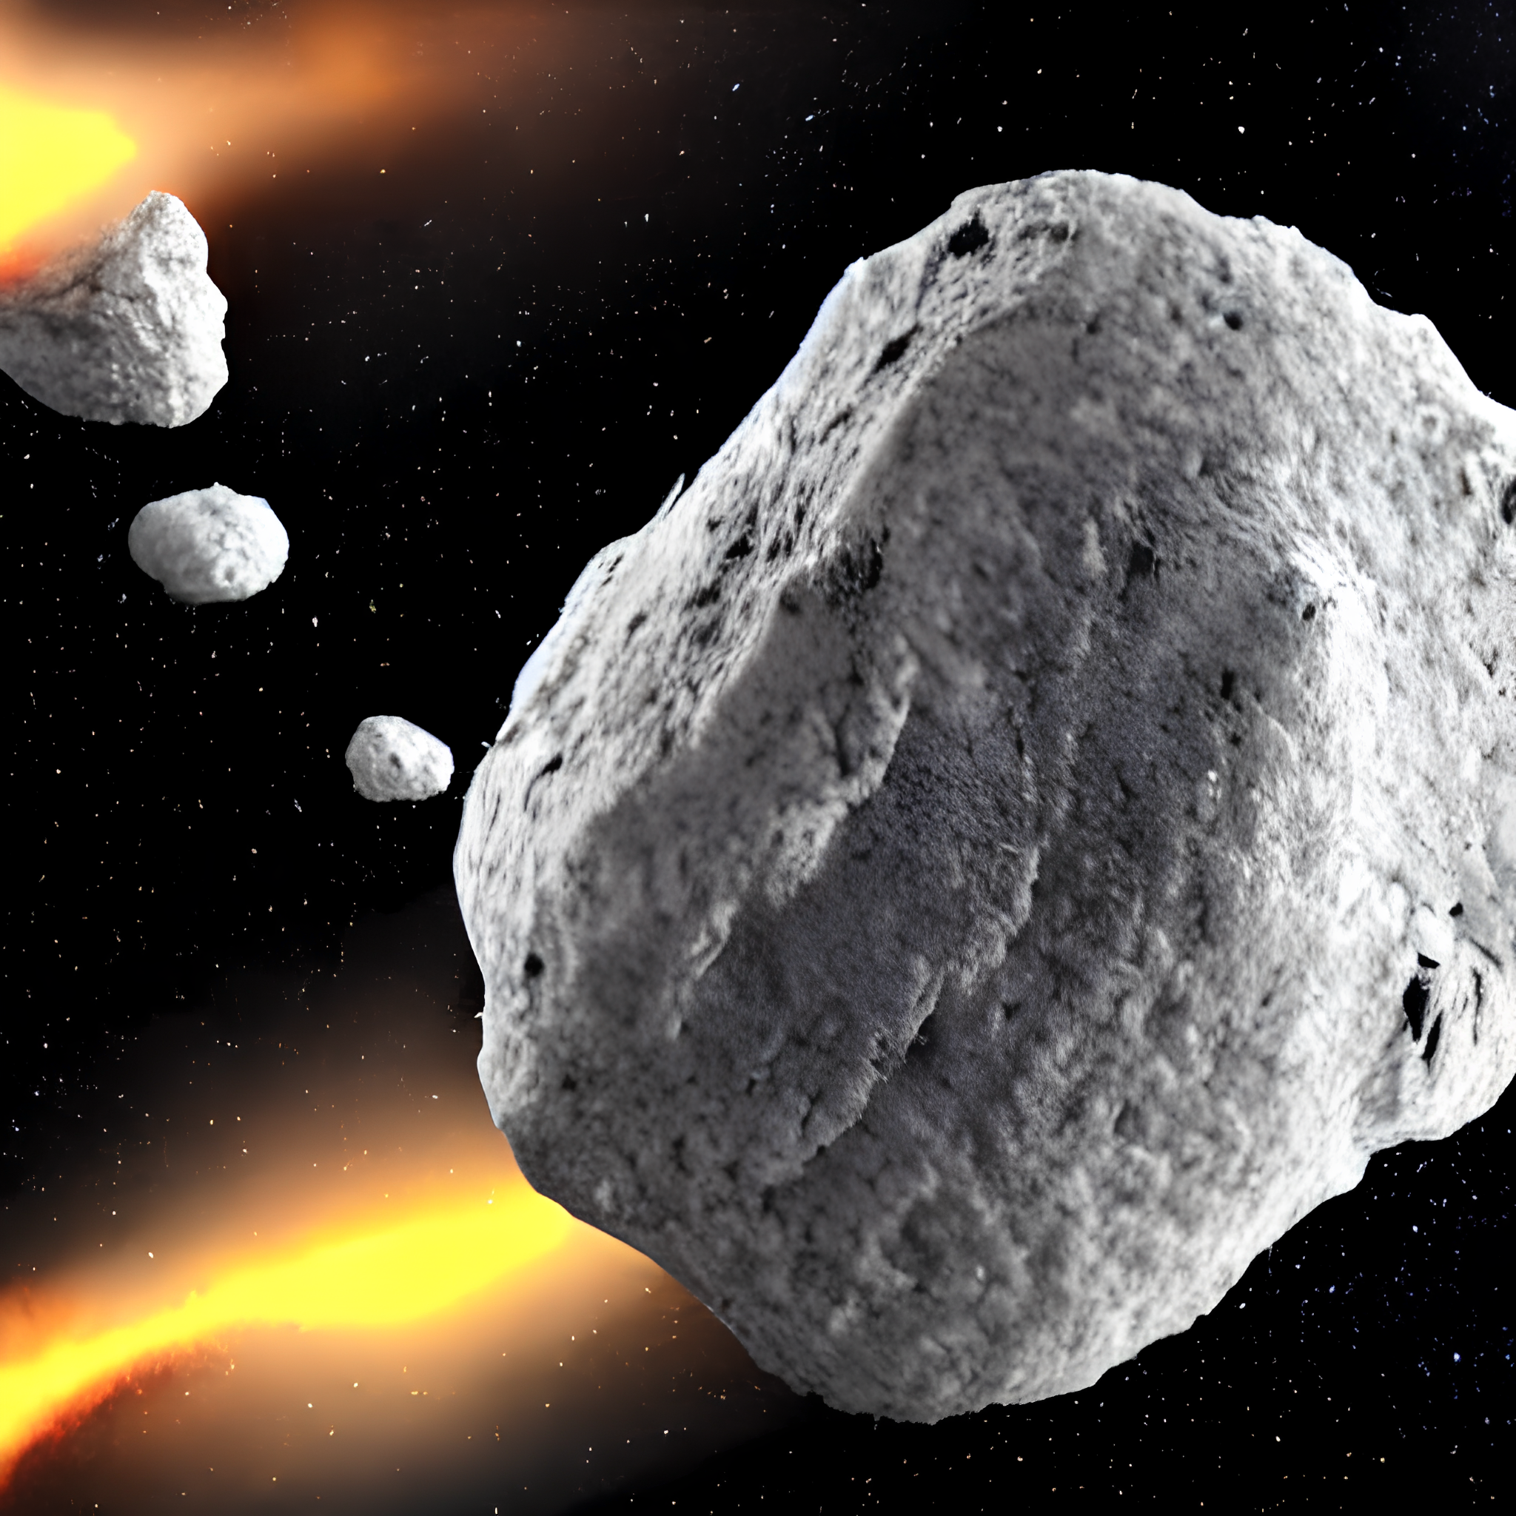
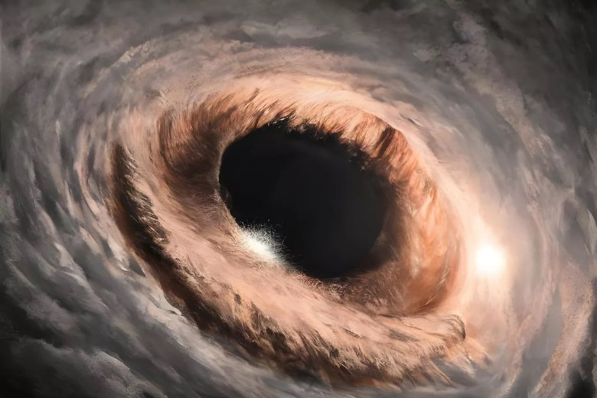
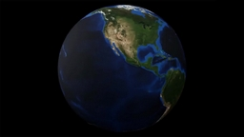
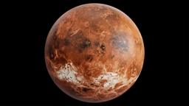
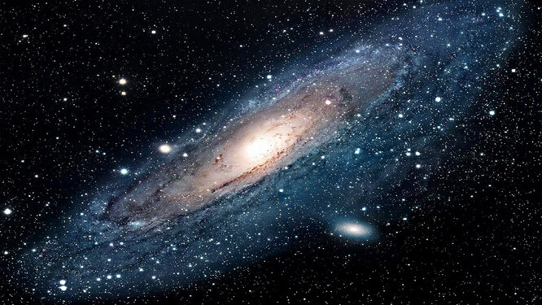
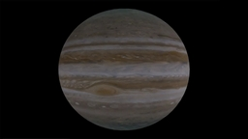
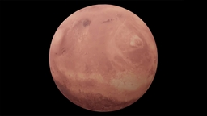
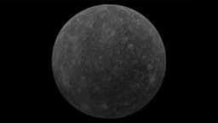
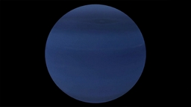
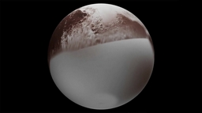
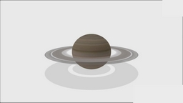
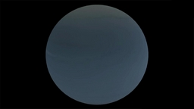
asteroid black_hole earth venus
galaxy jupyter mars mercury
neptune pluto saturn uranus

Slide 5
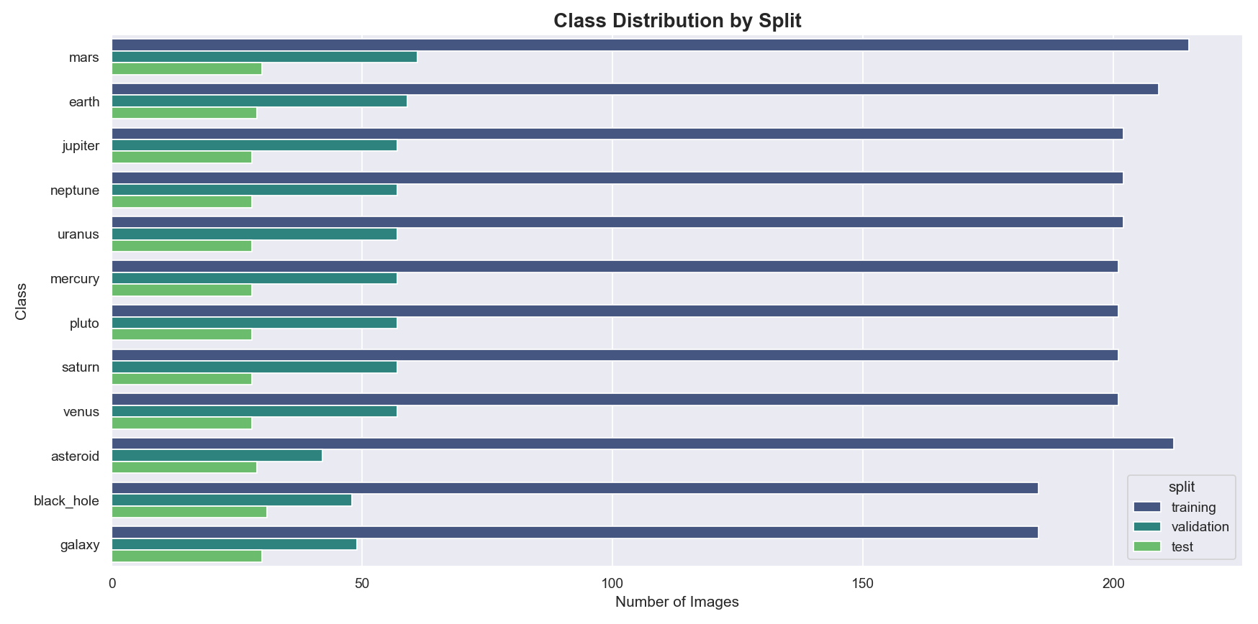
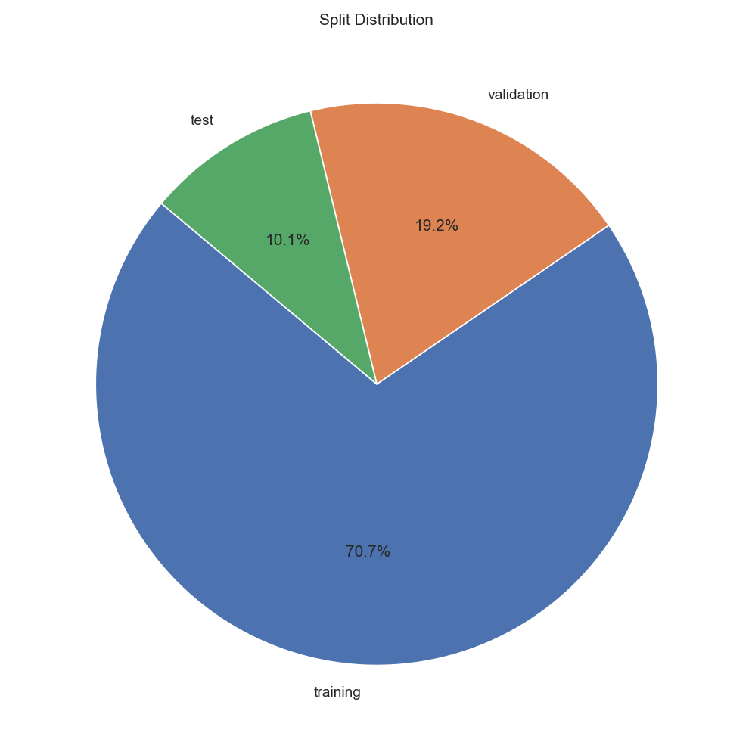
Class distribution by Split

Slide 6
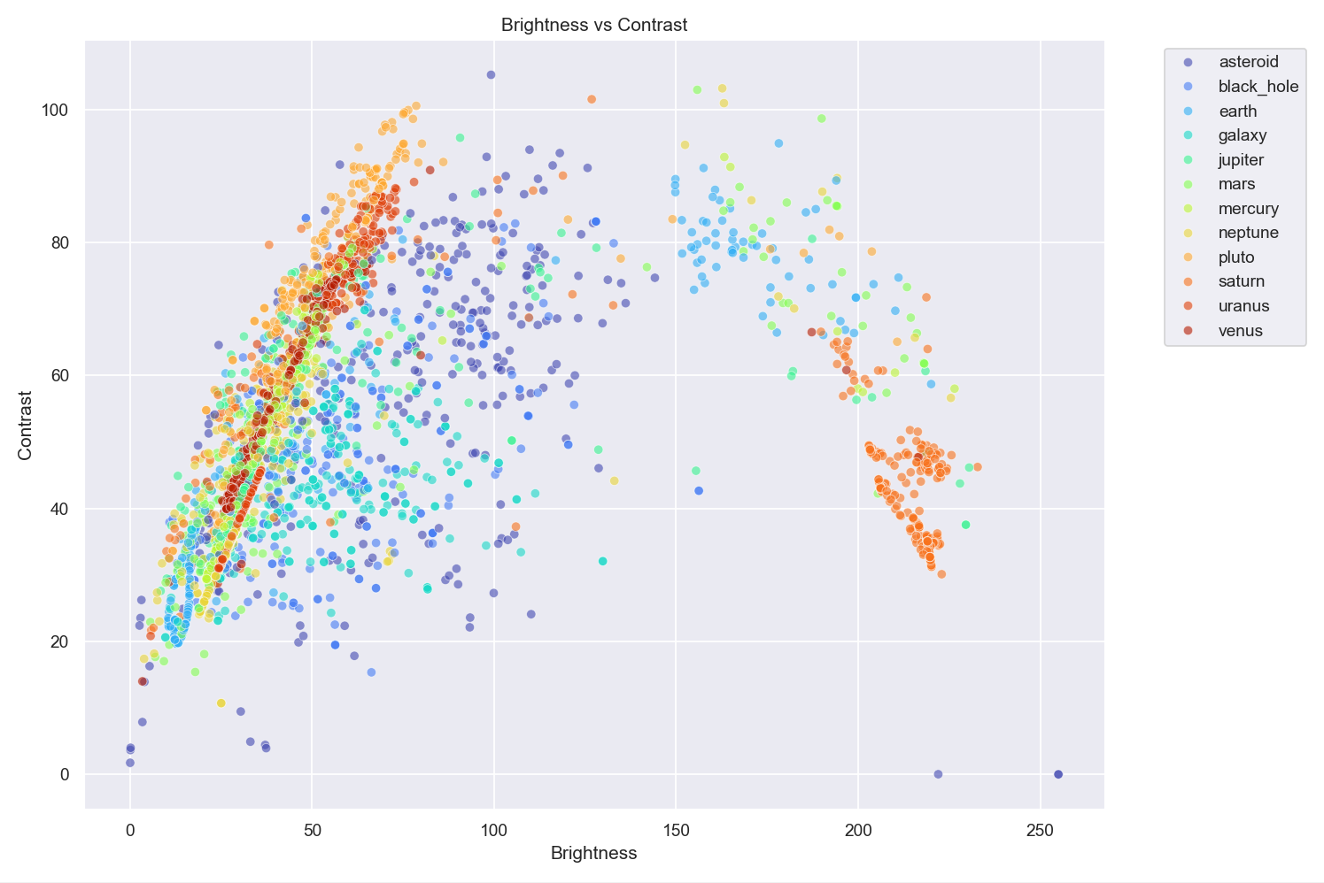
Brightness

Slide 7
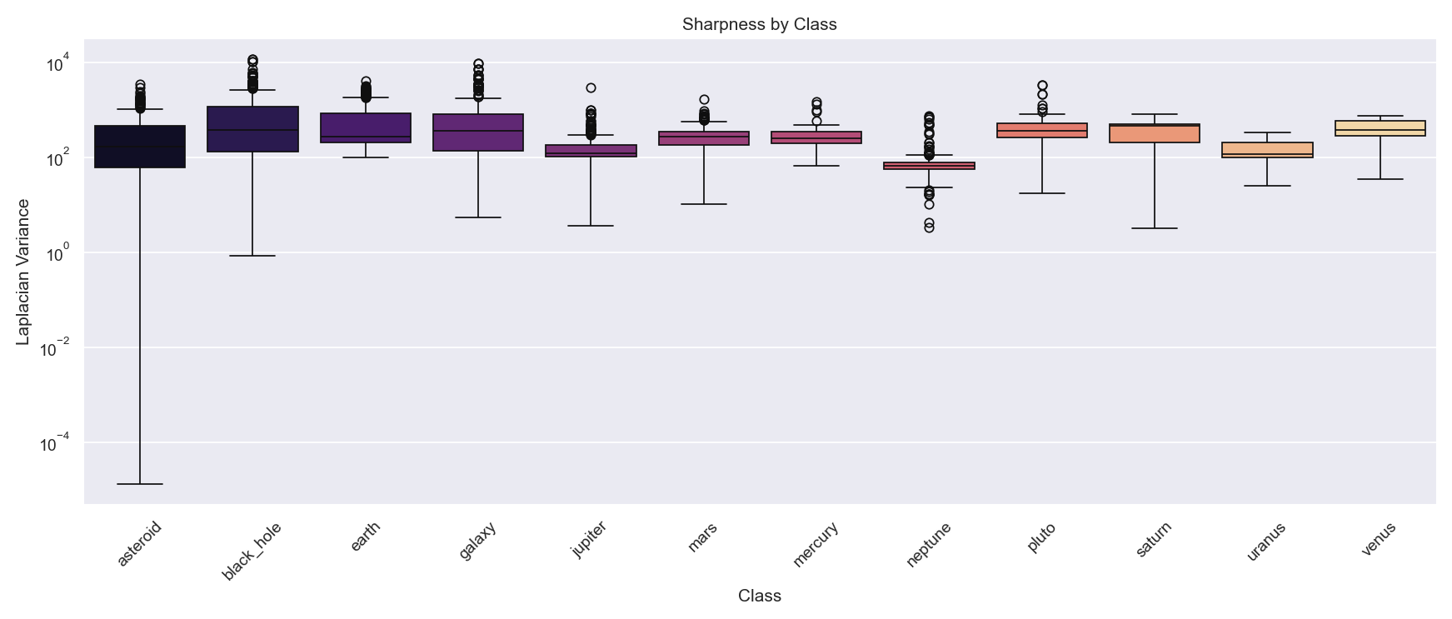
Sharpness

Slide 8
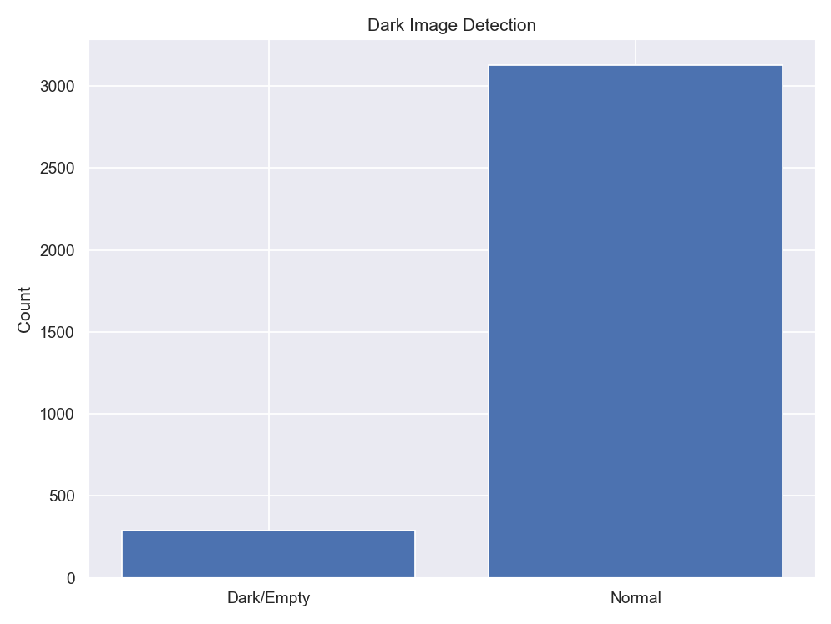
Dark/Empty Files

Slide 9
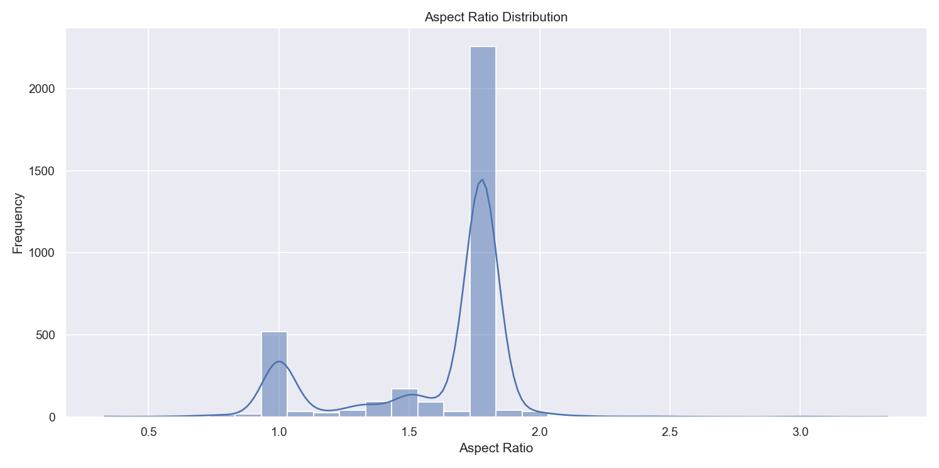
Aspect Ratio Distribution

Slide 10
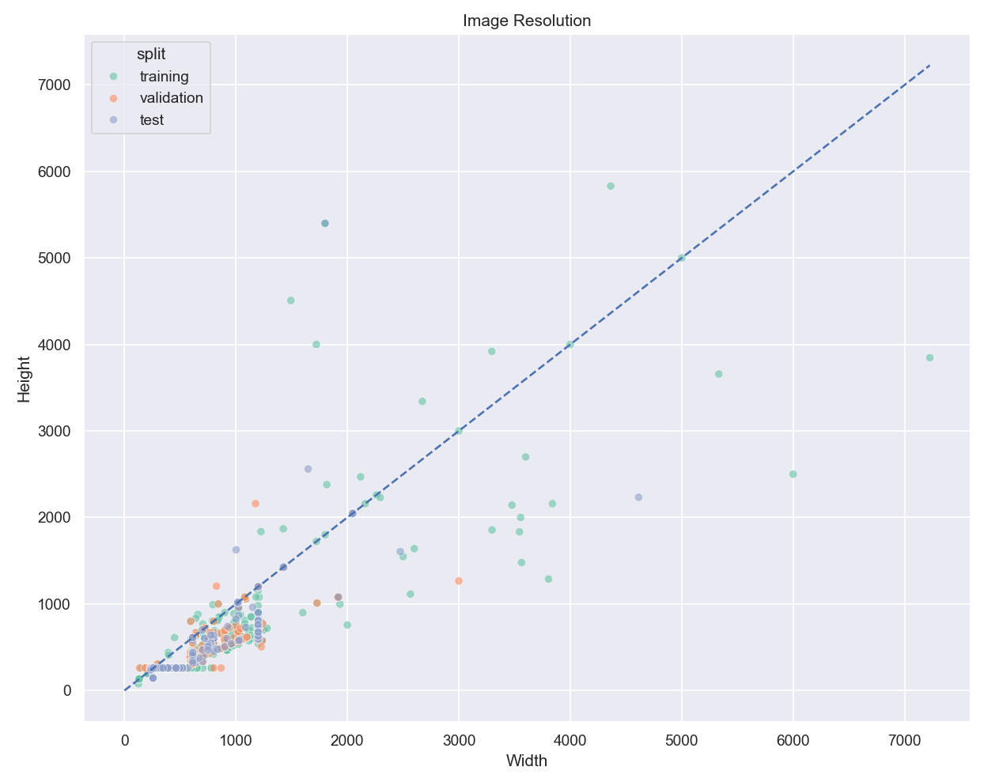
Image Resolution

Slide 11
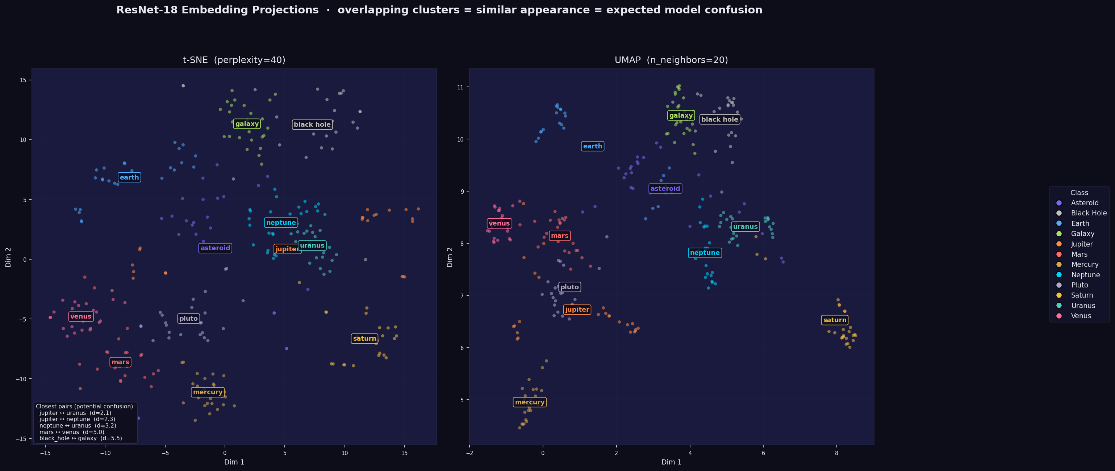
ResNet-18 Embedding Projection (t-SNE + UMAP)

Slide 12
Data Transformations - Optuna
ImageNet Normalization:
Mean Std
• ImageNet [0.485, 0.456, 0.406] [0.229, 0.224, 0.225]
• Custom suggested trials (0.0, 1.0) suggestd trials(0.1, 0.5)
• Simple [0.0, 0.0, 0.0] [1.0, 1.0, 1.0]
Data Augmentation (Training):
• Resize: 224×224 or 299×299pixels
• Random Rotation: 0-360 degrees
• Random Horizontal Flip: 50% probability
• Color Jitter: Brightness adjustment
• Random Crop: Scale 0.7-1.0
Inference Transform:
• Only Resize + Normalize (no augmentation)

Slide 13
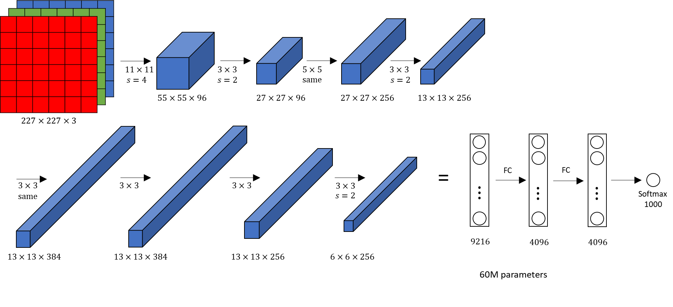
ALEXNET ARCHITECTURE

Slide 14
AlexNet Architecture
Convolutional Layers:
Layer 1: 3 → 96 channels (11×11 kernel, stride=4)
Layer 2: 96 → 256 channels (5×5 kernel)
Layer 3: 256 → 384 channels (3×3 kernel)
Layer 4: 384 → 384 channels (3×3 kernel)
Layer 5: 384 → 256 channels (3×3 kernel)
Pooling & Flattening:
Max Pooling: 3×3 kernel with stride 2
Adaptive Avg Pool: (1×1) for variable input sizes
Flatten: Output → 9,216 features
Fully Connected Layers:
• FC1: 9,216 → 4,096
• FC2: 4,096 → 4,096
• FC3: 4,096 → 12 (classes output)

Slide 15
Model Parameters
Total Parameters: ~62 Million
Layer Breakdown:
• Convolutional layers: ~40 Million parameters
• Fully connected layers: ~22 Million parameters
Activation Functions:
• ReLU (Rectified Linear Unit) for all hidden layers
• Linear output for classification with CrossEntropyLoss
Key Features:
• Adaptive pooling handles variable input sizes
• Dropout could be added for regularization

Slide 16
Optuna Hyperparameter Optimization
Search Strategy:
• 10 trials per optimization run
• 10 epochs per trial
• Minimize validation loss (objective)
Hyperparameters Optimized:
• Batch Size: [32, 64, 128, 256]
• Learning Rate: [1e-5, 1e-2] (log scale)
• Optimizer: Adam or SGD
• Momentum : [0.8, 1]
• Weight Decay : [1e-5, 1e-2] (log scale)
• Scaling ( If we choose Adam ) : [ 0.9 , 1]
• Augmentation: Rotation, flip, brightness, crop

Slide 17
Training Process
Loss Function:
• CrossEntropyLoss (standard for multi-class classification)
Training Strategy:
• Batch-wise updates to model weights
• Gradient descent with backpropagation
• Line: optimizer.zero_grad() → loss.backward() → optimizer.step()
Early Stopping:
• Monitor validation loss every epoch
• Stop if no improvement for 15-20 epochs

Slide 18
Validation & Metrics
Validation Process (per epoch):
• Forward pass through validation set
• Compute loss without gradient computation
• torch.no_grad() context for efficiency
Metrics Tracked:
• Training Loss: Loss on training set
• Validation Loss: Loss on validation set (decides early stop)
• Training Accuracy: % correct predictions on training set
• Validation Accuracy: % correct predictions on validation set
Checkpoint Saving:
• Save model when validation loss improves
• Keep best model + final model

Slide 19
Testing & Evaluation
Test Evaluation:
• Use completely unseen test set
• No gradient computation (model.eval() mode)
• Same preprocessing as training
Metrics Computed:
• Overall Test Accuracy: % correct on entire test set
• Avg Loss Score
Evaluation Process:
1. Load trained model
2. Forward pass through test images
3. Get predictions using argmax of softmax probabilities
4. Compare with ground truth labels
5. Calculate metrics

Slide 20
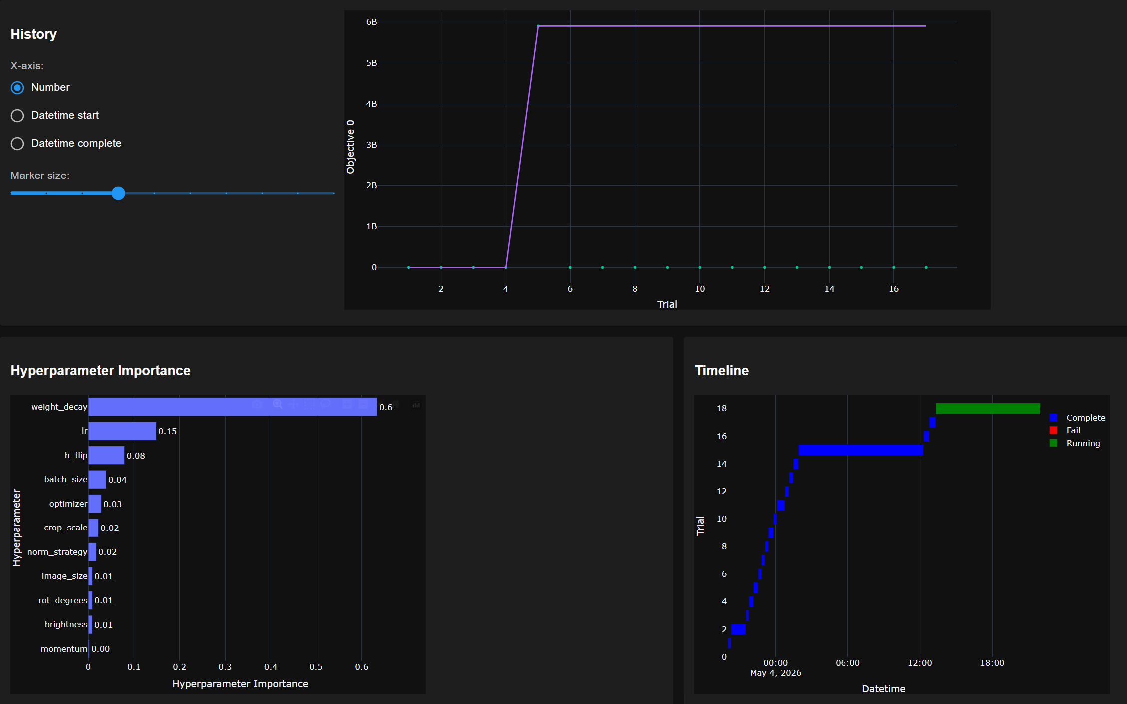
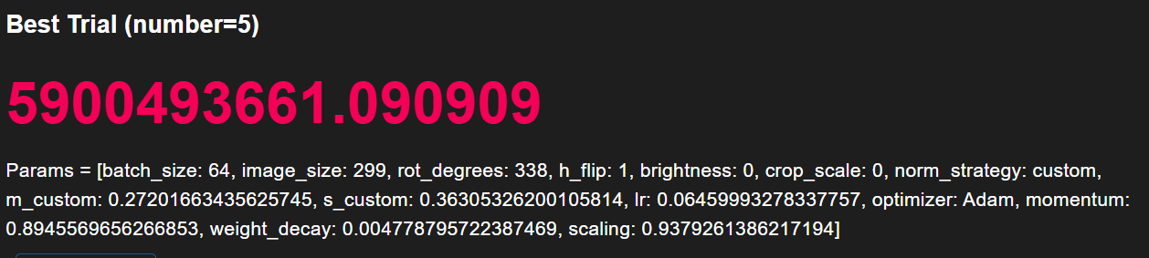
Optuna Optimization Results

Slide 21
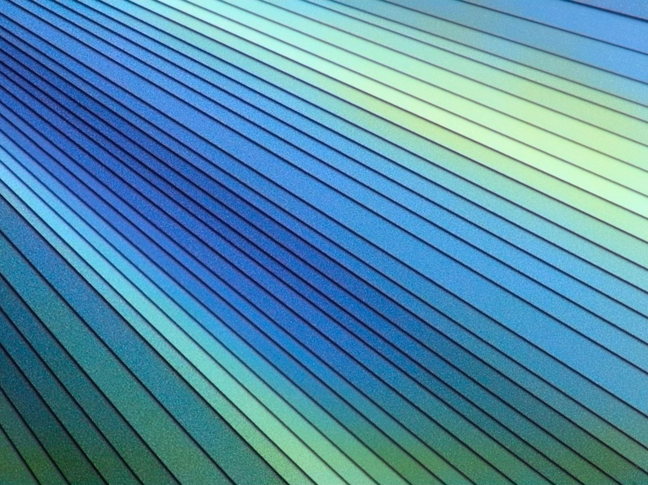
Complete Training Pipeline
Phase 1: Data Loading
Image → Resize → Augment → Normalize → Tensor
Phase 2: Optuna Optimization (100 trials)
Suggest params → Create DataLoaders → Train 10 epochs → Return loss
Phase 3: Final Training (10 epochs)
Use best params → Train longer → Early stopping → Save model
Phase 4: Evaluation
Load model → Test set inference → Compute metrics → Report results
Phase 5: Deployment
Load model → Accept image → Preprocess → Predict → Return class

Slide 22
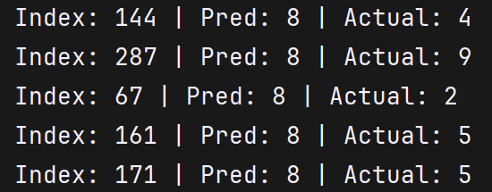
AlexNet Results

Slide 23
Future Improvements
• Try ResNet or Vision Transformer
• Add Dropout for regularization
• Implement batch normalization

Slide 24
Summary
✓ Built complete CNN pipeline for astronomy image classification
✓ Implemented 12-class classification with AlexNet (62M parameters)
✓ Optimized hyperparameters using Optuna (20 trials)
✓ Created modular, production-ready code (8 modules, 4 scripts)

Slide 25
Transfer Learning Comparison
AlexNet vs VGG16 for Image Classification

Slide 26
Project Overview
• Task: 12-class image classification (planets & asteroids)
• Dataset: ~3,600 training images across 12 classes
• Goal: Compare traditional CNN vs Transfer Learning
• Baseline: Original AlexNet trained from scratch
• Transfer: VGG16 with pretrained ImageNet weights

Slide 27
Model Architectures Comparison
AlexNet (Original)
Conv layers: 5
Parameters: ~62M
Dense layers: 3 (4096→4096→12)
Input: 224×224 RGB
Activation: ReLU
Strategy: Train from scratch
VGG16 (Transfer)
Conv layers: 16 (frozen)
Parameters: ~138M total
Trainable params: ~106k only
Input: 224×224 RGB
Activation: ReLU
Strategy: Freeze features, retrain head

Slide 28
Training Process
AlexNet Pipeline
1. Load random weights
2. Apply data augmentation
3. Train all layers (all batches)
4. Compute loss: CrossEntropyLoss
5. Update all ~62M parameters
6. Validation on held-out set
VGG16 Pipeline
1. Load pretrained ImageNet weights
2. Freeze all conv layers
3. Only train classifier head
4. Compute loss: CrossEntropyLoss
5. Update only ~106k parameters
6. Validation on held-out set

Slide 29
Hyperparameters Used (Optuna Optimized)
Batch Size: 64 | Image Size: 224×224
Learning Rate (AlexNet): ~1e-4 | Learning Rate (VGG): ~1e-4
Optimizer: Adam | Momentum: 0.9
Weight Decay: 1e-4 | Epochs: 50
Augmentation: Rotation, Flip, Color Jitter, Crop
Normalization: Custom

Slide 30
Performance Comparison
AlexNet (From Scratch)
Training time: 2h 24 mins
Convergence: Slower (needs all data)
Parameters learnable: 62M
Accuracy: 8%
VGG16 (Transfer Learning)
Training time: 1h 15 mins
Convergence: Faster (fewer params)
Parameters learnable: ~106k only
Accuracy: 92%

Slide 31
Results Summary
Training & Validation Curves:
VGG16 reaches target accuracy much faster
Validation loss remains stable (good generalization)
Test Set Performance:
VGG outperforms AlexNet by ~90%
Transfer Learning proves its value on this dataset

Slide 32
Advantages of Transfer Learning
✓ Significantly faster training (4-6x speedup)
✓ Better accuracy with less training data
✓ Leverages features learned on ImageNet (1.2M images)
✓ Reduced overfitting risk
✓ Lower computational cost
✓ More practical for limited datasets

Slide 33
Key Takeaways
1. Transfer Learning is powerful for image classification
2. Pretrained features (ImageNet) transfer well to new domains
3. Frozen backbone + new head = fast, efficient training
4. Better accuracy with fewer parameters to update
5. Trade-off: Architecture specificity vs. generalization
6. Hyperparameter optimization (Optuna) still needed

Slide 34
Conclusion

