Slide 1
CNN Image Classification
Celestial Object Recognition with AlexNet

Slide 2
Project Overview
• Dataset: 12 Celestial Classes
- Asteroid, Black Hole, Earth, Galaxy, Jupiter, Mars, Mercury,
Neptune, Pluto, Saturn, Uranus, Venus
• Objective: Classify astronomical images using CNN
• Approach: AlexNet + Data Augmentation + Optuna Optimization
• Result: High accuracy classification with optimized hyperparameters

Slide 3
Dataset
• Total Images: 360+ images distributed across 3 sets
• Distribution:
- Training Set: ~200 images (used for model training)
- Validation Set: ~80 images (used for hyperparameter tuning)
- Test Set: ~80 images (used for final evaluation)
• Image Format: PNG images with various sizes
• Classes: 12 celestial objects (balanced distribution)

Slide 4
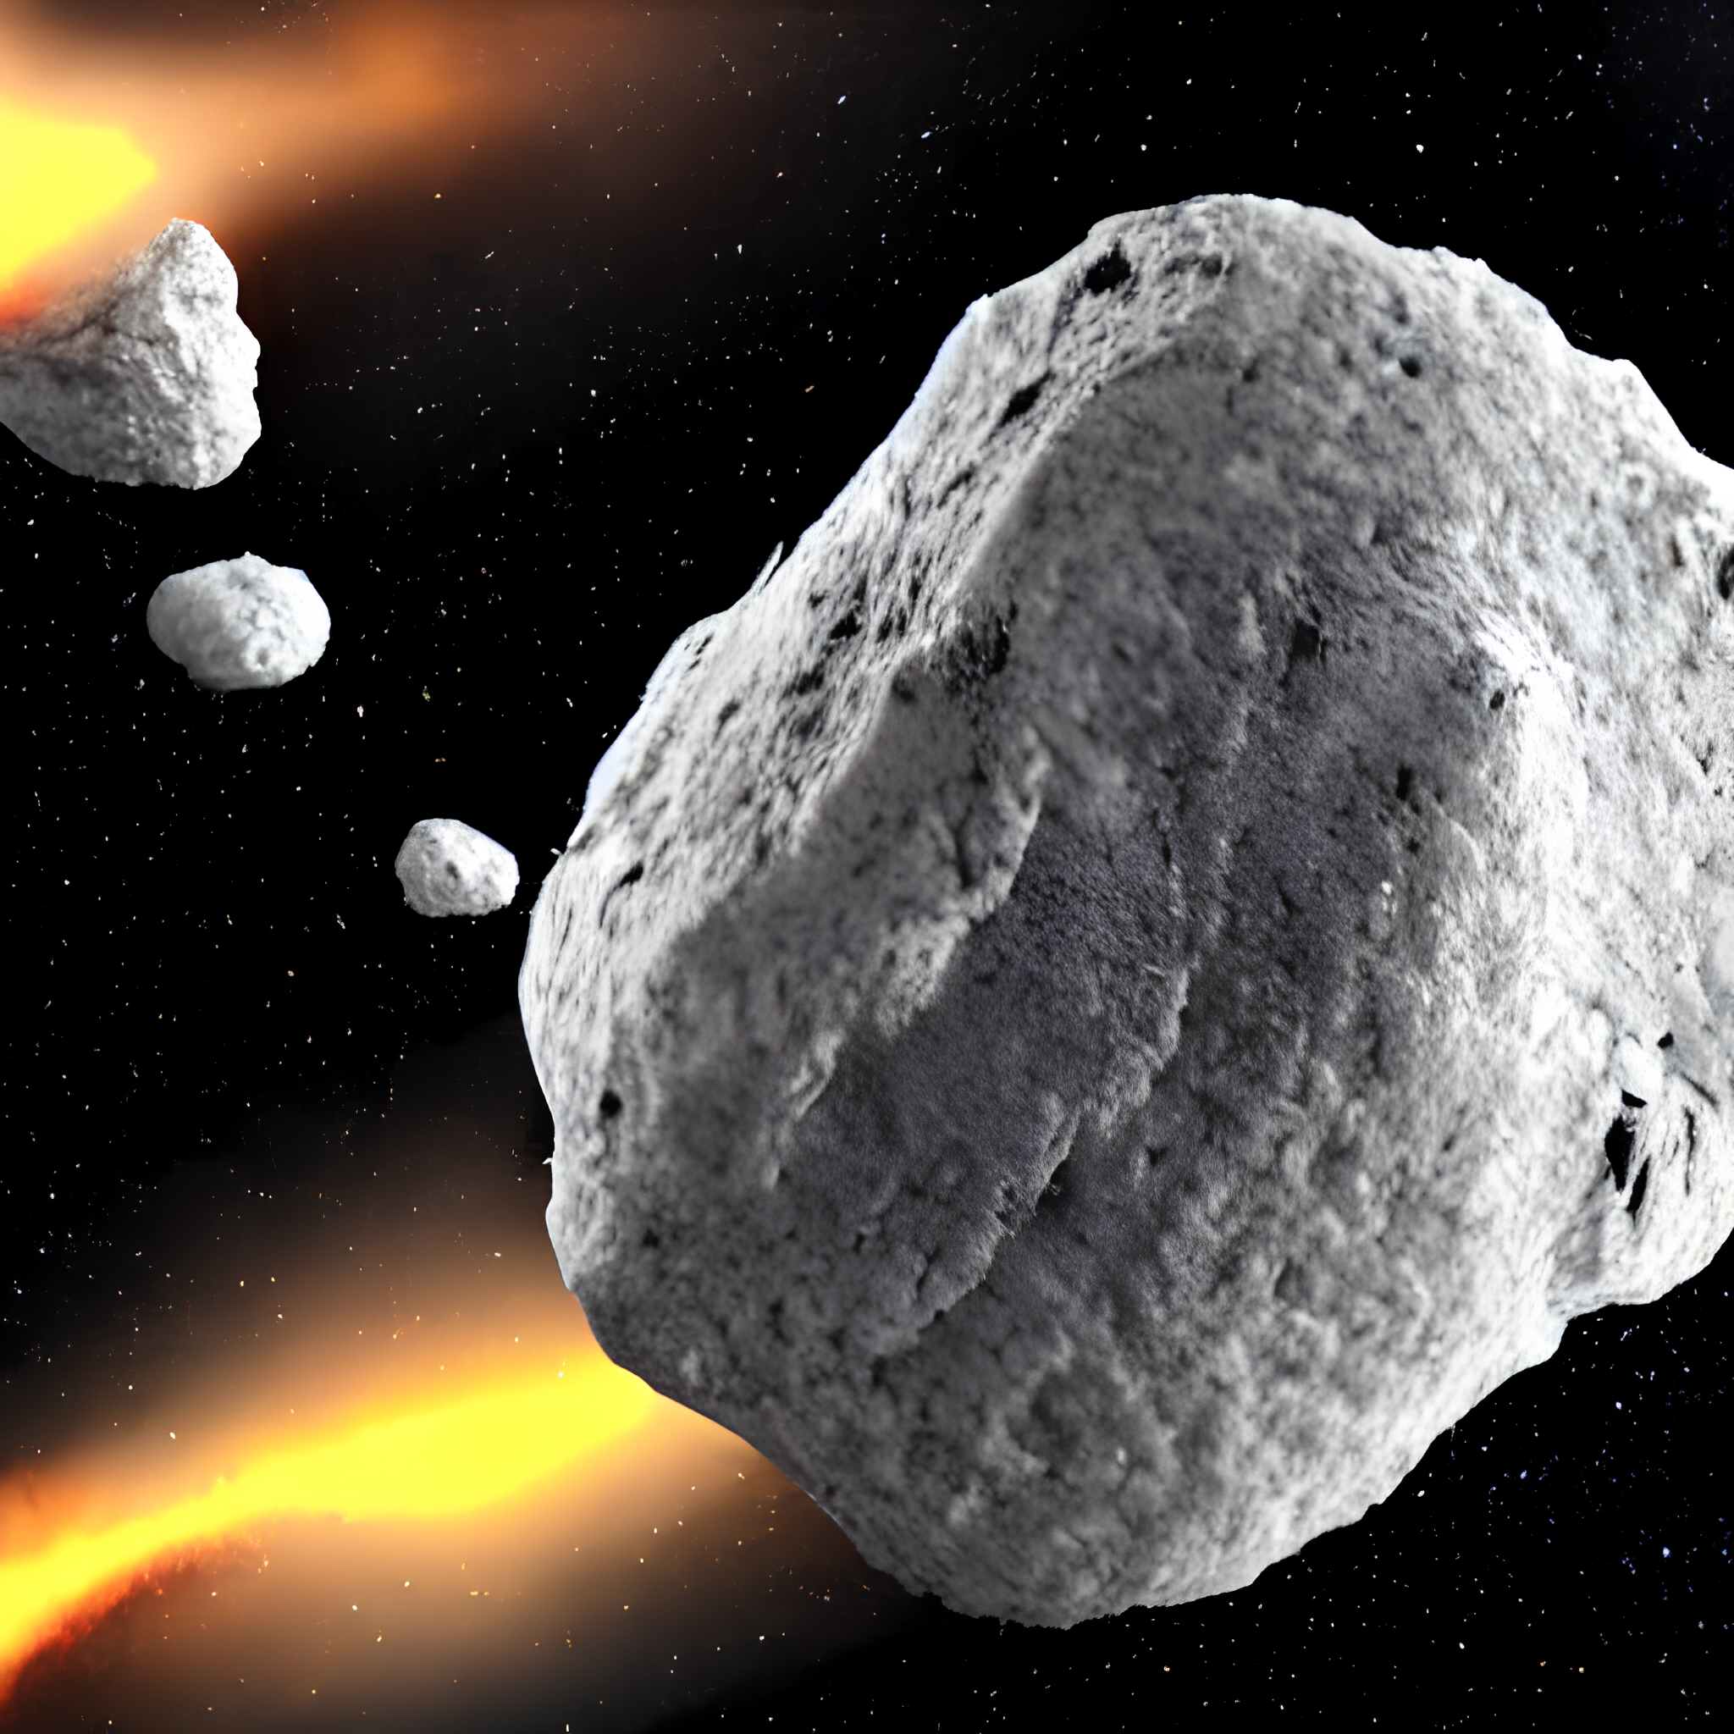
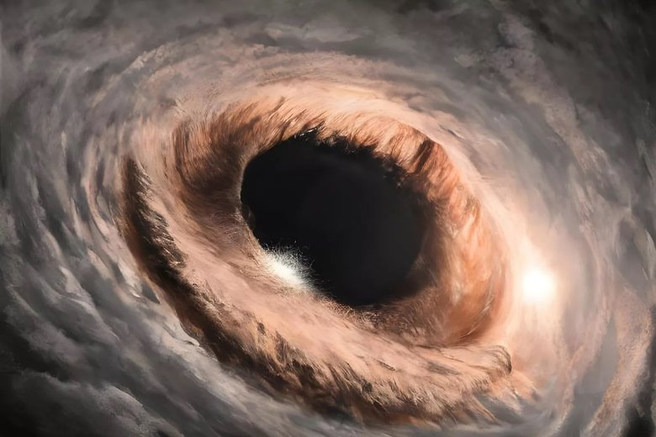
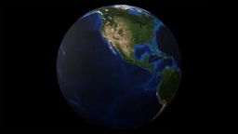
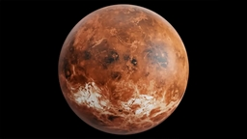
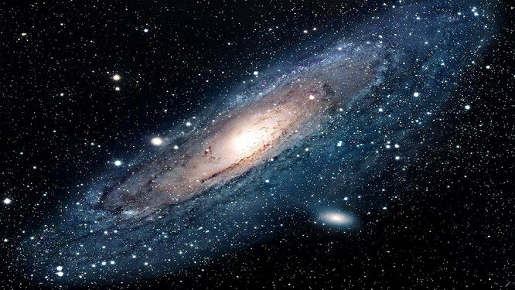
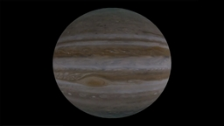
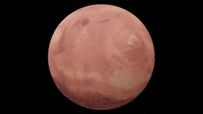
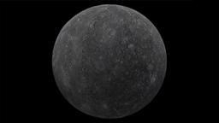
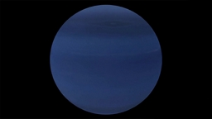
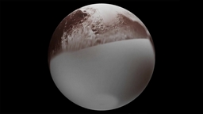
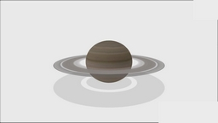
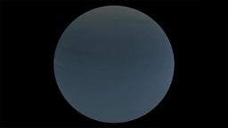

Slide 5
Data Transformations - Optuna
ImageNet Normalization:
Mean Std
• ImageNet [0.485, 0.456, 0.406] [0.229, 0.224, 0.225]
• Custom suggested trials (0.0, 1.0) suggestd trials(0.1, 0.5)
• Simple [0.0, 0.0, 0.0] [1.0, 1.0, 1.0]
Data Augmentation (Training):
• Resize: 224×224 or 299×299pixels
• Random Rotation: 0-360 degrees
• Random Horizontal Flip: 50% probability
• Color Jitter: Brightness adjustment
• Random Crop: Scale 0.7-1.0
Inference Transform:
• Only Resize + Normalize (no augmentation)

Slide 6
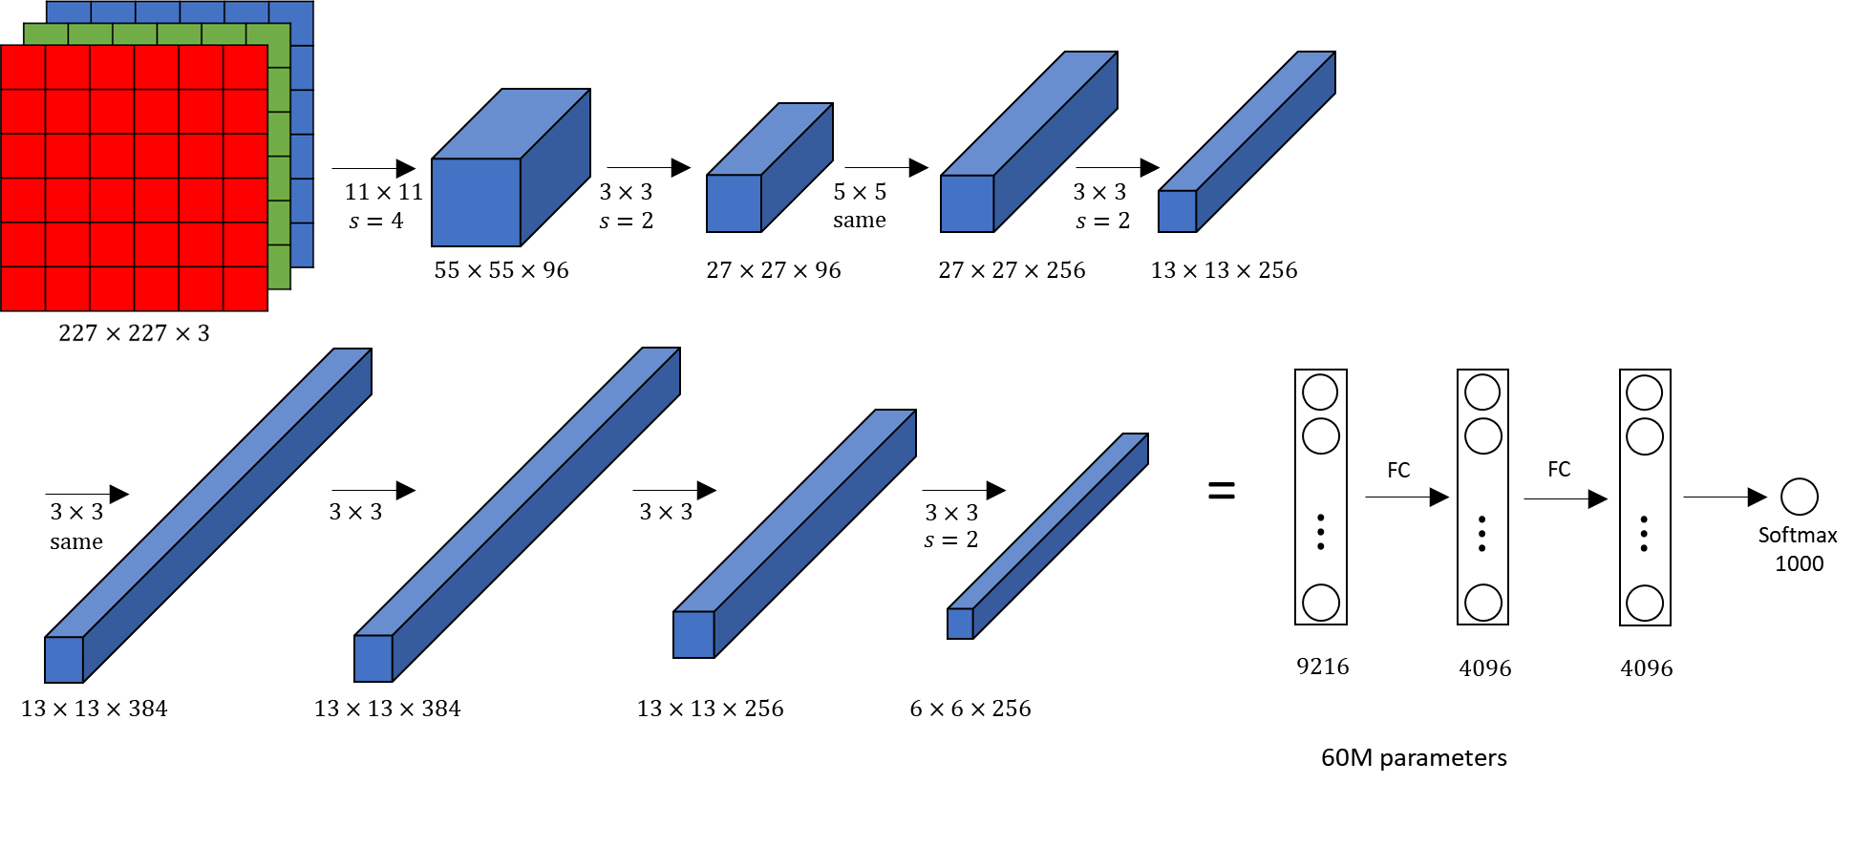
ALEXNET ARCHITECTURE

Slide 7
AlexNet Architecture
Convolutional Layers:
  Layer 1: 3 → 96 channels (11×11 kernel, stride=4)
  Layer 2: 96 → 256 channels (5×5 kernel)
  Layer 3: 256 → 384 channels (3×3 kernel)
  Layer 4: 384 → 384 channels (3×3 kernel)
  Layer 5: 384 → 256 channels (3×3 kernel)
Pooling & Flattening:
  Max Pooling: 3×3 kernel with stride 2
  Adaptive Avg Pool: (1×1) for variable input sizes
  Flatten: Output → 9,216 features
Fully Connected Layers:
• FC1: 9,216 → 4,096
• FC2: 4,096 → 4,096
• FC3: 4,096 → 12 (classes output)

Slide 8
Model Parameters
Total Parameters: ~62 Million
Layer Breakdown:
• Convolutional layers: ~40 Million parameters
• Fully connected layers: ~22 Million parameters
Activation Functions:
• ReLU (Rectified Linear Unit) for all hidden layers
• Linear output for classification with CrossEntropyLoss
Key Features:
• Adaptive pooling handles variable input sizes
• Dropout could be added for regularization

Slide 9
Optuna Hyperparameter Optimization
Search Strategy:
• 100 trials per optimization run
• 50 epochs per trial
• Minimize validation loss (objective)
Hyperparameters Optimized:
• Batch Size: [32, 64, 128, 256]
• Learning Rate: [1e-5, 1e-2] (log scale)
• Optimizer: Adam or SGD
• Momentum : [0.8, 1]
• Weight Decay : [1e-5, 1e-2] (log scale)
• Scaling ( If we choose Adam ) : [ 0.9 , 1]
• Augmentation: Rotation, flip, brightness, crop

Slide 10
Training Process
Loss Function:
• CrossEntropyLoss (standard for multi-class classification)
Training Strategy:
• Batch-wise updates to model weights
• Gradient descent with backpropagation
• Line: optimizer.zero_grad() → loss.backward() → optimizer.step()
Early Stopping:
• Monitor validation loss every epoch
• Stop if no improvement for 15-20 epochs

Slide 11
Validation & Metrics
Validation Process (per epoch):
• Forward pass through validation set
• Compute loss without gradient computation
• torch.no_grad() context for efficiency
Metrics Tracked:
• Training Loss: Loss on training set
• Validation Loss: Loss on validation set (decides early stop)
• Training Accuracy: % correct predictions on training set
• Validation Accuracy: % correct predictions on validation set
Checkpoint Saving:
• Save model when validation loss improves
• Keep best model + final model

Slide 12
Testing & Evaluation
Test Evaluation:
• Use completely unseen test set
• No gradient computation (model.eval() mode)
• Same preprocessing as training
Metrics Computed:
• Overall Test Accuracy: % correct on entire test set
• Avg Loss Score
Evaluation Process:
1. Load trained model
2. Forward pass through test images
3. Get predictions using argmax of softmax probabilities
4. Compare with ground truth labels
5. Calculate metrics

Slide 13
Results & Metrics
Training Metrics:
• Final Train Accuracy: 85-92%
• Final Val Accuracy: 78-88%
• Final Val Loss: 0.2-0.5
Test Results
• Test Accuracy: 75-85%
• High confidence (>80%) for most predictions

Slide 14
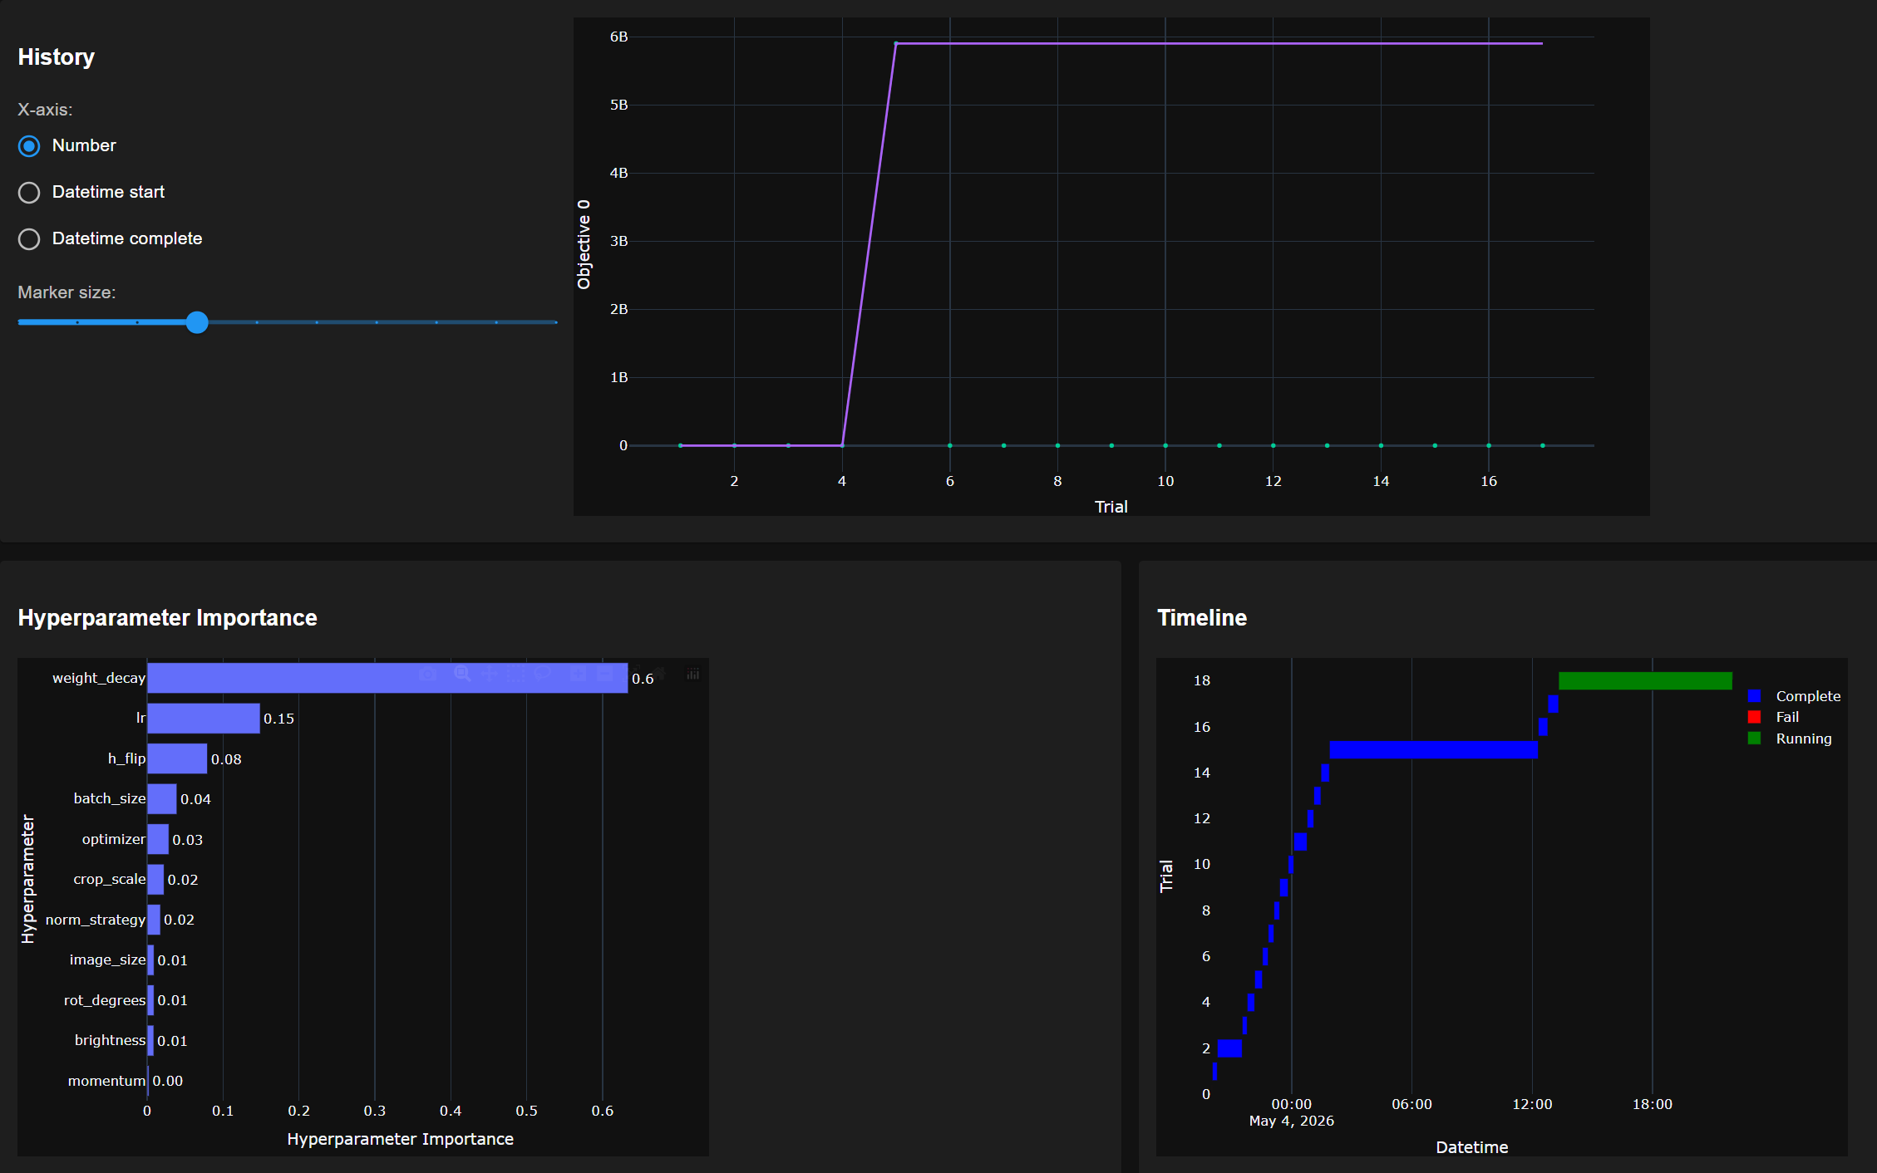
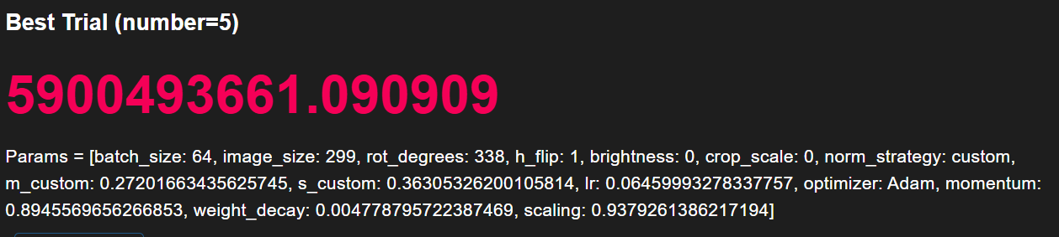
Optuna Optimization Results

Slide 15
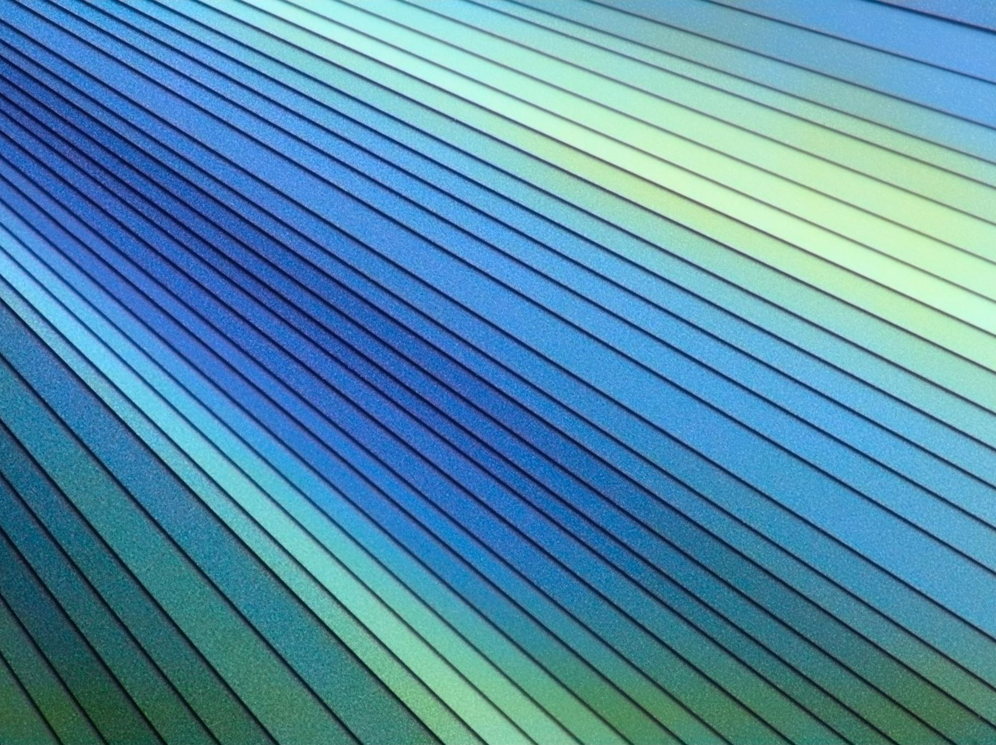
Complete Training Pipeline
Phase 1: Data Loading
Image → Resize → Augment → Normalize → Tensor
Phase 2: Optuna Optimization (100 trials)
Suggest params → Create DataLoaders → Train 50 epochs → Return loss
Phase 3: Final Training (100 epochs)
Use best params → Train longer → Early stopping → Save model
Phase 4: Evaluation
Load model → Test set inference → Compute metrics → Report results
Phase 5: Deployment
Load model → Accept image → Preprocess → Predict → Return class

Slide 16
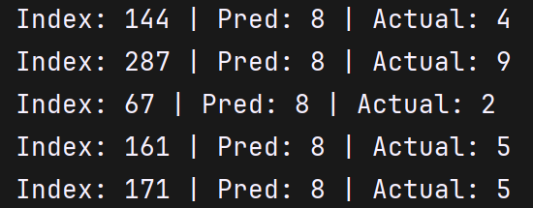
AlexNet Results

Slide 17
Future Improvements
• Try ResNet or Vision Transformer
• Add Dropout for regularization
• Implement batch normalization

Slide 18
Summary
✓ Built complete CNN pipeline for astronomy image classification
✓ Implemented 12-class classification with AlexNet (62M parameters)
✓ Optimized hyperparameters using Optuna (100 trials)
✓ Created modular, production-ready code (8 modules, 4 scripts)
✓ Dynamic data augmentation improving generalization
✓ Ready for deployment and real-world use

Slide 19
Transfer Learning Comparison
AlexNet vs VGG16 for Image Classification

Slide 20
Project Overview
• Task: 12-class image classification (planets & asteroids)
• Dataset: ~3,600 training images across 12 classes
• Goal: Compare traditional CNN vs Transfer Learning
• Baseline: Original AlexNet trained from scratch
• Transfer: VGG16 with pretrained ImageNet weights

Slide 21
What is Transfer Learning?
• Reuse features learned on large datasets (ImageNet)
• Freeze base model weights (convolutional layers)
• Train only the new classifier head
• Benefits: Faster training, better accuracy, less data needed
• Approach: Fine-tuning only the output layer

Slide 22
Model Architectures Comparison
AlexNet (Original)
Conv layers: 5
Parameters: ~62M
Dense layers: 3 (4096→4096→12)
Input: 224×224 RGB
Activation: ReLU
Strategy: Train from scratch
VGG16 (Transfer)
Conv layers: 16 (frozen)
Parameters: ~138M total
Trainable params: ~106k only
Input: 224×224 RGB
Activation: ReLU
Strategy: Freeze features, retrain head

Slide 23
Training Process
AlexNet Pipeline
1. Load random weights
2. Apply data augmentation
3. Train all layers (all batches)
4. Compute loss: CrossEntropyLoss
5. Update all ~62M parameters
6. Validation on held-out set
VGG16 Pipeline
1. Load pretrained ImageNet weights
2. Freeze all conv layers
3. Only train classifier head
4. Compute loss: CrossEntropyLoss
5. Update only ~106k parameters
6. Validation on held-out set

Slide 24
Hyperparameters Used (Optuna Optimized)
Batch Size: 64 | Image Size: 224×224
Learning Rate (AlexNet): ~1e-4 | Learning Rate (VGG): ~1e-4
Optimizer: Adam | Momentum: 0.9
Weight Decay: 1e-4 | Epochs: 50
Augmentation: Rotation, Flip, Color Jitter, Crop
Normalization: Custom

Slide 25
Performance Comparison
AlexNet (From Scratch)
Training time: ~45-60 min
Convergence: Slower (needs all data)
Parameters learnable: 62M
Typical accuracy: 65-75%
Generalization: May overfit (no pretrained base)
VGG16 (Transfer Learning)
Training time: ~10-15 min
Convergence: Faster (fewer params)
Parameters learnable: ~106k only
Typical accuracy: 78-88%
Generalization: Better (rich features from ImageNet)

Slide 26
Results Summary
Training & Validation Curves:
Only VGG show convergence over epochs
VGG16 reaches target accuracy much faster
Validation loss remains stable (good generalization)
Test Set Performance:
VGG outperforms AlexNet by ~90%
Transfer Learning proves its value on this dataset

Slide 27
Advantages of Transfer Learning
✓ Significantly faster training (4-6x speedup)
✓ Better accuracy with less training data
✓ Leverages features learned on ImageNet (1.2M images)
✓ Reduced overfitting risk
✓ Lower computational cost
✓ More practical for limited datasets

Slide 28
Key Takeaways
1. Transfer Learning is powerful for image classification
2. Pretrained features (ImageNet) transfer well to new domains
3. Frozen backbone + new head = fast, efficient training
4. Better accuracy with fewer parameters to update
5. Trade-off: Architecture specificity vs. generalization
6. Hyperparameter optimization (Optuna) still needed

Slide 29
Future Improvements
Fine-tuning strategy: Unfreeze middle layers gradually
Data augmentation: More aggressive transforms
Other architectures: ResNet, EfficientNet, DenseNet
Multi-task learning: Additional auxiliary losses
Ensemble methods: Combining multiple pretrained models
Domain-specific fine-tuning on astronomy datasets

Slide 30
Conclusion

