Slide 1










Slide 2




Slide 3




Slide 4




Slide 5






Slide 6

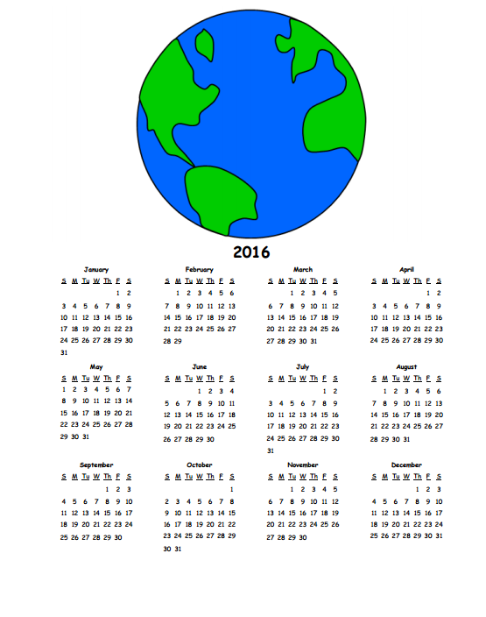







$$f\left(x\right)=a_{0}+\sum_{n=1}^{∞}{\left(a_{n}\cos{\frac{nπx}{L}}+b_{n}\sin{\frac{nπx}{L}}\right)}$$
$${\left(x+a\right)}^{n}=\sum_{k=0}^{n}{\left({n \atop k}\right)x^{k}a^{n−k}}$$
$$x=\frac{−b±\sqrt{b^{2}−4ac}}{2a}$$

