Slide 1
CRheoLab System of Equations

Slide 2
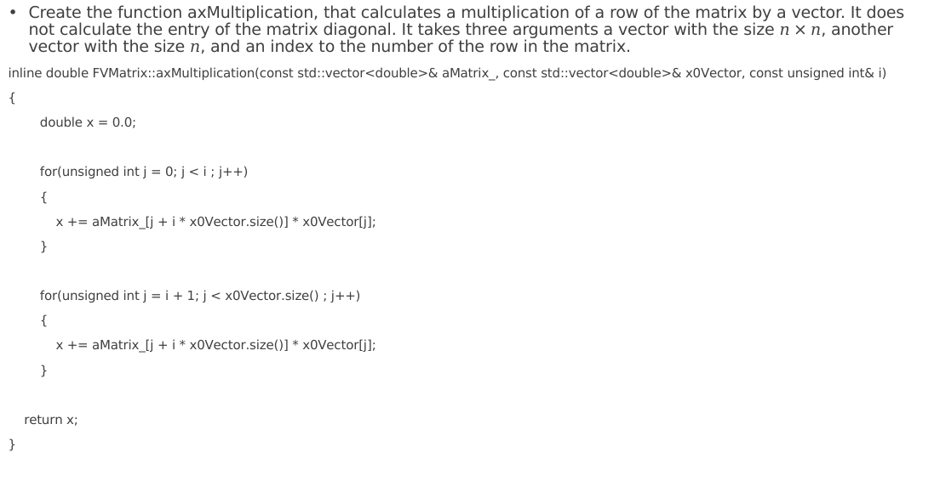
Matrix-line vector multiplication function
Create the function axMultiplication, that calculates a multiplication of a row of the matrix by a vector. It does not calculate the entry of the matrix diagonal. It takes three arguments a vector with the size $n×n$, another vector with the size $n$, and an index to the number of the row in the matrix.
inline double FVMatrix::axMultiplication(const std::vector<double>& aMatrix_, const std::vector<double>& x0Vector, const unsigned int& i)
{
double x = 0.0;
for(unsigned int j = 0; j < i ; j++)
{
x += aMatrix_[j + i * x0Vector.size()] * x0Vector[j];
}
for(unsigned int j = i + 1; j < x0Vector.size() ; j++)
{
x += aMatrix_[j + i * x0Vector.size()] * x0Vector[j];
}
return x;
}

Slide 3
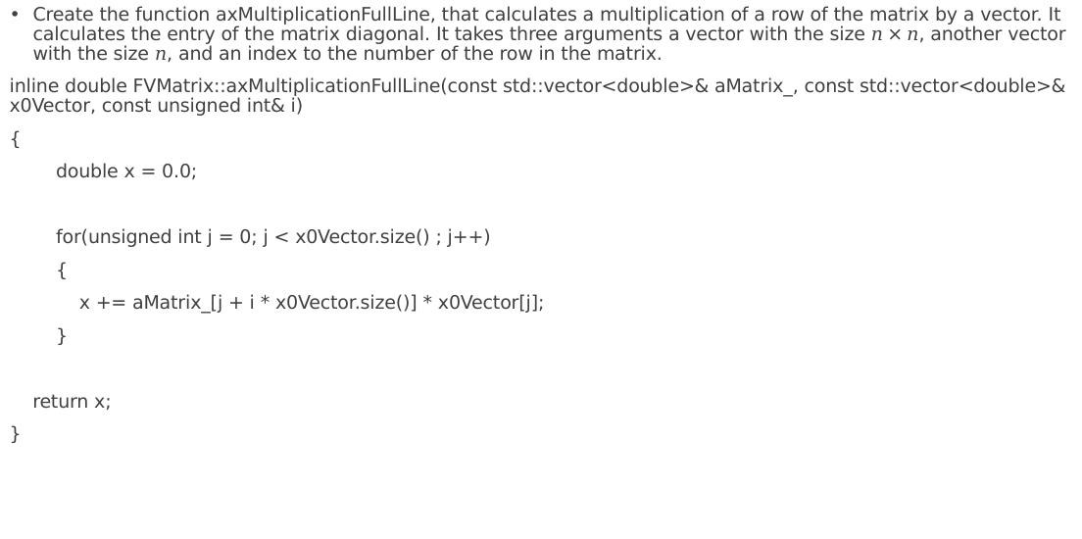
Matrix-line vector multiplication function
Create the function axMultiplicationFullLine, that calculates a multiplication of a row of the matrix by a vector. It calculates the entry of the matrix diagonal. It takes three arguments a vector with the size $n×n$, another vector with the size $n$, and an index to the number of the row in the matrix.
inline double FVMatrix::axMultiplicationFullLine(const std::vector<double>& aMatrix_, const std::vector<double>& x0Vector, const unsigned int& i)
{
double x = 0.0;
for(unsigned int j = 0; j < x0Vector.size() ; j++)
{
x += aMatrix_[j + i * x0Vector.size()] * x0Vector[j];
}
return x;
}

Slide 4
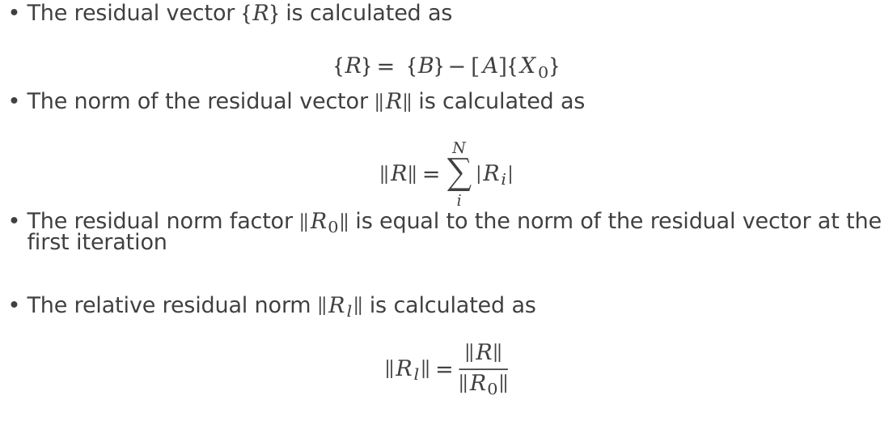
Compute the residual
The residual vector $\left\{R\right\}$ is calculated as
$$\left\{R\right\}= \left\{B\right\}−\left[A\right]\left\{X_{0}\right\}$$
The norm of the residual vector $\left\|R\right\|$ is calculated as
$$\left\|R\right\|=\sum_{i}^{N}{\left|R_{i}\right|}$$
The residual norm factor $\left\|R_{0}\right\|$ is equal to the norm of the residual vector at the first iteration
The relative residual norm $\left\|R_{l}\right\|$ is calculated as
$$\left\|R_{l}\right\|=\frac{\left\|R\right\|}{\left\|R_{0}\right\|}$$

Slide 5
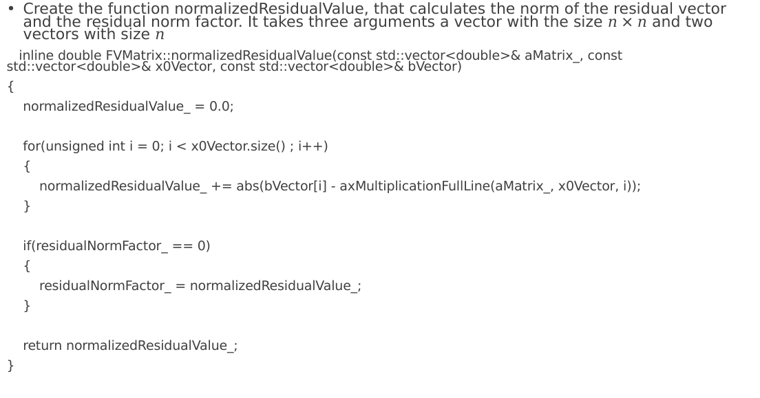
Compute the norm of the residual vector
Create the function normalizedResidualValue, that calculates the norm of the residual vector and the residual norm factor. It takes three arguments a vector with the size $n×n$ and two vectors with size $n$
inline double FVMatrix::normalizedResidualValue(const std::vector<double>& aMatrix_, const std::vector<double>& x0Vector, const std::vector<double>& bVector)
{
normalizedResidualValue_ = 0.0;
for(unsigned int i = 0; i < x0Vector.size() ; i++)
{
normalizedResidualValue_ += abs(bVector[i] - axMultiplicationFullLine(aMatrix_, x0Vector, i));
}
if(residualNormFactor_ == 0)
{
residualNormFactor_ = normalizedResidualValue_;
}
return normalizedResidualValue_;
}

Slide 6
Compute the relative residual norm
Create the function relativeResidualValue to calculate the relative residual norm
inline double FVMatrix::relativeResidualValue()
{
return normalizedResidualValue_ / residualNormFactor_;
}

