Slide 1
TECNOLOGÍAS de la COMPUTACIÓN GRÁFICA Programación Heterogénea
Jose María Buades Rubio
www.uib.cat
Máster Universitario. Ingeniería Informática (MINF)

Slide 2
INDEX
Introduction
OpenCL
API OpenCL

Slide 3
1. Introduction

Slide 4
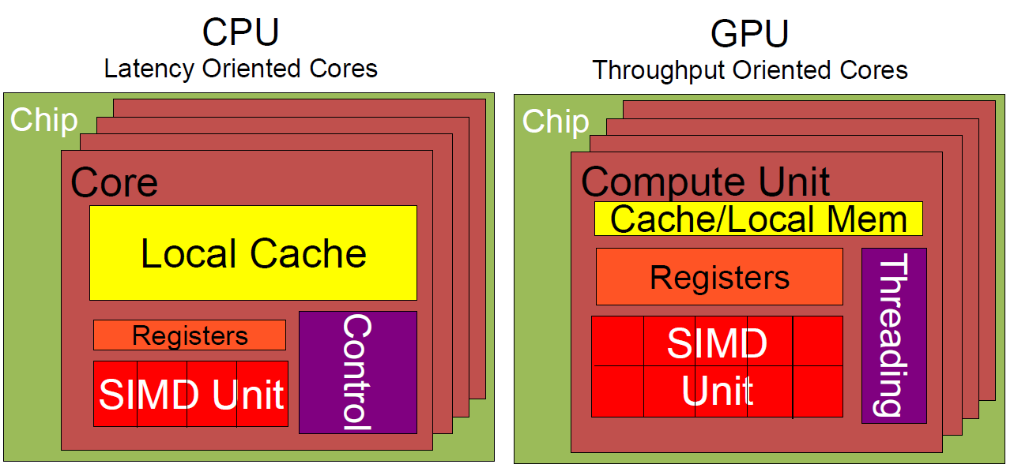
CPU vs GPU

Slide 5
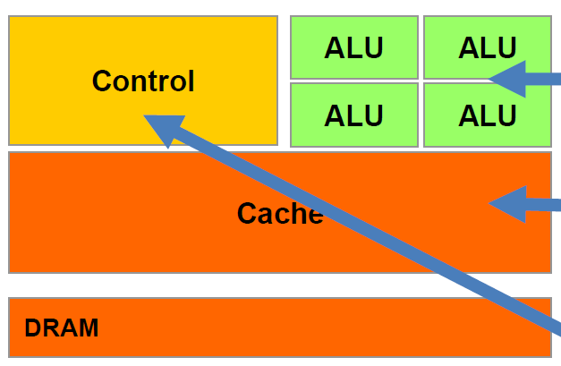
CPU (10x Sequencial Code)
Powerful ALU
Large Cache
Sophisticated and predictive flow control

Slide 6
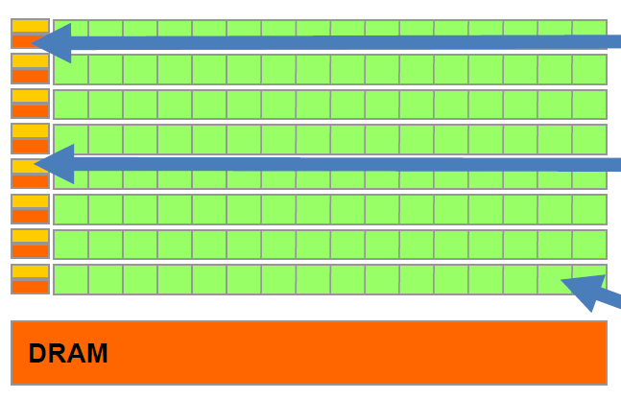
GPU (10x Parallel Code)
Small Cache
Control unit No Prediction
Efficient ALU
Require a lot of threads to counteract latency

Slide 7
GPU Evolution
2001: First chips many-core
2003: These processors are programmable
2006: Unified in a single type
2007: First version of CUDA
2008: OpenCL, consortium driven by Apple
2008: Floating Point Arithmetic and doble precision
2010: Normalization of operands and ECC memory
2012: Heterogeneous computation explooits
2014: Memory space unified CPU-GPU
Future: Hardiness in clusters and access to disk

Slide 8
Scope of use
Financial analysis
Audio and Video Processing
Scientific simulation
Simulation in engineering
Vision by Computer
Treatment of medical images
Statistical models
RayTracing Rendering
Interactive physics
Numerical methods

Slide 9
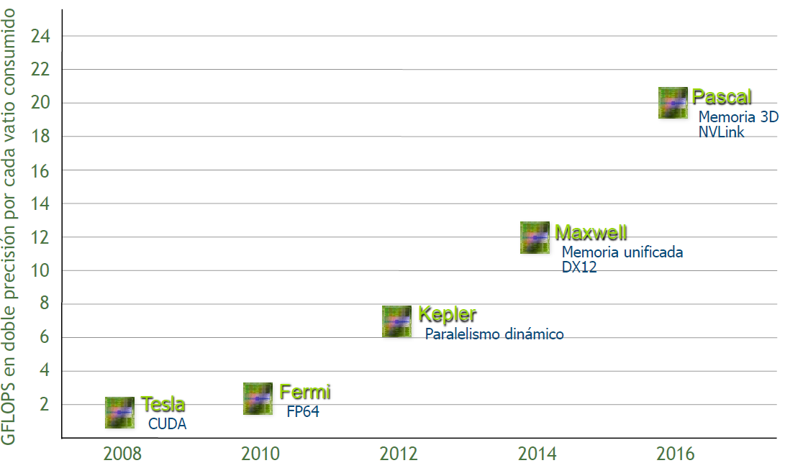
Hardware Evolution (Nvidia)

Slide 10
2. OpenCL

Slide 11
History
OpenCL was created by Apple and mantained by Khronos Group (OpenGL)
It’s applicable to CPUs, GPUs, DSPs (Digital Signal Processor), FPGAs (Field Programmable Gate Array)
CUDA and OpenCL are very similar
Source Code in host is more tedious

Slide 12
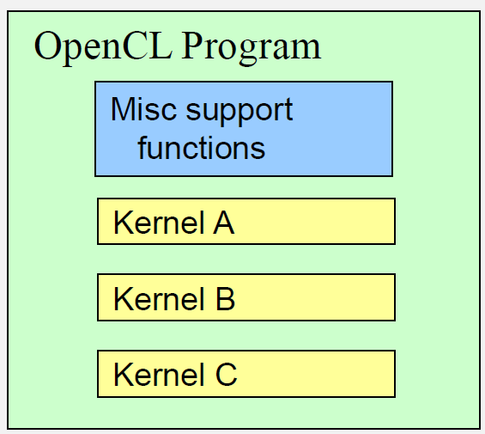
Programa OpenCL
It’s a “program” in C that contains one or more kernels, and support functions to kernels
Kernel is the basic unit of execution

Slide 13
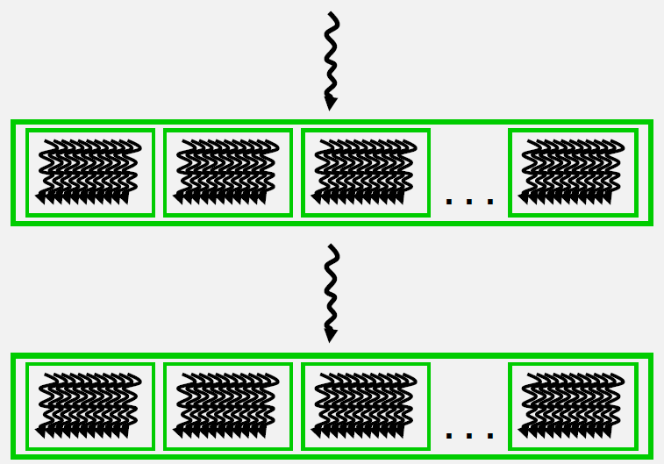
Execution Schema
CPU
GPU
CPU
GPU

Slide 14
OpenCL Concepts
host: device that controls CPU (the CPU)
device: device that executes OpenCL
kernel: program executed in the GPU
host program: program in the CPU
work item: core that executes a kernel
work group: set of work item that “goes together”
NDRange: number of kernesl (in each dimension)

Slide 15
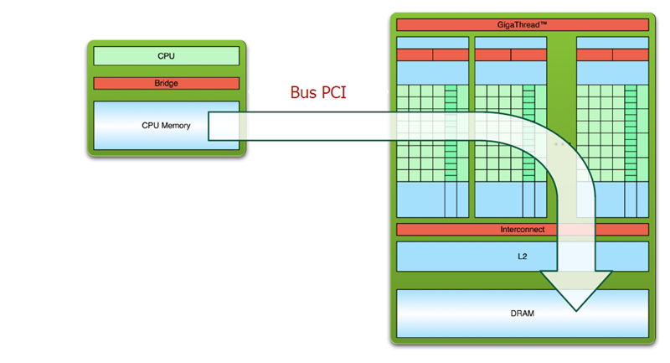
Execution Step (1/3)
Copy data from Host Memory to Device Memory

Slide 16
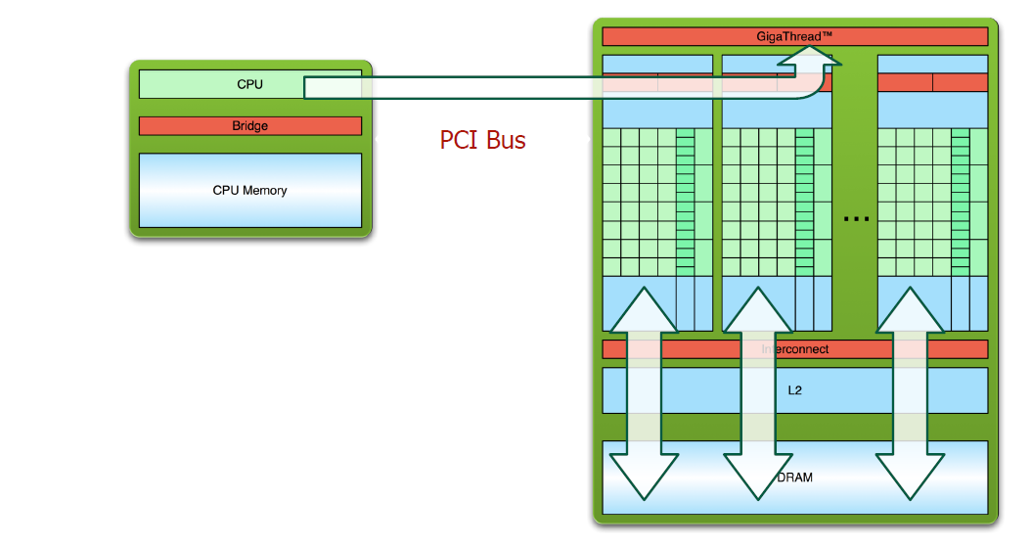
Execution Step (2/3)
Copy kernel and setup local memory (shared between WorkGroup)

Slide 17
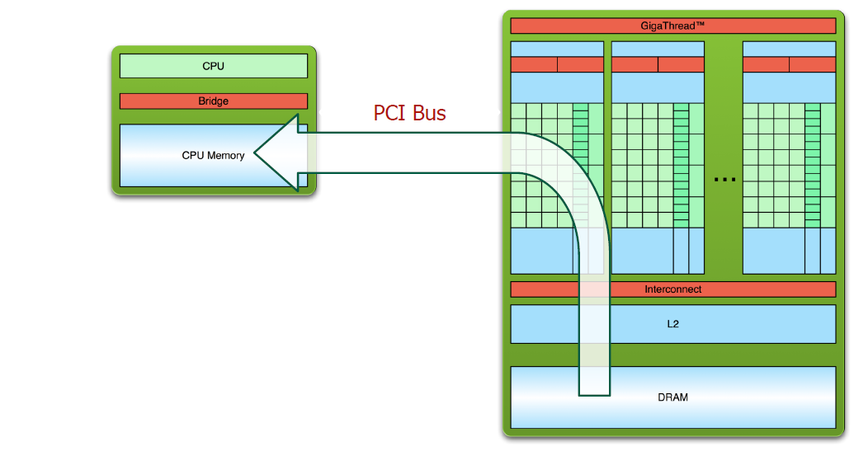
Execution Step(3/3)
Copy results to Host Memory

Slide 18
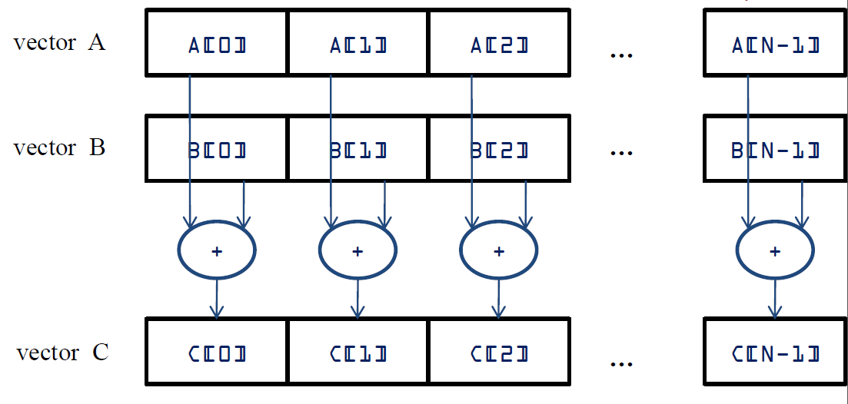
Sample Program
Add Vectors

Slide 19
Sample Program
Add Vectors
__kernel void vadd( __global const float *a,
__global const float *b,
__global float *result)
{
int id = get_global_id(0); // each kernel has a different id!!!
result[id] = a[id] + b[id];
}

Slide 20
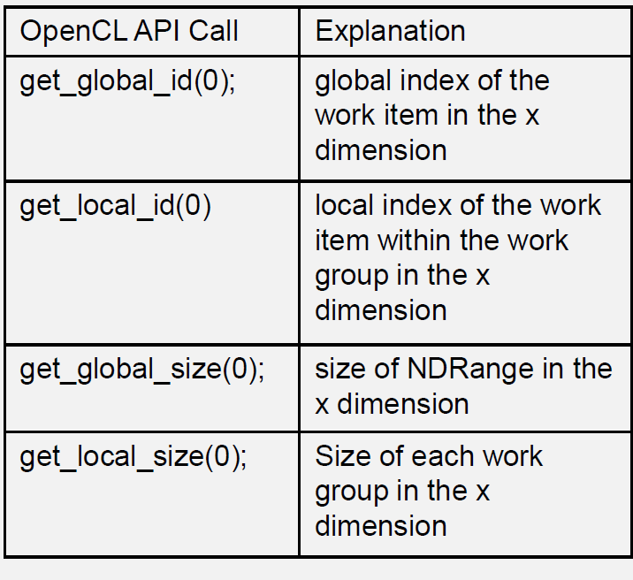
Kernels Identification
Kernel index
Index in the work-group
Number of kernels
Size of work group

Slide 21
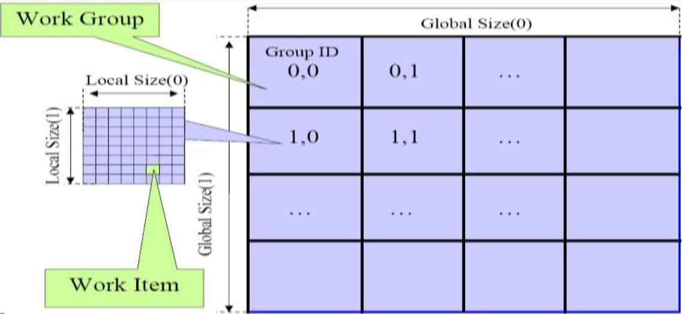
Kernels Identification

Slide 22
Executino Schema
Started from the host specifying the number of kernels
• Each Kernel is executed with a NDRange identificer, separating “work groups” and “work items”
• Work items in the same work group are able to synchronize between them and share a memory space

Slide 23
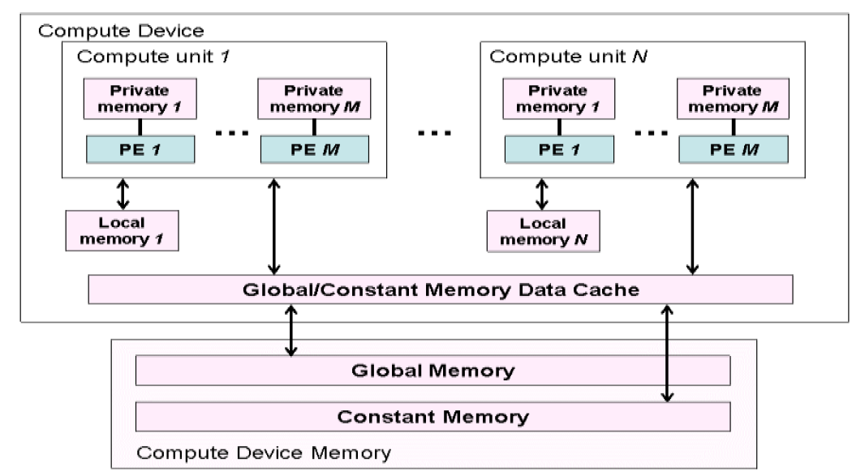
Execution Schema
Memory Access

Slide 24
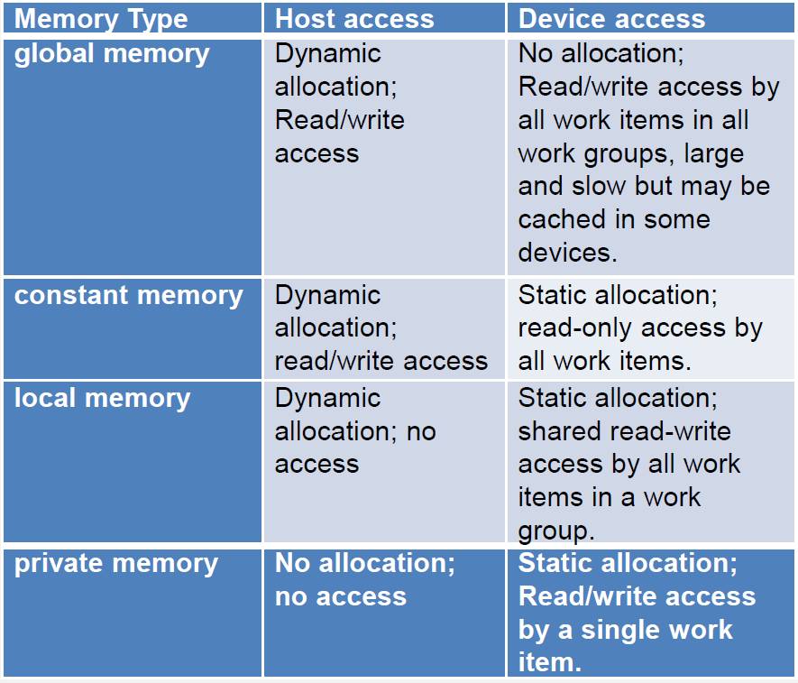
Execution Schema
Memory Access

Slide 25
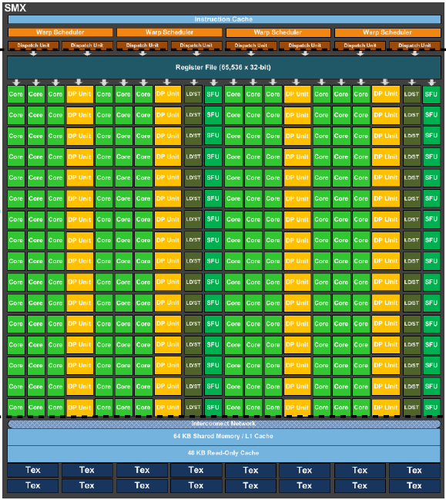
Execution Schema
The number of work-groups that share a “processor” is limited to the number of registers and other factors.
It’s called warp number
Increase in 1 the number of register can produce high performance decrease.

Slide 26
3. API OpenCL

Slide 27
Create Context
// Create context
cl_int clerr = CL_SUCCESS;
cl_context clctx = clCreateContextFromType(0, CL_DEVICE_TYPE_ALL, NULL, NULL, &clerr);
// Ask for the number of devices
size_t parmsz;
clerr = clGetContextInfo(clctx, CL_CONTEXT_DEVICES, 0, NULL, &parmsz);
// Get data about devices
cl_device_id* cldevs = (cl_device_id *) malloc(parmsz);
clerr = clGetContextInfo(clctx, CL_CONTEXT_DEVICES, parmsz, cldevs, NULL);

Slide 28
Create a queue for each device
// Create the execution queue fore each device (first)
cl_command_queue clcmdq = clCreateCommandQueue(clctx, cldevs[0], 0, &clerr);

Slide 29
Add Vector
__kernel void vadd( __global const float *a,
__global const float *b,
__global float *result,
unsigned int n)
{
int id = get_global_id(0); // each kernel has a different id!!!
if (id < n)
result[id] = a[id] + b[id];
}

Slide 30
Create a Kernel
// Create the kernel vaddsrc that contains the source codecl_program clpgm;
clpgm = clCreateProgramWithSource(clctx, 1, &vaddsrc, NULL, &clerr);
// Compile
char clcompileflags[4096];
sprintf(clcompileflags, “-cl-mad-enable");
clerr = clBuildProgram(clpgm, 0, NULL, clcompileflags, NULL, NULL);
// Create the kernel vadd (kernel detailed in vaddsrc)
cl_kernel clkern = clCreateKernel(clpgm, “vadd", &clerr);

Slide 31
Alloc memory in the Device
float *h_A = …, *h_B = …; // Host Data
int memSize = N * sizeof(float)
// Alloc memory in GPU
cl_mem d_A, d_B, d_C;
// Input Buffe
d_A = clCreateBuffer(clctx, CL_MEM_READ_ONLY | CL_MEM_COPY_HOST_PTR, memSize, h_A, NULL);
d_B = clCreateBuffer(clctx, CL_MEM_READ_ONLY | CL_MEM_COPY_HOST_PTR, memSize, h_B, NULL);
// Output Buffer
d_C = clCreateBuffer(clctx, CL_MEM_WRITE_ONLY, memSize , NULL, NULL);

Slide 32
Execute a Kernel
// Parameters
clSetKernelArg(clkern, 0, sizeof(cl_mem),(void *)&d_A);
clSetKernelArg(clkern, 1, sizeof(cl_mem),(void *)&d_B);
clSetKernelArg(clkern, 2, sizeof(cl_mem),(void *)&d_C);
clSetKernelArg(clkern, 3, sizeof(cl_uint), &N);
// Execute
cl_event event=NULL;
size_t num[1] = {N};
clEnqueueNDRangeKernel(clcmdq, clkern, 1, NULL, num, NULL, 0, NULL, &event);
// Wait until finish
clWaitForEvents(1, &event);

Slide 33
Recuperamos resultados
clEnqueueReadBuffer(clcmdq, d_C, CL_TRUE, 0, memSize, h_C, 0, NULL, NULL);
// Liberamos memoria de GPU
clReleaseMemObject(d_A);
clReleaseMemObject(d_B);
clReleaseMemObject(d_C);

