Slide 1
Content
  Why?
  What’s the goal?
Sources
Data organisation
Create a scriptlog
Define the task
Terminal
Regular Expressions
Create a shell script???

Slide 2

Sources/How to get help
Practical computing for biologists (Haddock and Dunn)
Software-Carpentry
( http://software-carpentry.org/ )
Manuals, Stack-Overflow, Google …

Slide 3
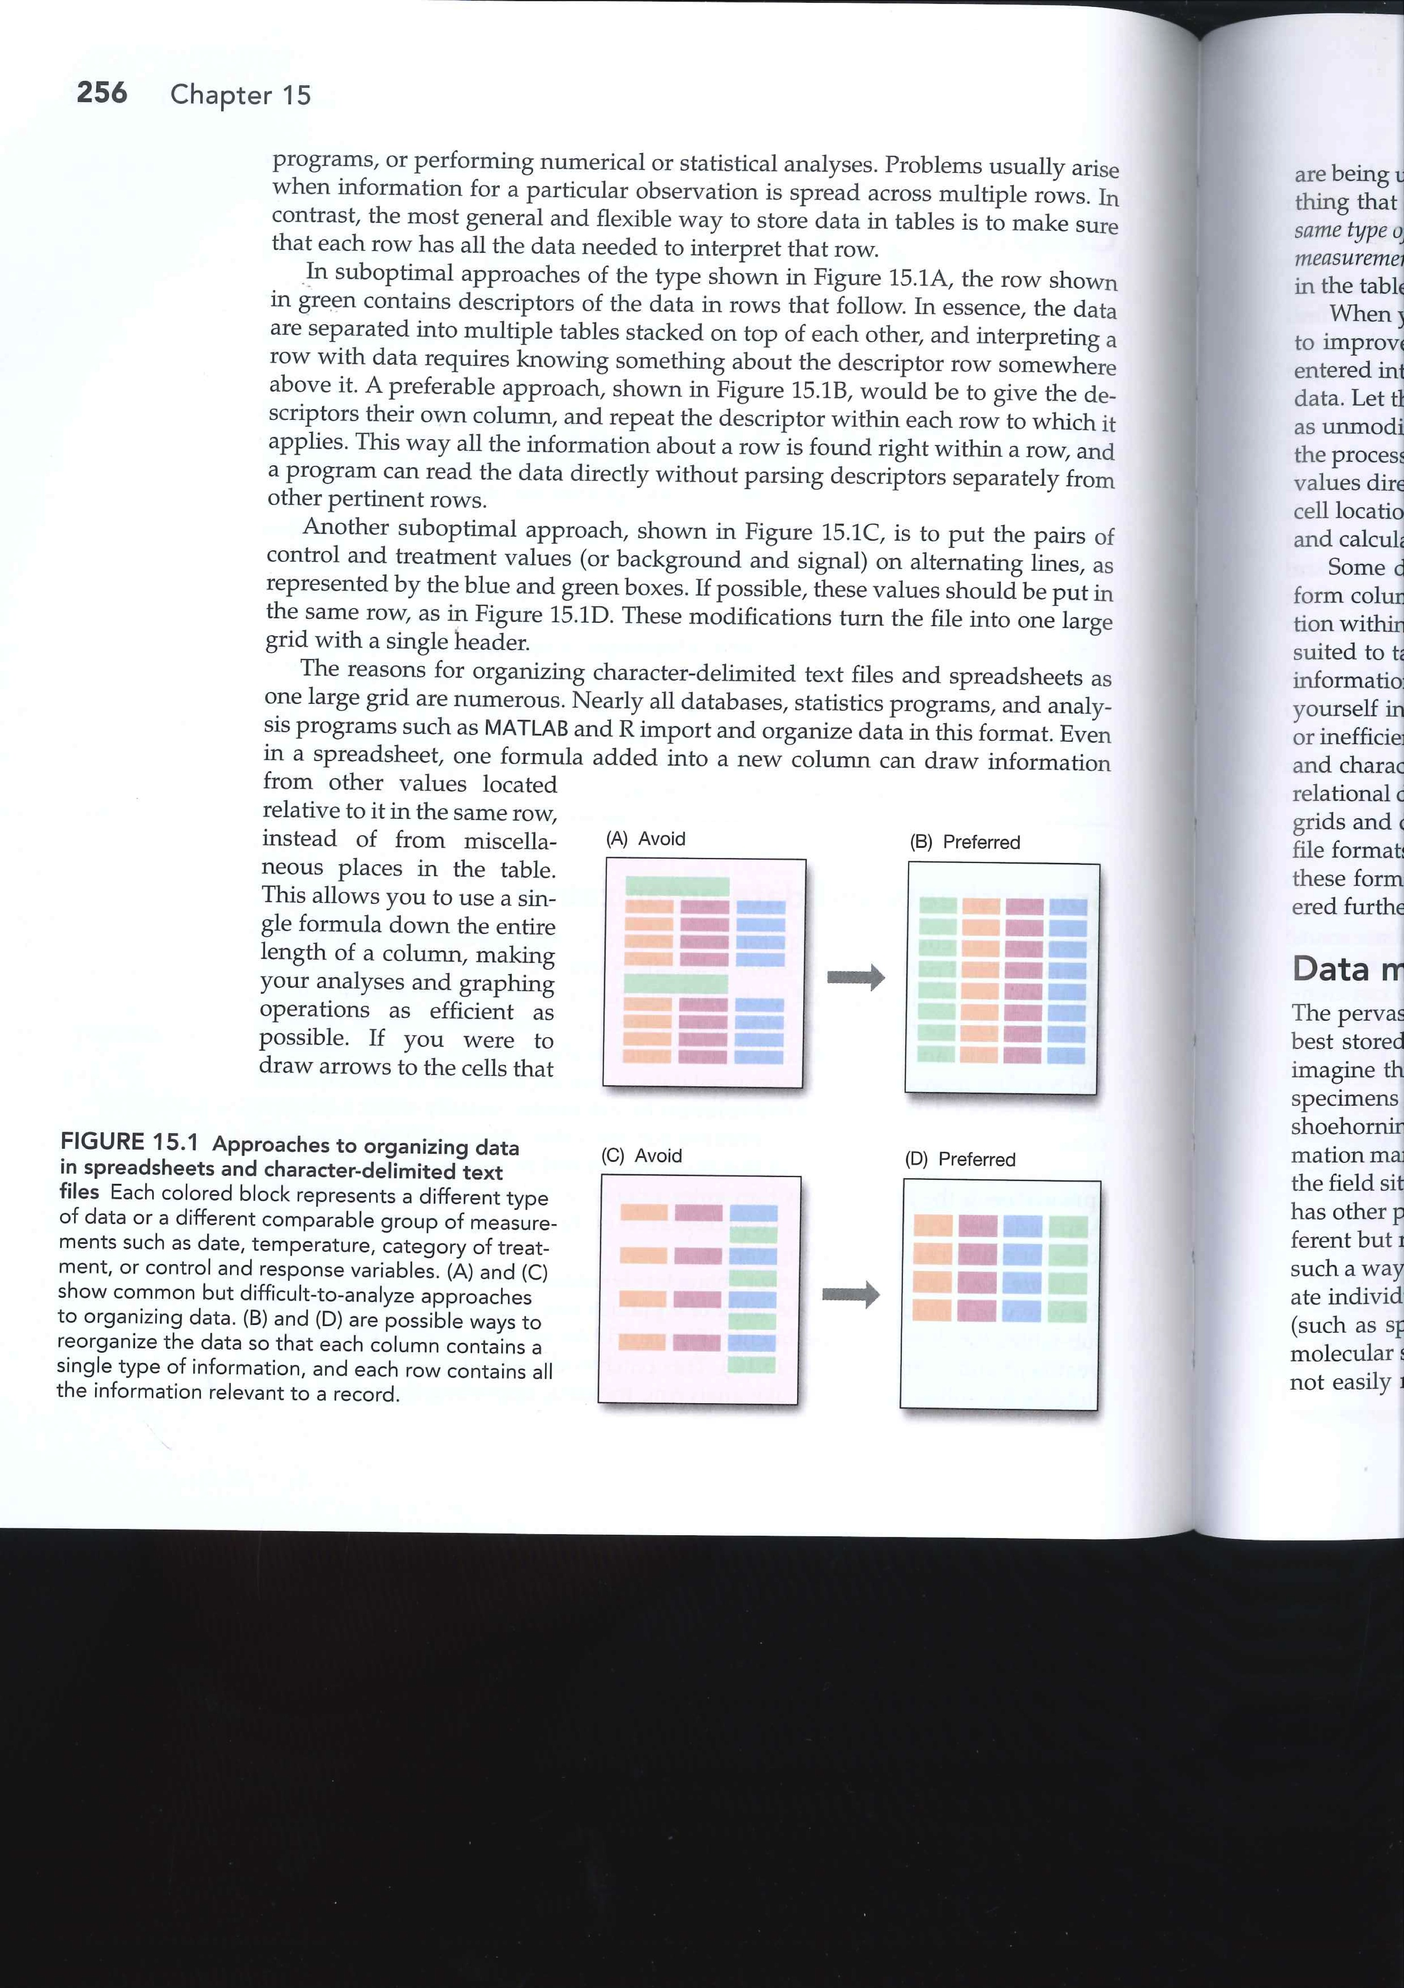
Data organisation
Figure: PCFB (Haddock and Dunn)

Slide 4
Data organisation
Chla_2010
lat | lon | 001_031
16.918 | -25.408 | 0.2
16.918 | -25.367 | 0.216
16.918 | -25.327 | 0.278
16.918 | -25.286 | 0.264
16.918 | -25.245 | 0.243
16.918 | -25.204 | 0.371
16.918 | -25.163 | 0.239
16.918 | -25.122 | 0.283
16.918 | -25.082 | 0.339
16.918 | -25.041 | 0.346
Each line contains all information
year_month_parameter | lat | lon | value
./A2010_001_2010_031_chlorophyll.asc: | 16.918 | -25.408 | 0.2
./A2010_001_2010_031_chlorophyll.asc: | 16.918 | -25.367 | 0.216
./A2010_001_2010_031_chlorophyll.asc: | 16.918 | -25.327 | 0.278
./A2010_001_2010_031_chlorophyll.asc: | 16.918 | -25.286 | 0.264
./A2010_001_2010_031_chlorophyll.asc: | 16.918 | -25.245 | 0.243
./A2010_001_2010_031_chlorophyll.asc: | 16.918 | -25.204 | 0.371
./A2010_001_2010_031_chlorophyll.asc: | 16.918 | -25.163 | 0.239
./A2010_001_2010_031_chlorophyll.asc: | 16.918 | -25.122 | 0.283
./A2010_001_2010_031_chlorophyll.asc: | 16.918 | -25.082 | 0.339
./A2010_001_2010_031_chlorophyll.asc: | 16.918 | -25.041 | 0.346

Slide 5
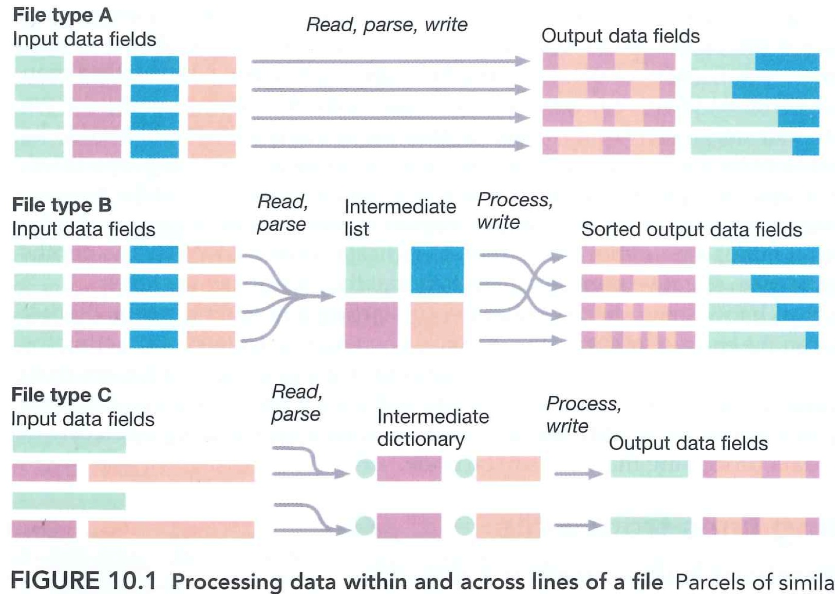
Data organisation
Arrange data in lists, not blocks
Figure: PCFB (Haddock and Dunn)

Slide 6
Data organisation
Chla_2010
lat | lon | 001_031
16.918 | -25.408 | 0.2
16.918 | -25.367 | 0.216
16.918 | -25.327 | 0.278
16.918 | -25.286 | 0.264
16.918 | -25.245 | 0.243
16.918 | -25.204 | 0.371
16.918 | -25.163 | 0.239
16.918 | -25.122 | 0.283
16.918 | -25.082 | 0.339
16.918 | -25.041 | 0.346
Each line contains all information
year_month_parameter | lat | lon | value
./A2010_001_2010_031_chlorophyll.asc: | 16.918 | -25.408 | 0.2
./A2010_001_2010_031_chlorophyll.asc: | 16.918 | -25.367 | 0.216
./A2010_001_2010_031_chlorophyll.asc: | 16.918 | -25.327 | 0.278
./A2010_001_2010_031_chlorophyll.asc: | 16.918 | -25.286 | 0.264
./A2010_001_2010_031_chlorophyll.asc: | 16.918 | -25.245 | 0.243
./A2010_001_2010_031_chlorophyll.asc: | 16.918 | -25.204 | 0.371
./A2010_001_2010_031_chlorophyll.asc: | 16.918 | -25.163 | 0.239
./A2010_001_2010_031_chlorophyll.asc: | 16.918 | -25.122 | 0.283
./A2010_001_2010_031_chlorophyll.asc: | 16.918 | -25.082 | 0.339
./A2010_001_2010_031_chlorophyll.asc: | 16.918 | -25.041 | 0.346

Slide 7
The task
Merge data from several files into one file
Reorganise the data for output and save
as a tabstop delimited txt file
using:
The Terminal
Regular expressions

Slide 8
Create a scriptlog for your project
As we will almost exclusively use scripting tools / type nearly every step of the analysis,
we can record every command in a scriptlog.
This will help to redo the analysis if the database changes or if one step in the analysis needs to be changed. (you’ll need to redo figures!!!)
Recording what you are doing with the data is an essential part of scientific work.
Create a script log

Slide 9
Use the terminal to handle files
A tool to handle files / call programs without clicking around
The main commands:
man “command” = see the manual for the respective command
cd = change directory
cd .. = change directory one level higher
ls = list content of directory
open = open file with default application
cat = concatenate one/several file(s) (load them to memory)
| = pipe = send data in memory to another program
sort = sort the contents in memory
cut –f1 = cut out the first column (tab-delimited) of a file
head –n100 = display the first 100 lines of a file
tail –n100 = display the last 100 lines of a file
> = redirect to file (overwrite)
>> = redirect to file (append)
wc = word count
cat test.txt | Rscript script.R
(load the file test.txt and pipe it to R where it
should be analysed using the script script.R)
mv = move a file / several files
cp = copy one / several files
grep “text” = display only lines that contain “text”
Pipe on german keyboard:
AltGr >

Slide 10
Use the terminal to handle files
A tool to handle files / call programs without clicking around
Concatenate the input files to one file and exclude the header line.

Slide 11
Use the terminal to handle files
A tool to handle files / call programs without clicking around
Some more examples
Extension of file names / directories with “tab”

Slide 12
Regular expressions
A tool to rearrange text / data
The main commands:
\t = tab-stop
\d = digital
\d+ = several digits
\d{1,4} = one to four digits
\d* = as many digits as possible
\w = alphanumeric characters plus underscore
\s = whitespace
. = any symbol
.* = as many symbols of any kind
^ = start of line
$ = end of line
\r = carriage return
\n = line feed
() = captures a term
Replace: \1 = returns the first captured term
Good explanation at: http://en.wikipedia.org/wiki/Regular_expression

Slide 13
Regular expressions
A tool to rearrange text / data
Change the sorting of the file and output into a text file

Slide 14
Regular expressions
A tool to rearrange text / data
Some more examples

Slide 15
List of MacOS X terminal commands: http://ss64.com/osx/
http://www.regular-expressions.info/

