Slide 1
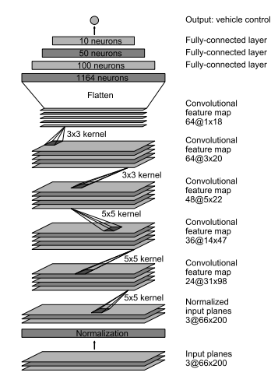
1 neuron
10 neurons
50 neuron
120 neurons

