Slide 1
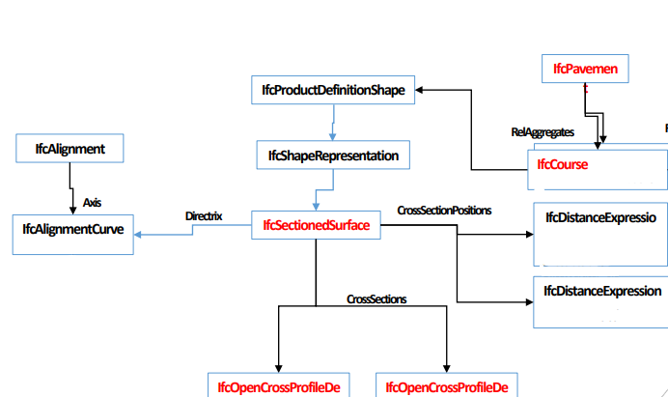
IfcPavement Example
Diagramm

Slide 2
IfcAlignment
Axis = IfcPolyline
X = 513220.00000
Y = 5454120.00000
Z = 92.0000
DistanceAlong = 14.14214
X = 513210.00000
Y = 5454110.00000
Z = 91.0000
DistanceAlong = 0.0

Slide 3
IfcPavement
IfcSectionedSurface at DistanceAlong = 0
Tag = AX
Width = 3
Slope = -3.006
Tag = -1AL
Width = -3
Slope = -3.006
Tag = +1AL
Width = 3
Slope = -3.006
DistanceAlong = 0.0
OffsetVertical = 91.0

Slide 4
IfcPavement
IfcSectionedSurface at DistanceAlong = 14.142
Tag = AX
Width = 3
Slope = -3.006
Tag = -1AL
Width = -3
Slope = -3.006
Tag = +1AL
Width = 3
Slope = -3.006
DistanceAlong = 14.142
OffsetVertical = 92.0

