Slide 1
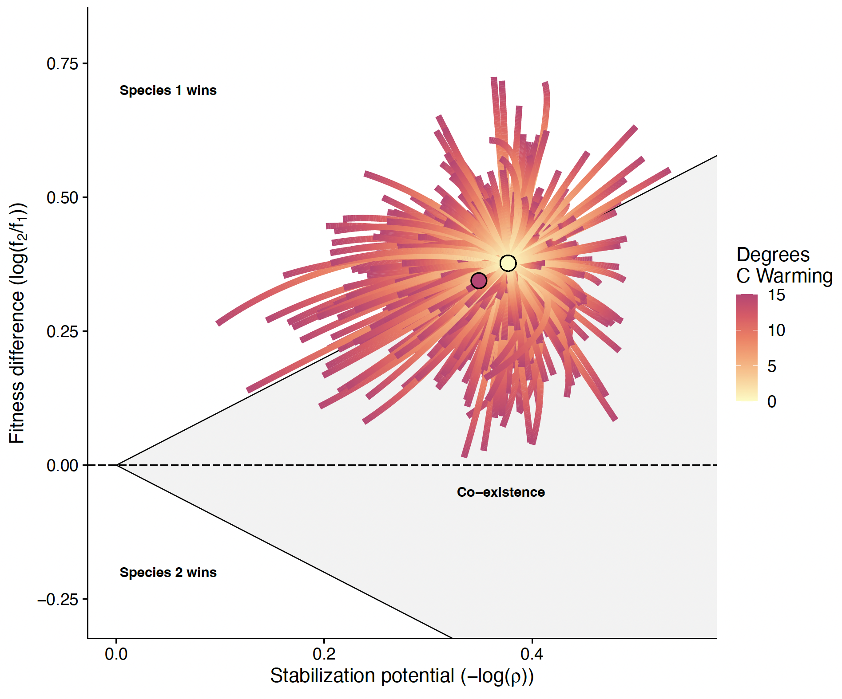
AWAY FROM
NEUTRALITY
TOWARD
NEUTRALITY
AWAY FROM
NEUTRALITY

Slide 2
m1
C1
C2
m2
C1R2
C2R1
C1R1
C2R2
R1
R2
r1
r2

