Slide 1
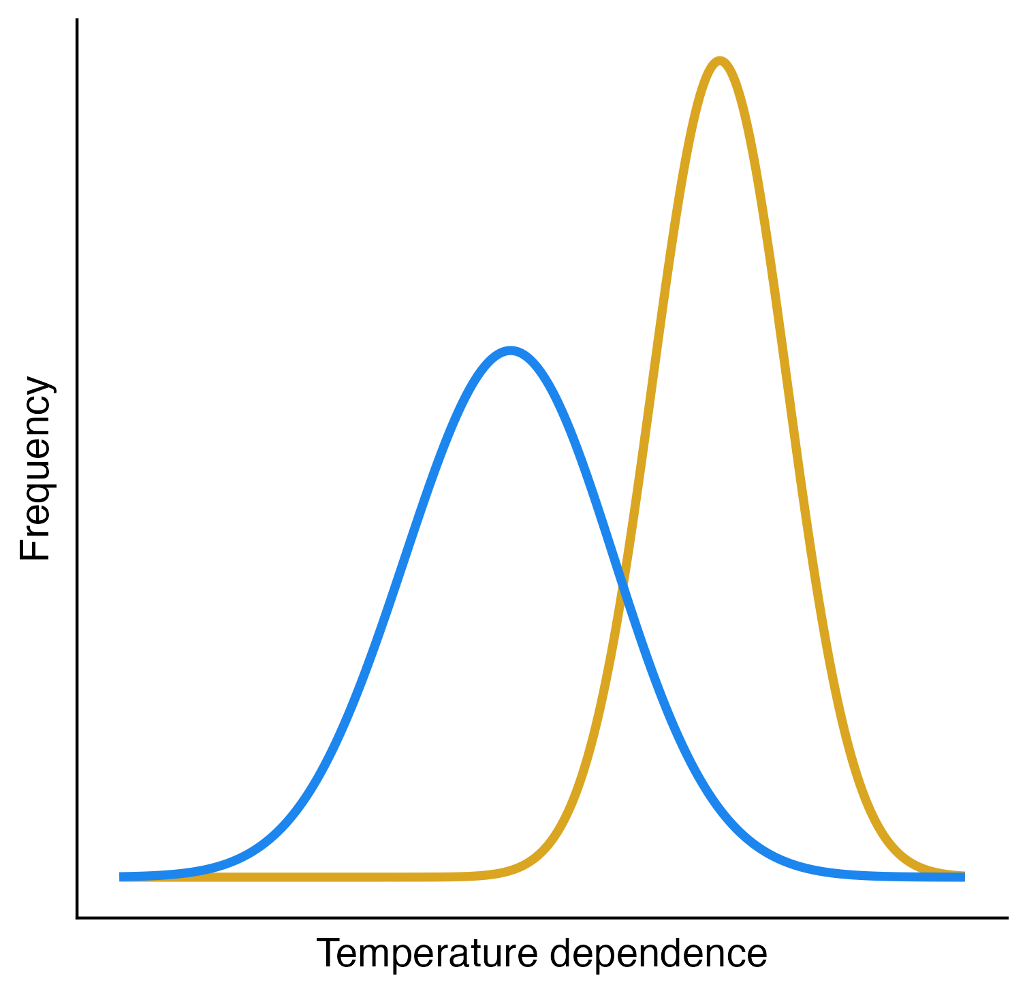
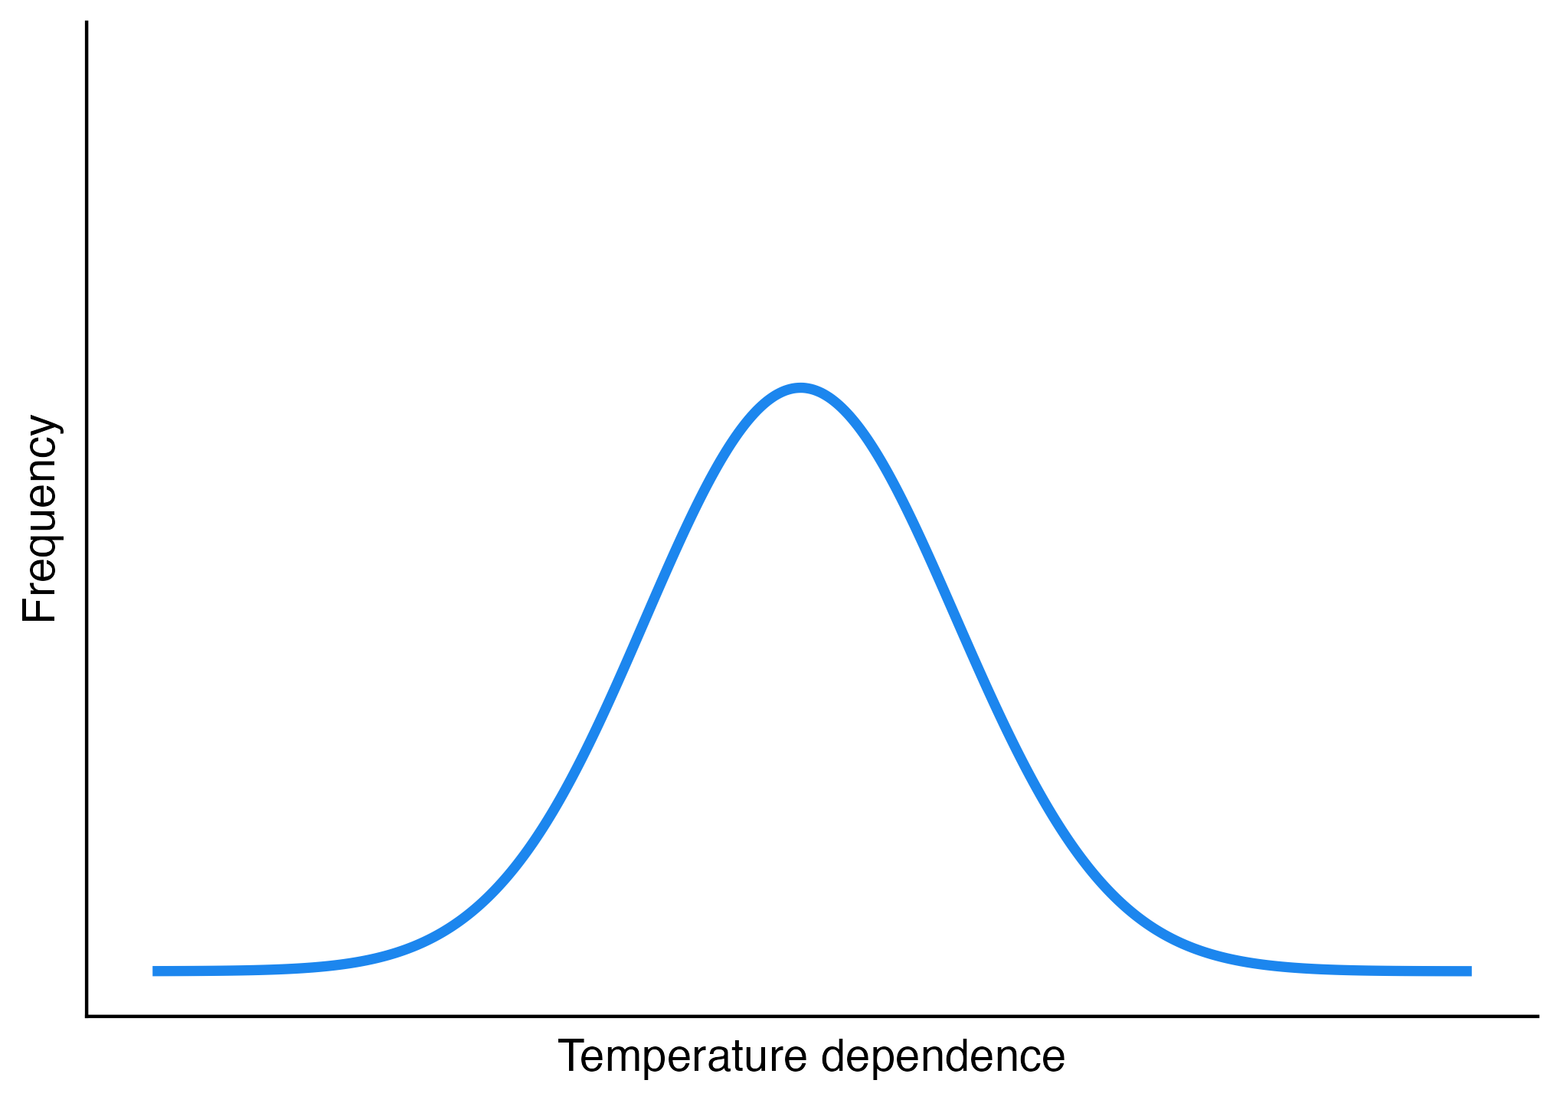

Slide 2



C₁
C₂
m₁
m₂
c_{1a}, v_{a}
c_{1b}, v_{b}
c_{2a}, v_{a}
c_{2b}, v_{b}
R_{a}
R_{b}
r_{a}, K_{a}
r_{b}, K_{b}

Slide 3



N₁
N₂
m₁
m₂
c_{1b}
c_{2a}
c_{1a}
c_{2b}
R_{a}
R_{b}
r_{a}
r_{b}

Slide 4

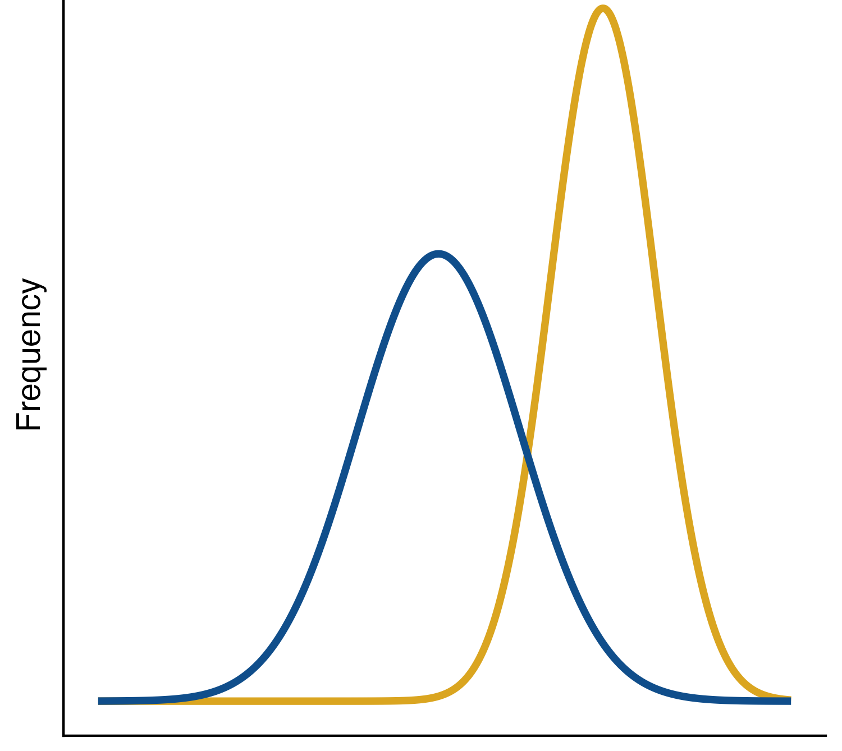





Inter-process thermal asymmetry
N₁
N₂
m₁
m₂
c_{1b}
c_{2a}
c_{1a}
c_{2b}
R_{a}
R_{b}
r_{a}
r_{b}
E_{rb}
E_{c2b}
Temperature Sensitivity

Slide 5
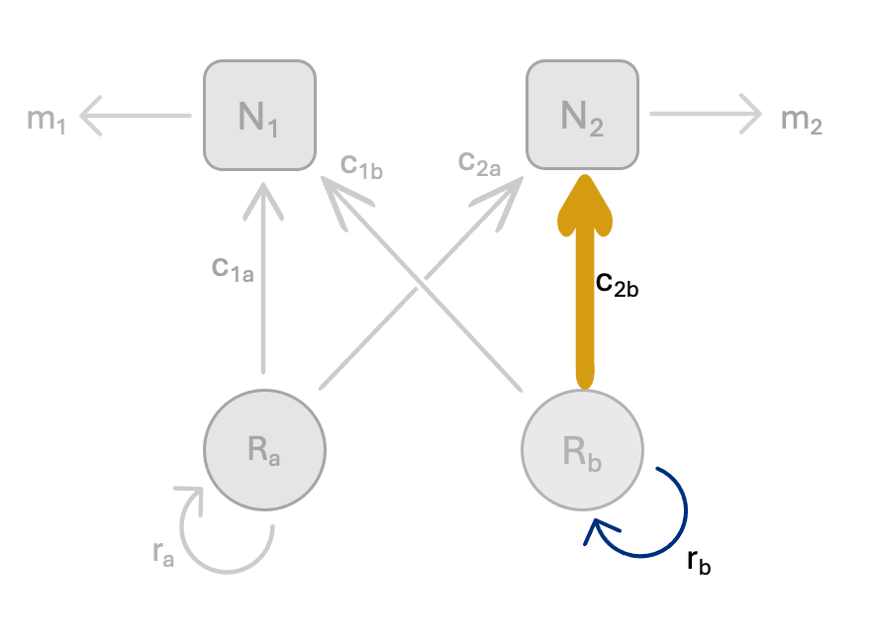
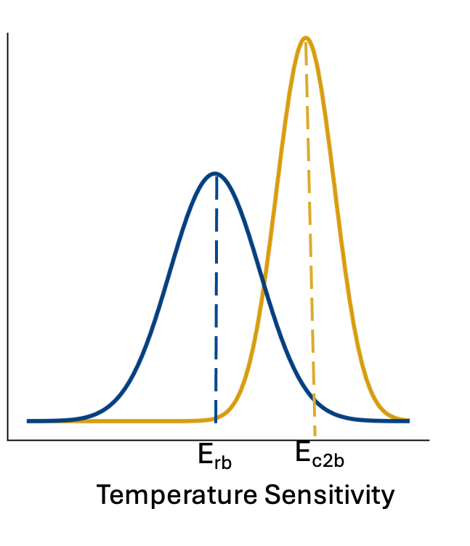
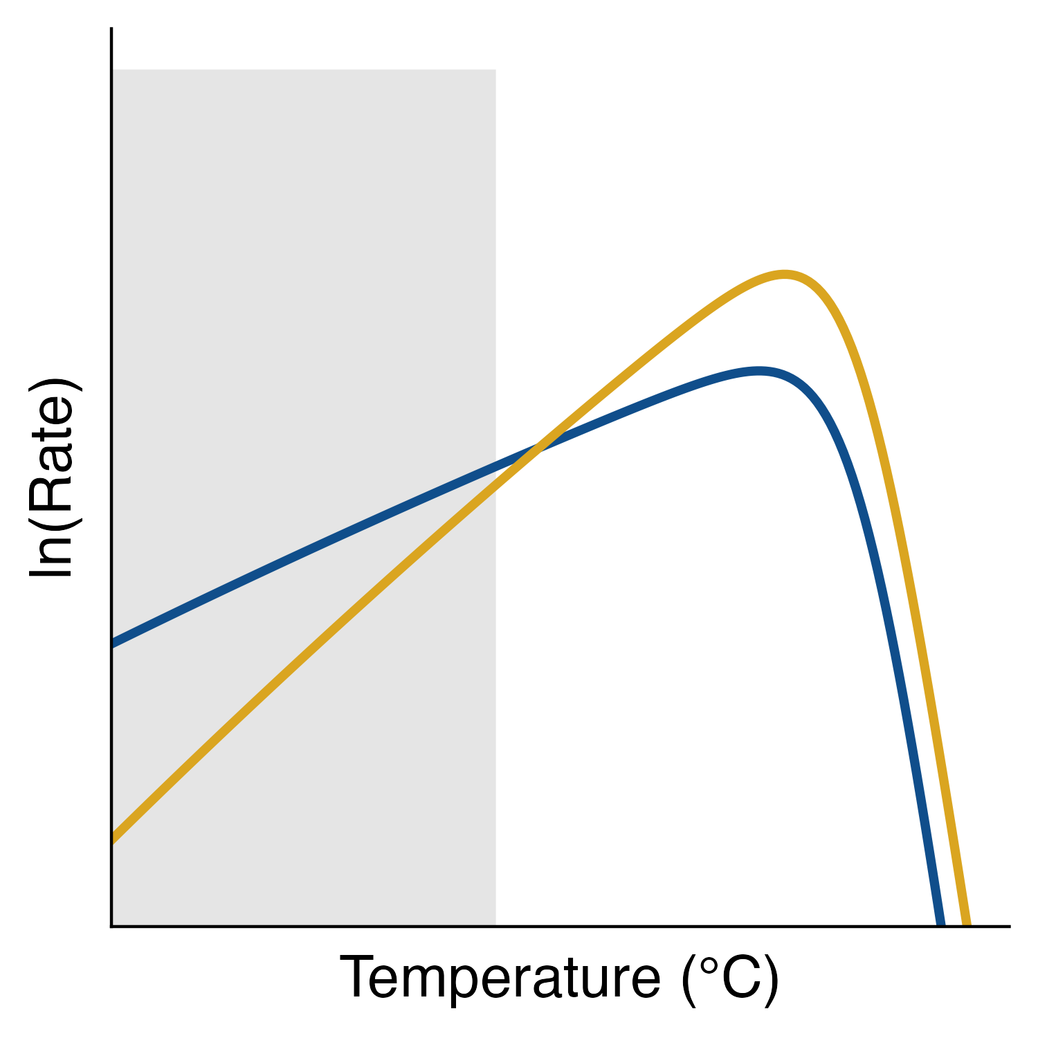


Inter-process thermal asymmetry
E_{rb}
Frequency
r_{b}
E_{c2b}
c_{2b}

Slide 6
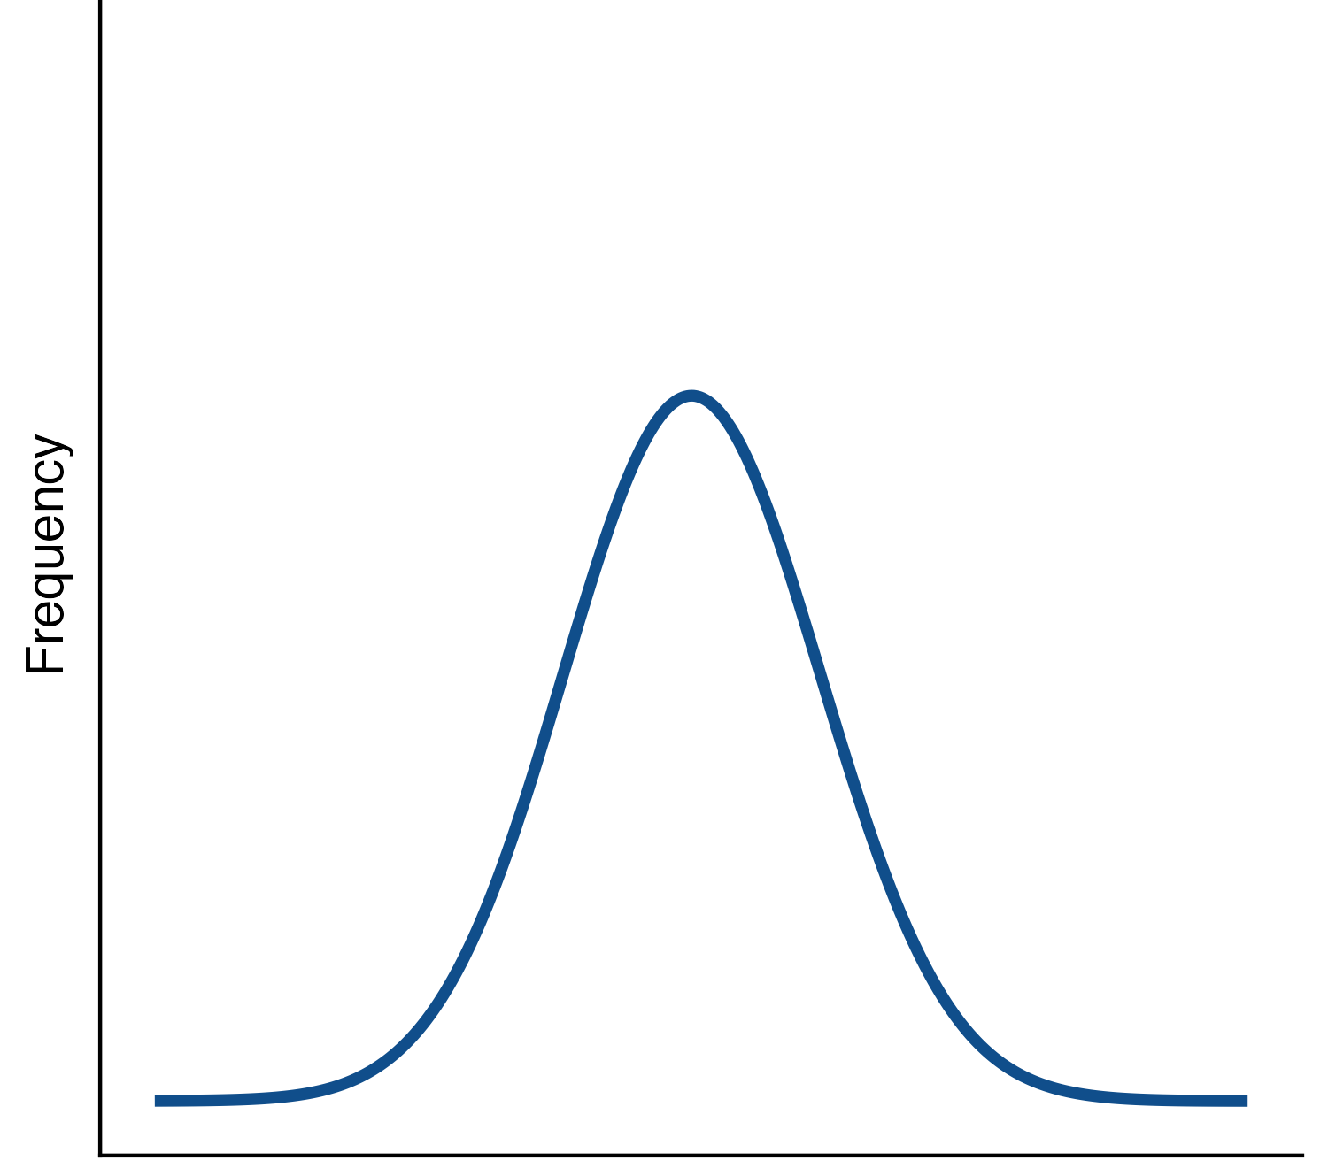


Intra-process thermal asymmetry
N₁
N₂
m₁
m₂
c_{1b}
c_{2a}
c_{1a}
c_{2b}
Frequency
R_{a}
R_{b}
r_{a}
r_{b}
E_{ra}
E_{rb}
Temperature Sensitivity

Slide 7
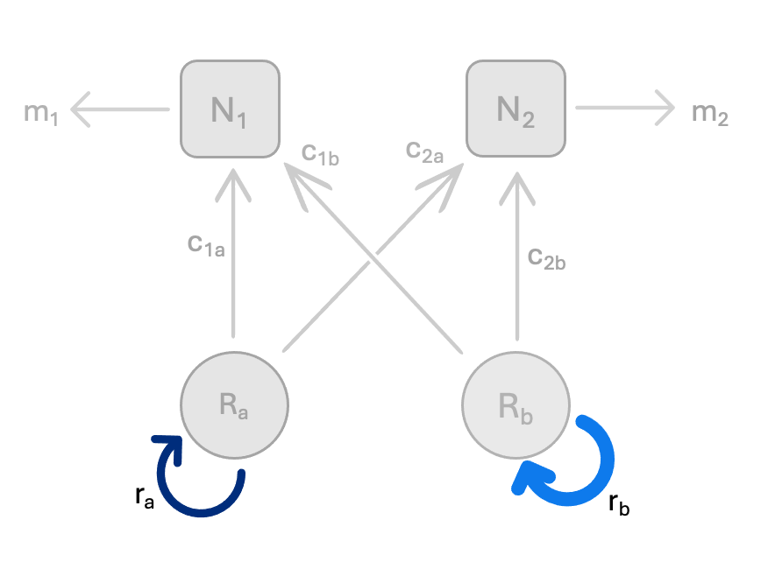
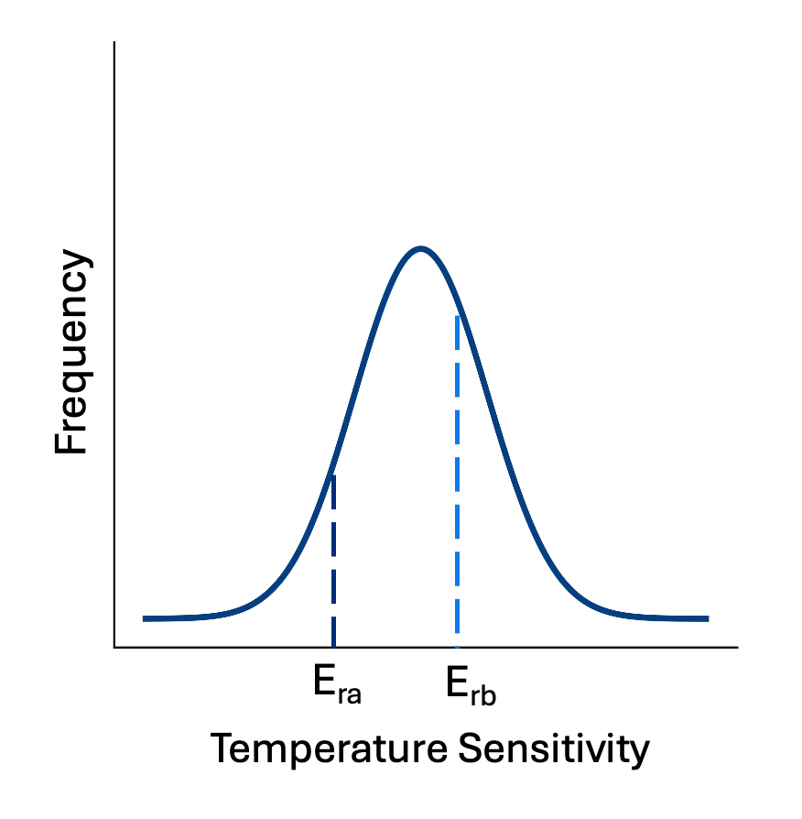
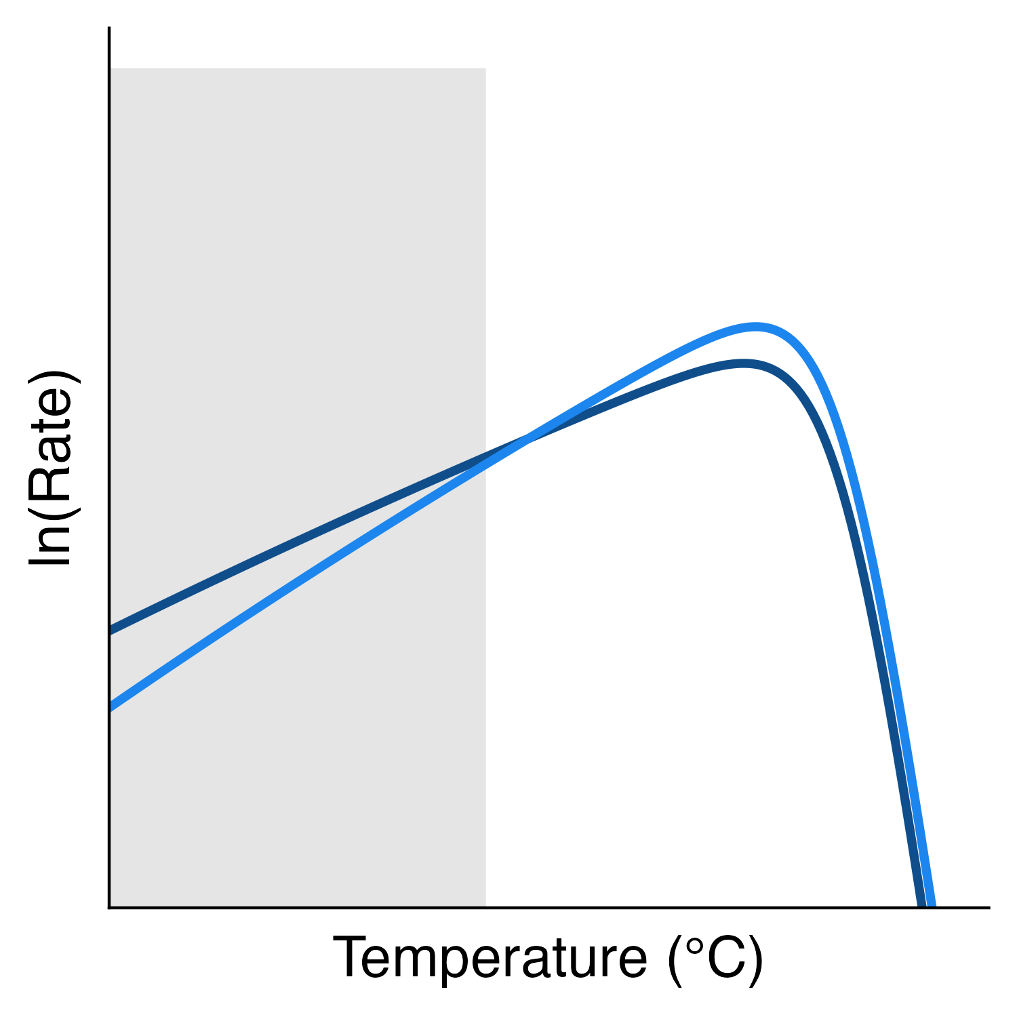
Intra-process thermal asymmetry
E_{ra}
r_{a}
E_{rb}
r_{b}

Slide 8
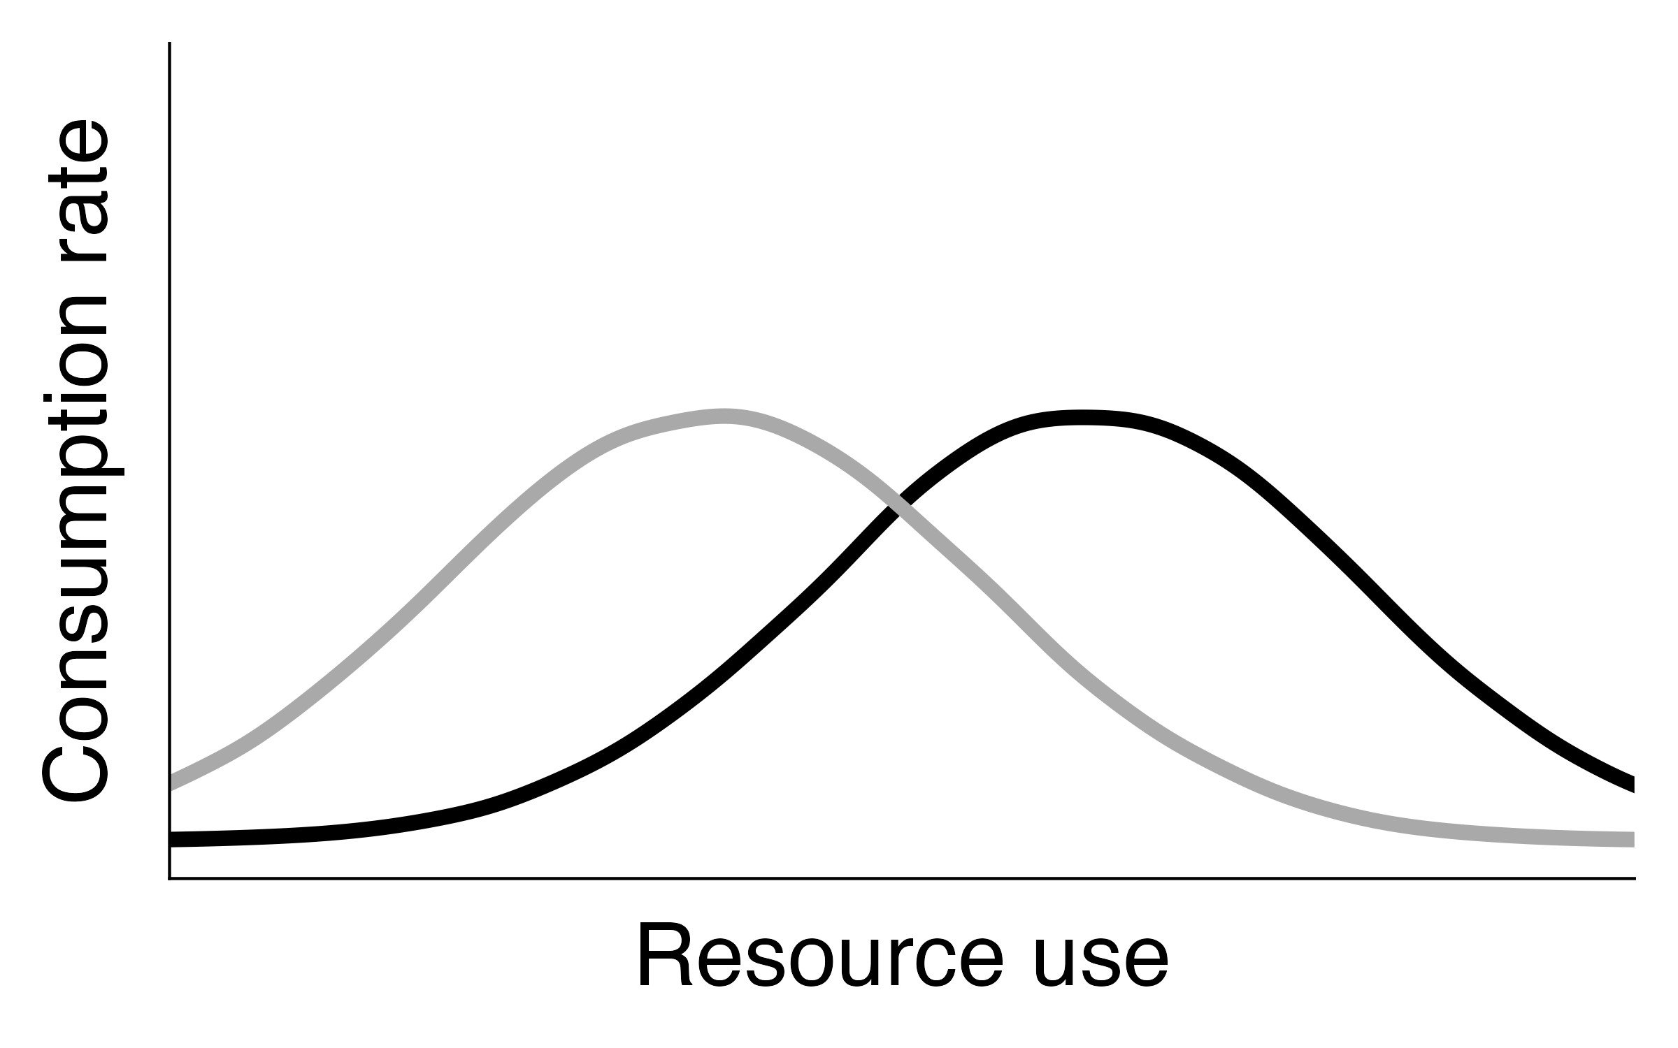
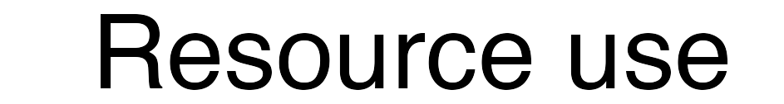
N₂
N₁
100% specialization on resource a
No resource preference
100% specialization on resource b

Slide 9
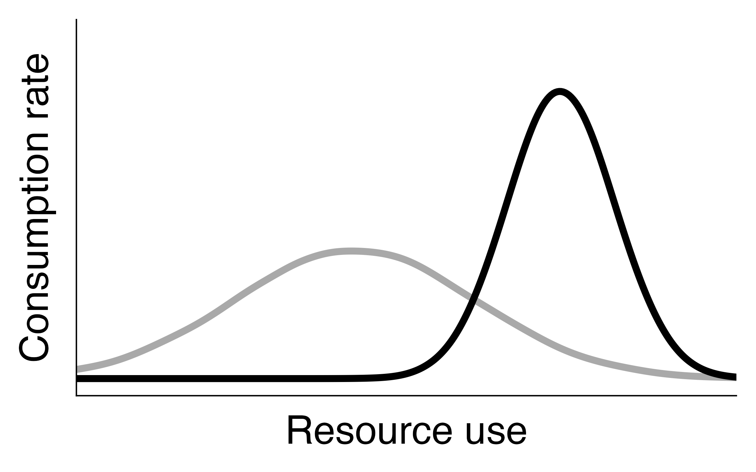
N₁
N₂
100% specialization on resource a
No resource preference
100% specialization on resource b

