Slide 2
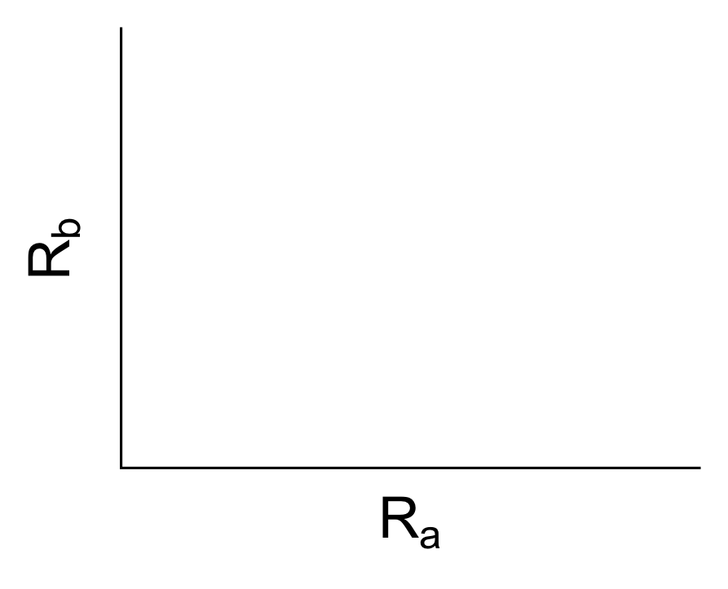
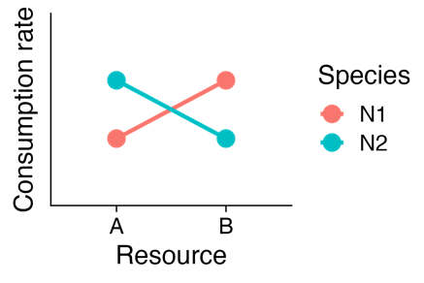
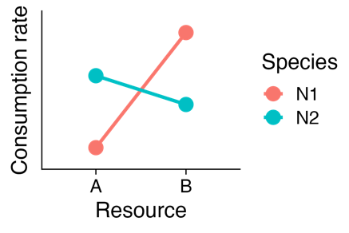
ZNGIs
Perfectly symmetrical resource use scenario
Generalist consumer vs. specialist consumer
Relative consumption rate figures

Slide 3
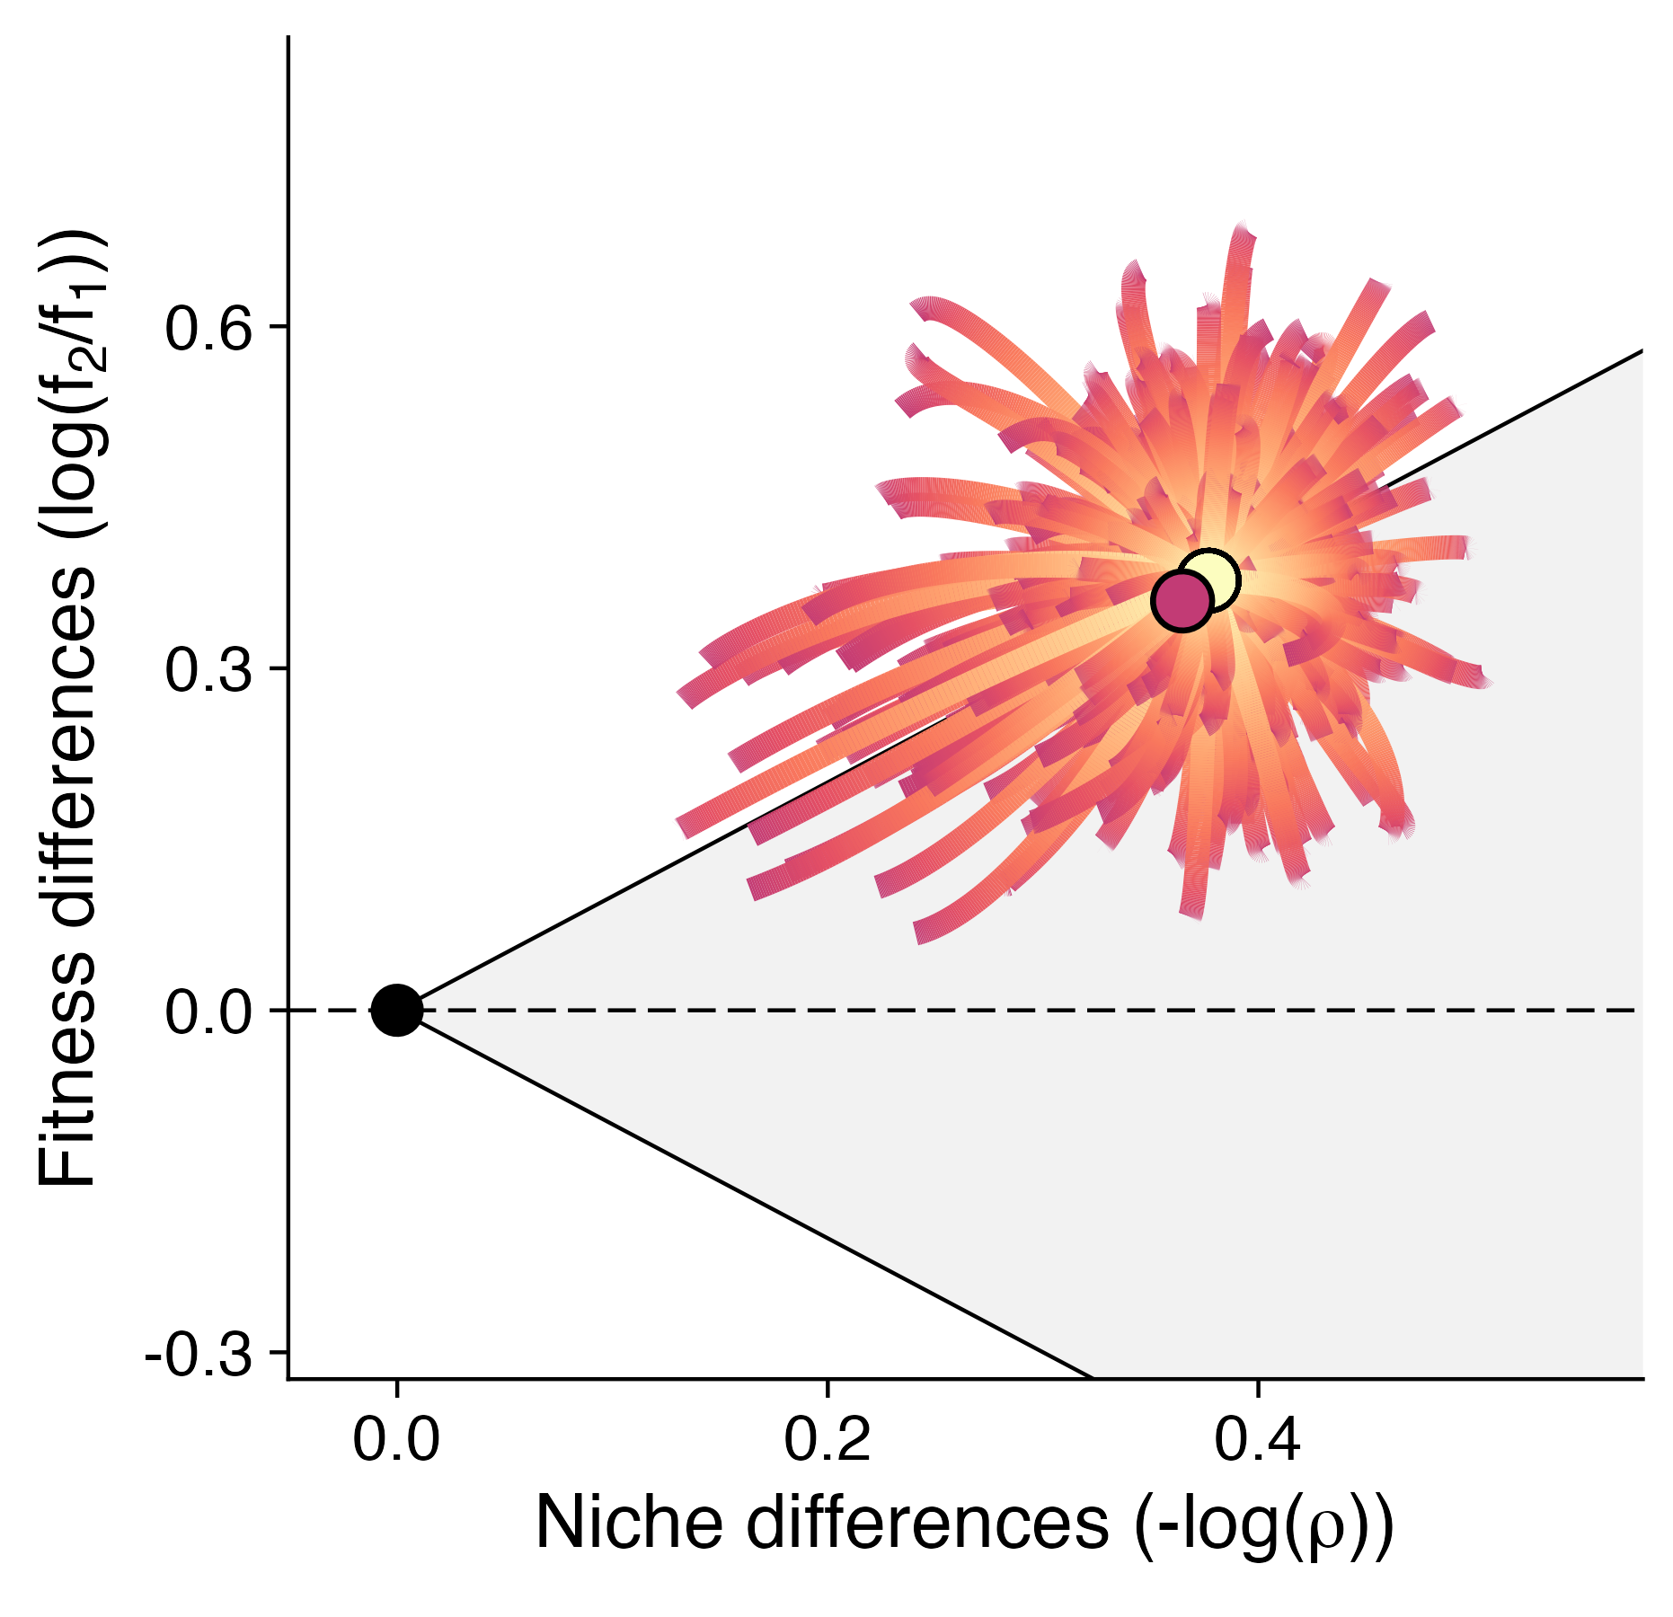
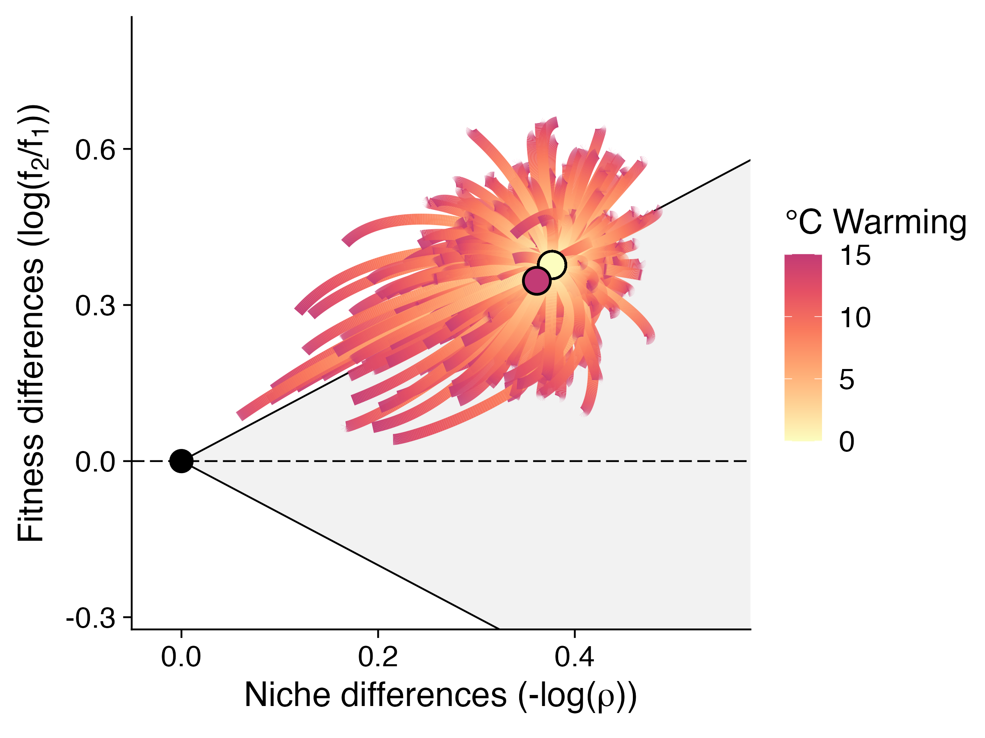
A
B
C
Rate
10
15
20
25
30
Temperature (°C)

Slide 4
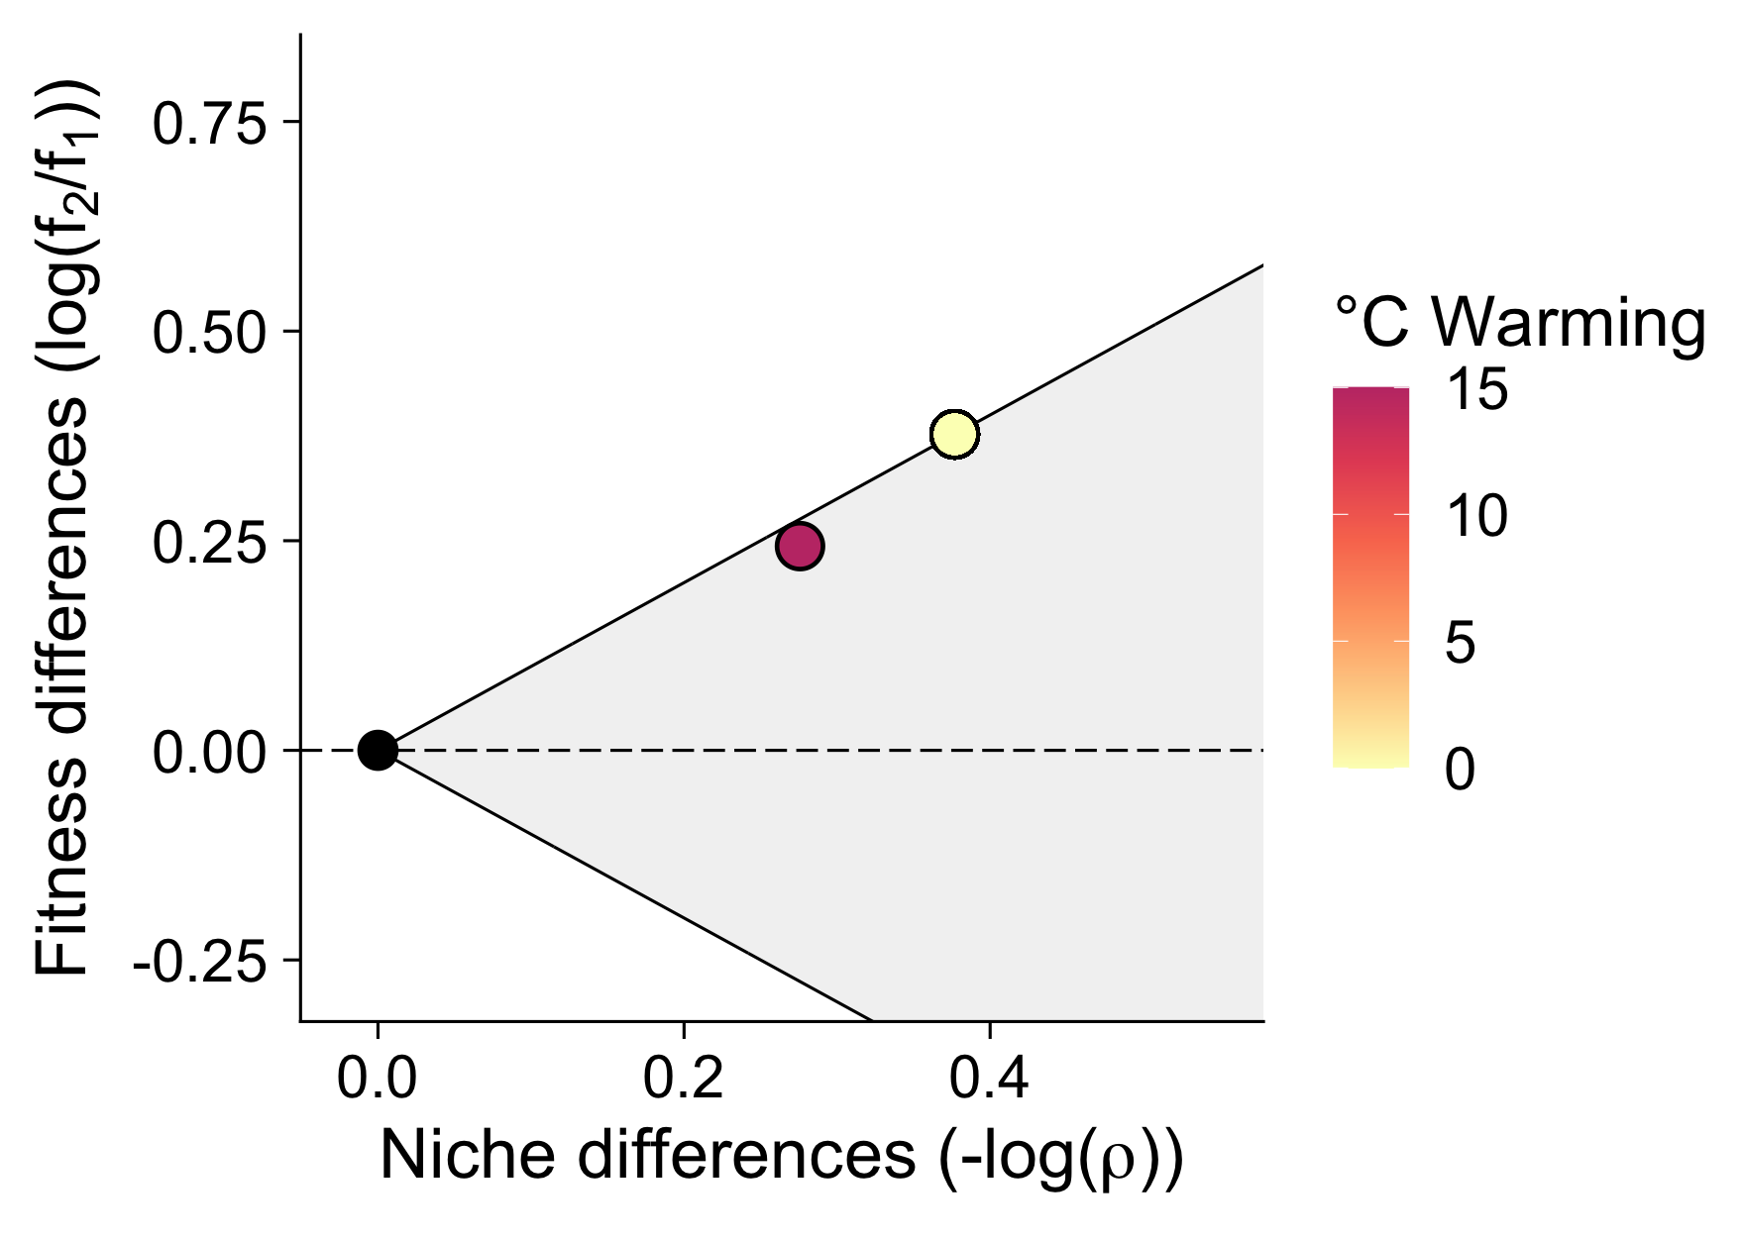
E_{c1b} > E_{c1a}
E_{rb} > E_{ra}
E_{c1a} > E_{c1b}
E_{ra} > E_{rb}
E_{Kb} > E_{Ka}
E_{Ka} > E_{Kb}
F
Displacement (Euclidean distance)
E_{vb} > E_{va}
E_{m2} > E_{m1}
E_{va} > E_{vb}
E_{m1} > E_{m2}
Notes:
When A is bigger than B, it’s pink

Slide 5
|E_{rb} – E_{ra}|
|E_{c1b} – E_{c2a}|
|E_{c1b} – E_{c1a}|
|E_{c1b} – E_{c2b}|
Displacement of species pair with warming (Euclidean distance)
|E_{c2b} – E_{c2a}|
|E_{c2b} – E_{c1a}|
|E_{c1a} – E_{c2a}|
|E_{Ka} – E_{Kb}|
|E_{va} – E_{vb}|
|E_{m1} – E_{m2}|
Magnitude of thermal asymmetry

Slide 6
mixed cellularity

Slide 7
A
c_{1a} = 0.5, c_{1b} = 0.2,
c_{2a} = 0.9, c_{2b} = 0.9,
r_{a} = 0.2, r_{b} = 0.7,
K_{a}= 1000, K_{b} = 1000,
v_{1a} = 0.1, v_{1b} = 0.6,
v_{2a} = 0.4, v_{2b} = 0.7,
m₁ = 0.01, m₂ = 0.01
B
c_{1a} = 1.3, c_{1b} = 0.9,
c_{2a} = 0.9, c_{2b} = 0.2,
r_{a} = 0.7, r_{b} = 2,
K_{a}= 1000, K_{b} = 1000,
v_{1a} = 0.9, v_{1b} = 0.9,
v_{2a} = 0.9, v_{2b} = 0.9,
m₁ = 0.1, m₂ = 0.1
C
c_{1a} = 1.3, c_{1b} = 0.8,
c_{2a} = 0.3, c_{2b} = 2,
r_{a} = 0.8, r_{b} = 0.8,
K_{a}= 1000, K_{b} = 1000,
v_{1a} = 0.9, v_{1b} = 0.8,
v_{2a} = 0.1, v_{2b} = 0.9,
m₁ = 0.1, m₂ = 0.1
D
E
F
c_{1a} = 1.3, c_{1b} = 0.4,
c_{2a} = 0.9, c_{2b} = 0.4,
r_{a} = 0.7, r_{b} = 1,
K_{a} = 1000, K_{b} = 1000,
v_{1a} = 0.9, v_{1b} = 0.4,
v_{2a} = 0.9, v_{2b} = 0.4,
m₁ = 0.1, m₂ = 0.1
c_{1a} = 0.6, c_{1b} = 0.9,
c_{2a} = 0.5, c_{2b} = 0.2,
r_{a} = 0.7, r_{b} = 0.2,
K_{a} = 1000, K_{b} = 1000,
v_{1a} = 0.3, v_{1b} = 0.9,
v_{2a} = 0.3, v_{2b} = 0.1,
m₁ = 0.01, m₂ = 0.01
c_{1a} = 1.3, c_{1b} = 0.6,
c_{2a} = 0.3, c_{2b} = 2,
r_{a} = 0.8, r_{b} = 1.5,
K_{a} = 1000, K_{b} = 1000,
v_{1a} = 0.9, v_{1b} = 0.8,
v_{2a} = 0.1, v_{2b} = 0.9,
m₁ = 0.1, m₂ = 0.1

Slide 8
A
c_{1a} = 0.5, c_{1b} = 0.2,
c_{2a} = 0.9, c_{2b} = 0.9,
r_{a} = 0.2, r_{b} = 0.7,
K_{a}= 1000, K_{b} = 1000,
v_{1a} = 0.1, v_{1b} = 0.6,
v_{2a} = 0.4, v_{2b} = 0.7,
m₁ = 0.01, m₂ = 0.01
B
c_{1a} = 1.3, c_{1b} = 0.9,
c_{2a} = 0.9, c_{2b} = 0.2,
r_{a} = 0.7, r_{b} = 2,
K_{a}= 1000, K_{b} = 1000,
v_{1a} = 0.9, v_{1b} = 0.9,
v_{2a} = 0.9, v_{2b} = 0.9,
m₁ = 0.1, m₂ = 0.1
C
c_{1a} = 1.3, c_{1b} = 0.8,
c_{2a} = 0.3, c_{2b} = 2,
r_{a} = 0.8, r_{b} = 0.8,
K_{a}= 1000, K_{b} = 1000,
v_{1a} = 0.9, v_{1b} = 0.8,
v_{2a} = 0.1, v_{2b} = 0.9,
m₁ = 0.1, m₂ = 0.1
D
E
F
c_{1a} = 1.3, c_{1b} = 0.4,
c_{2a} = 0.9, c_{2b} = 0.4,
r_{a} = 0.7, r_{b} = 1,
K_{a} = 1000, K_{b} = 1000,
v_{1a} = 0.9, v_{1b} = 0.4,
v_{2a} = 0.9, v_{2b} = 0.4,
m₁ = 0.1, m₂ = 0.1
c_{1a} = 0.6, c_{1b} = 0.9,
c_{2a} = 0.5, c_{2b} = 0.2,
r_{a} = 0.7, r_{b} = 0.2,
K_{a} = 1000, K_{b} = 1000,
v_{1a} = 0.3, v_{1b} = 0.9,
v_{2a} = 0.3, v_{2b} = 0.1,
m₁ = 0.01, m₂ = 0.01
c_{1a} = 1.3, c_{1b} = 0.6,
c_{2a} = 0.3, c_{2b} = 2,
r_{a} = 0.8, r_{b} = 1.5,
K_{a} = 1000, K_{b} = 1000,
v_{1a} = 0.9, v_{1b} = 0.8,
v_{2a} = 0.1, v_{2b} = 0.9,
m₁ = 0.1, m₂ = 0.1

Slide 9
0
Resource carrying capacity, K_{k}
n = 10000
n = 5000
n = 10000
n = 5000
n = 10000
0
m_{i}
mixed cellularity
n = 10000
n = 10000

Slide 10
r_{k}
c_{ik}
v_{k}
K_{k}
m_{i}

