Slide 1
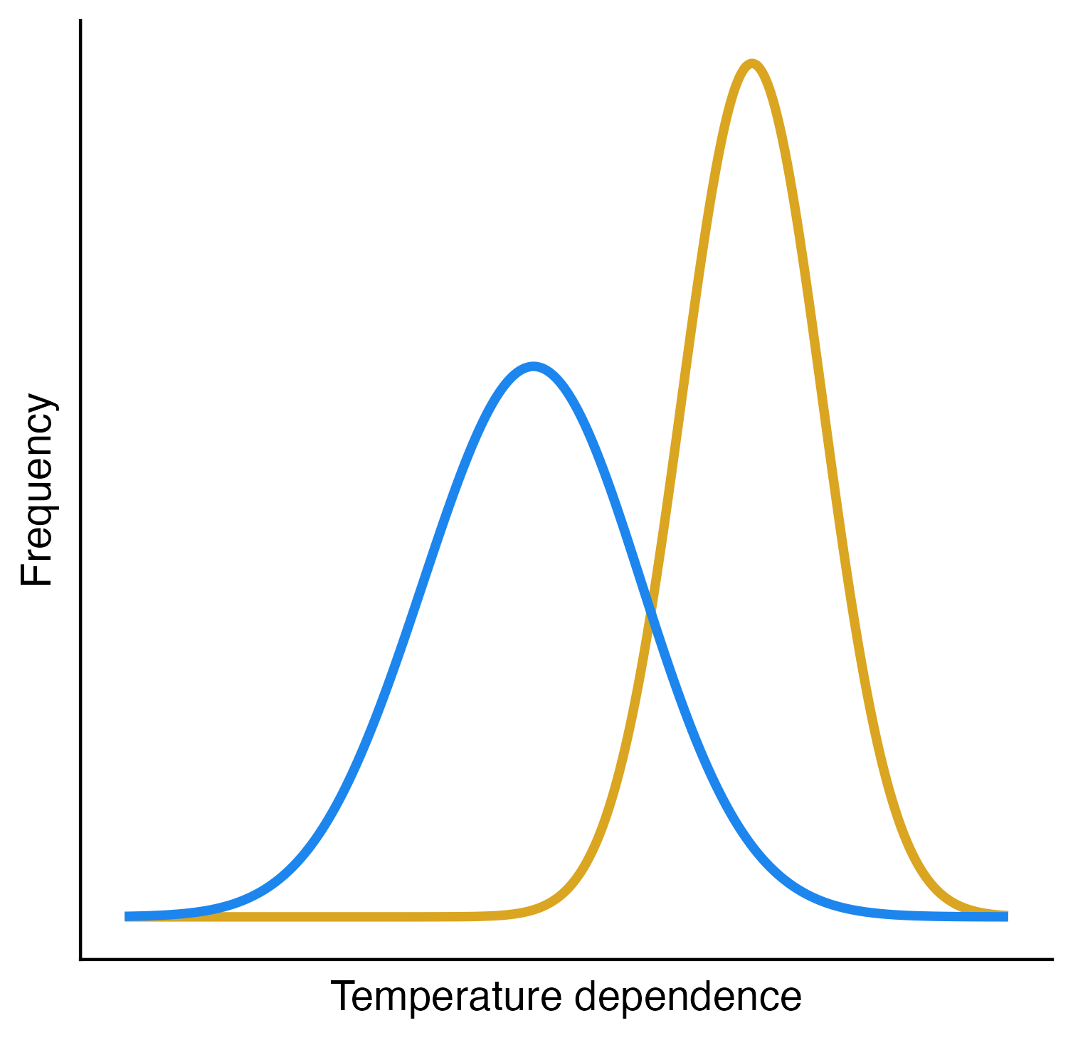
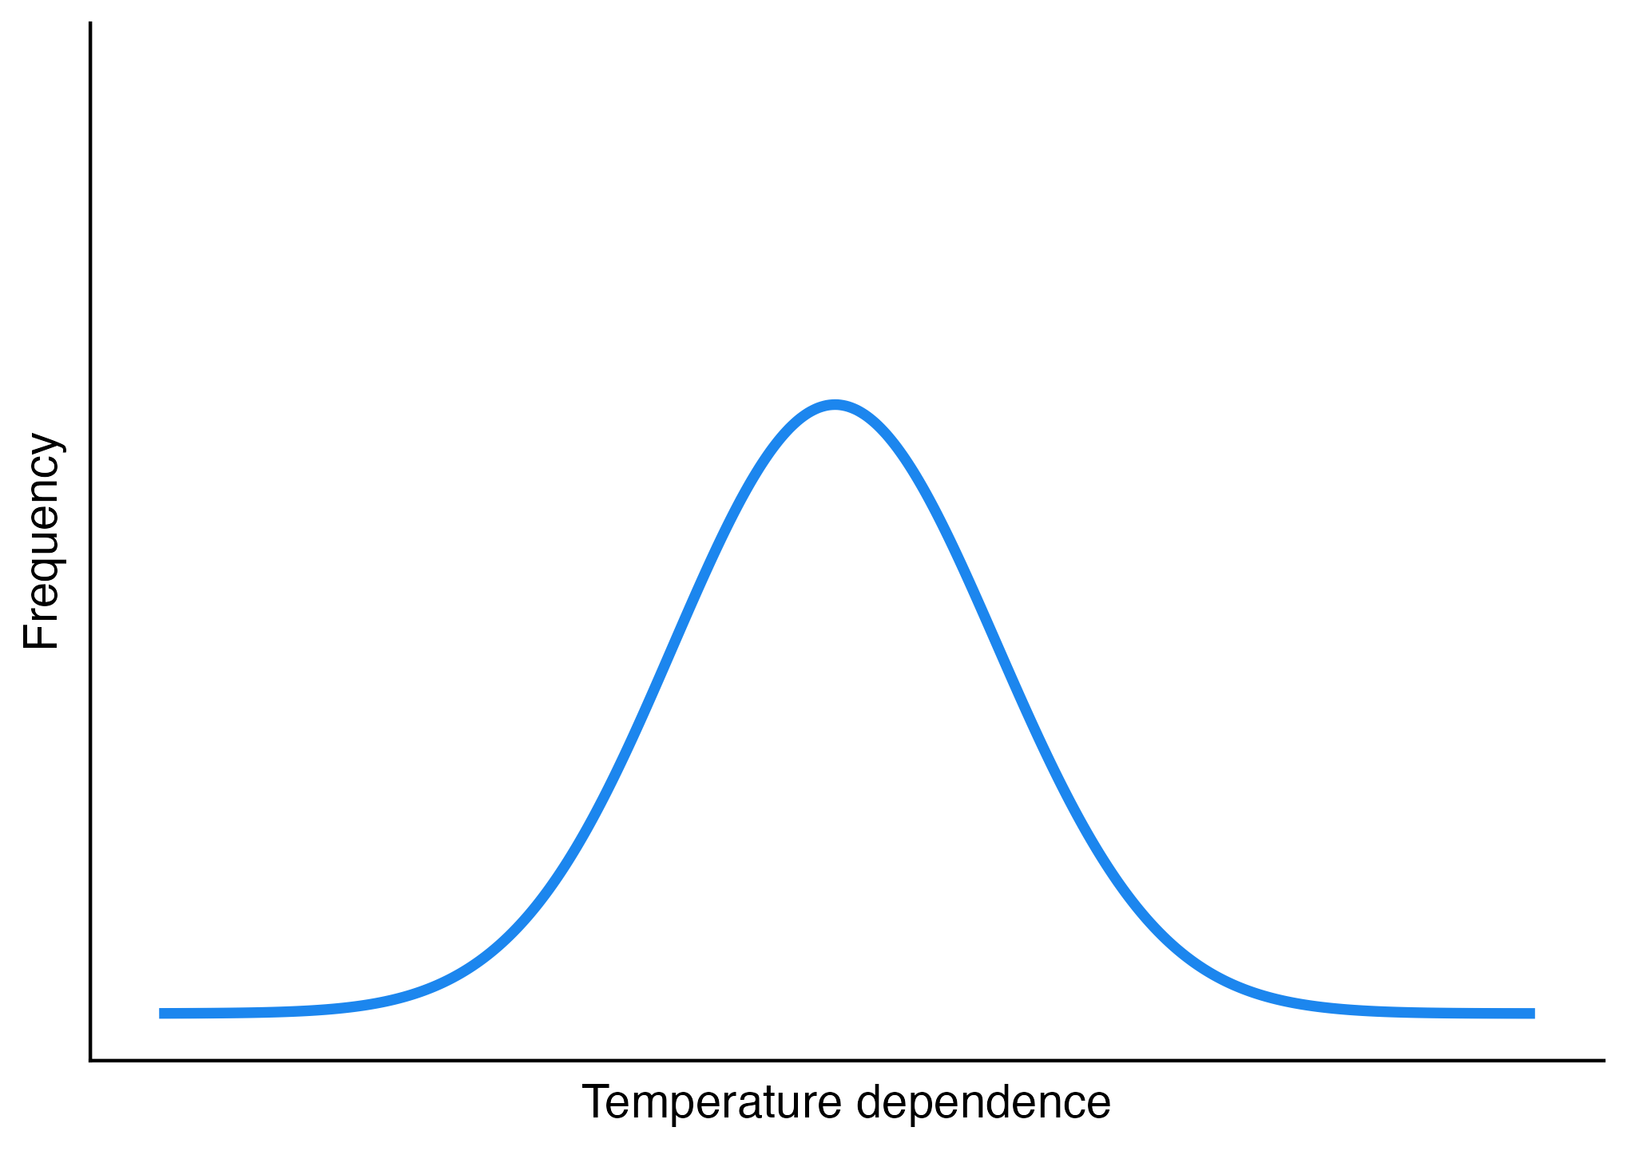

Slide 2



C₁
C₂
m₁
m₂
c_{1a}, v_{a}
c_{1b}, v_{b}
c_{2a}, v_{a}
c_{2b}, v_{b}
R_{a}
R_{b}
r_{a}, K_{a}
r_{b}, K_{b}

Slide 3



N₁
N₂
m₁
m₂
c_{1b}
c_{2a}
c_{1a}
c_{2b}
R_{a}
R_{b}
r_{a}
r_{b}

Slide 4

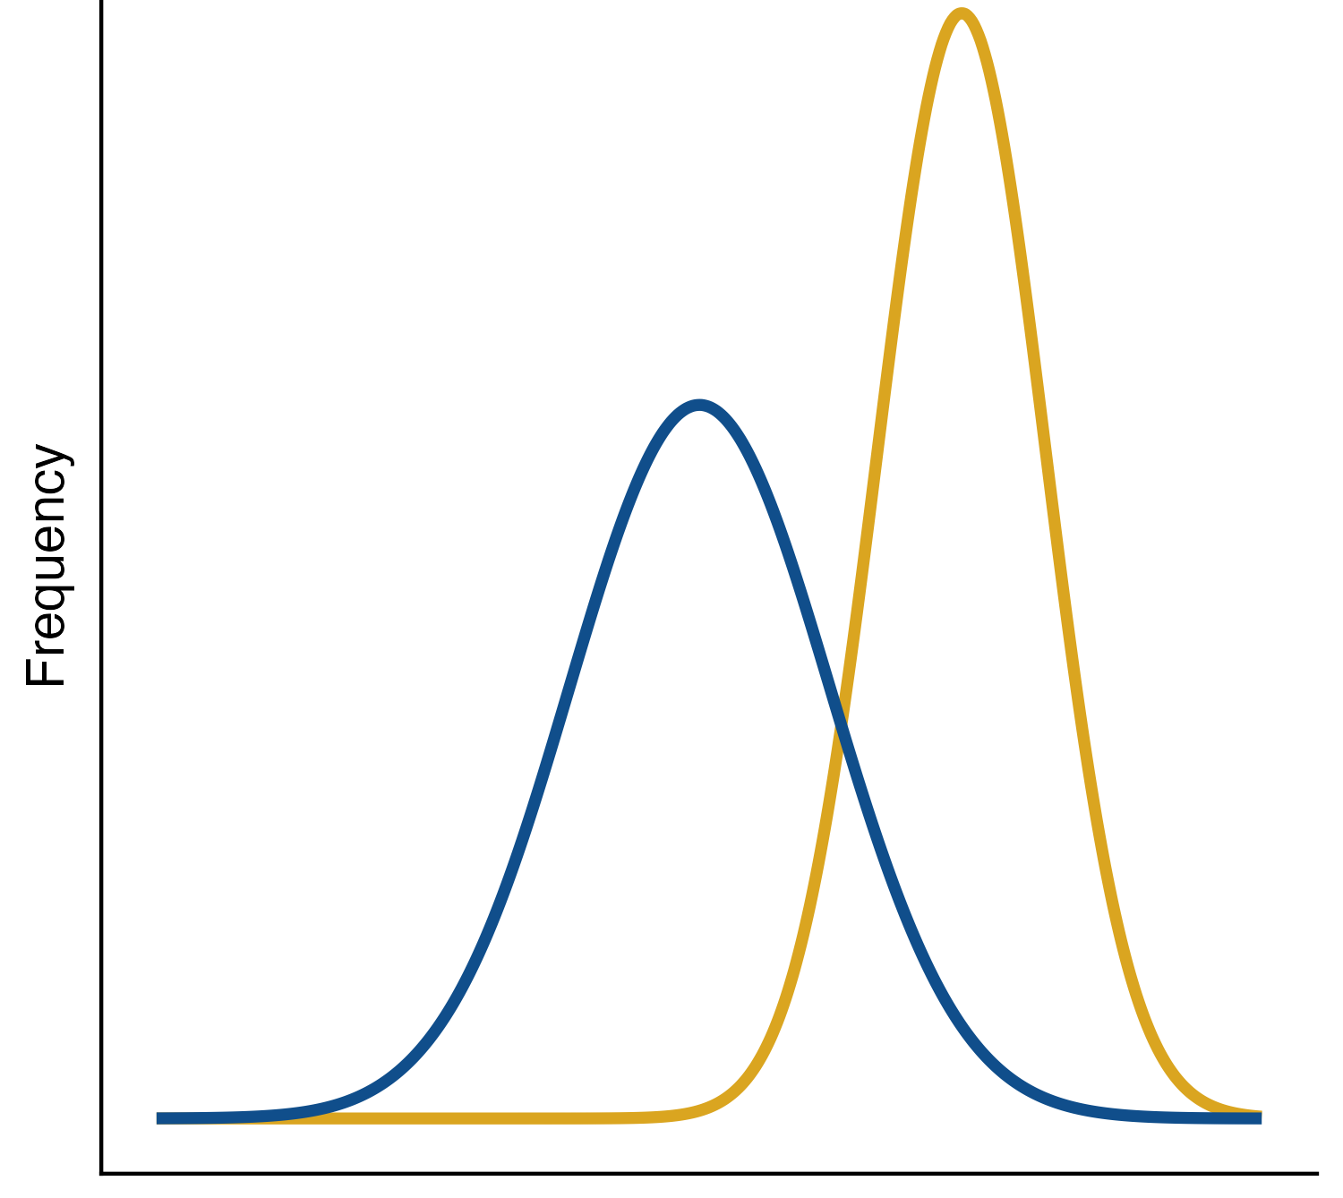







Inter-process thermal asymmetry
N₁
N₂
m₁
m₂
c_{1b}
c_{2a}
c_{1a}
c_{2b}
R_{a}
R_{b}
r_{a}
r_{b}
$$E_{r_{b}}$$
$$E_{{c2}_{b}}$$
Temperature Sensitivity

Slide 5
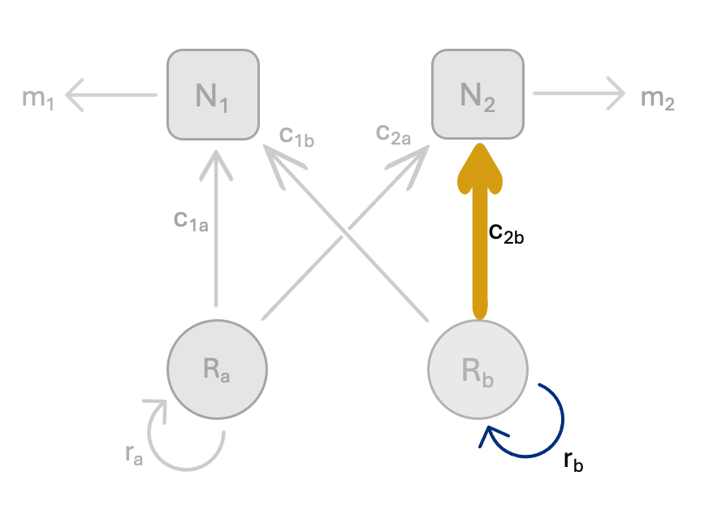
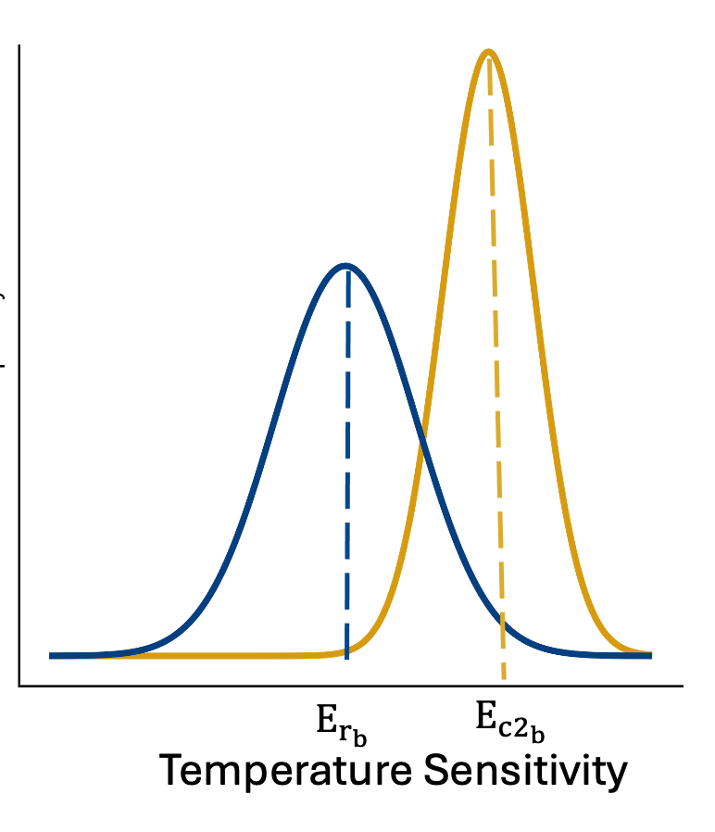
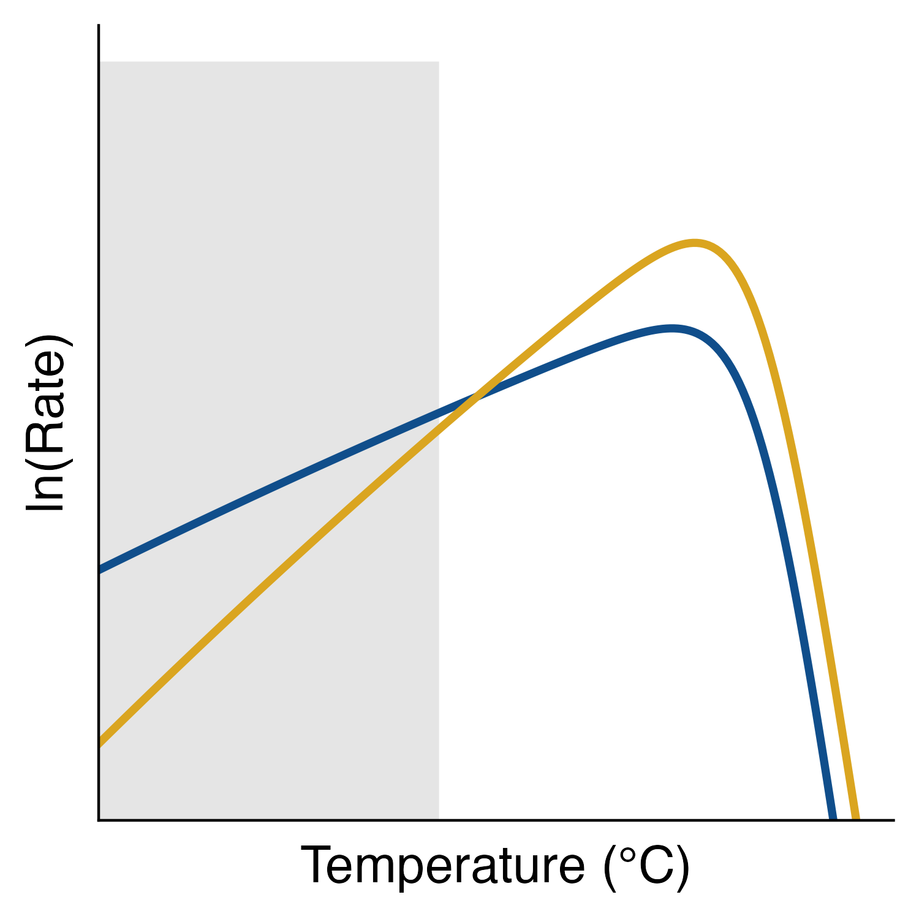




Inter-process thermal asymmetry
$$E_{r_{b}}$$
Frequency
r_{b}
$$E_{{c2}_{b}}$$
c_{2b}

Slide 6
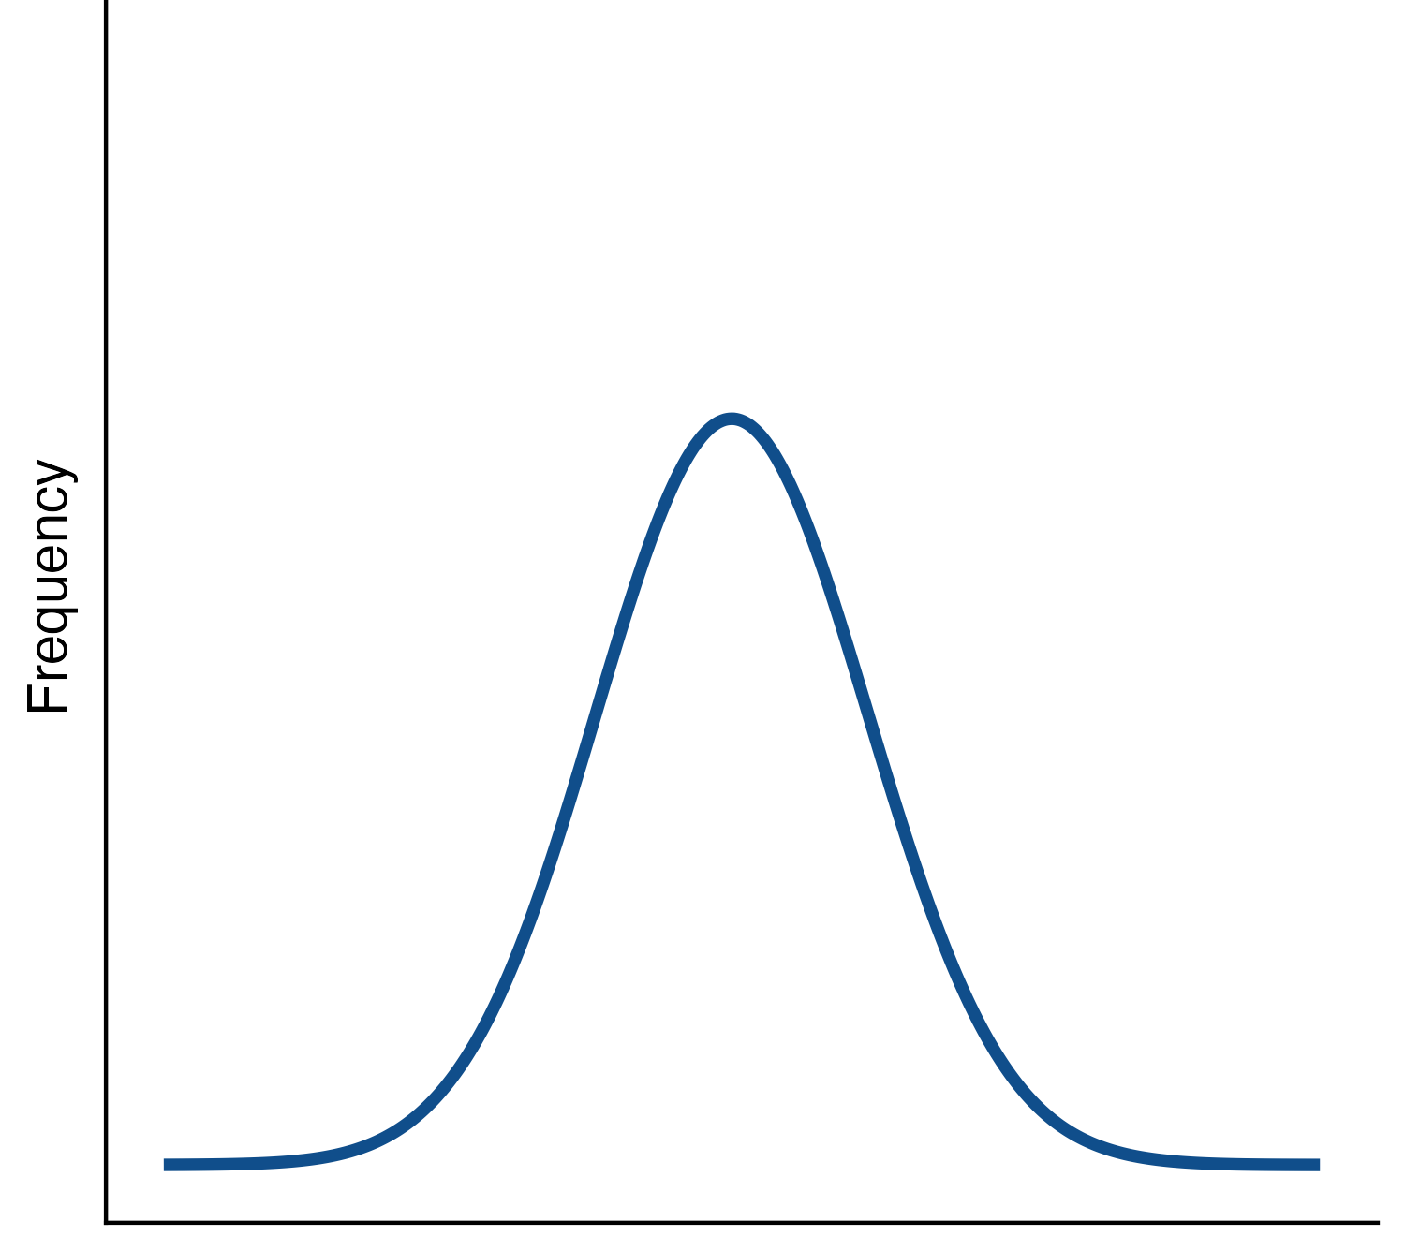




Intra-process thermal asymmetry
N₁
N₂
m₁
m₂
c_{1b}
c_{2a}
c_{1a}
c_{2b}
Frequency
R_{a}
R_{b}
r_{a}
r_{b}
$$E_{r_{b}}$$
$$E_{r_{a}}$$
Temperature Sensitivity

Slide 7
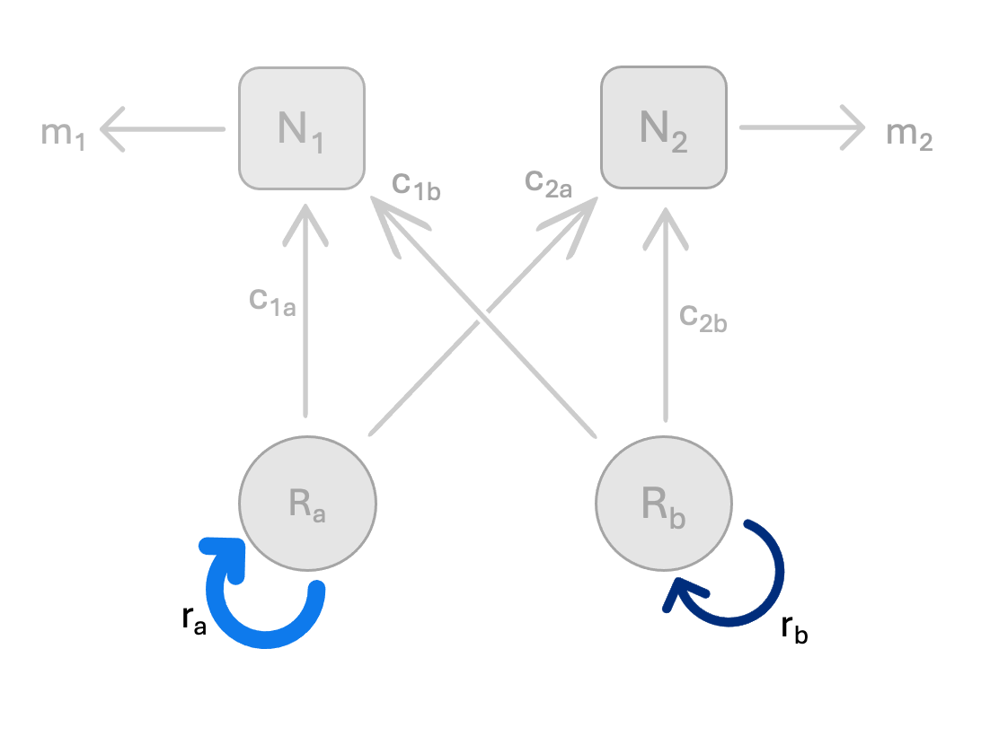
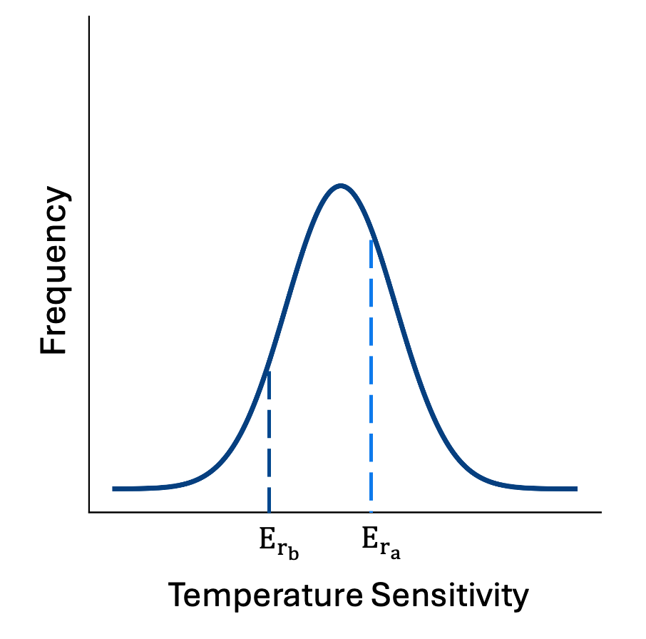
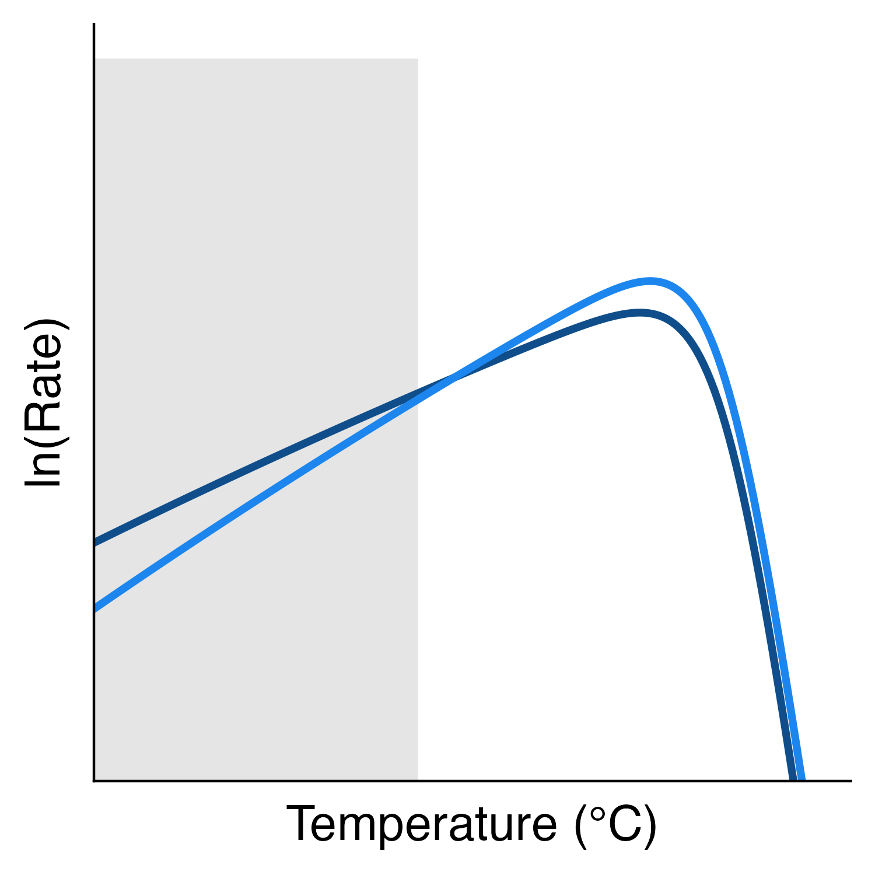


Intra-process thermal asymmetry
$$E_{r_{b}}$$
r_{b}
$$E_{r_{a}}$$
r_{a}

