Slide 1
PROJECT REPORT
Credit Card Approval Prediction
Bernice Wu (zw2911), Ding Jin (dj1448)
May, 2021

Slide 2
https://www.ypppt.com/
CONTENTS
1
Background
2
Input and Output
3
Implementation and Validation
4
Outcomes
5
Summary

Slide 3
01
Background

Slide 4

Background
Credit score cards are a common risk control method in the financial industry. It uses personal information and data submitted by credit card applicants to predict the probability of future defaults and credit card borrowings. The bank is able to decide whether to issue a credit card to the applicant. Credit scores can objectively quantify the magnitude of risk.
Context
Build a machine learning model to predict if an applicant is 'good' or 'bad' client, different from other tasks, the definition of 'good' or 'bad' is not given. we should use some technique, such as vintage analysis to construct our label. Also, unbalance data problem is a big problem in this task.
Credit card issued by the credibility of the clients
Task

Slide 5
02
Input and Output

Slide 6
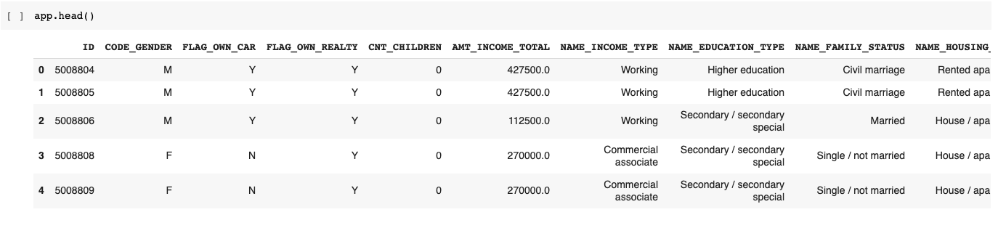
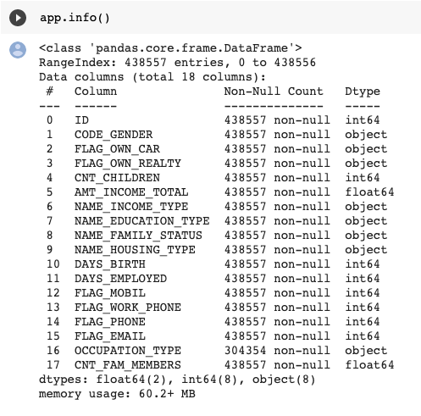
Input and Output
CLICK HERE TO ADD TITLE TEXT
Input
Output
A binary 0 and 1 array, with 0 representing the good credit status and 1 representing the bad credit status. Each value maps to the corresponding client.

Slide 7
03
Implementation
and
Validation

Slide 8
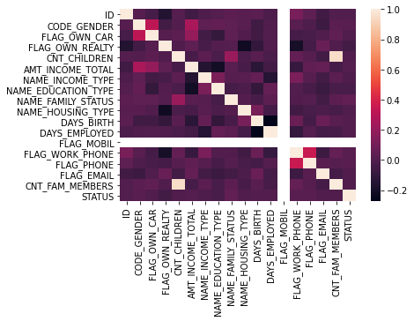
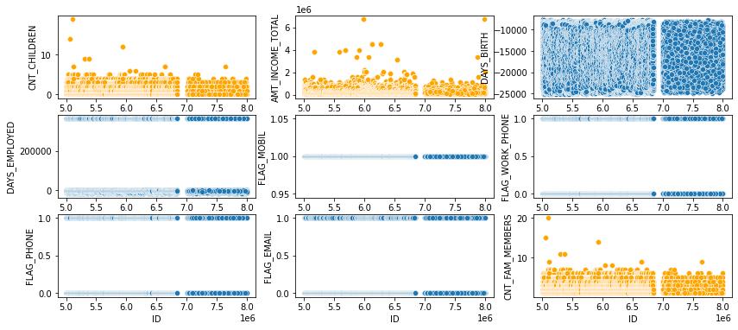
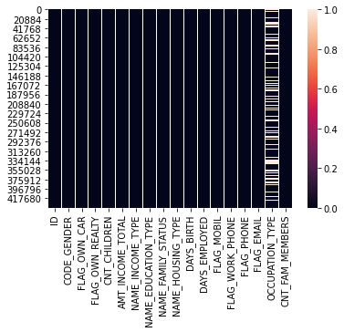
Implementation & Validation
Introduction
Data Preprocessing
Correlation
Missing value
Distribution
High-level Information
Logistic Regression
KNeighbors Classifier
SVC Classifier
Decision Tree
Random Forest
XGB Classifier
Validation
- Overall accuracy

Slide 9
04
Outcomes

Slide 10
Outcomes
Overall Accuracy
Male Accuracy
88.76%
Logistic Regression: 0.508532
KNeighbors: 0.716139
SVC Classifier: 0.750267
Decision Tree: 0.833274
Random Forest: 0.779950
XGBooster: 0.887664
90.64%
Logistic Regression: 0.506220
KNeighbors: 0.797729
SVC Classifier: 0.791779
Decision Tree: 0.922120
Random Forest: 0.869659
XGBooster: 0.906436
Female Accuracy
Disparate Impact
Logistic Regression: 0.542021
KNeighbors: 0.719232
SVC Classifier: 0.733711
Decision Tree: 0.792257
Random Forest: 0.726157
XGBooster: 0.856468
Favor Male
Mean difference: negative
Disparity impact: smaller than 1
False positive rate: smaller than 1
85.64%

Slide 11
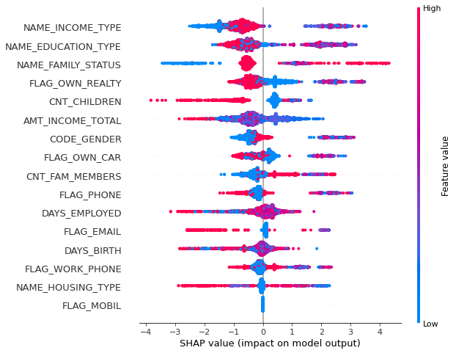
SHAP Explainer
SHAP Summary Plot
We can use summary_plot to summarize the most important features.:
- Each dot is an example in the test set
The color of each dot tells us about the magnitude of the feature
The SHAP value tells us the contribution of that feature to each prediction

Slide 12
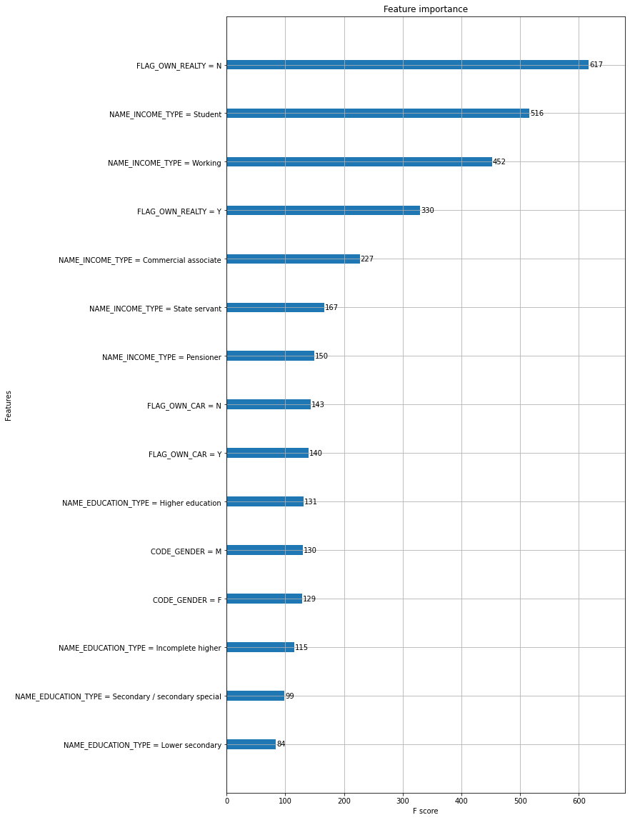
LIME Explainer
LIME Importance Plot
we're going to be looking at a measure of feature importance.
This is calculated for a single tree by counting how many splits occurred on each variable. We arrive at a feature importance for the entire model by averaging the score for each feature across all trees in the forest.

Slide 13
05
Summary

Slide 14
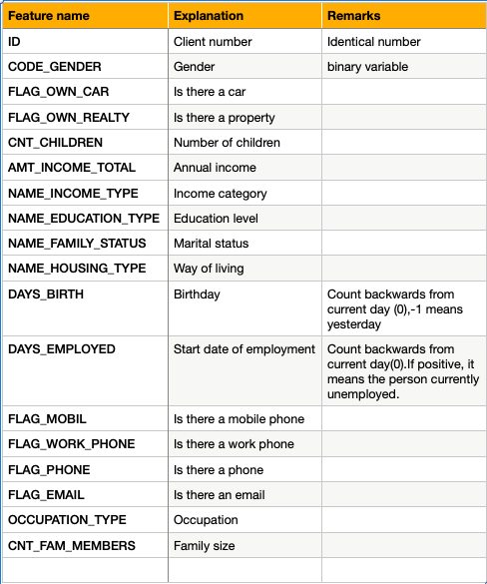
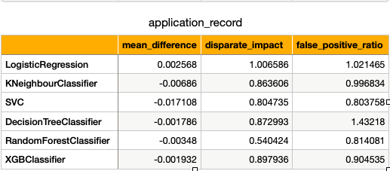
Nutritional Label
Recipe
Ingredients
Diversity
Fairness

Slide 15
PROJECT REPORT
Thank you for listening
Bernice Wu (zw2911), Ding Jin (dj1448)
May, 2021

