Slide 1
2020/12/09
Exercise

Slide 2
Passing Cars
Lesson5-prefix_sums

Slide 3
Lesson5-prefix_sums\PassingCars
在一條雙向道上，
每台車上都有車號為A[]的index，
向東行的車其值為0，向西行的車其值為1，
向東行的車號需<向西行的車號，
在這條雙向道上，有幾種會車的可能?
範例
A[0] = 0 -> 0號車向東行
A[1] = 1 -> 1號車向西行
A[2] = 0 -> 2號車向東行
A[3] = 1 -> 3號車向西行
A[4] = 1 -> 4號車向西行
因此會得到 (0, 1), (0, 3), (0, 4), (2, 3), (2, 4).，五種組合

Slide 4
第一次思考是 2東向 * 3西向
然而需要再減去向西大於向東的次數這個條件 = 6 - 1
反而直接考慮面條件 拆開 A[n] == 0 的情況去計算在向西大於向東的條件下的次數 較快
計算 A[n]==1 的次數可以使用 prefix Sums 方法。

Slide 5
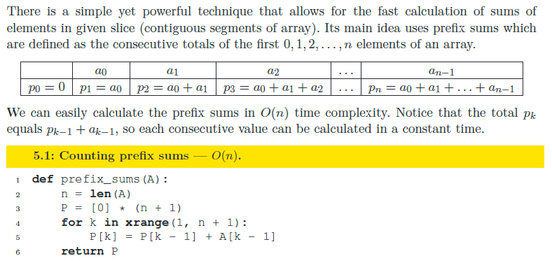
Prefix Sums

Slide 6
My Solution in Python
def prefix_sums(A):
P = [0]
for i in range(len(A)):
P += [P[i] + A[i]]
return P
def solution(A):
# write your code in Python 3.6
ret = 0
PreSum = prefix_sums(A)
TotalSum = PreSum[len(A)]
for i in range(len(A)):
if 0 == A[i]:
ret += TotalSum - PreSum[i]
if ret > 1000000000:
return -1
return ret

Slide 7
In C
int *prefix_sums(int *A, int N){
int *P = (int *)malloc((N+1)*sizeof(int));
P[0] = 0;
for (int i = 1; i<(N+1); i++){
P[i] = P[i-1] + A[i-1];
//printf("%d ", P[i]);
}
return P;
}
int solution(int A[], int N) {
// write your code in C99 (gcc 6.2.0)
int ret = 0;
int *P = prefix_sums(A,N);
for (int i = 0; i<N; i++){
if (!A[i]) {
ret += P[N]-P[i];
//printf("[%d i%d]", P[N], i);
}
}
free(P);
return ret<=1000000000? ret:-1;
}

Slide 8
Distinct
Lesson6-sorting

Slide 9
Lesson6-sorting\Distinct
int solution(int A[], int N);
that, given an array A consisting of N integers, returns the number of distinct values in array A.
For example, given array A consisting of six elements such that:
A[0] = 2 A[1] = 1 A[2] = 1
A[3] = 2 A[4] = 3 A[5] = 1
the function should return 3, because there are 3 distinct values appearing in array A, namely 1, 2 and 3.
Write an efficient algorithm for the following assumptions:
N is an integer within the range [0..100,000];
each element of array A is an integer within the range [−1,000,000..1,000,000].

Slide 10
My Solution in Python
# you can write to stdout for debugging purposes, e.g.
# print("this is a debug message")
def solution(A):
# write your code in Python 3.6
D = {}
ret = 0
for i in range(len(A)):
if A[i] not in D:
D[A[i]] = 1
ret += 1
return ret

Slide 11
My Solution in C
// you can write to stdout for debugging purposes, e.g.
// printf("this is a debug message\n");
#define OFFSET 1000000
int solution(int A[], int N) {
// write your code in C99 (gcc 6.2.0)
int i, ret = 0;
int ARR[2000000+1] = {0};
for (i = 0; i < N; i++){
ARR[A[i]+OFFSET] = 1;
}
for (i = 0; i <2000000+1; i++){
if (ARR[i])
ret+=1;
}
return ret;
}

Slide 12
Max Product Of Three
Lesson6-sorting

Slide 13
Maximize A[P] * A[Q] * A[R] for any triplet (P, Q, R)
一個不是空的陣列 A 含有 N個整數，產出的三個數字組合為 (P, Q, R)，相乘結果為 A[P] * A[Q] * A[R] (0 < P < Q < R < N) 舉例來說，有一個 陣列 A A[0] = -3 A[1] = 1 A[2] = 2 A[3] = -2 A[4] = 5 A[5] = 6 (0, 1, 2), 結果為 −3 * 1 * 2 = −6 (1, 2, 4), 結果為 1 * 2 * 5 = 10 (2, 4, 5), 結果為 2 * 5 * 6 = 60 所以 function 返回最大值 60，因為它是 (2, 4, 5) 的乘積最大值。

Slide 14
Detected time complexity: O(N * log(N))
先排序不論正負號的最大3個值的乘積 return
若不滿足 此三個 只有偶數個負號
狀況一(最大中佔有3個負數)
則找下一個正數取代第三大(絕對值)的數字
狀況二(最大中佔有1個負數)
若第四最大絕對值數原為正 則取代前三大中的負數
未考慮到
反之 取代前三大中最小正數
未考慮到

Slide 15
一開始沒有解未考慮到的狀況則正確率只有 75%
未考慮到: 若被取代數非三大中的最小數 則須確認新狀況
新狀況:
考慮正取代和負取代
https://app.codility.com/demo/results/trainingDPGMF7-4FJ/

Slide 16
Thank you

Slide 17
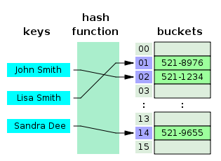
Hash Table
https://www.journaldev.com/35238/hash-table-in-c-plus-plus

Slide 18
Pros and Cons of Dynamic Memory Allocation
Barr Group Principal Engineer Salomon Singer: There are four big issues from my point of view.
1. Memory leak.
2. 需要處理 out of memory 情況. In some processors, it might cause a reset. And some of the processors, it might trigger an exception. Either way, not a good thing to happen.
3. Fragmentation. Due to the fact that you’re allocating and freeing chunks of memory of different sizes, you create this memory that looks a little bit Swiss cheese.
4. 回傳時間未知. Created by fragmentation itself, is the fact that you cannot be certain how long malloc is going to take. The more fragmentation you have and the bigger your heap is, the more time malloc is going to take to return to you.
https://barrgroup.com/tech-talks/memory-allocation

