Slide 1
2020/12/08
Exercise

Slide 2
Passing Cars
Lesson5-prefix_sums

Slide 3
Lesson5-prefix_sums\PassingCars
在一條雙向道上，每台車上都有車號為A[]的index，向東行的車其值為0，向西行的車其值為1，向東行的車號需<向西行的車號，在這條雙向道上，有幾種會車的可能?
範例
A[0] = 0 -> 0號車向東行
A[1] = 1 -> 1號車向西行
A[2] = 0 -> 2號車向東行
A[3] = 1 -> 3號車向西行
A[4] = 1 -> 4號車向西行
因此會得到 (0, 1), (0, 3), (0, 4), (2, 3), (2, 4).，五種組合

Slide 4
第一次思考是 2東向 * 3西向
然而需要再減去向西大於向東的次數這個條件 = 6 - 1
直接拆開 A[n] == 0 的情況去計算在向西大於向東的條件下的次數
計算 A[n]==1 的次數可以使用 prefix Sums 方法。

Slide 5
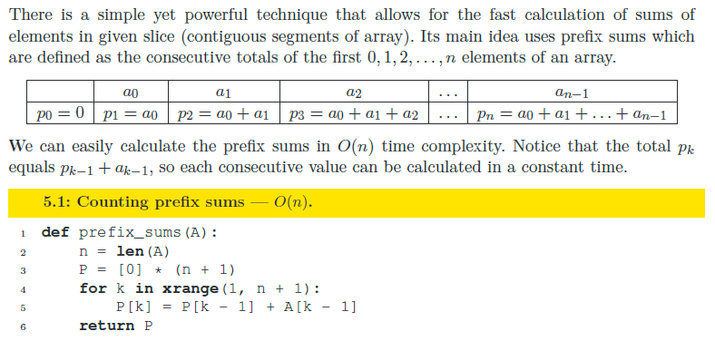
Prefix Sums

Slide 6
int *prefix_sums(int *A, int N){
int *P = (int *)malloc((N+1)*sizeof(int));
P[0] = 0;
for (int i = 1; i<(N+1); i++){
P[i] = P[i-1] + A[i-1];
//printf("%d ", P[i]);
}
return P;
}
int solution(int A[], int N) {
// write your code in C99 (gcc 6.2.0)
int ret = 0;
int *P = prefix_sums(A,N);
for (int i = 0; i<N; i++){
if (!A[i]) {
ret += P[N]-P[i];
//printf("[%d i%d]", P[N], i);
}
}
free(P);
return ret<=1000000000? ret:-1;
}

Slide 7
My Solution in Python
def prefix_sums(A):
P = [0]
for i in range(len(A)):
P += [P[i] + A[i]]
return P
def solution(A):
# write your code in Python 3.6
ret = 0
PreSum = prefix_sums(A)
TotalSum = PreSum[len(A)]
for i in range(len(A)):
if 0 == A[i]:
ret += TotalSum - PreSum[i]
if ret > 1000000000:
return -1
return ret

Slide 8
Distinct
Lesson6-sorting

Slide 9
Lesson6-sorting\Distinct
int solution(int A[], int N);
that, given an array A consisting of N integers, returns the number of distinct values in array A.
For example, given array A consisting of six elements such that:
A[0] = 2 A[1] = 1 A[2] = 1
A[3] = 2 A[4] = 3 A[5] = 1
the function should return 3, because there are 3 distinct values appearing in array A, namely 1, 2 and 3.
Write an efficient algorithm for the following assumptions:
N is an integer within the range [0..100,000];
each element of array A is an integer within the range [−1,000,000..1,000,000].

Slide 10
My Solution in C
// you can write to stdout for debugging purposes, e.g.
// printf("this is a debug message\n");
#define OFFSET 1000000
int solution(int A[], int N) {
// write your code in C99 (gcc 6.2.0)
int i, ret = 0;
int ARR[2000000+1] = {0};
for (i = 0; i < N; i++){
ARR[A[i]+OFFSET] = 1;
}
for (i = 0; i <2000000+1; i++){
if (ARR[i])
ret+=1;
}
return ret;
}

Slide 11
My Solution in Python
# you can write to stdout for debugging purposes, e.g.
# print("this is a debug message")
def solution(A):
# write your code in Python 3.6
D = {}
ret = 0
for i in range(len(A)):
if A[i] not in D:
D[A[i]] = 1
ret += 1
return ret

