Slide 1
AUTOMATED FOOD DISPENSER FOR PETS
Presented by
MUKONESI BERNICE MULINDI
ENE211-0235/2016
SUPERVISOR
MR KIVUVA

Slide 2
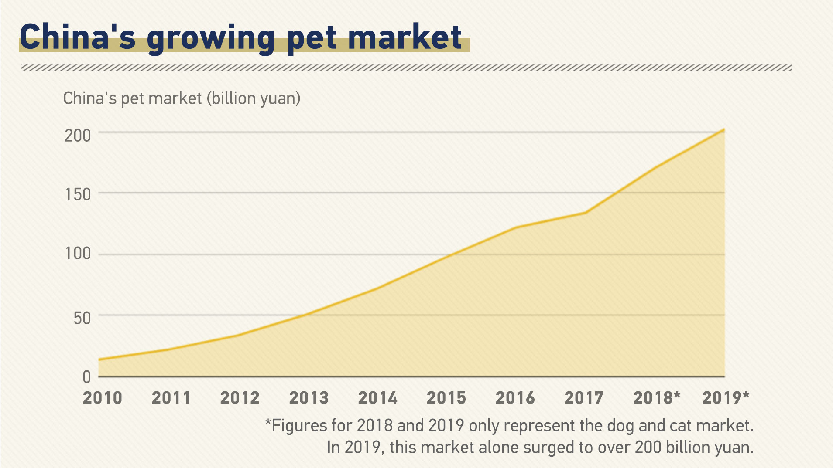
INTRODUCTION
Get a pet ?
Pet definition
Companionship
Entertainment
Why bother?
https://news.cgtn.com/news/2020-01-22/Graphics-China-s-booming-pet-economy-NsebhtYvNm/index.html

Slide 3
INTRODUCTION
Benefits of pet keeping
Companionship/Entertainment
Reduced stress/anxiety
Parental skills
But wait… is it enough?
Dog weight | Daily amount | Cat weight | Daily amount
5 Kgs | 125 grams | 5 Kgs | 100 grams
8 Kgs | 200 grams | 8 Kgs | 160 grams

Slide 4
PROBLEM STATEMENT
Lacking proper knowledge
Giving raw foods
Overfeeding/ Underfeeding
Time factor
Busy schedules
Forgetfulness
Need for vacations
Irregular feeding patterns

Slide 5
JUSTIFICATION
Automatic Food Dispenser is the solution!
Customizable
Monitor growth
Minimize wastage
Plan effectively
Worry free vacations

Slide 6
OBJECTIVES
MAIN OBJECTIVE
To design, implement and test a device that automatically releases food to pets based on user settings and sends the corresponding information to a database.
SPECIFIC OBJECTIVES
To design and implement a proximity sensor circuit that detects distance of the pet from the device.
To design and implement an automation system for opening and closing of a feeder door.
To design and implement a display circuit to allow the user to customize options and view the changes made.
To design and implement a feedback circuit that enables the device to hold or release food by detecting presence of food on the feeder plate.
To design a database system to store information pertaining the feeding.

Slide 7
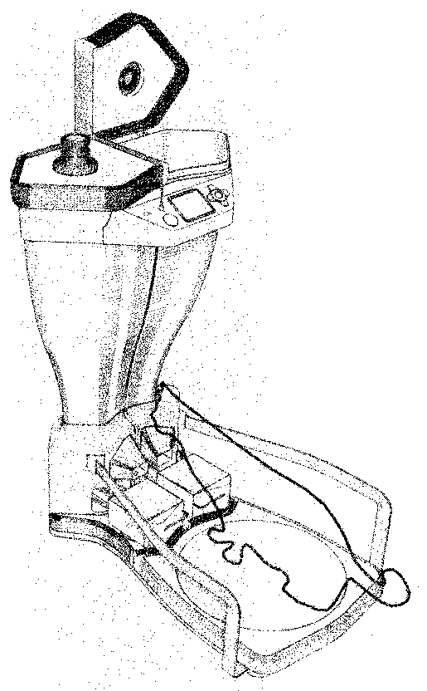
LITERATURE REVIEW
Different working principles governing the previous designs
Detection
Radio Frequency Identification
Food dispensing mechanism
Weight and food release mechanism

Slide 8
METHODOLOGY
Parts to be used
WIFI module
Display
Motor
Micro controller
Load Cell
Real Time Clock
Proximity sensor
 | Price | Familiarity and Simplicity | Platform Development | Peripheral features | Power consumption | Total
Raspberry Pi | 1 (Ksh 9000) | 1 | 1 | 2 | 1 (2W) | 6
Arduino UNO | 2 (Ksh 5000) | 2 | 2 | 1 | 2 (250mW) | 9
 | Price | Speed/Response time | Power consumption | Total
Servo motor | 2 (Ksh 400) | 2 (3000 RPM) | 2 (2W) | 6
Stepper motor | 2 (Ksh 300) | 1 (1200 RPM) | 1 (250mW) | 4

Slide 9
METHODOLOGY
Proximity sensor
Motor
Microcontroller
Load cell
WIFI module
User settings
Display

Slide 10
EXPECTED RESULTS
The device is expected to
Detect the pet’s proximity
Automatically open/close a feeder door
Display pertinent information
Measure the weight of food on the feeder plate as feedback
Send information to a database

Slide 11
BUDGET
Item | Description | Quantity | Rate | Amount
1 | Wi-Fi Module ESP8266-01 | 1 | 2000 | 2000
2 | LCD screen | 1 | 1000 | 1000
3 | Servo Motor SG90 | 1 | 1100 | 1100
4 | Ultrasonic Sensor HC-SR04 | 1 | 1200 | 1200
5 | Load Cell/Load Cell Amplifier HX711 | 1 | 900 | 900
6 | Arduino UNO | 1 | 4500 | 4500
7 | RTC DS3231 | 1 | 1500 | 1500
8 | Push Button | 4 | 100 | 400
9 | LED | 2 | 50 | 100
TOTAL |  |  |  | 12700

Slide 12
TIME PLAN
ACTIVITIES | JUNE | JULY | AUG | SEPT | OCT | NOV | DEC
Documentation
Proposal Writing
Literature Review
Proposal Presentation
Design and Coding
Hardware configuration, testing and adjustment
Final report writing
Final presentation

Slide 13
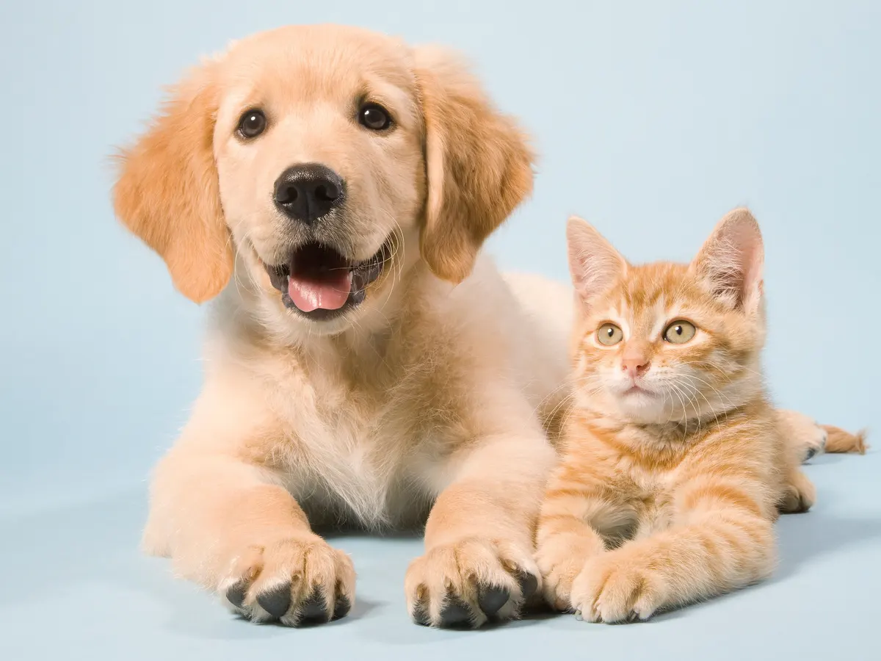
THANK YOU

