Slide 1
DATA STRUCTURES

Slide 2
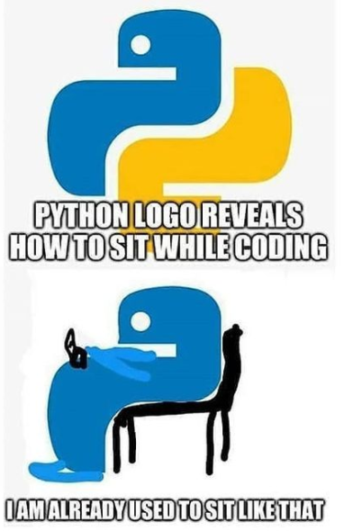

Slide 3
DICTIONARIES
name_of_the_dictionary = {
key : value ,
key : value,
key : value
}
key-value structures
Dictionary elements can be accessed and modified by using non-consecutive or non-integer keys
Their values can be modified
Each key needs to be unique
Same value can be used for multiple keys
No limitation on the type of keys or the values

Slide 4
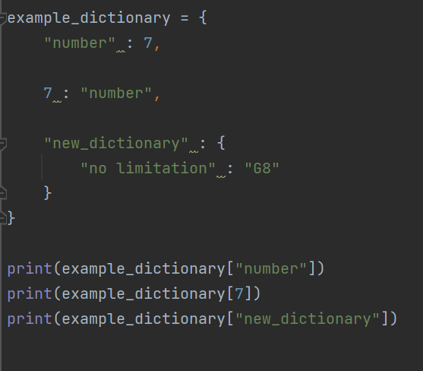
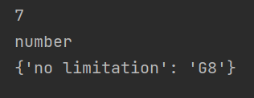

Slide 5
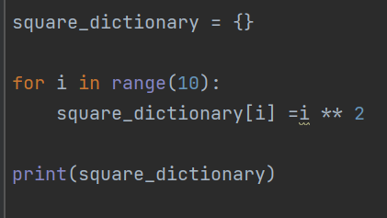
The dictionaries can be populated in the runtime of the application

Slide 6
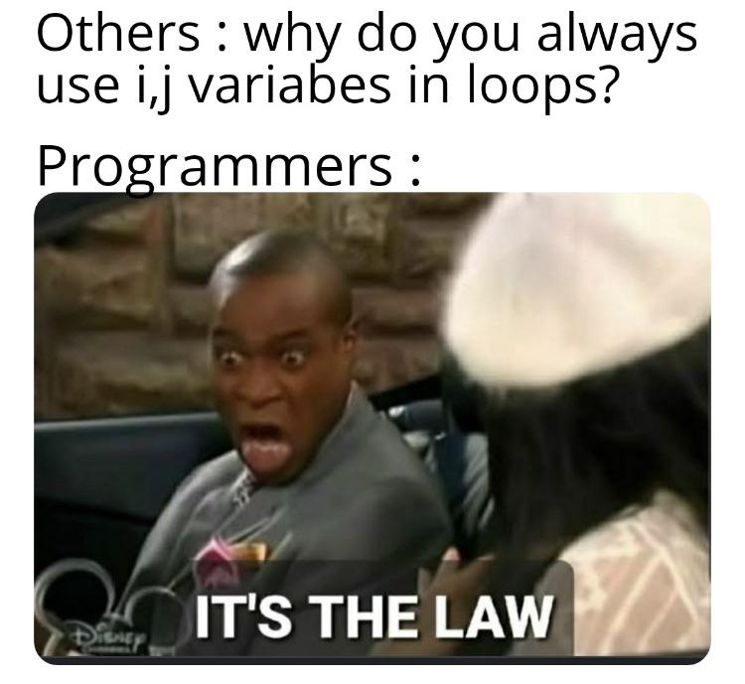

Slide 7
Lists []
The elements of list can be modified in the runtime
The elements are accessed by an index number
The same item can be added as many as necessary, at different positions in the list
The insertion order of elements is preserved until th list is modified

Slide 8
Tuples ()
The elements of a tuple cannot be modified in the runtime
The elements are accessed by an index number
The same item can be added as many times as necessary, at different positions in the tuple
The insertion order of elements is preserved throughout the life span of the tuple

Slide 9
Sets {}
The elements stored in a set have to be unique, no matter how many times they are added to the set, duplicates are not allowed.
The order of elements is not guaranteed to be preserved as the order of insertion to the set

Slide 10
Dictionaries {}
Dictionaries are special type of sets where the keys are unique as in sets
The ordering is similar to the sets based on the keys
len() of a dictionary is the number of keys in the dictionary

Slide 11
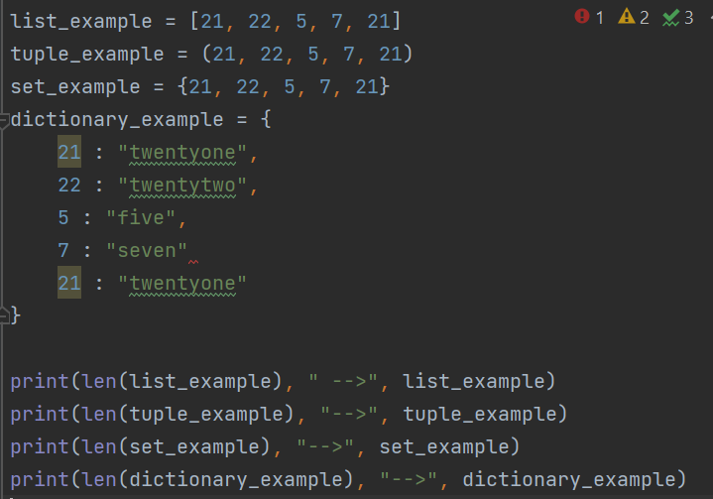
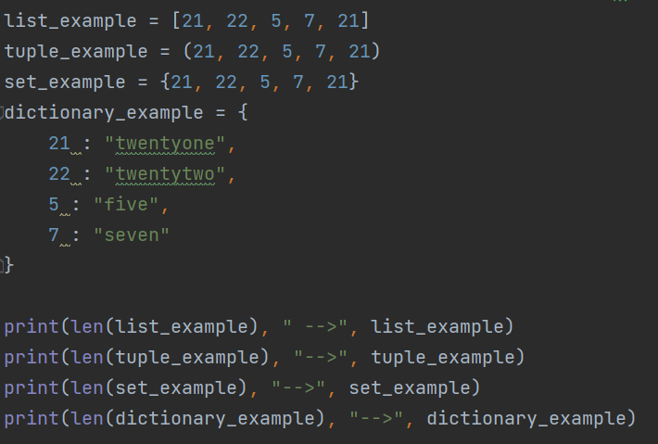
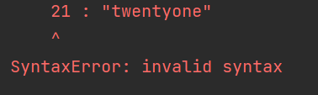
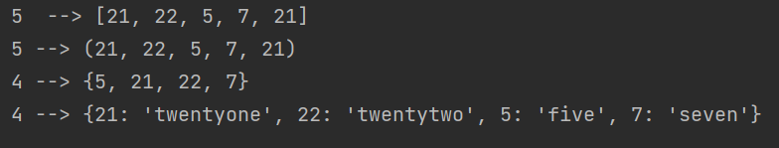
len() function for list, tuple, set, and dictionary
Since the order of elements is not guaranteed to be preserved ordering of the set is changed!!
Since keys of the dictionary must be unique, code does not work

Slide 12
The positional order does not imply the incremental or decremental ordering based on magnitude of numbers or the lexicographic ordering of strings in a list or a tuple. If such an ordering is necessary, the programmers will need to sort the items in the list or the tuple.

Slide 13
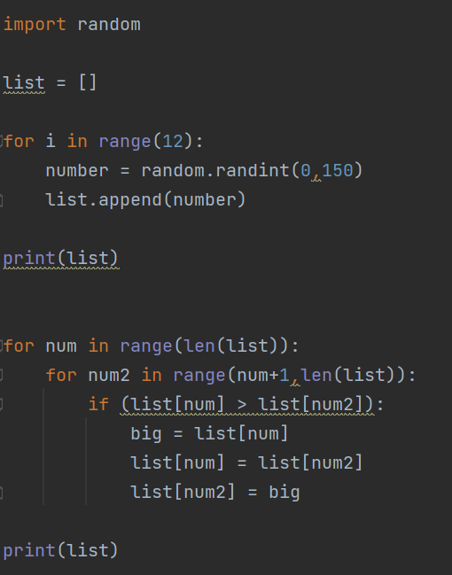

Sorting
Output

Slide 14
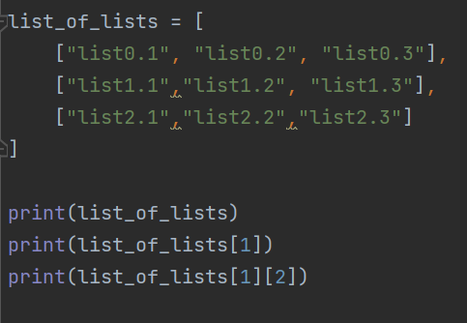
Multi-dimensional Lists
Lists can be organized in a multi-dimensional structure
Two dimensional lists is a list of lists
Output:
[['list0.1', 'list0.2', 'list0.3'], ['list1.1', 'list1.2', 'list1.3'], ['list2.1', 'list2.2', 'list2.3’]]
['list1.1', 'list1.2', 'list1.3’]
list1.3

Slide 15
Algorithms
Flow chartes are very useful for designing the main skeleton of algorithms.
Other software desing involves the use of UML (United Modelling Language) diagrams such as;
class diagrams,
object diagrams,
component diagrams,
composite structure diagrams,
deployment diagrams,
package diagrams,
profile diagrams, etc. that can be classified as the structural UML diagrams.
Additionally the flow of activities can be modeled by using behavioral UML diagrams such as
activity diagrams,
use case diagrams,
interaction overview diagrams
timing or timeline diagrams
state machine diagrams
communication diagrams
sequence diagrams, etc.

Slide 16
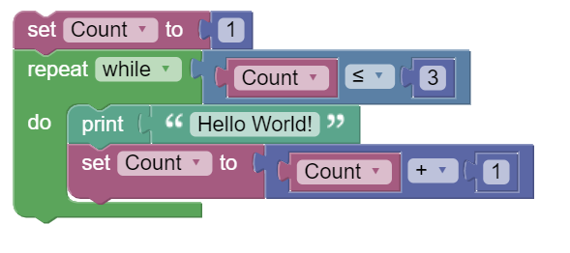
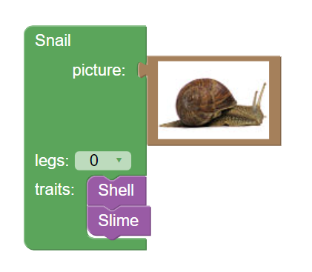
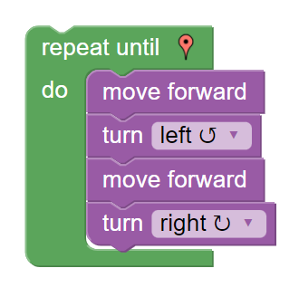
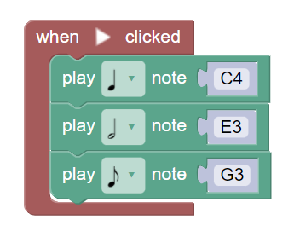
Examples
https://blockly.games/
https://developers.google.com/blockly

Slide 17
Conditional (while) Loops
The while loop is similar to if control statement, except that the inner code block is executed repeatedly as long as the condition statement evaluates to True.
The while loop can be nested inside other while and for loops
The for loops can be nested inside the while loops too
The break statement can be used to stop repepating the loop immediately
The continue statement will cause the loop to repeat the loop body with the next iteration, immediately abandoning the remaining code statements in the current loop iteration.
while (condition):
code statements

Slide 18


Slide 19
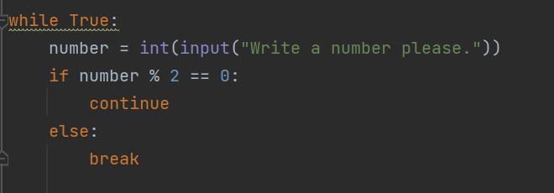
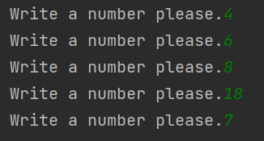

Slide 20
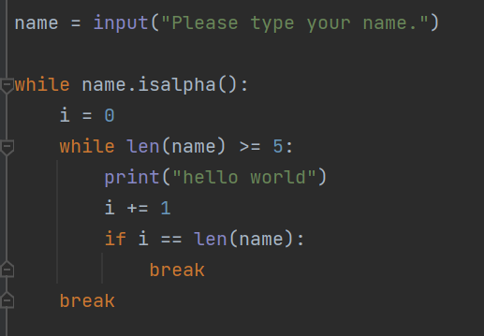
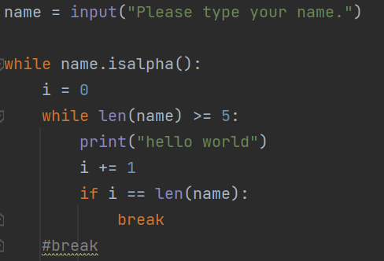
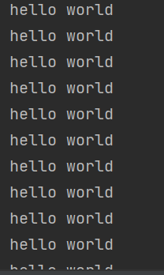
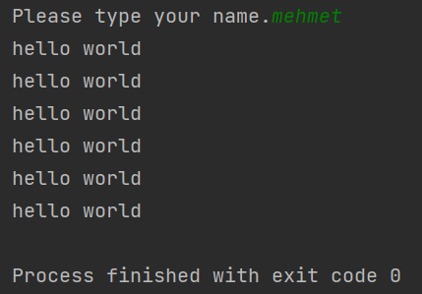
v

Slide 21
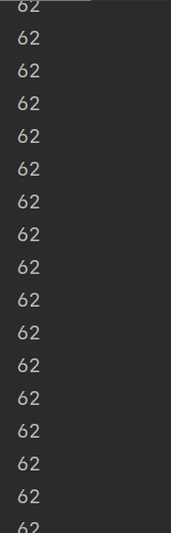
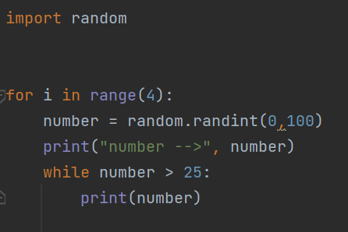
Importance of the break statement

Slide 22
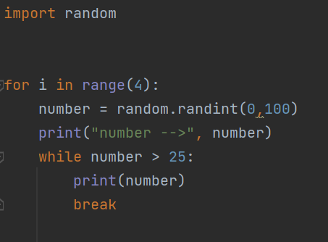
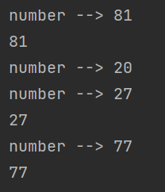

Slide 23


Slide 24


Slide 25


