Slide 1
PROCEDURAL PROGRAMMING PROJECT
A Neural Network
Written Entirely in C
No frameworks · No libraries · Just loops, and math
Austin Riha, Jackson Bedenbaugh, Anthony Skidmore
Notes:
-Austin

Slide 2
OVERVIEW
Agenda
01
Problem Formulation
What we're solving and why it matters
02
Methodology
Network architecture, math, and training
03
Results
Accuracy, performance, and the drawing app
04
Conclusion & Future Work
Takeaways and what comes next
Notes:
-Austin
Problem: it looks cool and I wanted to do it
Methodology: math, loops, matrix (but we never covered that)
Results: the app itself + 97.7 accuracy
Conclusion: youll see at the end of the slides :)

Slide 3
PROBLEM FORMULATION
The Problem
Given a 28×28 pixel image of a handwritten digit, classify it as 0–9.
The MNIST Dataset
Why This Matters
60,000 training images and 10,000 test images of handwritten digits. Each image is 28×28 pixels in grayscale — 784 values between 0 (black) and 255 (white).
Digit recognition is the "hello world" of machine learning. Simple enough to build from scratch, complex enough to demonstrate real neural network principles.
This is the same core technology behind modern AI and LLM, just at a smaller scale.
Notes:
-Jackson
-Explain
The MNIST data and how the data was needed because it is filtered and we can easily use it to train the Neural Network
This matters because we can accurately tell the system if a guess is right or wrong because the data we used to train it was already classified

Slide 4
PROBLEM FORMULATION
Why Build It in C?
No Libraries
Deep Understanding
Pure C
No TensorFlow, PyTorch, or NumPy. Every matrix multiply, every gradient — written by hand.
Building from scratch means understanding every single operation. Nothing is hidden behind library calls.
Just the standard library and the math library. Arrays and for loops — procedural programming.
The entire neural network fits in a single .c file — 189 lines of code.
189
109,386
0
LINES OF CODE
PARAMETERS
EXTERNAL LIBRARIES
Notes:
-Jackson
-Explain
everything hardcoded. No libraries, no containers, just raw code
-A deeper understanding of how each neuron learns and how the whole system is built
-the whole system is built in C
The Neural Network itself is built in 189 lines of code

Slide 5
METHODOLOGY
Network Architecture
Input
Hidden
Output
784
128
10
28×28 pixels
ReLU
Softmax
Fully connected: every neuron in one layer connects to every neuron in the next. Weights start random and gradually organize into digit-recognizing patterns.
Parameter Count:
(784×128) + 128 + (128×10) + 10 = 109,386 total trainable parameters
Notes:
Jackson
784 = 1 for each pixel in the image
128 = better accuracy
10 = 0-9 (output)

Slide 6
METHODOLOGY
The Forward Pass
Each neuron: multiply inputs by weights, add bias, apply activation.
// The neuron equation:
z = w1*x1 + w2*x2 + ... + wn*xn + b
a = activation(z)
// In C:
z1[i] += W1[i][j] * input[j];
a1[i] = z1[i] > 0 ? z1[i] : 0; // ReLU
Step 1: Hidden Layer
784 inputs × 128 weights = 128 outputs through ReLU.
Step 2: Output Layer
128 inputs × 10 weights = 10 probabilities via softmax.
Cached values (z1, a1, z2, a2) are stored because backpropagation needs them.
Notes:
Austin
The formula for each neuron
Z = W1 * X1 …
Activation function = ReLU
Explain how the activation function works
(open VS and start the training process as it will take a little bit of time)

Slide 7
METHODOLOGY
Activation Functions
ReLU (Hidden Layer)
Softmax (Output Layer)
max(0, z)
e^zi / Σ e^zj
If positive, pass it through.
If negative, output zero.
This lets the network learn nonlinear patterns. Without it, stacking layers would just be one big linear transformation.
Converts 10 raw scores into probabilities that sum to 1.0.
If the network is confident it's a "7", that neuron outputs 0.95 while others share 0.05.
Subtract max(z) first to prevent overflow.
Notes:
Austin
We need an activation function for each neuron so that each neuron can make a decision on if it should fire or not.
Softmax is how we compute the final layer into an actual probability distribution.

Slide 8
METHODOLOGY
Backpropagation — How It Learns
1
Forward Pass
Feed image through, get prediction
2
Compute Loss
Measure how wrong: L = −Σ yᵢ log(ŷᵢ)
3
Backward Pass
Chain rule: how much did each weight contribute to the error?
4
Update Weights
W ← W − learning_rate × gradient
Key insight: The output gradient simplifies to dz = prediction − truth — then chain rule carries it backward.
Notes:
Austin

Slide 9
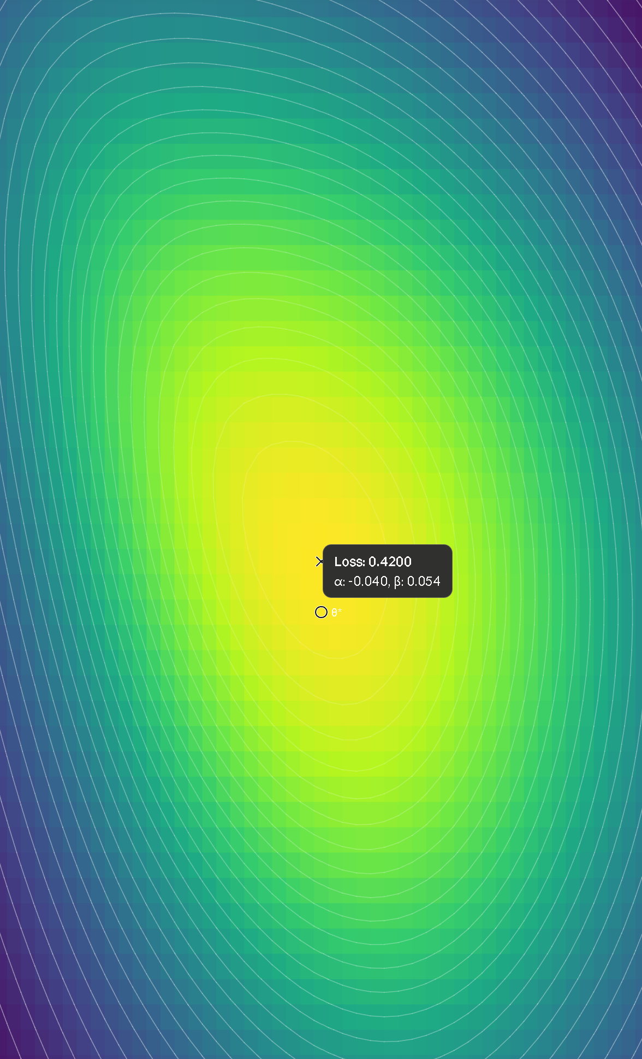
METHODOLOGY
Gradient Descent
The gradient tells you which direction is downhill. The learning rate tells you how far to step.
// The update rule:
W1[i][j] -= (lr / batch_size) * dW1[i][j];
// Nudge each weight in the direction
// that reduces the loss.
Analogy
Standing on a hill in thick fog. You can't see the valley, but you can feel which way the ground slopes. Step downhill each time.
Notes:
-Austin

Slide 10
METHODOLOGY
Training Configuration
Learning Rate
0.1
Step size per update. Too big = overshoot. Too small = slow.
Batch Size
32
Images per update. Average 32 gradients for stability.
Epochs
20
Full passes through all 60,000 images.
Notes:
-Anthony
Learning rate: how much the Neural Network is allowed to move with each learning pass
Batch size: the amount of images the Neural Network needs to analyze before updating the parameters
Epochs: the amount of times we make the system go through ALL of the data (all 60000 images)

Slide 11
RESULTS
Training Results
97.8%
FINAL ACCURACY
94.3%
AFTER 1 EPOCH
~2 min
TRAINING TIME
Notes:
-Anthony
The results rapidly grow towards the 95% accuracy and then levels off with marginal gain for each epoch
Total training time is two minutes

Slide 12
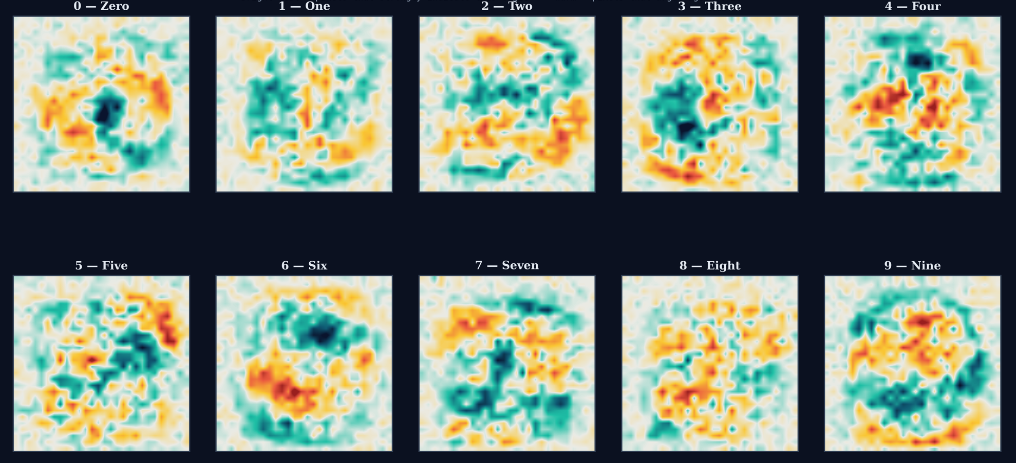
RESULTS
Performance Breakdown
Out of 10,000 test images the network has never seen this is what the network “looks for”:
Notes:
-Austin
Show off the pixels and where the NN looks for each number and how some numbers have the same “hot spot” which could cause an error
Or overlap
Or how the number could be a different number

Slide 13
RESULTS
Interactive Drawing App
A companion program lets you draw digits and watch the network classify them in real time.
How It Works
Controls
Loads trained weights from weights.bin, then runs the exact same forward pass on your drawing.
The 28×28 canvas is scaled up for visibility. A soft brush mimics MNIST's anti-aliasing.
Shows probability bars for all 10 digits.
Left drag
Draw on canvas
Right drag
Erase
G key
Guess the digit
C key
Clear canvas
Q key
Quit
Notes:
-Austin
(show off the program on VS)

Slide 14
RESULTS
Code Structure
init_weights()
update()
init: random × √(2/fan_in)
W -= (lr/batch) × gradient, zero grads
forward()
load_mnist()
Matrix multiply + ReLU/softmax, cache results
Parse big-endian IDX format, normalize pixels
backward()
main()
Chain rule: gradients for all 109K weights
Load → init → train → test → save weights
Notes:
Austin
Init_weights = random weights
Forward() = takes an image and throws it through the program
Backward() = chain rule and fine tuning the weights
Update() = updating each of the weights and bias
Load_mnist() = load the images into a sorted order so the system has an easier time
Main() = where the magic happens :)

Slide 15
CONCLUSION & FUTURE WORK
Conclusion & Next Steps
What We Built
What We Proved
A complete neural network from scratch in C — forward pass, backpropagation, gradient descent, MNIST loader, and interactive drawing app. 278 lines, zero libraries.
97.8% accuracy on unseen data proves the network learned generalizable patterns. The same math powers billion-parameter models.
FUTURE WORK
Add More Layers
784 → 256 → 128 → 64 → 10 for higher accuracy
Learning Rate Decay
Reduce lr each epoch for finer tuning in later stages
Data Augmentation
Rotate, shift, and scale images for robustness
Recognize Letters
Train on EMNIST to extend beyond digits to A-Z
Notes:
-Austin
In conclusion…
This was an interesting and very educational project showing off the world of AI and low level language barrier challenges
Future work: make it bigger and develop it so we can have the system recognize letters
(of if were getting fancy) images!

Slide 16
Questions? :)
Notes:
(don’t be stoopid lmao)
(thank yall for helping with the presentation)

