Slide 1
Deep Convolutional neural network for Fingerprint Pattern Classification
Xiao Zeng
Elham Tabassi

Slide 2
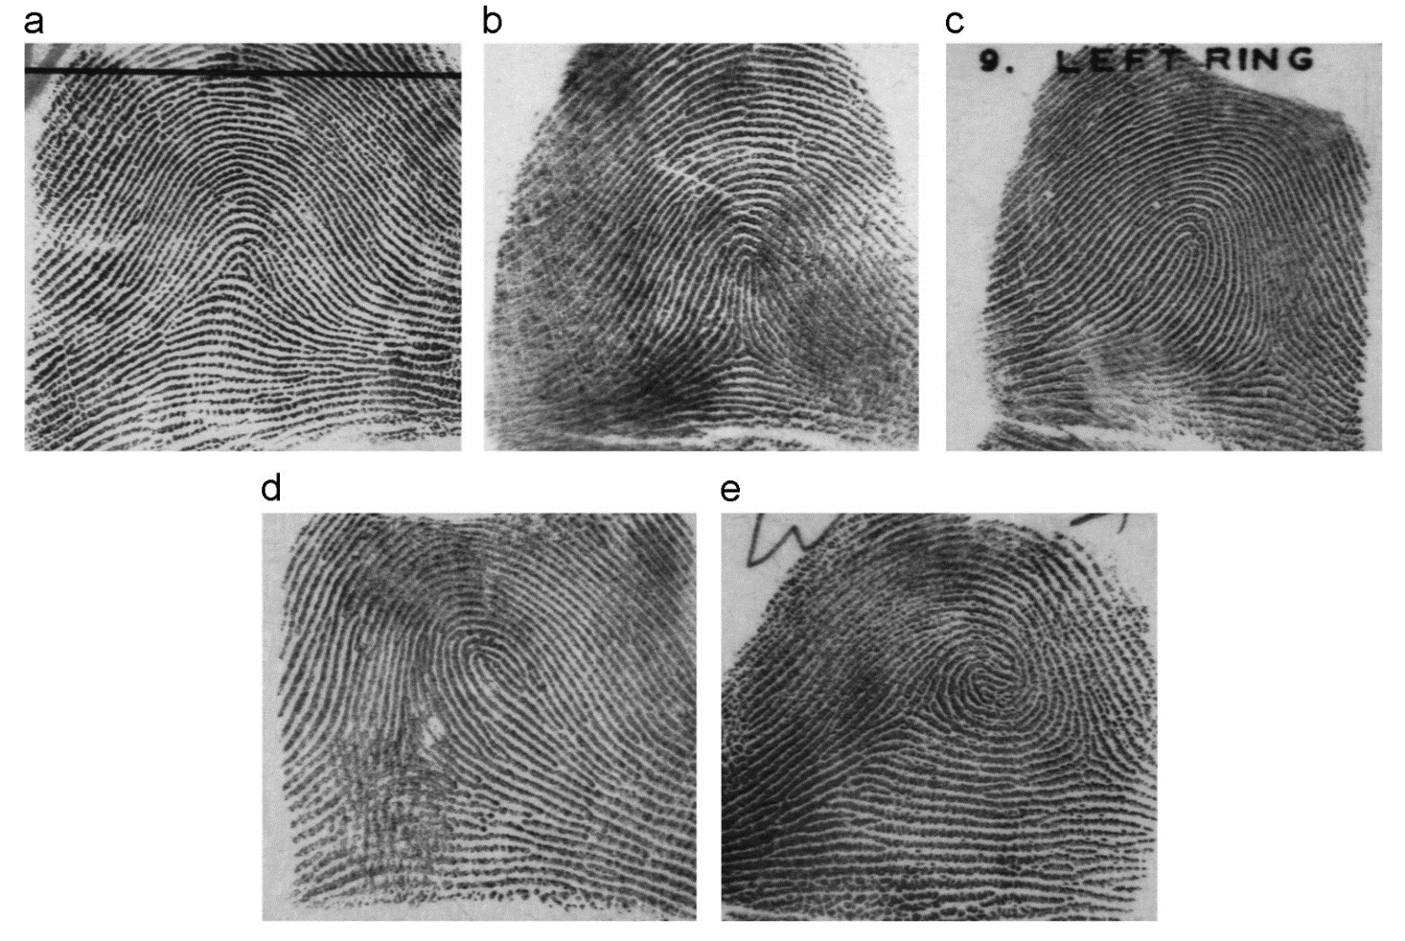
1. Problem
Arch
Tented Arch
Left Loop
5-class classification
4-class classification (combining arch tented arch)
Right Loop
Whorl

Slide 3
2. Proposed Approach
Training Images
Data Augmentation
Deep ConvNet
Training
SVM
Training
Testing
Images
SVM
Deep ConvNet
Prediction

Slide 4
2.1 Data Augmentation
Random Cropping. 512x512 -> 532 x 532 -> 512x512
Random Rotation. (-30 degree, 30 degree)
Random Brightness. (-50, 50)
Random Contrast. (0.4, 1.6)

Slide 5
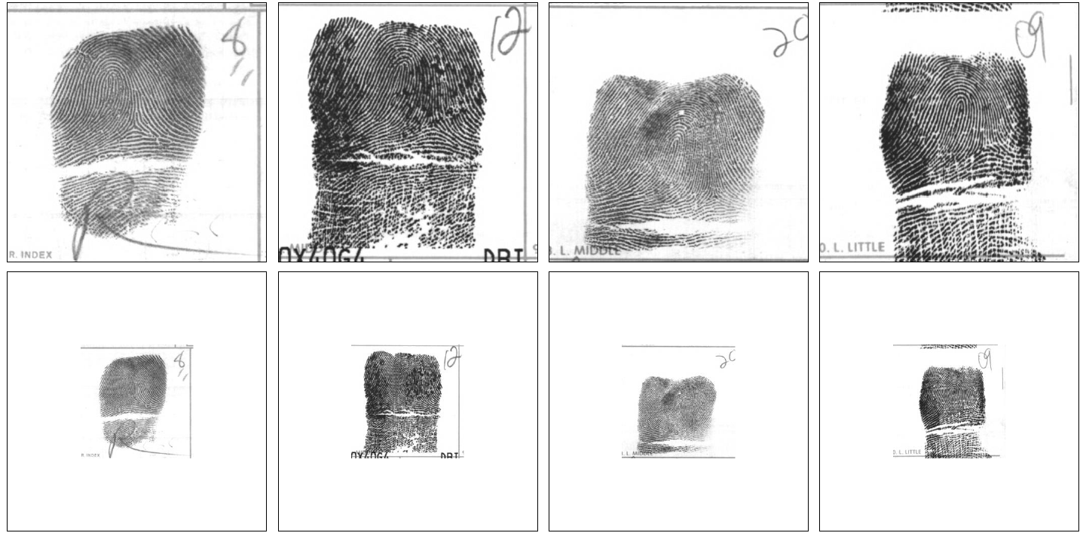

Slide 6
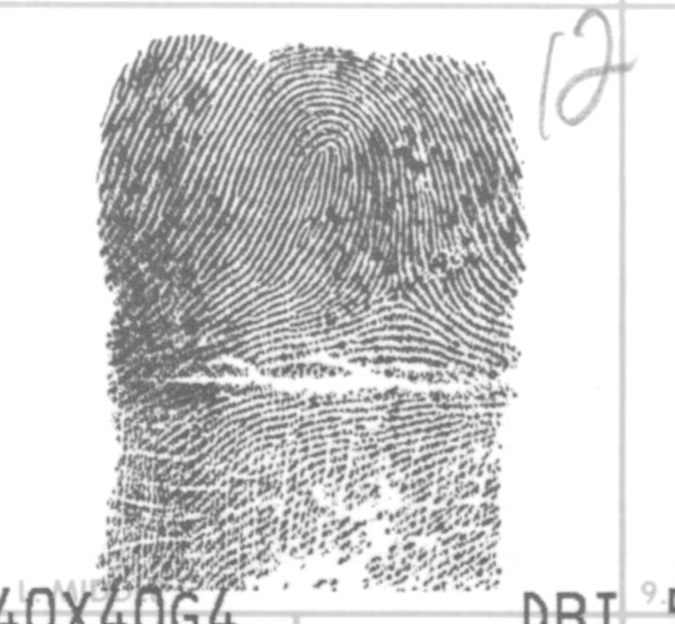
2.2 Network Architecture
512
256
128
512
256
128
1
1
Flatten
ResNet-50 layers
5
Conv1
conv2
5
96
96

Slide 7
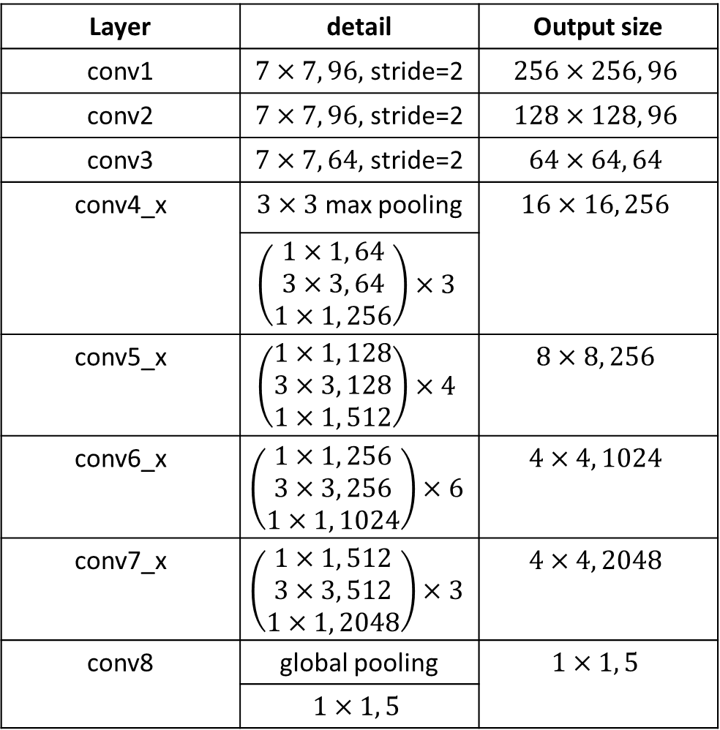
Layer | detail | Output size
conv1 | $7×7, 96,$ stride=2 | $$256×256, 96$$
conv2 | $7×7, 96,$ stride=2 | $$128×128, 96$$
conv3 | $7×7, 64,$ stride=2 | $$64×64, 64$$
conv4_x | $3×3$ max pooling | $$16×16, 256$$
 | $$\left(\begin{aligned}1×1, 64 \\ 3×3, 64 \\ 1×1, 256\end{aligned}\right)×3$$
conv5_x | $$\left(\begin{aligned}1×1, 128 \\ 3×3, 128 \\ 1×1, 512\end{aligned}\right)×4$$ | $$8×8, 256$$
conv6_x | $$\left(\begin{aligned}1×1, 256 \\ 3×3, 256 \\ 1×1, 1024\end{aligned}\right)×6$$ | $$4×4, 1024$$
conv7_x | $$\left(\begin{aligned}1×1, 512 \\ 3×3, 512 \\ 1×1, 2048\end{aligned}\right)×3$$ | $$4×4, 2048$$
conv8 | global pooling | $$1×1, 5$$
 | $$1×1, 5$$
2.2 Network Architecture
Activation function: ReLu
Weight Decay: 0.0001
Adam Optimizor

Slide 8
2.3 SVM
Feature : output of Conv7 as feature.
SVM parameter: Gamma = 1/32768, C = 1.0

Slide 9

3 Experiments
NIST SD 14
2700 subjects, 10 fingerprint, two samples per finger, totally 54000 samples
Spatial size: 768x832 -> 768x768 -> 512X512
80% subjects for training, 20% subjects for testing
NIST SD 4
Each of the five classes has 400 fingers, each finger has two smaples(800 images), totally 4000 images
Spatial Size: 512X512
50% for training(first sample of all fingers), 50% for testing (second sample)

Slide 10
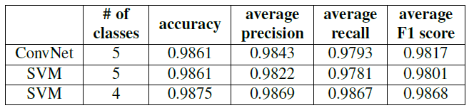
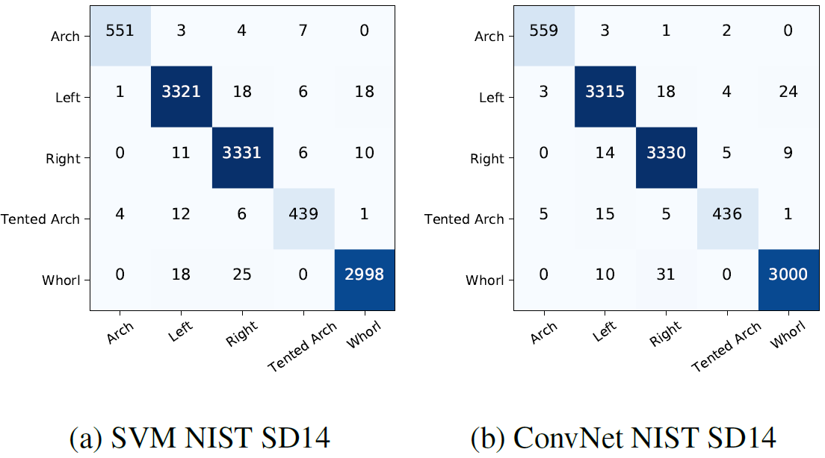
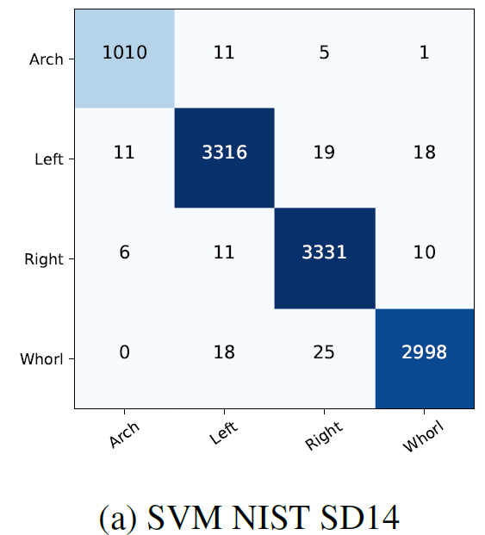
3.1 NIST SD14 result

Slide 11
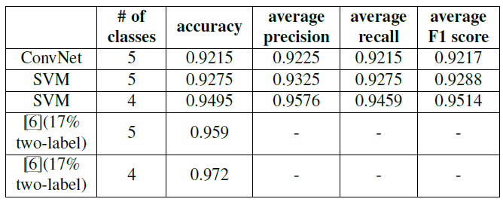
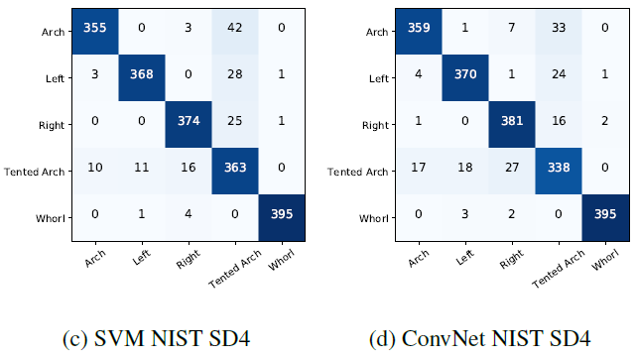
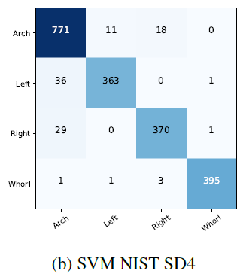
3.2 NIST SD4 result

Slide 12
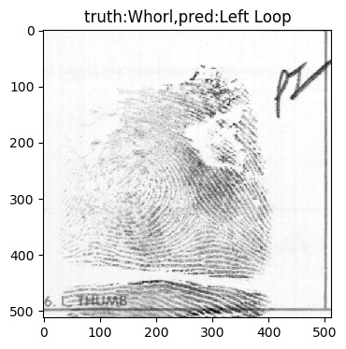
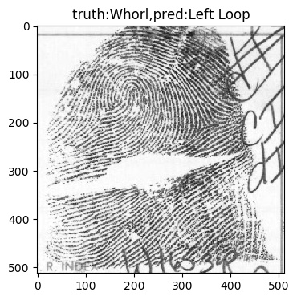
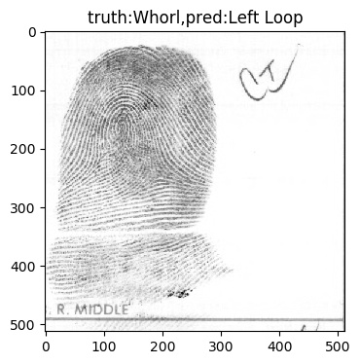
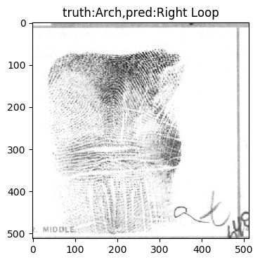
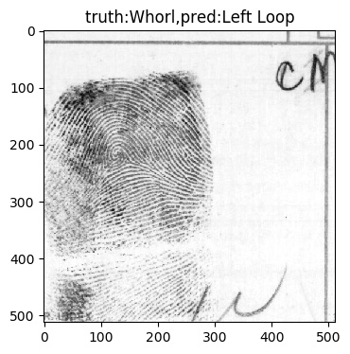
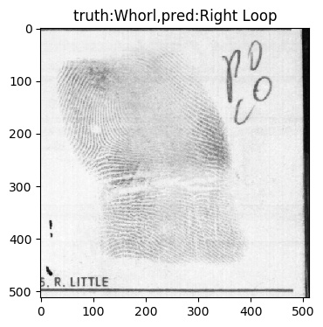
3.3 NIST SD14 fail cases

