Slide 1
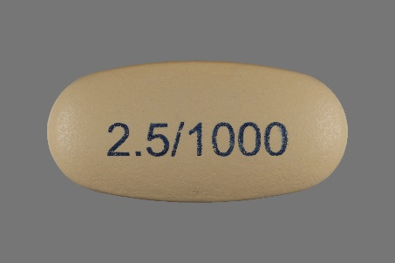
512
63
32
32
15
15
15
15
15
512
63
15
32
32
15
15
15
15
Conv1
pool1
conv21
conv22
conv31
conv32
conv41
conv42
conv5
fc1
fc2
5
96
256
256
256
384
256
256
256
1024

Slide 2
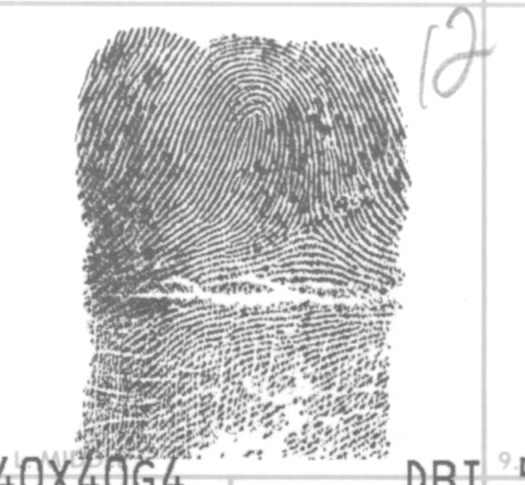
512
256
128
512
256
128
1
1
Flatten
ResNet-50 layers
5
Conv1
conv2
5
96
96

Slide 3
Training Images
Data Augmentation
SGD
Training
Deep
ConvNet
Testing
Images
Prediction

