Slide 1
Snakes
By : MICHAEL KASS, ANDREW WITKIN, and DEMETRI TERZOPOULOS

Slide 2
What are Snakes ?
Snake are active contour models that help to determine features like edges, lines and subjective contours while in motion of an image.
In this paper, Snakes have been implemented interactively (Using Snake Pit, A user-interface for snakes in a symbolic LISP machine) by applying user-imposed forces which can guide them to the nearby features in the image.

Slide 3
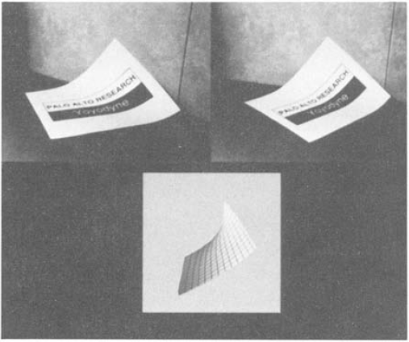
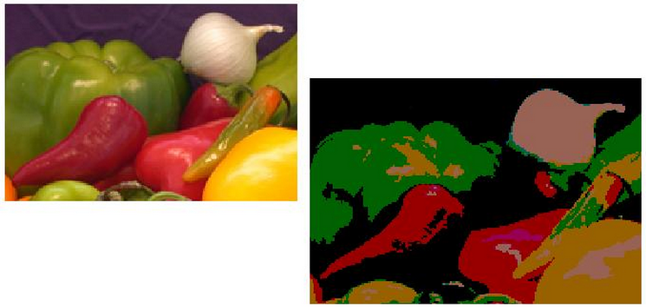
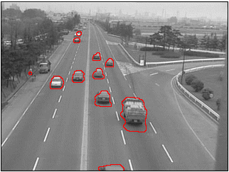
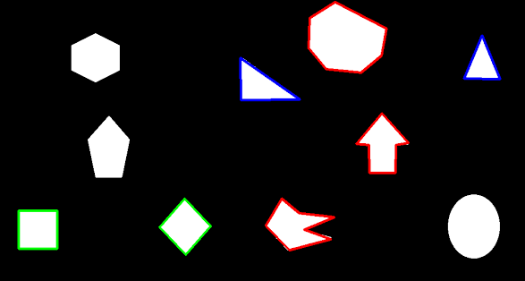
Applications of Snakes
Image Segmentation Stereo Matching
Motion Tracking Shape Recognition

Slide 4
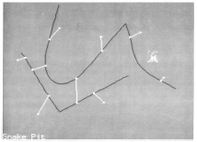
Snake Pit
It is a user interface designed on symbolic LISP machine that allows a user to initialize a snake and exert external forces on them.
Once User pushes the snake near a feature, the energy minimization pulls the snake towards the image.
Constraint forces of the energy functional can be applied using this interface.
The Volcano can be used to move snake from one local minima to another one.

Slide 5
How Snake Works ?
A snake is initialized around an image boundary either with the help of a user or a high level process.
To guide a snake to a nearby feature in an image, an energy functional is designed which tries to minimize itself continuously and thus locking the snake onto nearby image.

Slide 6


Internal Energy of Snake
increases energy of snake as it stretches more.
increases energy of snake as it develops more curves.

Slide 7
Image Forces
There are three different energy functional of an image which attracts a snake towards itself
Weights associated with different energy functional determines which feature of the image will be more dominant to attract the snake towards itself
Line : Attracts towards either light or dark lines
Edge : Attracts towards contours with large image gradient
Term : Attracts towards corners and terminations .

Slide 8

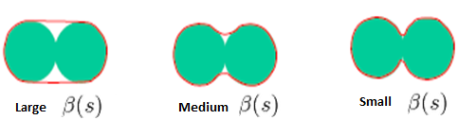
Focusing on Internal Energy
=
Elasticity, increases if the snake stretches more
Stiffness, increases if the curve bends more

Slide 9

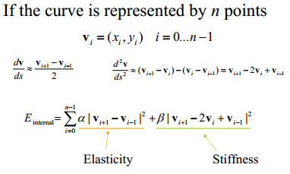

Slide 10
Implementation
GUI and Back-end Processing is done in MATLAB
We can modify below variables from UI
Alpha, Beta, Gamma
W(Line), W(Edge), W(Terminal)
Number of Iterations
We can Apply Filters to the image to get better results

Slide 11
Getting a Snake
Snake is create around an image by selecting initial “n”points using getpts
A spline is created using above n points using spline

Slide 12
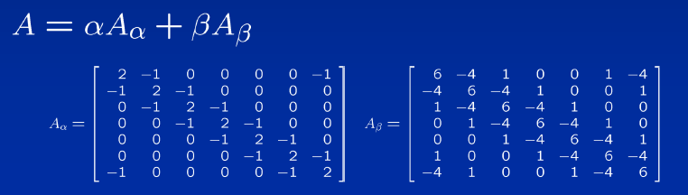

Snake Energy
A = zeros(m,m);
b = [(2*alpha + 6 *beta) -(alpha + 4*beta) beta];
temp = zeros(1,m);
temp(1,1:3) = temp(1,1:3) + b;
temp(1,m-1:m) = temp(1,m-1:m) + [beta -(alpha + 4*beta)];
for i=1:m
A(i,:) = temp;
temp = circshift(temp',1)';
end
[L U] = lu(A + gamma .* eye(m,m));
Ainv = inv(U) * inv(L);

Slide 13

Image Forces
Line Energy : Image Intensity
Terminal Energy : Convolution with masking
cx= conv2(image,[-1 1],'same');
cy = conv2(image,[-1;1],'same');
cxx = conv2(image,[1 -2 1],'same');
cyy = conv2(image,[1;-2;1],'same');
cxy = conv2(image,[1 -1;-1 1],'same');
Edge Energy : Gradient in x and y direction
Eimage = Wline*image_intensities + Wedge*Edge_energy –Wterm*Terminal_Energy;

Slide 14
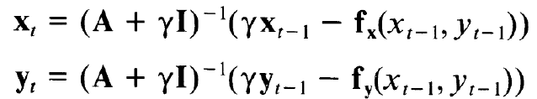
Energy Minimization
For i = 1: no_of_iterations
[Xnew, Ynew = [Ainv(Gamma* Xold - .1*interp2(fx,Xold,Yold),
Ainv(Gamma* Xold - .1*interp2(fx,Xold,Yold)
Spring Forces( Modify Xold, Yold)
end

Slide 15
Spring Forces
Spring Forces has been implemented to bring snake out of local Minima.
It is implemented using a combination of
Buttondownfcn : Initial Point
WindowButtonMotionFcn : For dragging
WindowButtonUpFcn : Final Point

Slide 16
References
http://alumni.media.mit.edu/~maov/classes/vision09/lect/09_Image_Filtering_Edge_Detection_09.pdf
http://www.mathworks.com/matlabcentral/fileexchange/28109-snakes-active-contour-models
http://en.wikipedia.org/wiki/Active_contour_model
http://www.cs.ucla.edu/~dt/papers/ijcv88/ijcv88.pdf
Thanks…

