Slide 1
Kubernetes Demystified
A practical guide

Slide 2
What is Kubernetes?
Official Definition: A platform for running applications in the cloud
Which means…
It’s a way to host your docker images in the cloud
It provides a way to scale up or down your web site and to load balance the traffic
It auto-magically recovers if something goes wrong
It provides security and resource management
It provides a way to monitor the health of your apps

Slide 3
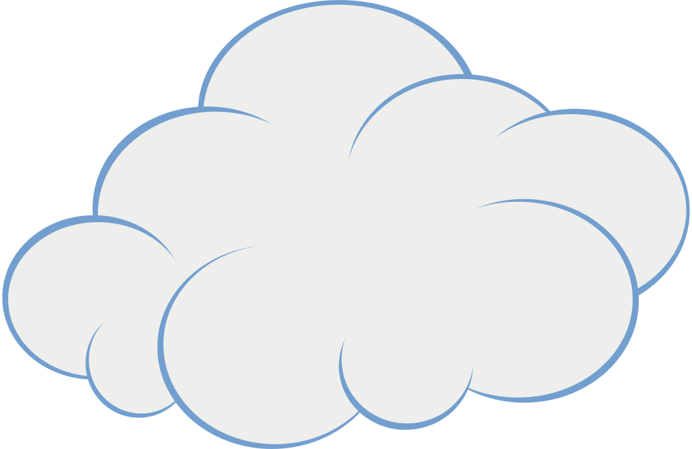
What is a cluster?
Cluster Admin
goes here
It’s defined in a cloud (any cloud will do)
Composed of a Master Node
And a few worker nodes
But this can be configured
easily
Master
Worker 2
Worker 1
Pods go here

Slide 4
What’s a pod?
It’s the most basic cluster building block
It holds containers that hold Docker Images
POD
Pod Name
Pod Labels
Metadata
Spec
Container:
Name
Image
Env var
Lifecycle
Security
Resources
Storage
…

Slide 5
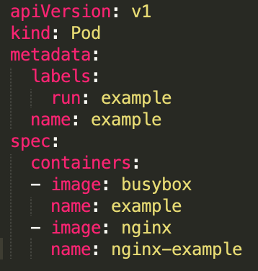
How can I define a pod? YAML is your friend
apiVersion
kind
metadata
spec
All the required elements
Note how indentation indicates parent/child relationships
The number of spaces don’t matter, just be consistent
The “-” indicates that this item is part of an array

Slide 6
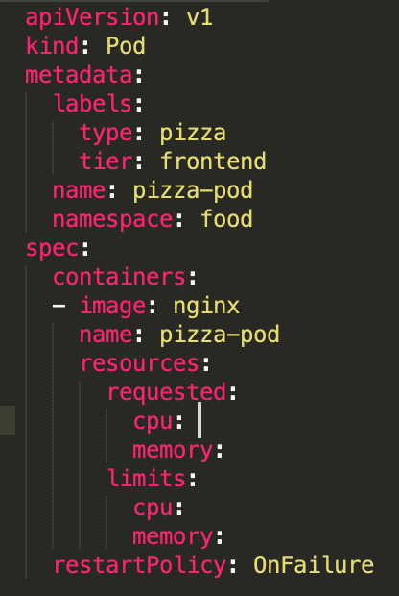
What else can be configured in a pod?
Add more properties to this file
This is where we can explain namespaces, resources, liveness probes, security, volumes

Slide 7
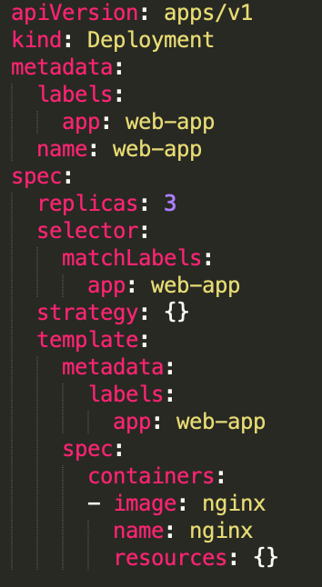
How do I create pods?
You can define an individual pod if you want to, but defining a Deployment is usually better
kind: Deployment
kind: POD
Interesting

Slide 8
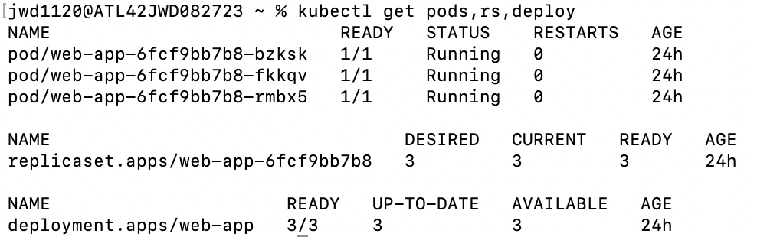
When I create a deployment, I get pods
What’s this?

