Slide 1
Kubernetes DeMystified
A practical guide to understanding and using Kubernetes

Slide 2


What is Kubernetes and why do people like it?
Official Definition: A platform for running applications in the cloud
Real Life Definition:
It’s a way to host your docker images
It provides a way to scale up or down your web site and to load balance the traffic
It can even add a new node to your cluster automatically if you tell it to
It auto-magically recovers if something goes wrong
If a pod crashes, Kubernetes will restart it
Rollout / rollback versions of your site without interrupting traffic

Slide 3
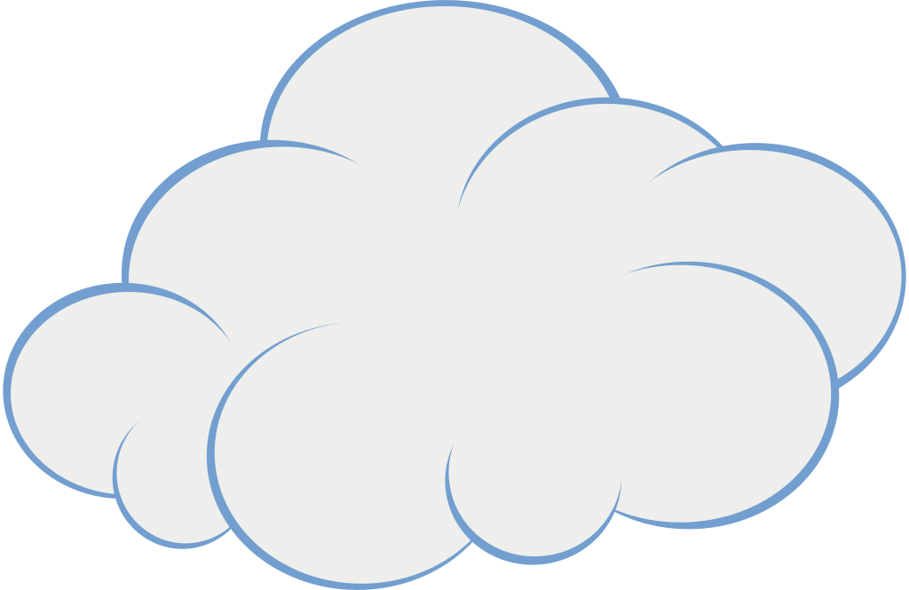
What is a Kubernetes cluster?
Master
A cluster is just a group of nodes in a cloud (any cloud will do)
Typically a cluster is made of one master node, and two worker nodes
The master node is your gateway to the worker nodes via the kubectl tool
The worker nodes host your code, and the master node keeps everything running
Worker 2
Worker 1

Slide 4
What’s a pod?
It’s the most basic object in a cluster
A pod holds your code by creating ”containers” that hold docker images
A pod can hold many containers, but usually just holds one
If there are two containers in one pod, they should be closely related, and work together
POD
Pod Name
Pod Labels
Metadata
Spec
Container:
Name
Image
Env var
Lifecycle
Security
Resources
Storage
…

Slide 5



How do I get my code into a pod?
Create a Docker image
Push the image to an image repository
Kubernetes will pull the image from the repo when it creates the container
Create a yaml config file that references the image name
Apply the config file to your cluster

Slide 6
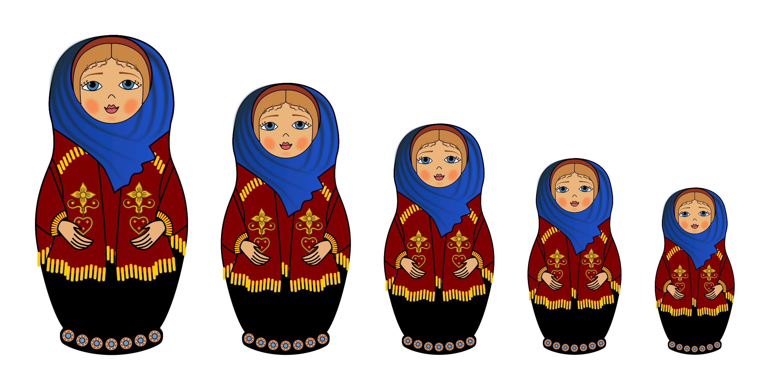
How is my code hosted in a cluster?
A cluster is ultimately a collection of pods, with some helpers available for organization / management (config maps, secrets, namespaces)
How does a pod relate to other objects in the cluster?
A docker image of your code goes into a container
A container goes into a pod
A pod is controlled by a replicaset
The replicaset is the thing that restarts crashed pods
A replicaset is created by a deployment
The deployment scales up / down the site by creating bigger / smaller replicasets and replacing the old set with the new set
The deployment is added to the cluster
Cluster
Deployment
Pod
Container
Docker Image

Slide 7
How can I see what’s in my cluster?
There are a few ways:
Kubectl - a command line tool that will let you query your cluster, and/or configure it
Yaml files – text files that follow a certain format that let you declare what your cluster will do when the file gets applied to the cluster
Third party tools like “Lens” can help you manage / monitor your cluster

Slide 8
What’s in my cluster? (via KubeCtl)
from the command line:
Kubectl get <resource>,<Resource> | All
-w
-o wide
-o yaml
-o json
--show-labels
--all-namespaces
-n my-namespace
Kubectl describe <resource>

Slide 9
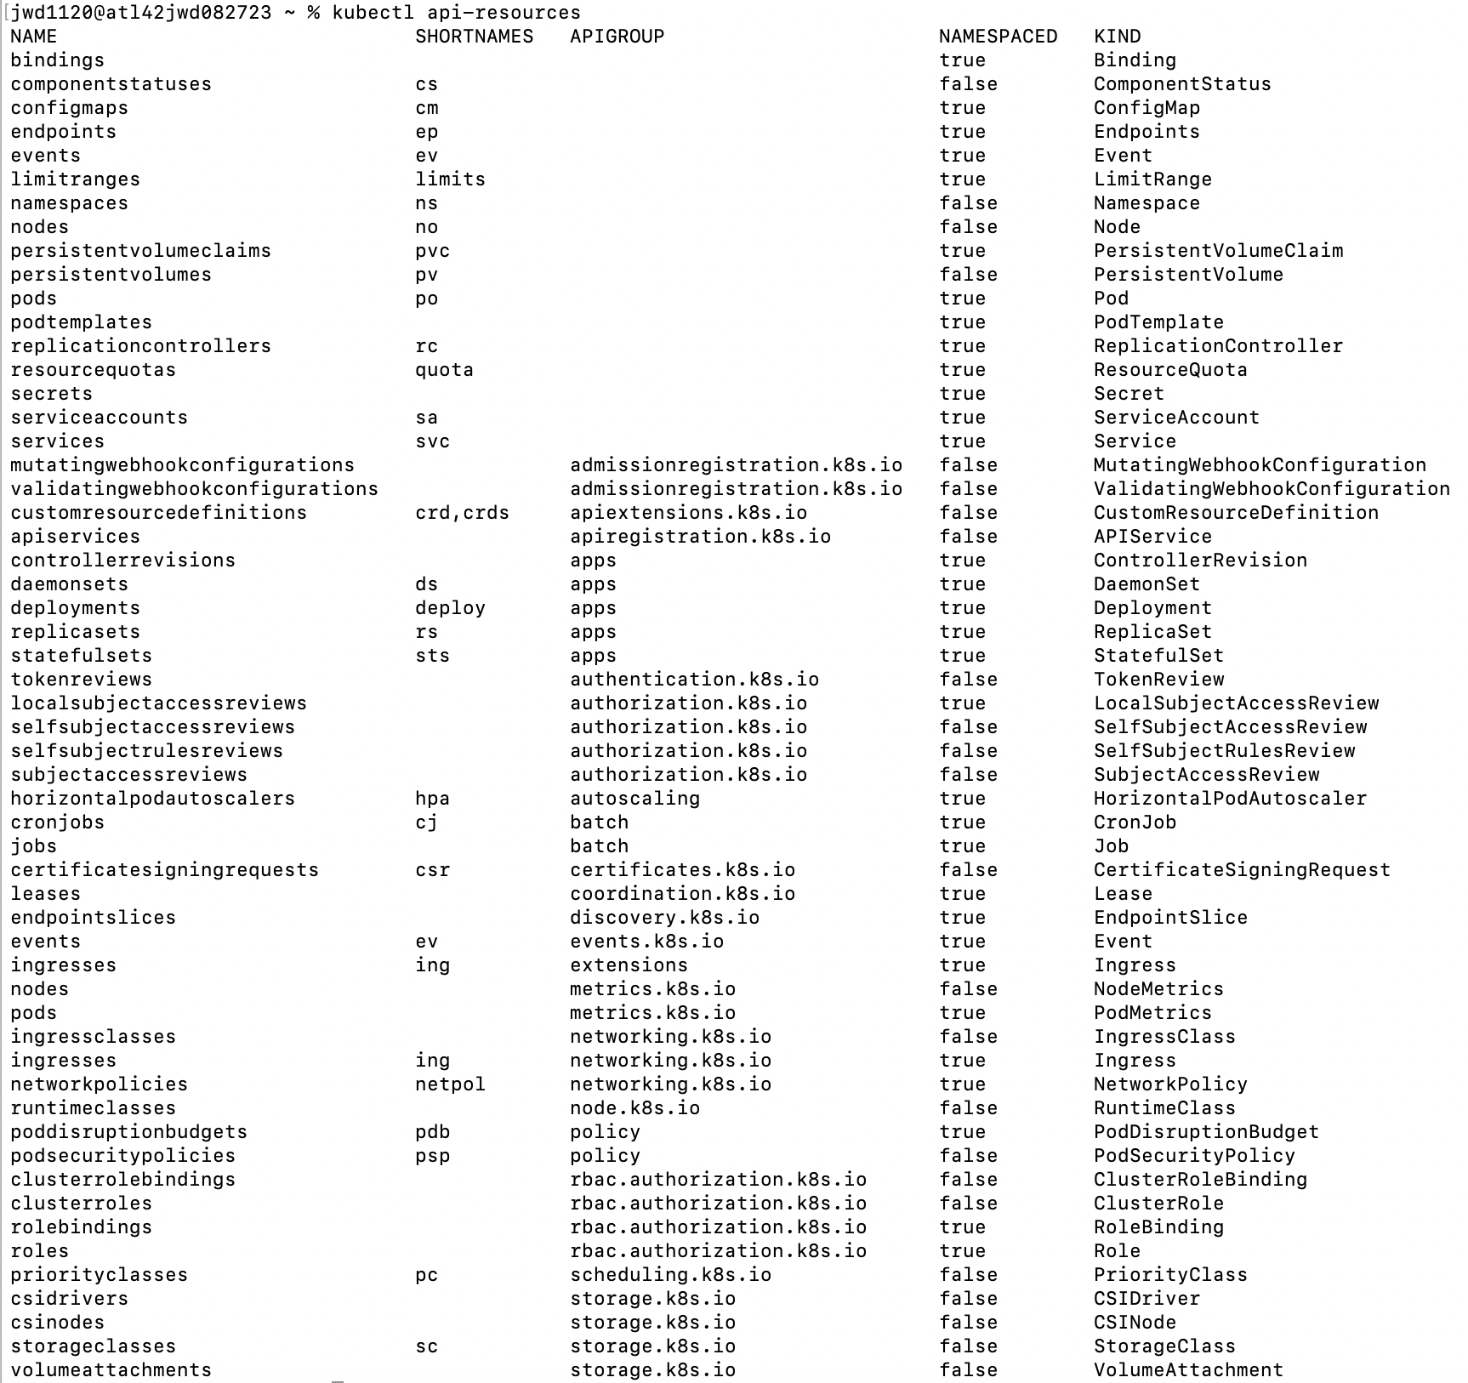
What types of resources are there?
“kubectl api-resources” Is your friend

Slide 10
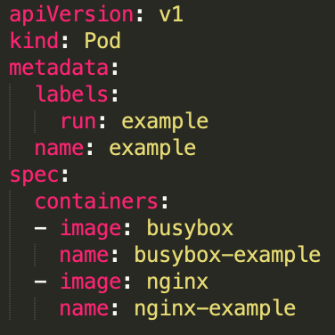
What’s a YAML file?
YAML is a format, and we use it to declare how Kubernetes will create our pod
Four Required elements:
apiVersion
kind
metadata
spec
Indentations show parent/child relationships
The number of spaces don’t matter, just be consistent
Image and name are siblings, and both are children of containers
The “-” indicates an array of objects. There are two containers defined in an array of containers.

Slide 11
All about deployments
Create a deployment to tell Kubernetes to create a set of pods, and create a way to manage them, like scale the number of pods up or down, and restart crashed pods
Deployment -> creates replicaset of a certain size -> creates whatever number of pods are requested
If the deployment definition changes, a new replicaset is created, and the original is terminated.
Changes are rolled out one by one, users are oblivious to the updates
However….. There’s a complication….

Slide 12
Each pod has its own ip address
Each pod has its own ip address, so as pods are created / destroyed, new Ip addresses become available in the cluster
How can the deployment manage the pods? And how can requests reach the pods?
The answer is: Services!!
A service is the connection between the pods and the deployment object
Service IP addresses stay constant, and they forward requests to the pods they are related to
All three objects are related by their labels. The deployment controls pods that have a certain label defined in the deployment yaml file. Each pod has a label that matches what is in the deployment. The service forwards traffic to pods that match the labels specified.

Slide 13
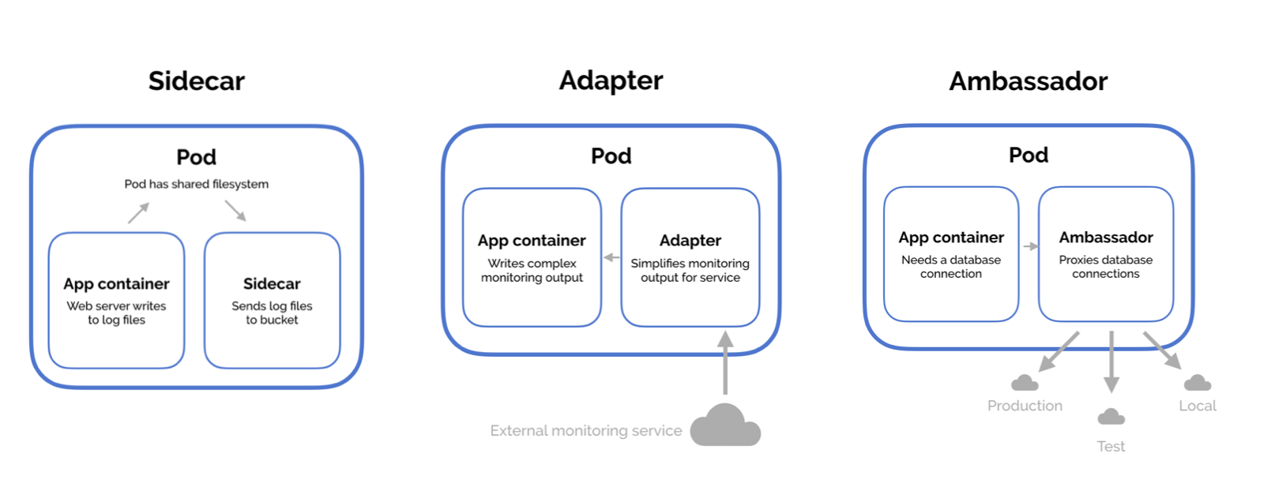
Why would I put two containers in one pod?
Ambassador: The ambassador pattern is a useful way to connect containers with the outside world.
Sidecar: The sidecar pattern consists of a main application—i.e. your web application—plus a helper container with a responsibility that is essential to your application, but is not necessarily part of the application itself, like a logging utility
Adapter: The adapter pattern is used to standardize and normalize application output or monitoring data for aggregation.

Slide 14
Quick resource descriptions
Pod
Deployment / replicaset
Service
configmap
Secret
namespace

Slide 15
What if something goes wrong?
Kubectl logs <pod-name> -c <container name>
Kubectl describe <pod-name>
Kubectl get events
Kubectl exec -it <pod-name> -- <command to run>

Slide 16
Frickin’ awesome shortcuts
Kubectl api-resources shows abbreviations
Po
Cm
Deploy
Alias k=kubectl
Output related:
-o wide
-o yaml | json
--all-namespaces
Get all
Get pods –show-labels
Kubectl set image <pod-name> <container-name>=<docker-image>

