Slide 1
The Earth Below, the Sky Above
Colin Berry
M0GXV

Slide 2
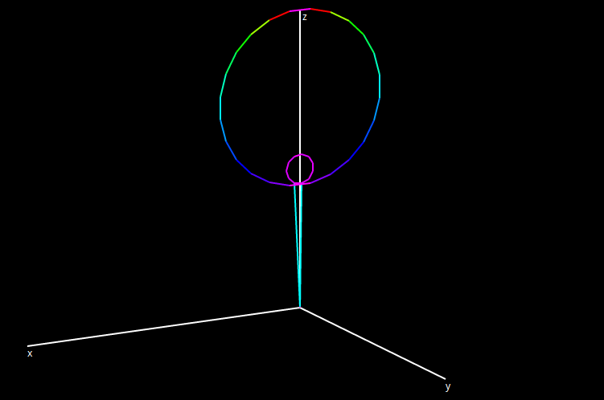
The Loop Antenna Revisited

Slide 3
Developments
Fine tuning control
Pully operation to gain height
Rebuilt to be more robust
Pole mounted with extensions and guys
Use on 30m (10.1MHz) band to avoid contests

Slide 4
Where has all the power gone?
Skin effect, dielectric losses, bad joints?
Don’t explain the low efficiency
Good for reception, not for transmission
Thermal test – nothing gets warm on transmit
Conclusion? Absorption by nearby “stuff”

Slide 5
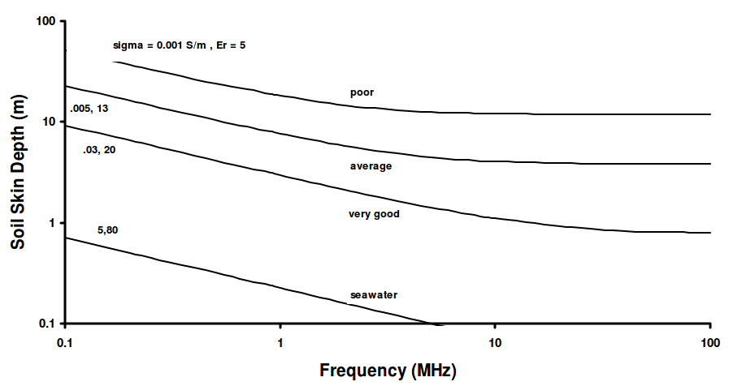
Internet Resources
https://www.antennasbyn6lf.com/files/ground_skin_depth_and_wavelength.pdf

Slide 6
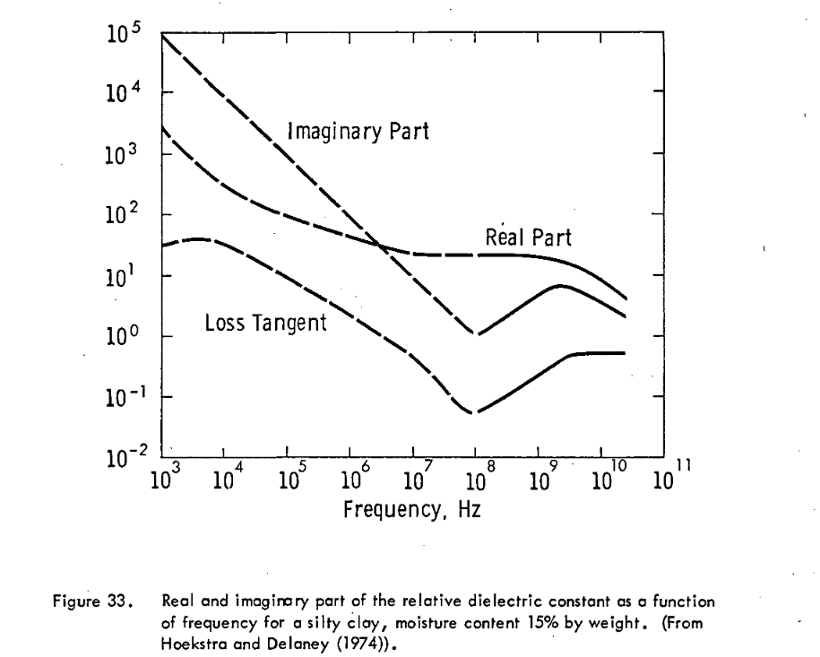
Internet Resources
https://ntrs.nasa.gov/archive/nasa/casi.ntrs.nasa.gov/19750018483.pdf

Slide 7
Absorbent Objects
Radiators
Window frames
Coated window panes
Buildings (brick and wood)
Ground
Can identify by moving closer to object

Slide 8
Experimental Approach
1. Measure the loop and feed into model
2. Calculate reactance and resistance (from skin effect and radiation)
3. Attach antenna analyser via short patch lead
4. Tune loop to chosen frequency and adjust coupling to get 50 ohms
5. Measure bandwidth (where SWR is 2.62)
6. Calculate Q and hence total loop resistance
7. Change height above ground and measure impedance (or bandwidth) at new resonance

Slide 9
Model Parameters
Try to reproduce observations by varying:
  Resistance of antenna elements
  Efficiency of capacitor dielectric (loss tangent)
  Relative Permittivity of ground
  Conductivity of ground
What if you can’t?
  Modelling method may be imprecise
  Observations not under “laboratory conditions”

Slide 10
Earth Interactions
Local electric field from charges
  Treat earth like a lossy capacitor
  Mainly from high voltage points on antenna
Local magnetic field from currents
  Creates circuit within earth, around which eddy current flows
  Mainly from high current points on antenna
Travelling electromagnetic wave
  Partial reflection, rest is absorbed - “opaque”
  Evanescence, “skin depth”

Slide 11
Types of Model
Antenna modelling software (e.g. xnec2c)
  Limitations close to ground
  Professional versions more precise than free one
  file:///home/colin/Documents/xnec2c/earthsky
Local interactions using equivalent circuits
  Model is ‘simple’ but parameters are highly subjective: qualitative but unreliable
  file:///home/colin/Documents/loop%20eddy%20current%20losses.ods
  file:///home/colin/Documents/xnec2c/earthsky/earth%20E%20coupling.ods

Slide 12
Example NEC Model Results
Loop 43cm above earth, 0.3 ohm resistance
Ground type | Resonant impedance | Bandwidth
Perfect | 51 | 14
Low conductivity | 40 | 19
Higher conductivity | 30 | 26

Slide 13
Total Radiated Power
Divide upper hemisphere into regions
  22 and 45 degrees “broadside” and “plane”
  Vertical (assume zero horizontal)
Measure gain in a representative direction for each region, relative to “perfect isotropic radiator”
Estimate total power radiated
Subtract from input power and known losses to find absorption

Slide 14
Example Radiation Efficiency
Loop 43cm above earth, 0.3 ohm resistance
  file:///home/colin/Documents/total%20radiation%20sum.ods
Ground type | Total radiation | Efficiency
Perfect | 0.070 | 7.5%
Typical | 0.028 | 3%
Perfect, no loop resistance | 0.94

Slide 15
Near Vertical Incidence Skywave Propagation
Low antennas radiate mainly upwards
Covers distance up to several hundred Km which low-angle skywaves skip over
Unaffected by local hills which hinder line of sight
Local QSOs can be weaker than distant ones
Frequency specific
Simple ground reflector improves efficiency

Slide 16
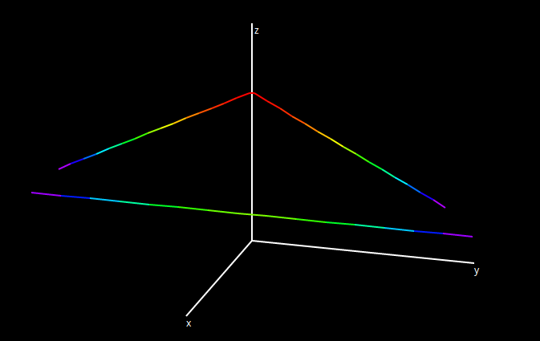
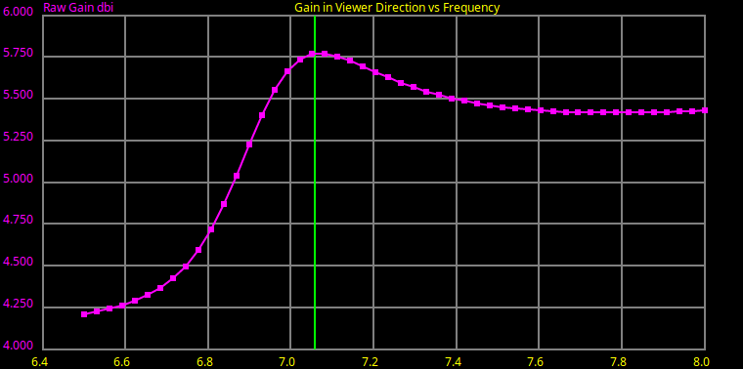
Inverted V with Reflector

Slide 17
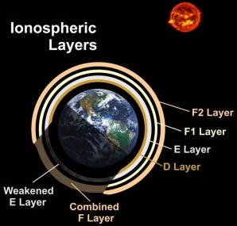
The Sky Above like the Earth Below
Similar process – slightly conducting medium
Want reflections from F layer(s)
Want transparency through D layer
Also refraction – bending back to earth
  plasma behaves as if
  refractive index < 1

Slide 18
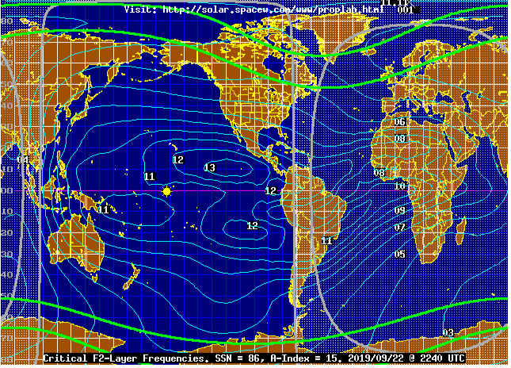
F Layer(s)
Critical Frequency limits vertical reflection
  http://www.spacew.com/www/fof2.html

Slide 19
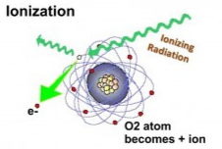
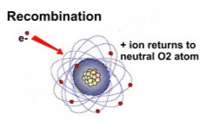
D Layer
Limits minimum frequency during daylight
Large amount of short-duration ionisation
Absorbs low frequencies due to ion re-combination
Near-vertical paths shorter through layer: less attenuation
  https://hamradioschool.com/d-layer-absorption/

Slide 20
Usable Frequencies
Day: 5 – 7 MHz reliably
Night: 2 – 4 MHz reliably
Dusk: 7MHz good, as D layer quickly dissipates but MUF still high from F layer
Military users and Shortwave broadcasters switch bands by day/night to maintain coverage
Shortwave broadcast bands are lower near tropics

Slide 21
IonoSondes
Uses NVIS to analyse composition of ionosphere
Emits ‘radar’ pulses at various frequencies, listens for echoes
Deduces electron density at various heights
Identifies effective locations of ionosphere layers on Ionogram
https://en.wikipedia.org/wiki/Ionosonde#Ionogram

Slide 22
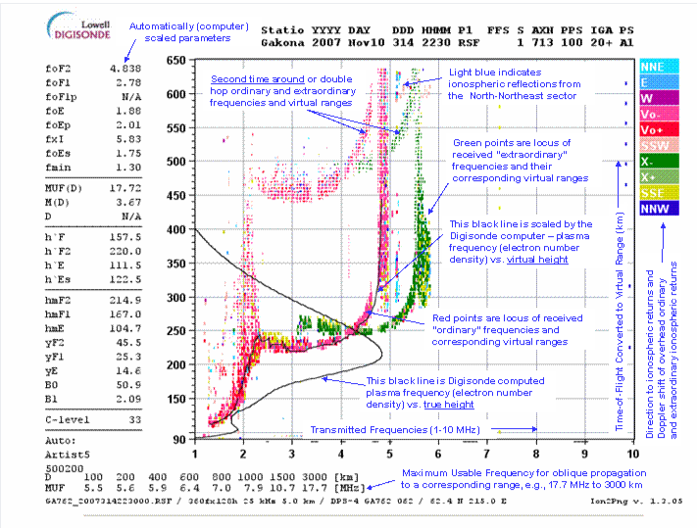
Ionogram Explanation

Slide 23
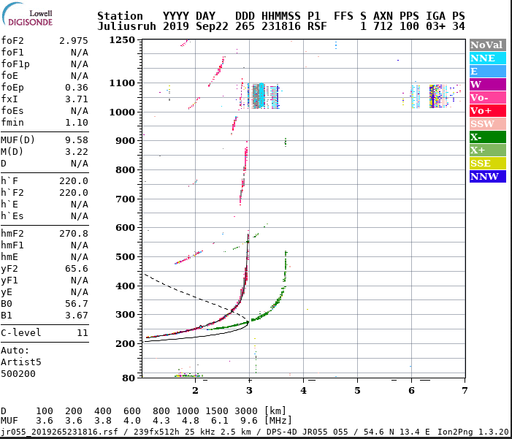
Current Ionogram from Juliusruh
https://www.iap-kborn.de/en/research/department-radar-remote-sensing/current-radar-observations/ionosonde-ionogram/

Slide 24
Going Forward
Loop robustness – wind stress detunes
More reliable fixed capacitor
Escape from urban noise
Inverted V with reflector?

