Slide 1

MindTrace: Real Time Emotion Based Productivity Monitoring System
Shraddha Dashpute
Sankalp Gaikwad
Hemant Choudhary
Priyanshu Jadhav
Balaji Motkulwar
Guide-Mrs. Yogita Narwadkar
Project Stage-I
PES Modern College of Engineering Department of Computer Engineering Savitribai Phule Pune University
MindTrace

Slide 2
Contents
1
2
3
4
5
6
7
8
9
10
11
12
13
14
15
Introduction Literature Review
Need / Objective and Scope Problem Statement Architectural Diagram/s
Mathematical Model with formula
Features- (Functionality, details of Algorithm) Use Case Diagram/ DFD
Class Diagram/ DFD System Specification Data Sets
Expected Results Conclusion Paper Published References
MindTrace

Slide 3
Introduction
The "MindTrace" project is a smart system designed to monitor your productivity by understanding your emotions. While most productivity tools only track how much time you spend working, MindTrace uses your webcam to see if you're feeling happy, sad, or tired. It uses ML algorithms to analyze your facial expressions in real-time. The main goal is to help you understand your work habits better, prevent burnout by suggesting breaks when you seem fatigued, and ultimately promote a healthier and more engaged way of working.
MindTrace

Slide 4
Literature Survey(1/2)
Project Module | Relevant Paper / Source | Technology Used | Contribution to Project
Real-time Emotion Recognition & Adaptive Learning | Emotion Recognition for Enhanced Learning | CNN-based Facial Emotion Recognition, OpenCV, TensorFlow/Keras, Real-time webcam processing | Helps the system detect whether a student is happy, bored, confused, or stressed—allowing dynamic adjustment of learning difficulty, hints, or alerts.
Emotion Tracking in Live Online Sessions | Facial Expression Recognition for Examining Emotional Regulation in Synchronous Online Collaborative Learning | FER models (VGG-Face, ResNet-based FER), Landmark Detection, Live Video Analytics | Improves the ability to analyze subtle facial cues during online learning and supports more accurate emotional state classification in group or collaborative settings.
MindTrace

Slide 5
Literature Survey(2/2)
Project Module | Relevant Paper / Source | Technology Used | Contribution to Project
Engagement Detection & Attention Monitoring | Optimizing Student Engagement Detection using Facial and Behavioral Features | Behavioral tracking (eye gaze, head pose), Action Unit detection, ML models for engagement scoring | Adds non-verbal behavior analysis—eye contact, movement, screen focus—to give more accurate engagement scores rather than relying only on facial expressions.
Fatigue & Stress Detection (Cross-Domain Inspiration) | Advancements in Driver Fatigue Detection – Springer, 2024 (Li) | Drowsiness detection, blink rate, PERCLOS, deep learning fatigue classifiers | Provided insights into scalability and guided future integration of multimodal emotion and fatigue inputs.
MindTrace

Slide 6
Need / Objective and Scope
Need:
Track emotions and focus patterns through visual analytics.
Help users manage workload and prevent fatigue.
Encourage balanced and healthy work habits.
Objective:
To detect emotions and fatigue using facial analysis.
To train the AI model on the FER-2013 dataset.
To display emotional and fatigue trends on a Streamlit dashboard.
To promote mental well-being and prevent burnout.
MindTrace

Slide 7
Need / Objective and Scope
Scope:
Capture real-time webcam video.
Detect and analyze facial emotions locally.
Monitor fatigue and provide real-time suggestions (e.g., “Take a short break”).
Display emotional data and fatigue scores on a Streamlit dashboard.
Ensure all processing is done locally for privacy.
MindTrace

Slide 8
Problem Statement
Build a non-intrusive, emotion-aware system that uses computer vision and deep learning to analyze facial expressions, classify emotions (like happy, sad, neutral) via a CNN trained on the FER-2013 dataset, and identify signs of mental fatigue over time.
MindTrace

Slide 9
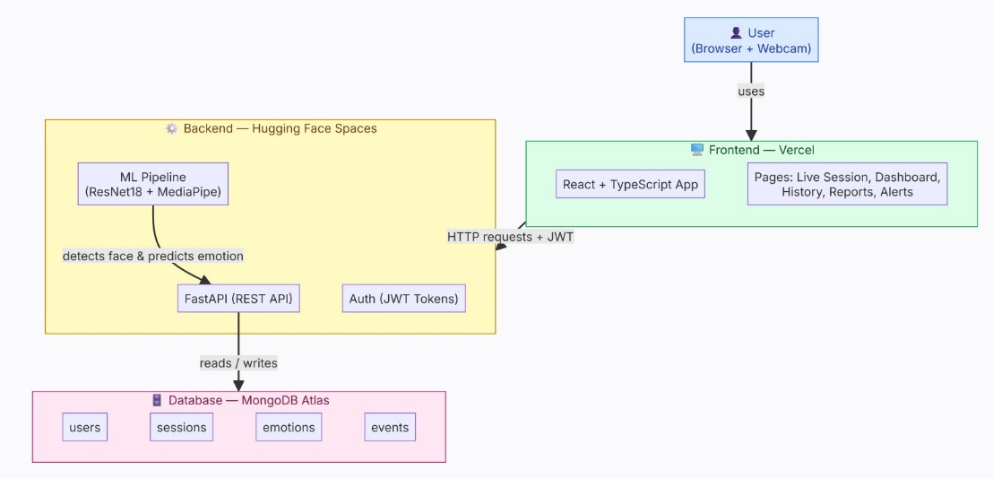
Architectural Diagram/s
Figure: 1.System Architectural Diagram.
MindTrace

Slide 10



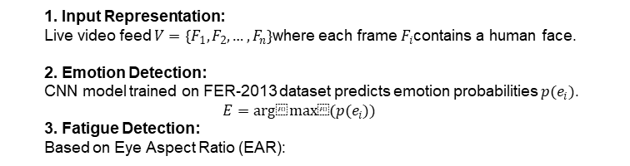
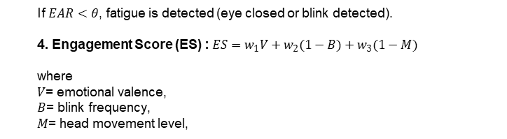
Mathematical Model(1/2)
1. Input Representation:
Live video feed $V=\{F_{1},F_{2},…,F_{n}\}$where each frame $F_{i}$contains a human face.
2. Emotion Detection:
CNN model trained on FER-2013 dataset predicts emotion probabilities $p(e_{i})$.
$$E=arg⁡max⁡(p(e_{i}))$$
3. Fatigue Detection:
Based on Eye Aspect Ratio (EAR):
1. Eye Aspect Ratio (EAR) for Blink Detection: Used to calculate Mb (Blink Modifier) for fatigue tracking.
$$EAR=\frac{\text{‖}p_{2}−p_{6}\text{‖}+\text{‖}p_{3}−p_{5}\text{‖}}{2\text{‖}p_{1}−p_{4}\text{‖}}$$
If $EAR<θ$, fatigue is detected (eye closed or blink detected).
4. Engagement Score (ES) : $ES=w_{1}V+w_{2}(1−B)+w_{3}(1−M)$
where $V$= emotional valence, $B$= blink frequency, $M$= head movement level,
Where: p1, p4 are horizontal eye landmarks; p2, p3, p5, p6 are vertical eye landmarks.
MindTrace
2. Head Pose Estimation (Perspective-n-Point / PnP): Used to map 3D face model points to 2D image coordinates to find Pitch (θ), Yaw (φ), and Roll (ψ).
Where: s = scale factor, pc = 2D image coordinates, K = Camera Intrinsic Matrix [R | t] = Rotation and Translation matrix, Pw = 3D World coordinates

Slide 11

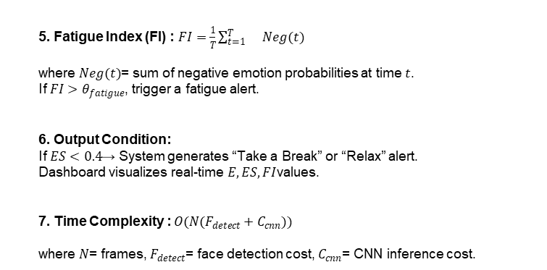
Mathematical Model(2/2)
5. Fatigue Index (FI) : $FI=\frac{1}{T}\sum_{t=1}^{T}{}Neg(t)$
where $Neg(t)$= sum of negative emotion probabilities at time $t$. If $FI>θ_{fatigue}$, trigger a fatigue alert.
6. Output Condition:
If $ES<0.4$→ System generates “Take a Break” or “Relax” alert.
Dashboard visualizes real-time $E,ES,FI$values.
7. Time Complexity : $O(N(F_{detect}+C_{cnn}))$
where $N$= frames, $F_{detect}$= face detection cost, $C_{cnn}$= CNN inference cost.
3. Total Engagement / Focus Score (E): Calculated on a scale of 0 to 100.
Where: Be (Base Emotion Score): 85-95 for Happy/Surprise, 65-80 for Neutral, 30-50 for Negative. Ph (Head Pose Penalty): -30 IF |φ| > 30° OR |θ| > 30° (Looking away). Mb (Blink Modifier): -15 if blink rate > 35 (Fatigued), +10 if blink rate < 5 (Intense focus).
MindTrace

Slide 12
Features- (Functionality, details of Algorithm)
A. Initialization
• Initialize webcam, frame capture rate (1 FPS), and load the CNN model._x000B_• Load the self-trained ResNet18 model for emotion detection._x000B_Model Initialization:_x000B_Model = ResNet18(weights = FER2013)
B. Video Frame Acquisition
• Capture real-time video using OpenCV: cap = cv2.VideoCapture(0) • Extract frames at fixed intervals: fₜ = V(t), where t = 1, 2, 3…
C. Face Detection
• Detect face in every frame using MediaPipe or Haar Cascade: (x, y, w, h) = FaceDetector(fₜ) • Crop and resize face region to 96x96 pixels: I′ = resize(I_face, (48,48))
MindTrace

Slide 13
Features- (Functionality, details of Algorithm)
D. Preprocessing
• Convert cropped face to grayscale and normalize pixel values (0–1): I_norm = I′ / 255 • Reshape image tensor for CNN: I_input = I_norm.reshape(1, 96, 96, 3)
E. Emotion Recognition (ResNet18 CNN)
• Pass normalized face to the ResNet18 model for classification._x000B_• CNN performs convolution, ReLU, batch normalization, GAP, and softmax.
Mathematical Model: O = Softmax(Wₙ * fₙ₋₁ + bₙ)
Predicted Emotion: Emotion = argmax(O)
F. Fatigue Detection
• Maintain sliding window of recent emotions: E = [e₁, e₂, …, eₙ] • Compute fatigue score: F = Count(negative + neutral) / Count(total) • If F ≥ 0.6 → Fatigue Detected
MindTrace

Slide 14
Features- (Functionality, details of Algorithm)
G. Suggestion Module
• When fatigue is detected, trigger context-aware suggestions: – “Take a short break” – “Stretch for a minute” – “Drink some water” • Rule-based implementation: If (F ≥ threshold): Suggestion = S(F)
H. Dashboard Visualization
• Store session data (time, emotion, fatigue score) in database. • Use React to display: – Emotion distribution (pie chart) – Fatigue level over time (line chart) – Session summary and analytics
MindTrace

Slide 15
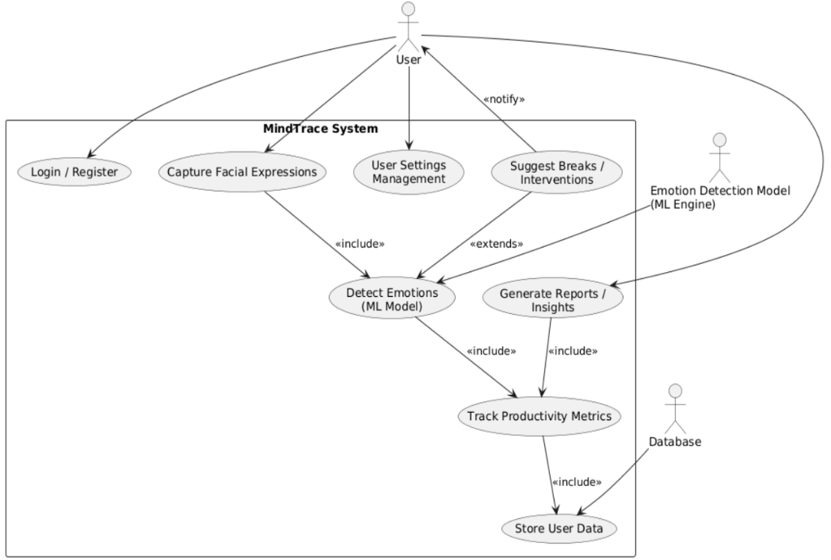
Use Case Diagram/DFD
MindTrace

Slide 16
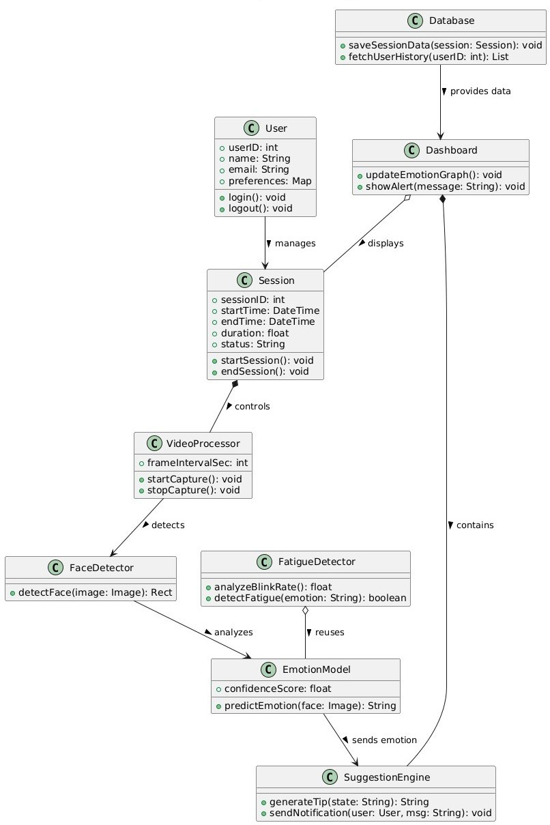
Class Diagram/DFD
MindTrace

Slide 17
System Specifications
Software Requirements:
Operating System: Windows 10+, Ubuntu 22.04, or macOS
Language: Python 3.11+
Libraries: TensorFlow, Keras, OpenCV, MediaPipe, React, NumPy, Pandas
Hardware Requirements:
Processor: Intel i5 or higher (minimum 2.4 GHz)
Memory: 8 GB RAM minimum
Webcam: HD (720p or higher)
Optional GPU: NVIDIA GTX series or better (for faster processing)
MindTrace

Slide 18
Data sets
The dataset is downloaded from website:-https://www.kaggle.com/datasets/msambare/fer2013
FER-2013 contains 48×48 grayscale facial images with over 35,000 samples.
Images are labeled into seven emotions: Angry, Disgust, Fear, Happy, Sad, Surprise, Neutral.
Originally introduced for the Kaggle Facial Expression Recognition Challenge.
Used in this project to train and validate the CNN-based emotion recognition model.
MindTrace

Slide 19
Expected Result
Real-Time Emotion Detection
Accurate Fatigue Recognition Dynamic Dashboard Visualization Automated Productivity Insights Real-Time Alerts & Suggestions
Local Data Processing (Privacy Preserved) Cross-Platform Functionality
Improved Productivity Awareness
MindTrace

Slide 20
Conclusion
The MindTrace system successfully uses AI and computer vision to monitor real-time emotions and engagement. It provides an intelligent, non-intrusive way to evaluate productivity and well-being by using a CNN to classify emotions and analyzing trends to detect fatigue. The dashboard offers users clear analytics of their emotional patterns, and the system validates that efficient, privacy-preserving emotion detection can be achieved locally. Overall, MindTrace bridges the gap between emotional intelligence and productivity, offering a human-centered platform that promotes better focus, reduced fatigue, and improved mental wellness.
MindTrace

Slide 21
Papers Published
Survey On: Web Usage Mining Techniques Generating Frequent Patterns for Web-Page Recommendation,”International Journal of Computer Science and Information Technologies, Vol. 7 (3) , 2016, 1435-1437”.
Integrating PL4UP a Fast Sequence Pattern Mining Algorithm with Ontology for Web-Page Recommendation,”CPGCON 2016”.
MindTrace

Slide 22
References I
[1] C. Liang and J. Dong, “A Survey of Deep Learning-Based Facial Expression Recognition Research,” IEEE Transactions on Affective Computing, 2023.
[2] H. Zhang, Y. Chen, and L. Wang, “Improved Facial Emotion Recognition Model Based on a Novel Deep Network,” Elsevier Journal of Computer Vision and AI, 2024.
[3] Q. Li, “Advancements in Driver Fatigue Detection: Comprehensive Analysis of Eye Movement and Facial Feature Approaches,” Springer Journal of Intelligent Systems, 2024.
[4] H. Ma, S. Liu, and J. Zhao, “Non-Invasive Fatigue Detection and Human–Machine Interaction via Facial Parameters,” IEEE Access, 2025.
MindTrace

Slide 23
References II
[5] K. Kakhi, R. Patel, and D. Mehra, “Fatigue Monitoring Using Wearables and AI,” Journal of Human– Computer Interaction and Data Science, 2025.
[6] S. Li, X. Liu, and Y. Zhao, “Deep Learning-Based Emotion Recognition for Human–Computer Interaction,” IEEE Transactions on Cognitive Systems, 2023.
[7] T. Baltrusaitis, A. Zadeh, and L. Morency, “OpenFace 2.0: Facial Behavior Analysis Toolkit,” IEEE International Conference on Automatic Face & Gesture Recognition, 2022.
[8] Z. Zhang, “Feature Extraction and Classification in Facial Expression Recognition,” Pattern Recognition Letters, 2021.
[9] K. Niu and J. Huang, “Streamlit-Based Real-Time Emotion Visualization System,” International Journal of AI & Data Science, 2024.
MindTrace

Slide 24

Short Title

