Slide 1
Pitch Deck
REVOLUTIONIZE YOUR STORE’S PERFORMANCE
Andrii Kostiushko
Maksym Bobukh
Maksym Liutyi
Erste
Group

Slide 2


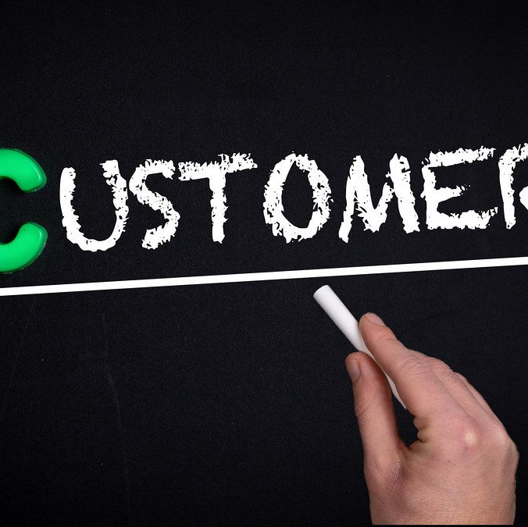

Who are they?
Inventory Management
Sales Optimization
Customer Experience
Operational Efficiency
Erste
Group

Slide 3
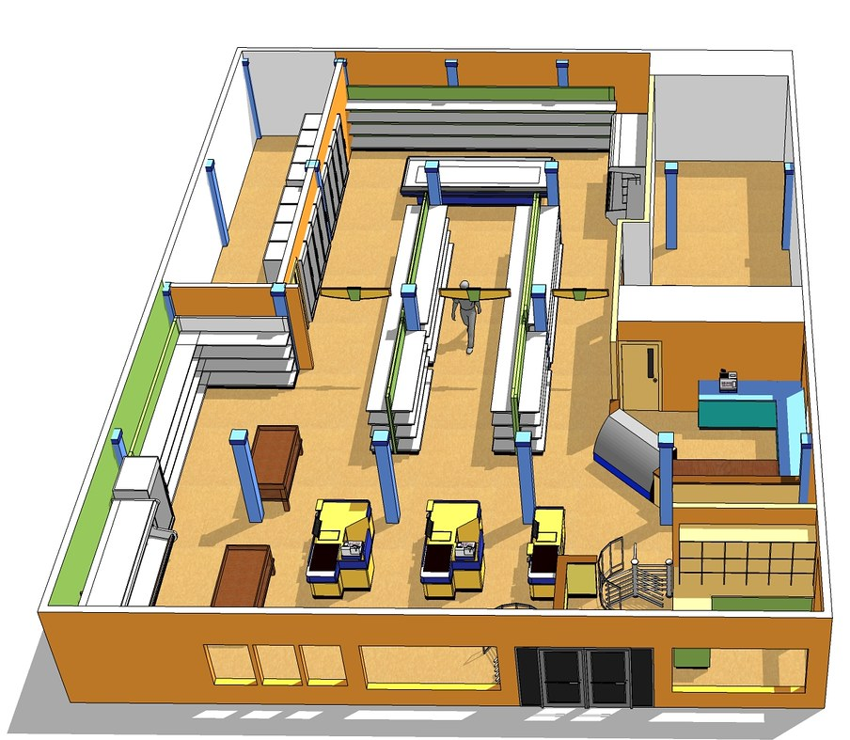
What do we solve?
Our system alleviates stores from the manual data analysis and provides pleasure by optimizing aisles, predicting sales and discovering popular pairs.
Erste
Group

Slide 4

What is the value?
Implementing our system eliminates the need for costly consultants. Our automated solution analyzes purchasing patterns, optimally places products to meet customer needs, and continuously provides targeted discounting strategies.
Erste
Group

Slide 5
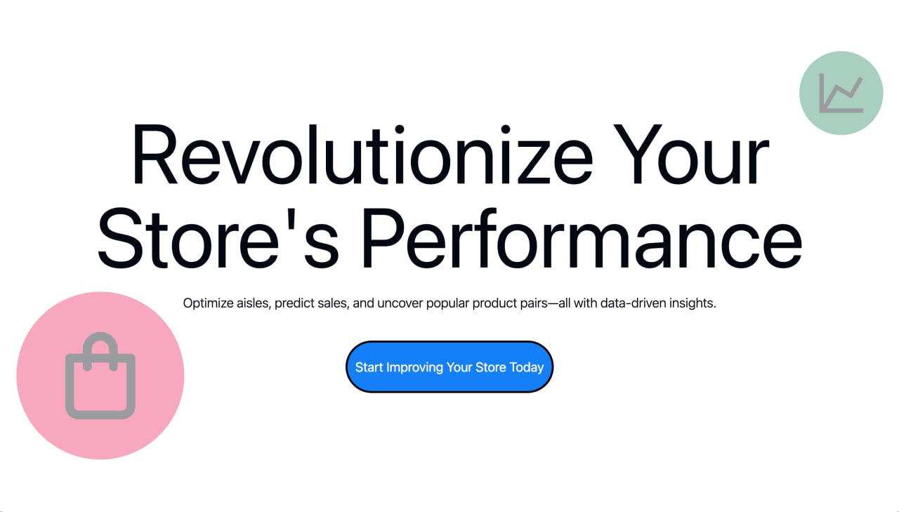
What is the technology?
We present our web application, where you can select your store and instantly view data in an intuitive format. Access Demand Forecast for future sales predictions, Product Pairs for discount strategies, and Arrangement System for effective behavioral merchandising.
Erste
Group

Slide 6
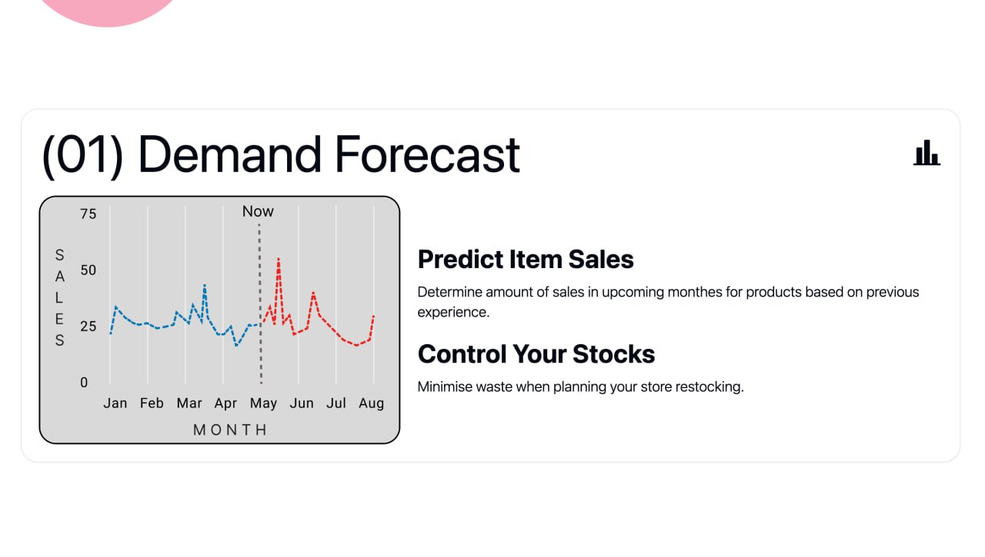
Access Demand Forecast
A feature that uses data-driven insights to predict future sales, helping store owners anticipate customer demand, optimize inventory levels, and reduce stockouts or overstock, ensuring that popular items are always available when needed.
Erste
Group

Slide 7
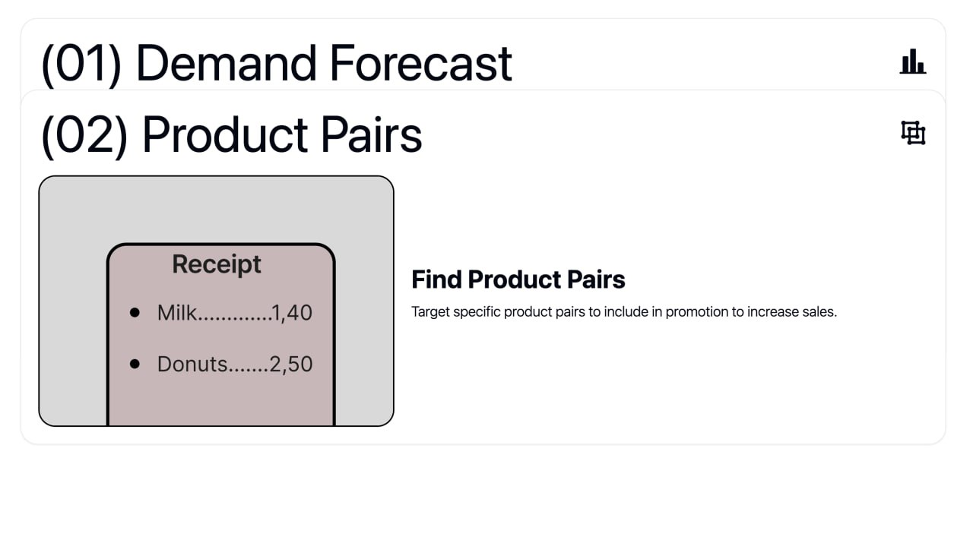
Product Pairs
A feature that identifies items frequently bought together, enabling store owners to create targeted discount bundles and promotions. This helps increase sales, improves customer satisfaction, and encourages higher basket values by offering relevant product combinations.
Erste
Group

Slide 8
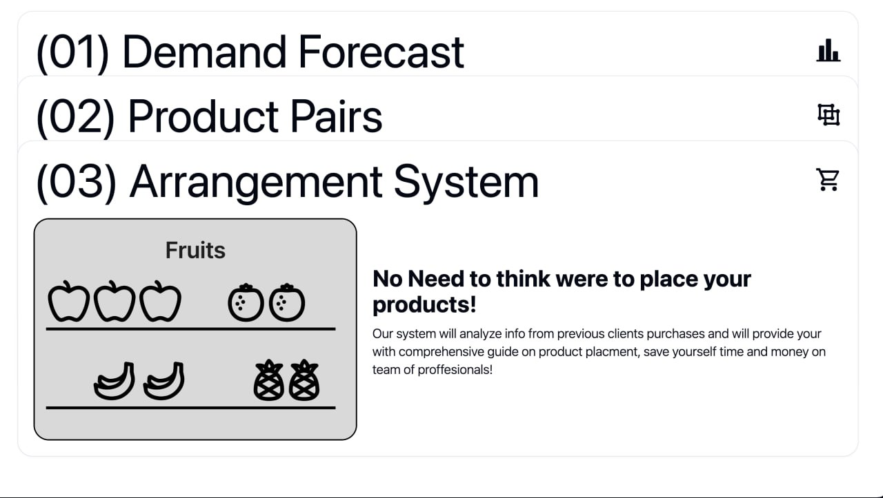
Arrangement System
We present our web application, where, with a single click, you can select your store and instantly view data in an intuitive format. Access Demand Forecast for future sales predictions, Product Pairs for discount strategies, and Arrangement System for effective behavioral merchandising.
Erste
Group

Slide 9

How to Go-To-Market?
Our go-to-market strategy focuses on advertising our product by showcasing successful implementations in large companies, emphasizing the low cost of maintenance, and highlighting its simple, intuitive navigation.
Erste
Group

Slide 10

Why our model?
Our model is affordable, easy to navigate, and highly effective. It provides essential features to help your store create an optimal user experience while delivering financial benefits for your company.
Erste
Group

Slide 11
Our team
In our project, tasks were allocated among team members as follows: Andrii Kostiushko is responsible for data analysis and presentation, Maksym Bobukh handles design and front-end development, and Maksym Liutyi oversees data analysis and back-end development.
Erste
Group

Slide 12

Forecast of our model
Titans of sales like Walmart and Amazon have already demonstrated the value of these strategies, showing measurable positive outcomes for their businesses. With proper implementation, we’re confident our model can deliver similar success for your business, optimizing inventory, predicting demand, and enhancing customer engagement.
Erste
Group

Slide 13
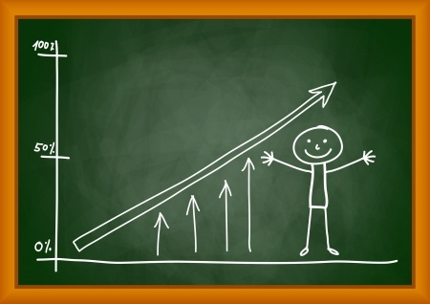
Current state
Our model is currently in the prototype stage, primarily due to limited data and development time. With additional data and further refinement, our model’s accuracy will improve, making it adaptable and optimized for stores of any type.
Erste
Group

Slide 14
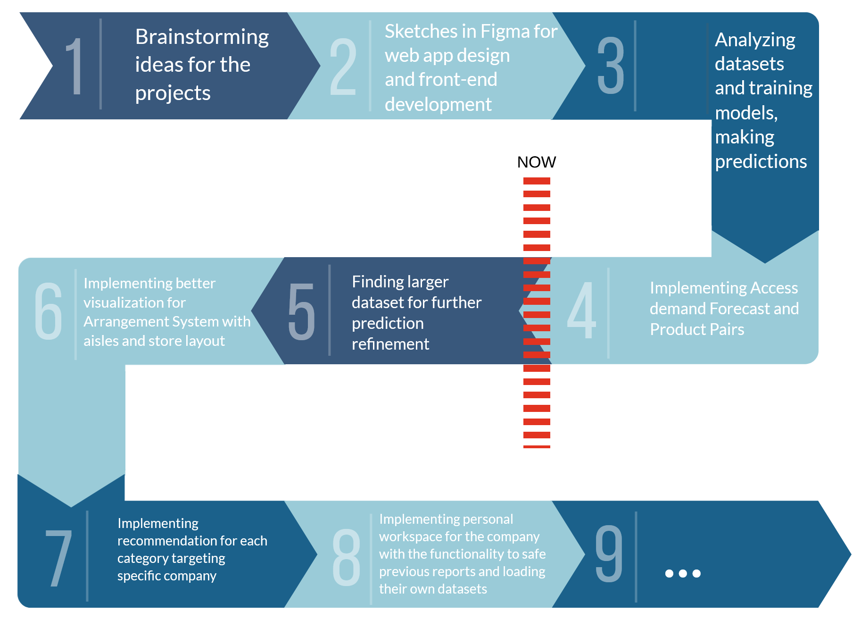
Roadmap
Erste
Group

