Slide 1
ADVISOR MEETING · STATUS + DECISIONS
Numeric ASNets
What the experiments now say —
and what still has to close
Nine domains · 10-seed mainstream replication · policy, MCTS, training and search-correctness extensions
3
6
65
5.93 TiB
stable domains
imperfect domains
jobs running
requested live RAM
Roee Hersco · 30 August 2026
Notes:
[Sources]
C:\Users\roeeh\Desktop\School\Meitar\Thesis\Code\numeric-asnets\.codex-worktrees\mcts-safe-context\experiment_tracking\advisor_audit_20260830\cluster_workload.csv
C:\Users\roeeh\Desktop\School\Meitar\Thesis\Code\numeric-asnets\.codex-worktrees\mcts-safe-context\experiment_tracking\experiments.csv
[/Sources]

Slide 2
EXECUTIVE SUMMARY
The thesis story in five sentences
1
Stage-2 training is not uniformly beneficial
Counters can improve strongly; Block Grouping and FO Counters often regress.
2
MCTS helps selectively
Strong Stage-1 gains in Drone/VH-on and FO Counters; not a universal policy upgrade.
3
Efficiency is now an explicit result
PW Kmin=3 keeps most coverage while sharply reducing long-tail runtime.
4
Search correctness matters
SAFE-1 fixes 2/4 failures; action-history aliasing is common enough to warrant SAFE-CONTEXT.
5
The domain split changed
MPrime is not stably solved: three stable domains, six imperfect domains.
NUMERIC ASNETS · ADVISOR STATUS · 30 AUG 2026
02
Notes:
[Sources]
C:\Users\roeeh\Desktop\School\Meitar\Thesis\Code\numeric-asnets\.codex-worktrees\mcts-safe-context\experiment_tracking\advisor_audit_20260830\advisor_meeting_brief.md
[/Sources]

Slide 3
RESEARCH MAP
Four RQs, three evidence layers
RQ
Question
Registered estimand
State
RQ1
Does continued MCTS-guided training improve policy?
VH-off S2 policy − S1 policy
Complete
RQ2
Does inference-time MCTS improve policy?
VH-off S2 MCTS − same policy
Primary incomplete
RQ3
Does the value head improve refinement?
(on S2−S1) − (off S2−S1)
Complete
RQ4
Does the value head improve inference-time MCTS?
VH-on S2 MCTS − same policy
Primary incomplete
PRIMARY
Stage-2 comparisons answer the registered thesis questions.
SECONDARY
Stage-1 policy→MCTS is already complete and informative, but not a substitute for RQ2/RQ4.
NUMERIC ASNETS · ADVISOR STATUS · 30 AUG 2026
03
Notes:
[Sources]
C:\Users\roeeh\Desktop\School\Meitar\Thesis\Code\numeric-asnets\.codex-worktrees\mcts-safe-context\thesis\draft\research_questions.md
[/Sources]

Slide 4
TWO MAINSTREAM ROUTES
Checkpoint choice is itself an experimental factor
MAIN-VAL · COMPLETE
MAIN-TERM · COMPLETE
Validation-led
Terminal-led
S1 validation-selected checkpoint
S1 final checkpoint
→ Stage-2 training
→ Stage-2 training
→ S2 validation-selected checkpoint
→ S2 validation-selected checkpoint
Ten matched seeds × five domains × two VH modes
Terminal sensitivity, not strict paper replication
Policy endpoints: complete
Strict stopping fidelity: STOP-ORIG held
Interpretation rule: checkpoint selection can change results dramatically; never merge these routes into one aggregate.
NUMERIC ASNETS · ADVISOR STATUS · 30 AUG 2026
04
Notes:
[Sources]
C:\Users\roeeh\Desktop\School\Meitar\Thesis\Code\numeric-asnets\.codex-worktrees\mcts-safe-context\experiment_tracking\experiments.csv
[/Sources]

Slide 5
DOMAIN FRAMING
The domain landscape is now 3 stable + 6 imperfect
STABLE / PRESERVATION
IMPERFECT / IMPROVEMENT
Delivery · S1 selected 19.8 / 19.2
Block Grouping
Drone
TPP · S1 selected 20.0 / 20.0
FO Counters
Rover
Zenotravel · S1 selected 20.0 / 20.0
Counters
MPrime · corrected selected 15.0 / 14.6
Why MPrime moved
The corrected validation set removes epoch-1 bias, yet validation/test rank agreement remains weak and selected test coverage is far below the historic 19/20 claim.
NUMERIC ASNETS · ADVISOR STATUS · 30 AUG 2026
05
Notes:
[Sources]
C:\Users\roeeh\Desktop\School\Meitar\Thesis\Code\numeric-asnets\.codex-worktrees\mcts-safe-context\experiment_tracking\advisor_audit_20260830\advisor_meeting_brief.md
[/Sources]

Slide 6
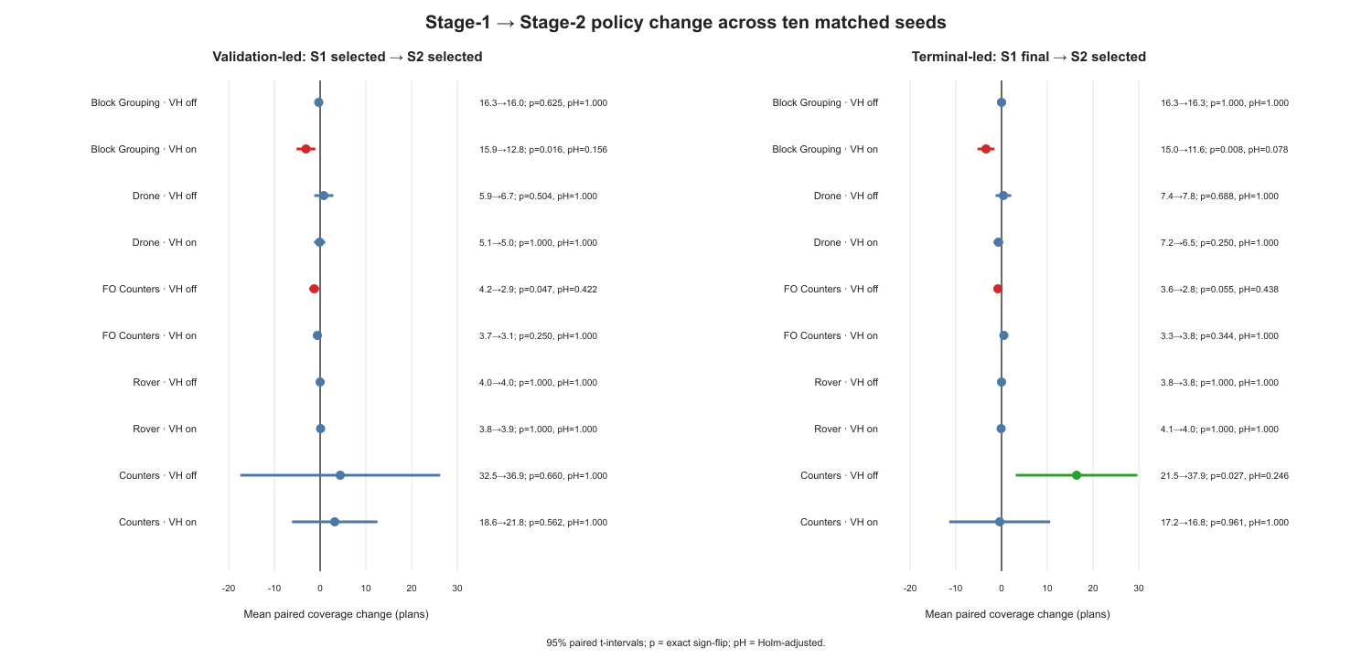
MAINSTREAM POLICY
RQ1: Stage-2 policy gains are domain-dependent
No domain survives Holm correction
RQ1 uses VH-off and corrects across five domains within the RQ.
Signals worth discussing
Counters terminal-led: +16.4, raw p=.027
FO Counters: consistent negative point estimates
Drone: small positive, high uncertainty
NUMERIC ASNETS · ADVISOR STATUS · 30 AUG 2026
06
Notes:
[Sources]
C:\Users\roeeh\Desktop\School\Meitar\Thesis\Code\numeric-asnets\.codex-worktrees\mcts-safe-context\experiment_tracking\advisor_audit_20260830\rq_results.csv
[/Sources]

Slide 7
VALUE HEAD
RQ3: value-head effect is a difference-in-differences
Domain
MAIN-VAL: on-change minus off-change
MAIN-TERM: on-change minus off-change
Block Grouping
−2.8 [−4.61, −.99] · pH=.088
−3.4 [−5.13, −1.67] · pH=.0195
Drone
−.9 [−2.88, 1.08]
−1.1 [−3.57, 1.37]
FO Counters
+.7 [−.26, 1.66]
+1.3 [.08, 2.52] · pH=.188
Rover
+.1 [−.31, .51]
−.1 [−.51, .31]
Counters
−1.2 [−25.87, 23.47]
−16.8 [−29.64, −3.96] · pH=.078
Only terminal-led Block Grouping is significant after Holm: the value head worsens refinement relative to VH-off.
NUMERIC ASNETS · ADVISOR STATUS · 30 AUG 2026
07
Notes:
[Sources]
C:\Users\roeeh\Desktop\School\Meitar\Thesis\Code\numeric-asnets\.codex-worktrees\mcts-safe-context\experiment_tracking\advisor_audit_20260830\rq_results.csv
[/Sources]

Slide 8
SECONDARY RQ2/RQ4
Stage-1 MCTS: strong gains, but only in selected cells
VH-off
BG
-0.9
Holm-significant
Drone
+1.0
VH-off: FO Counters +3.6
VH-on: Drone +5.3; FO +2.0
FO
+3.6
Rover
+1.0
Counters
-10.6
VH-on
Important caveat
BG
+0.3
These are validation-selected Stage-1 checkpoints. The registered primary RQ2/RQ4 estimand is Stage-2 policy versus Stage-2 MCTS.
Drone
+5.3
FO
+2.0
Rover
+0.6
Counters
-1.9
NUMERIC ASNETS · ADVISOR STATUS · 30 AUG 2026
08
Notes:
[Sources]
C:\Users\roeeh\Desktop\School\Meitar\Thesis\Code\numeric-asnets\.codex-worktrees\mcts-safe-context\experiment_tracking\advisor_audit_20260830\rq_results.csv
[/Sources]

Slide 9
STAGE-2 MCTS
Primary RQ2/RQ4 evidence is the biggest open mainstream gap
20/20
4/20
16
Drone Stage-2 policy endpoints available
matching MCTS endpoints already recovered
gap jobs submitted and memory-pending
What closes this hole
Finish the 16 submitted Drone selected-checkpoint MCTS jobs
Then release domain-matched Stage-2 MCTS by information value and resource risk
Keep Stage-2-final MCTS excluded unless the protocol changes
Until this closes, Stage-1 MCTS is secondary evidence—not the final RQ2/RQ4 answer.
NUMERIC ASNETS · ADVISOR STATUS · 30 AUG 2026
09
Notes:
[Sources]
C:\Users\roeeh\Desktop\School\Meitar\Thesis\Code\numeric-asnets\.codex-worktrees\mcts-safe-context\experiment_tracking\main_val_stage2_drone_mcts_gap.csv
[/Sources]

Slide 10
DELIVERY · TPP · ZENOTRAVEL
Stable-domain preservation is live, not yet a finished claim
Domain
Confirmation state
Stage 1
Stage 2
Estimate
Zenotravel
Complete
S1 selected 20.0/off, 20.0/on
S2 selected 20.0/off, 19.9/on
No material loss
Delivery
13/16 held-out terminal; 3 live
S1 selected 19.8/off, 19.2/on
Stage-2 endpoints accumulating
~5–6 h for live training
TPP
13/16 held-out terminal; 3 live
S1 selected 20.0 / 20.0
Stage-2 endpoints accumulating
~7.5 h, 23 h, ≤32 h
Required reporting discipline
The winning coefficient uses two tuning seeds per VH. Present those separately from the eight held-out confirmation seeds; all ten are not equally held out.
NUMERIC ASNETS · ADVISOR STATUS · 30 AUG 2026
10
Notes:
[Sources]
C:\Users\roeeh\Desktop\School\Meitar\Thesis\Code\numeric-asnets\.codex-worktrees\mcts-safe-context\experiment_tracking\four_domain_preservation
[/Sources]

Slide 11
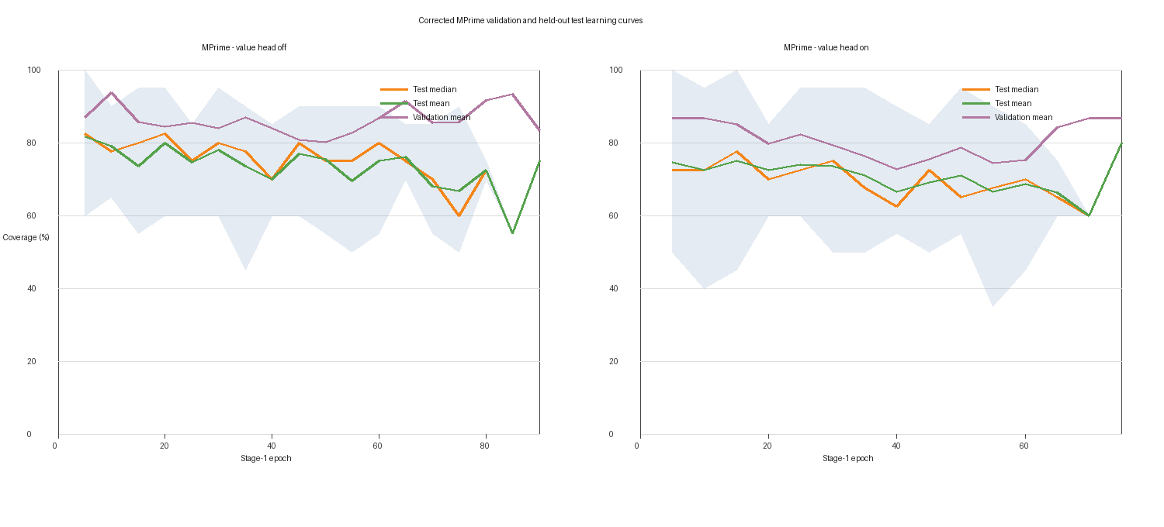
VALIDATION REDESIGN
MPrime correction worked—but ranking remains weak
15.0 / 14.6
selected test mean · off / on
13.5 / 13.2
final test mean · off / on
Checkpoint-ranking signal
Pooled Spearman ≈ .25
Selected regret to retrospective best: 3.1/off, 2.5/on
Conclusion: MPrime joins the six imperfect domains; anchor tuning is live.
NUMERIC ASNETS · ADVISOR STATUS · 30 AUG 2026
11
Notes:
[Sources]
C:\Users\roeeh\Desktop\School\Meitar\Thesis\Code\numeric-asnets\.codex-worktrees\mcts-safe-context\experiment_tracking\mprime_validation_ipc_scale_v1\corrected_learning_curves.png
[/Sources]

Slide 12
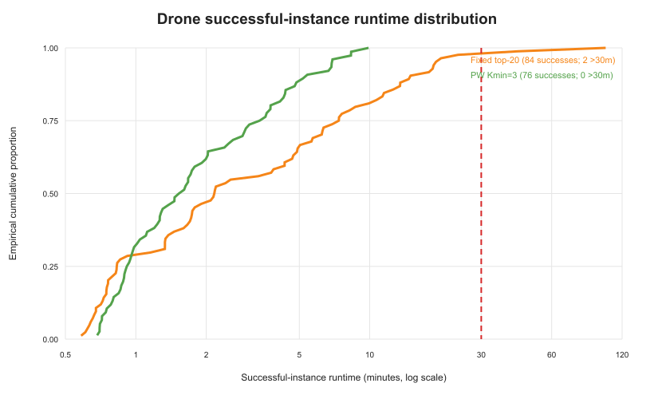
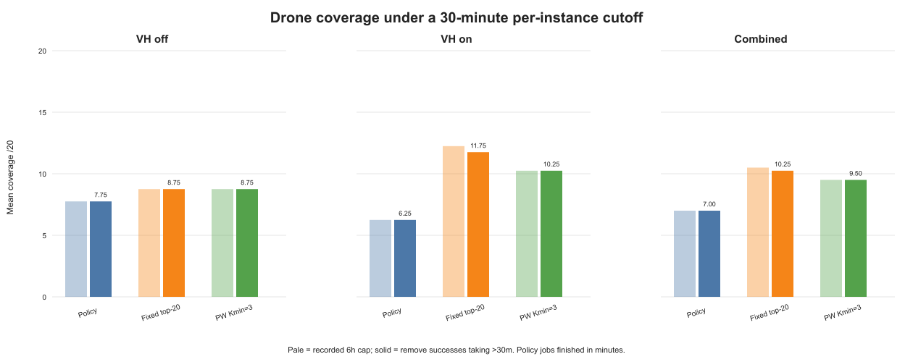
SEARCH EFFICIENCY
Progressive widening exposes an efficiency–coverage frontier
COVERAGE
Policy 7.0 · fixed 10.5 · PW Kmin=3 9.5
TAIL
p90: 893 s → 318 s · max: 6,127 s → 594 s
NUMERIC ASNETS · ADVISOR STATUS · 30 AUG 2026
12
Notes:
[Sources]
C:\Users\roeeh\Desktop\School\Meitar\Thesis\Code\numeric-asnets\.codex-worktrees\mcts-safe-context\experiment_tracking\advisor_figures\pw_kmin3_30min_coverage.png
[/Sources]

Slide 13
PW LIVE EXTENSION
Cross-domain PW is a screen, not yet confirmation
Domain
State
Current evidence
Estimate
Block Grouping
4 running
11–13/20 classified; all successes so far
Likely 1–4 h
Counters Stage 1
4 running
12–21 successes; 21–26 classified
Hours to a day
Counters Stage 2
3 running + 1 pending
18–52 lower-bound successes
Hours to a day
FO Counters / Rover
0 running / 8 pending
Awaiting memory
No honest start estimate
Decision rule
Use two seeds to screen. Expand only a promising domain/arm to five matched seeds; do not turn every arm into a large grid.
NUMERIC ASNETS · ADVISOR STATUS · 30 AUG 2026
13
Notes:
[Sources]
C:\Users\roeeh\Desktop\School\Meitar\Thesis\Code\numeric-asnets\.codex-worktrees\mcts-safe-context\experiment_tracking\mcts_progressive_widening_cross_domain
[/Sources]

Slide 14
SEARCH CORRECTNESS
SAFE-1 fixes choices; SAFE-CONTEXT fixes identity
SAFE-1 · COMPLETE
SAFE-CONTEXT · LIVE
2 / 4
47.1%
5.44×
physical revisits had a different action-history context
maximum diagnostic node multiplier
known terminal-choice failures repaired
Hard-mask known non-goal terminal children
Independent node/prior/value/visit cache per context digest
Restore safe duplicates before unsafe actions
Physical-state cycle detection retained
Two failures still wandered into failure
Full 20-job Drone match must report coverage + RSS + nodes
NUMERIC ASNETS · ADVISOR STATUS · 30 AUG 2026
14
Notes:
[Sources]
C:\Users\roeeh\Desktop\School\Meitar\Thesis\Code\numeric-asnets\.codex-worktrees\mcts-safe-context\experiment_tracking\mcts_safe_context\README.md
[/Sources]

Slide 15
FINITE-HORIZON SEARCH
Binding horizon is nearly a non-effect in Drone
8 pairs
7 ties
+1
1 cutoff
aware/unaware terminal
exact coverage equality
one aware improvement
mechanism actually triggered
Two aware arms remain live
16–17/20 instances classified; expected within roughly 6–8 hours.
If cutoffs remain rare
Move the efficacy test to cutoff-rich Counters instances with a preregistered action limit. Do not interpret run-to-run coverage variation as a horizon effect when the cutoff never fires.
NUMERIC ASNETS · ADVISOR STATUS · 30 AUG 2026
15
Notes:
[Sources]
C:\Users\roeeh\Desktop\School\Meitar\Thesis\Code\numeric-asnets\.codex-worktrees\mcts-safe-context\experiment_tracking\mcts_horizon_binding\results.csv
[/Sources]

Slide 16
NARROW SEARCH
Counters shows why width and failure mode must be explicit
Cell
Policy
Normal 20/70
Narrow 5/20
Interpretation
Stage 1 · VH-off
32.5
21.9
≥25.7
7 partial lower-bound rows
Stage 1 · VH-on
18.6
16.7
≥22.5
6 partial lower-bound rows
Stage 2 · VH-off
44.83
not declared
43.67 · n=6
11/12 misses diverged to 10k
Stage 2 · VH-on
29.4
not declared
33.8 · n=5
remaining jobs live
Interrupted jobs are conservative fixed-budget lower bounds—not invalid plans. Every printed plan in the audited partial logs was VAL-valid.
NUMERIC ASNETS · ADVISOR STATUS · 30 AUG 2026
16
Notes:
[Sources]
C:\Users\roeeh\Desktop\School\Meitar\Thesis\Code\numeric-asnets\.codex-worktrees\mcts-safe-context\experiment_tracking\mcts_counters_width_sensitivity
[/Sources]

Slide 17
CLUSTER WORKLOAD
The queue is full on memory, not on job count
65
390
5.93 TiB
43 + 20
running jobs
requested CPUs
running RAM request
ordinary + held pending
Experiment
Jobs
CPU
Requested RAM
SAFE-CONTEXT
19
114
2,280 GiB
PW cross-domain
11 + 9 pending
66 + 54
1,320 + 1,080 GiB
MPrime anchor
18
108
864 GiB
Counters S2 narrow
6
36
720 GiB
Delivery + TPP
6
36
288 GiB
Horizon + Rover
5 + 18 pending
30 + 108
600 + 2,160 GiB
NUMERIC ASNETS · ADVISOR STATUS · 30 AUG 2026
17
Notes:
[Sources]
C:\Users\roeeh\Desktop\School\Meitar\Thesis\Code\numeric-asnets\.codex-worktrees\mcts-safe-context\experiment_tracking\advisor_audit_20260830\cluster_workload.csv
[/Sources]

Slide 18
LIVE ETA BOARD
What should finish next
Experiment
Queue
Estimate
Next evidence
MPrime anchor
18 live
≈0.3–9 h
Freeze coefficient; refresh policy curves
Delivery Stage 2
3 live
≈5–6 h
Evaluate every-five + selected/final
Binding Horizon
2 live
≈6–8 h
Finalize matched aware/unaware
TPP Stage 2
3 live
≈7.5 h / 23 h / ≤32 h
One likely scheduler-limited
Counters S2 narrow
6 live
≤19.4 h hard bound
Conservative lower bounds if interrupted
SAFE-CONTEXT
19 live
many 2–12 h; heavy 12–30 h
Coverage/runtime/nodes/peak RSS
Rover MCTS
3 live + 18 pending
historically ~30 h; 72 h cap
High OOM risk
NUMERIC ASNETS · ADVISOR STATUS · 30 AUG 2026
18
Notes:
[Sources]
C:\Users\roeeh\Desktop\School\Meitar\Thesis\Code\numeric-asnets\.codex-worktrees\mcts-safe-context\experiment_tracking\live_jobs.csv
[/Sources]

Slide 19
THREATS TO INFERENCE
The biggest story holes are actionable
Hole
Defensible cover
Work
Priority
Primary RQ2/RQ4 incomplete
Finish selected-checkpoint Stage-2 MCTS
Compute
High
MAIN-TERM ≠ strict paper stopping
Pilot STOP-ORIG on 3 seeds
Training
High
OOM/time censoring
2 workers / 160 GiB lifecycle-safe resumption
Compute
High
MPrime weak ranking
Report regret; consider frozen larger validation
Analysis
High
PW cross-domain n=2
Expand only promising arms to n=5
Conditional
Medium
SAFE-CONTEXT memory risk
Make peak RSS and node multiplier co-primary
Instrumentation
High
Full 18-item register: story_holes.csv
NUMERIC ASNETS · ADVISOR STATUS · 30 AUG 2026
19
Notes:
[Sources]
C:\Users\roeeh\Desktop\School\Meitar\Thesis\Code\numeric-asnets\.codex-worktrees\mcts-safe-context\experiment_tracking\advisor_audit_20260830\story_holes.csv
[/Sources]

Slide 20
EXPERIMENT PORTFOLIO
Improvements are prioritized against overlap
Improvement
Priority / relevance
Predicted benefit
Overlap check
Finish Stage-2 MCTS gaps
5 / 5
High RQ closure
No duplicate
STOP-ORIG 3-seed pilot
5 / 5
High fidelity
Covers MAIN-TERM caveat
Lifecycle-safe resource resumption
5 / 5
High reliability
Covers Rover/FO legacy
SAFE-CONTEXT joint coverage/RSS analysis
5 / 5
High correctness
Extends SAFE-1
Automated anchor→policy→confirmation chain
5 / 4
High operational
Supports PRESERVE-4
PW screen→selective n=5 expansion
4 / 5
Medium-high
Avoids duplicate grid
SAFE-2 state×h profiling
2 / 4
Uncertain
Held; distinct from cutoff-only
Every registered experiment has a scored improvement in improvement_priorities.csv (22/22).
NUMERIC ASNETS · ADVISOR STATUS · 30 AUG 2026
20
Notes:
[Sources]
C:\Users\roeeh\Desktop\School\Meitar\Thesis\Code\numeric-asnets\.codex-worktrees\mcts-safe-context\experiment_tracking\advisor_audit_20260830\improvement_priorities.csv
[/Sources]

Slide 21
DECISIONS FOR THE NEXT MEETING
Recommended continuation order
NOW
Let running primary policy/training and the 16 Drone Stage-2 MCTS gaps finish.
FREEZE
Adopt the RQ-aligned statistics and three-stable/six-imperfect framing.
CONFIRM
Finish Delivery/TPP; separate tuning seeds from eight held-out seeds.
SELECT
Use PW cross-domain n=2 as a screen; expand only promising arms.
REPAIR
Deploy lifecycle-safe Rover/FO resource continuation before broad release.
REPLICATE
Pilot STOP-ORIG on three seeds before a full strict-paper campaign.
Defer SAFE-2, path-batched PW, PUCT/estimator sweeps and Stage-2-final MCTS until the primary RQs close.
NUMERIC ASNETS · ADVISOR STATUS · 30 AUG 2026
21
Notes:
[Sources]
C:\Users\roeeh\Desktop\School\Meitar\Thesis\Code\numeric-asnets\.codex-worktrees\mcts-safe-context\experiment_tracking\advisor_audit_20260830\advisor_meeting_brief.md
[/Sources]

Slide 22
APPENDIX
Experiment register — completed and live
ID
Status
Role
MAIN-VAL
Completed
Policy mainstream
MAIN-TERM
Completed
Terminal sensitivity
PRESERVE-4
Live
Stable-three confirmation
MPRIME-VAL
Completed / reclassified
Corrected validation
ANCHOR-4
Live
Coefficient tuning
MCTS-WIDTH
Live
Counters narrow
MCTS-PW
Completed
Efficiency trade-off
MCTS-PW-SAFE
Completed extension
Kmin=3
MCTS-SAFE
Completed diagnostic
2/4 repairs
MCTS-HORIZON
Live
Binding 750-action
MCTS-SAFE-CONTEXT
Live
Contextual nodes
NUMERIC ASNETS · ADVISOR STATUS · 30 AUG 2026
22
Notes:
[Sources]
C:\Users\roeeh\Desktop\School\Meitar\Thesis\Code\numeric-asnets\.codex-worktrees\mcts-safe-context\experiment_tracking\experiments.csv
[/Sources]

Slide 23
APPENDIX
Experiment register — held and secondary
ID
Status
Purpose
MAIN-VAL-S2-MCTS
Live/pending
Primary RQ2/RQ4 gap
MCTS-PW-CROSS-DOMAIN
Live
Two-seed screen
MCTS-RESOURCE
Held
Lifecycle/resource sensitivity
MCTS-LEGACY-ROVER
Resource-pending
Endpoint release
LONG-DRONE
Live/static follow-up
Training duration
STOP-ORIG
Held
Strict stopping fidelity
MCTS-SAFE2
Held design
State × horizon
MCTS-PW-PATHBATCH
Held design
Multi-node widening
PUCT-EST
Held
Search coefficients
ENHSP-LEAF
Completed exploratory
Leaf estimator
BG-HIST
Completed historical
Provenance only
NUMERIC ASNETS · ADVISOR STATUS · 30 AUG 2026
23
Notes:
[Sources]
C:\Users\roeeh\Desktop\School\Meitar\Thesis\Code\numeric-asnets\.codex-worktrees\mcts-safe-context\experiment_tracking\experiments.csv
[/Sources]

Slide 24
APPENDIX
Statistical interpretation
Independent unit: network seed, not individual planning instance.
Effect: paired per-seed coverage difference; RQ3 uses paired difference-in-differences.
95% confidence interval: t interval over ten seed-level effects.
p-value: exact sign-flip enumeration over all 2¹⁰ sign assignments.
Multiplicity: Holm correction over five domains within each RQ.
A non-significant result means insufficient evidence—not proof of no effect.
Paper baselines lack seed-level variance; compare descriptively, never with a fabricated p-value.
All corrected estimands and both raw/Holm p-values are in rq_results.csv.
NUMERIC ASNETS · ADVISOR STATUS · 30 AUG 2026
24
Notes:
[Sources]
C:\Users\roeeh\Desktop\School\Meitar\Thesis\Code\numeric-asnets\.codex-worktrees\mcts-safe-context\experiment_tracking\advisor_audit_20260830\rq_results.csv
[/Sources]

