Slide 1
Final Project Azure Batch
Martin Bertrand
Deep Azure
Dr. Zoran B. Djordjević

Slide 2
The problem…
You are receiving a steady flow of X12 EDI files that need to be transformed to XML format for further processing.
Once a week a client sends you a LARGE number of X12 files (40 000), which overwhelms your X12 to XML transformation infrastructure.
How would you solve such problem?

Slide 3
The traditional solution
Your infrastructure needs to be large enough to handle the highest workload possible.
Analysis and architecture;
Hardware purchase (RFP, PO, …);
Computer room infrastructure (floor space, power, UPS, …)
Network infrastructure;
Systems installation and configuration;
Software installation and configuration;
Support all this!

Slide 4

The traditional solution - 2
Most of the time, that infrastructure would sit there doing nothing, since the large bursts of files are infrequent.
This implies costs and waste of resources.

Slide 5
The Azure Batch solution
Azure Batch is a platform created to run parallel, high-performance computing.
It also offers auto-scaling of compute resources, to meet varying demands.
This reduces costs and resources waste.

Slide 6
Azure Batch examples
Batch processing
Invoices, billing
Inventory updates
Payroll
Financial reports
High-performance computing applications
Computational Fluid Dynamic (CFD)
Deep Learning
Molecular Dynamics
Video processing

Slide 7
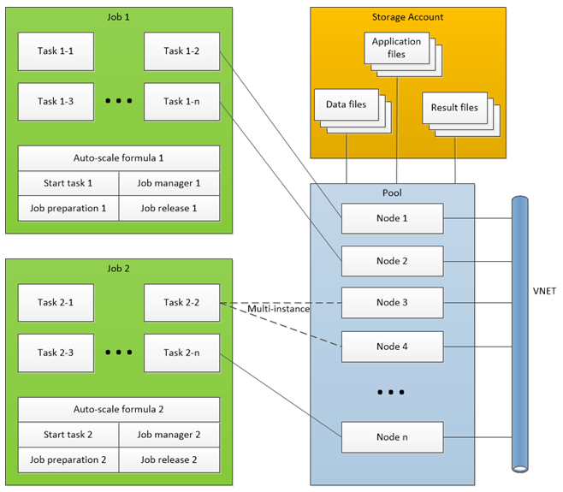
Azure Batch - Resources

Slide 8
Azure Batch - Jobs
Application are broken down in to jobs.
Jobs are collections of tasks and define on which compute node pool(s) they will run.
Jobs also define
Tasks priority and constraints.
The auto-scaling formula (based on the number of queue tasks, completion rate, time, resources, other metrics).

Slide 9
Azure Batch - Tasks
Tasks are units of computation.
Each task can be executed on one or more compute nodes.
They define:
What command to execute.
What files are required (application and data).
Environment variables.
Constraints.
Application packages or container images to use.
Tasks can have dependencies between one another.
The output of a task can be the input of another.

Slide 10
Azure Batch - Pool
A pool is a collection of identical compute nodes.
A pool defines:
How many nodes of what size will be created.
What scaling policy will be used.
A tasks scheduling policy.
Resources quotas.

Slide 11
Azure Batch – Compute nodes
Compute nodes are virtual machines (Windows or Linux) or cloud service VMs (Windows only).
Provide CPU, memory and disks resources.
Are all identical within a unique pool. Create other pools is different nodes are required.
Can be :
accessed like a regular VM (RDP or SSH).
based on standard or custom images.
dedicated (more expansive but never pre-empted) or low-priority (less expansive, uses surplus capacity).
added to the pool (scaling up), or removed from the pool (scaling down), depending on the auto-scaling formula, defined at the job level.
created for each job, and deleted as soon as it is complete, or be created ahead of time, thus reducing the start time, but increasing costs.

Slide 12
Azure Batch - Files
Types: application, data files (input) and result files (output).
They are stored in a storage account blob.
Application files are downloaded on compute nodes and executed.
Data files are downloaded and processed by the application.
Result files are uploaded back to the storage account.
Files associated to a compute node are lost when the node is destroyed.

Slide 13
Azure Batch - Applications
They can be managed via packages.
Can have many versions of an application used at the same time.
Can be defined at the job, or task level.
Job level: deployed to all nodes in the pool.
Task level: only on nodes that are defined to run that particular package.

Slide 14
Azure Batch - Network
All nodes must be in the same region, in the same batch account, under the same subscription.
Network Security Groups must allow communications between batch services and the nodes.

Slide 15
Azure Batch - API
Communicate with Azure Batch services.
Create and manage nodes.
Schedule jobs and tasks.
Can be used via CLI, REST, .NET, Python, Node.js or Java.

Slide 16
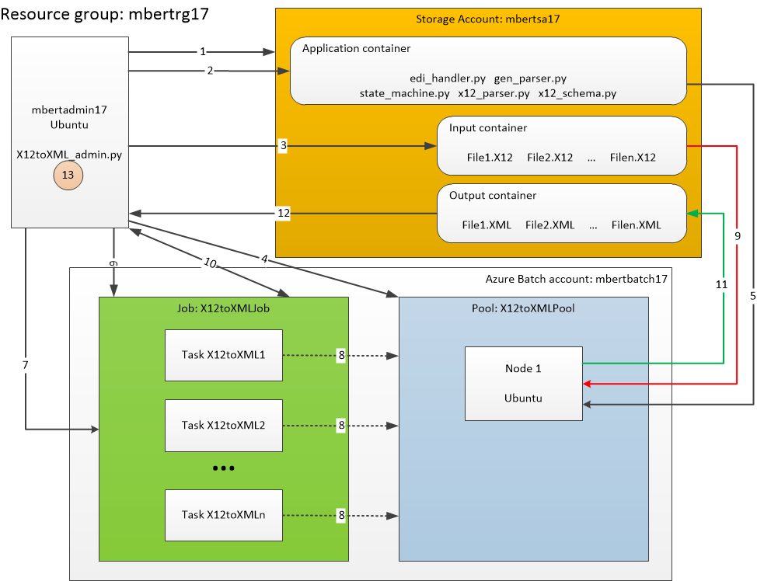
X12 to XML transformation - Infrastructure

Slide 17
X12 to XML transformation – Infrastructure - 2
An administration VM (Linux based) runs a Python script to administer Batch.
This Python script uses the Azure Batch API to communicate with Batch and the storage account.
The administration script creates required components and prepares files for processing using Batch.
It also cleans up when the processing is done, to keep costs to a minimum.

Slide 18
X12 to XML conversion - Executing
A Linux bash script creates the required components on Azure, using Azure CLI commands.
It creates:
The resource group.
A storage account.
A batch account.
The administration VM, with associated external IP and network components.
It configures the administration VM to run the transformation script.
It uploads the application and data files to the administration VM.

Slide 19
X12 to XML conversion – Executing - 2
The Python administration script performs:
Create 3 containers in the storage account:
“application”: contains all the scripts that will perform the transformation.
“input”: will contain all the X12 format data files.
“output”: will contain the XML transformed files.
Upload the application and input files in the appropriate containers.
Create a pool that will contain compute node(s).
Create a job which will contain the tasks.
Create tasks inside the job. One task is created per input file. Each task uploads the transformed file to the “output” storage container.
Waits for all tasks to complete.
Download the output files from the output container.
Delete the storage containers.
Delete the job.
Delete the pool.

Slide 20
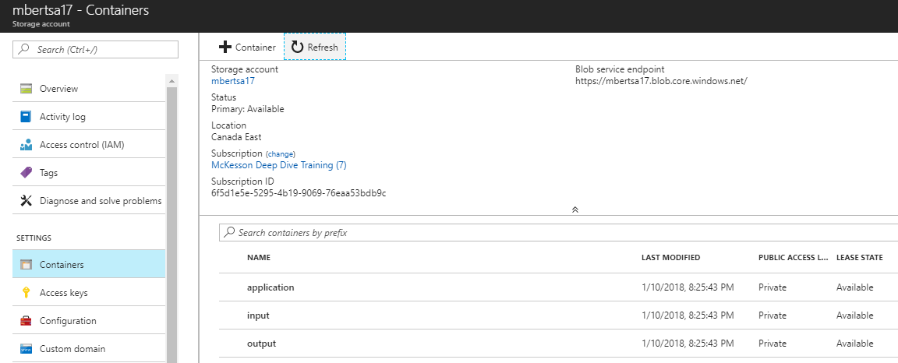
X12 to XML conversion – Portal
While files are transformed, it is possible to view the status of Batch resources via the Azure Portal. This view shows the Storage Account containers:

Slide 21
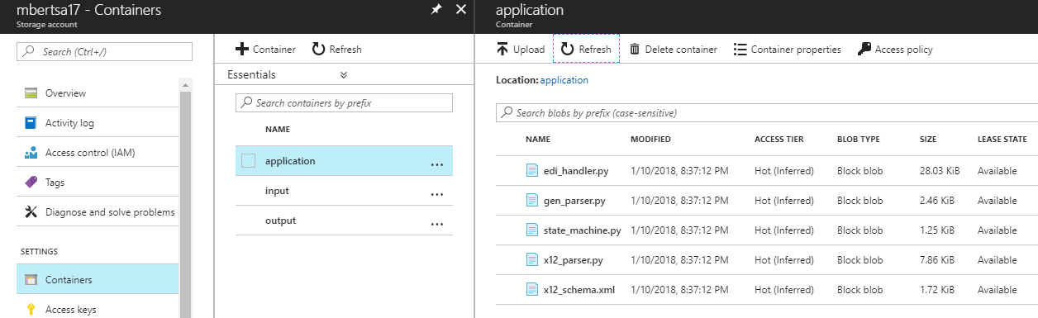
X12 to XML conversion – Portal - 2
The application container contains the scripts:

Slide 22
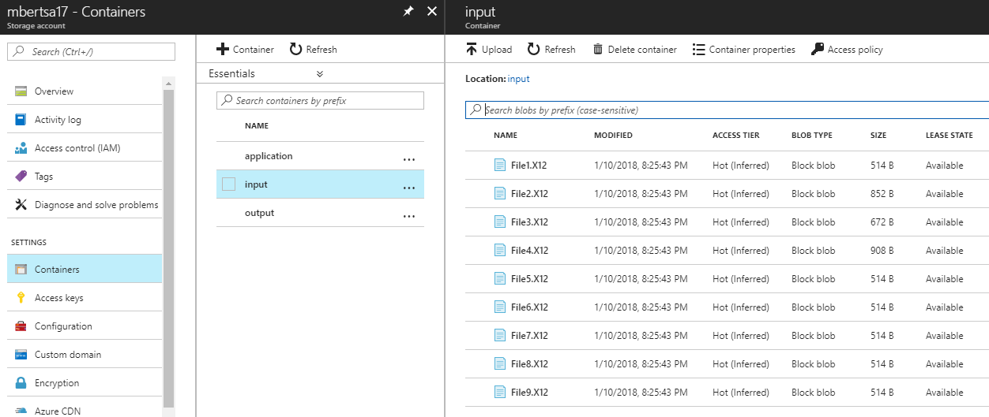
X12 to XML conversion – Portal - 3
The input container contains the X12 files:

Slide 23
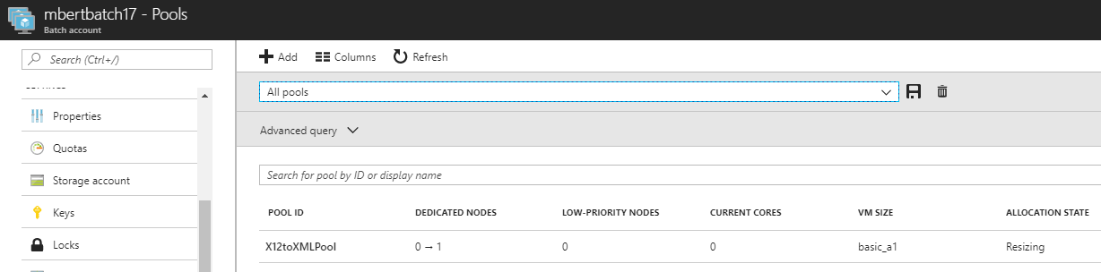
X12 to XML conversion – Portal - 4
A batch pool is created:

Slide 24
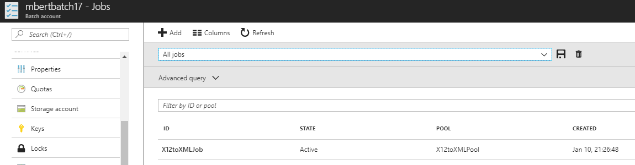
X12 to XML conversion – Portal - 5
A job is created:

Slide 25
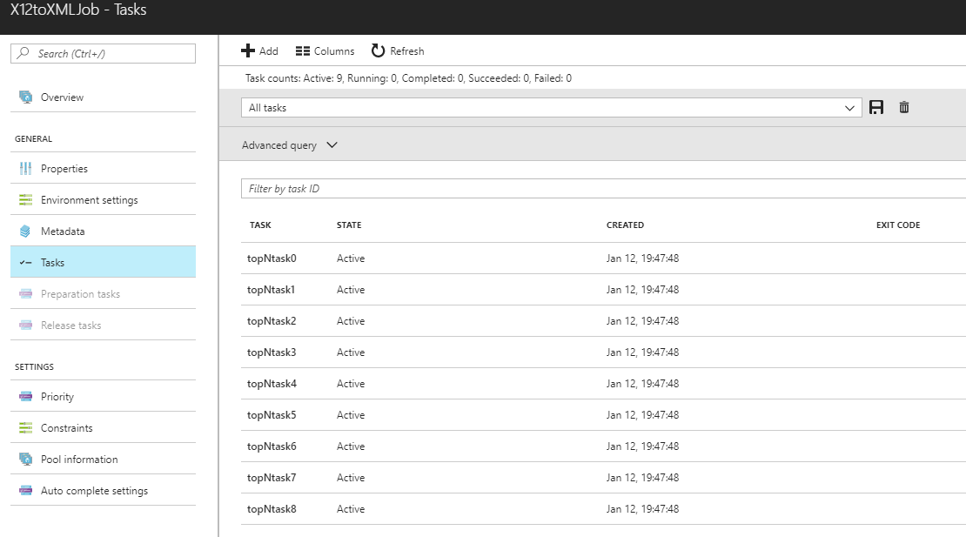
X12 to XML conversion – Portal - 6
Tasks are added to the job:

Slide 26
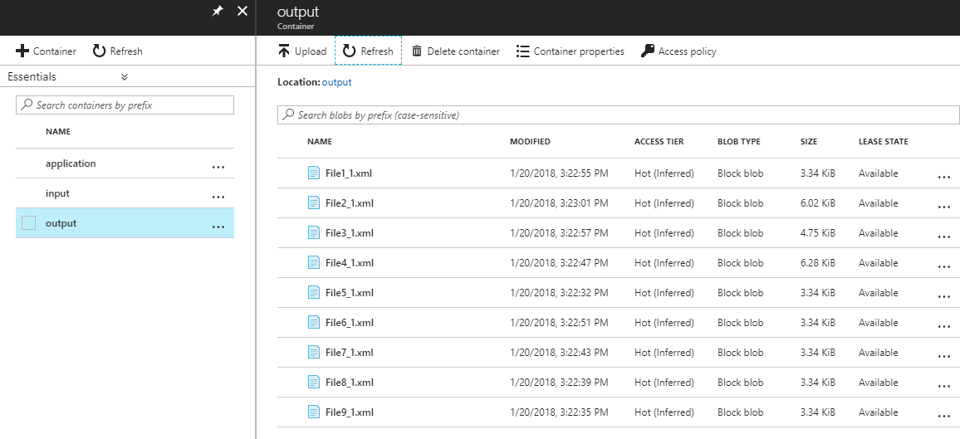
X12 to XML conversion – Portal - 7
As tasks complete the transformation , result files are uploaded to the Storage Account, in the “output” container:

Slide 27
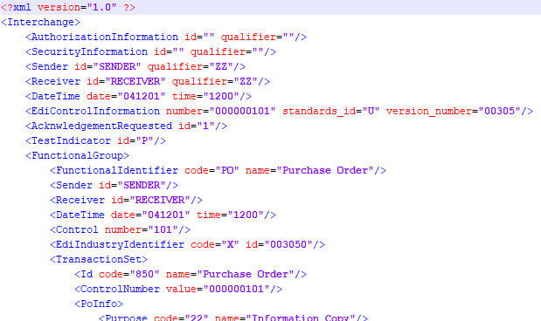
X12 to XML conversion – Results
Result files are downloaded from the “output” container of the Storage Account by the administration VM.
If all goes well, these will now be XML representations of X12 files.

Slide 28
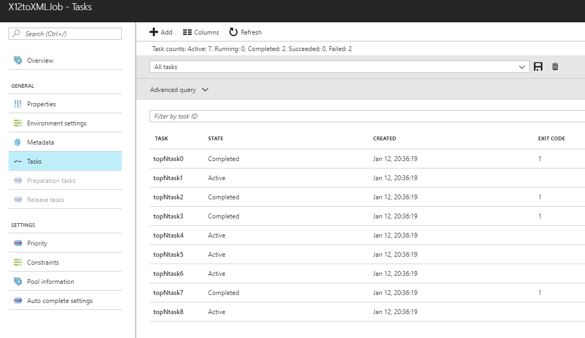
Troubleshooting Batch
The administration script only shows the tasks are completed, but does not show the exit code. While it is running, the status and exit codes can be seen in the console:

Slide 29
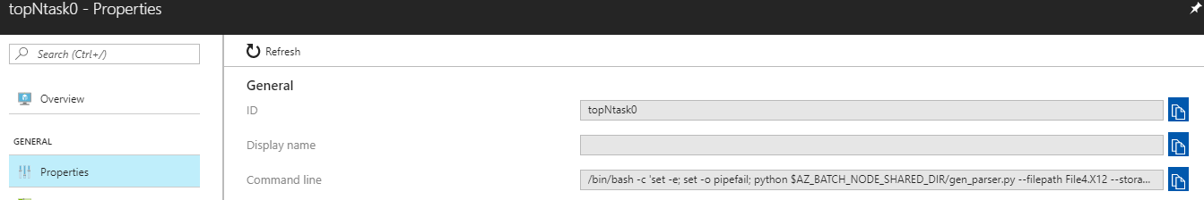
Troubleshooting Batch - 2
You can verify the properties of a task, even after it is completed.
The most crucial property is the command line.
Ensure the command line is correct and the number of arguments to the application is correct.

Slide 30
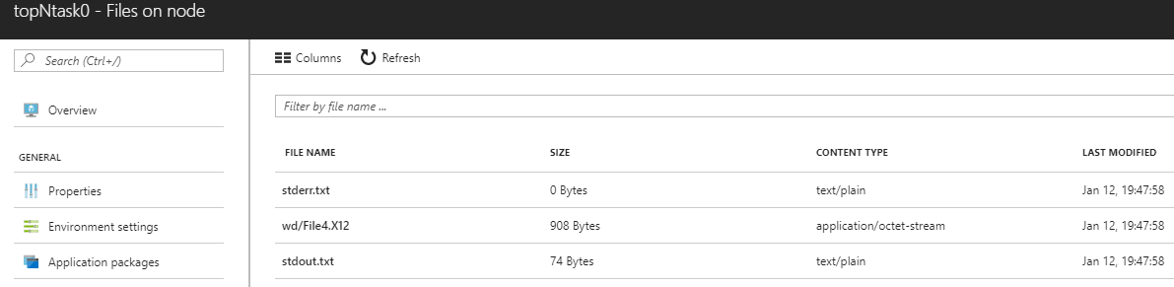
Troubleshooting Batch - 3
It is also possible to view certain files on the node that ran a task.
The most useful for debugging are “stderr.txt” and “stdout.txt”, which contain the output of the conversion script.

Slide 31
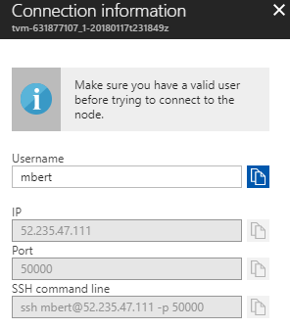
Troubleshooting Batch - 4
It is also possible to SSH connect directly to a node for further troubleshooting and tests.
Select “Connect” in the sub-menu displayed when clicking on the icon.
You will have the option of adding a user.
Azure will then display connect information.

Slide 32
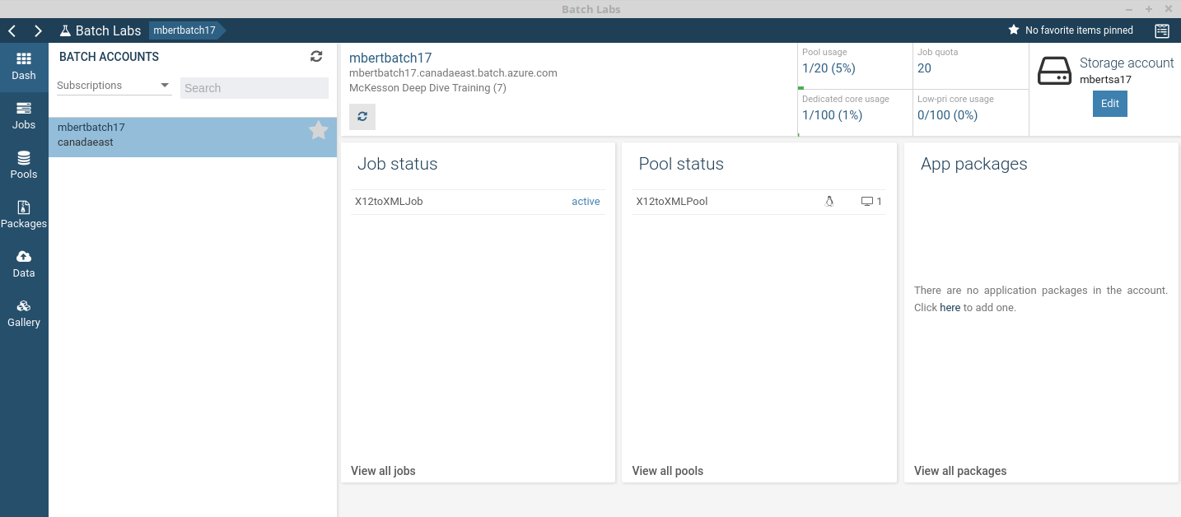
Batch Labs
Azure Portal is the primary tool for administering Azure Batch.
Microsoft also provides Batch Labs (https://azure.github.io/BatchLabs ).
It can be used to create, debug and monitor Batch applications.
Batch Labs dash view while running the demo application:

Slide 33
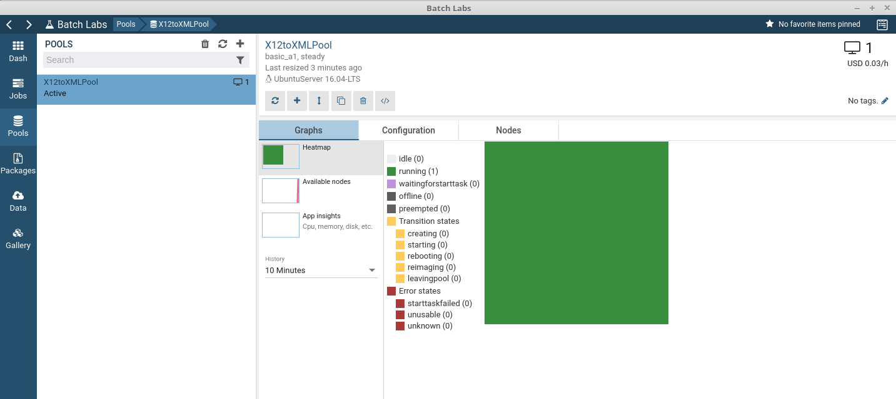
Batch Labs - 2
Batch Labs Pools view while running the demo application:

Slide 34
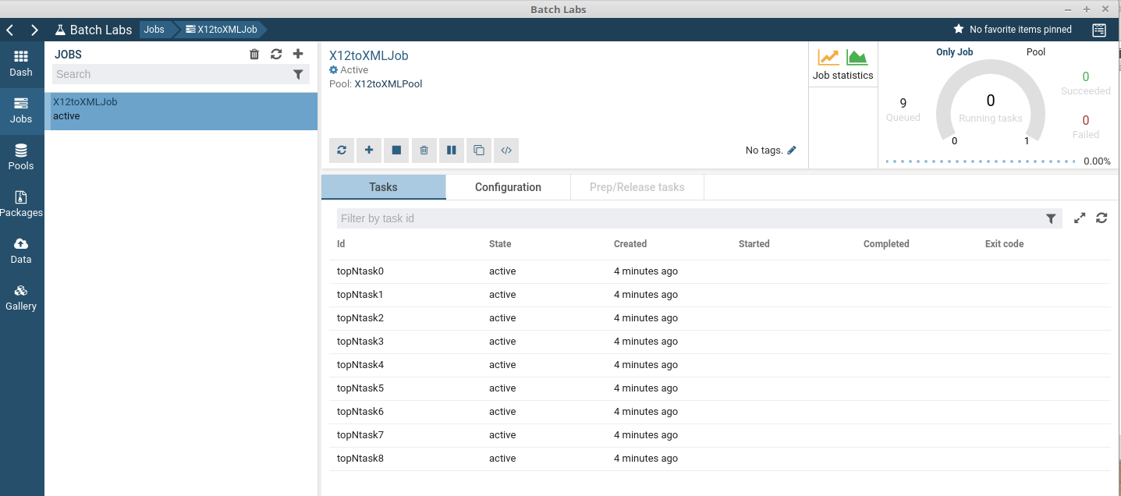
Batch Labs - 3
Batch Labs Jobs view while running the demo application:

Slide 35
YouTube URLs, GitHub URL
Two minute (short): https://youtu.be/M8QKy-FlpKM
15 minutes (long): https://youtu.be/aznI3NiFVL0
GitHub Repository with all artifacts: https://github.com/BertBertrand/Week17-Final

