Slide 1
THE PRICE OF
HAPPINESS
A country-level analysis of life evaluation,
explanatory components and regional differences
FINAL DATA ANALYTICS PROJECT | 2011–2025
Presentation length: approximately 8–10 minutes

Slide 2
01 | RESEARCH FOCUS
What does happiness look like across countries?
MAIN QUESTION
How do country-level happiness scores vary over time, across regions, and in relation to the report’s explanatory components?
TIME
COUNTRIES & REGIONS
EXPLANATORY COMPONENTS
How did average and median life evaluation change from 2011 to 2025?
Which countries and geographical regions reported the highest and lowest scores?
Which components show the strongest statistical association with happiness?
Scope: country-level observations. The analysis describes patterns and associations; it does not test causality.
02

Slide 3
02 | DATASET
Data and preparation
2,116 ROWS
2011–2025
1,019 ROWS
147 COUNTRIES
Original happiness dataset
2013 is not present in the data
Factor analysis subset, 2019–2025
2025 happiness ranking
Preparation steps
• Removed 15 completely empty columns.
• Converted comma-decimal values and parsed numeric fields.
• Checked duplicates and missing values; explanatory components are unavailable for 2011–2018.
• Merged 2025 country records with geographical classifications: 146 matches; Kosovo had no match.
Important: factor-level analyses use available observations and do not treat early-year missing components as zero.
03

Slide 4
03 | METHOD AND TOOLS
End-to-end analytical workflow
01 COLLECT
02 CLEAN
03 STORE & QUERY
Happiness data
+ country reference
Pandas, missing values,
column selection
SQLite database
+ SQL queries
04 EXPLORE
05 TEST
06 COMMUNICATE
Trends, rankings,
regional comparisons
Pearson correlation
+ p-values + Bonferroni
Charts, findings,
limitations
Tools: Python • pandas • NumPy • Matplotlib • Seaborn • SciPy • SQLite • SQL • Jupyter Notebook
04

Slide 5
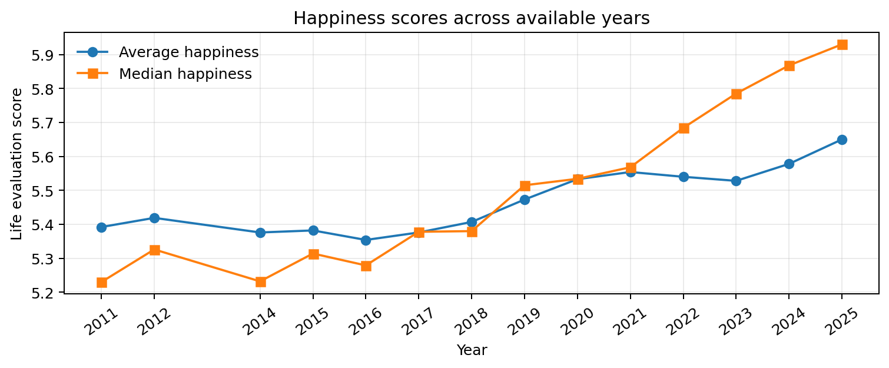
04 | TIME TRENDS
Happiness scores increased over the observed period
AVERAGE
5.392 in 2011
5.650 in 2025
MEDIAN
5.230 in 2011
5.930 in 2025
Interpretation: the observed averages rose, but country coverage varies by year (137–158). Changing coverage may contribute to the pattern.
05

Slide 6
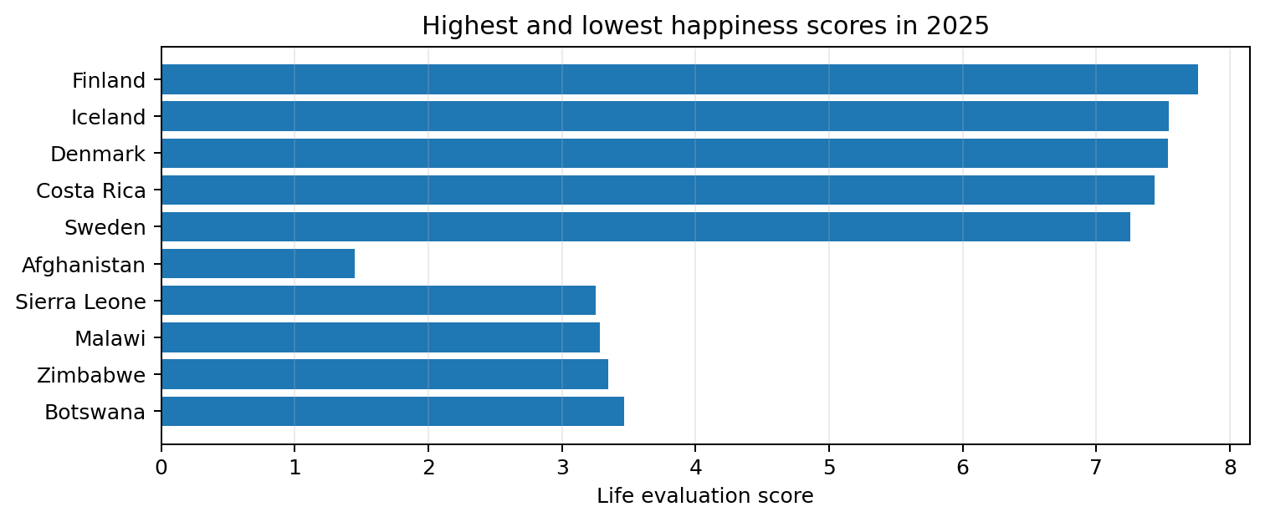
05 | COUNTRY COMPARISON
The 2025 country ranking shows a wide spread
HIGHEST
Finland • 7.764
LOWEST
Afghanistan • 1.446
GAP
6.318 points
The ranking describes reported life evaluations; it does not explain why countries differ.
06

Slide 7
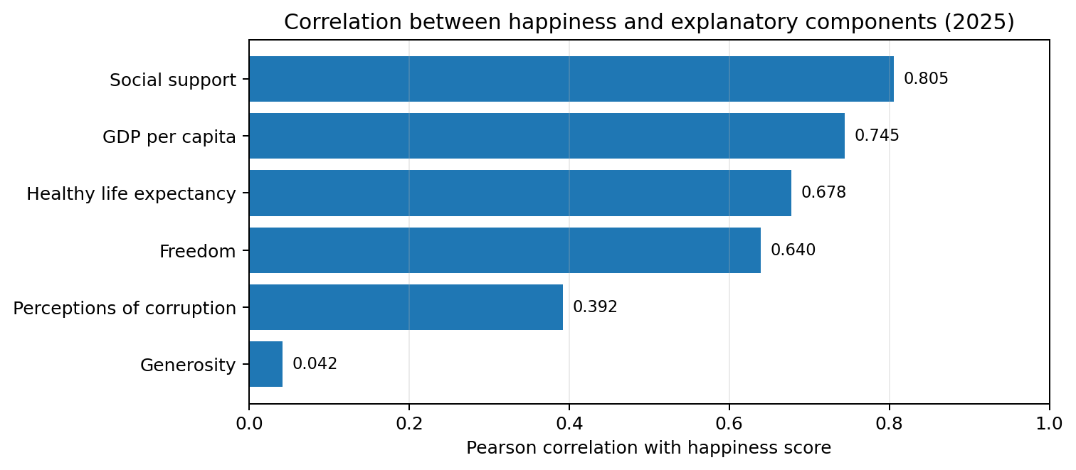
06 | STATISTICAL ANALYSIS
Social support has the strongest association
Pearson r | 2025
Social support
0.805
p < 0.001
GDP per capita
0.745
p < 0.001
Healthy life expectancy
0.678
p < 0.001
Freedom
0.640
p < 0.001
Perceptions of corruption
0.392
p < 0.001
Generosity
0.042
p = 0.615
Bonferroni correction across six tests: the first five associations remain significant; generosity does not.
07

Slide 8
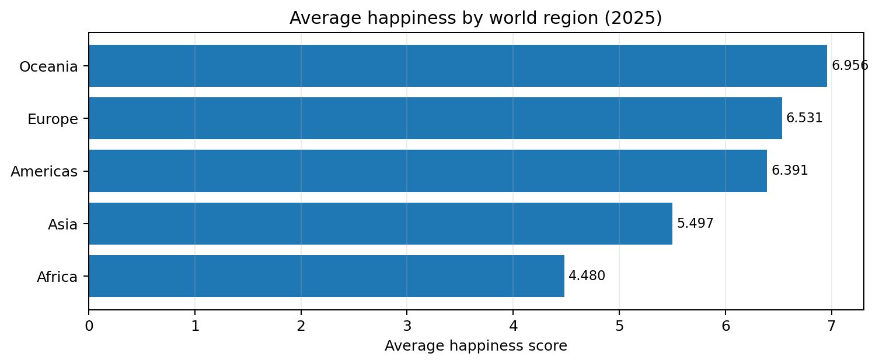
07 | GEOGRAPHICAL ANALYSIS
Regional differences are substantial
REGION
AVERAGE
COUNTRIES
Oceania
6.956
2
Europe
6.531
38
Americas
6.391
23
Asia
5.497
42
Africa
4.480
41
Sub-regional highlights: Northern Europe 7.044 (10 countries); Southern Asia 4.211 (7); Sub-Saharan Africa 4.414 (36).
Oceania's average is based on only two countries; interpret it cautiously.
08

Slide 9
08 | VALIDATION
SQL independently reproduced the regional results
PYTHON
SQLITE
VALIDATION
pandas groupby aggregation
Regional mean scores
SQL GROUP BY + AVG + COUNT
Same regional results
All five regional averages
matched to three decimals
What the evidence suggests
• Social support and GDP per capita show the strongest positive correlations with happiness.
• Generosity has a near-zero, non-significant correlation in the 2025 sample.
• Average happiness differs across regions and sub-regions.
• The 2011–2025 trend is upward in the available data, but country coverage changes.
These are country-level associations and descriptive comparisons—not causal effects.
09

Slide 10
09 | CONCLUSIONS AND LIMITATIONS
Conclusion: happiness is multidimensional
TAKEAWAY
Across countries in 2025, social support had the strongest association with reported life evaluation. Happiness scores also varied meaningfully across geographical regions.
LIMITATION 01
LIMITATION 02
LIMITATION 03
The explanatory variables are score-decomposition components, not raw measures of social conditions.
Country coverage changes over time; some regional averages rely on small samples.
Country-level correlations cannot establish causation or describe individual experiences.
Next steps: use a balanced country panel, investigate within-country change, and compare with independent raw indicators.
Thank you | Questions
10

