Slide 1
LOWER SIXTH ARTS
GEOGRAPHY
Lesson 1
The Soil
Notes:
Good morning, class, and welcome to our geography lesson. I am your geography teacher, Mr Kamdem. Today we are starting Lesson 1: The Soil.

Slide 2
CLASS INFO
Class, Chapter and Duration
Class | Lower Sixth Arts
Chapter | Module 3: Understanding and managing biogeographic zones across the world in general and Cameroon in particular
Duration | 2 periods (2 × 50 minutes)
Notes:
This lesson is for Lower Sixth Arts. It belongs to Module 3: Understanding and managing biogeographic zones across the world in general and Cameroon in particular. We shall need 2 periods to cover it.

Slide 3
IDENTIFICATION
Lesson Identification
Topic | Soil and its Properties
Sub-topic | The Soil System
Lesson | Lesson 1: The Soil
Notions / Concepts | Soil, pedology, mineral matter, organic matter, soil air, soil water, soil system.
Syllabus focus | Meaning of soil; components and their variation with depth; importance of soil; the soil system.
Competence | Learners are able to describe what soil is made of and explain why it is important to man and to living things.
Notes:
Our topic is Soil and its Properties, and the sub-topic is The Soil System. The key notions we shall use today are: soil, pedology, mineral matter, organic matter, soil air, soil water, soil system. At the end, you should be able to do this: learners are able to describe what soil is made of and explain why it is important to man and to living things.

Slide 4

HOMEWORK CORRECTION
Correction of the Homework
Question (Lesson 16: Coastal Processes and Features):
Name the four components of soil.
Notes:
Before we start the new lesson, let us correct the homework I gave you at the end of Lesson 16: Coastal Processes and Features. The question was: Name the four components of soil. Take out your exercise books.

Slide 5
HOMEWORK CORRECTION
Correction: Possible Answer
Mineral matter, organic matter (humus), water and air.
Notes:
Here is a good answer. Mineral matter, organic matter (humus), water and air. Compare it with your own answer and correct your work in red.

Slide 6
LESSON PLAN
Lesson Plan
Correction of the homework
Objectives and recall
Real-life situation and action to take
Learning activities
Board summary
Evaluation, remediation and homework
Notes:
Here is the plan of our lesson today. First, we shall correct the homework. Then we shall look at the objectives and recall what you already know. After that, we shall study a situation from real life and the action to take, and do the learning activities. Finally, we shall copy the board summary, do the evaluation and the remediation, and I will give you the homework.

Slide 7
OBJECTIVES
Objectives
By the end of this lesson, you should be able to:
Define soil and pedology.
Describe the four components of soil and how they change with depth.
Notes:
Take your time to copy this part; we will continue together.

Slide 8
OBJECTIVES
Objectives (continued)
Explain the importance of soil and the soil as a system.
Notes:
By the end of this lesson, you should be able to do three things. Number 1: define soil and pedology. Number 2: describe the four components of soil and how they change with depth. Number 3: explain the importance of soil and the soil as a system.

Slide 9
PREVIOUS KNOWLEDGE
Previous Knowledge
Weathering breaks rocks into small pieces.
Plants need water and nutrients.
Notes:
Let us first remember what you already know. Weathering breaks rocks into small pieces. Plants need water and nutrients. Keep this in mind, because we shall build on it today.

Slide 10
REAL-LIFE SITUATION
Situation in Real Life
A farmer in Foumbot says that his dark soil feeds his family, while a builder says that soil is only "dirt" to be removed. The class wants to know what soil really is.
Notes:
Listen carefully to this situation from real life. A farmer in Foumbot says that his dark soil feeds his family, while a builder says that soil is only "dirt" to be removed. The class wants to know what soil really is. Think about it, because I am going to ask you some questions.

Slide 11
REAL-LIFE SITUATION
Situation: Question 1
What is the problem in the situation?
Notes:
Question 1: What is the problem in the situation? Think for a moment, then raise your hand to answer.

Slide 12
REAL-LIFE SITUATION
Answer
People do not agree on what soil is and why it matters.
Notes:
Good. People do not agree on what soil is and why it matters.

Slide 13
REAL-LIFE SITUATION
Situation: Question 2
Is soil only broken rock?
Notes:
Question 2: Is soil only broken rock? Think for a moment, then raise your hand to answer.

Slide 14
REAL-LIFE SITUATION
Answer
No. It also contains humus, water, air and living things.
Notes:
Good. No. It also contains humus, water, air and living things.

Slide 15
REAL-LIFE SITUATION
Situation: Question 3
Why is soil important?
Notes:
Question 3: Why is soil important? Think for a moment, then raise your hand to answer.

Slide 16
REAL-LIFE SITUATION
Possible Answer
It grows our food and supports all land life.
Notes:
Good. It grows our food and supports all land life.

Slide 17
ACTION TO TAKE
Action to Take
Protect and conserve the soils that feed us.
Notes:
From this situation, the action we are working towards in this lesson is the following: protect and conserve the soils that feed us.

Slide 18
JUSTIFICATION
Justification of the Lesson
This lesson helps us to understand the soil, the base of farming and of land ecosystems.
Notes:
Why is this lesson important for you? This lesson helps us to understand the soil, the base of farming and of land ecosystems.

Slide 19

1. MEANING
Activity 1
A soil pit showing layers of soil.
Notes:
Activity 1. Look carefully at this picture: a soil pit showing layers of soil. Observe every detail before I ask the question.

Slide 20
1. MEANING
Activity 1: Question
What does the pit show about soil?
Notes:
Here is the question for Activity 1: What does the pit show about soil? Take one minute to think and write your answer in your rough notebook.

Slide 21
1. MEANING
Activity 1: Answer
Soil is a thin layer over rock, with different layers from the top down.
Notes:
Let us check the answer together. Soil is a thin layer over rock, with different layers from the top down.

Slide 22
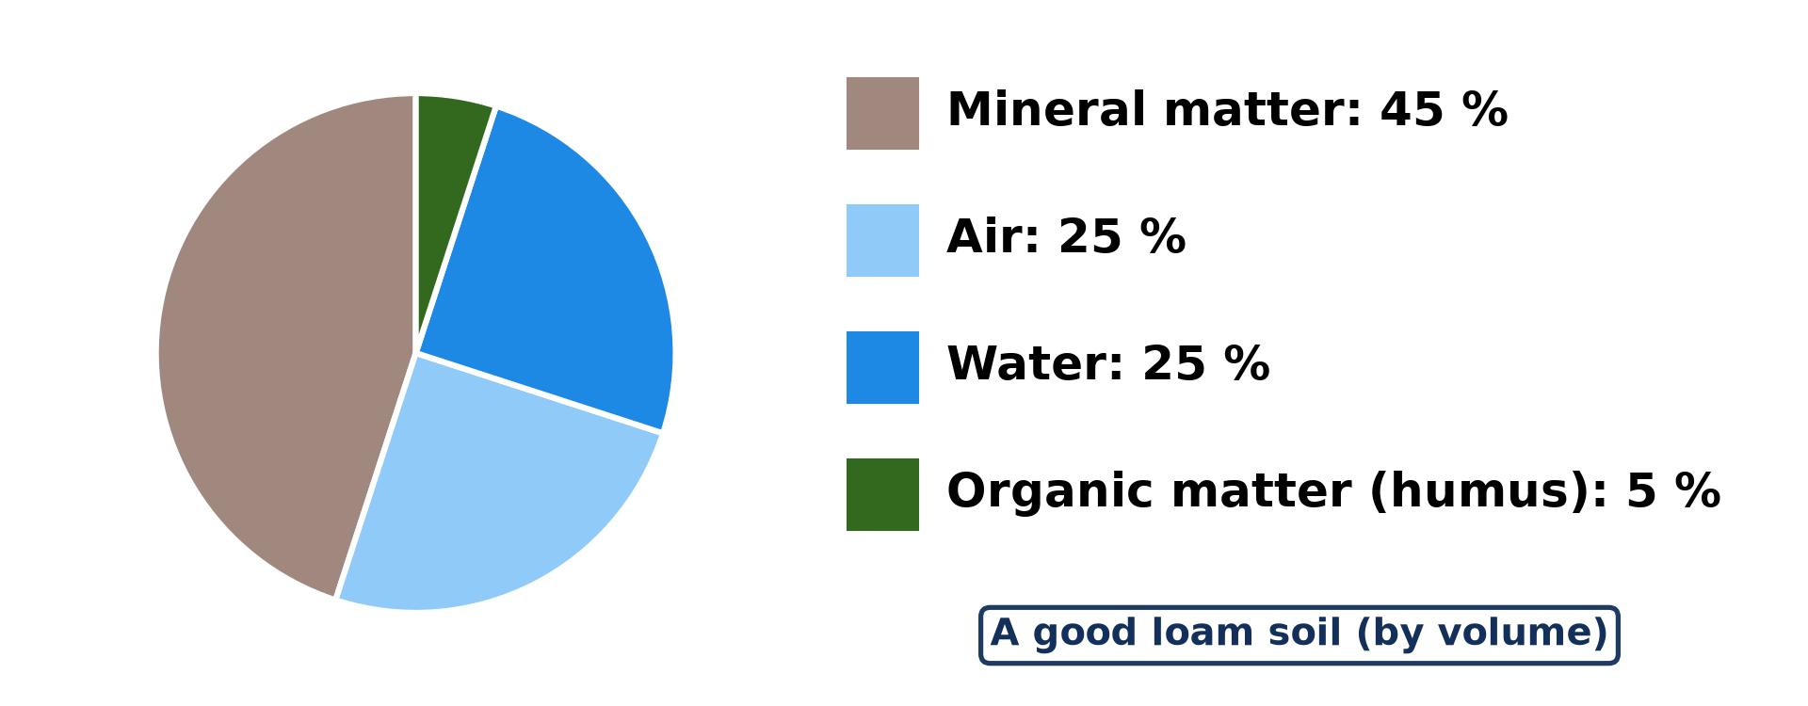
2. SOIL COMPONENTS
Activity 2
The four components of a good soil.
Notes:
Activity 2. Look carefully at this diagram: the four components of a good soil. Observe every detail before I ask the question.

Slide 23
2. SOIL COMPONENTS
Activity 2: Question
Name the four components of soil. Which is the largest?
Notes:
Here is the question for Activity 2: Name the four components of soil. Which is the largest? Take one minute to think and write your answer in your rough notebook.

Slide 24
2. SOIL COMPONENTS
Activity 2: Answer
Mineral matter, water, air and organic matter; mineral matter is the largest (45 %).
Notes:
Let us check the answer together. Mineral matter, water, air and organic matter; mineral matter is the largest (45 %).

Slide 25
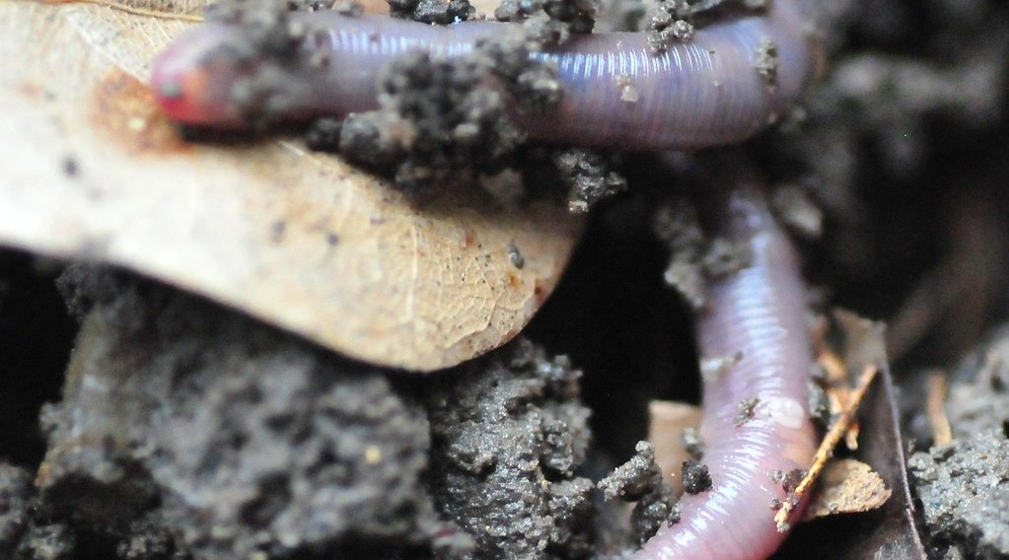
2. SOIL COMPONENTS
Activity 3
An earthworm in the soil.
Notes:
Activity 3. Look carefully at this picture: an earthworm in the soil. Observe every detail before I ask the question.

Slide 26
2. SOIL COMPONENTS
Activity 3: Question
Why is the earthworm part of the soil?
Notes:
Here is the question for Activity 3: Why is the earthworm part of the soil? Take one minute to think and write your answer in your rough notebook.

Slide 27
2. SOIL COMPONENTS
Activity 3: Answer
Soil contains living organisms that mix it and make humus.
Notes:
Let us check the answer together. Soil contains living organisms that mix it and make humus.

Slide 28

3. IMPORTANCE OF SOIL
Activity 4
A woman farmer in her farm in Cameroon.
Notes:
Activity 4. Look carefully at this picture: a woman farmer in her farm in Cameroon. Observe every detail before I ask the question.

Slide 29
3. IMPORTANCE OF SOIL
Activity 4: Question
Give two uses of soil for man.
Notes:
Here is the question for Activity 4: Give two uses of soil for man. Take one minute to think and write your answer in your rough notebook.

Slide 30
3. IMPORTANCE OF SOIL
Activity 4: Answer
It grows food and cash crops and gives building materials (clay, sand).
Notes:
Let us check the answer together. It grows food and cash crops and gives building materials (clay, sand).

Slide 31
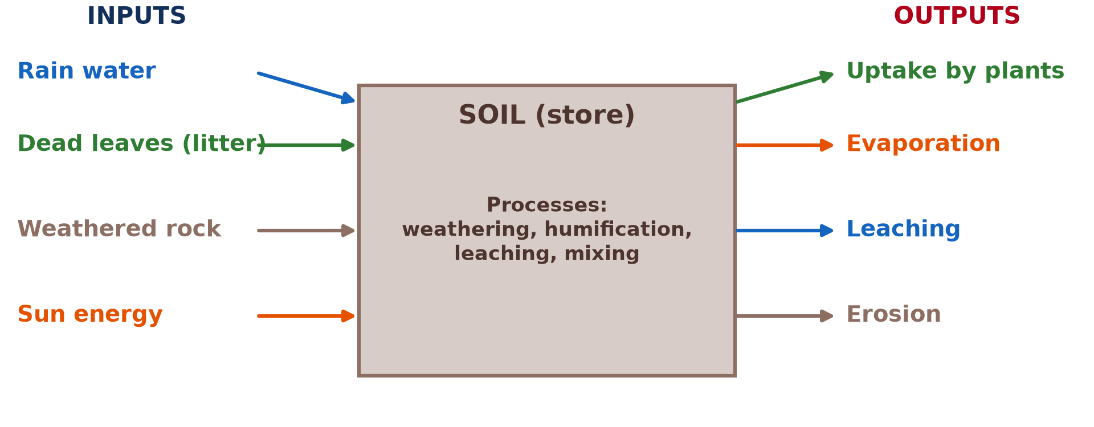
4. THE SOIL SYSTEM
Activity 5
The soil as an open system.
Notes:
Activity 5. Look carefully at this diagram: the soil as an open system. Observe every detail before I ask the question.

Slide 32
4. THE SOIL SYSTEM
Activity 5: Question
Name two inputs and two outputs of the soil system.
Notes:
Here is the question for Activity 5: Name two inputs and two outputs of the soil system. Take one minute to think and write your answer in your rough notebook.

Slide 33
4. THE SOIL SYSTEM
Activity 5: Answer
Inputs: rain, dead leaves (also weathered rock, sun). Outputs: leaching, erosion (also uptake, evaporation).
Notes:
Let us check the answer together. Inputs: rain, dead leaves (also weathered rock, sun). Outputs: leaching, erosion (also uptake, evaporation).

Slide 34
BOARD SUMMARY
Board Summary
Topic: Soil and its Properties
Sub-topic: The Soil System
Lesson 1: The Soil
Notes:
Now we are going to copy the board summary. Write the title and the headings neatly in your notebooks. I will give you enough time for each slide, so do not rush.

Slide 35
BOARD SUMMARY
1. Meaning of Soil
Soil can be understood as follows:
Soil: It is the thin, loose layer of weathered rock, organic matter, water and air that covers the land surface and supports plant growth.
Notes:
Let us copy Meaning of Soil. Soil can be understood as follows. On this slide we have Soil. Write each point on a new line, with the key term first, and explain it in your own words when we revise.

Slide 36
BOARD SUMMARY
2. Soil Components and Variations with Depth
Soil is made up of four main components:
Mineral matter (about 45 %): It comes from the weathering of the parent rock, as sand, silt and clay. It gives the soil its body and many nutrients.
Notes:
Let us copy Soil Components and Variations with Depth. Soil is made up of four main components. On this slide we have Mineral matter (about 45 %). Write each point on a new line, with the key term first, and explain it in your own words when we revise. When you finish, we go to the next slide.

Slide 37
BOARD SUMMARY
2. Soil Components and Variations with Depth (continued)
Organic matter (about 5 %): It comes from dead plants and animals that decompose into humus. It makes the soil dark, fertile and able to hold water.
Notes:
We continue with Soil Components and Variations with Depth. On this slide we have Organic matter (about 5 %). Write each point on a new line, with the key term first, and explain it in your own words when we revise. When you finish, we go to the next slide.

Slide 38
BOARD SUMMARY
2. Soil Components and Variations with Depth (continued)
Water and air (about 25 % each): They fill the pores between particles. Water carries dissolved nutrients to roots, and air supplies oxygen to roots and organisms.
Notes:
We continue with Soil Components and Variations with Depth. On this slide we have Water and air (about 25 % each). Write each point on a new line, with the key term first, and explain it in your own words when we revise. When you finish, we go to the next slide.

Slide 39
BOARD SUMMARY
2. Soil Components and Variations with Depth (continued)
Variations with depth: Organic matter, air and organisms decrease with depth, while stones and weathered rock increase. This creates layers called horizons.
Notes:
We continue with Soil Components and Variations with Depth. On this slide we have Variations with depth. Write each point on a new line, with the key term first, and explain it in your own words when we revise.

Slide 40
BOARD SUMMARY
2. Soil Components and Variations with Depth
Illustration: the components of soil
Notes:
Now draw this illustration in your notebook: the components of soil. Give it a title and label it clearly.

Slide 41
BOARD SUMMARY
3. Importance of Soil to Man and the Biosphere
Soil is important in the following ways:
For man: Soil supports farming, which provides food, cash crops and raw materials. It also supplies building materials such as clay and laterite.
Notes:
Let us copy Importance of Soil to Man and the Biosphere. Soil is important in the following ways. On this slide we have For man. Write each point on a new line, with the key term first, and explain it in your own words when we revise. When you finish, we go to the next slide.

Slide 42
BOARD SUMMARY
3. Importance of Soil to Man and the Biosphere (continued)
For the biosphere: Soil anchors plants and supplies them with water and nutrients. It is the home of many organisms and recycles dead matter.
Notes:
We continue with Importance of Soil to Man and the Biosphere. On this slide we have For the biosphere. Write each point on a new line, with the key term first, and explain it in your own words when we revise.

Slide 43
BOARD SUMMARY
4. The Soil System
The soil can be studied as an open system:
Inputs: Inputs are weathered rock, organic matter, rain water, air and solar energy. Man adds fertilisers and manure.
Notes:
Let us copy The Soil System. The soil can be studied as an open system. On this slide we have Inputs. Write each point on a new line, with the key term first, and explain it in your own words when we revise. When you finish, we go to the next slide.

Slide 44
BOARD SUMMARY
4. The Soil System (continued)
Processes and state: Processes include weathering, decomposition, leaching and translocation. The state of the soil is its properties at a given time: texture, structure, pH, fertility.
Notes:
We continue with The Soil System. On this slide we have Processes and state. Write each point on a new line, with the key term first, and explain it in your own words when we revise. When you finish, we go to the next slide.

Slide 45
BOARD SUMMARY
4. The Soil System (continued)
Outputs: Outputs are nutrients taken by plants, water lost by evaporation and drainage, and soil lost by erosion. Crops removed by man are also an output.
Notes:
We continue with The Soil System. On this slide we have Outputs. Write each point on a new line, with the key term first, and explain it in your own words when we revise.

Slide 46
BOARD SUMMARY
4. The Soil System
Illustration: the soil system
Notes:
Now draw this illustration in your notebook: the soil system. Give it a title and label it clearly.

Slide 47
FORMATIVE EVALUATION
Evaluation 1
Name the four components of soil with their proportions.
Notes:
Now let us check what you have understood. Question 1: Name the four components of soil with their proportions. Answer in your exercise book.

Slide 48
FORMATIVE EVALUATION
Expected Answer
Mineral matter 45 %, water 25 %, air 25 %, organic matter 5 %.
Notes:
The expected answer is: mineral matter 45 %, water 25 %, air 25 %, organic matter 5 %. If you got it right, well done.

Slide 49
FORMATIVE EVALUATION
Evaluation 2
Give two outputs of the soil system.
Notes:
Now let us check what you have understood. Question 2: Give two outputs of the soil system. Answer in your exercise book.

Slide 50
FORMATIVE EVALUATION
Expected Answer
Leaching and erosion (also uptake, evaporation).
Notes:
The expected answer is: leaching and erosion (also uptake, evaporation). If you got it right, well done.

Slide 51
REMEDIATION
Remediation
Fill in the blanks:
The study of soils is ______.
Decayed organic matter is ______.
The largest component of soil is ______ matter.
Notes:
For those who need more practice, fill in the blanks in your exercise book. The answers are: number 1, pedology; number 2, humus; number 3, mineral.

Slide 52
HOMEWORK
Homework
Collect a handful of soil and list what you can see in it.
Notes:
For your homework: Collect a handful of soil and list what you can see in it. We shall correct it at the beginning of our next lesson.

Slide 53
NEXT LESSON
Next Lesson
Our next lesson will be on:
Lesson 2: Physical Properties of the Soil: Texture
Notes:
Our next lesson will be on Lesson 2: Physical Properties of the Soil: Texture. Thank you for your attention, and see you next time.

Slide 54
BILINGUAL GAME
Bilingual Game (Jeu Bilingue)
English | Français
Soil | Le sol
Humus | L'humus
Pore | Le pore
Earthworm | Le ver de terre
Leaching | Le lessivage
Pedology | La pédologie
Notes:
Let us play the bilingual game. I say a word in English, and you give me the French word. Then we do the reverse.

Slide 55
LOGBOOK
Official Logbook (1/2)
Module / Topic | Soil and its Properties
Lesson Title | Lesson 1: The Soil
Expected Learning Outcomes | Define soil and pedology. Describe the four components of soil and how they change with depth. Explain the importance of soil and the soil as a system.
Competence | Learners are able to describe what soil is made of and explain why it is important to man and to living things.
Notes:
I record this information in the official logbook of the class after the lesson.

Slide 56
LOGBOOK
Official Logbook (2/2)
Matter Taught | Meaning of Soil; Soil Components and Variations with Depth; Importance of Soil to Man and the Biosphere; The Soil System.
Evaluation | Formative evaluation and remediation exercise.
Homework | Collect a handful of soil and list what you can see in it.
Enrolment / Present / Absent | ____ / ____ / ____
Achievement | To be completed after the lesson.
Notes:
I complete the second page of the logbook: the matter taught, the evaluation, the homework and the attendance.

Slide 57
TEACHER'S NOTE
Teacher's Note
Timing: Homework correction, plan, objectives 8 min | Recall, situation, action 10 min | 5 activities 30 min | Board summary (copying) 30 min | Evaluation, remediation 10 min | Homework, next lesson 5 min | Logbook 7 min
Without the projector (Activity 1): dig a small hole near the school.
Without the projector (Activity 2): draw the pie chart.
Without the projector (Activity 3): look for worms after rain.
Without the projector (Activity 4): list crops grown in your area.
Without the projector (Activity 5): draw the three boxes.
Notes:
This slide is for me, the teacher: it gives the timing of the lesson and what to do if the projector is not available.

Slide 58
REFERENCES
References
National Geography Syllabus, MINESEC/IGE/IP-SS, 2019 — Module 3 (Biogeography).
Photo, Activity 1: “Humic Dystrudept (fine-loamy, isotic, frigid)” by SoilScience.info, CC BY 2.0, via Flickr (https://www.flickr.com/photos/22503286@N06/5140645742)
Photo, Activity 3: “Earthworm In Soil” by jwinfred, CC BY-NC-ND 2.0, via Flickr (https://www.flickr.com/photos/98937825@N00/3532746937)
Photo, Activity 4: “Cameroon - UN Women's Gender Road Project” by UN Women Gallery, CC BY-NC-ND 2.0, via Flickr (https://www.flickr.com/photos/51431730@N04/46914753474)
Diagrams and animations: drawn for this lesson (Geography Department).
Notes:
These are the references and picture credits used to prepare this lesson.

