Slide 1
LOWER SIXTH ARTS
GEOGRAPHY
Lesson 2
Physical Properties of the Soil: Texture
Notes:
Good morning, class, and welcome to our geography lesson. I am your geography teacher, Mr Kamdem. Today we are starting Lesson 2: Physical Properties of the Soil: Texture.

Slide 2
CLASS INFO
Class, Chapter and Duration
Class | Lower Sixth Arts
Chapter | Module 3: Understanding and managing biogeographic zones across the world in general and Cameroon in particular
Duration | 2 periods (2 × 50 minutes)
Notes:
This lesson is for Lower Sixth Arts. It belongs to Module 3: Understanding and managing biogeographic zones across the world in general and Cameroon in particular. We shall need 2 periods to cover it.

Slide 3
IDENTIFICATION
Lesson Identification
Topic | Soil and its Properties
Sub-topic | Soil Properties and their Significance
Lesson | Lesson 2: Physical Properties of the Soil: Texture
Notions / Concepts | Soil texture, sand, silt, clay, loam, textural class, texture triangle.
Syllabus focus | Meaning of texture; textural classes; field and laboratory determination; representation; factors; significance.
Competence | Learners are able to identify soil texture and explain its importance for farming.
Notes:
Our topic is Soil and its Properties, and the sub-topic is Soil Properties and their Significance. The key notions we shall use today are: soil texture, sand, silt, clay, loam, textural class, texture triangle. At the end, you should be able to do this: learners are able to identify soil texture and explain its importance for farming.

Slide 4

HOMEWORK CORRECTION
Correction of the Homework
Question (Lesson 1: The Soil):
Collect a handful of soil and list what you can see in it.
Notes:
Before we start the new lesson, let us correct the homework I gave you at the end of Lesson 1: The Soil. The question was: Collect a handful of soil and list what you can see in it. Take out your exercise books.

Slide 5
HOMEWORK CORRECTION
Correction: Possible Answer
A handful of soil contains mineral particles (sand, clay, small stones), dead leaves and roots (organic matter), small animals (ants, worms), and it may feel damp (water).
Notes:
Here is a good answer. A handful of soil contains mineral particles (sand, clay, small stones), dead leaves and roots (organic matter), small animals (ants, worms), and it may feel damp (water). Compare it with your own answer and correct your work in red.

Slide 6
LESSON PLAN
Lesson Plan
Correction of the homework
Objectives and recall
Real-life situation and action to take
Learning activities
Board summary
Evaluation, remediation and homework
Notes:
Here is the plan of our lesson today. First, we shall correct the homework. Then we shall look at the objectives and recall what you already know. After that, we shall study a situation from real life and the action to take, and do the learning activities. Finally, we shall copy the board summary, do the evaluation and the remediation, and I will give you the homework.

Slide 7
OBJECTIVES
Objectives
By the end of this lesson, you should be able to:
Define soil texture and name the particle sizes.
Determine texture in the field and in the laboratory.
Notes:
Take your time to copy this part; we will continue together.

Slide 8
OBJECTIVES
Objectives (continued)
Read the texture triangle and explain the significance of texture.
Notes:
By the end of this lesson, you should be able to do three things. Number 1: define soil texture and name the particle sizes. Number 2: determine texture in the field and in the laboratory. Number 3: read the texture triangle and explain the significance of texture.

Slide 9
PREVIOUS KNOWLEDGE
Previous Knowledge
Mineral matter comes from weathered rock.
Soil holds water and air in its pores.
Notes:
Let us first remember what you already know. Mineral matter comes from weathered rock. Soil holds water and air in its pores. Keep this in mind, because we shall build on it today.

Slide 10
REAL-LIFE SITUATION
Situation in Real Life
In the Adamawa, a farmer notices that water disappears quickly in his sandy field, while in a valley the clay soil stays wet and sticky for days after rain.
Notes:
Listen carefully to this situation from real life. In the Adamawa, a farmer notices that water disappears quickly in his sandy field, while in a valley the clay soil stays wet and sticky for days after rain. Think about it, because I am going to ask you some questions.

Slide 11
REAL-LIFE SITUATION
Situation: Question 1
What is the problem in the situation?
Notes:
Question 1: What is the problem in the situation? Think for a moment, then raise your hand to answer.

Slide 12
REAL-LIFE SITUATION
Answer
Soils behave differently with water.
Notes:
Good. Soils behave differently with water.

Slide 13
REAL-LIFE SITUATION
Situation: Question 2
What property explains this?
Notes:
Question 2: What property explains this? Think for a moment, then raise your hand to answer.

Slide 14
REAL-LIFE SITUATION
Answer
Soil texture.
Notes:
Good. Soil texture.

Slide 15
REAL-LIFE SITUATION
Situation: Question 3
Which soil holds more water?
Notes:
Question 3: Which soil holds more water? Think for a moment, then raise your hand to answer.

Slide 16
REAL-LIFE SITUATION
Possible Answer
The clay soil.
Notes:
Good. The clay soil.

Slide 17
ACTION TO TAKE
Action to Take
Know the texture of our soils to choose the right crops and farming methods.
Notes:
From this situation, the action we are working towards in this lesson is the following: know the texture of our soils to choose the right crops and farming methods.

Slide 18
JUSTIFICATION
Justification of the Lesson
This lesson helps us to know soil texture, which controls water, air and fertility.
Notes:
Why is this lesson important for you? This lesson helps us to know soil texture, which controls water, air and fertility.

Slide 19
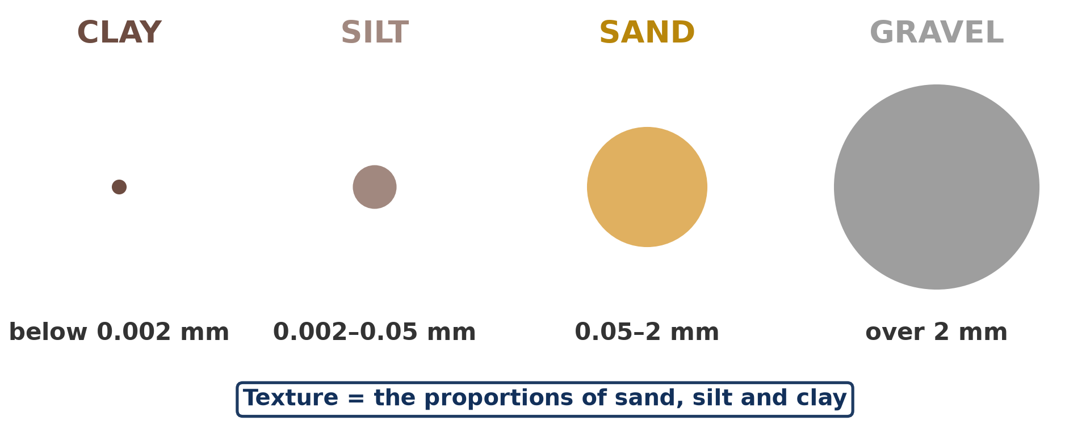
1. MEANING: PARTICLE SIZES
Activity 1
The size of soil particles.
Notes:
Activity 1. Look carefully at this diagram: the size of soil particles. Observe every detail before I ask the question.

Slide 20
1. MEANING: PARTICLE SIZES
Activity 1: Question
Put sand, silt and clay in order from the largest to the smallest.
Notes:
Here is the question for Activity 1: Put sand, silt and clay in order from the largest to the smallest. Take one minute to think and write your answer in your rough notebook.

Slide 21
1. MEANING: PARTICLE SIZES
Activity 1: Answer
Sand, silt, clay.
Notes:
Let us check the answer together. Sand, silt, clay.

Slide 22
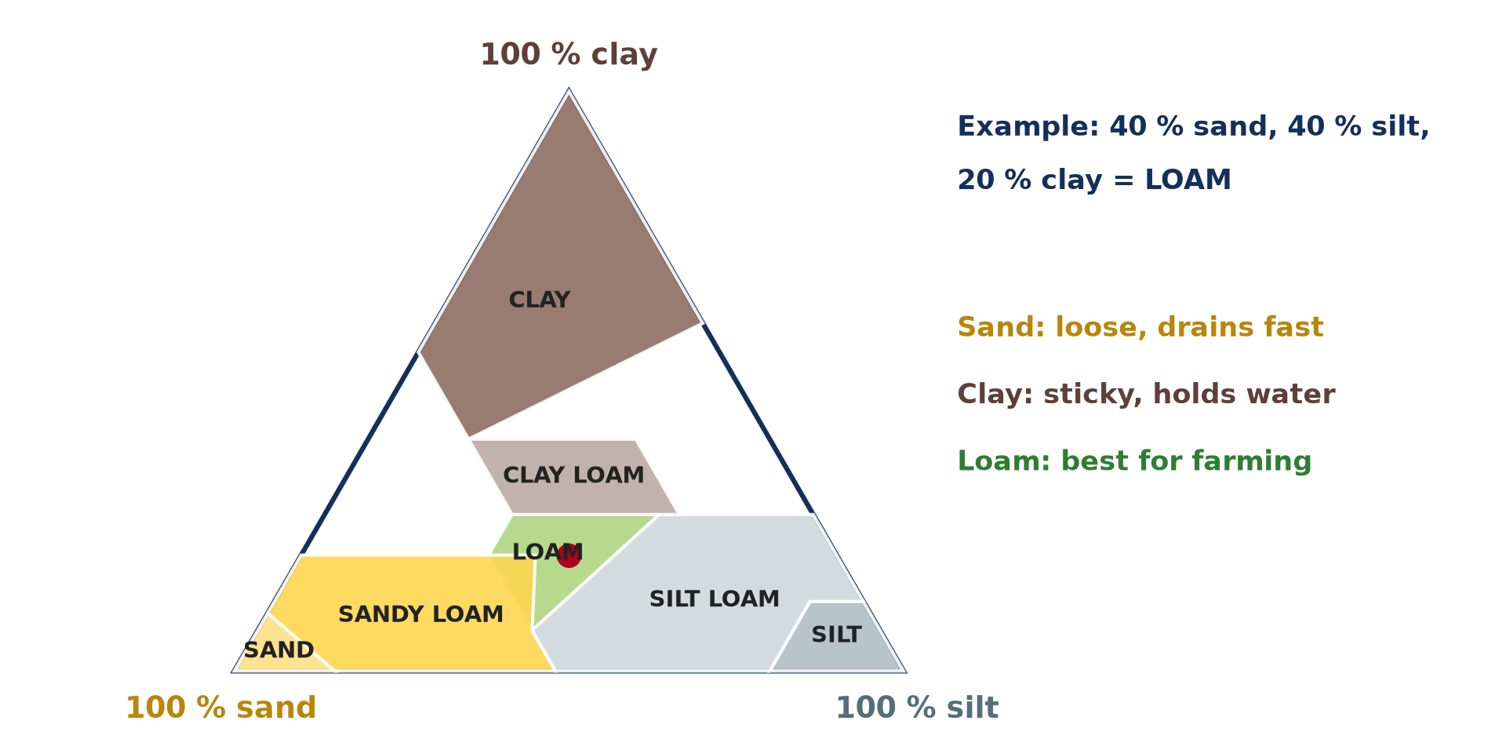
2. TEXTURAL CLASSES
Activity 2
The soil texture triangle.
Notes:
Activity 2. Look carefully at this diagram: the soil texture triangle. Observe every detail before I ask the question.

Slide 23
2. TEXTURAL CLASSES
Activity 2: Question
A soil has 40 % sand, 40 % silt and 20 % clay. What is its class?
Notes:
Here is the question for Activity 2: A soil has 40 % sand, 40 % silt and 20 % clay. What is its class? Take one minute to think and write your answer in your rough notebook.

Slide 24
2. TEXTURAL CLASSES
Activity 2: Answer
Loam.
Notes:
Let us check the answer together. Loam.

Slide 25
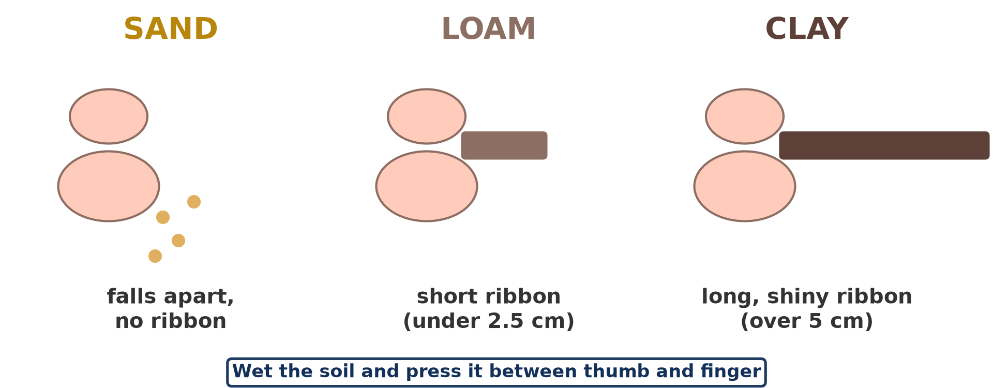
3. DETERMINATION
Activity 3
The ribbon test for soil texture.
Notes:
Activity 3. Look carefully at this diagram: the ribbon test for soil texture. Observe every detail before I ask the question.

Slide 26
3. DETERMINATION
Activity 3: Question
In the field, how can you tell if a wet soil is sandy or clayey?
Notes:
Here is the question for Activity 3: In the field, how can you tell if a wet soil is sandy or clayey? Take one minute to think and write your answer in your rough notebook.

Slide 27
3. DETERMINATION
Activity 3: Answer
Sand feels gritty and falls apart; clay feels sticky and makes a long ribbon.
Notes:
Let us check the answer together. Sand feels gritty and falls apart; clay feels sticky and makes a long ribbon.

Slide 28

5. FACTORS
Activity 4
A red tropical soil.
Notes:
Activity 4. Look carefully at this picture: a red tropical soil. Observe every detail before I ask the question.

Slide 29
5. FACTORS
Activity 4: Question
Why are soils on granite often sandy, and soils on basalt often clayey?
Notes:
Here is the question for Activity 4: Why are soils on granite often sandy, and soils on basalt often clayey? Take one minute to think and write your answer in your rough notebook.

Slide 30
5. FACTORS
Activity 4: Answer
Granite weathers into quartz sand; basalt weathers into clay.
Notes:
Let us check the answer together. Granite weathers into quartz sand; basalt weathers into clay.

Slide 31

6. SIGNIFICANCE
Activity 5
A rice field.
Notes:
Activity 5. Look carefully at this picture: a rice field. Observe every detail before I ask the question.

Slide 32
6. SIGNIFICANCE
Activity 5: Question
Why is rice grown on clay soils?
Notes:
Here is the question for Activity 5: Why is rice grown on clay soils? Take one minute to think and write your answer in your rough notebook.

Slide 33
6. SIGNIFICANCE
Activity 5: Answer
Clay holds water and keeps the field flooded.
Notes:
Let us check the answer together. Clay holds water and keeps the field flooded.

Slide 34
BOARD SUMMARY
Board Summary
Topic: Soil and its Properties
Sub-topic: Soil Properties and their Significance
Lesson 2: Physical Properties of the Soil: Texture
Notes:
Now we are going to copy the board summary. Write the title and the headings neatly in your notebooks. I will give you enough time for each slide, so do not rush.

Slide 35
BOARD SUMMARY
1. Meaning of Soil Texture
Soil texture can be understood as follows:
Soil texture: It is the relative proportion of sand, silt and clay particles in a soil.
Particle sizes: Sand particles measure 2–0.05 mm, silt 0.05–0.002 mm and clay less than 0.002 mm. Gravel and stones are larger than 2 mm.
Notes:
Let us copy Meaning of Soil Texture. Soil texture can be understood as follows. On this slide we have Soil texture and Particle sizes. Write each point on a new line, with the key term first, and explain it in your own words when we revise.

Slide 36
BOARD SUMMARY
1. Meaning of Soil Texture
Illustration: particle sizes
Notes:
Now draw this illustration in your notebook: particle sizes. Give it a title and label it clearly.

Slide 37
BOARD SUMMARY
2. Textural Classes and Representation
Soils are grouped into textural classes:
Main classes: Sandy soils are light and drain fast; clay soils are heavy, sticky and hold water. Loam, a balanced mixture, is the best for farming.
Notes:
Let us copy Textural Classes and Representation. Soils are grouped into textural classes. On this slide we have Main classes. Write each point on a new line, with the key term first, and explain it in your own words when we revise. When you finish, we go to the next slide.

Slide 38
BOARD SUMMARY
2. Textural Classes and Representation (continued)
Representation: Textural classes are shown on a triangular (ternary) graph with sand, silt and clay percentages. A soil with 40 % sand, 40 % silt and 20 % clay is a loam.
Notes:
We continue with Textural Classes and Representation. On this slide we have Representation. Write each point on a new line, with the key term first, and explain it in your own words when we revise.

Slide 39
BOARD SUMMARY
2. Textural Classes and Representation
Illustration: the soil texture triangle
Notes:
Now draw this illustration in your notebook: the soil texture triangle. Give it a title and label it clearly.

Slide 40
BOARD SUMMARY
3. Determination of Soil Texture
Texture can be determined by two methods:
Field methods: A moist sample is rubbed and moulded: sand feels gritty, silt feels smooth and clay feels sticky. Clay makes a long ribbon and a ring, while sand crumbles.
Notes:
Let us copy Determination of Soil Texture. Texture can be determined by two methods. On this slide we have Field methods. Write each point on a new line, with the key term first, and explain it in your own words when we revise. When you finish, we go to the next slide.

Slide 41
BOARD SUMMARY
3. Determination of Soil Texture (continued)
Laboratory methods: Dry soil is sieved through meshes of different sizes and each fraction is weighed. The sedimentation method measures fine particles settling in water.
Notes:
We continue with Determination of Soil Texture. On this slide we have Laboratory methods. Write each point on a new line, with the key term first, and explain it in your own words when we revise.

Slide 42
BOARD SUMMARY
3. Determination of Soil Texture
Illustration: the ribbon test
Notes:
Now draw this illustration in your notebook: the ribbon test. Give it a title and label it clearly.

Slide 43
BOARD SUMMARY
4. Factors and Significance
The factors and significance of texture are:
Factors: Parent rock is the main factor: granite gives sandy soils and basalt clayey soils. Weathering, age and deposition by rivers and wind also matter.
Notes:
Let us copy Factors and Significance. The factors and significance of texture are. On this slide we have Factors. Write each point on a new line, with the key term first, and explain it in your own words when we revise. When you finish, we go to the next slide.

Slide 44
BOARD SUMMARY
4. Factors and Significance (continued)
Significance: Texture controls drainage, aeration, water-holding capacity and ease of ploughing. Rice grows on clay, while groundnuts prefer sandy soils.
Notes:
We continue with Factors and Significance. On this slide we have Significance. Write each point on a new line, with the key term first, and explain it in your own words when we revise.

Slide 45
FORMATIVE EVALUATION
Evaluation 1
What is soil texture?
Notes:
Now let us check what you have understood. Question 1: What is soil texture? Answer in your exercise book.

Slide 46
FORMATIVE EVALUATION
Expected Answer
The proportion of sand, silt and clay in a soil.
Notes:
The expected answer is: the proportion of sand, silt and clay in a soil. If you got it right, well done.

Slide 47
FORMATIVE EVALUATION
Evaluation 2
Give one advantage and one disadvantage of a sandy soil.
Notes:
Now let us check what you have understood. Question 2: Give one advantage and one disadvantage of a sandy soil. Answer in your exercise book.

Slide 48
FORMATIVE EVALUATION
Expected Answer
Advantage: easy to dig and well aerated. Disadvantage: dries fast and loses nutrients.
Notes:
The expected answer is: advantage: easy to dig and well aerated. Disadvantage: dries fast and loses nutrients. If you got it right, well done.

Slide 49
REMEDIATION
Remediation
Fill in the blanks:
The smallest soil particles are ______.
A soil with a good mix of particles is ______.
Texture classes are read on the texture ______.
Notes:
For those who need more practice, fill in the blanks in your exercise book. The answers are: number 1, clay; number 2, loam; number 3, triangle.

Slide 50
HOMEWORK
Homework
Test three soils from home by feel and give the texture of each.
Notes:
For your homework: Test three soils from home by feel and give the texture of each. We shall correct it at the beginning of our next lesson.

Slide 51
NEXT LESSON
Next Lesson
Our next lesson will be on:
Practical Work 1: Determining Soil Texture
Notes:
Our next lesson will be on Practical Work 1: Determining Soil Texture. Thank you for your attention, and see you next time.

Slide 52
BILINGUAL GAME
Bilingual Game (Jeu Bilingue)
English | Français
Texture | La texture
Sand | Le sable
Silt | Le limon
Clay | L'argile
Loam | Le sol limoneux équilibré
Sieve | Le tamis
Notes:
Let us play the bilingual game. I say a word in English, and you give me the French word. Then we do the reverse.

Slide 53
LOGBOOK
Official Logbook (1/2)
Module / Topic | Soil and its Properties
Lesson Title | Lesson 2: Physical Properties of the Soil: Texture
Expected Learning Outcomes | Define soil texture and name the particle sizes. Determine texture in the field and in the laboratory. Read the texture triangle and explain the significance of texture.
Competence | Learners are able to identify soil texture and explain its importance for farming.
Notes:
I record this information in the official logbook of the class after the lesson.

Slide 54
LOGBOOK
Official Logbook (2/2)
Matter Taught | Meaning of Soil Texture; Textural Classes and Representation; Determination of Soil Texture; Factors and Significance.
Evaluation | Formative evaluation and remediation exercise.
Homework | Test three soils from home by feel and give the texture of each.
Enrolment / Present / Absent | ____ / ____ / ____
Achievement | To be completed after the lesson.
Notes:
I complete the second page of the logbook: the matter taught, the evaluation, the homework and the attendance.

Slide 55
TEACHER'S NOTE
Teacher's Note
Timing: Homework correction, plan, objectives 8 min | Recall, situation, action 10 min | 5 activities 30 min | Board summary (copying) 30 min | Evaluation, remediation 10 min | Homework, next lesson 5 min | Logbook 7 min
Without the projector (Activity 1): show sand, flour and clay.
Without the projector (Activity 2): draw the triangle.
Without the projector (Activity 3): rub wet soil between the fingers.
Without the projector (Activity 4): compare local rocks.
Without the projector (Activity 5): mention rice at Ndop and Yagoua.
Notes:
This slide is for me, the teacher: it gives the timing of the lesson and what to do if the projector is not available.

Slide 56
REFERENCES
References
National Geography Syllabus, MINESEC/IGE/IP-SS, 2019 — Module 3 (Biogeography).
Photo, Activity 4: “in the middle of nowhere, morocco” by mariusz kluzniak, CC BY-NC-ND 2.0, via Flickr (https://www.flickr.com/photos/39997856@N03/8398997251)
Photo, Activity 5: “Irrigated rice fields in Sefula, Zambia. Photo by Kate Longley, 2013.” by WorldFish, CC BY-NC-ND 2.0, via Flickr (https://www.flickr.com/photos/61545321@N06/8608804590)
Diagrams and animations: drawn for this lesson (Geography Department).
Notes:
These are the references and picture credits used to prepare this lesson.

