Slide 1
LOWER SIXTH ARTS
GEOGRAPHY
Lesson 21
Energy Flows in Ecosystems
Notes:
Good morning, class, and welcome to our geography lesson. I am your geography teacher, Mr Kamdem. Today we are starting Lesson 21: Energy Flows in Ecosystems.

Slide 2
CLASS INFO
Class, Chapter and Duration
Class | Lower Sixth Arts
Chapter | Module 3: Understanding and managing biogeographic zones across the world in general and Cameroon in particular
Duration | 2 periods (2 × 50 minutes)
Notes:
This lesson is for Lower Sixth Arts. It belongs to Module 3: Understanding and managing biogeographic zones across the world in general and Cameroon in particular. We shall need 2 periods to cover it.

Slide 3
IDENTIFICATION
Lesson Identification
Topic | Ecological Systems (Ecosystems)
Sub-topic | The Functioning of Ecosystems
Lesson | Lesson 21: Energy Flows in Ecosystems
Notions / Concepts | Energy flow, photosynthesis, respiration, first law of thermodynamics, second law of thermodynamics, 10 % rule.
Syllabus focus | Sources of energy in the ecosystem; the two energy laws analysed.
Competence | Learners are able to explain how energy enters and flows through ecosystems using the two energy laws.
Notes:
Our topic is Ecological Systems (Ecosystems), and the sub-topic is The Functioning of Ecosystems. The key notions we shall use today are: energy flow, photosynthesis, respiration, first law of thermodynamics, second law of thermodynamics, 10 % rule. At the end, you should be able to do this: learners are able to explain how energy enters and flows through ecosystems using the two energy laws.

Slide 4

HOMEWORK CORRECTION
Correction of the Homework
Question (Lesson 20: Interactions within Ecosystems):
Give an example of an ecosystem in your area that has lost its balance and explain why.
Notes:
Before we start the new lesson, let us correct the homework I gave you at the end of Lesson 20: Interactions within Ecosystems. The question was: Give an example of an ecosystem in your area that has lost its balance and explain why. Take out your exercise books.

Slide 5
HOMEWORK CORRECTION
Correction: Possible Answer
Example: the savanna near town has been overgrazed and burnt; grass cover has disappeared, soil is eroded and wild animals have left, so the ecosystem has lost its balance.
Notes:
Here is a good answer. Example: the savanna near town has been overgrazed and burnt; grass cover has disappeared, soil is eroded and wild animals have left, so the ecosystem has lost its balance. Compare it with your own answer and correct your work in red.

Slide 6
LESSON PLAN
Lesson Plan
Correction of the homework
Objectives and recall
Real-life situation and action to take
Learning activities
Board summary
Evaluation, remediation and homework
Notes:
Here is the plan of our lesson today. First, we shall correct the homework. Then we shall look at the objectives and recall what you already know. After that, we shall study a situation from real life and the action to take, and do the learning activities. Finally, we shall copy the board summary, do the evaluation and the remediation, and I will give you the homework.

Slide 7
OBJECTIVES
Objectives
By the end of this lesson, you should be able to:
Identify the source of energy in ecosystems.
Explain the first and second laws of energy.
Notes:
Take your time to copy this part; we will continue together.

Slide 8
OBJECTIVES
Objectives (continued)
Explain why energy decreases along a food chain.
Notes:
By the end of this lesson, you should be able to do three things. Number 1: identify the source of energy in ecosystems. Number 2: explain the first and second laws of energy. Number 3: explain why energy decreases along a food chain.

Slide 9
PREVIOUS KNOWLEDGE
Previous Knowledge
Plants make food by photosynthesis.
Animals eat plants or other animals.
Notes:
Let us first remember what you already know. Plants make food by photosynthesis. Animals eat plants or other animals. Keep this in mind, because we shall build on it today.

Slide 10
REAL-LIFE SITUATION
Situation in Real Life
A herder feeds his cattle on grass. A learner calculates that the cattle use most of the energy in the grass to walk and keep warm, and very little becomes meat.
Notes:
Listen carefully to this situation from real life. A herder feeds his cattle on grass. A learner calculates that the cattle use most of the energy in the grass to walk and keep warm, and very little becomes meat. Think about it, because I am going to ask you some questions.

Slide 11
REAL-LIFE SITUATION
Situation: Question 1
What is the problem in the situation?
Notes:
Question 1: What is the problem in the situation? Think for a moment, then raise your hand to answer.

Slide 12
REAL-LIFE SITUATION
Answer
Much energy is lost between grass and meat.
Notes:
Good. Much energy is lost between grass and meat.

Slide 13
REAL-LIFE SITUATION
Situation: Question 2
Where does the energy go?
Notes:
Question 2: Where does the energy go? Think for a moment, then raise your hand to answer.

Slide 14
REAL-LIFE SITUATION
Answer
It is lost as heat through respiration and movement.
Notes:
Good. It is lost as heat through respiration and movement.

Slide 15
REAL-LIFE SITUATION
Situation: Question 3
Where does the energy of grass come from?
Notes:
Question 3: Where does the energy of grass come from? Think for a moment, then raise your hand to answer.

Slide 16
REAL-LIFE SITUATION
Possible Answer
From the Sun.
Notes:
Good. From the Sun.

Slide 17
ACTION TO TAKE
Action to Take
Use energy flows to understand why food production is most efficient at low trophic levels.
Notes:
From this situation, the action we are working towards in this lesson is the following: use energy flows to understand why food production is most efficient at low trophic levels.

Slide 18
JUSTIFICATION
Justification of the Lesson
This lesson helps us to understand why energy flows in one direction and why food chains are short.
Notes:
Why is this lesson important for you? This lesson helps us to understand why energy flows in one direction and why food chains are short.

Slide 19
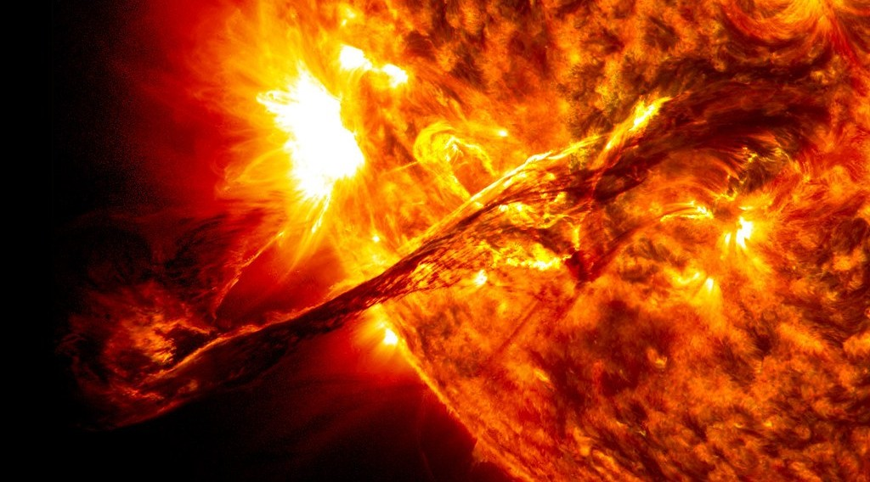
1. SOURCES OF ENERGY
Activity 1
The Sun, source of all energy in ecosystems.
Notes:
Activity 1. Look carefully at this picture: the Sun, source of all energy in ecosystems. Observe every detail before I ask the question.

Slide 20
1. SOURCES OF ENERGY
Activity 1: Question
How does solar energy enter the ecosystem?
Notes:
Here is the question for Activity 1: How does solar energy enter the ecosystem? Take one minute to think and write your answer in your rough notebook.

Slide 21
1. SOURCES OF ENERGY
Activity 1: Answer
Through photosynthesis by green plants.
Notes:
Let us check the answer together. Through photosynthesis by green plants.

Slide 22

1. SOURCES OF ENERGY
Activity 2
Photosynthesis.
Notes:
Activity 2. Look carefully at this diagram: photosynthesis. Observe every detail before I ask the question.

Slide 23
1. SOURCES OF ENERGY
Activity 2: Question
Into what form is solar energy changed by plants?
Notes:
Here is the question for Activity 2: Into what form is solar energy changed by plants? Take one minute to think and write your answer in your rough notebook.

Slide 24
1. SOURCES OF ENERGY
Activity 2: Answer
Chemical energy stored in food (sugars).
Notes:
Let us check the answer together. Chemical energy stored in food (sugars).

Slide 25
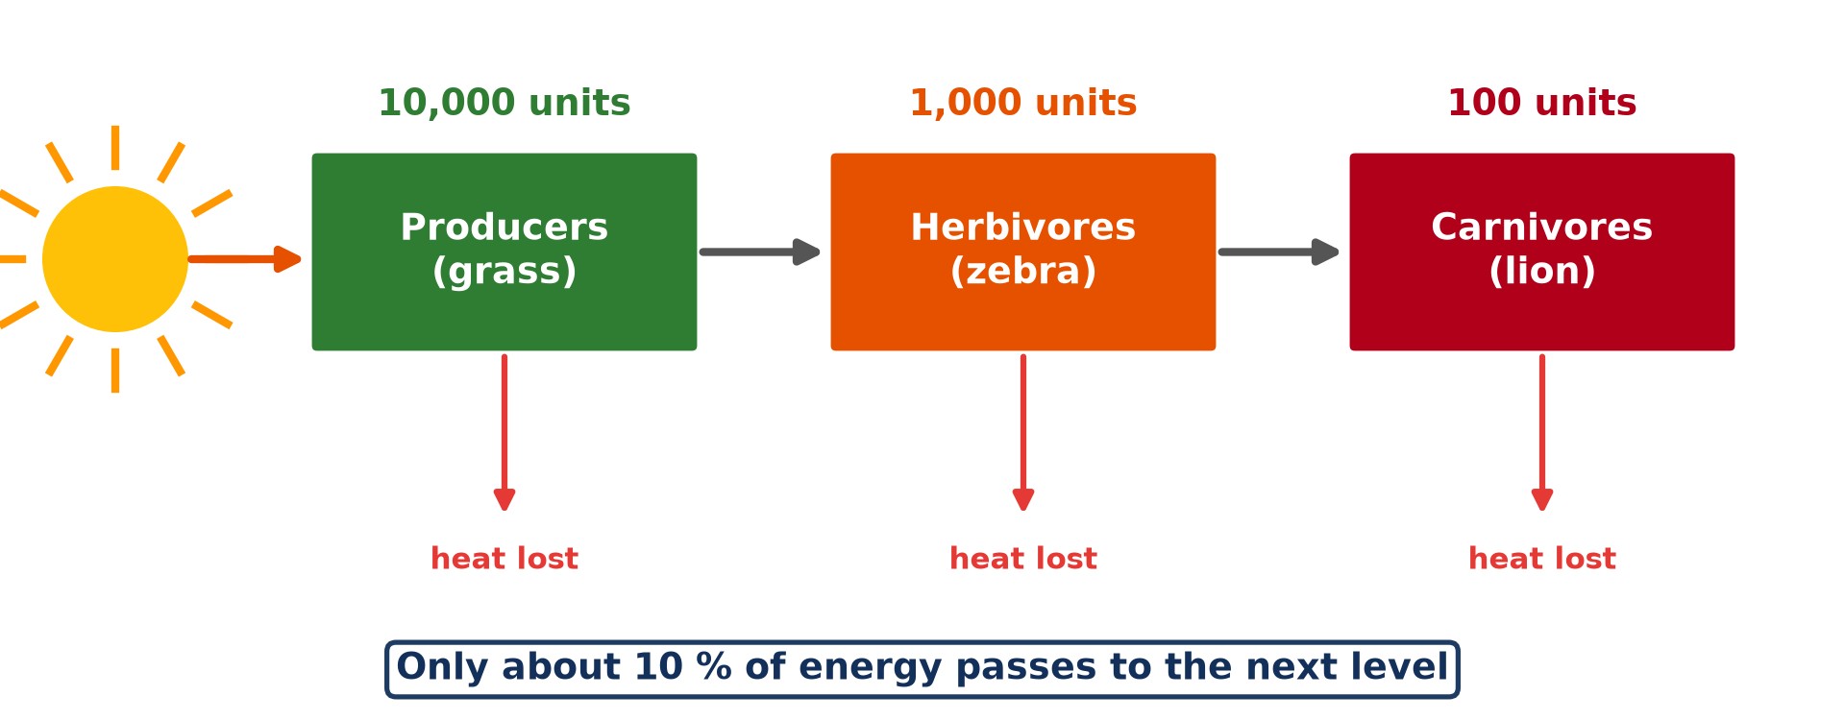
2. ENERGY FLOW
Activity 3
Energy flow along a food chain.
Notes:
Activity 3. Look carefully at this diagram: energy flow along a food chain. Observe every detail before I ask the question.

Slide 26
2. ENERGY FLOW
Activity 3: Question
If grass has 10,000 units, how much reaches the lion?
Notes:
Here is the question for Activity 3: If grass has 10,000 units, how much reaches the lion? Take one minute to think and write your answer in your rough notebook.

Slide 27
2. ENERGY FLOW
Activity 3: Answer
About 100 units (10 % at each step).
Notes:
Let us check the answer together. About 100 units (10 % at each step).

Slide 28

3. THE FIRST LAW
Activity 4
Zebras grazing.
Notes:
Activity 4. Look carefully at this picture: zebras grazing. Observe every detail before I ask the question.

Slide 29
3. THE FIRST LAW
Activity 4: Question
Why does the zebra keep only a small part of the grass energy?
Notes:
Here is the question for Activity 4: Why does the zebra keep only a small part of the grass energy? Take one minute to think and write your answer in your rough notebook.

Slide 30
3. THE FIRST LAW
Activity 4: Answer
It loses most as heat when it moves and breathes (second law).
Notes:
Let us check the answer together. It loses most as heat when it moves and breathes (second law).

Slide 31

3. THE SECOND LAW
Activity 5
A lioness stalking zebras.
Notes:
Activity 5. Look carefully at this picture: a lioness stalking zebras. Observe every detail before I ask the question.

Slide 32
3. THE SECOND LAW
Activity 5: Question
Why are there few lions and many zebras?
Notes:
Here is the question for Activity 5: Why are there few lions and many zebras? Take one minute to think and write your answer in your rough notebook.

Slide 33
3. THE SECOND LAW
Activity 5: Answer
Little energy is left at the top of the chain.
Notes:
Let us check the answer together. Little energy is left at the top of the chain.

Slide 34
BOARD SUMMARY
Board Summary
Topic: Ecological Systems (Ecosystems)
Sub-topic: The Functioning of Ecosystems
Lesson 21: Energy Flows in Ecosystems
Notes:
Now we are going to copy the board summary. Write the title and the headings neatly in your notebooks. I will give you enough time for each slide, so do not rush.

Slide 35
BOARD SUMMARY
1. Sources of Energy in the Ecosystem
Energy enters the ecosystem as follows:
Solar energy: The sun is the main source of energy for almost all ecosystems. Only about 1 % of the sunlight reaching plants is used in photosynthesis.
Notes:
Let us copy Sources of Energy in the Ecosystem. Energy enters the ecosystem as follows. On this slide we have Solar energy. Write each point on a new line, with the key term first, and explain it in your own words when we revise. When you finish, we go to the next slide.

Slide 36
BOARD SUMMARY
1. Sources of Energy in the Ecosystem (continued)
Photosynthesis: Plants change light energy into chemical energy stored in food (glucose). This energy is passed on to animals when they feed.
Notes:
We continue with Sources of Energy in the Ecosystem. On this slide we have Photosynthesis. Write each point on a new line, with the key term first, and explain it in your own words when we revise.

Slide 37
BOARD SUMMARY
2. The Two Energy Laws
Energy flow obeys the two laws of thermodynamics:
First law: Energy cannot be created or destroyed; it only changes form. Light becomes chemical energy, then movement and heat.
Notes:
Let us copy The Two Energy Laws. Energy flow obeys the two laws of thermodynamics. On this slide we have First law. Write each point on a new line, with the key term first, and explain it in your own words when we revise. When you finish, we go to the next slide.

Slide 38
BOARD SUMMARY
2. The Two Energy Laws (continued)
Second law: At each transfer, some energy is lost as heat, so less is available at the next level. Only about 10 % passes from one trophic level to the next.
Consequence: Energy flows in one direction and cannot be recycled. This is why there are many zebras but few lions.
Notes:
We continue with The Two Energy Laws. On this slide we have Second law and Consequence. Write each point on a new line, with the key term first, and explain it in your own words when we revise.

Slide 39
BOARD SUMMARY
2. The Two Energy Laws
Illustration: energy flow through trophic levels
Notes:
Now draw this illustration in your notebook: energy flow through trophic levels. Give it a title and label it clearly.

Slide 40
FORMATIVE EVALUATION
Evaluation 1
State the two energy laws.
Notes:
Now let us check what you have understood. Question 1: State the two energy laws. Answer in your exercise book.

Slide 41
FORMATIVE EVALUATION
Expected Answer
First: energy is not created or destroyed, only changed. Second: each change loses some energy as heat.
Notes:
The expected answer is: first: energy is not created or destroyed, only changed. Second: each change loses some energy as heat. If you got it right, well done.

Slide 42
FORMATIVE EVALUATION
Evaluation 2
Why are food chains short?
Notes:
Now let us check what you have understood. Question 2: Why are food chains short? Answer in your exercise book.

Slide 43
FORMATIVE EVALUATION
Expected Answer
About 90 % of energy is lost at each level.
Notes:
The expected answer is: about 90 % of energy is lost at each level. If you got it right, well done.

Slide 44
REMEDIATION
Remediation
Fill in the blanks:
All energy in ecosystems comes from the ______.
Plants take in energy by ______.
At each level about ______ % of energy passes on.
Notes:
For those who need more practice, fill in the blanks in your exercise book. The answers are: number 1, Sun; number 2, photosynthesis; number 3, 10.

Slide 45
HOMEWORK
Homework
Calculate how much energy reaches a hawk if grass has 50,000 units in the chain grass → grasshopper → bird → hawk.
Notes:
For your homework: Calculate how much energy reaches a hawk if grass has 50,000 units in the chain grass → grasshopper → bird → hawk. We shall correct it at the beginning of our next lesson.

Slide 46
NEXT LESSON
Next Lesson
Our next lesson will be on:
Lesson 22: Trophic Levels, Food Chains and Food Webs
Notes:
Our next lesson will be on Lesson 22: Trophic Levels, Food Chains and Food Webs. Thank you for your attention, and see you next time.

Slide 47
BILINGUAL GAME
Bilingual Game (Jeu Bilingue)
English | Français
Energy | L'énergie
Heat | La chaleur
Law | La loi
Flow | Le flux
Sunlight | La lumière solaire
Respiration | La respiration
Notes:
Let us play the bilingual game. I say a word in English, and you give me the French word. Then we do the reverse.

Slide 48
LOGBOOK
Official Logbook (1/2)
Module / Topic | Ecological Systems (Ecosystems)
Lesson Title | Lesson 21: Energy Flows in Ecosystems
Expected Learning Outcomes | Identify the source of energy in ecosystems. Explain the first and second laws of energy. Explain why energy decreases along a food chain.
Competence | Learners are able to explain how energy enters and flows through ecosystems using the two energy laws.
Notes:
I record this information in the official logbook of the class after the lesson.

Slide 49
LOGBOOK
Official Logbook (2/2)
Matter Taught | Sources of Energy in the Ecosystem; The Two Energy Laws.
Evaluation | Formative evaluation and remediation exercise.
Homework | Calculate how much energy reaches a hawk if grass has 50,000 units in the chain grass → grasshopper → bird → hawk.
Enrolment / Present / Absent | ____ / ____ / ____
Achievement | To be completed after the lesson.
Notes:
I complete the second page of the logbook: the matter taught, the evaluation, the homework and the attendance.

Slide 50
TEACHER'S NOTE
Teacher's Note
Timing: Homework correction, plan, objectives 8 min | Recall, situation, action 10 min | 5 activities 30 min | Board summary (copying) 30 min | Evaluation, remediation 10 min | Homework, next lesson 5 min | Logbook 7 min
Without the projector (Activity 1): explain why plants need light.
Without the projector (Activity 2): write the equation in words.
Without the projector (Activity 3): do the calculation.
Without the projector (Activity 4): feel body heat after running.
Without the projector (Activity 5): compare numbers in a park.
Notes:
This slide is for me, the teacher: it gives the timing of the lesson and what to do if the projector is not available.

Slide 51
REFERENCES
References
National Geography Syllabus, MINESEC/IGE/IP-SS, 2019 — Module 3 (Biogeography).
Photo, Activity 1: “Scientists Propose Mechanism to Describe Solar Eruptions of All Sizes” by NASA's Marshall Space Flight Center, CC BY-NC 2.0, via nasa (https://www.flickr.com/photos/28634332@N05/36084784530)
Photo, Activity 4: “Zebra” by mape_s, CC BY 2.0, via Flickr (https://www.flickr.com/photos/50931380@N00/333863114)
Photo, Activity 5: “hunt is on” by @Doug88888, CC BY-NC-SA 2.0, via Flickr (https://www.flickr.com/photos/29468339@N02/2930690305)
Diagrams and animations: drawn for this lesson (Geography Department).
Notes:
These are the references and picture credits used to prepare this lesson.

