Slide 1
LOWER SIXTH ARTS
GEOGRAPHY
Lesson 22
Trophic Levels, Food Chains and Food Webs
Notes:
Good morning, class, and welcome to our geography lesson. I am your geography teacher, Mr Kamdem. Today we are starting Lesson 22: Trophic Levels, Food Chains and Food Webs.

Slide 2
CLASS INFO
Class, Chapter and Duration
Class | Lower Sixth Arts
Chapter | Module 3: Understanding and managing biogeographic zones across the world in general and Cameroon in particular
Duration | 2 periods (2 × 50 minutes)
Notes:
This lesson is for Lower Sixth Arts. It belongs to Module 3: Understanding and managing biogeographic zones across the world in general and Cameroon in particular. We shall need 2 periods to cover it.

Slide 3
IDENTIFICATION
Lesson Identification
Topic | Ecological Systems (Ecosystems)
Sub-topic | The Functioning of Ecosystems
Lesson | Lesson 22: Trophic Levels, Food Chains and Food Webs
Notions / Concepts | Trophic level, herbivore, carnivore, omnivore, food chain, food web, ecological pyramid.
Syllabus focus | Meaning and illustration of trophic levels; stepwise nature and limits; food chains and food webs.
Competence | Learners are able to build food chains and food webs and explain trophic levels.
Notes:
Our topic is Ecological Systems (Ecosystems), and the sub-topic is The Functioning of Ecosystems. The key notions we shall use today are: trophic level, herbivore, carnivore, omnivore, food chain, food web, ecological pyramid. At the end, you should be able to do this: learners are able to build food chains and food webs and explain trophic levels.

Slide 4

HOMEWORK CORRECTION
Correction of the Homework
Question (Lesson 21: Energy Flows in Ecosystems):
Calculate how much energy reaches a hawk if grass has 50,000 units in the chain grass → grasshopper → bird → hawk.
Notes:
Before we start the new lesson, let us correct the homework I gave you at the end of Lesson 21: Energy Flows in Ecosystems. The question was: Calculate how much energy reaches a hawk if grass has 50,000 units in the chain grass → grasshopper → bird → hawk. Take out your exercise books.

Slide 5
HOMEWORK CORRECTION
Correction: Possible Answer
With about 10 % passed at each level: grass 50,000 → grasshopper 5,000 → bird 500 → hawk 50 units.
Notes:
Here is a good answer. With about 10 % passed at each level: grass 50,000 → grasshopper 5,000 → bird 500 → hawk 50 units. Compare it with your own answer and correct your work in red.

Slide 6
LESSON PLAN
Lesson Plan
Correction of the homework
Objectives and recall
Real-life situation and action to take
Learning activities
Board summary
Evaluation, remediation and homework
Notes:
Here is the plan of our lesson today. First, we shall correct the homework. Then we shall look at the objectives and recall what you already know. After that, we shall study a situation from real life and the action to take, and do the learning activities. Finally, we shall copy the board summary, do the evaluation and the remediation, and I will give you the homework.

Slide 7
OBJECTIVES
Objectives
By the end of this lesson, you should be able to:
Define trophic level and name the levels.
Build a food chain and a food web.
Explain why the number of trophic levels is limited.
Notes:
By the end of this lesson, you should be able to do three things. Number 1: define trophic level and name the levels. Number 2: build a food chain and a food web. Number 3: explain why the number of trophic levels is limited.

Slide 8
PREVIOUS KNOWLEDGE
Previous Knowledge
Energy decreases by about 90 % at each level.
Producers, consumers and decomposers make an ecosystem.
Notes:
Let us first remember what you already know. Energy decreases by about 90 % at each level. Producers, consumers and decomposers make an ecosystem. Keep this in mind, because we shall build on it today.

Slide 9
REAL-LIFE SITUATION
Situation in Real Life
In the Bénoué National Park, poachers killed many lions. Rangers then saw antelopes and warthogs increase and the grass disappear in some places.
Notes:
Listen carefully to this situation from real life. In the Bénoué National Park, poachers killed many lions. Rangers then saw antelopes and warthogs increase and the grass disappear in some places. Think about it, because I am going to ask you some questions.

Slide 10
REAL-LIFE SITUATION
Situation: Question 1
What is the problem in the situation?
Notes:
Question 1: What is the problem in the situation? Think for a moment, then raise your hand to answer.

Slide 11
REAL-LIFE SITUATION
Answer
Removing one animal changed the whole food web.
Notes:
Good. Removing one animal changed the whole food web.

Slide 12
REAL-LIFE SITUATION
Situation: Question 2
Which level did the lions occupy?
Notes:
Question 2: Which level did the lions occupy? Think for a moment, then raise your hand to answer.

Slide 13
REAL-LIFE SITUATION
Answer
The top carnivore level.
Notes:
Good. The top carnivore level.

Slide 14
REAL-LIFE SITUATION
Situation: Question 3
Why did the grass disappear?
Notes:
Question 3: Why did the grass disappear? Think for a moment, then raise your hand to answer.

Slide 15
REAL-LIFE SITUATION
Possible Answer
More herbivores ate more grass.
Notes:
Good. More herbivores ate more grass.

Slide 16
ACTION TO TAKE
Action to Take
Protect all levels of food chains, because each level depends on the others.
Notes:
From this situation, the action we are working towards in this lesson is the following: protect all levels of food chains, because each level depends on the others.

Slide 17
JUSTIFICATION
Justification of the Lesson
This lesson helps us to understand feeding links and why protecting all species keeps ecosystems stable.
Notes:
Why is this lesson important for you? This lesson helps us to understand feeding links and why protecting all species keeps ecosystems stable.

Slide 18
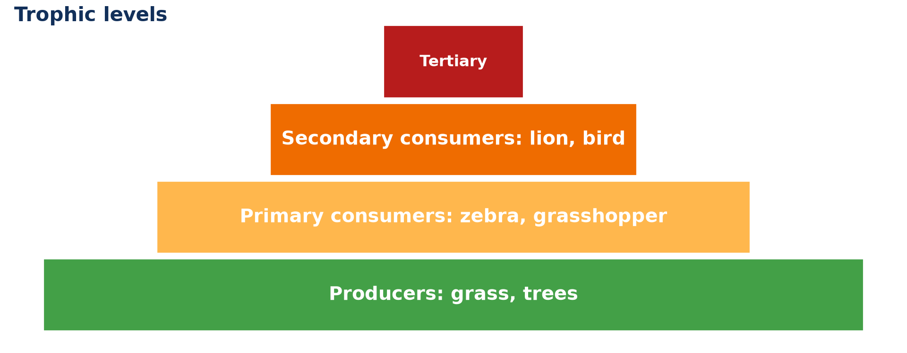
1. MEANING AND ILLUSTRATION
Activity 1
Trophic levels as a pyramid.
Notes:
Activity 1. Look carefully at this diagram: trophic levels as a pyramid. Observe every detail before I ask the question.

Slide 19
1. MEANING AND ILLUSTRATION
Activity 1: Question
Name the trophic levels from the bottom to the top.
Notes:
Here is the question for Activity 1: Name the trophic levels from the bottom to the top. Take one minute to think and write your answer in your rough notebook.

Slide 20
1. MEANING AND ILLUSTRATION
Activity 1: Answer
Producers, primary consumers, secondary consumers, tertiary consumers.
Notes:
Let us check the answer together. Producers, primary consumers, secondary consumers, tertiary consumers.

Slide 21

3. FOOD CHAINS
Activity 2
A lioness stalking zebras.
Notes:
Activity 2. Look carefully at this picture: a lioness stalking zebras. Observe every detail before I ask the question.

Slide 22
3. FOOD CHAINS
Activity 2: Question
Write a food chain with the lion.
Notes:
Here is the question for Activity 2: Write a food chain with the lion. Take one minute to think and write your answer in your rough notebook.

Slide 23
3. FOOD CHAINS
Activity 2: Answer
Grass → zebra → lion.
Notes:
Let us check the answer together. Grass → zebra → lion.

Slide 24
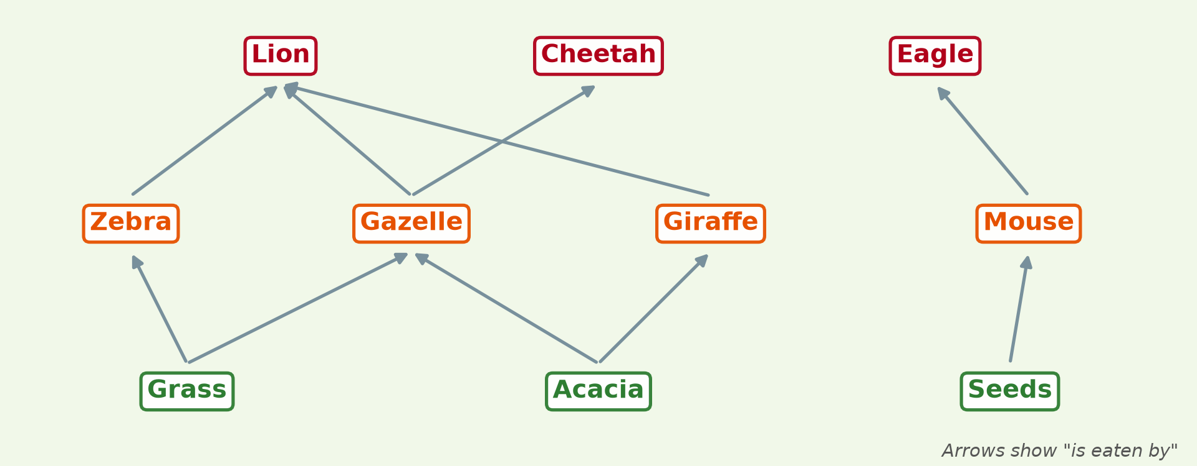
3. FOOD WEBS
Activity 3
A savanna food web.
Notes:
Activity 3. Look carefully at this diagram: a savanna food web. Observe every detail before I ask the question.

Slide 25
3. FOOD WEBS
Activity 3: Question
Why is a food web more stable than a single chain?
Notes:
Here is the question for Activity 3: Why is a food web more stable than a single chain? Take one minute to think and write your answer in your rough notebook.

Slide 26
3. FOOD WEBS
Activity 3: Answer
Animals have several food sources, so losing one is less serious.
Notes:
Let us check the answer together. Animals have several food sources, so losing one is less serious.

Slide 27

3. FOOD WEBS: DECOMPOSERS
Activity 4
A fungus feeding on dead wood.
Notes:
Activity 4. Look carefully at this picture: a fungus feeding on dead wood. Observe every detail before I ask the question.

Slide 28
3. FOOD WEBS: DECOMPOSERS
Activity 4: Question
Where do decomposers fit in a food web?
Notes:
Here is the question for Activity 4: Where do decomposers fit in a food web? Take one minute to think and write your answer in your rough notebook.

Slide 29
3. FOOD WEBS: DECOMPOSERS
Activity 4: Answer
They feed on dead matter from all levels.
Notes:
Let us check the answer together. They feed on dead matter from all levels.

Slide 30

2. LIMITATION OF TROPHIC LEVELS
Activity 5
Elephants, large herbivores.
Notes:
Activity 5. Look carefully at this picture: elephants, large herbivores. Observe every detail before I ask the question.

Slide 31
2. LIMITATION OF TROPHIC LEVELS
Activity 5: Question
Why are there rarely more than four or five trophic levels?
Notes:
Here is the question for Activity 5: Why are there rarely more than four or five trophic levels? Take one minute to think and write your answer in your rough notebook.

Slide 32
2. LIMITATION OF TROPHIC LEVELS
Activity 5: Answer
Too little energy is left for another level.
Notes:
Let us check the answer together. Too little energy is left for another level.

Slide 33
BOARD SUMMARY
Board Summary
Topic: Ecological Systems (Ecosystems)
Sub-topic: The Functioning of Ecosystems
Lesson 22: Trophic Levels, Food Chains and Food Webs
Notes:
Now we are going to copy the board summary. Write the title and the headings neatly in your notebooks. I will give you enough time for each slide, so do not rush.

Slide 34
BOARD SUMMARY
1. Meaning and Illustration of Trophic Levels
Trophic levels can be understood as follows:
Trophic level: It is the position of an organism in a food chain, according to how it gets its food.
Notes:
Let us copy Meaning and Illustration of Trophic Levels. Trophic levels can be understood as follows. On this slide we have Trophic level. Write each point on a new line, with the key term first, and explain it in your own words when we revise. When you finish, we go to the next slide.

Slide 35
BOARD SUMMARY
1. Meaning and Illustration of Trophic Levels (continued)
Illustration: Level 1 is producers (plants), level 2 primary consumers (herbivores), level 3 secondary consumers and level 4 tertiary consumers. They are shown as a pyramid.
Notes:
We continue with Meaning and Illustration of Trophic Levels. On this slide we have Illustration. Write each point on a new line, with the key term first, and explain it in your own words when we revise.

Slide 36
BOARD SUMMARY
1. Meaning and Illustration of Trophic Levels
Illustration: a trophic pyramid
Notes:
Now draw this illustration in your notebook: a trophic pyramid. Give it a title and label it clearly.

Slide 37
BOARD SUMMARY
2. Stepwise Nature and Limitation
Trophic levels are limited as follows:
Stepwise nature: Energy passes step by step from one level to the next. Each step has less energy, fewer organisms and less biomass.
Notes:
Let us copy Stepwise Nature and Limitation. Trophic levels are limited as follows. On this slide we have Stepwise nature. Write each point on a new line, with the key term first, and explain it in your own words when we revise. When you finish, we go to the next slide.

Slide 38
BOARD SUMMARY
2. Stepwise Nature and Limitation (continued)
Limitation: Because about 90 % of energy is lost at each step, there is rarely enough energy for more than four or five levels. Top predators such as lions are few.
Notes:
We continue with Stepwise Nature and Limitation. On this slide we have Limitation. Write each point on a new line, with the key term first, and explain it in your own words when we revise.

Slide 39
BOARD SUMMARY
3. Food Chains and Food Webs
Feeding relationships are shown as follows:
Food chain: It is a simple line showing who eats whom. Example: grass → zebra → lion.
Food web: It is a network of connected food chains in an ecosystem. It is more stable, because animals have several food sources.
Notes:
Let us copy Food Chains and Food Webs. Feeding relationships are shown as follows. On this slide we have Food chain and Food web. Write each point on a new line, with the key term first, and explain it in your own words when we revise. When you finish, we go to the next slide.

Slide 40
BOARD SUMMARY
3. Food Chains and Food Webs (continued)
Decomposers: They feed on dead matter from all levels. They recycle nutrients back to the producers.
Notes:
We continue with Food Chains and Food Webs. On this slide we have Decomposers. Write each point on a new line, with the key term first, and explain it in your own words when we revise.

Slide 41
BOARD SUMMARY
3. Food Chains and Food Webs
Illustration: a food web
Notes:
Now draw this illustration in your notebook: a food web. Give it a title and label it clearly.

Slide 42
FORMATIVE EVALUATION
Evaluation 1
Distinguish a food chain and a food web.
Notes:
Now let us check what you have understood. Question 1: Distinguish a food chain and a food web. Answer in your exercise book.

Slide 43
FORMATIVE EVALUATION
Expected Answer
A food chain is one line of feeding; a food web is a network of linked chains.
Notes:
The expected answer is: a food chain is one line of feeding; a food web is a network of linked chains. If you got it right, well done.

Slide 44
FORMATIVE EVALUATION
Evaluation 2
Why are trophic levels limited?
Notes:
Now let us check what you have understood. Question 2: Why are trophic levels limited? Answer in your exercise book.

Slide 45
FORMATIVE EVALUATION
Expected Answer
Energy is lost at each level, so little is left for higher levels.
Notes:
The expected answer is: energy is lost at each level, so little is left for higher levels. If you got it right, well done.

Slide 46
REMEDIATION
Remediation
Fill in the blanks:
Plants are on the first ______ level.
Herbivores are ______ consumers.
A network of food chains is a food ______.
Notes:
For those who need more practice, fill in the blanks in your exercise book. The answers are: number 1, trophic; number 2, primary; number 3, web.

Slide 47
HOMEWORK
Homework
Build a food web of five animals and three plants from your area.
Notes:
For your homework: Build a food web of five animals and three plants from your area. We shall correct it at the beginning of our next lesson.

Slide 48
NEXT LESSON
Next Lesson
Our next lesson will be on:
Lesson 23: Nutrient Cycling and the Gersmehl Model
Notes:
Our next lesson will be on Lesson 23: Nutrient Cycling and the Gersmehl Model. Thank you for your attention, and see you next time.

Slide 49
BILINGUAL GAME
Bilingual Game (Jeu Bilingue)
English | Français
Trophic level | Le niveau trophique
Herbivore | L'herbivore
Carnivore | Le carnivore
Food web | Le réseau alimentaire
Pyramid | La pyramide
Prey | La proie
Notes:
Let us play the bilingual game. I say a word in English, and you give me the French word. Then we do the reverse.

Slide 50
LOGBOOK
Official Logbook (1/2)
Module / Topic | Ecological Systems (Ecosystems)
Lesson Title | Lesson 22: Trophic Levels, Food Chains and Food Webs
Expected Learning Outcomes | Define trophic level and name the levels. Build a food chain and a food web. Explain why the number of trophic levels is limited.
Competence | Learners are able to build food chains and food webs and explain trophic levels.
Notes:
I record this information in the official logbook of the class after the lesson.

Slide 51
LOGBOOK
Official Logbook (2/2)
Matter Taught | Meaning and Illustration of Trophic Levels; Stepwise Nature and Limitation; Food Chains and Food Webs.
Evaluation | Formative evaluation and remediation exercise.
Homework | Build a food web of five animals and three plants from your area.
Enrolment / Present / Absent | ____ / ____ / ____
Achievement | To be completed after the lesson.
Notes:
I complete the second page of the logbook: the matter taught, the evaluation, the homework and the attendance.

Slide 52
TEACHER'S NOTE
Teacher's Note
Timing: Homework correction, plan, objectives 8 min | Recall, situation, action 10 min | 5 activities 30 min | Board summary (copying) 30 min | Evaluation, remediation 10 min | Homework, next lesson 5 min | Logbook 7 min
Without the projector (Activity 1): draw the pyramid.
Without the projector (Activity 2): write chains from the savanna.
Without the projector (Activity 3): draw arrows between animals.
Without the projector (Activity 4): add decomposers to the web.
Without the projector (Activity 5): recall the 10 % rule.
Notes:
This slide is for me, the teacher: it gives the timing of the lesson and what to do if the projector is not available.

Slide 53
REFERENCES
References
National Geography Syllabus, MINESEC/IGE/IP-SS, 2019 — Module 3 (Biogeography).
Photo, Activity 2: “hunt is on” by @Doug88888, CC BY-NC-SA 2.0, via Flickr (https://www.flickr.com/photos/29468339@N02/2930690305)
Photo, Activity 4: “Mushroom, underneath_2012-09-21-14.51.00 ZS PMax” by Sam Droege, Public domain 1.0, via Flickr (https://www.flickr.com/photos/54563451@N08/8016189217)
Photo, Activity 5: “African Bush Elephants, Maasai Mara” by Ray in Manila, CC BY 2.0, via Flickr (https://www.flickr.com/photos/21186555@N07/50627864261)
Diagrams and animations: drawn for this lesson (Geography Department).
Notes:
These are the references and picture credits used to prepare this lesson.

