Slide 1
LOWER SIXTH ARTS
GEOGRAPHY
Practical Work 2
Measurement of Ecosystem Productivity
Notes:
Good morning, class, and welcome to our geography lesson. I am your geography teacher, Mr Kamdem. Today we are starting Practical Work 2: Measurement of Ecosystem Productivity.

Slide 2
CLASS INFO
Class, Chapter and Duration
Class | Lower Sixth Arts
Chapter | Module 3: Understanding and managing biogeographic zones across the world in general and Cameroon in particular
Duration | 2 periods (2 × 50 minutes)
Notes:
This lesson is for Lower Sixth Arts. It belongs to Module 3: Understanding and managing biogeographic zones across the world in general and Cameroon in particular. We shall need 2 periods to cover it.

Slide 3
IDENTIFICATION
Lesson Identification
Topic | Ecological Systems (Ecosystems)
Sub-topic | Ecosystem Productivity
Lesson | Practical Work 2: Measurement of Ecosystem Productivity
Notions / Concepts | GPP, respiration, NPP, net productivity per unit area, bar graph, ranking.
Syllabus focus | Calculate net productivity from tables; draw bar graphs; classify ecosystems by net productivity per unit area; explain differences.
Competence | Learners are able to calculate and compare the net productivity of ecosystems.
Notes:
Our topic is Ecological Systems (Ecosystems), and the sub-topic is Ecosystem Productivity. The key notions we shall use today are: gPP, respiration, NPP, net productivity per unit area, bar graph, ranking. At the end, you should be able to do this: learners are able to calculate and compare the net productivity of ecosystems.

Slide 4

HOMEWORK CORRECTION
Correction of the Homework
Question (Lesson 26: Productivity of Ecosystems):
Rank five biomes by productivity and give one reason for each.
Notes:
Before we start the new lesson, let us correct the homework I gave you at the end of Lesson 26: Productivity of Ecosystems. The question was: Rank five biomes by productivity and give one reason for each. Take out your exercise books.

Slide 5
HOMEWORK CORRECTION
Correction: Possible Answer
Rainforest (warm and wet all year) > swamp (water and nutrients) > savanna (dry season) > temperate grassland > desert (lack of water) and tundra (cold).
Notes:
Here is a good answer. Rainforest (warm and wet all year) > swamp (water and nutrients) > savanna (dry season) > temperate grassland > desert (lack of water) and tundra (cold). Compare it with your own answer and correct your work in red.

Slide 6
LESSON PLAN
Lesson Plan
Correction of the homework
Objectives and recall
Real-life situation and action to take
Learning activities
Board summary
Evaluation, remediation and homework
Notes:
Here is the plan of our lesson today. First, we shall correct the homework. Then we shall look at the objectives and recall what you already know. After that, we shall study a situation from real life and the action to take, and do the learning activities. Finally, we shall copy the board summary, do the evaluation and the remediation, and I will give you the homework.

Slide 7
OBJECTIVES
Objectives
By the end of this lesson, you should be able to:
Calculate NPP from GPP and respiration.
Draw a bar graph of productivity.
Rank ecosystems and explain the differences.
Notes:
By the end of this lesson, you should be able to do three things. Number 1: calculate NPP from GPP and respiration. Number 2: draw a bar graph of productivity. Number 3: rank ecosystems and explain the differences.

Slide 8
PREVIOUS KNOWLEDGE
Previous Knowledge
NPP = GPP − respiration.
Rainforests are the most productive land biomes.
Notes:
Let us first remember what you already know. NPP = GPP − respiration. Rainforests are the most productive land biomes. Keep this in mind, because we shall build on it today.

Slide 9
REAL-LIFE SITUATION
Situation in Real Life
The Ministry of Forests gives the class a table of gross productivity and respiration for four biomes. The class must calculate net productivity and rank the biomes.
Notes:
Listen carefully to this situation from real life. The Ministry of Forests gives the class a table of gross productivity and respiration for four biomes. The class must calculate net productivity and rank the biomes. Think about it, because I am going to ask you some questions.

Slide 10
REAL-LIFE SITUATION
Situation: Question 1
What is the problem in the situation?
Notes:
Question 1: What is the problem in the situation? Think for a moment, then raise your hand to answer.

Slide 11
REAL-LIFE SITUATION
Answer
The class must calculate and compare productivity.
Notes:
Good. The class must calculate and compare productivity.

Slide 12
REAL-LIFE SITUATION
Situation: Question 2
What formula will they use?
Notes:
Question 2: What formula will they use? Think for a moment, then raise your hand to answer.

Slide 13
REAL-LIFE SITUATION
Answer
NPP = GPP − respiration.
Notes:
Good. NPP = GPP − respiration.

Slide 14
REAL-LIFE SITUATION
Situation: Question 3
How will they show the results?
Notes:
Question 3: How will they show the results? Think for a moment, then raise your hand to answer.

Slide 15
REAL-LIFE SITUATION
Possible Answer
With a bar graph.
Notes:
Good. With a bar graph.

Slide 16
ACTION TO TAKE
Action to Take
Calculate and compare the productivity of ecosystems.
Notes:
From this situation, the action we are working towards in this lesson is the following: calculate and compare the productivity of ecosystems.

Slide 17
JUSTIFICATION
Justification of the Lesson
This practical work helps us to use data to compare ecosystems.
Notes:
Why is this lesson important for you? This practical work helps us to use data to compare ecosystems.

Slide 18
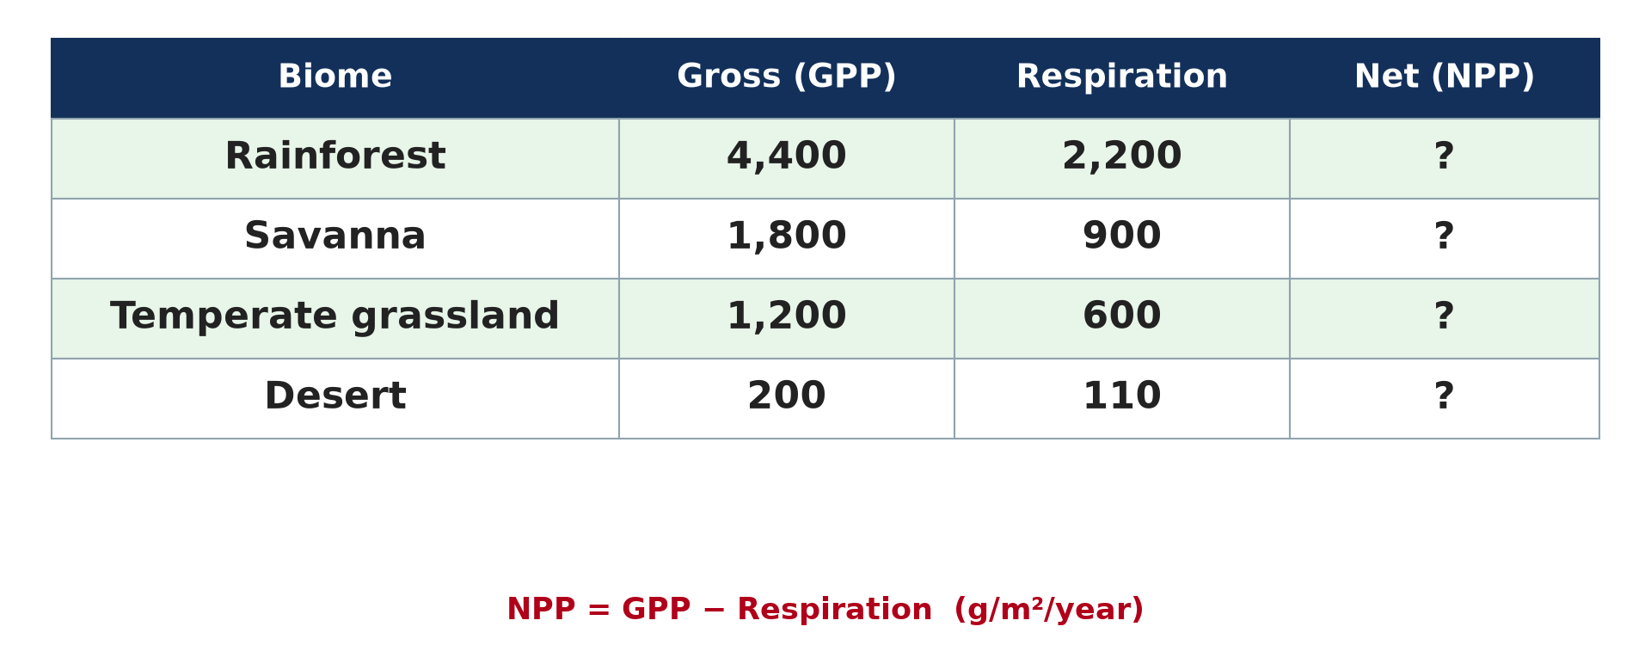
1. THE DATA
Activity 1
GPP and respiration of four biomes.
Notes:
Activity 1. Look carefully at this diagram: gPP and respiration of four biomes. Observe every detail before I ask the question.

Slide 19
1. THE DATA
Activity 1: Question
Calculate the NPP of the rainforest and the desert.
Notes:
Here is the question for Activity 1: Calculate the NPP of the rainforest and the desert. Take one minute to think and write your answer in your rough notebook.

Slide 20
1. THE DATA
Activity 1: Answer
Rainforest: 4,400 − 2,200 = 2,200. Desert: 200 − 110 = 90 g/m²/year.
Notes:
Let us check the answer together. Rainforest: 4,400 − 2,200 = 2,200. Desert: 200 − 110 = 90 g/m²/year.

Slide 21
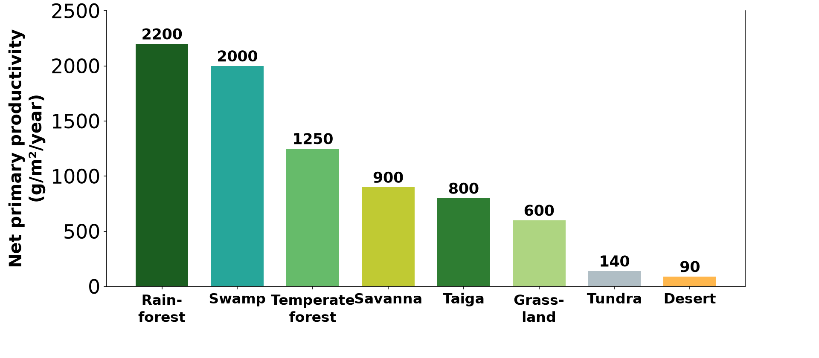
2. BAR GRAPH
Activity 2
A bar graph of NPP.
Notes:
Activity 2. Look carefully at this diagram: a bar graph of NPP. Observe every detail before I ask the question.

Slide 22
2. BAR GRAPH
Activity 2: Question
Rank the four biomes from highest to lowest NPP.
Notes:
Here is the question for Activity 2: Rank the four biomes from highest to lowest NPP. Take one minute to think and write your answer in your rough notebook.

Slide 23
2. BAR GRAPH
Activity 2: Answer
Rainforest (2,200), savanna (900), temperate grassland (600), desert (90).
Notes:
Let us check the answer together. Rainforest (2,200), savanna (900), temperate grassland (600), desert (90).

Slide 24

3. PRODUCTIVITY PER UNIT AREA
Activity 3
A quadrat used to sample vegetation.
Notes:
Activity 3. Look carefully at this picture: a quadrat used to sample vegetation. Observe every detail before I ask the question.

Slide 25
3. PRODUCTIVITY PER UNIT AREA
Activity 3: Question
A 1 m² quadrat of grass gives 900 g of dry matter in a year. What is the NPP?
Notes:
Here is the question for Activity 3: A 1 m² quadrat of grass gives 900 g of dry matter in a year. What is the NPP? Take one minute to think and write your answer in your rough notebook.

Slide 26
3. PRODUCTIVITY PER UNIT AREA
Activity 3: Answer
900 g/m²/year.
Notes:
Let us check the answer together. 900 g/m²/year.

Slide 27

4. INTERPRETATION
Activity 4
Savanna in the dry season.
Notes:
Activity 4. Look carefully at this picture: savanna in the dry season. Observe every detail before I ask the question.

Slide 28
4. INTERPRETATION
Activity 4: Question
Why is savanna NPP lower than rainforest NPP?
Notes:
Here is the question for Activity 4: Why is savanna NPP lower than rainforest NPP? Take one minute to think and write your answer in your rough notebook.

Slide 29
4. INTERPRETATION
Activity 4: Answer
It has a long dry season, so plants grow only part of the year.
Notes:
Let us check the answer together. It has a long dry season, so plants grow only part of the year.

Slide 30

4. INTERPRETATION
Activity 5
The main biomes of the world.
Notes:
Activity 5. Look carefully at this diagram: the main biomes of the world. Observe every detail before I ask the question.

Slide 31
4. INTERPRETATION
Activity 5: Question
What is the main reason for the low NPP of deserts?
Notes:
Here is the question for Activity 5: What is the main reason for the low NPP of deserts? Take one minute to think and write your answer in your rough notebook.

Slide 32
4. INTERPRETATION
Activity 5: Answer
Lack of water.
Notes:
Let us check the answer together. Lack of water.

Slide 33
BOARD SUMMARY
Board Summary
Topic: Ecological Systems (Ecosystems)
Sub-topic: Ecosystem Productivity
Practical Work 2: Measurement of Ecosystem Productivity
Notes:
Now we are going to copy the board summary. Write the title and the headings neatly in your notebooks. I will give you enough time for each slide, so do not rush.

Slide 34
BOARD SUMMARY
DEFINITIONS
The key terms of this lesson are defined as follows:
Gross productivity: It is the total organic matter produced by plants.
Net productivity: It is the gross productivity minus the matter used in respiration.
Notes:
Let us copy the definitions. The key terms of this lesson are defined as follows. On this slide we have Gross productivity and Net productivity. Write each point on a new line, with the key term first, and explain it in your own words when we revise.

Slide 35
BOARD SUMMARY
1. Calculations
Productivity data are processed as follows:
Net productivity: NPP = gross productivity − respiration. For example, 4,000 − 1,800 = 2,200 g/m²/year for the rainforest.
Notes:
Let us copy Calculations. Productivity data are processed as follows. On this slide we have Net productivity. Write each point on a new line, with the key term first, and explain it in your own words when we revise. When you finish, we go to the next slide.

Slide 36
BOARD SUMMARY
1. Calculations (continued)
Productivity per unit area: Divide the total production by the surface area to compare ecosystems of different sizes. A 1 m² quadrat giving 900 g of dry matter gives 900 g/m²/year.
Notes:
We continue with Calculations. On this slide we have Productivity per unit area. Write each point on a new line, with the key term first, and explain it in your own words when we revise.

Slide 37
BOARD SUMMARY
1. Calculations
Illustration: productivity data
Notes:
Now draw this illustration in your notebook: productivity data. Give it a title and label it clearly.

Slide 38
BOARD SUMMARY
2. Presentation and Interpretation
The results are presented and interpreted as follows:
Bar graph: Draw one bar for the NPP of each biome and rank them from highest to lowest. Label the axes and give a title.
Notes:
Let us copy Presentation and Interpretation. The results are presented and interpreted as follows. On this slide we have Bar graph. Write each point on a new line, with the key term first, and explain it in your own words when we revise. When you finish, we go to the next slide.

Slide 39
BOARD SUMMARY
2. Presentation and Interpretation (continued)
Classification: The rainforest is high, the savanna medium and the desert low in NPP per unit area. Ecosystems are classed as high, medium or low productivity.
Reasons for differences: Rainforests have heat, light and water all year. Savannas have a dry season, and deserts lack water.
Notes:
We continue with Presentation and Interpretation. On this slide we have Classification and Reasons for differences. Write each point on a new line, with the key term first, and explain it in your own words when we revise.

Slide 40
BOARD SUMMARY
2. Presentation and Interpretation
Illustration: bar graph of NPP
Notes:
Now draw this illustration in your notebook: bar graph of NPP. Give it a title and label it clearly.

Slide 41
FORMATIVE EVALUATION
Evaluation 1
A grassland has GPP 1,500 and respiration 700. Find the NPP.
Notes:
Now let us check what you have understood. Question 1: A grassland has GPP 1,500 and respiration 700. Find the NPP. Answer in your exercise book.

Slide 42
FORMATIVE EVALUATION
Expected Answer
800 g/m²/year.
Notes:
The expected answer is: 800 g/m²/year. If you got it right, well done.

Slide 43
FORMATIVE EVALUATION
Evaluation 2
Why does the tundra have a low NPP?
Notes:
Now let us check what you have understood. Question 2: Why does the tundra have a low NPP? Answer in your exercise book.

Slide 44
FORMATIVE EVALUATION
Expected Answer
It is very cold with a short growing season.
Notes:
The expected answer is: it is very cold with a short growing season. If you got it right, well done.

Slide 45
REMEDIATION
Remediation
Fill in the blanks:
NPP is measured in g per m² per ______.
The biome with the lowest NPP is the ______.
Plants in a quadrat are cut, dried and ______.
Notes:
For those who need more practice, fill in the blanks in your exercise book. The answers are: number 1, year; number 2, desert; number 3, weighed.

Slide 46
HOMEWORK
Homework
Draw the bar graph of the four biomes and write three sentences explaining it.
Notes:
For your homework: Draw the bar graph of the four biomes and write three sentences explaining it. We shall correct it at the beginning of our next lesson.

Slide 47
NEXT LESSON
Next Lesson
Our next lesson will be on:
Lesson 27: Biomes
Notes:
Our next lesson will be on Lesson 27: Biomes. Thank you for your attention, and see you next time.

Slide 48
BILINGUAL GAME
Bilingual Game (Jeu Bilingue)
English | Français
Table | Le tableau
Calculate | Calculer
Bar graph | L'histogramme
Rank | Classer
Average | La moyenne
Sample | L'échantillon
Notes:
Let us play the bilingual game. I say a word in English, and you give me the French word. Then we do the reverse.

Slide 49
LOGBOOK
Official Logbook (1/2)
Module / Topic | Ecological Systems (Ecosystems)
Lesson Title | Practical Work 2: Measurement of Ecosystem Productivity
Expected Learning Outcomes | Calculate NPP from GPP and respiration. Draw a bar graph of productivity. Rank ecosystems and explain the differences.
Competence | Learners are able to calculate and compare the net productivity of ecosystems.
Notes:
I record this information in the official logbook of the class after the lesson.

Slide 50
LOGBOOK
Official Logbook (2/2)
Matter Taught | DEFINITIONS; Calculations; Presentation and Interpretation.
Evaluation | Formative evaluation and remediation exercise.
Homework | Draw the bar graph of the four biomes and write three sentences explaining it.
Enrolment / Present / Absent | ____ / ____ / ____
Achievement | To be completed after the lesson.
Notes:
I complete the second page of the logbook: the matter taught, the evaluation, the homework and the attendance.

Slide 51
TEACHER'S NOTE
Teacher's Note
Timing: Homework correction, plan, objectives 8 min | Recall, situation, action 10 min | 5 activities 30 min | Board summary (copying) 30 min | Evaluation, remediation 10 min | Homework, next lesson 5 min | Logbook 7 min
Without the projector (Activity 1): copy the table.
Without the projector (Activity 2): draw bars on graph paper.
Without the projector (Activity 3): describe cutting, drying and weighing.
Without the projector (Activity 4): link to climate graphs.
Without the projector (Activity 5): find the deserts on the map.
Notes:
This slide is for me, the teacher: it gives the timing of the lesson and what to do if the projector is not available.

Slide 52
REFERENCES
References
National Geography Syllabus, MINESEC/IGE/IP-SS, 2019 — Module 3 (Biogeography).
Photo, Activity 3: “Vegetation Monitoring, Katmai NPP” by swanNPS, CC BY-NC 2.0, via Flickr (https://www.flickr.com/photos/90673956@N06/16796099732)
Photo, Activity 4: “Blue Wildebeest in the Lowveld” by Martin_Heigan, CC BY-NC-ND 2.0, via Flickr (https://www.flickr.com/photos/97303475@N00/2089079933)
Diagrams and animations: drawn for this lesson (Geography Department).
Notes:
These are the references and picture credits used to prepare this lesson.

