Slide 1
LOWER SIXTH ARTS
GEOGRAPHY
Further Study 3
Ecosystem Services
Notes:
Good morning, class, and welcome to our geography lesson. I am your geography teacher, Mr Kamdem. Today we are starting Further Study 3: Ecosystem Services.

Slide 2
CLASS INFO
Class, Chapter and Duration
Class | Lower Sixth Arts
Chapter | Module 3: Understanding and managing biogeographic zones across the world in general and Cameroon in particular
Duration | 2 periods (2 × 50 minutes)
Notes:
This lesson is for Lower Sixth Arts. It belongs to Module 3: Understanding and managing biogeographic zones across the world in general and Cameroon in particular. We shall need 2 periods to cover it.

Slide 3
IDENTIFICATION
Lesson Identification
Topic | Ecological Systems (Ecosystems)
Sub-topic | Global Terrestrial Ecosystems (Biomes)
Lesson | Further Study 3: Ecosystem Services
Notions / Concepts | Ecosystem services, provisioning, regulating, cultural, supporting services.
Syllabus focus | Resources of ecosystems to man: provisioning, regulating, cultural and supporting services, with examples.
Competence | Learners are able to explain the benefits of ecosystems and why they must be protected.
Notes:
Our topic is Ecological Systems (Ecosystems), and the sub-topic is Global Terrestrial Ecosystems (Biomes). The key notions we shall use today are: ecosystem services, provisioning, regulating, cultural, supporting services. At the end, you should be able to do this: learners are able to explain the benefits of ecosystems and why they must be protected.

Slide 4

HOMEWORK CORRECTION
Correction of the Homework
Question (Lesson 28: Characteristics of Tropical Biomes):
Make a table comparing the climate, vegetation, soils and uses of the three tropical biomes.
Notes:
Before we start the new lesson, let us correct the homework I gave you at the end of Lesson 28: Characteristics of Tropical Biomes. The question was: Make a table comparing the climate, vegetation, soils and uses of the three tropical biomes. Take out your exercise books.

Slide 5
HOMEWORK CORRECTION
Correction: Possible Answer
Rainforest: hot and wet; tall trees; ferrallitic soils; timber and cocoa. Savanna: wet and dry seasons; grass and trees; ferruginous soils; cattle and cotton. Desert: very dry; cacti and shrubs; thin sandy soils; oases and nomadic herding.
Notes:
Here is a good answer. Rainforest: hot and wet; tall trees; ferrallitic soils; timber and cocoa. Savanna: wet and dry seasons; grass and trees; ferruginous soils; cattle and cotton. Desert: very dry; cacti and shrubs; thin sandy soils; oases and nomadic herding. Compare it with your own answer and correct your work in red.

Slide 6
LESSON PLAN
Lesson Plan
Correction of the homework
Objectives and recall
Real-life situation and action to take
Learning activities
Board summary
Evaluation, remediation and homework
Notes:
Here is the plan of our lesson today. First, we shall correct the homework. Then we shall look at the objectives and recall what you already know. After that, we shall study a situation from real life and the action to take, and do the learning activities. Finally, we shall copy the board summary, do the evaluation and the remediation, and I will give you the homework.

Slide 7
OBJECTIVES
Objectives
By the end of this lesson, you should be able to:
Define ecosystem services.
Explain the four types of services with examples.
Notes:
Take your time to copy this part; we will continue together.

Slide 8
OBJECTIVES
Objectives (continued)
Explain why ecosystem services must be protected.
Notes:
By the end of this lesson, you should be able to do three things. Number 1: define ecosystem services. Number 2: explain the four types of services with examples. Number 3: explain why ecosystem services must be protected.

Slide 9
PREVIOUS KNOWLEDGE
Previous Knowledge
Ecosystems produce food and wood.
Vegetation protects soils and water.
Notes:
Let us first remember what you already know. Ecosystems produce food and wood. Vegetation protects soils and water. Keep this in mind, because we shall build on it today.

Slide 10
REAL-LIFE SITUATION
Situation in Real Life
Villagers near Korup National Park say that the forest gives them bush mango, medicines and clean water. Tourists also pay to visit it. A logger says the forest is only useful for timber.
Notes:
Listen carefully to this situation from real life. Villagers near Korup National Park say that the forest gives them bush mango, medicines and clean water. Tourists also pay to visit it. A logger says the forest is only useful for timber. Think about it, because I am going to ask you some questions.

Slide 11
REAL-LIFE SITUATION
Situation: Question 1
What is the problem in the situation?
Notes:
Question 1: What is the problem in the situation? Think for a moment, then raise your hand to answer.

Slide 12
REAL-LIFE SITUATION
Answer
People see different benefits in the forest.
Notes:
Good. People see different benefits in the forest.

Slide 13
REAL-LIFE SITUATION
Situation: Question 2
Name three benefits the forest gives the villagers.
Notes:
Question 2: Name three benefits the forest gives the villagers. Think for a moment, then raise your hand to answer.

Slide 14
REAL-LIFE SITUATION
Answer
Food, medicines and clean water.
Notes:
Good. Food, medicines and clean water.

Slide 15
REAL-LIFE SITUATION
Situation: Question 3
What do we call these benefits?
Notes:
Question 3: What do we call these benefits? Think for a moment, then raise your hand to answer.

Slide 16
REAL-LIFE SITUATION
Possible Answer
Ecosystem services.
Notes:
Good. Ecosystem services.

Slide 17
ACTION TO TAKE
Action to Take
Value and protect the services that ecosystems give us.
Notes:
From this situation, the action we are working towards in this lesson is the following: value and protect the services that ecosystems give us.

Slide 18
JUSTIFICATION
Justification of the Lesson
This further study helps us to value all the benefits that ecosystems give us.
Notes:
Why is this lesson important for you? This further study helps us to value all the benefits that ecosystems give us.

Slide 19
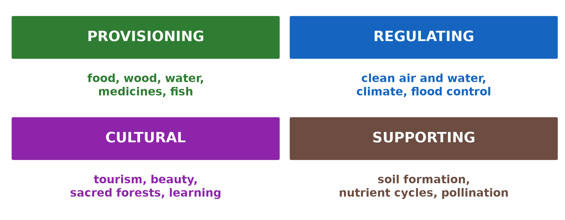
1. TYPES OF SERVICES
Activity 1
The four types of ecosystem services.
Notes:
Activity 1. Look carefully at this diagram: the four types of ecosystem services. Observe every detail before I ask the question.

Slide 20
1. TYPES OF SERVICES
Activity 1: Question
Name the four types of ecosystem services.
Notes:
Here is the question for Activity 1: Name the four types of ecosystem services. Take one minute to think and write your answer in your rough notebook.

Slide 21
1. TYPES OF SERVICES
Activity 1: Answer
Provisioning, regulating, cultural and supporting.
Notes:
Let us check the answer together. Provisioning, regulating, cultural and supporting.

Slide 22

2. PROVISIONING SERVICES
Activity 2
A fish market.
Notes:
Activity 2. Look carefully at this picture: a fish market. Observe every detail before I ask the question.

Slide 23
2. PROVISIONING SERVICES
Activity 2: Question
Give three provisioning services.
Notes:
Here is the question for Activity 2: Give three provisioning services. Take one minute to think and write your answer in your rough notebook.

Slide 24
2. PROVISIONING SERVICES
Activity 2: Answer
Food (fish, fruit), wood and water (also medicines).
Notes:
Let us check the answer together. Food (fish, fruit), wood and water (also medicines).

Slide 25
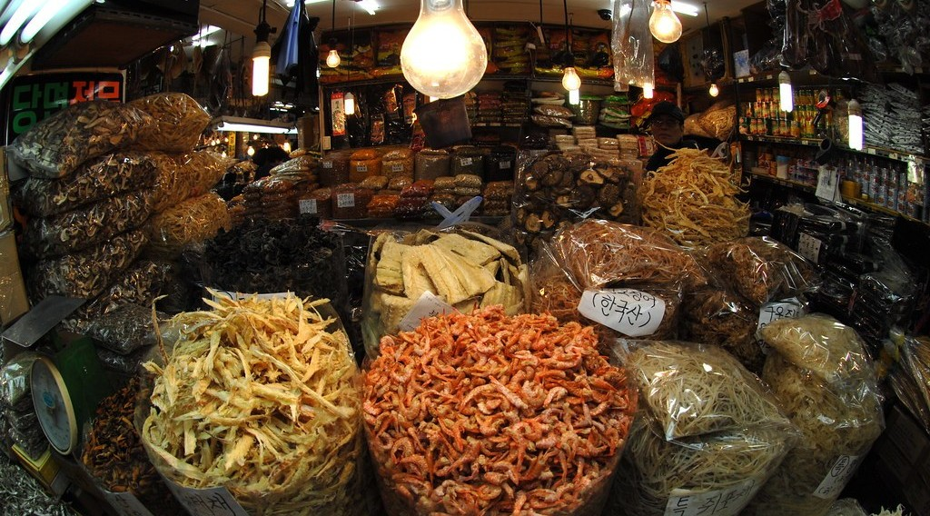
2. PROVISIONING SERVICES
Activity 3
Dried medicinal plants for sale in a market (Seoul).
Notes:
Activity 3. Look carefully at this picture: dried medicinal plants for sale in a market (Seoul). Observe every detail before I ask the question.

Slide 26
2. PROVISIONING SERVICES
Activity 3: Question
Why are ecosystems important for medicines?
Notes:
Here is the question for Activity 3: Why are ecosystems important for medicines? Take one minute to think and write your answer in your rough notebook.

Slide 27
2. PROVISIONING SERVICES
Activity 3: Answer
Many medicines come from plants and animals.
Notes:
Let us check the answer together. Many medicines come from plants and animals.

Slide 28
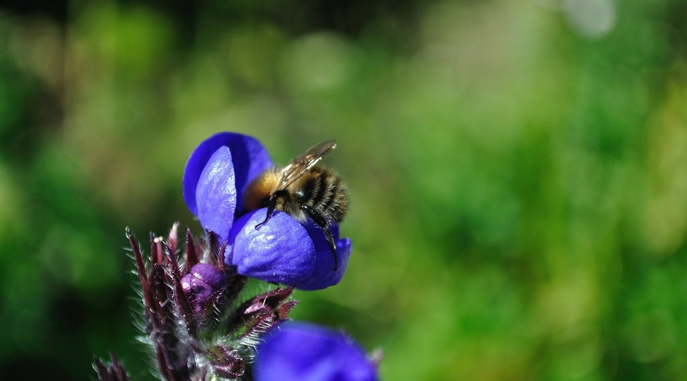
5. SUPPORTING SERVICES
Activity 4
A bee pollinating a flower.
Notes:
Activity 4. Look carefully at this picture: a bee pollinating a flower. Observe every detail before I ask the question.

Slide 29
5. SUPPORTING SERVICES
Activity 4: Question
Which service does the bee give to farmers?
Notes:
Here is the question for Activity 4: Which service does the bee give to farmers? Take one minute to think and write your answer in your rough notebook.

Slide 30
5. SUPPORTING SERVICES
Activity 4: Answer
Pollination (a supporting service).
Notes:
Let us check the answer together. Pollination (a supporting service).

Slide 31

4. CULTURAL SERVICES
Activity 5
A leopard seen on a safari drive.
Notes:
Activity 5. Look carefully at this picture: a leopard seen on a safari drive. Observe every detail before I ask the question.

Slide 32
4. CULTURAL SERVICES
Activity 5: Question
Give two cultural services of ecosystems.
Notes:
Here is the question for Activity 5: Give two cultural services of ecosystems. Take one minute to think and write your answer in your rough notebook.

Slide 33
4. CULTURAL SERVICES
Activity 5: Answer
Tourism and recreation (also sacred forests, education).
Notes:
Let us check the answer together. Tourism and recreation (also sacred forests, education).

Slide 34
BOARD SUMMARY
Board Summary
Topic: Ecological Systems (Ecosystems)
Sub-topic: Global Terrestrial Ecosystems (Biomes)
Further Study 3: Ecosystem Services
Notes:
Now we are going to copy the board summary. Write the title and the headings neatly in your notebooks. I will give you enough time for each slide, so do not rush.

Slide 35
BOARD SUMMARY
1. Meaning of Ecosystem Services
Ecosystem services can be understood as follows:
Ecosystem services: They are the benefits that people obtain from ecosystems. They are grouped into provisioning, regulating, cultural and supporting services.
Notes:
Let us copy Meaning of Ecosystem Services. Ecosystem services can be understood as follows. On this slide we have Ecosystem services. Write each point on a new line, with the key term first, and explain it in your own words when we revise.

Slide 36
BOARD SUMMARY
1. Meaning of Ecosystem Services
Illustration: types of ecosystem services
Notes:
Now draw this illustration in your notebook: types of ecosystem services. Give it a title and label it clearly.

Slide 37
BOARD SUMMARY
2. Types of Ecosystem Services
The four types of services are:
Provisioning services: Ecosystems supply food, fresh water, timber, fuelwood, fibres and medicines. For example, forests give bush mango and medicinal plants, and rivers give fish.
Notes:
Let us copy Types of Ecosystem Services. The four types of services are. On this slide we have Provisioning services. Write each point on a new line, with the key term first, and explain it in your own words when we revise. When you finish, we go to the next slide.

Slide 38
BOARD SUMMARY
2. Types of Ecosystem Services (continued)
Regulating services: Ecosystems regulate climate, store carbon, purify water and control floods and erosion. Mangroves protect coasts from storms.
Notes:
We continue with Types of Ecosystem Services. On this slide we have Regulating services. Write each point on a new line, with the key term first, and explain it in your own words when we revise. When you finish, we go to the next slide.

Slide 39
BOARD SUMMARY
2. Types of Ecosystem Services (continued)
Cultural services: Ecosystems give places for tourism, recreation, education and religious ceremonies. Waza park and sacred forests are examples.
Notes:
We continue with Types of Ecosystem Services. On this slide we have Cultural services. Write each point on a new line, with the key term first, and explain it in your own words when we revise. When you finish, we go to the next slide.

Slide 40
BOARD SUMMARY
2. Types of Ecosystem Services (continued)
Supporting services: They make all other services possible: soil formation, nutrient cycling, photosynthesis and pollination. Bees pollinate crops such as coffee.
Notes:
We continue with Types of Ecosystem Services. On this slide we have Supporting services. Write each point on a new line, with the key term first, and explain it in your own words when we revise.

Slide 41
FORMATIVE EVALUATION
Evaluation 1
Define ecosystem services.
Notes:
Now let us check what you have understood. Question 1: Define ecosystem services. Answer in your exercise book.

Slide 42
FORMATIVE EVALUATION
Expected Answer
The benefits that people get from ecosystems.
Notes:
The expected answer is: the benefits that people get from ecosystems. If you got it right, well done.

Slide 43
FORMATIVE EVALUATION
Evaluation 2
Give one example of each type of service.
Notes:
Now let us check what you have understood. Question 2: Give one example of each type of service. Answer in your exercise book.

Slide 44
FORMATIVE EVALUATION
Expected Answer
Provisioning: food; regulating: flood control; cultural: tourism; supporting: pollination.
Notes:
The expected answer is: provisioning: food; regulating: flood control; cultural: tourism; supporting: pollination. If you got it right, well done.

Slide 45
REMEDIATION
Remediation
Fill in the blanks:
Food and wood are ______ services.
Flood control is a ______ service.
Pollination is a ______ service.
Notes:
For those who need more practice, fill in the blanks in your exercise book. The answers are: number 1, provisioning; number 2, regulating; number 3, supporting.

Slide 46
HOMEWORK
Homework
List the services given by an ecosystem near your home and classify them.
Notes:
For your homework: List the services given by an ecosystem near your home and classify them. We shall correct it at the beginning of our next lesson.

Slide 47
BILINGUAL GAME
Bilingual Game (Jeu Bilingue)
English | Français
Service | Le service
Benefit | Le bénéfice
Pollination | La pollinisation
Tourism | Le tourisme
Medicine | Le médicament
Wetland | La zone humide
Notes:
Let us play the bilingual game. I say a word in English, and you give me the French word. Then we do the reverse.

Slide 48
LOGBOOK
Official Logbook (1/2)
Module / Topic | Ecological Systems (Ecosystems)
Lesson Title | Further Study 3: Ecosystem Services
Expected Learning Outcomes | Define ecosystem services. Explain the four types of services with examples. Explain why ecosystem services must be protected.
Competence | Learners are able to explain the benefits of ecosystems and why they must be protected.
Notes:
I record this information in the official logbook of the class after the lesson.

Slide 49
LOGBOOK
Official Logbook (2/2)
Matter Taught | Meaning of Ecosystem Services; Types of Ecosystem Services.
Evaluation | Formative evaluation and remediation exercise.
Homework | List the services given by an ecosystem near your home and classify them.
Enrolment / Present / Absent | ____ / ____ / ____
Achievement | To be completed after the lesson.
Notes:
I complete the second page of the logbook: the matter taught, the evaluation, the homework and the attendance.

Slide 50
TEACHER'S NOTE
Teacher's Note
Timing: Homework correction, plan, objectives 8 min | Recall, situation, action 10 min | 5 activities 30 min | Board summary (copying) 30 min | Evaluation, remediation 10 min | Homework, next lesson 5 min | Logbook 7 min
Without the projector (Activity 1): draw four boxes.
Without the projector (Activity 2): list products from forests and rivers.
Without the projector (Activity 3): name local medicinal plants.
Without the projector (Activity 4): explain pollination.
Without the projector (Activity 5): mention Waza and Limbe.
Notes:
This slide is for me, the teacher: it gives the timing of the lesson and what to do if the projector is not available.

Slide 51
REFERENCES
References
National Geography Syllabus, MINESEC/IGE/IP-SS, 2019 — Module 3 (Biogeography).
Photo, Activity 2: “Kenyan food, farming and landscapes” by CGIAR Climate, CC BY-NC-SA 2.0, via Flickr (https://www.flickr.com/photos/55227776@N04/14310899853)
Photo, Activity 3: “MEDICINE MARKET - SEOUL” by U.S. Army Korea (Historical Image Archive), CC BY-NC-ND 2.0, via Flickr (https://www.flickr.com/photos/28486074@N08/2920744660)
Photo, Activity 4: “Bee pollinating flower” by tombayly13, CC BY-SA 2.0, via Flickr (https://www.flickr.com/photos/60174932@N05/5797724005)
Photo, Activity 5: “Sri Lankan Leopard” by Shanaka Kalubowila, CC BY-NC-ND 2.0, via Flickr (https://www.flickr.com/photos/50057113@N06/43689916724)
Diagrams and animations: drawn for this lesson (Geography Department).
Notes:
These are the references and picture credits used to prepare this lesson.

