Slide 1
LOWER SIXTH ARTS
GEOGRAPHY
Lesson 2
Internal Structure of the Earth
Notes:
Good morning, class, and welcome to our geography lesson. I am your geography teacher, Mr Kamdem. Today we are starting Lesson 2: Internal Structure of the Earth.

Slide 2
CLASS INFO
Class, Chapter and Duration
Class | Lower Sixth Arts
Chapter | Module 2: Understanding and managing physical landscapes, geomorphological processes and hazards across the world in general and Cameroon in particular
Duration | 2 periods (2 × 50 minutes)
Notes:
This lesson is for Lower Sixth Arts. It belongs to Module 2: Understanding and managing physical landscapes, geomorphological processes and hazards across the world in general and Cameroon in particular. We shall need 2 periods to cover it.

Slide 3
IDENTIFICATION
Lesson Identification
Topic | The Development of the Earth's Structure
Sub-topic | The Origin and Earth's Structure
Lesson | Lesson 2: Internal Structure of the Earth
Notions / Concepts | Crust, lithosphere, mantle, asthenosphere, core, rock cycle, igneous, sedimentary and metamorphic rocks, internal and external forces, landform orders.
Syllabus focus | Layers of the Earth; the rock cycle and the three types of rocks; internal and external forces shaping the landscape; categories of landforms.
Competence | Learners are able to describe the internal structure of the Earth, the rock cycle and the forces that shape landforms around Garoua.
Notes:
Our topic is The Development of the Earth's Structure, and the sub-topic is The Origin and Earth's Structure. The key notions we shall use today are: crust, lithosphere, mantle, asthenosphere, core, rock cycle, igneous, sedimentary and metamorphic rocks, internal and external forces, landform orders. At the end, you should be able to do this: learners are able to describe the internal structure of the Earth, the rock cycle and the forces that shape landforms around Garoua.

Slide 4

HOMEWORK CORRECTION
Correction of the Homework
Question (Lesson 1: Origin of the Earth):
Name the three main layers of the Earth.
Notes:
Before we start the new lesson, let us correct the homework I gave you at the end of Lesson 1: Origin of the Earth. The question was: Name the three main layers of the Earth. Take out your exercise books.

Slide 5
HOMEWORK CORRECTION
Correction: Possible Answer
The crust, the mantle and the core.
Notes:
Here is a good answer. The crust, the mantle and the core. Compare it with your own answer and correct your work in red.

Slide 6
LESSON PLAN
Lesson Plan
Correction of the homework
Objectives and recall
Real-life situation and action to take
Learning activities
Board summary
Evaluation, remediation and homework
Notes:
Here is the plan of our lesson today. First, we shall correct the homework. Then we shall look at the objectives and recall what you already know. After that, we shall study a situation from real life and the action to take, and do the learning activities. Finally, we shall copy the board summary, do the evaluation and the remediation, and I will give you the homework.

Slide 7
OBJECTIVES
Objectives
By the end of this lesson, you should be able to:
Describe the crust, the mantle and the core.
Explain the rock cycle and the three types of rocks.
Notes:
Take your time to copy this part; we will continue together.

Slide 8
OBJECTIVES
Objectives (continued)
Distinguish internal and external forces.
Classify landforms into orders with examples.
Notes:
By the end of this lesson, you should be able to do four things. Number 1: describe the crust, the mantle and the core. Number 2: explain the rock cycle and the three types of rocks. Number 3: distinguish internal and external forces. Number 4: classify landforms into orders with examples.

Slide 9
PREVIOUS KNOWLEDGE
Previous Knowledge
The Earth formed about 4.6 billion years ago.
Endogenic processes build up the land.
Exogenic processes wear down the land.
Notes:
Let us first remember what you already know. The Earth formed about 4.6 billion years ago. Endogenic processes build up the land. Exogenic processes wear down the land. Keep this in mind, because we shall build on it today.

Slide 10
REAL-LIFE SITUATION
Situation in Real Life
Hassan helps his father build a new room in their compound at Yelwa, Garoua.
They use sand and gravel from the Benue riverbed for the concrete, but for the foundation his father insists on hard rocks bought from a quarry near the mountains.
Notes:
Take your time to copy this part; we will continue together.

Slide 11
REAL-LIFE SITUATION
Situation in Real Life (continued)
Hassan notices how different the soft river sand is from the hard quarry stone.
He asks: "Why are rocks so different, and what lies under all this sand and rock?"
Notes:
Listen carefully to this situation from real life. Hassan helps his father build a new room in their compound at Yelwa, Garoua. They use sand and gravel from the Benue riverbed for the concrete, but for the foundation his father insists on hard rocks bought from a quarry near the mountains. Hassan notices how different the soft river sand is from the hard quarry stone. He asks: "Why are rocks so different, and what lies under all this sand and rock?" Think about it, because I am going to ask you some questions.

Slide 12
REAL-LIFE SITUATION
Situation: Question 1
What is the problem in the situation?
Notes:
Question 1: What is the problem in the situation? Think for a moment, then raise your hand to answer.

Slide 13
REAL-LIFE SITUATION
Answer
Hassan does not know the internal structure of the Earth and how rocks form.
Notes:
Good. Hassan does not know the internal structure of the Earth and how rocks form.

Slide 14
REAL-LIFE SITUATION
Situation: Question 2
What are the main layers of the Earth?
Notes:
Question 2: What are the main layers of the Earth? Think for a moment, then raise your hand to answer.

Slide 15
REAL-LIFE SITUATION
Answer
The crust, the mantle and the core.
Notes:
Good. The crust, the mantle and the core.

Slide 16
REAL-LIFE SITUATION
Situation: Question 3
How do rocks form and change?
Notes:
Question 3: How do rocks form and change? Think for a moment, then raise your hand to answer.

Slide 17
REAL-LIFE SITUATION
Possible Answer
Through the rock cycle, powered by internal heat and surface energy.
Notes:
Good. Through the rock cycle, powered by internal heat and surface energy.

Slide 18
ACTION TO TAKE
Action to Take
Recognise the types of rocks around you and use them sustainably for building.
Notes:
From this situation, the action we are working towards in this lesson is the following: recognise the types of rocks around you and use them sustainably for building.

Slide 19
JUSTIFICATION
Justification of the Lesson
This lesson helps us to understand the materials and forces that shape the relief, and to choose building materials wisely.
Notes:
Why is this lesson important for you? This lesson helps us to understand the materials and forces that shape the relief, and to choose building materials wisely.

Slide 20

1. LAYERS
Activity 1
The layers of the Earth.
Notes:
Activity 1. Look carefully at this diagram: the layers of the Earth. Observe every detail before I ask the question.

Slide 21
1. LAYERS
Activity 1: Question
Which layer is the thickest?
Notes:
Here is the question for Activity 1: Which layer is the thickest? Take one minute to think and write your answer in your rough notebook.

Slide 22
1. LAYERS
Activity 1: Answer
The mantle (about 84 % of the volume of the Earth).
Notes:
Let us check the answer together. The mantle (about 84 % of the volume of the Earth).

Slide 23
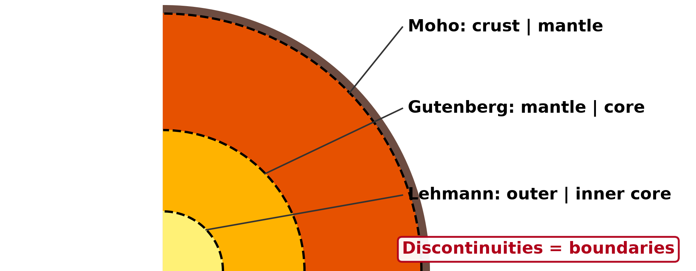
1. LAYERS
Activity 2
Boundaries inside the Earth.
Notes:
Activity 2. Look carefully at this diagram: boundaries inside the Earth. Observe every detail before I ask the question.

Slide 24
1. LAYERS
Activity 2: Question
What separates the crust from the mantle?
Notes:
Here is the question for Activity 2: What separates the crust from the mantle? Take one minute to think and write your answer in your rough notebook.

Slide 25
1. LAYERS
Activity 2: Answer
The Moho discontinuity.
Notes:
Let us check the answer together. The Moho discontinuity.

Slide 26
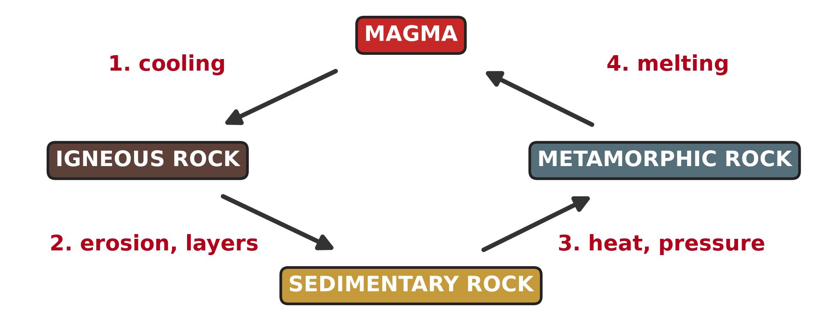
2. ROCK CYCLE
Activity 3
The rock cycle.
Notes:
Activity 3. Look carefully at this diagram: the rock cycle. Observe every detail before I ask the question.

Slide 27
2. ROCK CYCLE
Activity 3: Question
How does igneous rock form?
Notes:
Here is the question for Activity 3: How does igneous rock form? Take one minute to think and write your answer in your rough notebook.

Slide 28
2. ROCK CYCLE
Activity 3: Answer
When magma or lava cools and solidifies.
Notes:
Let us check the answer together. When magma or lava cools and solidifies.

Slide 29

3. FORCES
Activity 4
A gully cut by running water.
Notes:
Activity 4. Look carefully at this picture: a gully cut by running water. Observe every detail before I ask the question.

Slide 30
3. FORCES
Activity 4: Question
Is gully erosion an internal or an external force?
Notes:
Here is the question for Activity 4: Is gully erosion an internal or an external force? Take one minute to think and write your answer in your rough notebook.

Slide 31
3. FORCES
Activity 4: Answer
An external (exogenic) force.
Notes:
Let us check the answer together. An external (exogenic) force.

Slide 32
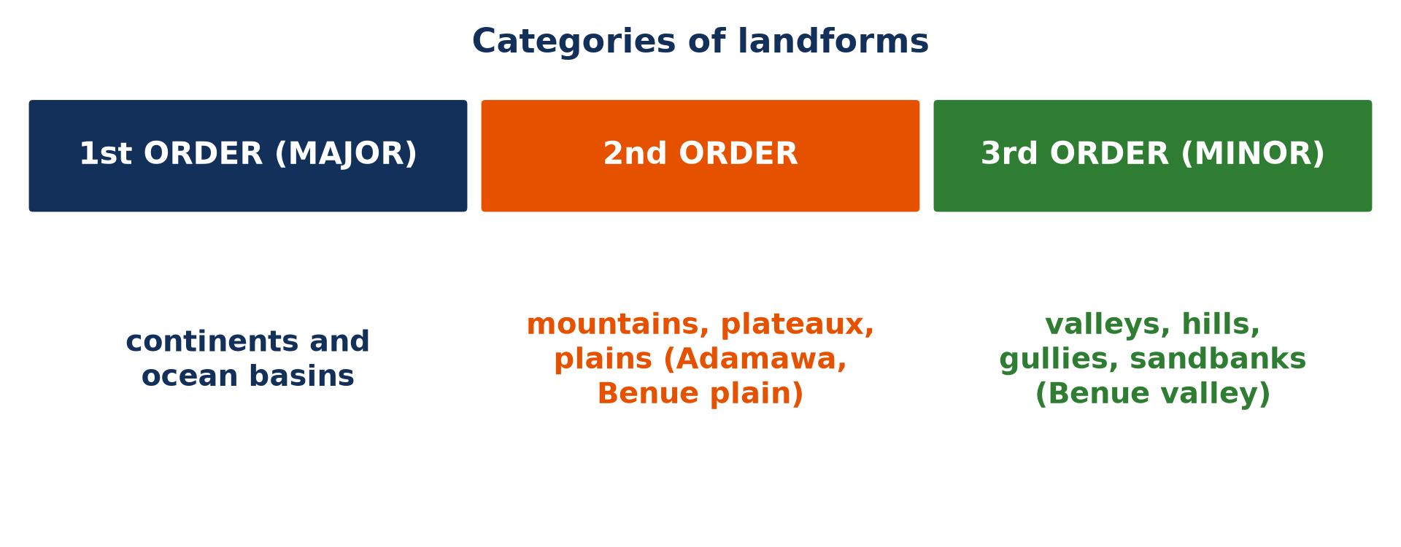
4. LANDFORMS
Activity 5
Categories of landforms.
Notes:
Activity 5. Look carefully at this picture: categories of landforms. Observe every detail before I ask the question.

Slide 33
4. LANDFORMS
Activity 5: Question
Give one landform of the second order in Cameroon.
Notes:
Here is the question for Activity 5: Give one landform of the second order in Cameroon. Take one minute to think and write your answer in your rough notebook.

Slide 34
4. LANDFORMS
Activity 5: Answer
The Adamawa Plateau, the Mandara Mountains or the Benue plain.
Notes:
Let us check the answer together. The Adamawa Plateau, the Mandara Mountains or the Benue plain.

Slide 35
BOARD SUMMARY
Board Summary
Topic: The Development of the Earth's Structure
Sub-topic: The Origin and Earth's Structure
Lesson 2: Internal Structure of the Earth
Notes:
Now we are going to copy the board summary. Write the title and the headings neatly in your notebooks. I will give you enough time for each slide, so do not rush.

Slide 36
BOARD SUMMARY
DEFINITIONS
The key terms of this lesson are defined as follows:
Lithosphere: It is the rigid layer made of the crust and the upper part of the mantle.
Discontinuity: It is a boundary inside the Earth where the speed of earthquake waves changes suddenly.
Notes:
Let us copy the definitions. The key terms of this lesson are defined as follows. On this slide we have Lithosphere and Discontinuity. Write each point on a new line, with the key term first, and explain it in your own words when we revise. When you finish, we go to the next slide.

Slide 37
BOARD SUMMARY
DEFINITIONS (continued)
Endogenesis: It is the set of internal processes, driven by the heat of the Earth, that build up the relief.
Exogenesis: It is the set of external processes, driven by the Sun and gravity, that wear down the relief.
Notes:
We continue with the definitions. On this slide we have Endogenesis and Exogenesis. Write each point on a new line, with the key term first, and explain it in your own words when we revise. When you finish, we go to the next slide.

Slide 38
BOARD SUMMARY
DEFINITIONS (continued)
Rock cycle: It is the continuous process by which rocks are formed, broken down and formed again.
Notes:
We continue with the definitions. On this slide we have Rock cycle. Write each point on a new line, with the key term first, and explain it in your own words when we revise.

Slide 39
BOARD SUMMARY
1. Layers of the Earth and their Properties
A) The Crust and the Mantle
The outer layers of the Earth have the following properties:
Continental crust: It forms the continents and is thick, from about 35 km to 70 km under mountains. It is light, with a density of about 2.7, and made mainly of granite, rich in silica and aluminium (SIAL).
Illustration: the layers of the Earth
Notes:
Let us copy The Crust and the Mantle. The outer layers of the Earth have the following properties. Copy the point on Continental crust on the left, then draw the diagram on the right: the layers of the Earth. Give it a title and label it clearly.

Slide 40
BOARD SUMMARY
1. Layers of the Earth and their Properties
A) The Crust and the Mantle
Oceanic crust: It forms the ocean floor and is thin, about 7 km. It is denser, about 3.0, and made of basalt, rich in silica and magnesium (SIMA), and it is younger than the continental crust.
Notes:
We continue with The Crust and the Mantle. Copy the point on Oceanic crust: write the key term first, then its explanation.

Slide 41
BOARD SUMMARY
1. Layers of the Earth and their Properties
A) The Crust and the Mantle
The mantle: The mantle reaches a depth of about 2,900 km and contains about 84 % of the volume of the Earth. Its rocks are solid but so hot that, in the asthenosphere, they flow very slowly like thick honey.
Notes:
We continue with The Crust and the Mantle. Copy the point on The mantle: write the key term first, then its explanation.

Slide 42
BOARD SUMMARY
1. Layers of the Earth and their Properties
A) The Crust and the Mantle
Lithosphere and asthenosphere: The crust and the rigid top of the mantle form the lithosphere, about 100 km thick, which is broken into plates. These plates move over the soft asthenosphere, which is why this part of the mantle is so important for landforms.
Notes:
We continue with The Crust and the Mantle. Copy the point on Lithosphere and asthenosphere: write the key term first, then its explanation.

Slide 43
BOARD SUMMARY
1. Layers of the Earth and their Properties
B) The Core and the Discontinuities
The deep layers of the Earth and their boundaries have the following properties:
Outer core: The outer core lies between about 2,900 and 5,100 km deep and is made of liquid iron and nickel. Its movements produce the magnetic field of the Earth.
Illustration: the interior of the Earth
Notes:
Let us copy The Core and the Discontinuities. The deep layers of the Earth and their boundaries have the following properties. Copy the point on Outer core on the left, then draw the diagram on the right: the interior of the Earth. Give it a title and label it clearly.

Slide 44
BOARD SUMMARY
1. Layers of the Earth and their Properties
B) The Core and the Discontinuities
Inner core: The inner core is a solid ball of iron and nickel at the centre, with a temperature of about 5,500 °C. It stays solid because of the enormous pressure.
Notes:
We continue with The Core and the Discontinuities. Copy the point on Inner core: write the key term first, then its explanation.

Slide 45
BOARD SUMMARY
1. Layers of the Earth and their Properties
B) The Core and the Discontinuities
Discontinuities: The Mohorovičić (Moho) discontinuity separates the crust from the mantle, and the Gutenberg discontinuity separates the mantle from the core. They were discovered because earthquake waves change speed and direction when they cross them.
Notes:
We continue with The Core and the Discontinuities. Copy the point on Discontinuities: write the key term first, then its explanation.

Slide 46
BOARD SUMMARY
2. The Rock Material Cycle
Rocks change from one type to another in the following cycle:
Igneous rocks: They form when magma cools inside the crust, like granite, or when lava cools at the surface, like basalt. They are the first rocks of the cycle and are common in the Western Highlands and around Mount Cameroon.
Illustration: the rock cycle
Notes:
Let us copy The Rock Material Cycle. Rocks change from one type to another in the following cycle. Copy the point on Igneous rocks on the left, then draw the diagram on the right: the rock cycle. Give it a title and label it clearly.

Slide 47
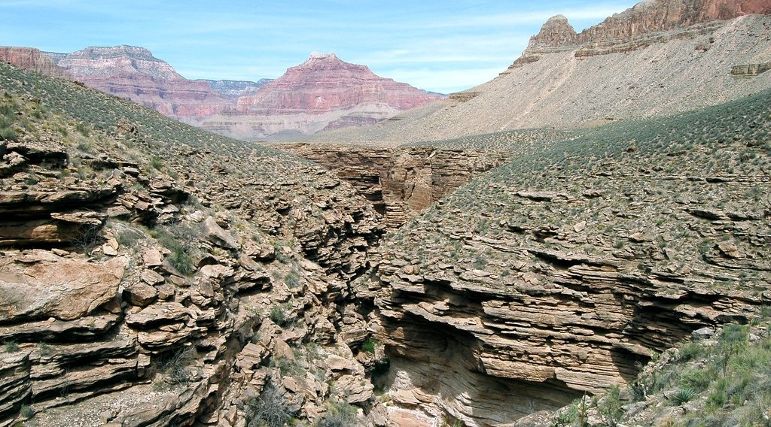
BOARD SUMMARY
2. The Rock Material Cycle
Sedimentary rocks: Rocks at the surface are weathered and eroded, and the fragments are deposited in layers that are compressed and cemented. The sandstones of the Benue valley near Garoua formed in this way.
Illustration: sandstone
Notes:
Copy the point on Sedimentary rocks on the left, then draw the diagram on the right: sandstone. Give it a title and label it clearly.

Slide 48
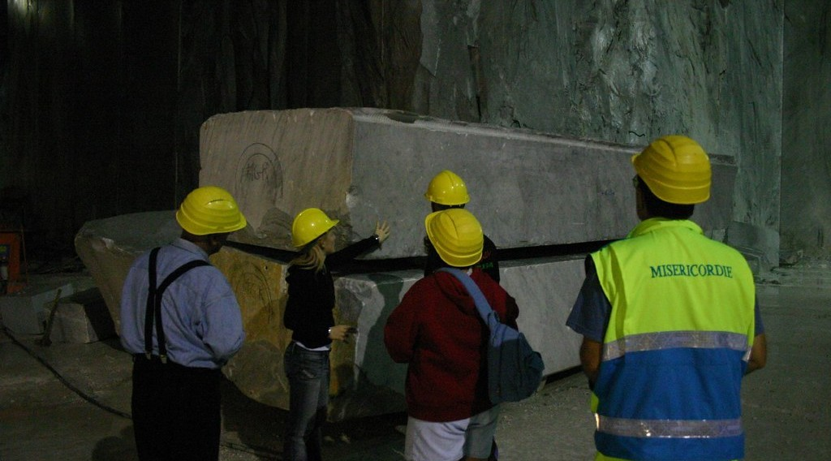
BOARD SUMMARY
2. The Rock Material Cycle
Metamorphic rocks: When igneous or sedimentary rocks are buried deep and heated and squeezed, their minerals change without melting. Limestone becomes marble and granite becomes gneiss, which is common in the basement rocks of Cameroon.
Illustration: marble
Notes:
Copy the point on Metamorphic rocks on the left, then draw the diagram on the right: marble. Give it a title and label it clearly.

Slide 49
BOARD SUMMARY
2. The Rock Material Cycle
Closing the cycle: If rocks are pushed deeper still, they melt into magma, which may rise and form new igneous rocks. The cycle therefore never stops, driven by the heat of the Earth and by the energy of the Sun.
Notes:
We continue with The Rock Material Cycle. Copy the point on Closing the cycle: write the key term first, then its explanation.

Slide 50

BOARD SUMMARY
3. Forces that Shape the Landscape
The landscape is shaped by the following two groups of forces:
Internal (endogenic) forces: They are driven by the heat of the interior of the Earth and act through plate movements, volcanism, earthquakes, folding and faulting. They build up the relief and create mountains, plateaux and rift valleys.
Illustration: a volcanic eruption
Notes:
Let us copy Forces that Shape the Landscape. The landscape is shaped by the following two groups of forces. Copy the point on Internal (endogenic) forces on the left, then draw the diagram on the right: a volcanic eruption. Give it a title and label it clearly.

Slide 51
BOARD SUMMARY
3. Forces that Shape the Landscape
External (exogenic) forces: They are driven by the energy of the Sun and by gravity and act through weathering, mass movement and erosion by rivers, wind, waves and ice. They wear down the relief and deposit the material in lowlands, as the Benue does around Garoua.
Illustration: gully erosion
Notes:
Copy the point on External (exogenic) forces on the left, then draw the diagram on the right: gully erosion. Give it a title and label it clearly.

Slide 52
BOARD SUMMARY
4. Categories of Landforms
Landforms are classified into the following categories:
First-order (major) landforms: They are the largest features of the Earth: the continents and the ocean basins. They are due to the difference between the light continental crust and the dense oceanic crust.
Illustration: the orders of relief
Notes:
Let us copy Categories of Landforms. Landforms are classified into the following categories. Copy the point on First-order (major) landforms on the left, then draw the diagram on the right: the orders of relief. Give it a title and label it clearly.

Slide 53
BOARD SUMMARY
4. Categories of Landforms
Second-order landforms: They are the large features found on the continents and ocean floors, such as mountain ranges, plateaux and plains. Examples in Cameroon are the Mandara Mountains, the Adamawa Plateau and the Benue plain.
Notes:
We continue with Categories of Landforms. Copy the point on Second-order landforms: write the key term first, then its explanation.

Slide 54
BOARD SUMMARY
4. Categories of Landforms
Third-order (minor) landforms: They are smaller features carved on the second-order ones, such as valleys, hills, gullies, waterfalls and sand dunes. They are shaped mainly by external forces over short periods.
Notes:
We continue with Categories of Landforms. Copy the point on Third-order (minor) landforms: write the key term first, then its explanation.

Slide 55
FORMATIVE EVALUATION
Evaluation 1
Distinguish continental crust from oceanic crust.
Notes:
Now let us check what you have understood. Question 1: Distinguish continental crust from oceanic crust. Answer in your exercise book.

Slide 56
FORMATIVE EVALUATION
Expected Answer
Continental crust is thick, light and granitic; oceanic crust is thin, dense and basaltic.
Notes:
The expected answer is: continental crust is thick, light and granitic; oceanic crust is thin, dense and basaltic. If you got it right, well done.

Slide 57
FORMATIVE EVALUATION
Evaluation 2
How is a sedimentary rock formed?
Notes:
Now let us check what you have understood. Question 2: How is a sedimentary rock formed? Answer in your exercise book.

Slide 58
FORMATIVE EVALUATION
Expected Answer
By the compression of layers of sediments such as sand and mud.
Notes:
The expected answer is: by the compression of layers of sediments such as sand and mud. If you got it right, well done.

Slide 59
REMEDIATION
Remediation
Fill in the blanks:
The thickest layer of the Earth is the ______.
Rock formed from cooled magma is ______.
Continents and ocean basins are landforms of the ______ order.
Notes:
For those who need more practice, fill in the blanks in your exercise book. The answers are: number 1, mantle; number 2, igneous; number 3, first.

Slide 60
HOMEWORK
Homework
Name the supercontinent proposed by Wegener.
Notes:
For your homework: Name the supercontinent proposed by Wegener. We shall correct it at the beginning of our next lesson.

Slide 61
NEXT LESSON
Next Lesson
Our next lesson will be on:
Further Study 1: Early Theories of Crustal Movements
Notes:
Our next lesson will be on Further Study 1: Early Theories of Crustal Movements. Thank you for your attention, and see you next time.

Slide 62
BILINGUAL GAME
Bilingual Game (Jeu Bilingue)
English | Français
Crust | La croûte terrestre
Mantle | Le manteau
Core | Le noyau
Rock cycle | Le cycle des roches
Igneous rock | La roche magmatique
Sedimentary rock | La roche sédimentaire
Notes:
Let us play the bilingual game. I say a word in English, and you give me the French word. Then we do the reverse.

Slide 63
LOGBOOK
Official Logbook (1/2)
Module / Topic | The Development of the Earth's Structure
Lesson Title | Lesson 2: Internal Structure of the Earth
Expected Learning Outcomes | Describe the crust, the mantle and the core. Explain the rock cycle and the three types of rocks. Distinguish internal and external forces. Classify landforms into orders with examples.
Competence | Learners are able to describe the internal structure of the Earth, the rock cycle and the forces that shape landforms around Garoua.
Notes:
I record this information in the official logbook of the class after the lesson.

Slide 64
LOGBOOK
Official Logbook (2/2)
Matter Taught | DEFINITIONS; The Crust and the Mantle; The Core and the Discontinuities; The Rock Material Cycle; Forces that Shape the Landscape; Categories of Landforms.
Evaluation | Formative evaluation and remediation exercise.
Homework | Name the supercontinent proposed by Wegener.
Enrolment / Present / Absent | ____ / ____ / ____
Achievement | To be completed after the lesson.
Notes:
I complete the second page of the logbook: the matter taught, the evaluation, the homework and the attendance.

Slide 65
TEACHER'S NOTE
Teacher's Note
Timing: Homework correction, plan, objectives 8 min | Recall, situation, action 10 min | 5 activities 30 min | Board summary (copying) 30 min | Evaluation, remediation 10 min | Homework, next lesson 5 min | Logbook 7 min
Without the projector (Activity 1): use a boiled egg: shell, white and yolk.
Without the projector (Activity 2): draw the layers as circles.
Without the projector (Activity 3): draw the cycle with arrows.
Without the projector (Activity 4): describe a gully in your quarter.
Without the projector (Activity 5): list landforms around Garoua.
Notes:
This slide is for me, the teacher: it gives the timing of the lesson and what to do if the projector is not available.

Slide 66
REFERENCES
References
Geography Syllabus for Sixth Forms (Lower and Upper Sixth), MINESEC, 2019 — Module 2 (Geomorphology).
Teacher's course notes: Mr KAMDEM E., Geomorphology (LSA), GBHS Garoua, 2026.
Photo, Activity 4: “Soil erosion in the central Mexican Highlands” by CIMMYT, CC BY-NC-SA 2.0, via Flickr (https://www.flickr.com/photos/44760652@N05/6244930288)
Photo, board summary (Sedimentary rocks): “Grand Canyon: Tapeats Sandstone 0283” by Grand Canyon NPS, CC BY 2.0, via Flickr (https://www.flickr.com/photos/50693818@N08/8238057843)
Photo, board summary (Metamorphic rocks): “Marble quarry, Carrara” by Russell Carman, CC BY-NC-SA 2.0, via Flickr (https://www.flickr.com/photos/11328254@N02/2095886412)
Photo, board summary (Internal (endogenic) forces): “Happy Anniversary Hawaii” by U.S. Geological Survey, CC0 1.0, via Flickr (https://www.flickr.com/photos/27784370@N05/14802198589)
Diagrams and animations: drawn for this lesson (Geography Department).
Notes:
These are the references and picture credits used to prepare this lesson.

