Slide 1
LOWER SIXTH ARTS
GEOGRAPHY
Further Study 1
Early Theories of Crustal Movements
Notes:
Good morning, class, and welcome to our geography lesson. I am your geography teacher, Mr Kamdem. Today we are starting Further Study 1: Early Theories of Crustal Movements.

Slide 2
CLASS INFO
Class, Chapter and Duration
Class | Lower Sixth Arts
Chapter | Module 2: Understanding and managing physical landscapes, geomorphological processes and hazards across the world in general and Cameroon in particular
Duration | 2 periods (2 × 50 minutes)
Notes:
This lesson is for Lower Sixth Arts. It belongs to Module 2: Understanding and managing physical landscapes, geomorphological processes and hazards across the world in general and Cameroon in particular. We shall need 2 periods to cover it.

Slide 3
IDENTIFICATION
Lesson Identification
Topic | The Development of the Earth's Structure
Sub-topic | Theories of Earth Structure and Resultant Landforms
Lesson | Further Study 1: Early Theories of Crustal Movements
Notions / Concepts | Isostasy, isostatic equilibrium, isostatic rebound, continental drift, Pangaea, Laurasia, Gondwanaland.
Syllabus focus | Isostasy; the theory of continental drift (Wegener, 1912): Pangaea and its break-up, evidence, strengths and weaknesses.
Competence | Learners are able to explain isostasy and continental drift and evaluate the evidence for Wegener's theory.
Notes:
Our topic is The Development of the Earth's Structure, and the sub-topic is Theories of Earth Structure and Resultant Landforms. The key notions we shall use today are: isostasy, isostatic equilibrium, isostatic rebound, continental drift, Pangaea, Laurasia, Gondwanaland. At the end, you should be able to do this: learners are able to explain isostasy and continental drift and evaluate the evidence for Wegener's theory.

Slide 4

HOMEWORK CORRECTION
Correction of the Homework
Question (Lesson 2: Internal Structure of the Earth):
Name the supercontinent proposed by Wegener.
Notes:
Before we start the new lesson, let us correct the homework I gave you at the end of Lesson 2: Internal Structure of the Earth. The question was: Name the supercontinent proposed by Wegener. Take out your exercise books.

Slide 5
HOMEWORK CORRECTION
Correction: Possible Answer
Pangaea ("all lands").
Notes:
Here is a good answer. Pangaea ("all lands"). Compare it with your own answer and correct your work in red.

Slide 6
LESSON PLAN
Lesson Plan
Correction of the homework
Objectives and recall
Real-life situation and action to take
Learning activities
Board summary
Evaluation, remediation and homework
Notes:
Here is the plan of our lesson today. First, we shall correct the homework. Then we shall look at the objectives and recall what you already know. After that, we shall study a situation from real life and the action to take, and do the learning activities. Finally, we shall copy the board summary, do the evaluation and the remediation, and I will give you the homework.

Slide 7
OBJECTIVES
Objectives
By the end of this lesson, you should be able to:
Define isostasy and explain isostatic equilibrium and rebound.
State the theory of continental drift.
Describe the break-up of Pangaea.
Notes:
Take your time to copy this part; we will continue together.

Slide 8
OBJECTIVES
Objectives (continued)
Explain the evidence for continental drift.
Give the strengths and weaknesses of the theory.
Notes:
By the end of this lesson, you should be able to do five things. Number 1: define isostasy and explain isostatic equilibrium and rebound. Number 2: state the theory of continental drift. Number 3: describe the break-up of Pangaea. Number 4: explain the evidence for continental drift. Number 5: give the strengths and weaknesses of the theory.

Slide 9
PREVIOUS KNOWLEDGE
Previous Knowledge
The crust floats on the mantle.
The Palaeozoic ended with the supercontinent Pangaea.
Fossils are found in sedimentary rocks.
Notes:
Let us first remember what you already know. The crust floats on the mantle. The Palaeozoic ended with the supercontinent Pangaea. Fossils are found in sedimentary rocks. Keep this in mind, because we shall build on it today.

Slide 10
REAL-LIFE SITUATION
Situation in Real Life
Your cousin from Douala sends you a world map for your room in Garoua.
You notice that the curve of the West African coast, from Nigeria to Cameroon, looks as if it could fit against the east coast of South America, like two pieces of a puzzle pulled apart.
Notes:
Take your time to copy this part; we will continue together.

Slide 11
REAL-LIFE SITUATION
Situation in Real Life (continued)
You ask: "Is this a coincidence, or were these lands, now separated by the Atlantic Ocean, once joined?"
Notes:
Listen carefully to this situation from real life. Your cousin from Douala sends you a world map for your room in Garoua. You notice that the curve of the West African coast, from Nigeria to Cameroon, looks as if it could fit against the east coast of South America, like two pieces of a puzzle pulled apart. You ask: "Is this a coincidence, or were these lands, now separated by the Atlantic Ocean, once joined?" Think about it, because I am going to ask you some questions.

Slide 12
REAL-LIFE SITUATION
Situation: Question 1
What is the problem in the situation?
Notes:
Question 1: What is the problem in the situation? Think for a moment, then raise your hand to answer.

Slide 13
REAL-LIFE SITUATION
Answer
The learner does not know the theories that explain the movement of continents.
Notes:
Good. The learner does not know the theories that explain the movement of continents.

Slide 14
REAL-LIFE SITUATION
Situation: Question 2
Which theory says that the continents were once joined?
Notes:
Question 2: Which theory says that the continents were once joined? Think for a moment, then raise your hand to answer.

Slide 15
REAL-LIFE SITUATION
Answer
The theory of continental drift of Alfred Wegener.
Notes:
Good. The theory of continental drift of Alfred Wegener.

Slide 16
REAL-LIFE SITUATION
Situation: Question 3
How can the crust "float"?
Notes:
Question 3: How can the crust "float"? Think for a moment, then raise your hand to answer.

Slide 17
REAL-LIFE SITUATION
Possible Answer
Through isostasy: the crust floats on the denser mantle.
Notes:
Good. Through isostasy: the crust floats on the denser mantle.

Slide 18
ACTION TO TAKE
Action to Take
Use evidence, not appearance alone, to test scientific ideas.
Notes:
From this situation, the action we are working towards in this lesson is the following: use evidence, not appearance alone, to test scientific ideas.

Slide 19
JUSTIFICATION
Justification of the Lesson
This lesson shows how scientists first explained the movements of the crust, which led to the theory of plate tectonics.
Notes:
Why is this lesson important for you? This lesson shows how scientists first explained the movements of the crust, which led to the theory of plate tectonics.

Slide 20
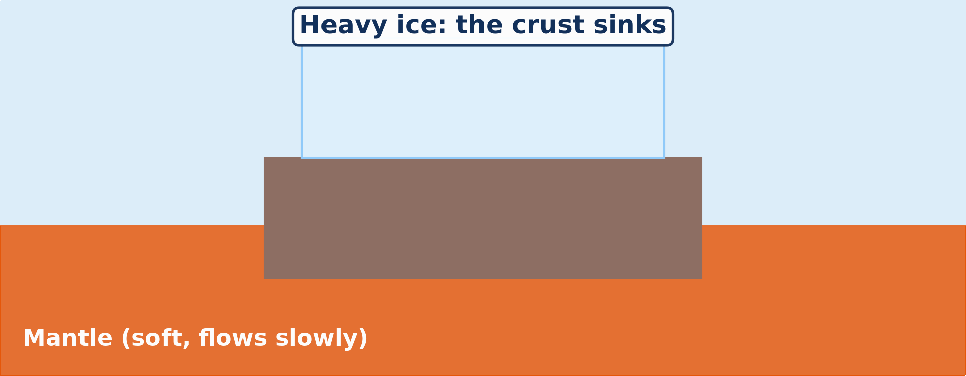
1. ISOSTASY
Activity 1
Animation: isostasy.
Notes:
Activity 1. Look carefully at this animation: animation: isostasy. Watch the animation to the end; it will play again.

Slide 21
1. ISOSTASY
Activity 1: Question
What happens to the crust when an ice sheet melts?
Notes:
Here is the question for Activity 1: What happens to the crust when an ice sheet melts? Take one minute to think and write your answer in your rough notebook.

Slide 22
1. ISOSTASY
Activity 1: Answer
It slowly rises (isostatic rebound).
Notes:
Let us check the answer together. It slowly rises (isostatic rebound).

Slide 23
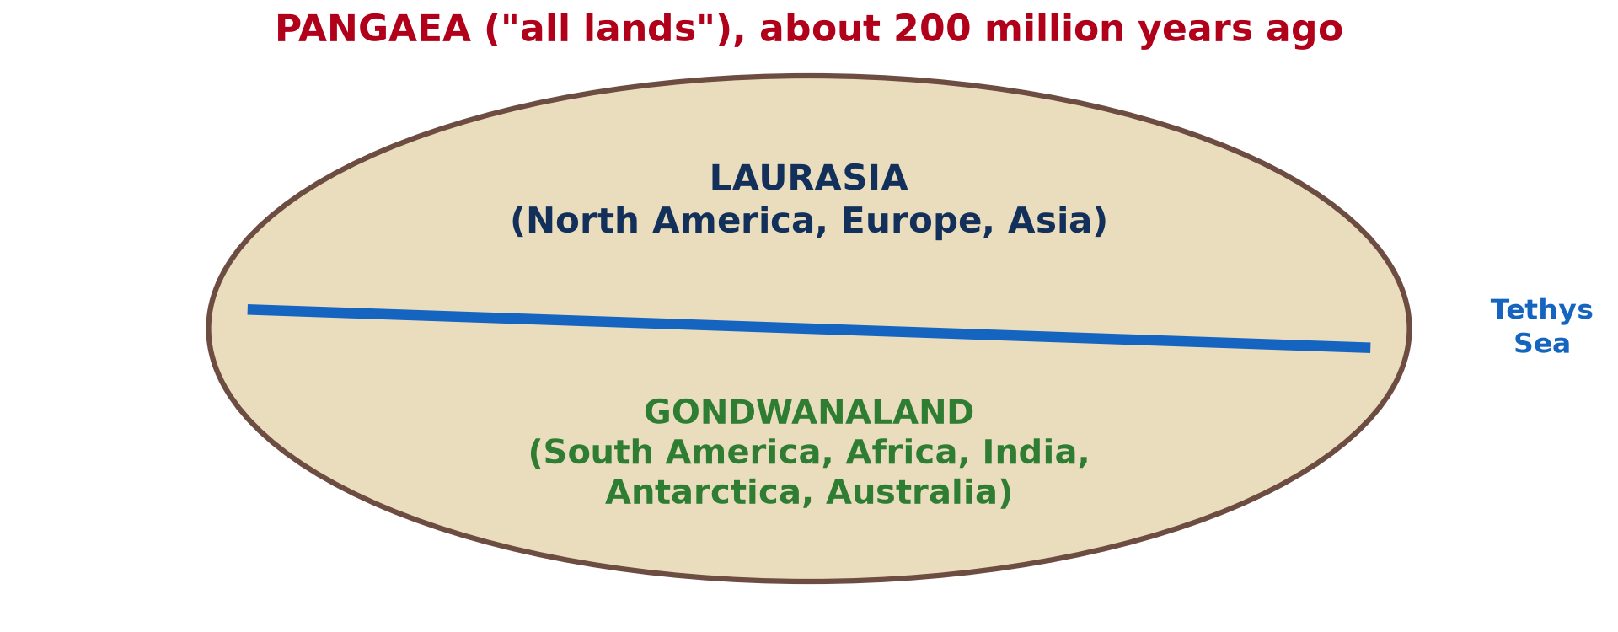
2. CONTINENTAL DRIFT
Activity 2
Pangaea.
Notes:
Activity 2. Look carefully at this picture: pangaea. Observe every detail before I ask the question.

Slide 24
2. CONTINENTAL DRIFT
Activity 2: Question
Into which two landmasses did Pangaea split?
Notes:
Here is the question for Activity 2: Into which two landmasses did Pangaea split? Take one minute to think and write your answer in your rough notebook.

Slide 25
2. CONTINENTAL DRIFT
Activity 2: Answer
Laurasia in the north and Gondwanaland in the south.
Notes:
Let us check the answer together. Laurasia in the north and Gondwanaland in the south.

Slide 26

3. EVIDENCE
Activity 3
Animation: the continents fit together.
Notes:
Activity 3. Look carefully at this animation: animation: the continents fit together. Watch the animation to the end; it will play again.

Slide 27
3. EVIDENCE
Activity 3: Question
Which two continents fit best like a jigsaw?
Notes:
Here is the question for Activity 3: Which two continents fit best like a jigsaw? Take one minute to think and write your answer in your rough notebook.

Slide 28
3. EVIDENCE
Activity 3: Answer
South America and Africa.
Notes:
Let us check the answer together. South America and Africa.

Slide 29
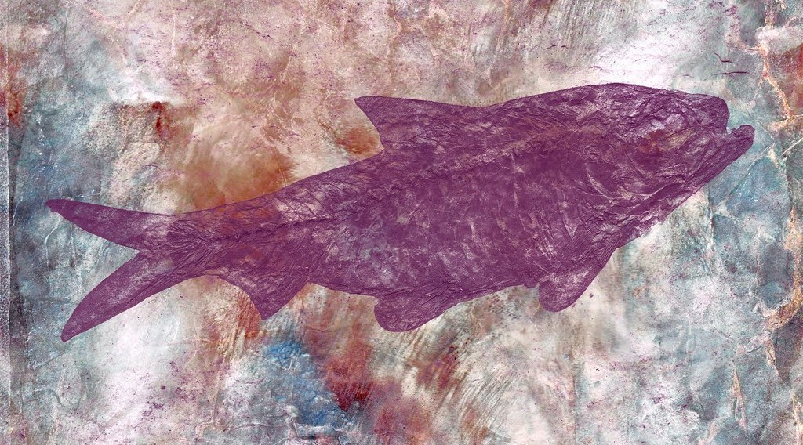
3. EVIDENCE
Activity 4
A fossil.
Notes:
Activity 4. Look carefully at this picture: a fossil. Observe every detail before I ask the question.

Slide 30
3. EVIDENCE
Activity 4: Question
Why is Mesosaurus evidence of drift?
Notes:
Here is the question for Activity 4: Why is Mesosaurus evidence of drift? Take one minute to think and write your answer in your rough notebook.

Slide 31
3. EVIDENCE
Activity 4: Answer
This freshwater reptile is found only in South America and southern Africa, which must have been joined.
Notes:
Let us check the answer together. This freshwater reptile is found only in South America and southern Africa, which must have been joined.

Slide 32
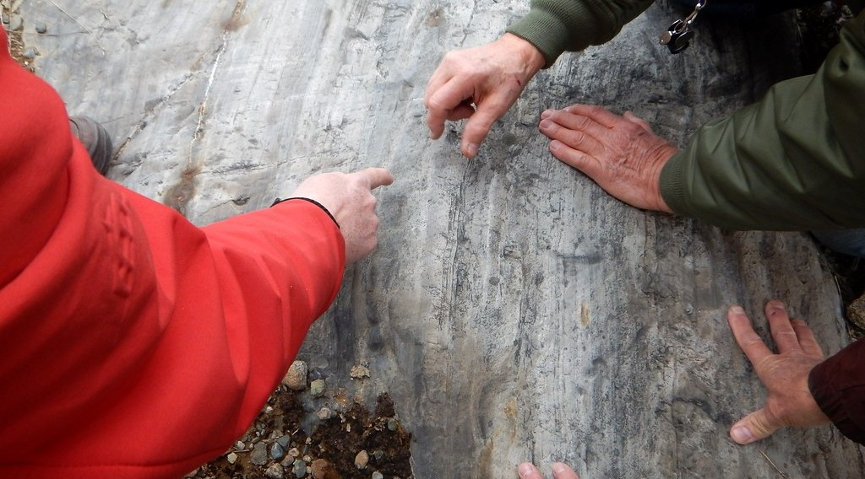
3. EVIDENCE
Activity 5
Rocks scratched by a glacier.
Notes:
Activity 5. Look carefully at this picture: rocks scratched by a glacier. Observe every detail before I ask the question.

Slide 33
3. EVIDENCE
Activity 5: Question
Why are glacial scratches in Africa surprising?
Notes:
Here is the question for Activity 5: Why are glacial scratches in Africa surprising? Take one minute to think and write your answer in your rough notebook.

Slide 34
3. EVIDENCE
Activity 5: Answer
Africa is hot today, so it must once have been near a pole.
Notes:
Let us check the answer together. Africa is hot today, so it must once have been near a pole.

Slide 35
BOARD SUMMARY
Board Summary
Topic: The Development of the Earth's Structure
Sub-topic: Theories of Earth Structure and Resultant Landforms
Further Study 1: Early Theories of Crustal Movements
Notes:
Now we are going to copy the board summary. Write the title and the headings neatly in your notebooks. I will give you enough time for each slide, so do not rush.

Slide 36
BOARD SUMMARY
DEFINITIONS
The key terms of this lesson are defined as follows:
Isostasy: It is the balance of the crust floating on the denser mantle below.
Isostatic rebound: It is the slow rise of the crust when a load such as an ice sheet is removed.
Notes:
Let us copy the definitions. The key terms of this lesson are defined as follows. On this slide we have Isostasy and Isostatic rebound. Write each point on a new line, with the key term first, and explain it in your own words when we revise. When you finish, we go to the next slide.

Slide 37
BOARD SUMMARY
DEFINITIONS (continued)
Continental drift: It is the theory that the continents have moved slowly across the surface of the Earth.
Pangaea: It is the single supercontinent that existed about 200 million years ago.
Notes:
We continue with the definitions. On this slide we have Continental drift and Pangaea. Write each point on a new line, with the key term first, and explain it in your own words when we revise.

Slide 38
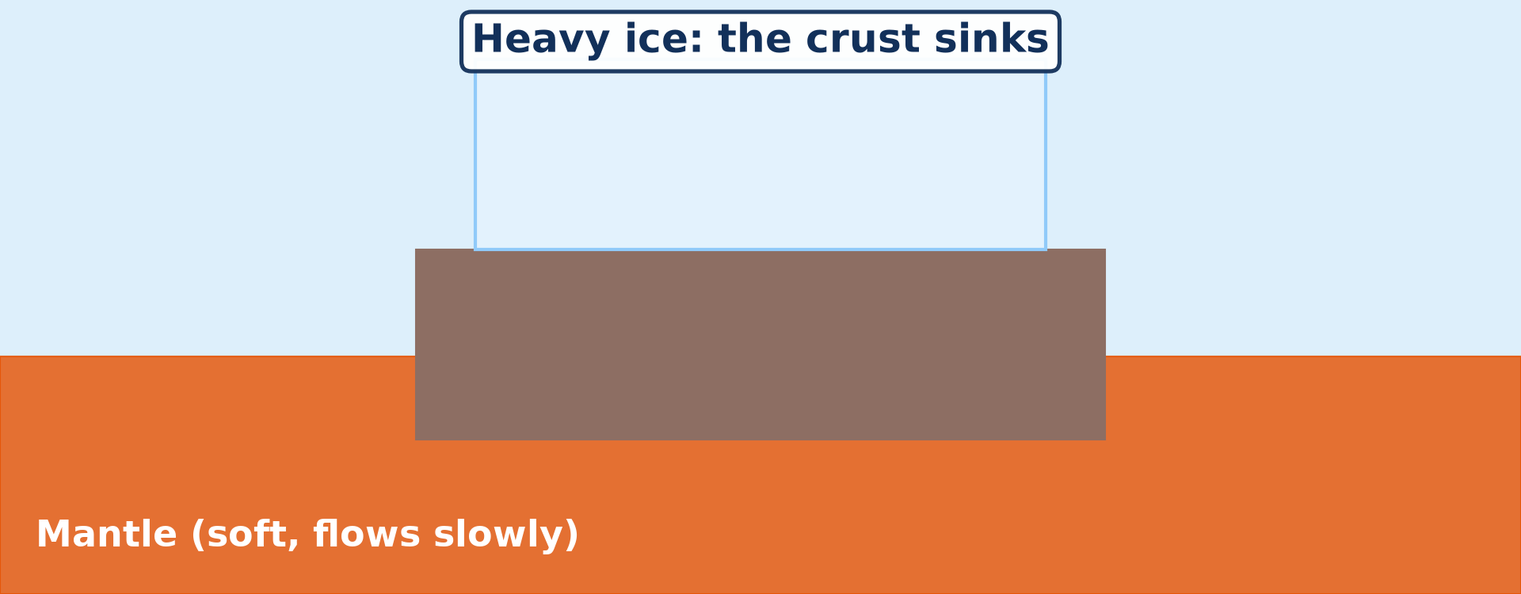
BOARD SUMMARY
1. Isostasy
Isostasy is explained as follows:
Meaning: Isostasy is the idea that the rigid lithosphere floats on the denser, soft asthenosphere, like a block of wood on water. Thick, light continental crust stands high, while thin, dense oceanic crust lies low.
Illustration: isostasy
Notes:
Let us copy Isostasy. Isostasy is explained as follows. Copy the point on Meaning on the left, then draw the diagram on the right: isostasy. Give it a title and label it clearly.

Slide 39
BOARD SUMMARY
1. Isostasy
Isostatic equilibrium and adjustment: When a load such as a mountain range or an ice sheet is added, the crust sinks deeper into the mantle until it is balanced again. When the load is removed by erosion or melting, the crust slowly rises, as Scandinavia is still rising today after the last ice age.
Notes:
We continue with Isostasy. Copy the point on Isostatic equilibrium and adjustment: write the key term first, then its explanation.

Slide 40
BOARD SUMMARY
2. The Theory of Continental Drift
The theory explains the splitting and drifting of land masses as follows:
The author and his idea: In 1912, the German scientist Alfred Wegener proposed that the continents are not fixed but move slowly across the Earth. He said that they were once joined together and have since drifted apart.
Notes:
Let us copy The Theory of Continental Drift. The theory explains the splitting and drifting of land masses as follows. Copy the point on The author and his idea: write the key term first, then its explanation.

Slide 41
BOARD SUMMARY
2. The Theory of Continental Drift
Pangaea: About 200 million years ago, all the continents formed one supercontinent, Pangaea, meaning all lands. It was surrounded by a single great ocean called Panthalassa.
Illustration: Pangaea
Notes:
Copy the point on Pangaea on the left, then draw the diagram on the right: pangaea. Give it a title and label it clearly.

Slide 42
BOARD SUMMARY
2. The Theory of Continental Drift
The splitting of Pangaea: Pangaea first split into Laurasia in the north, with North America, Europe and Asia, and Gondwanaland in the south, with South America, Africa, India, Antarctica and Australia. These land masses then broke into the present continents.
Notes:
We continue with The Theory of Continental Drift. Copy the point on The splitting of Pangaea: write the key term first, then its explanation.

Slide 43
BOARD SUMMARY
2. The Theory of Continental Drift
The drifting of the continents: The continents drifted slowly to their present positions, and the Atlantic Ocean opened between the Americas and Africa and Europe. The opening of the South Atlantic stretched Africa and created the Benue Trough, in which the Benue now flows.
Notes:
We continue with The Theory of Continental Drift. Copy the point on The drifting of the continents: write the key term first, then its explanation.

Slide 44
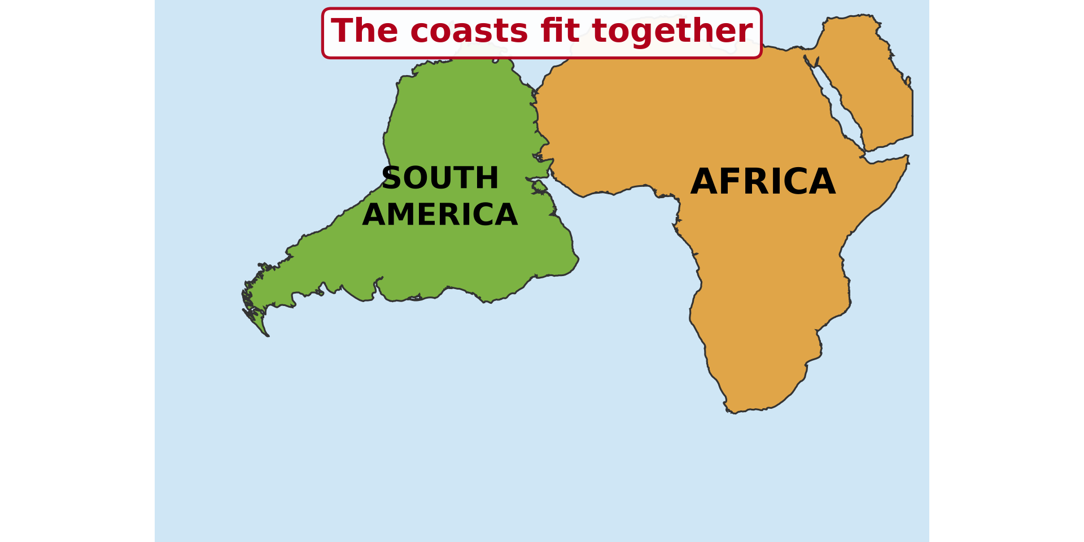
BOARD SUMMARY
3. Evidence of Continental Drift
Wegener supported his theory with the following evidence:
The jigsaw fit: The coasts of South America and Africa fit together like the pieces of a puzzle. The fit is even better at the edge of the continental shelves.
Illustration: the fit of the continents
Notes:
Let us copy Evidence of Continental Drift. Wegener supported his theory with the following evidence. Copy the point on The jigsaw fit on the left, then draw the diagram on the right: the fit of the continents. Give it a title and label it clearly.

Slide 45
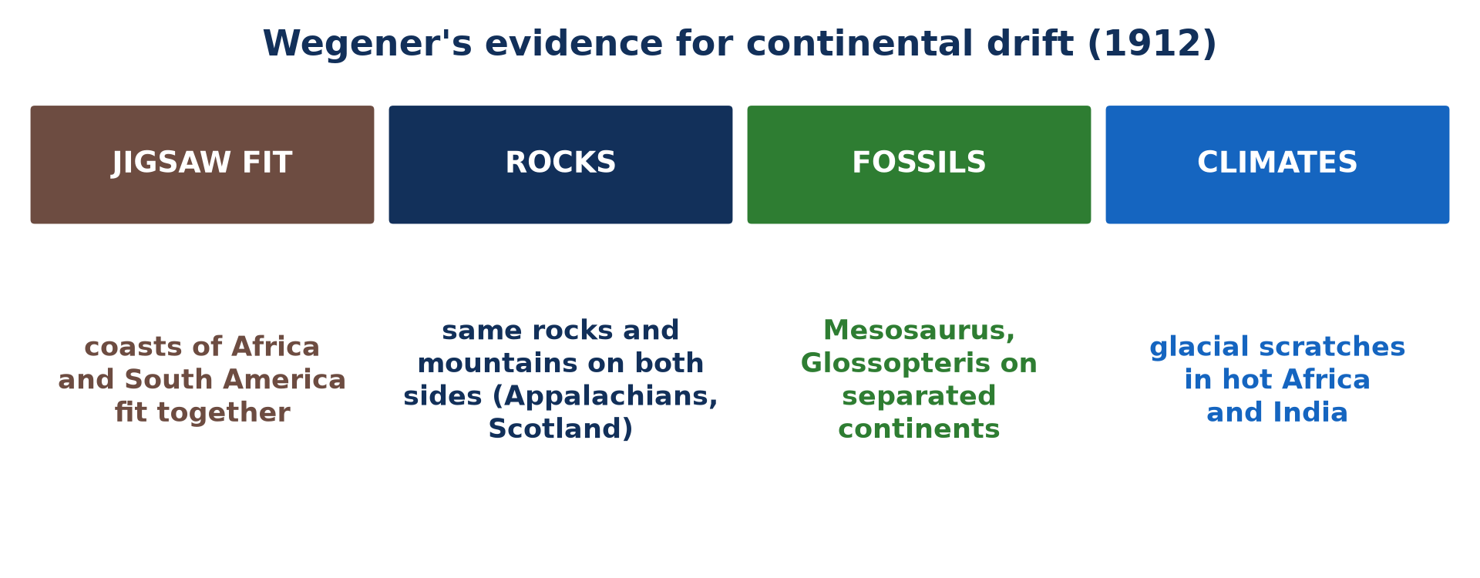
BOARD SUMMARY
3. Evidence of Continental Drift
Geological evidence: Rocks of the same type and age, and mountain chains, continue from one continent to another across the oceans. For example, the Appalachians of North America continue in the mountains of Scotland and Norway.
Illustration: evidence of drift
Notes:
Copy the point on Geological evidence on the left, then draw the diagram on the right: evidence of drift. Give it a title and label it clearly.

Slide 46
BOARD SUMMARY
3. Evidence of Continental Drift
Fossil evidence: The fossils of Mesosaurus, a small freshwater reptile, are found only in South America and southern Africa, and the fern Glossopteris on all the southern continents. These organisms could not have crossed the oceans, so the continents must have been joined.
Illustration: a fossil
Notes:
Copy the point on Fossil evidence on the left, then draw the diagram on the right: a fossil. Give it a title and label it clearly.

Slide 47
BOARD SUMMARY
3. Evidence of Continental Drift
Climatic evidence: Scratches left by glaciers are found in hot India, Africa and Australia, and coal from tropical forests in cold Antarctica. These lands must once have been at different latitudes.
Notes:
We continue with Evidence of Continental Drift. Copy the point on Climatic evidence: write the key term first, then its explanation.

Slide 48
BOARD SUMMARY
4. Strengths and Weaknesses of the Theory
The theory of continental drift has the following strengths and weaknesses:
Strength: one idea explains many facts: The theory explained the fit of the coasts, the fossils, the rocks and the ancient climates with a single idea. It also explained the formation of fold mountains such as the Himalayas where continents collide.
Notes:
Let us copy Strengths and Weaknesses of the Theory. The theory of continental drift has the following strengths and weaknesses. Copy the point on Strength: one idea explains many facts: write the key term first, then its explanation.

Slide 49
BOARD SUMMARY
4. Strengths and Weaknesses of the Theory
Strength: a dynamic Earth: It showed that the crust is not fixed but always moving. This idea became the basis of the modern theory of plate tectonics.
Notes:
We continue with Strengths and Weaknesses of the Theory. Copy the point on Strength: a dynamic Earth: write the key term first, then its explanation.

Slide 50
BOARD SUMMARY
4. Strengths and Weaknesses of the Theory
Weakness: no driving force: Wegener could not explain what force was strong enough to move whole continents. The forces he proposed, such as the rotation of the Earth, were far too weak.
Notes:
We continue with Strengths and Weaknesses of the Theory. Copy the point on Weakness: no driving force: write the key term first, then its explanation.

Slide 51
BOARD SUMMARY
4. Strengths and Weaknesses of the Theory
Weakness: the continents and the ocean floor: He thought that the continents ploughed through the rigid ocean floor, which scientists showed was impossible. For these reasons, most scientists rejected the theory until the discovery of sea-floor spreading in the 1960s.
Notes:
We continue with Strengths and Weaknesses of the Theory. Copy the point on Weakness: the continents and the ocean floor: write the key term first, then its explanation.

Slide 52
FORMATIVE EVALUATION
Evaluation 1
State the theory of continental drift.
Notes:
Now let us check what you have understood. Question 1: State the theory of continental drift. Answer in your exercise book.

Slide 53
FORMATIVE EVALUATION
Expected Answer
All continents were once joined in Pangaea, which broke up about 200 million years ago; the pieces drifted to their present positions.
Notes:
The expected answer is: all continents were once joined in Pangaea, which broke up about 200 million years ago; the pieces drifted to their present positions. If you got it right, well done.

Slide 54
FORMATIVE EVALUATION
Evaluation 2
Give two pieces of evidence for continental drift.
Notes:
Now let us check what you have understood. Question 2: Give two pieces of evidence for continental drift. Answer in your exercise book.

Slide 55
FORMATIVE EVALUATION
Expected Answer
The jigsaw fit, matching rocks and mountains, fossils such as Mesosaurus, glacial scratches in Africa (any two).
Notes:
The expected answer is: the jigsaw fit, matching rocks and mountains, fossils such as Mesosaurus, glacial scratches in Africa (any two). If you got it right, well done.

Slide 56
REMEDIATION
Remediation
Fill in the blanks:
Wegener proposed continental drift in ______.
The southern part of Pangaea was ______.
The main weakness of the theory was the lack of a ______.
Notes:
For those who need more practice, fill in the blanks in your exercise book. The answers are: number 1, 1912; number 2, Gondwanaland; number 3, mechanism (force).

Slide 57
HOMEWORK
Homework
Define a mid-ocean ridge.
Notes:
For your homework: Define a mid-ocean ridge. We shall correct it at the beginning of our next lesson.

Slide 58
NEXT LESSON
Next Lesson
Our next lesson will be on:
Further Study 2: Theory of Sea-Floor Spreading
Notes:
Our next lesson will be on Further Study 2: Theory of Sea-Floor Spreading. Thank you for your attention, and see you next time.

Slide 59
BILINGUAL GAME
Bilingual Game (Jeu Bilingue)
English | Français
Continental drift | La dérive des continents
Isostasy | L'isostasie
Crust | La croûte terrestre
Pangaea | La Pangée
Evidence | La preuve
Fossil | Le fossile
Notes:
Let us play the bilingual game. I say a word in English, and you give me the French word. Then we do the reverse.

Slide 60
LOGBOOK
Official Logbook (1/2)
Module / Topic | The Development of the Earth's Structure
Lesson Title | Further Study 1: Early Theories of Crustal Movements
Expected Learning Outcomes | Define isostasy and explain isostatic equilibrium and rebound. State the theory of continental drift. Describe the break-up of Pangaea. Explain the evidence for continental drift. Give the strengths and weaknesses of the theory.
Competence | Learners are able to explain isostasy and continental drift and evaluate the evidence for Wegener's theory.
Notes:
I record this information in the official logbook of the class after the lesson.

Slide 61
LOGBOOK
Official Logbook (2/2)
Matter Taught | DEFINITIONS; Isostasy; The Theory of Continental Drift; Evidence of Continental Drift; Strengths and Weaknesses of the Theory.
Evaluation | Formative evaluation and remediation exercise.
Homework | Define a mid-ocean ridge.
Enrolment / Present / Absent | ____ / ____ / ____
Achievement | To be completed after the lesson.
Notes:
I complete the second page of the logbook: the matter taught, the evaluation, the homework and the attendance.

Slide 62
TEACHER'S NOTE
Teacher's Note
Timing: Homework correction, plan, objectives 8 min | Recall, situation, action 10 min | 5 activities 30 min | Board summary (copying) 30 min | Evaluation, remediation 10 min | Homework, next lesson 5 min | Logbook 7 min
Activities 1 and 3 are animations (GIF): it plays automatically in slide-show mode.
Without the projector (Activity 1): float blocks of wood in a bucket.
Without the projector (Activity 2): draw Pangaea on the board.
Without the projector (Activity 3): cut out the two continents from paper.
Without the projector (Activity 4): describe a fossil.
Without the projector (Activity 5): explain glacial scratches.
Notes:
This slide is for me, the teacher: it gives the timing of the lesson and what to do if the projector is not available.

Slide 63
REFERENCES
References
Geography Syllabus for Sixth Forms (Lower and Upper Sixth), MINESEC, 2019 — Module 2 (Geomorphology).
Teacher's course notes: Mr KAMDEM E., Geomorphology (LSA), GBHS Garoua, 2026.
Photo, Activity 4: “Marble Skin Fish Fossil” by Bold Frontiers, CC BY 2.0, via Flickr (https://www.flickr.com/photos/82955120@N05/14091612527)
Photo, Activity 5: “geoscience crowd sourcing” by subarcticmike, CC BY 2.0, via Flickr (https://www.flickr.com/photos/31856336@N03/37633979015)
Diagrams and animations: drawn for this lesson (Geography Department).
Notes:
These are the references and picture credits used to prepare this lesson.

