Slide 1
LOWER SIXTH ARTS
GEOGRAPHY
Lesson 22
Introduction to Hydrology
Notes:
Good morning, class, and welcome to our geography lesson. I am your geography teacher, Mr Kamdem. Today we are starting Lesson 22: Introduction to Hydrology.

Slide 2
CLASS INFO
Class, Chapter and Duration
Class | Lower Sixth Arts
Chapter | Module 1: Understanding and managing atmospheric and hydrological phenomena and hazards across the world in general and Cameroon in particular
Duration | 2 periods (2 × 50 minutes)
Notes:
This lesson is for Lower Sixth Arts. It belongs to Module 1: Understanding and managing atmospheric and hydrological phenomena and hazards across the world in general and Cameroon in particular. We shall need 2 periods to cover it.

Slide 3
IDENTIFICATION
Lesson Identification
Topic | Global Water in Storage and Circulation
Sub-topic | Introduction and Scope of Hydrology
Lesson | Lesson 22: Introduction to Hydrology
Notions / Concepts | Hydrology, fresh water, salt water, ground water, ice cap, water demand.
Syllabus focus | Meaning and scope of hydrology; distribution of the world's water; main uses and increasing demand.
Competence | Learners are able to describe where the world's water is stored and explain why demand for water is increasing.
Notes:
Our topic is Global Water in Storage and Circulation, and the sub-topic is Introduction and Scope of Hydrology. The key notions we shall use today are: hydrology, fresh water, salt water, ground water, ice cap, water demand. At the end, you should be able to do this: learners are able to describe where the world's water is stored and explain why demand for water is increasing.

Slide 4

HOMEWORK CORRECTION
Correction of the Homework
Question (Further Study 2: Weather Observation, Prediction, Modification and Mapping):
Define hydrology.
Notes:
Before we start the new lesson, let us correct the homework I gave you at the end of Further Study 2: Weather Observation, Prediction, Modification and Mapping. The question was: Define hydrology. Take out your exercise books.

Slide 5
HOMEWORK CORRECTION
Correction: Possible Answer
Hydrology is the science that studies water on and under the surface of the Earth, its movements and its distribution.
Notes:
Here is a good answer. Hydrology is the science that studies water on and under the surface of the Earth, its movements and its distribution. Compare it with your own answer and correct your work in red.

Slide 6
LESSON PLAN
Lesson Plan
Correction of the homework
Objectives and recall
Real-life situation and action to take
Learning activities
Board summary
Evaluation, remediation and homework
Notes:
Here is the plan of our lesson today. First, we shall correct the homework. Then we shall look at the objectives and recall what you already know. After that, we shall study a situation from real life and the action to take, and do the learning activities. Finally, we shall copy the board summary, do the evaluation and the remediation, and I will give you the homework.

Slide 7
OBJECTIVES
Objectives
By the end of this lesson, you should be able to:
Define hydrology and give its scope.
Describe the distribution of the world's water.
Notes:
Take your time to copy this part; we will continue together.

Slide 8
OBJECTIVES
Objectives (continued)
Explain the main uses of water and the rising demand.
Notes:
By the end of this lesson, you should be able to do three things. Number 1: define hydrology and give its scope. Number 2: describe the distribution of the world's water. Number 3: explain the main uses of water and the rising demand.

Slide 9
PREVIOUS KNOWLEDGE
Previous Knowledge
Water exists as ice, liquid water and vapour.
Rain comes from the evaporation of seas and lakes.
Notes:
Let us first remember what you already know. Water exists as ice, liquid water and vapour. Rain comes from the evaporation of seas and lakes. Keep this in mind, because we shall build on it today.

Slide 10
REAL-LIFE SITUATION
Situation in Real Life
In Maroua, women walk many kilometres to fetch water in the dry season, yet most of the Earth is covered by water. A learner asks why there is not enough water if the planet is "blue".
Notes:
Listen carefully to this situation from real life. In Maroua, women walk many kilometres to fetch water in the dry season, yet most of the Earth is covered by water. A learner asks why there is not enough water if the planet is "blue". Think about it, because I am going to ask you some questions.

Slide 11
REAL-LIFE SITUATION
Situation: Question 1
What is the problem in the situation?
Notes:
Question 1: What is the problem in the situation? Think for a moment, then raise your hand to answer.

Slide 12
REAL-LIFE SITUATION
Answer
People lack fresh water although the Earth has much water.
Notes:
Good. People lack fresh water although the Earth has much water.

Slide 13
REAL-LIFE SITUATION
Situation: Question 2
Why is most of the water not usable?
Notes:
Question 2: Why is most of the water not usable? Think for a moment, then raise your hand to answer.

Slide 14
REAL-LIFE SITUATION
Answer
About 97.5 % is salt water in the oceans.
Notes:
Good. About 97.5 % is salt water in the oceans.

Slide 15
REAL-LIFE SITUATION
Situation: Question 3
Where is most fresh water?
Notes:
Question 3: Where is most fresh water? Think for a moment, then raise your hand to answer.

Slide 16
REAL-LIFE SITUATION
Possible Answer
In ice caps and glaciers, then under the ground.
Notes:
Good. In ice caps and glaciers, then under the ground.

Slide 17
ACTION TO TAKE
Action to Take
Use water resources wisely and protect water sources in our locality.
Notes:
From this situation, the action we are working towards in this lesson is the following: use water resources wisely and protect water sources in our locality.

Slide 18
JUSTIFICATION
Justification of the Lesson
This lesson helps us to understand how little fresh water we have and why we must manage it well.
Notes:
Why is this lesson important for you? This lesson helps us to understand how little fresh water we have and why we must manage it well.

Slide 19

1. MEANING AND SCOPE
Activity 1
The "blue planet" seen from space.
Notes:
Activity 1. Look carefully at this picture: the "blue planet" seen from space. Observe every detail before I ask the question.

Slide 20
1. MEANING AND SCOPE
Activity 1: Question
Which part of the Earth's surface is covered by water?
Notes:
Here is the question for Activity 1: Which part of the Earth's surface is covered by water? Take one minute to think and write your answer in your rough notebook.

Slide 21
1. MEANING AND SCOPE
Activity 1: Answer
About 71 %.
Notes:
Let us check the answer together. About 71 %.

Slide 22
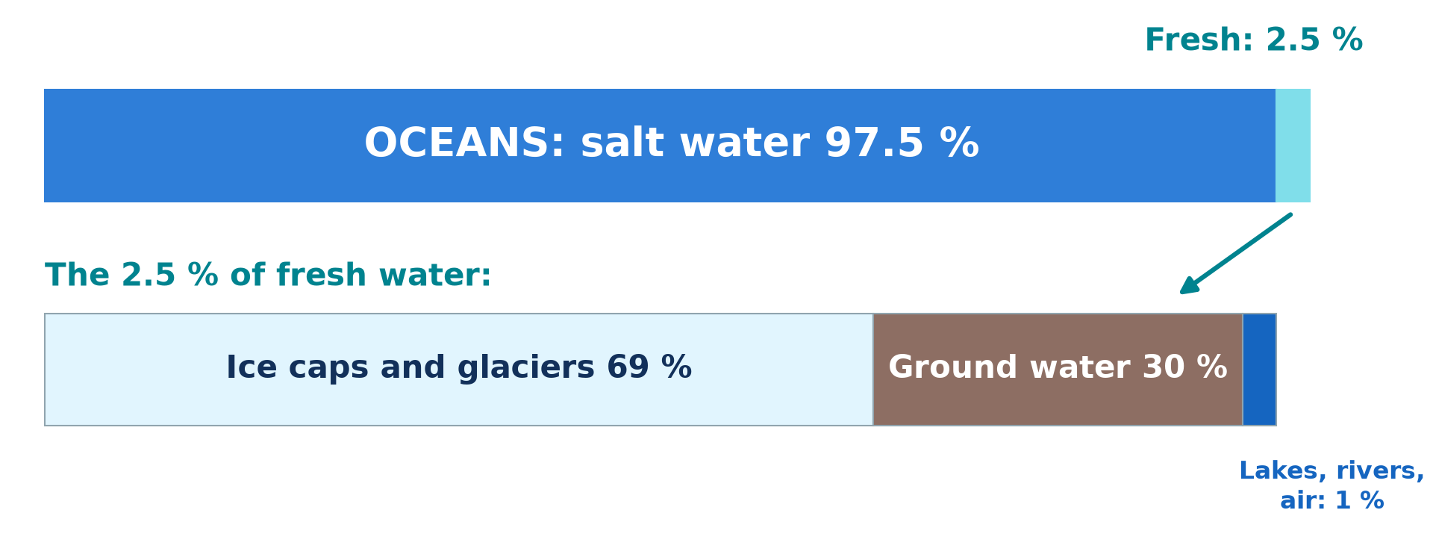
2. DISTRIBUTION OF WATER RESOURCES
Activity 2
Where the world's water is.
Notes:
Activity 2. Look carefully at this diagram: where the world's water is. Observe every detail before I ask the question.

Slide 23
2. DISTRIBUTION OF WATER RESOURCES
Activity 2: Question
What percentage of the world's water is fresh? Where is most of it?
Notes:
Here is the question for Activity 2: What percentage of the world's water is fresh? Where is most of it? Take one minute to think and write your answer in your rough notebook.

Slide 24
2. DISTRIBUTION OF WATER RESOURCES
Activity 2: Answer
About 2.5 %; most of it is in ice caps and glaciers.
Notes:
Let us check the answer together. About 2.5 %; most of it is in ice caps and glaciers.

Slide 25
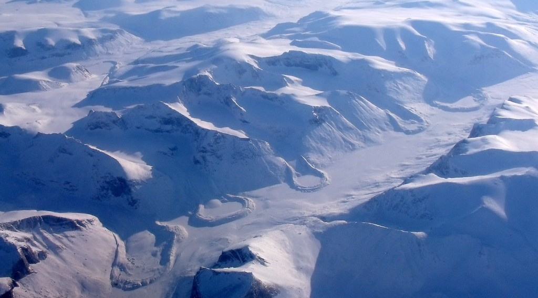
2. DISTRIBUTION: ICE CAPS
Activity 3
Ice caps and glaciers in the Arctic.
Notes:
Activity 3. Look carefully at this picture: ice caps and glaciers in the Arctic. Observe every detail before I ask the question.

Slide 26
2. DISTRIBUTION: ICE CAPS
Activity 3: Question
Why can people not easily use the water in ice caps?
Notes:
Here is the question for Activity 3: Why can people not easily use the water in ice caps? Take one minute to think and write your answer in your rough notebook.

Slide 27
2. DISTRIBUTION: ICE CAPS
Activity 3: Answer
It is frozen and far from where people live.
Notes:
Let us check the answer together. It is frozen and far from where people live.

Slide 28

2. DISTRIBUTION: UNDERGROUND WATER
Activity 4
People collecting water at a borehole.
Notes:
Activity 4. Look carefully at this picture: people collecting water at a borehole. Observe every detail before I ask the question.

Slide 29
2. DISTRIBUTION: UNDERGROUND WATER
Activity 4: Question
Where does the water from a borehole come from?
Notes:
Here is the question for Activity 4: Where does the water from a borehole come from? Take one minute to think and write your answer in your rough notebook.

Slide 30
2. DISTRIBUTION: UNDERGROUND WATER
Activity 4: Answer
From ground water stored in rocks under the surface.
Notes:
Let us check the answer together. From ground water stored in rocks under the surface.

Slide 31

3. USES AND INCREASING DEMAND
Activity 5
Irrigation of a field.
Notes:
Activity 5. Look carefully at this picture: irrigation of a field. Observe every detail before I ask the question.

Slide 32
3. USES AND INCREASING DEMAND
Activity 5: Question
Which activity uses the most fresh water in the world? Why is demand rising?
Notes:
Here is the question for Activity 5: Which activity uses the most fresh water in the world? Why is demand rising? Take one minute to think and write your answer in your rough notebook.

Slide 33
3. USES AND INCREASING DEMAND
Activity 5: Answer
Agriculture (about 70 %). Demand rises with population, towns and industry.
Notes:
Let us check the answer together. Agriculture (about 70 %). Demand rises with population, towns and industry.

Slide 34
BOARD SUMMARY
Board Summary
Topic: Global Water in Storage and Circulation
Sub-topic: Introduction and Scope of Hydrology
Lesson 22: Introduction to Hydrology
Notes:
Now we are going to copy the board summary. Write the title and the headings neatly in your notebooks. I will give you enough time for each slide, so do not rush.

Slide 35
BOARD SUMMARY
1. Meaning and Scope of Hydrology
Hydrology can be understood as follows:
Hydrology: It is the scientific study of water on, above and below the Earth's surface, its movement and its distribution.
Notes:
Let us copy Meaning and Scope of Hydrology. Hydrology can be understood as follows. On this slide we have Hydrology. Write each point on a new line, with the key term first, and explain it in your own words when we revise. When you finish, we go to the next slide.

Slide 36
BOARD SUMMARY
1. Meaning and Scope of Hydrology (continued)
Scope: Hydrology studies rainfall, evaporation, rivers, lakes, soil water and underground water. It is used to manage water supply, floods, irrigation and hydro-electricity.
Notes:
We continue with Meaning and Scope of Hydrology. On this slide we have Scope. Write each point on a new line, with the key term first, and explain it in your own words when we revise.

Slide 37
BOARD SUMMARY
2. Distribution of the World's Water Resources
The water of the Earth is distributed as follows:
Oceans and seas: They contain about 97 % of all water, which is salty. It cannot be drunk or used for farming without desalination.
Notes:
Let us copy Distribution of the World's Water Resources. The water of the Earth is distributed as follows. On this slide we have Oceans and seas. Write each point on a new line, with the key term first, and explain it in your own words when we revise. When you finish, we go to the next slide.

Slide 38
BOARD SUMMARY
2. Distribution of the World's Water Resources (continued)
Ice caps and glaciers: They hold about 2 % of all water, or nearly 70 % of fresh water. It is locked up in Antarctica and Greenland, far from people.
Notes:
We continue with Distribution of the World's Water Resources. On this slide we have Ice caps and glaciers. Write each point on a new line, with the key term first, and explain it in your own words when we revise. When you finish, we go to the next slide.

Slide 39
BOARD SUMMARY
2. Distribution of the World's Water Resources (continued)
Underground water: It forms about 0.6 % of all water, or 30 % of fresh water. It is stored in aquifers and reached by wells and boreholes.
Notes:
We continue with Distribution of the World's Water Resources. On this slide we have Underground water. Write each point on a new line, with the key term first, and explain it in your own words when we revise. When you finish, we go to the next slide.

Slide 40
BOARD SUMMARY
2. Distribution of the World's Water Resources (continued)
Lakes, rivers, soil and atmosphere: Together they hold less than 0.1 % of all water. Yet this small part is the water that people use most easily.
Notes:
We continue with Distribution of the World's Water Resources. On this slide we have Lakes, rivers, soil and atmosphere. Write each point on a new line, with the key term first, and explain it in your own words when we revise.

Slide 41
BOARD SUMMARY
2. Distribution of the World's Water Resources
Illustration: distribution of the world's water
Notes:
Now draw this illustration in your notebook: distribution of the world's water. Give it a title and label it clearly.

Slide 42
BOARD SUMMARY
3. Main Uses of Water and Increasing Demand
People use water resources in the following ways:
Main uses: Agriculture (irrigation) uses about 70 % of fresh water, industry about 20 % and homes about 10 %. Water is also used for hydro-electricity, transport and fishing.
Notes:
Let us copy Main Uses of Water and Increasing Demand. People use water resources in the following ways. On this slide we have Main uses. Write each point on a new line, with the key term first, and explain it in your own words when we revise. When you finish, we go to the next slide.

Slide 43
BOARD SUMMARY
3. Main Uses of Water and Increasing Demand (continued)
Increasing demand: Demand is rising because of population growth, urbanisation, industrial growth and irrigation. Climate change and pollution reduce the water available.
Notes:
We continue with Main Uses of Water and Increasing Demand. On this slide we have Increasing demand. Write each point on a new line, with the key term first, and explain it in your own words when we revise.

Slide 44
FORMATIVE EVALUATION
Evaluation 1
Define hydrology.
Notes:
Now let us check what you have understood. Question 1: Define hydrology. Answer in your exercise book.

Slide 45
FORMATIVE EVALUATION
Expected Answer
The study of water on and under the Earth and in the air.
Notes:
The expected answer is: the study of water on and under the Earth and in the air. If you got it right, well done.

Slide 46
FORMATIVE EVALUATION
Evaluation 2
Why is fresh water scarce although the Earth is covered by water?
Notes:
Now let us check what you have understood. Question 2: Why is fresh water scarce although the Earth is covered by water? Answer in your exercise book.

Slide 47
FORMATIVE EVALUATION
Expected Answer
97.5 % is salt water and most fresh water is frozen in ice caps.
Notes:
The expected answer is: 97.5 % is salt water and most fresh water is frozen in ice caps. If you got it right, well done.

Slide 48
REMEDIATION
Remediation
Fill in the blanks:
About ______ % of the world's water is salt water.
Most fresh water is stored in ______.
The activity that uses most water is ______.
Notes:
For those who need more practice, fill in the blanks in your exercise book. The answers are: number 1, 9; number 7, 5; number 2, ice caps and glaciers; number 3, agriculture.

Slide 49
HOMEWORK
Homework
List the sources of water in your area and say which ones dry up in the dry season.
Notes:
For your homework: List the sources of water in your area and say which ones dry up in the dry season. We shall correct it at the beginning of our next lesson.

Slide 50
NEXT LESSON
Next Lesson
Our next lesson will be on:
Lesson 23: The Hydrological Cycle
Notes:
Our next lesson will be on Lesson 23: The Hydrological Cycle. Thank you for your attention, and see you next time.

Slide 51
BILINGUAL GAME
Bilingual Game (Jeu Bilingue)
English | Français
Hydrology | L'hydrologie
Fresh water | L'eau douce
Ground water | L'eau souterraine
Ice cap | La calotte glaciaire
Demand | La demande
Irrigation | L'irrigation
Notes:
Let us play the bilingual game. I say a word in English, and you give me the French word. Then we do the reverse.

Slide 52
LOGBOOK
Official Logbook (1/2)
Module / Topic | Global Water in Storage and Circulation
Lesson Title | Lesson 22: Introduction to Hydrology
Expected Learning Outcomes | Define hydrology and give its scope. Describe the distribution of the world's water. Explain the main uses of water and the rising demand.
Competence | Learners are able to describe where the world's water is stored and explain why demand for water is increasing.
Notes:
I record this information in the official logbook of the class after the lesson.

Slide 53
LOGBOOK
Official Logbook (2/2)
Matter Taught | Meaning and Scope of Hydrology; Distribution of the World's Water Resources; Main Uses of Water and Increasing Demand.
Evaluation | Formative evaluation and remediation exercise.
Homework | List the sources of water in your area and say which ones dry up in the dry season.
Enrolment / Present / Absent | ____ / ____ / ____
Achievement | To be completed after the lesson.
Notes:
I complete the second page of the logbook: the matter taught, the evaluation, the homework and the attendance.

Slide 54
TEACHER'S NOTE
Teacher's Note
Timing: Homework correction, plan, objectives 8 min | Recall, situation, action 10 min | 5 activities 30 min | Board summary (copying) 30 min | Evaluation, remediation 10 min | Homework, next lesson 5 min | Logbook 7 min
Without the projector (Activity 1): show a globe.
Without the projector (Activity 2): draw the two bars.
Without the projector (Activity 3): find Greenland and Antarctica on the map.
Without the projector (Activity 4): ask where the village gets its water.
Without the projector (Activity 5): list uses of water at home and on farms.
Notes:
This slide is for me, the teacher: it gives the timing of the lesson and what to do if the projector is not available.

Slide 55
REFERENCES
References
National Geography Syllabus, MINESEC/IGE/IP-SS, 2019 — Module 1 (Meteorology, Climatology & Hydrology).
Photo, Activity 1: “Blue Marble, Eastern Hemisphere March 2014” by NASA Goddard Photo and Video, CC BY 2.0, via nasa (https://www.flickr.com/photos/24662369@N07/14990033062)
Photo, Activity 3: “The Art of Retreat” by subarcticmike, CC BY 2.0, via Flickr (https://www.flickr.com/photos/31856336@N03/7048837663)
Photo, Activity 4: “i'll fight you for it...” by the apostrophe, CC BY-NC-SA 2.0, via Flickr (https://www.flickr.com/photos/66441426@N00/4019192363)
Photo, Activity 5: “Mid-West Agriculture” by Djof, CC BY-NC-SA 2.0, via Flickr (https://www.flickr.com/photos/10787942@N00/147222315)
Diagrams and animations: drawn for this lesson (Geography Department).
Notes:
These are the references and picture credits used to prepare this lesson.

