Slide 1
LOWER SIXTH ARTS
GEOGRAPHY
Lesson 29
Infiltration and Overland Flow
Notes:
Good morning, class, and welcome to our geography lesson. I am your geography teacher, Mr Kamdem. Today we are starting Lesson 29: Infiltration and Overland Flow.

Slide 2
CLASS INFO
Class, Chapter and Duration
Class | Lower Sixth Arts
Chapter | Module 1: Understanding and managing atmospheric and hydrological phenomena and hazards across the world in general and Cameroon in particular
Duration | 2 periods (2 × 50 minutes)
Notes:
This lesson is for Lower Sixth Arts. It belongs to Module 1: Understanding and managing atmospheric and hydrological phenomena and hazards across the world in general and Cameroon in particular. We shall need 2 periods to cover it.

Slide 3
IDENTIFICATION
Lesson Identification
Topic | The Drainage Basin Hydrological Cycle
Sub-topic | Components of the Drainage Basin Hydrological Cycle
Lesson | Lesson 29: Infiltration and Overland Flow
Notions / Concepts | Infiltration, infiltration capacity, infiltration rate, Hortonian overland flow, saturation overland flow, infiltrometer.
Syllabus focus | Meaning, types, process, measurement, variations, factors and significance of infiltration and overland flow.
Competence | Learners are able to explain why rain soaks in or runs off, and how to increase infiltration.
Notes:
Our topic is The Drainage Basin Hydrological Cycle, and the sub-topic is Components of the Drainage Basin Hydrological Cycle. The key notions we shall use today are: infiltration, infiltration capacity, infiltration rate, Hortonian overland flow, saturation overland flow, infiltrometer. At the end, you should be able to do this: learners are able to explain why rain soaks in or runs off, and how to increase infiltration.

Slide 4

HOMEWORK CORRECTION
Correction of the Homework
Question (Lesson 28: Interception as a Store):
Put one cup under a tree and one in the open during rain. Compare the water collected.
Notes:
Before we start the new lesson, let us correct the homework I gave you at the end of Lesson 28: Interception as a Store. The question was: Put one cup under a tree and one in the open during rain. Compare the water collected. Take out your exercise books.

Slide 5
HOMEWORK CORRECTION
Correction: Possible Answer
The cup under the tree collects less water than the cup in the open, because the leaves intercept part of the rain.
Notes:
Here is a good answer. The cup under the tree collects less water than the cup in the open, because the leaves intercept part of the rain. Compare it with your own answer and correct your work in red.

Slide 6
LESSON PLAN
Lesson Plan
Correction of the homework
Objectives and recall
Real-life situation and action to take
Learning activities
Board summary
Evaluation, remediation and homework
Notes:
Here is the plan of our lesson today. First, we shall correct the homework. Then we shall look at the objectives and recall what you already know. After that, we shall study a situation from real life and the action to take, and do the learning activities. Finally, we shall copy the board summary, do the evaluation and the remediation, and I will give you the homework.

Slide 7
OBJECTIVES
Objectives
By the end of this lesson, you should be able to:
Define infiltration and infiltration capacity.
Distinguish Hortonian and saturation overland flow.
Notes:
Take your time to copy this part; we will continue together.

Slide 8
OBJECTIVES
Objectives (continued)
Explain the factors and significance of infiltration.
Notes:
By the end of this lesson, you should be able to do three things. Number 1: define infiltration and infiltration capacity. Number 2: distinguish Hortonian and saturation overland flow. Number 3: explain the factors and significance of infiltration.

Slide 9
PREVIOUS KNOWLEDGE
Previous Knowledge
Intense rain gives more runoff.
Soil can store water.
Notes:
Let us first remember what you already know. Intense rain gives more runoff. Soil can store water. Keep this in mind, because we shall build on it today.

Slide 10
REAL-LIFE SITUATION
Situation in Real Life
After a storm in Maroua, water runs over a hard, bare football field and cuts small channels, but in the nearby millet field with zai pits the water soaks into the soil.
Notes:
Listen carefully to this situation from real life. After a storm in Maroua, water runs over a hard, bare football field and cuts small channels, but in the nearby millet field with zai pits the water soaks into the soil. Think about it, because I am going to ask you some questions.

Slide 11
REAL-LIFE SITUATION
Situation: Question 1
What is the problem in the situation?
Notes:
Question 1: What is the problem in the situation? Think for a moment, then raise your hand to answer.

Slide 12
REAL-LIFE SITUATION
Answer
On bare ground the water runs off instead of soaking in.
Notes:
Good. On bare ground the water runs off instead of soaking in.

Slide 13
REAL-LIFE SITUATION
Situation: Question 2
What do we call water soaking into the soil?
Notes:
Question 2: What do we call water soaking into the soil? Think for a moment, then raise your hand to answer.

Slide 14
REAL-LIFE SITUATION
Answer
Infiltration.
Notes:
Good. Infiltration.

Slide 15
REAL-LIFE SITUATION
Situation: Question 3
How do zai pits help?
Notes:
Question 3: How do zai pits help? Think for a moment, then raise your hand to answer.

Slide 16
REAL-LIFE SITUATION
Possible Answer
They hold the water so it has time to infiltrate.
Notes:
Good. They hold the water so it has time to infiltrate.

Slide 17
ACTION TO TAKE
Action to Take
Increase infiltration on farms and in towns to reduce floods and erosion.
Notes:
From this situation, the action we are working towards in this lesson is the following: increase infiltration on farms and in towns to reduce floods and erosion.

Slide 18
JUSTIFICATION
Justification of the Lesson
This lesson helps us to understand how to keep water in the soil and reduce erosion and floods.
Notes:
Why is this lesson important for you? This lesson helps us to understand how to keep water in the soil and reduce erosion and floods.

Slide 19
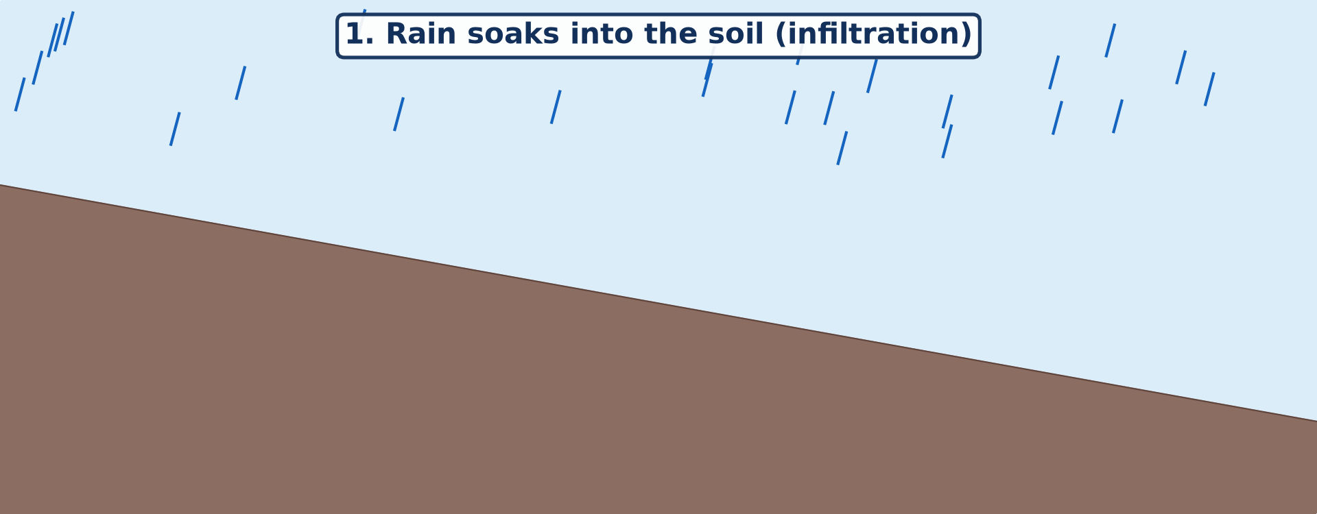
1. MEANING
Activity 1
Animation: rain soaks in, then flows over the surface.
Notes:
Activity 1. Look carefully at this animation: animation: rain soaks in, then flows over the surface. Watch the animation to the end; it will play again.

Slide 20
1. MEANING
Activity 1: Question
When does water start to flow over the surface?
Notes:
Here is the question for Activity 1: When does water start to flow over the surface? Take one minute to think and write your answer in your rough notebook.

Slide 21
1. MEANING
Activity 1: Answer
When the soil cannot take in more water.
Notes:
Let us check the answer together. When the soil cannot take in more water.

Slide 22
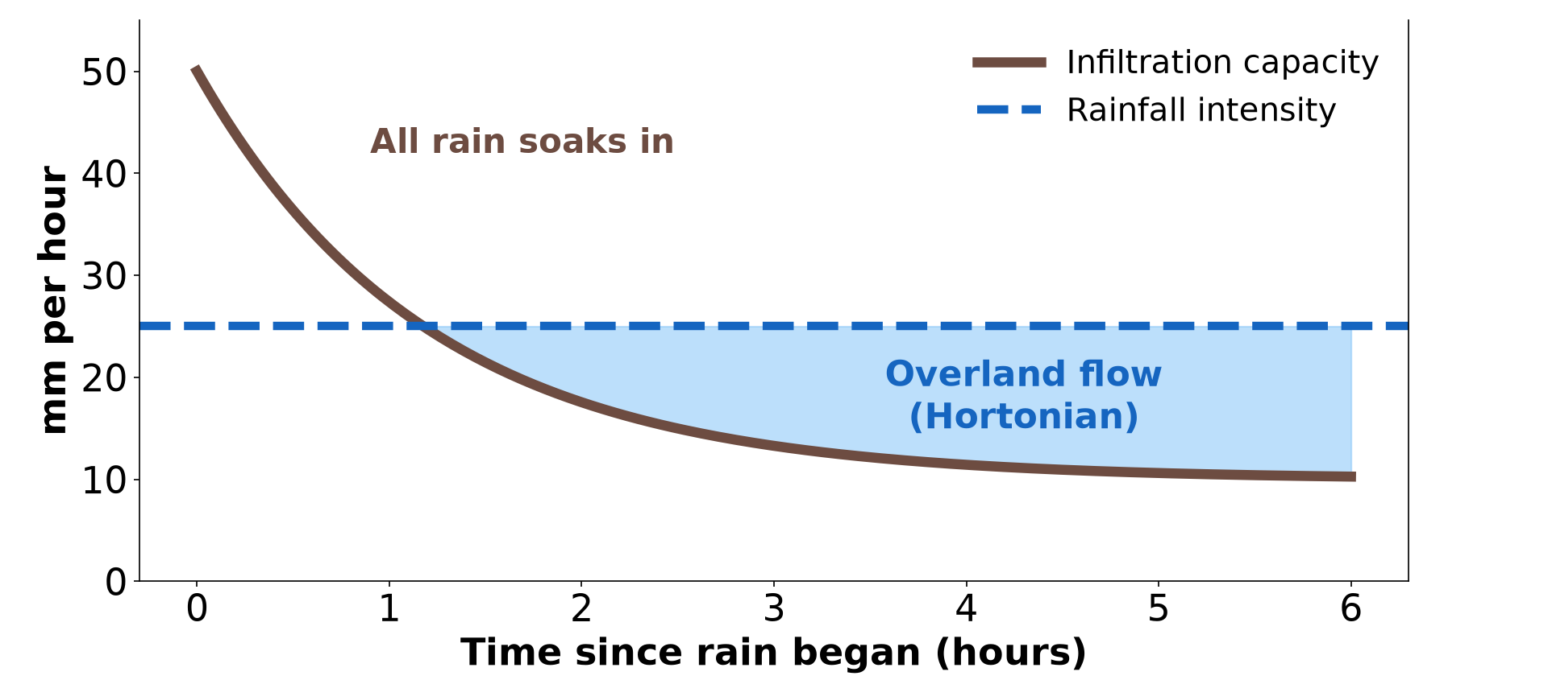
2. TYPES: HORTONIAN OVERLAND FLOW
Activity 2
Infiltration capacity falls during a storm.
Notes:
Activity 2. Look carefully at this diagram: infiltration capacity falls during a storm. Observe every detail before I ask the question.

Slide 23
2. TYPES: HORTONIAN OVERLAND FLOW
Activity 2: Question
What is Hortonian overland flow?
Notes:
Here is the question for Activity 2: What is Hortonian overland flow? Take one minute to think and write your answer in your rough notebook.

Slide 24
2. TYPES: HORTONIAN OVERLAND FLOW
Activity 2: Answer
Flow that happens when rain falls faster than the soil can absorb it.
Notes:
Let us check the answer together. Flow that happens when rain falls faster than the soil can absorb it.

Slide 25
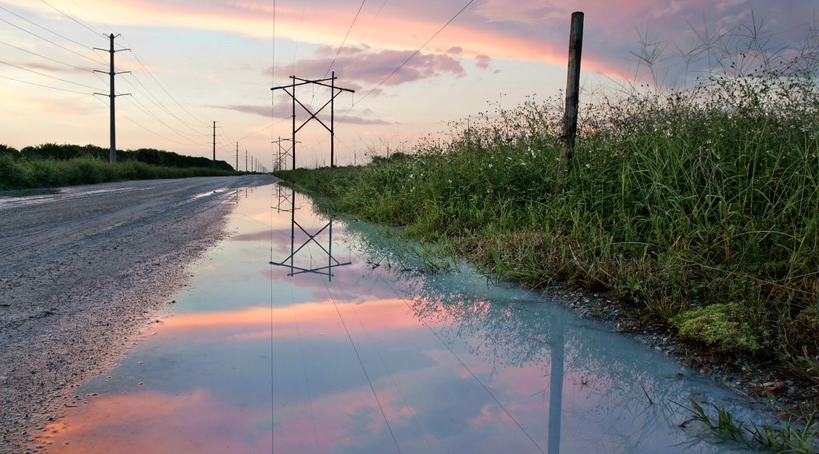
2. TYPES: SATURATION OVERLAND FLOW
Activity 3
Water lying on the surface after rain.
Notes:
Activity 3. Look carefully at this picture: water lying on the surface after rain. Observe every detail before I ask the question.

Slide 26
2. TYPES: SATURATION OVERLAND FLOW
Activity 3: Question
The soil is full of water. What type of overland flow follows?
Notes:
Here is the question for Activity 3: The soil is full of water. What type of overland flow follows? Take one minute to think and write your answer in your rough notebook.

Slide 27
2. TYPES: SATURATION OVERLAND FLOW
Activity 3: Answer
Saturation overland flow.
Notes:
Let us check the answer together. Saturation overland flow.

Slide 28

5. FACTORS
Activity 4
A gully on bare ground.
Notes:
Activity 4. Look carefully at this picture: a gully on bare ground. Observe every detail before I ask the question.

Slide 29
5. FACTORS
Activity 4: Question
Give three factors that reduce infiltration.
Notes:
Here is the question for Activity 4: Give three factors that reduce infiltration. Take one minute to think and write your answer in your rough notebook.

Slide 30
5. FACTORS
Activity 4: Answer
Bare, compacted or clay soil, steep slopes, and very intense rain.
Notes:
Let us check the answer together. Bare, compacted or clay soil, steep slopes, and very intense rain.

Slide 31

6. SIGNIFICANCE
Activity 5
Zai pits in the Sahel.
Notes:
Activity 5. Look carefully at this picture: zai pits in the Sahel. Observe every detail before I ask the question.

Slide 32
6. SIGNIFICANCE
Activity 5: Question
Why do farmers dig zai pits?
Notes:
Here is the question for Activity 5: Why do farmers dig zai pits? Take one minute to think and write your answer in your rough notebook.

Slide 33
6. SIGNIFICANCE
Activity 5: Answer
To hold rain so it infiltrates and waters the crops.
Notes:
Let us check the answer together. To hold rain so it infiltrates and waters the crops.

Slide 34
BOARD SUMMARY
Board Summary
Topic: The Drainage Basin Hydrological Cycle
Sub-topic: Components of the Drainage Basin Hydrological Cycle
Lesson 29: Infiltration and Overland Flow
Notes:
Now we are going to copy the board summary. Write the title and the headings neatly in your notebooks. I will give you enough time for each slide, so do not rush.

Slide 35
BOARD SUMMARY
1. Meaning and Process
Infiltration and overland flow can be understood as follows:
Infiltration: It is the movement of water from the surface into the soil. The maximum rate is the infiltration capacity.
Notes:
Let us copy Meaning and Process. Infiltration and overland flow can be understood as follows. On this slide we have Infiltration. Write each point on a new line, with the key term first, and explain it in your own words when we revise. When you finish, we go to the next slide.

Slide 36
BOARD SUMMARY
1. Meaning and Process (continued)
Overland flow: It is water that flows over the ground surface when it cannot infiltrate. It moves quickly to rivers.
Notes:
We continue with Meaning and Process. On this slide we have Overland flow. Write each point on a new line, with the key term first, and explain it in your own words when we revise.

Slide 37
BOARD SUMMARY
1. Meaning and Process
Illustration: infiltration and overland flow
Notes:
Now draw this illustration in your notebook: infiltration and overland flow. Give it a title and label it clearly.

Slide 38
BOARD SUMMARY
2. Types of Overland Flow
Overland flow is of two types:
Hortonian (infiltration-excess) flow: It occurs when rain falls faster than the soil can absorb it. It is common in heavy tropical storms on bare or compacted soils.
Notes:
Let us copy Types of Overland Flow. Overland flow is of two types. On this slide we have Hortonian (infiltration-excess) flow. Write each point on a new line, with the key term first, and explain it in your own words when we revise. When you finish, we go to the next slide.

Slide 39
BOARD SUMMARY
2. Types of Overland Flow (continued)
Saturation overland flow: It occurs when the soil is already full of water, so no more can enter. It is common at the foot of slopes and near rivers after long rain.
Notes:
We continue with Types of Overland Flow. On this slide we have Saturation overland flow. Write each point on a new line, with the key term first, and explain it in your own words when we revise.

Slide 40
BOARD SUMMARY
2. Types of Overland Flow
Illustration: types of overland flow
Notes:
Now draw this illustration in your notebook: types of overland flow. Give it a title and label it clearly.

Slide 41
BOARD SUMMARY
3. Measurement, Variations and Factors
Infiltration is measured, varies and depends on factors as follows:
Measurement: An infiltrometer (a ring pushed into the soil) measures how fast water sinks in, in mm per hour. Overland flow is measured in small plots with collecting troughs.
Notes:
Let us copy Measurement, Variations and Factors. Infiltration is measured, varies and depends on factors as follows. On this slide we have Measurement. Write each point on a new line, with the key term first, and explain it in your own words when we revise. When you finish, we go to the next slide.

Slide 42
BOARD SUMMARY
3. Measurement, Variations and Factors (continued)
Space-time variations: Infiltration is high on sandy soils and under forest, low on clay, rock and roads. It falls during a storm as the soil fills with water.
Notes:
We continue with Measurement, Variations and Factors. On this slide we have Space-time variations. Write each point on a new line, with the key term first, and explain it in your own words when we revise. When you finish, we go to the next slide.

Slide 43
BOARD SUMMARY
3. Measurement, Variations and Factors (continued)
Factors: Rain intensity, soil texture, soil moisture, vegetation, slope and land use control infiltration. Compaction and urbanisation reduce it.
Notes:
We continue with Measurement, Variations and Factors. On this slide we have Factors. Write each point on a new line, with the key term first, and explain it in your own words when we revise.

Slide 44
BOARD SUMMARY
4. Significance
Infiltration and overland flow are important because:
Infiltration: It recharges soil moisture and groundwater and keeps rivers flowing in the dry season. Zaï pits and stone lines increase it on farms.
Notes:
Let us copy Significance. Infiltration and overland flow are important because. On this slide we have Infiltration. Write each point on a new line, with the key term first, and explain it in your own words when we revise. When you finish, we go to the next slide.

Slide 45
BOARD SUMMARY
4. Significance (continued)
Overland flow: It causes rapid floods and soil erosion (sheet, rill and gully). It carries pollutants and sediment to rivers.
Notes:
We continue with Significance. On this slide we have Overland flow. Write each point on a new line, with the key term first, and explain it in your own words when we revise.

Slide 46
FORMATIVE EVALUATION
Evaluation 1
Distinguish Hortonian and saturation overland flow.
Notes:
Now let us check what you have understood. Question 1: Distinguish Hortonian and saturation overland flow. Answer in your exercise book.

Slide 47
FORMATIVE EVALUATION
Expected Answer
Hortonian: rain faster than infiltration capacity; saturation: the soil is already full.
Notes:
The expected answer is: hortonian: rain faster than infiltration capacity; saturation: the soil is already full. If you got it right, well done.

Slide 48
FORMATIVE EVALUATION
Evaluation 2
Give two ways to increase infiltration.
Notes:
Now let us check what you have understood. Question 2: Give two ways to increase infiltration. Answer in your exercise book.

Slide 49
FORMATIVE EVALUATION
Expected Answer
Plant cover and zai pits (also terraces, mulching).
Notes:
The expected answer is: plant cover and zai pits (also terraces, mulching). If you got it right, well done.

Slide 50
REMEDIATION
Remediation
Fill in the blanks:
Water soaking into the soil is ______.
The maximum rate of infiltration is the infiltration ______.
Flow when the soil is full is ______ overland flow.
Notes:
For those who need more practice, fill in the blanks in your exercise book. The answers are: number 1, infiltration; number 2, capacity; number 3, saturation.

Slide 51
HOMEWORK
Homework
Pour one litre of water on bare ground and on grass. Time how long it takes to soak in.
Notes:
For your homework: Pour one litre of water on bare ground and on grass. Time how long it takes to soak in. We shall correct it at the beginning of our next lesson.

Slide 52
NEXT LESSON
Next Lesson
Our next lesson will be on:
Lesson 30: Soil Moisture Storage
Notes:
Our next lesson will be on Lesson 30: Soil Moisture Storage. Thank you for your attention, and see you next time.

Slide 53
BILINGUAL GAME
Bilingual Game (Jeu Bilingue)
English | Français
Infiltration | L'infiltration
Overland flow | Le ruissellement
Soil | Le sol
Saturated | Saturé
Clay | L'argile
Sand | Le sable
Notes:
Let us play the bilingual game. I say a word in English, and you give me the French word. Then we do the reverse.

Slide 54
LOGBOOK
Official Logbook (1/2)
Module / Topic | The Drainage Basin Hydrological Cycle
Lesson Title | Lesson 29: Infiltration and Overland Flow
Expected Learning Outcomes | Define infiltration and infiltration capacity. Distinguish Hortonian and saturation overland flow. Explain the factors and significance of infiltration.
Competence | Learners are able to explain why rain soaks in or runs off, and how to increase infiltration.
Notes:
I record this information in the official logbook of the class after the lesson.

Slide 55
LOGBOOK
Official Logbook (2/2)
Matter Taught | Meaning and Process; Types of Overland Flow; Measurement, Variations and Factors; Significance.
Evaluation | Formative evaluation and remediation exercise.
Homework | Pour one litre of water on bare ground and on grass. Time how long it takes to soak in.
Enrolment / Present / Absent | ____ / ____ / ____
Achievement | To be completed after the lesson.
Notes:
I complete the second page of the logbook: the matter taught, the evaluation, the homework and the attendance.

Slide 56
TEACHER'S NOTE
Teacher's Note
Timing: Homework correction, plan, objectives 8 min | Recall, situation, action 10 min | 5 activities 30 min | Board summary (copying) 30 min | Evaluation, remediation 10 min | Homework, next lesson 5 min | Logbook 7 min
Activity 1 is an animation (GIF): it plays automatically in slide-show mode.
Without the projector (Activity 1): pour water slowly, then fast, on a pot of soil.
Without the projector (Activity 2): draw the two lines.
Without the projector (Activity 3): describe waterlogged fields.
Without the projector (Activity 4): compare sand and clay.
Without the projector (Activity 5): describe farming in the Far North.
Notes:
This slide is for me, the teacher: it gives the timing of the lesson and what to do if the projector is not available.

Slide 57
REFERENCES
References
National Geography Syllabus, MINESEC/IGE/IP-SS, 2019 — Module 1 (Meteorology, Climatology & Hydrology).
Photo, Activity 3: “Powerline Road after the rain.” by Jill Bazeley, CC BY-NC 2.0, via Flickr (https://www.flickr.com/photos/13111532@N07/29857035555)
Photo, Activity 4: “Soil erosion in the central Mexican Highlands” by CIMMYT, CC BY-NC-SA 2.0, via Flickr (https://www.flickr.com/photos/44760652@N05/6244930288)
Photo, Activity 5: “Women sowing okra in zai holes” by abossuet, CC BY-NC 2.0, via Flickr (https://www.flickr.com/photos/30450178@N07/7175750825)
Diagrams and animations: drawn for this lesson (Geography Department).
Notes:
These are the references and picture credits used to prepare this lesson.

