Slide 1
LOWER SIXTH ARTS
GEOGRAPHY
Lesson 3
Solar Radiation
Notes:
Good morning, class, and welcome to our geography lesson. I am your geography teacher, Mr Kamdem. Today we are starting Lesson 3: Solar Radiation.

Slide 2
CLASS INFO
Class, Chapter and Duration
Class | Lower Sixth Arts
Chapter | Module 1: Understanding and managing atmospheric and hydrological phenomena and hazards across the world in general and Cameroon in particular
Duration | 2 periods (2 × 50 minutes)
Notes:
This lesson is for Lower Sixth Arts. It belongs to Module 1: Understanding and managing atmospheric and hydrological phenomena and hazards across the world in general and Cameroon in particular. We shall need 2 periods to cover it.

Slide 3
IDENTIFICATION
Lesson Identification
Topic | Energy in the Atmosphere
Sub-topic | Transfer of Solar Energy
Lesson | Lesson 3: Solar Radiation
Notions / Concepts | Solar radiation, insolation, electromagnetic spectrum, ultraviolet, visible light, infrared, reflection, albedo, scattering, absorption.
Syllabus focus | Source and nature of solar radiation; its depletion in the atmosphere by reflection (albedo), scattering and absorption.
Competence | Learners are able to explain how the atmosphere reduces the solar energy reaching the ground and why surfaces heat differently.
Notes:
Our topic is Energy in the Atmosphere, and the sub-topic is Transfer of Solar Energy. The key notions we shall use today are: solar radiation, insolation, electromagnetic spectrum, ultraviolet, visible light, infrared, reflection, albedo, scattering, absorption. At the end, you should be able to do this: learners are able to explain how the atmosphere reduces the solar energy reaching the ground and why surfaces heat differently.

Slide 4

HOMEWORK CORRECTION
Correction of the Homework
Question (Lesson 2: Structure of the Atmosphere):
Define insolation.
Notes:
Before we start the new lesson, let us correct the homework I gave you at the end of Lesson 2: Structure of the Atmosphere. The question was: Define insolation. Take out your exercise books.

Slide 5
HOMEWORK CORRECTION
Correction: Possible Answer
Insolation (incoming solar radiation) is the energy that the Earth receives from the Sun.
Notes:
Here is a good answer. Insolation (incoming solar radiation) is the energy that the Earth receives from the Sun. Compare it with your own answer and correct your work in red.

Slide 6
LESSON PLAN
Lesson Plan
Correction of the homework
Objectives and recall
Real-life situation and action to take
Learning activities
Board summary
Evaluation, remediation and homework
Notes:
Here is the plan of our lesson today. First, we shall correct the homework. Then we shall look at the objectives and recall what you already know. After that, we shall study a situation from real life and the action to take, and do the learning activities. Finally, we shall copy the board summary, do the evaluation and the remediation, and I will give you the homework.

Slide 7
OBJECTIVES
Objectives
By the end of this lesson, you should be able to:
Define solar radiation (insolation).
Describe the nature of solar radiation.
Explain reflection and albedo.
Explain scattering and absorption.
Notes:
By the end of this lesson, you should be able to do four things. Number 1: define solar radiation (insolation). Number 2: describe the nature of solar radiation. Number 3: explain reflection and albedo. Number 4: explain scattering and absorption.

Slide 8
PREVIOUS KNOWLEDGE
Previous Knowledge
Ozone absorbs ultraviolet rays.
Clouds are made of water droplets.
Dark clothes feel hot in the sun.
Notes:
Let us first remember what you already know. Ozone absorbs ultraviolet rays. Clouds are made of water droplets. Dark clothes feel hot in the sun. Keep this in mind, because we shall build on it today.

Slide 9
REAL-LIFE SITUATION
Situation in Real Life
On a hot, sunny morning in Garoua, you walk to school.
In the direct sun, the heat is intense; under a big neem tree, it is much cooler.
When a small white cloud passes, its shadow also gives some relief.
Notes:
Take your time to copy this part; we will continue together.

Slide 10
REAL-LIFE SITUATION
Situation in Real Life (continued)
Your friend in a white boubou feels cooler than you in a dark shirt.
You ask: "What is this energy coming from the Sun, and why do shade, clouds and colours change how much of it we receive?"
Notes:
Listen carefully to this situation from real life. On a hot, sunny morning in Garoua, you walk to school. In the direct sun, the heat is intense; under a big neem tree, it is much cooler. When a small white cloud passes, its shadow also gives some relief. Your friend in a white boubou feels cooler than you in a dark shirt. You ask: "What is this energy coming from the Sun, and why do shade, clouds and colours change how much of it we receive?" Think about it, because I am going to ask you some questions.

Slide 11
REAL-LIFE SITUATION
Situation: Question 1
What is the problem in the situation?
Notes:
Question 1: What is the problem in the situation? Think for a moment, then raise your hand to answer.

Slide 12
REAL-LIFE SITUATION
Answer
The learner does not know how solar radiation reaches the ground and is reduced.
Notes:
Good. The learner does not know how solar radiation reaches the ground and is reduced.

Slide 13
REAL-LIFE SITUATION
Situation: Question 2
What is the energy we receive from the Sun called?
Notes:
Question 2: What is the energy we receive from the Sun called? Think for a moment, then raise your hand to answer.

Slide 14
REAL-LIFE SITUATION
Answer
Solar radiation, or insolation.
Notes:
Good. Solar radiation, or insolation.

Slide 15
REAL-LIFE SITUATION
Situation: Question 3
Why is a white boubou cooler than a dark shirt?
Notes:
Question 3: Why is a white boubou cooler than a dark shirt? Think for a moment, then raise your hand to answer.

Slide 16
REAL-LIFE SITUATION
Possible Answer
White reflects more radiation; dark absorbs more.
Notes:
Good. White reflects more radiation; dark absorbs more.

Slide 17
ACTION TO TAKE
Action to Take
Use light colours, shade trees and light roofs to keep homes cooler.
Notes:
From this situation, the action we are working towards in this lesson is the following: use light colours, shade trees and light roofs to keep homes cooler.

Slide 18
JUSTIFICATION
Justification of the Lesson
This lesson explains the source of energy of all weather and why surfaces heat differently.
Notes:
Why is this lesson important for you? This lesson explains the source of energy of all weather and why surfaces heat differently.

Slide 19
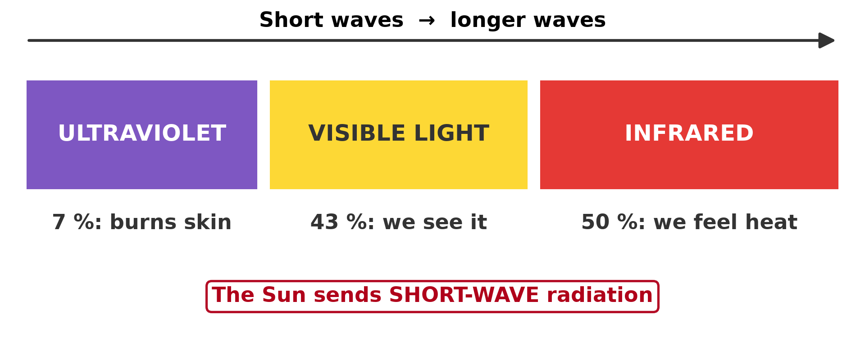
1. NATURE
Activity 1
The spectrum of solar radiation.
Notes:
Activity 1. Look carefully at this diagram: the spectrum of solar radiation. Observe every detail before I ask the question.

Slide 20
1. NATURE
Activity 1: Question
Which part of solar radiation do we feel as heat?
Notes:
Here is the question for Activity 1: Which part of solar radiation do we feel as heat? Take one minute to think and write your answer in your rough notebook.

Slide 21
1. NATURE
Activity 1: Answer
Infrared radiation.
Notes:
Let us check the answer together. Infrared radiation.

Slide 22
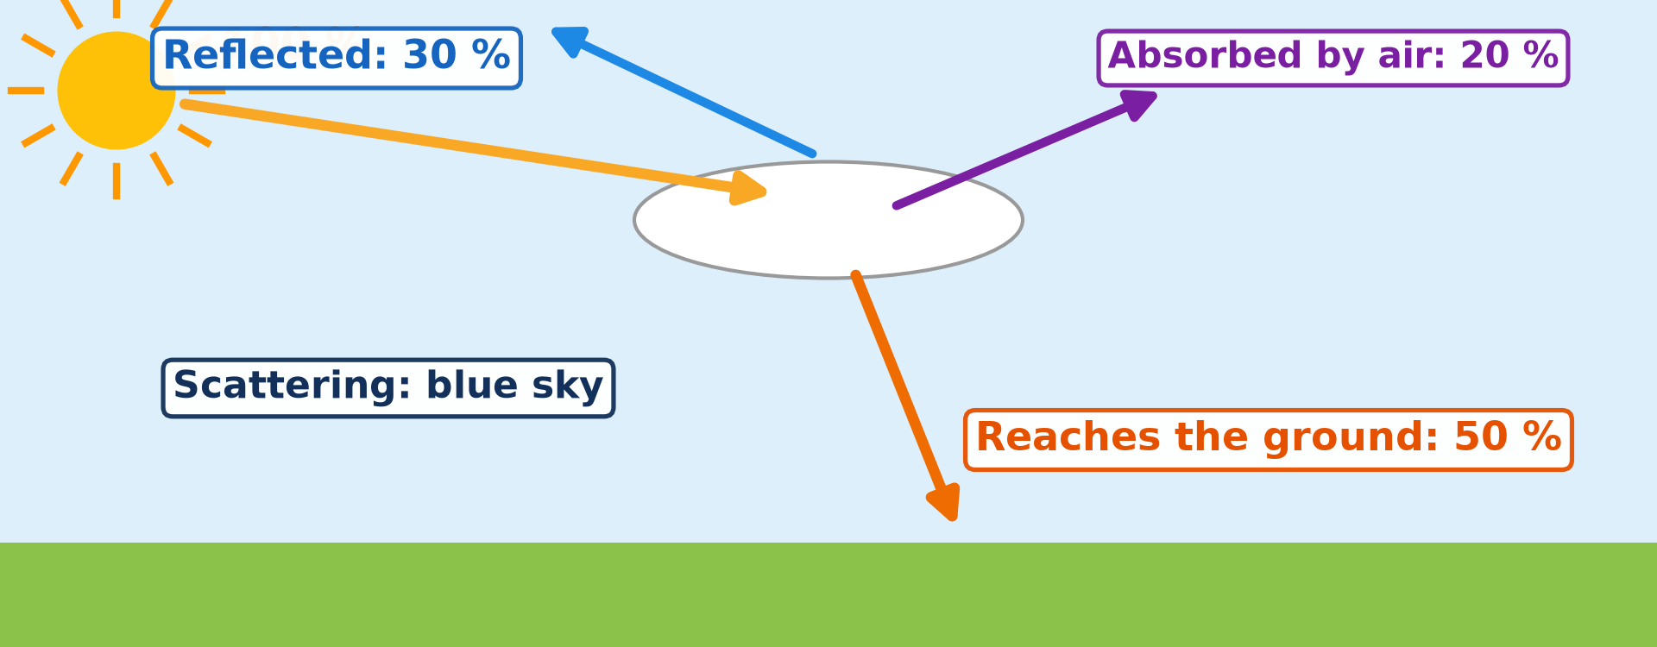
2. DEPLETION
Activity 2
What happens to sunlight.
Notes:
Activity 2. Look carefully at this diagram: what happens to sunlight. Observe every detail before I ask the question.

Slide 23
2. DEPLETION
Activity 2: Question
Name the three processes that reduce solar radiation in the atmosphere.
Notes:
Here is the question for Activity 2: Name the three processes that reduce solar radiation in the atmosphere. Take one minute to think and write your answer in your rough notebook.

Slide 24
2. DEPLETION
Activity 2: Answer
Reflection, scattering and absorption.
Notes:
Let us check the answer together. Reflection, scattering and absorption.

Slide 25
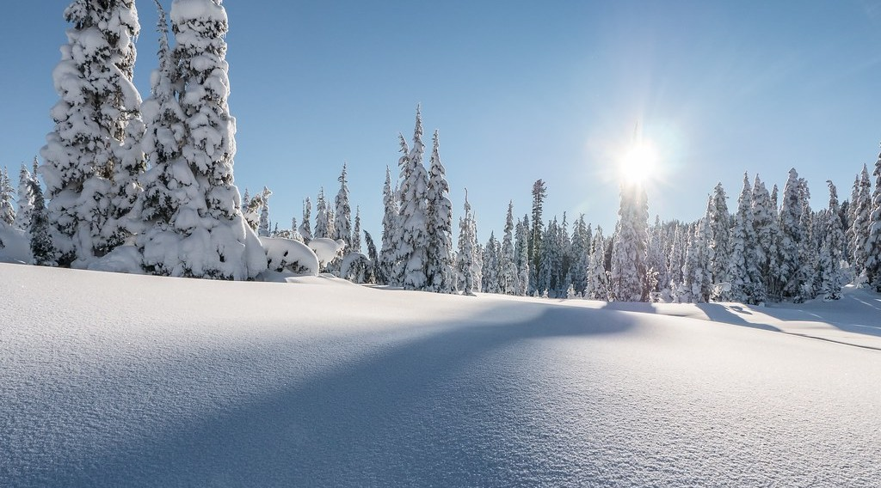
2. REFLECTION
Activity 3
Snow reflects most sunlight.
Notes:
Activity 3. Look carefully at this picture: snow reflects most sunlight. Observe every detail before I ask the question.

Slide 26
2. REFLECTION
Activity 3: Question
What is albedo?
Notes:
Here is the question for Activity 3: What is albedo? Take one minute to think and write your answer in your rough notebook.

Slide 27
2. REFLECTION
Activity 3: Answer
The proportion of radiation a surface reflects.
Notes:
Let us check the answer together. The proportion of radiation a surface reflects.

Slide 28

2. SCATTERING
Activity 4
A red sunrise.
Notes:
Activity 4. Look carefully at this picture: a red sunrise. Observe every detail before I ask the question.

Slide 29
2. SCATTERING
Activity 4: Question
Why is the sky blue?
Notes:
Here is the question for Activity 4: Why is the sky blue? Take one minute to think and write your answer in your rough notebook.

Slide 30
2. SCATTERING
Activity 4: Answer
Gas molecules scatter blue light more than other colours.
Notes:
Let us check the answer together. Gas molecules scatter blue light more than other colours.

Slide 31
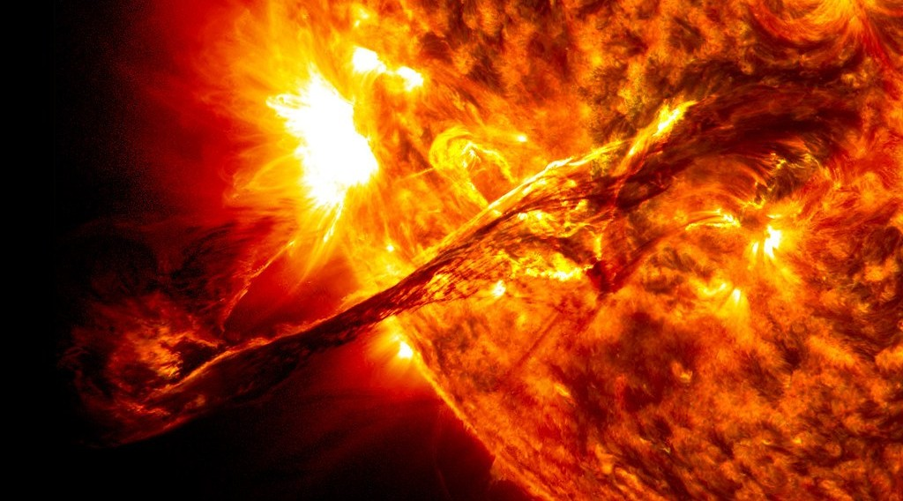
2. ABSORPTION
Activity 5
The Sun.
Notes:
Activity 5. Look carefully at this picture: the Sun. Observe every detail before I ask the question.

Slide 32
2. ABSORPTION
Activity 5: Question
Which gases absorb infrared heat?
Notes:
Here is the question for Activity 5: Which gases absorb infrared heat? Take one minute to think and write your answer in your rough notebook.

Slide 33
2. ABSORPTION
Activity 5: Answer
Water vapour and carbon dioxide.
Notes:
Let us check the answer together. Water vapour and carbon dioxide.

Slide 34
BOARD SUMMARY
Board Summary
Topic: Energy in the Atmosphere
Sub-topic: Transfer of Solar Energy
Lesson 3: Solar Radiation
Notes:
Now we are going to copy the board summary. Write the title and the headings neatly in your notebooks. I will give you enough time for each slide, so do not rush.

Slide 35
BOARD SUMMARY
DEFINITIONS
The key terms of this lesson are defined as follows:
Solar radiation (insolation): It is the energy received by the Earth from the Sun.
Albedo: It is the proportion of solar radiation reflected by a surface.
Notes:
Let us copy the definitions. The key terms of this lesson are defined as follows. On this slide we have Solar radiation (insolation) and Albedo. Write each point on a new line, with the key term first, and explain it in your own words when we revise. When you finish, we go to the next slide.

Slide 36
BOARD SUMMARY
DEFINITIONS (continued)
Scattering: It is the redirection of solar radiation in all directions by gas molecules and small particles.
Absorption: It is the taking in of radiation by gases, particles or surfaces, which turns it into heat.
Notes:
We continue with the definitions. On this slide we have Scattering and Absorption. Write each point on a new line, with the key term first, and explain it in your own words when we revise.

Slide 37
BOARD SUMMARY
1. Source and Nature of Solar Radiation
A) Source
Solar radiation has the following source:
The Sun: The Sun produces energy by nuclear fusion, in which hydrogen changes into helium, and its surface is at about 5,500 °C. This energy travels through space at the speed of light and reaches the Earth in about 8 minutes.
Illustration: the Sun
Notes:
Let us copy Source. Solar radiation has the following source. Copy the point on The Sun on the left, then draw the diagram on the right: the Sun. Give it a title and label it clearly.

Slide 38
BOARD SUMMARY
1. Source and Nature of Solar Radiation
A) Source
The solar constant: At the top of the atmosphere, each square metre facing the Sun receives about 1,361 watts. The Earth receives only a tiny part of the energy of the Sun, but it is enough to drive all weather.
Notes:
We continue with Source. Copy the point on The solar constant: write the key term first, then its explanation.

Slide 39
BOARD SUMMARY
1. Source and Nature of Solar Radiation
B) Nature
Solar radiation is short-wave electromagnetic energy made of the following rays:
Ultraviolet rays (about 9 %): They are short, invisible waves with much energy. Most are absorbed by the ozone layer, and those that reach the ground burn the skin.
Illustration: the solar spectrum
Notes:
Let us copy Nature. Solar radiation is short-wave electromagnetic energy made of the following rays. Copy the point on Ultraviolet rays (about 9 %) on the left, then draw the diagram on the right: the solar spectrum. Give it a title and label it clearly.

Slide 40
BOARD SUMMARY
1. Source and Nature of Solar Radiation
B) Nature
Visible light (about 40 %): It is the part of solar radiation that our eyes can see, made of the colours of the rainbow. It lights the Earth and is used by plants for photosynthesis.
Notes:
We continue with Nature. Copy the point on Visible light (about 40 %): write the key term first, then its explanation.

Slide 41
BOARD SUMMARY
1. Source and Nature of Solar Radiation
B) Nature
Infrared rays (about 51 %): They are longer, invisible waves felt as heat. They warm the surface and are partly absorbed by water vapour and carbon dioxide.
Notes:
We continue with Nature. Copy the point on Infrared rays (about 51 %): write the key term first, then its explanation.

Slide 42
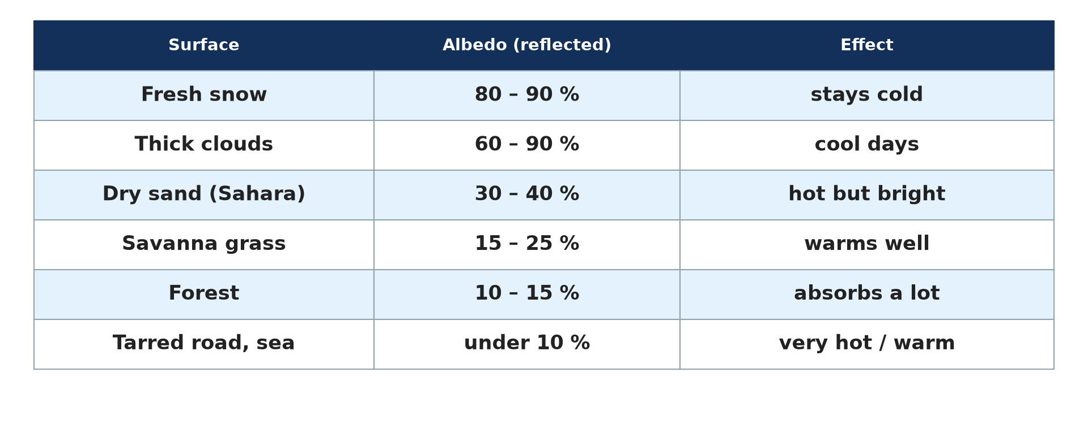
BOARD SUMMARY
2. Depletion of Solar Radiation
Solar radiation is reduced as it crosses the atmosphere by the following processes:
Reflection: Clouds, snow, ice and bright surfaces send part of the radiation back to space without changing it. The proportion reflected is the albedo: fresh snow reflects about 85 %, thick clouds up to 90 %, forests about 12 % and a tarred road less than 10 %.
Illustration: the albedo of surfaces
Notes:
Let us copy Depletion of Solar Radiation. Solar radiation is reduced as it crosses the atmosphere by the following processes. Copy the point on Reflection on the left, then draw the diagram on the right: the albedo of surfaces. Give it a title and label it clearly.

Slide 43
BOARD SUMMARY
2. Depletion of Solar Radiation
Scattering: Gas molecules and tiny particles send part of the light in all directions, and blue light is scattered most, which makes the sky blue. At sunrise and sunset, light crosses more air, so the blue is lost and the sky looks red.
Illustration: a red sunrise
Notes:
Copy the point on Scattering on the left, then draw the diagram on the right: a red sunrise. Give it a title and label it clearly.

Slide 44
BOARD SUMMARY
2. Depletion of Solar Radiation
Absorption: Ozone absorbs ultraviolet rays, while water vapour, carbon dioxide and dust absorb infrared rays. The absorbed energy is turned into heat that warms the atmosphere.
Notes:
We continue with Depletion of Solar Radiation. Copy the point on Absorption: write the key term first, then its explanation.

Slide 45
BOARD SUMMARY
2. Depletion of Solar Radiation
Energy reaching the surface: Because of these three processes, only about half of the solar energy reaching the top of the atmosphere is absorbed by the ground. About 30 % is reflected to space and about 20 % is absorbed by the air and clouds.
Illustration: the depletion of solar radiation
Notes:
Copy the point on Energy reaching the surface on the left, then draw the diagram on the right: the depletion of solar radiation. Give it a title and label it clearly.

Slide 46
FORMATIVE EVALUATION
Evaluation 1
Distinguish reflection by a cloud from scattering by gas molecules.
Notes:
Now let us check what you have understood. Question 1: Distinguish reflection by a cloud from scattering by gas molecules. Answer in your exercise book.

Slide 47
FORMATIVE EVALUATION
Expected Answer
Reflection sends radiation straight back to space; scattering sends it in all directions.
Notes:
The expected answer is: reflection sends radiation straight back to space; scattering sends it in all directions. If you got it right, well done.

Slide 48
FORMATIVE EVALUATION
Evaluation 2
Why is a tarred road hotter than a grassy field?
Notes:
Now let us check what you have understood. Question 2: Why is a tarred road hotter than a grassy field? Answer in your exercise book.

Slide 49
FORMATIVE EVALUATION
Expected Answer
The road has a low albedo and absorbs most radiation; grass reflects more and cools by transpiration.
Notes:
The expected answer is: the road has a low albedo and absorbs most radiation; grass reflects more and cools by transpiration. If you got it right, well done.

Slide 50
REMEDIATION
Remediation
Fill in the blanks:
Solar radiation is also called ______.
The reflectivity of a surface is its ______.
The sky is blue because of ______.
Notes:
For those who need more practice, fill in the blanks in your exercise book. The answers are: number 1, insolation; number 2, albedo; number 3, scattering.

Slide 51
HOMEWORK
Homework
Define the heat budget of the Earth.
Notes:
For your homework: Define the heat budget of the Earth. We shall correct it at the beginning of our next lesson.

Slide 52
NEXT LESSON
Next Lesson
Our next lesson will be on:
Lesson 4: The Earth's Radiation Balance
Notes:
Our next lesson will be on Lesson 4: The Earth's Radiation Balance. Thank you for your attention, and see you next time.

Slide 53
BILINGUAL GAME
Bilingual Game (Jeu Bilingue)
English | Français
Sun | Le Soleil
Radiation | Le rayonnement
Reflection | La réflexion
Scattering | La diffusion
Absorption | L'absorption
Albedo | L'albédo
Notes:
Let us play the bilingual game. I say a word in English, and you give me the French word. Then we do the reverse.

Slide 54
LOGBOOK
Official Logbook (1/2)
Module / Topic | Energy in the Atmosphere
Lesson Title | Lesson 3: Solar Radiation
Expected Learning Outcomes | Define solar radiation (insolation). Describe the nature of solar radiation. Explain reflection and albedo. Explain scattering and absorption.
Competence | Learners are able to explain how the atmosphere reduces the solar energy reaching the ground and why surfaces heat differently.
Notes:
I record this information in the official logbook of the class after the lesson.

Slide 55
LOGBOOK
Official Logbook (2/2)
Matter Taught | DEFINITIONS; Source; Nature; Depletion of Solar Radiation.
Evaluation | Formative evaluation and remediation exercise.
Homework | Define the heat budget of the Earth.
Enrolment / Present / Absent | ____ / ____ / ____
Achievement | To be completed after the lesson.
Notes:
I complete the second page of the logbook: the matter taught, the evaluation, the homework and the attendance.

Slide 56
TEACHER'S NOTE
Teacher's Note
Timing: Homework correction, plan, objectives 8 min | Recall, situation, action 10 min | 5 activities 30 min | Board summary (copying) 30 min | Evaluation, remediation 10 min | Homework, next lesson 5 min | Logbook 7 min
Without the projector (Activity 1): draw the spectrum.
Without the projector (Activity 2): draw arrows for each process.
Without the projector (Activity 3): compare white and black cloth in the sun.
Without the projector (Activity 4): clap chalky dusters in a torch beam.
Without the projector (Activity 5): feel a tin roof at midday.
Notes:
This slide is for me, the teacher: it gives the timing of the lesson and what to do if the projector is not available.

Slide 57
REFERENCES
References
Geography Syllabus for Sixth Forms (Lower and Upper Sixth), MINESEC, 2019 — Module 1 (Meteorology, Climatology & Hydrology).
Teacher's course notes: Mr KAMDEM E., Meteorology (LSA), GBHS Garoua, 2026.
Photo, Activity 3: “Peaceful Winter” by `James Wheeler, CC BY-NC-SA 2.0, via Flickr (https://www.flickr.com/photos/24128704@N08/25673217581)
Photo, Activity 4: “African Sunrise, Amboseli National Park” by Ray in Manila, CC BY 2.0, via Flickr (https://www.flickr.com/photos/21186555@N07/30385097358)
Photo, Activity 5: “Scientists Propose Mechanism to Describe Solar Eruptions of All Sizes” by NASA's Marshall Space Flight Center, CC BY-NC 2.0, via nasa (https://www.flickr.com/photos/28634332@N05/36084784530)
Diagrams and animations: drawn for this lesson (Geography Department).
Notes:
These are the references and picture credits used to prepare this lesson.

