Slide 1
LOWER SIXTH ARTS
GEOGRAPHY
Lesson 12
Global Distribution of Precipitation
Notes:
Good morning, class, and welcome to our geography lesson. I am your geography teacher, Mr Kamdem. Today we are starting Lesson 12: Global Distribution of Precipitation.

Slide 2
CLASS INFO
Class, Chapter and Duration
Class | Lower Sixth Arts
Chapter | Module 1: Understanding and managing atmospheric and hydrological phenomena and hazards across the world in general and Cameroon in particular
Duration | 2 periods (2 × 50 minutes)
Notes:
This lesson is for Lower Sixth Arts. It belongs to Module 1: Understanding and managing atmospheric and hydrological phenomena and hazards across the world in general and Cameroon in particular. We shall need 2 periods to cover it.

Slide 3
IDENTIFICATION
Lesson Identification
Topic | Moisture in the Atmosphere
Sub-topic | Precipitation
Lesson | Lesson 12: Global Distribution of Precipitation
Notions / Concepts | Pressure belts, ITCZ, subtropical high, temperate low, polar high, maritime and continental air masses, relief rainfall, rain shadow, continentality.
Syllabus focus | The global pattern of precipitation and its primary factors (pressure belts, air masses); secondary factors (relief, distance from the sea, vegetation, currents, lakes, towns).
Competence | Learners are able to explain the world pattern of rainfall and the contrast between Douala and Garoua.
Notes:
Our topic is Moisture in the Atmosphere, and the sub-topic is Precipitation. The key notions we shall use today are: pressure belts, ITCZ, subtropical high, temperate low, polar high, maritime and continental air masses, relief rainfall, rain shadow, continentality. At the end, you should be able to do this: learners are able to explain the world pattern of rainfall and the contrast between Douala and Garoua.

Slide 4

HOMEWORK CORRECTION
Correction of the Homework
Question (Lesson 11: Forms of Condensation and Precipitation):
Name the world's wettest belt of latitude.
Notes:
Before we start the new lesson, let us correct the homework I gave you at the end of Lesson 11: Forms of Condensation and Precipitation. The question was: Name the world's wettest belt of latitude. Take out your exercise books.

Slide 5
HOMEWORK CORRECTION
Correction: Possible Answer
The equatorial belt, around the Equator.
Notes:
Here is a good answer. The equatorial belt, around the Equator. Compare it with your own answer and correct your work in red.

Slide 6
LESSON PLAN
Lesson Plan
Correction of the homework
Objectives and recall
Real-life situation and action to take
Learning activities
Board summary
Evaluation, remediation and homework
Notes:
Here is the plan of our lesson today. First, we shall correct the homework. Then we shall look at the objectives and recall what you already know. After that, we shall study a situation from real life and the action to take, and do the learning activities. Finally, we shall copy the board summary, do the evaluation and the remediation, and I will give you the homework.

Slide 7
OBJECTIVES
Objectives
By the end of this lesson, you should be able to:
Describe the global pattern of precipitation.
Explain the role of pressure belts.
Explain the role of air masses.
Notes:
Take your time to copy this part; we will continue together.

Slide 8
OBJECTIVES
Objectives (continued)
Explain the secondary factors of rainfall.
Notes:
By the end of this lesson, you should be able to do four things. Number 1: describe the global pattern of precipitation. Number 2: explain the role of pressure belts. Number 3: explain the role of air masses. Number 4: explain the secondary factors of rainfall.

Slide 9
PREVIOUS KNOWLEDGE
Previous Knowledge
Rising air cools and forms clouds.
Relief forces air to rise.
The Harmattan is continental air.
Notes:
Let us first remember what you already know. Rising air cools and forms clouds. Relief forces air to rise. The Harmattan is continental air. Keep this in mind, because we shall build on it today.

Slide 10
REAL-LIFE SITUATION
Situation in Real Life
In late March, the heat in Garoua is intense and there is no rain yet.
Your uncle in Douala calls and complains that heavy rains have already started there and flooded his quarter.
He says: "You people in Garoua are lucky with your long dry season!"
Notes:
Take your time to copy this part; we will continue together.

Slide 11
REAL-LIFE SITUATION
Situation in Real Life (continued)
You ask: "Why does Douala receive so much rain so early, while Garoua has less rain and a shorter rainy season?"
Notes:
Listen carefully to this situation from real life. In late March, the heat in Garoua is intense and there is no rain yet. Your uncle in Douala calls and complains that heavy rains have already started there and flooded his quarter. He says: "You people in Garoua are lucky with your long dry season!" You ask: "Why does Douala receive so much rain so early, while Garoua has less rain and a shorter rainy season?" Think about it, because I am going to ask you some questions.

Slide 12
REAL-LIFE SITUATION
Situation: Question 1
What is the problem in the situation?
Notes:
Question 1: What is the problem in the situation? Think for a moment, then raise your hand to answer.

Slide 13
REAL-LIFE SITUATION
Answer
The learner does not know the factors of the distribution of rainfall.
Notes:
Good. The learner does not know the factors of the distribution of rainfall.

Slide 14
REAL-LIFE SITUATION
Situation: Question 2
Why is Douala so wet?
Notes:
Question 2: Why is Douala so wet? Think for a moment, then raise your hand to answer.

Slide 15
REAL-LIFE SITUATION
Answer
It is near the equatorial low-pressure belt, on the coast, and at the foot of Mount Cameroon.
Notes:
Good. It is near the equatorial low-pressure belt, on the coast, and at the foot of Mount Cameroon.

Slide 16
REAL-LIFE SITUATION
Situation: Question 3
Why is Garoua drier?
Notes:
Question 3: Why is Garoua drier? Think for a moment, then raise your hand to answer.

Slide 17
REAL-LIFE SITUATION
Possible Answer
It is far inland and under the dry Harmattan for a long part of the year.
Notes:
Good. It is far inland and under the dry Harmattan for a long part of the year.

Slide 18
ACTION TO TAKE
Action to Take
Save water during the long dry season and plan farming with the rainfall calendar.
Notes:
From this situation, the action we are working towards in this lesson is the following: save water during the long dry season and plan farming with the rainfall calendar.

Slide 19
JUSTIFICATION
Justification of the Lesson
This lesson explains the world pattern of rainfall and the differences in water availability within Cameroon.
Notes:
Why is this lesson important for you? This lesson explains the world pattern of rainfall and the differences in water availability within Cameroon.

Slide 20
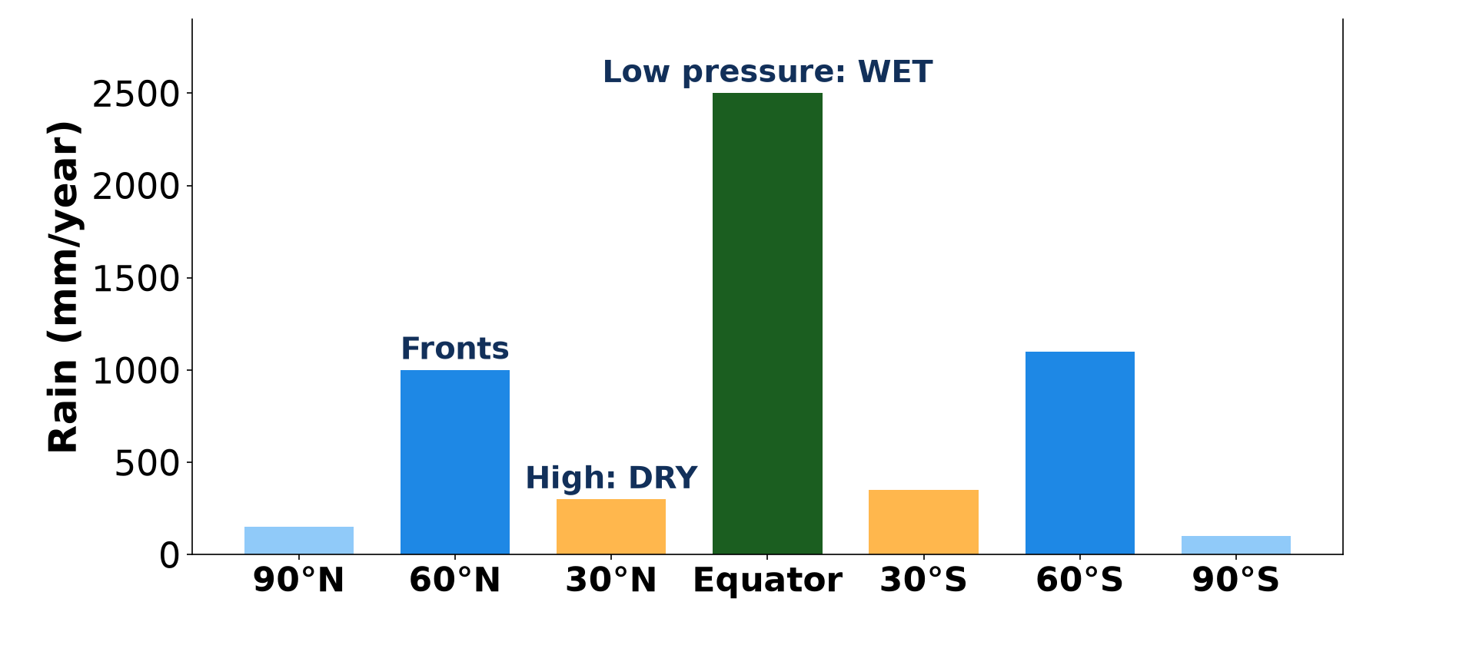
1. GLOBAL PATTERN
Activity 1
Rainfall by latitude.
Notes:
Activity 1. Look carefully at this diagram: rainfall by latitude. Observe every detail before I ask the question.

Slide 21
1. GLOBAL PATTERN
Activity 1: Question
Where is rainfall heaviest on the globe?
Notes:
Here is the question for Activity 1: Where is rainfall heaviest on the globe? Take one minute to think and write your answer in your rough notebook.

Slide 22
1. GLOBAL PATTERN
Activity 1: Answer
Around the Equator.
Notes:
Let us check the answer together. Around the Equator.

Slide 23

1. PRESSURE BELTS
Activity 2
The pressure belts.
Notes:
Activity 2. Look carefully at this diagram: the pressure belts. Observe every detail before I ask the question.

Slide 24
1. PRESSURE BELTS
Activity 2: Question
Why are the great deserts near 30° N and S?
Notes:
Here is the question for Activity 2: Why are the great deserts near 30° N and S? Take one minute to think and write your answer in your rough notebook.

Slide 25
1. PRESSURE BELTS
Activity 2: Answer
Air sinks in the subtropical high-pressure belts, so clouds do not form.
Notes:
Let us check the answer together. Air sinks in the subtropical high-pressure belts, so clouds do not form.

Slide 26

1. PRESSURE BELTS
Activity 3
The Sahara.
Notes:
Activity 3. Look carefully at this picture: the Sahara. Observe every detail before I ask the question.

Slide 27
1. PRESSURE BELTS
Activity 3: Question
Which pressure belt lies over the Sahara?
Notes:
Here is the question for Activity 3: Which pressure belt lies over the Sahara? Take one minute to think and write your answer in your rough notebook.

Slide 28
1. PRESSURE BELTS
Activity 3: Answer
The subtropical high-pressure belt.
Notes:
Let us check the answer together. The subtropical high-pressure belt.

Slide 29

2. SECONDARY FACTORS
Activity 4
Rainfall of Douala and Garoua.
Notes:
Activity 4. Look carefully at this diagram: rainfall of Douala and Garoua. Observe every detail before I ask the question.

Slide 30
2. SECONDARY FACTORS
Activity 4: Question
Give one reason why Douala is wetter than Garoua.
Notes:
Here is the question for Activity 4: Give one reason why Douala is wetter than Garoua. Take one minute to think and write your answer in your rough notebook.

Slide 31
2. SECONDARY FACTORS
Activity 4: Answer
It is on the coast, close to the moist monsoon air, and at the foot of Mount Cameroon.
Notes:
Let us check the answer together. It is on the coast, close to the moist monsoon air, and at the foot of Mount Cameroon.

Slide 32
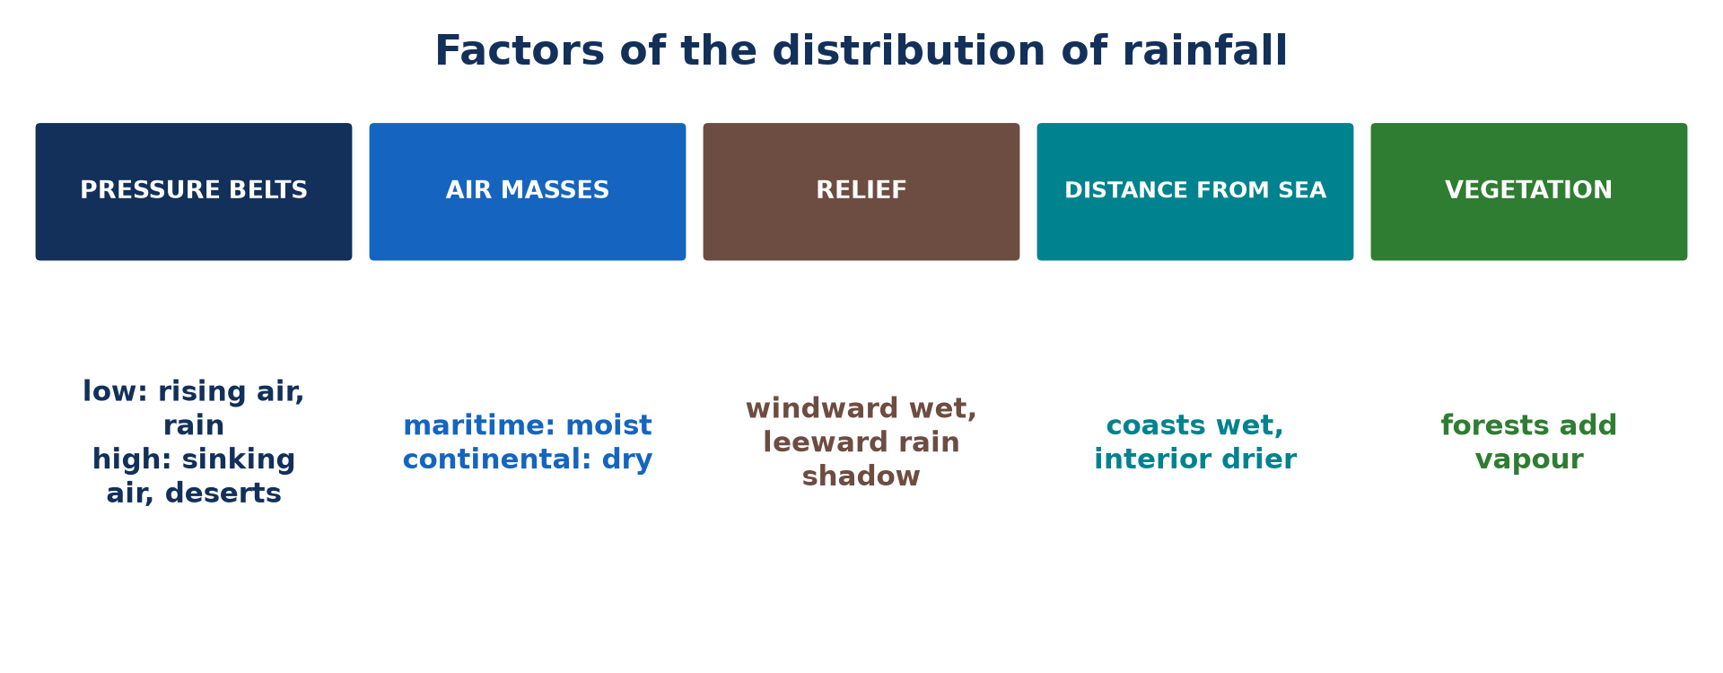
2. SECONDARY FACTORS
Activity 5
Factors of rainfall.
Notes:
Activity 5. Look carefully at this picture: factors of rainfall. Observe every detail before I ask the question.

Slide 33
2. SECONDARY FACTORS
Activity 5: Question
How do forests increase rainfall?
Notes:
Here is the question for Activity 5: How do forests increase rainfall? Take one minute to think and write your answer in your rough notebook.

Slide 34
2. SECONDARY FACTORS
Activity 5: Answer
They release water vapour by transpiration.
Notes:
Let us check the answer together. They release water vapour by transpiration.

Slide 35
BOARD SUMMARY
Board Summary
Topic: Moisture in the Atmosphere
Sub-topic: Precipitation
Lesson 12: Global Distribution of Precipitation
Notes:
Now we are going to copy the board summary. Write the title and the headings neatly in your notebooks. I will give you enough time for each slide, so do not rush.

Slide 36
BOARD SUMMARY
DEFINITIONS
The key terms of this lesson are defined as follows:
Pressure belt: It is a zone of high or low pressure that circles the globe along a latitude.
Notes:
Let us copy the definitions. The key terms of this lesson are defined as follows. On this slide we have Pressure belt. Write each point on a new line, with the key term first, and explain it in your own words when we revise. When you finish, we go to the next slide.

Slide 37
BOARD SUMMARY
DEFINITIONS (continued)
Intertropical Convergence Zone (ITCZ): It is the equatorial low-pressure zone where the trade winds meet and air rises.
Air mass: It is a large body of air with similar temperature and humidity.
Notes:
We continue with the definitions. On this slide we have Intertropical Convergence Zone (ITCZ) and Air mass. Write each point on a new line, with the key term first, and explain it in your own words when we revise. When you finish, we go to the next slide.

Slide 38
BOARD SUMMARY
DEFINITIONS (continued)
Continentality: It is the effect of distance from the sea, which makes inland areas drier and their temperatures more extreme.
Insularity: It is the effect of being surrounded by the sea, which makes islands and coasts wetter and milder.
Notes:
We continue with the definitions. On this slide we have Continentality and Insularity. Write each point on a new line, with the key term first, and explain it in your own words when we revise.

Slide 39
BOARD SUMMARY
1. Spatial Pattern of Distribution by Latitude
Precipitation is distributed by latitude as follows:
Equatorial zone (0° to 10° N and S): This zone receives the heaviest rainfall on Earth, usually more than 2,000 mm a year, with rain in every month. It is the zone of rainforests, such as the Congo Basin and the Amazon.
Illustration: rainfall and latitude
Notes:
Let us copy Spatial Pattern of Distribution by Latitude. Precipitation is distributed by latitude as follows. Copy the point on Equatorial zone (0° to 10° N and S) on the left, then draw the diagram on the right: rainfall and latitude. Give it a title and label it clearly.

Slide 40

BOARD SUMMARY
1. Spatial Pattern of Distribution by Latitude
Tropical and subtropical zones (10° to 30°): Rainfall decreases away from the Equator, and the dry season becomes longer. Around 20° to 30°, it falls below 250 mm a year in the great hot deserts such as the Sahara.
Illustration: the hot deserts
Notes:
Copy the point on Tropical and subtropical zones (10° to 30°) on the left, then draw the diagram on the right: the hot deserts. Give it a title and label it clearly.

Slide 41
BOARD SUMMARY
1. Spatial Pattern of Distribution by Latitude
Temperate zone (40° to 60°): Rainfall rises again to a moderate amount, between about 500 and 1,500 mm a year. It falls in all seasons, especially on the western coasts of the continents.
Notes:
We continue with Spatial Pattern of Distribution by Latitude. Copy the point on Temperate zone (40° to 60°): write the key term first, then its explanation.

Slide 42
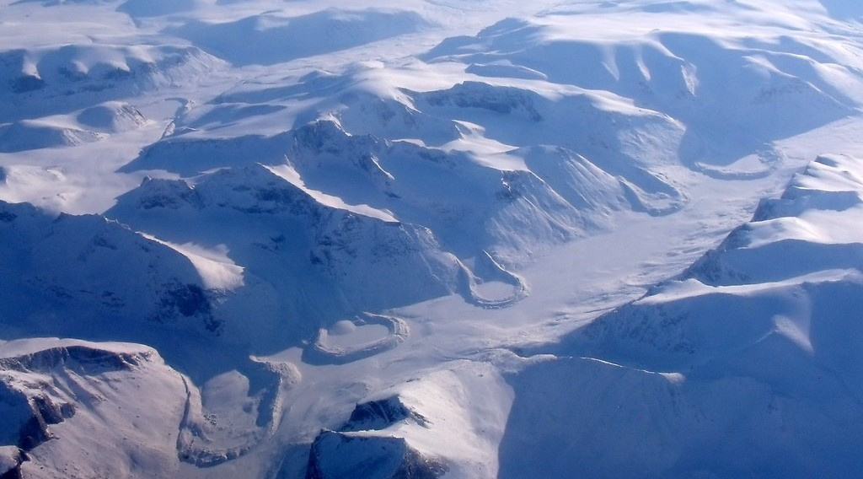
BOARD SUMMARY
1. Spatial Pattern of Distribution by Latitude
Polar zones (above 60°): Precipitation is very low, often less than 250 mm a year, and falls mainly as snow. These regions are therefore called cold or ice deserts.
Illustration: an ice cap
Notes:
Copy the point on Polar zones (above 60°) on the left, then draw the diagram on the right: an ice cap. Give it a title and label it clearly.

Slide 43
BOARD SUMMARY
2. Primary Factors of Variation
A) Pressure Belts
The pressure belts explain this pattern in the following ways:
Equatorial low pressure (ITCZ): Intense heating makes the air rise, expand and cool, so its vapour condenses into cumulonimbus clouds. This gives heavy convectional rain all year near the Equator.
Illustration: the pressure belts
Notes:
Let us copy Pressure Belts. The pressure belts explain this pattern in the following ways. Copy the point on Equatorial low pressure (ITCZ) on the left, then draw the diagram on the right: the pressure belts. Give it a title and label it clearly.

Slide 44
BOARD SUMMARY
2. Primary Factors of Variation
A) Pressure Belts
Subtropical high pressure (about 30° N and S): Here, air sinks from high altitudes, is compressed and warms, so it can hold its vapour and no clouds form. This is why the great deserts, such as the Sahara and the Kalahari, lie along these latitudes.
Illustration: a sand desert
Notes:
Copy the point on Subtropical high pressure (about 30° N and S) on the left, then draw the diagram on the right: a sand desert. Give it a title and label it clearly.

Slide 45
BOARD SUMMARY
2. Primary Factors of Variation
A) Pressure Belts
Temperate low pressure (about 60° N and S): Warm tropical air and cold polar air meet along the polar front. The warm air is forced to rise, which gives frontal rain throughout the year.
Notes:
We continue with Pressure Belts. Copy the point on Temperate low pressure (about 60° N and S): write the key term first, then its explanation.

Slide 46
BOARD SUMMARY
2. Primary Factors of Variation
A) Pressure Belts
Polar high pressure: Very cold, dense air sinks over the poles and holds very little moisture. Precipitation is therefore very low.
Notes:
We continue with Pressure Belts. Copy the point on Polar high pressure: write the key term first, then its explanation.

Slide 47
BOARD SUMMARY
2. Primary Factors of Variation
B) Air Masses
Air masses influence precipitation in the following ways:
Maritime air masses: They form over the oceans and are moist, so they bring rain to the lands they cross. For example, the maritime tropical air of the south-west monsoon brings the rainy season to Cameroon from April to October in the North.
Notes:
Let us copy Air Masses. Air masses influence precipitation in the following ways. Copy the point on Maritime air masses: write the key term first, then its explanation.

Slide 48

BOARD SUMMARY
2. Primary Factors of Variation
B) Air Masses
Continental air masses: They form over land and are dry, so they bring dry weather. For example, the continental tropical air of the Harmattan, from the Sahara, brings the dry season to northern Cameroon.
Illustration: the Harmattan
Notes:
Copy the point on Continental air masses on the left, then draw the diagram on the right: the Harmattan. Give it a title and label it clearly.

Slide 49
BOARD SUMMARY
3. Secondary (Local) Factors
A) Relief, the Sea and Ocean Currents
Local rainfall is influenced by the following physical factors:
Relief: Moist air forced to rise over mountains gives heavy rain on the windward side and a rain shadow on the leeward side. Debundscha, at the foot of Mount Cameroon, receives about 10,000 mm a year, one of the highest totals in the world.
Illustration: local factors of rainfall
Notes:
Let us copy Relief, the Sea and Ocean Currents. Local rainfall is influenced by the following physical factors. Copy the point on Relief on the left, then draw the diagram on the right: local factors of rainfall. Give it a title and label it clearly.

Slide 50
BOARD SUMMARY
3. Secondary (Local) Factors
A) Relief, the Sea and Ocean Currents
Distance from the sea (insularity and continentality): Coasts and islands receive much moisture from the sea, while inland areas are far from it and drier. Douala receives about 4,000 mm a year, but Garoua only about 1,000 mm.
Illustration: rainfall of Douala and Garoua
Notes:
Copy the point on Distance from the sea (insularity and continentality) on the left, then draw the diagram on the right: rainfall of Douala and Garoua. Give it a title and label it clearly.

Slide 51
BOARD SUMMARY
3. Secondary (Local) Factors
A) Relief, the Sea and Ocean Currents
Ocean currents: Warm currents warm the air above them, which picks up moisture and brings rain to the coast. Cold currents cool the air, which becomes stable, so coasts along them are dry, like the Namib and Atacama deserts.
Notes:
We continue with Relief, the Sea and Ocean Currents. Copy the point on Ocean currents: write the key term first, then its explanation.

Slide 52

BOARD SUMMARY
3. Secondary (Local) Factors
B) Vegetation, Water Bodies and Towns
Local rainfall is also influenced by the following factors:
Vegetation: Forests release a lot of water vapour by transpiration, which feeds the clouds and encourages convectional rain. Deforestation therefore tends to reduce local rainfall.
Illustration: a rainforest
Notes:
Let us copy Vegetation, Water Bodies and Towns. Local rainfall is also influenced by the following factors. Copy the point on Vegetation on the left, then draw the diagram on the right: a rainforest. Give it a title and label it clearly.

Slide 53

BOARD SUMMARY
3. Secondary (Local) Factors
B) Vegetation, Water Bodies and Towns
Water bodies: Large lakes and reservoirs, such as Lake Chad and Lake Lagdo, add water vapour to the air by evaporation. They can increase rainfall on their shores, especially on the side where the winds blow.
Illustration: Lake Chad
Notes:
Copy the point on Water bodies on the left, then draw the diagram on the right: lake Chad. Give it a title and label it clearly.

Slide 54
BOARD SUMMARY
3. Secondary (Local) Factors
B) Vegetation, Water Bodies and Towns
Urban effects: Towns are warmer than the countryside and their air contains many dust particles. The rising warm air and these condensation nuclei can increase storms and rainfall over and downwind of big cities.
Notes:
We continue with Vegetation, Water Bodies and Towns. Copy the point on Urban effects: write the key term first, then its explanation.

Slide 55
FORMATIVE EVALUATION
Evaluation 1
Why does the Equator receive heavy rain all year while 30° N is very dry?
Notes:
Now let us check what you have understood. Question 1: Why does the Equator receive heavy rain all year while 30° N is very dry? Answer in your exercise book.

Slide 56
FORMATIVE EVALUATION
Expected Answer
At the Equator, low pressure makes air rise and form rain clouds; at 30° N, high pressure makes air sink and warm, so no clouds form.
Notes:
The expected answer is: at the Equator, low pressure makes air rise and form rain clouds; at 30° N, high pressure makes air sink and warm, so no clouds form. If you got it right, well done.

Slide 57
FORMATIVE EVALUATION
Evaluation 2
Give two reasons why Douala is wetter than Garoua.
Notes:
Now let us check what you have understood. Question 2: Give two reasons why Douala is wetter than Garoua. Answer in your exercise book.

Slide 58
FORMATIVE EVALUATION
Expected Answer
It is on the coast near moist monsoon air; Mount Cameroon forces the air to rise (relief rain).
Notes:
The expected answer is: it is on the coast near moist monsoon air; Mount Cameroon forces the air to rise (relief rain). If you got it right, well done.

Slide 59
REMEDIATION
Remediation
Fill in the blanks:
The equatorial low-pressure zone is the ______.
Deserts lie under the subtropical ______ pressure belts.
Notes:
Take your time to copy this part; we will continue together.

Slide 60
REMEDIATION
Remediation (continued)
The dry side of a mountain is the rain ______.
Notes:
For those who need more practice, fill in the blanks in your exercise book. The answers are: number 1, ITCZ; number 2, high; number 3, shadow.

Slide 61
HOMEWORK
Homework
Define atmospheric pressure.
Notes:
For your homework: Define atmospheric pressure. We shall correct it at the beginning of our next lesson.

Slide 62
NEXT LESSON
Next Lesson
Our next lesson will be on:
Lesson 13: Pressure Systems
Notes:
Our next lesson will be on Lesson 13: Pressure Systems. Thank you for your attention, and see you next time.

Slide 63
BILINGUAL GAME
Bilingual Game (Jeu Bilingue)
English | Français
Precipitation | Les précipitations
Pressure belt | La ceinture de pression
Relief | Le relief
Windward side | Le versant au vent
Rain shadow | L'ombre pluviométrique
Air mass | La masse d'air
Notes:
Let us play the bilingual game. I say a word in English, and you give me the French word. Then we do the reverse.

Slide 64
LOGBOOK
Official Logbook (1/2)
Module / Topic | Moisture in the Atmosphere
Lesson Title | Lesson 12: Global Distribution of Precipitation
Expected Learning Outcomes | Describe the global pattern of precipitation. Explain the role of pressure belts. Explain the role of air masses. Explain the secondary factors of rainfall.
Competence | Learners are able to explain the world pattern of rainfall and the contrast between Douala and Garoua.
Notes:
I record this information in the official logbook of the class after the lesson.

Slide 65
LOGBOOK
Official Logbook (2/2)
Matter Taught | DEFINITIONS; Spatial Pattern of Distribution by Latitude; Pressure Belts; Air Masses; Relief, the Sea and Ocean Currents; Vegetation, Water Bodies and Towns.
Evaluation | Formative evaluation and remediation exercise.
Homework | Define atmospheric pressure.
Enrolment / Present / Absent | ____ / ____ / ____
Achievement | To be completed after the lesson.
Notes:
I complete the second page of the logbook: the matter taught, the evaluation, the homework and the attendance.

Slide 66
TEACHER'S NOTE
Teacher's Note
Timing: Homework correction, plan, objectives 8 min | Recall, situation, action 10 min | 5 activities 30 min | Board summary (copying) 30 min | Evaluation, remediation 10 min | Homework, next lesson 5 min | Logbook 7 min
Without the projector (Activity 1): draw rainfall bars by latitude.
Without the projector (Activity 2): draw the pressure belts.
Without the projector (Activity 3): locate the Sahara.
Without the projector (Activity 4): compare the two towns.
Without the projector (Activity 5): list the factors.
Notes:
This slide is for me, the teacher: it gives the timing of the lesson and what to do if the projector is not available.

Slide 67
REFERENCES
References
Geography Syllabus for Sixth Forms (Lower and Upper Sixth), MINESEC, 2019 — Module 1 (Meteorology, Climatology & Hydrology).
Teacher's course notes: Mr KAMDEM E., Meteorology (LSA), GBHS Garoua, 2026.
Photo, Activity 3: “Desert trekking in Merzouga” by Antonio Cinotti , CC BY-NC-ND 2.0, via Flickr (https://www.flickr.com/photos/46378751@N02/15331399979)
Photo, board summary (Polar zones (above 60°)): “The Art of Retreat” by subarcticmike, CC BY 2.0, via Flickr (https://www.flickr.com/photos/31856336@N03/7048837663)
Photo, board summary (Continental air masses): “Bamenda sob a poeira do Harmattan” by carlosoliveirareis, CC BY-NC-SA 2.0, via Flickr (https://www.flickr.com/photos/54218923@N00/387054136)
Photo, board summary (Vegetation): “Amazon 11” by CIAT International Center for Tropical Agriculture, CC BY-SA 2.0, via Flickr (https://www.flickr.com/photos/38476503@N08/5641587148)
Photo, board summary (Water bodies): “Lake Chad: almost gone” by GRIDArendal, CC BY-NC-SA 2.0, via Flickr (https://www.flickr.com/photos/148768555@N05/32323646926)
Notes:
Take your time to copy this part; we will continue together.

Slide 68
REFERENCES
References (continued)
Diagrams and animations: drawn for this lesson (Geography Department).
Notes:
These are the references and picture credits used to prepare this lesson.

