Slide 1
LOWER SIXTH ARTS
GEOGRAPHY
Lesson 15
Planetary Winds
Notes:
Good morning, class, and welcome to our geography lesson. I am your geography teacher, Mr Kamdem. Today we are starting Lesson 15: Planetary Winds.

Slide 2
CLASS INFO
Class, Chapter and Duration
Class | Lower Sixth Arts
Chapter | Module 1: Understanding and managing atmospheric and hydrological phenomena and hazards across the world in general and Cameroon in particular
Duration | 2 periods (2 × 50 minutes)
Notes:
This lesson is for Lower Sixth Arts. It belongs to Module 1: Understanding and managing atmospheric and hydrological phenomena and hazards across the world in general and Cameroon in particular. We shall need 2 periods to cover it.

Slide 3
IDENTIFICATION
Lesson Identification
Topic | Global and Local Atmospheric Circulation
Sub-topic | Macroscale or Global Scale Winds
Lesson | Lesson 15: Planetary Winds
Notions / Concepts | Wind, pressure gradient, Coriolis effect, Ferrel's law, planetary winds, trade winds, westerlies, polar easterlies, doldrums, horse latitudes.
Syllabus focus | Meaning of wind and planetary winds; the Coriolis effect; the three planetary winds (trade winds, westerlies, polar easterlies) and their characteristics.
Competence | Learners are able to explain the pattern of planetary winds and the winds that affect Cameroon.
Notes:
Our topic is Global and Local Atmospheric Circulation, and the sub-topic is Macroscale or Global Scale Winds. The key notions we shall use today are: wind, pressure gradient, Coriolis effect, Ferrel's law, planetary winds, trade winds, westerlies, polar easterlies, doldrums, horse latitudes. At the end, you should be able to do this: learners are able to explain the pattern of planetary winds and the winds that affect Cameroon.

Slide 4

HOMEWORK CORRECTION
Correction of the Homework
Question (Lesson 14: Vertical Motions: Stability and Instability):
Define wind.
Notes:
Before we start the new lesson, let us correct the homework I gave you at the end of Lesson 14: Vertical Motions: Stability and Instability. The question was: Define wind. Take out your exercise books.

Slide 5
HOMEWORK CORRECTION
Correction: Possible Answer
Wind is the movement of air from an area of high pressure to an area of low pressure.
Notes:
Here is a good answer. Wind is the movement of air from an area of high pressure to an area of low pressure. Compare it with your own answer and correct your work in red.

Slide 6
LESSON PLAN
Lesson Plan
Correction of the homework
Objectives and recall
Real-life situation and action to take
Learning activities
Board summary
Evaluation, remediation and homework
Notes:
Here is the plan of our lesson today. First, we shall correct the homework. Then we shall look at the objectives and recall what you already know. After that, we shall study a situation from real life and the action to take, and do the learning activities. Finally, we shall copy the board summary, do the evaluation and the remediation, and I will give you the homework.

Slide 7
OBJECTIVES
Objectives
By the end of this lesson, you should be able to:
Define wind and planetary winds.
Explain the causes of wind and the Coriolis effect.
Describe the trade winds.
Notes:
Take your time to copy this part; we will continue together.

Slide 8
OBJECTIVES
Objectives (continued)
Describe the westerlies and the polar easterlies.
Notes:
By the end of this lesson, you should be able to do four things. Number 1: define wind and planetary winds. Number 2: explain the causes of wind and the Coriolis effect. Number 3: describe the trade winds. Number 4: describe the westerlies and the polar easterlies.

Slide 9
PREVIOUS KNOWLEDGE
Previous Knowledge
Air moves from high to low pressure.
Pressure belts lie at 0°, 30°, 60° and 90°.
The Hadley cell produces the north-east trade winds.
Notes:
Let us first remember what you already know. Air moves from high to low pressure. Pressure belts lie at 0°, 30°, 60° and 90°. The Hadley cell produces the north-east trade winds. Keep this in mind, because we shall build on it today.

Slide 10
REAL-LIFE SITUATION
Situation in Real Life
In an old book, you read that sailing ships crossing the Atlantic followed winds that "always blow from the same direction", which sailors called the trade winds.
Near the Equator, the ships were sometimes stuck for days without wind.
Notes:
Take your time to copy this part; we will continue together.

Slide 11
REAL-LIFE SITUATION
Situation in Real Life (continued)
You then notice that the Harmattan blows over Garoua from the north-east for months.
You ask: "Which great winds blow over the Earth, and why do they not blow straight from north to south?"
Notes:
Listen carefully to this situation from real life. In an old book, you read that sailing ships crossing the Atlantic followed winds that "always blow from the same direction", which sailors called the trade winds. Near the Equator, the ships were sometimes stuck for days without wind. You then notice that the Harmattan blows over Garoua from the north-east for months. You ask: "Which great winds blow over the Earth, and why do they not blow straight from north to south?" Think about it, because I am going to ask you some questions.

Slide 12
REAL-LIFE SITUATION
Situation: Question 1
What is the problem in the situation?
Notes:
Question 1: What is the problem in the situation? Think for a moment, then raise your hand to answer.

Slide 13
REAL-LIFE SITUATION
Answer
The learner does not know the planetary winds and their directions.
Notes:
Good. The learner does not know the planetary winds and their directions.

Slide 14
REAL-LIFE SITUATION
Situation: Question 2
What are the trade winds?
Notes:
Question 2: What are the trade winds? Think for a moment, then raise your hand to answer.

Slide 15
REAL-LIFE SITUATION
Answer
Steady winds blowing from the subtropical highs towards the Equator.
Notes:
Good. Steady winds blowing from the subtropical highs towards the Equator.

Slide 16
REAL-LIFE SITUATION
Situation: Question 3
Why do winds curve instead of blowing straight?
Notes:
Question 3: Why do winds curve instead of blowing straight? Think for a moment, then raise your hand to answer.

Slide 17
REAL-LIFE SITUATION
Possible Answer
Because of the rotation of the Earth (the Coriolis effect).
Notes:
Good. Because of the rotation of the Earth (the Coriolis effect).

Slide 18
ACTION TO TAKE
Action to Take
Use wind directions to explain the dry and rainy seasons of your region.
Notes:
From this situation, the action we are working towards in this lesson is the following: use wind directions to explain the dry and rainy seasons of your region.

Slide 19
JUSTIFICATION
Justification of the Lesson
This lesson explains the permanent winds that move heat and moisture around the world and influence the climate of Cameroon.
Notes:
Why is this lesson important for you? This lesson explains the permanent winds that move heat and moisture around the world and influence the climate of Cameroon.

Slide 20

1. WIND
Activity 1
A windsock.
Notes:
Activity 1. Look carefully at this picture: a windsock. Observe every detail before I ask the question.

Slide 21
1. WIND
Activity 1: Question
Why does wind blow?
Notes:
Here is the question for Activity 1: Why does wind blow? Take one minute to think and write your answer in your rough notebook.

Slide 22
1. WIND
Activity 1: Answer
Air moves from high pressure to low pressure.
Notes:
Let us check the answer together. Air moves from high pressure to low pressure.

Slide 23
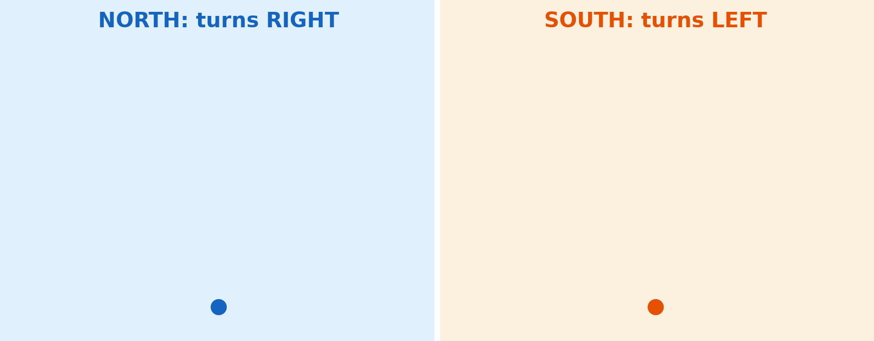
1. CORIOLIS EFFECT
Activity 2
Animation: the Coriolis effect.
Notes:
Activity 2. Look carefully at this animation: animation: the Coriolis effect. Watch the animation to the end; it will play again.

Slide 24
1. CORIOLIS EFFECT
Activity 2: Question
To which side are winds deflected in the northern hemisphere?
Notes:
Here is the question for Activity 2: To which side are winds deflected in the northern hemisphere? Take one minute to think and write your answer in your rough notebook.

Slide 25
1. CORIOLIS EFFECT
Activity 2: Answer
To the right.
Notes:
Let us check the answer together. To the right.

Slide 26
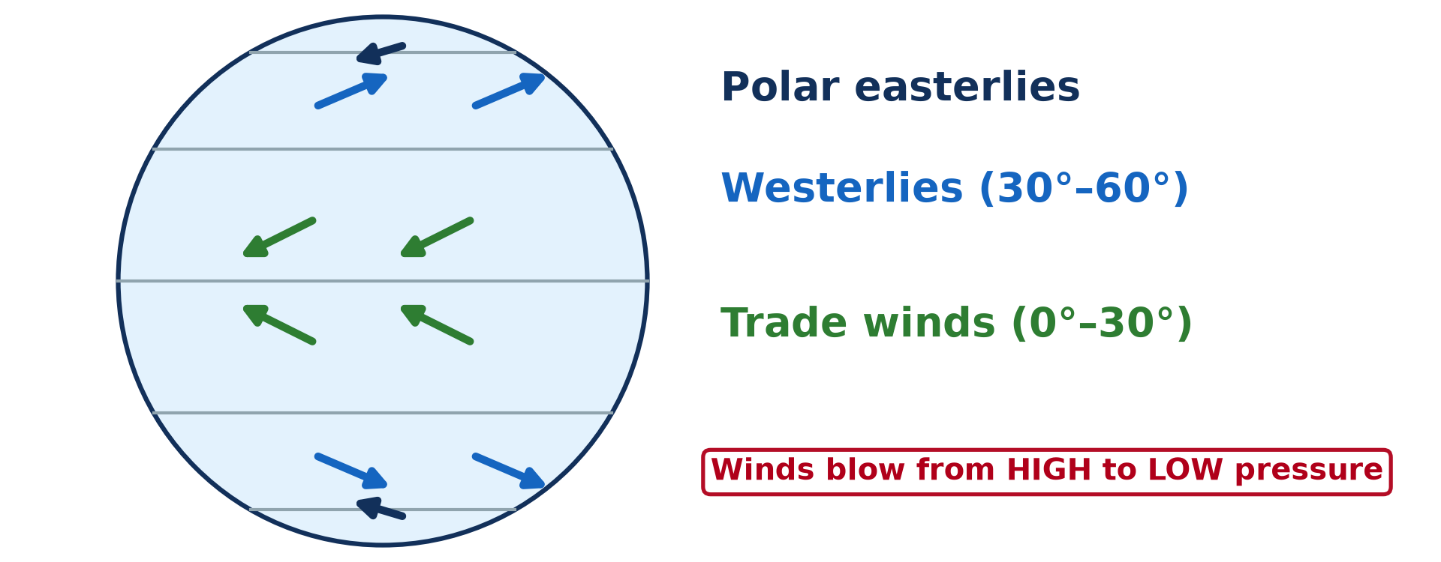
2. PLANETARY WINDS
Activity 3
The planetary winds.
Notes:
Activity 3. Look carefully at this diagram: the planetary winds. Observe every detail before I ask the question.

Slide 27
2. PLANETARY WINDS
Activity 3: Question
Which winds blow between the subtropical highs and the Equator?
Notes:
Here is the question for Activity 3: Which winds blow between the subtropical highs and the Equator? Take one minute to think and write your answer in your rough notebook.

Slide 28
2. PLANETARY WINDS
Activity 3: Answer
The trade winds.
Notes:
Let us check the answer together. The trade winds.

Slide 29
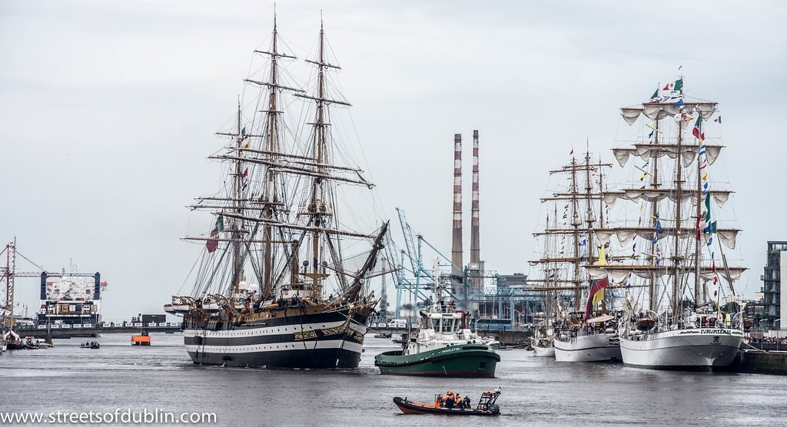
2. PLANETARY WINDS
Activity 4
A sailing ship.
Notes:
Activity 4. Look carefully at this picture: a sailing ship. Observe every detail before I ask the question.

Slide 30
2. PLANETARY WINDS
Activity 4: Question
Why were the trade winds useful to sailors?
Notes:
Here is the question for Activity 4: Why were the trade winds useful to sailors? Take one minute to think and write your answer in your rough notebook.

Slide 31
2. PLANETARY WINDS
Activity 4: Answer
They blow steadily in the same direction.
Notes:
Let us check the answer together. They blow steadily in the same direction.

Slide 32

2. PLANETARY WINDS
Activity 5
Stormy seas.
Notes:
Activity 5. Look carefully at this picture: stormy seas. Observe every detail before I ask the question.

Slide 33
2. PLANETARY WINDS
Activity 5: Question
Why are the westerlies stronger in the southern hemisphere?
Notes:
Here is the question for Activity 5: Why are the westerlies stronger in the southern hemisphere? Take one minute to think and write your answer in your rough notebook.

Slide 34
2. PLANETARY WINDS
Activity 5: Answer
There is little land to slow them down.
Notes:
Let us check the answer together. There is little land to slow them down.

Slide 35
BOARD SUMMARY
Board Summary
Topic: Global and Local Atmospheric Circulation
Sub-topic: Macroscale or Global Scale Winds
Lesson 15: Planetary Winds
Notes:
Now we are going to copy the board summary. Write the title and the headings neatly in your notebooks. I will give you enough time for each slide, so do not rush.

Slide 36
BOARD SUMMARY
DEFINITIONS
The key terms of this lesson are defined as follows:
Wind: It is the horizontal movement of air from high pressure to low pressure.
Planetary winds: They are permanent winds that blow all year between the pressure belts.
Notes:
Let us copy the definitions. The key terms of this lesson are defined as follows. On this slide we have Wind and Planetary winds. Write each point on a new line, with the key term first, and explain it in your own words when we revise. When you finish, we go to the next slide.

Slide 37
BOARD SUMMARY
DEFINITIONS (continued)
Coriolis effect: It is the deflection of winds by the rotation of the Earth: to the right in the northern hemisphere and to the left in the southern hemisphere.
Notes:
We continue with the definitions. On this slide we have Coriolis effect. Write each point on a new line, with the key term first, and explain it in your own words when we revise.

Slide 38
BOARD SUMMARY
1. Meaning and Illustration of Planetary Winds
Planetary winds are explained as follows:
Pressure gradient: Air always moves from high pressure towards low pressure, and the difference of pressure between two places is the pressure gradient. The bigger the difference, the stronger the wind.
Illustration: a windsock
Notes:
Let us copy Meaning and Illustration of Planetary Winds. Planetary winds are explained as follows. Copy the point on Pressure gradient on the left, then draw the diagram on the right: a windsock. Give it a title and label it clearly.

Slide 39
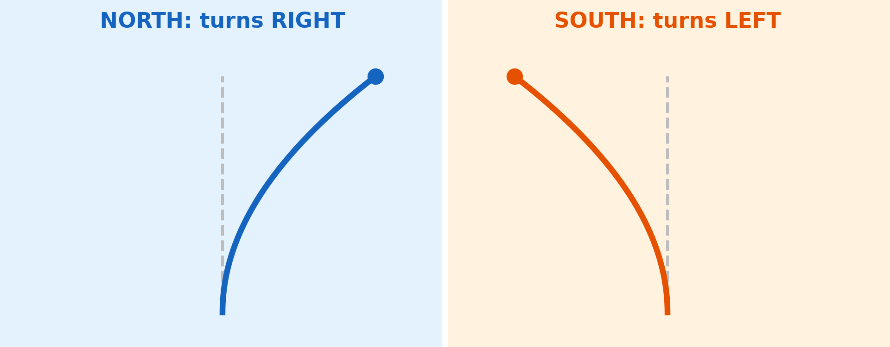
BOARD SUMMARY
1. Meaning and Illustration of Planetary Winds
The Coriolis effect (Ferrel's law): Because the Earth rotates, winds do not blow straight from high to low pressure. They are deflected to the right in the northern hemisphere and to the left in the southern hemisphere.
Illustration: the Coriolis effect
Notes:
Copy the point on The Coriolis effect (Ferrel's law) on the left, then draw the diagram on the right: the Coriolis effect. Give it a title and label it clearly.

Slide 40
BOARD SUMMARY
1. Meaning and Illustration of Planetary Winds
Naming of winds: A wind is named after the direction from which it blows. For example, a north-east wind blows from the north-east towards the south-west.
Notes:
We continue with Meaning and Illustration of Planetary Winds. Copy the point on Naming of winds: write the key term first, then its explanation.

Slide 41
BOARD SUMMARY
2. Types and Characteristics of Planetary Winds
The three planetary winds have the following characteristics:
Trade winds: They blow from the subtropical highs (30°) towards the equatorial low, from the north-east in the northern hemisphere and from the south-east in the southern hemisphere. They are steady and regular, dry over land like the Harmattan but moist over the oceans, and meet in the calm doldrums at the ITCZ.
Illustration: the planetary winds
Notes:
Let us copy Types and Characteristics of Planetary Winds. The three planetary winds have the following characteristics. Copy the point on Trade winds on the left, then draw the diagram on the right: the planetary winds. Give it a title and label it clearly.

Slide 42
BOARD SUMMARY
2. Types and Characteristics of Planetary Winds
Westerlies: They blow from the subtropical highs towards the subpolar lows (30° to 60°), from the south-west in the northern hemisphere and from the north-west in the southern hemisphere. They are variable, bring depressions and rain to western Europe, and are strongest over the southern oceans, where they are called the Roaring Forties.
Illustration: rough seas
Notes:
Copy the point on Westerlies on the left, then draw the diagram on the right: rough seas. Give it a title and label it clearly.

Slide 43
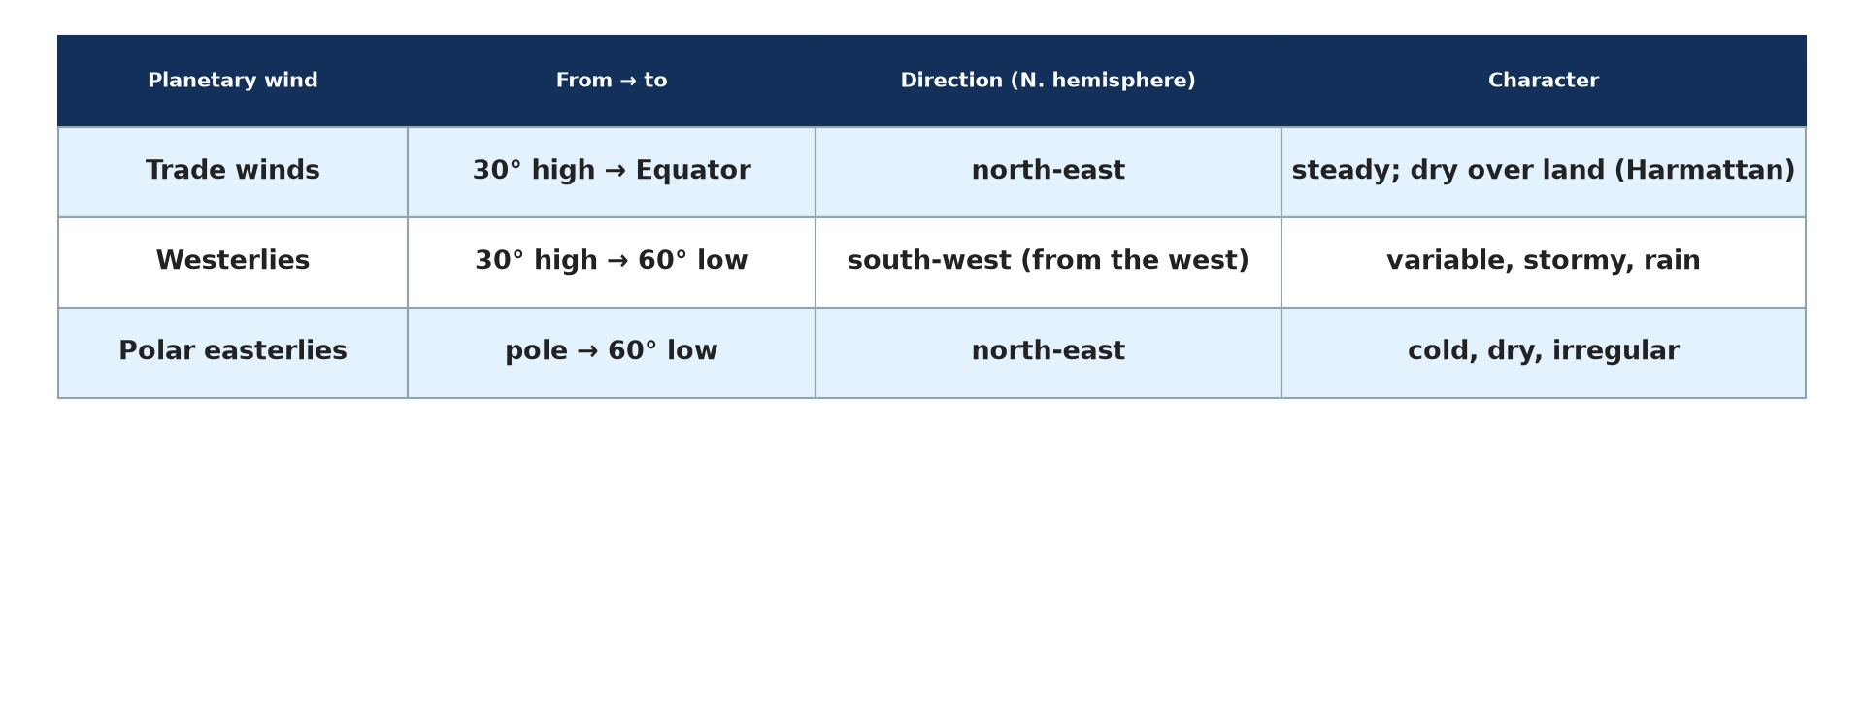
BOARD SUMMARY
2. Types and Characteristics of Planetary Winds
Polar easterlies: They blow from the polar highs towards the subpolar lows (above 60°), from the east. They are very cold, dry and irregular, and where they meet the westerlies the polar front forms.
Illustration: the three planetary winds
Notes:
Copy the point on Polar easterlies on the left, then draw the diagram on the right: the three planetary winds. Give it a title and label it clearly.

Slide 44
FORMATIVE EVALUATION
Evaluation 1
Describe the trade winds.
Notes:
Now let us check what you have understood. Question 1: Describe the trade winds. Answer in your exercise book.

Slide 45
FORMATIVE EVALUATION
Expected Answer
Steady winds blowing from the subtropical highs to the Equator, from the north-east (N. hemisphere) and south-east (S. hemisphere).
Notes:
The expected answer is: steady winds blowing from the subtropical highs to the Equator, from the north-east (N. hemisphere) and south-east (S. hemisphere). If you got it right, well done.

Slide 46
FORMATIVE EVALUATION
Evaluation 2
Explain the Coriolis effect.
Notes:
Now let us check what you have understood. Question 2: Explain the Coriolis effect. Answer in your exercise book.

Slide 47
FORMATIVE EVALUATION
Expected Answer
The rotation of the Earth deflects winds to the right in the northern hemisphere and to the left in the southern hemisphere.
Notes:
The expected answer is: the rotation of the Earth deflects winds to the right in the northern hemisphere and to the left in the southern hemisphere. If you got it right, well done.

Slide 48
REMEDIATION
Remediation
Fill in the blanks:
Winds blow from high to ______ pressure.
The winds between 30° and 60° are the ______.
The calm belt at the Equator is the ______.
Notes:
For those who need more practice, fill in the blanks in your exercise book. The answers are: number 1, low; number 2, westerlies; number 3, doldrums.

Slide 49
HOMEWORK
Homework
Name the dry wind that blows over Garoua in the dry season.
Notes:
For your homework: Name the dry wind that blows over Garoua in the dry season. We shall correct it at the beginning of our next lesson.

Slide 50
NEXT LESSON
Next Lesson
Our next lesson will be on:
Lesson 16: Tropical Seasonal Winds: Monsoon and Harmattan
Notes:
Our next lesson will be on Lesson 16: Tropical Seasonal Winds: Monsoon and Harmattan. Thank you for your attention, and see you next time.

Slide 51
BILINGUAL GAME
Bilingual Game (Jeu Bilingue)
English | Français
Wind | Le vent
Trade winds | Les alizés
Westerlies | Les vents d'ouest
Coriolis effect | L'effet de Coriolis
Doldrums | Le pot au noir
Pressure gradient | Le gradient de pression
Notes:
Let us play the bilingual game. I say a word in English, and you give me the French word. Then we do the reverse.

Slide 52
LOGBOOK
Official Logbook (1/2)
Module / Topic | Global and Local Atmospheric Circulation
Lesson Title | Lesson 15: Planetary Winds
Expected Learning Outcomes | Define wind and planetary winds. Explain the causes of wind and the Coriolis effect. Describe the trade winds. Describe the westerlies and the polar easterlies.
Competence | Learners are able to explain the pattern of planetary winds and the winds that affect Cameroon.
Notes:
I record this information in the official logbook of the class after the lesson.

Slide 53
LOGBOOK
Official Logbook (2/2)
Matter Taught | DEFINITIONS; Meaning and Illustration of Planetary Winds; Types and Characteristics of Planetary Winds.
Evaluation | Formative evaluation and remediation exercise.
Homework | Name the dry wind that blows over Garoua in the dry season.
Enrolment / Present / Absent | ____ / ____ / ____
Achievement | To be completed after the lesson.
Notes:
I complete the second page of the logbook: the matter taught, the evaluation, the homework and the attendance.

Slide 54
TEACHER'S NOTE
Teacher's Note
Timing: Homework correction, plan, objectives 8 min | Recall, situation, action 10 min | 5 activities 30 min | Board summary (copying) 30 min | Evaluation, remediation 10 min | Homework, next lesson 5 min | Logbook 7 min
Activity 2 is an animation (GIF): it plays automatically in slide-show mode.
Without the projector (Activity 1): observe the direction of smoke.
Without the projector (Activity 2): draw a line on a spinning paper disc.
Without the projector (Activity 3): draw the winds on a globe sketch.
Without the projector (Activity 4): trace a sailing route.
Without the projector (Activity 5): compare the two hemispheres.
Notes:
This slide is for me, the teacher: it gives the timing of the lesson and what to do if the projector is not available.

Slide 55
REFERENCES
References
Geography Syllabus for Sixth Forms (Lower and Upper Sixth), MINESEC, 2019 — Module 1 (Meteorology, Climatology & Hydrology).
Teacher's course notes: Mr KAMDEM E., Meteorology (LSA), GBHS Garoua, 2026.
Photo, Activity 1: “Windsock” by Wajahat Mahmood, CC BY-SA 2.0, via Flickr (https://www.flickr.com/photos/26116471@N03/6613272897)
Photo, Activity 4: “The Amerigo Vespucci Arrives In Dublin (Tall Ships Race Dublin - 2012)” by infomatique, CC BY-SA 2.0, via Flickr (https://www.flickr.com/photos/80824546@N00/7846937046)
Photo, Activity 5: “Wave Explosion, Monterey Bay, California” by John William Hammond, CC BY-NC-SA 2.0, via Flickr (https://www.flickr.com/photos/8398907@N02/16328053911)
Diagrams and animations: drawn for this lesson (Geography Department).
Notes:
These are the references and picture credits used to prepare this lesson.

