Slide 1
FORM 3
GEOGRAPHY
Practical Work 2
Calculation of Time and Date
Notes:
Good morning, class, and welcome to our geography lesson. I am your geography teacher, Madam Che. Today we are starting Practical Work 2: Calculation of Time and Date.

Slide 2
CLASS INFO
Class, Chapter and Duration
Class | Form 3
Chapter | The Earth as a Planet in the Solar System — Location and Time
Duration | 50 minutes
Notes:
This lesson is for Form 3. It belongs to The Earth as a Planet in the Solar System — Location and Time. We shall need 50 minutes to cover it.

Slide 3
IDENTIFICATION
Lesson Identification
Topic | The Earth as a Planet in the Solar System
Sub-topic | Location and Time
Lesson | Practical Work 2: Calculation of Time and Date
Notions / Concepts | Longitude difference, time difference, GMT, International Date Line.
Syllabus focus | Sun time: calculating local time from longitude and longitude from local time; calculating standard time with time zones; calculating the date when crossing midnight or the International Date Line.
Competence | Learners are able to calculate the time and the date in another place, for example to follow a match or to call a relative abroad.
Notes:
Our topic is The Earth as a Planet in the Solar System, and the sub-topic is Location and Time. The key notions we shall use today are: longitude difference, time difference, GMT, International Date Line. At the end, you should be able to do this: learners are able to calculate the time and the date in another place, for example to follow a match or to call a relative abroad.

Slide 4

HOMEWORK CORRECTION
Correction of the Homework
Question (Lesson 4: Local Time, Standard Time and Time Zones):
Calculate the local time at 30° E when it is 12:00 at 0°.
Notes:
Before we start the new lesson, let us correct the homework I gave you at the end of Lesson 4: Local Time, Standard Time and Time Zones. The question was: Calculate the local time at 30° E when it is 12:00 at 0°. Take out your exercise books.

Slide 5
HOMEWORK CORRECTION
Correction: Possible Answer
30 × 4 = 120 minutes = 2 hours ahead, so 14:00.
Notes:
Here is a good answer. 30 × 4 = 120 minutes = 2 hours ahead, so 14:00. Compare it with your own answer and correct your work in red.

Slide 6
LESSON PLAN
Lesson Plan
Correction of the homework
Objectives and recall
Real-life situation and action to take
Learning activities
Board summary
Evaluation, remediation and homework
Notes:
Here is the plan of our lesson today. First, we shall correct the homework. Then we shall look at the objectives and recall what you already know. After that, we shall study a situation from real life and the action to take, and do the learning activities. Finally, we shall copy the board summary, do the evaluation and the remediation, and I will give you the homework.

Slide 7
OBJECTIVES
Objectives
By the end of this lesson, you should be able to:
State the three rules for time calculations.
Calculate local time from a difference of longitude, and longitude from local time.
Notes:
Take your time to copy this part; we will continue together.

Slide 8
OBJECTIVES
Objectives (continued)
Calculate standard time with time zones.
Find the correct date after crossing midnight or the International Date Line.
Notes:
By the end of this lesson, you should be able to do four things. Number 1: state the three rules for time calculations. Number 2: calculate local time from a difference of longitude, and longitude from local time. Number 3: calculate standard time with time zones. Number 4: find the correct date after crossing midnight or the International Date Line.

Slide 9
PREVIOUS KNOWLEDGE
Previous Knowledge
The Earth turns 15° in 1 hour, and 1° in 4 minutes.
Cameroon uses West Africa Time: GMT + 1.
Crossing the IDL going west, we add one day; going east, we remove one day.
Notes:
Let us first remember what you already know. The Earth turns 15° in 1 hour, and 1° in 4 minutes. Cameroon uses West Africa Time: GMT + 1. Crossing the IDL going west, we add one day; going east, we remove one day. Keep this in mind, because we shall build on it today.

Slide 10
REAL-LIFE SITUATION
Situation in Real Life
A World Cup match in Los Angeles (GMT − 7) starts at 5 p.m. on Sunday, local time. Paul and his friends in Cameroon (GMT + 1) want to watch it live. Paul asks: "At what time and on what day must we switch on the television?"
Notes:
Listen carefully to this situation from real life. A World Cup match in Los Angeles (GMT − 7) starts at 5 p.m. on Sunday, local time. Paul and his friends in Cameroon (GMT + 1) want to watch it live. Paul asks: "At what time and on what day must we switch on the television?" Think about it, because I am going to ask you some questions.

Slide 11
REAL-LIFE SITUATION
Situation: Question 1
What is the problem in the situation?
Notes:
Question 1: What is the problem in the situation? Think for a moment, then raise your hand to answer.

Slide 12
REAL-LIFE SITUATION
Answer
Paul must calculate the time and the day of the match in Cameroon.
Notes:
Good. Paul must calculate the time and the day of the match in Cameroon.

Slide 13
REAL-LIFE SITUATION
Situation: Question 2
What is the time difference between Los Angeles and Cameroon?
Notes:
Question 2: What is the time difference between Los Angeles and Cameroon? Think for a moment, then raise your hand to answer.

Slide 14
REAL-LIFE SITUATION
Answer
8 hours (from GMT − 7 to GMT + 1).
Notes:
Good. 8 hours (from GMT − 7 to GMT + 1).

Slide 15
REAL-LIFE SITUATION
Situation: Question 3
At what time will they watch?
Notes:
Question 3: At what time will they watch? Think for a moment, then raise your hand to answer.

Slide 16
REAL-LIFE SITUATION
Possible Answer
At 1 a.m. on Monday.
Notes:
Good. At 1 a.m. on Monday.

Slide 17
ACTION TO TAKE
Action to Take
Follow the rules step by step when calculating time and date.
Notes:
From this situation, the action we are working towards in this lesson is the following: follow the rules step by step when calculating time and date.

Slide 18
JUSTIFICATION
Justification of the Lesson
This practical work helps us to calculate the time and the date in other places.
Notes:
Why is this lesson important for you? This practical work helps us to calculate the time and the date in other places.

Slide 19
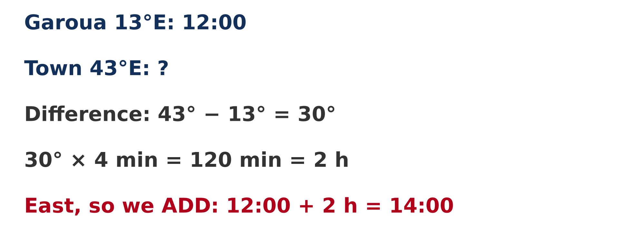
1. SUN TIME
Activity 1
A worked example.
Notes:
Activity 1. Look carefully at this diagram: a worked example. Observe every detail before I ask the question.

Slide 20
1. SUN TIME
Activity 1: Question
It is 12:00 at a place on longitude 13° E. What is the local time at 43° E?
Notes:
Here is the question for Activity 1: It is 12:00 at a place on longitude 13° E. What is the local time at 43° E? Take one minute to think and write your answer in your rough notebook.

Slide 21
1. SUN TIME
Activity 1: Answer
14:00: the difference is 30°, which is 2 hours, and we add because the place is to the east.
Notes:
Let us check the answer together. 14:00: the difference is 30°, which is 2 hours, and we add because the place is to the east.

Slide 22
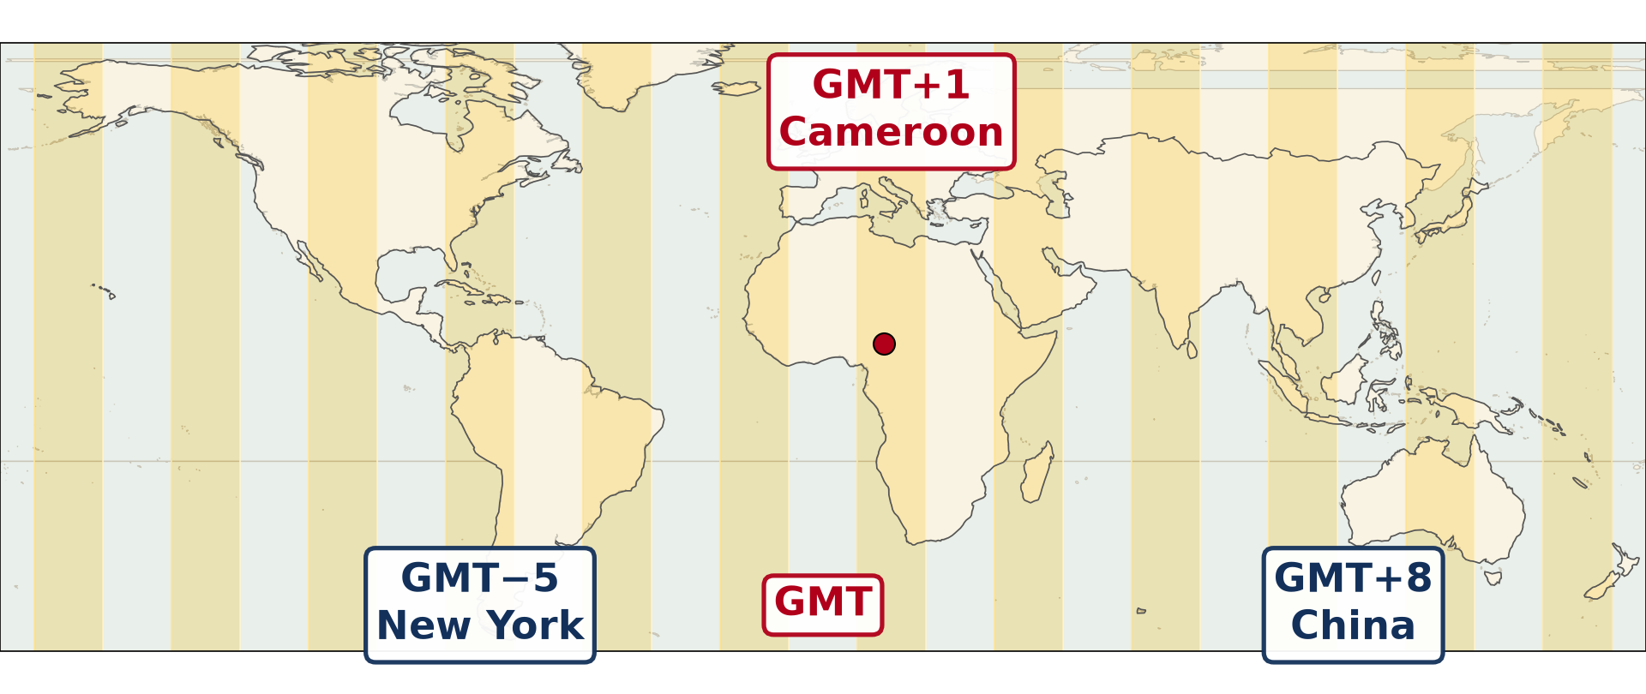
2. STANDARD TIME
Activity 2
The time zones of the world.
Notes:
Activity 2. Look carefully at this diagram: the time zones of the world. Observe every detail before I ask the question.

Slide 23
2. STANDARD TIME
Activity 2: Question
It is 22:00 on Friday in Cameroon (GMT + 1). What time is it in Tokyo (GMT + 9)?
Notes:
Here is the question for Activity 2: It is 22:00 on Friday in Cameroon (GMT + 1). What time is it in Tokyo (GMT + 9)? Take one minute to think and write your answer in your rough notebook.

Slide 24
2. STANDARD TIME
Activity 2: Answer
06:00 on Saturday.
Notes:
Let us check the answer together. 06:00 on Saturday.

Slide 25
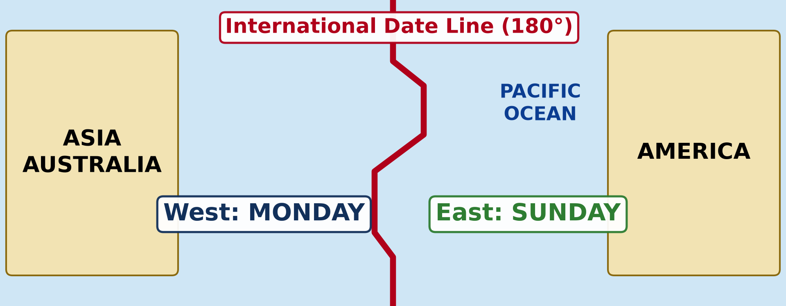
3. THE DATE LINE
Activity 3
The International Date Line.
Notes:
Activity 3. Look carefully at this diagram: the International Date Line. Observe every detail before I ask the question.

Slide 26
3. THE DATE LINE
Activity 3: Question
It is 10:00 on Sunday just west of the Date Line. What is the day just east of the line?
Notes:
Here is the question for Activity 3: It is 10:00 on Sunday just west of the Date Line. What is the day just east of the line? Take one minute to think and write your answer in your rough notebook.

Slide 27
3. THE DATE LINE
Activity 3: Answer
Saturday, at 10:00: we remove one day.
Notes:
Let us check the answer together. Saturday, at 10:00: we remove one day.

Slide 28
BOARD SUMMARY
Board Summary
Topic: The Earth as a Planet in the Solar System
Sub-topic: Location and Time
Practical Work 2: Calculation of Time and Date
Notes:
Now we are going to copy the board summary. Write the title and the headings neatly in your notebooks. I will give you enough time for each slide, so do not rush.

Slide 29
BOARD SUMMARY
DEFINITIONS
The key terms of this lesson are defined as follows:
Difference of longitude: It is the number of degrees between the meridians of two places.
Date: It is the day, the month and the year.
Notes:
Let us copy the definitions. The key terms of this lesson are defined as follows. On this slide we have Difference of longitude and Date. Write each point on a new line, with the key term first, and explain it in your own words when we revise.

Slide 30
BOARD SUMMARY
1. Sun Time (Local Time)
A) Local Time from Longitude
Local time is calculated from longitude as follows:
Difference of longitude: If both places are on the same side of Greenwich, we subtract; if not, we add.
Illustration: calculating sun time
Notes:
Let us copy Local Time from Longitude. Local time is calculated from longitude as follows. Copy the point on Difference of longitude on the left, then draw the diagram on the right: calculating sun time. Give it a title and label it clearly.

Slide 31
BOARD SUMMARY
1. Sun Time (Local Time)
A) Local Time from Longitude
Time difference: We multiply the difference of longitude by 4 minutes.
East or west: We add the time difference for a place to the east and remove it for a place to the west.
Notes:
We continue with Local Time from Longitude. On this slide we have Time difference and East or west. Write each point on a new line, with the key term first, and explain it in your own words when we revise. When you finish, we go to the next slide.

Slide 32
BOARD SUMMARY
1. Sun Time (Local Time)
A) Local Time from Longitude (continued)
Example: a place on 13° E has 12:00; at 43° E: 30° × 4 = 120 min = 2 h, so 14:00.
Notes:
We continue with Local Time from Longitude. On this slide we have Example. Write each point on a new line, with the key term first, and explain it in your own words when we revise.

Slide 33
BOARD SUMMARY
1. Sun Time (Local Time)
B) Longitude from Local Time
Longitude is calculated from local time as follows:
Time difference: We find the difference between the two local times in minutes.
Difference of longitude: We divide the time difference by 4 to get the degrees.
Notes:
Let us copy Longitude from Local Time. Longitude is calculated from local time as follows. On this slide we have Time difference and Difference of longitude. Write each point on a new line, with the key term first, and explain it in your own words when we revise. When you finish, we go to the next slide.

Slide 34
BOARD SUMMARY
1. Sun Time (Local Time)
B) Longitude from Local Time (continued)
Direction: If the place is ahead in time it is to the east; if it is behind, it is to the west.
Example: It is 12:00 at 0° and 14:00 at place X: 120 ÷ 4 = 30°, so X is at 30° E.
Notes:
We continue with Longitude from Local Time. On this slide we have Direction and Example. Write each point on a new line, with the key term first, and explain it in your own words when we revise.

Slide 35
BOARD SUMMARY
2. Standard Time from Standard Time Zones
Standard time is calculated with time zones as follows:
Reading the zones: We read the zone of each place in hours ahead of GMT (+) or behind GMT (−).
Illustration: the time zones of the world
Notes:
Let us copy Standard Time from Standard Time Zones. Standard time is calculated with time zones as follows. Copy the point on Reading the zones on the left, then draw the diagram on the right: the time zones of the world. Give it a title and label it clearly.

Slide 36
BOARD SUMMARY
2. Standard Time from Standard Time Zones
Time difference: We find the difference in hours between the two zones.
Example: Cameroon (GMT + 1) at 22:00 Friday; Tokyo GMT + 9 is 8 hours ahead, so 06:00 Saturday.
Notes:
We continue with Standard Time from Standard Time Zones. On this slide we have Time difference and Example. Write each point on a new line, with the key term first, and explain it in your own words when we revise.

Slide 37
BOARD SUMMARY
3. Time and Date across the International Date Line
The date is calculated across the Date Line as follows:
Crossing westwards: A traveller going west across the line adds one day.
Illustration: the International Date Line
Notes:
Let us copy Time and Date across the International Date Line. The date is calculated across the Date Line as follows. Copy the point on Crossing westwards on the left, then draw the diagram on the right: the International Date Line. Give it a title and label it clearly.

Slide 38
BOARD SUMMARY
3. Time and Date across the International Date Line
Crossing eastwards: A traveller going east across the line removes one day.
Passing midnight: When a calculated time passes midnight, the date also changes.
Example: Sunday 10:00 just west of the line is Saturday 10:00 just east of it.
Notes:
We continue with Time and Date across the International Date Line. On this slide we have Crossing eastwards, Passing midnight and Example. Write each point on a new line, with the key term first, and explain it in your own words when we revise.

Slide 39
FORMATIVE EVALUATION
Evaluation 1
It is 10:00 at a place on longitude 13° E. What is the local time at 17° W?
Notes:
Now let us check what you have understood. Question 1: It is 10:00 at a place on longitude 13° E. What is the local time at 17° W? Answer in your exercise book.

Slide 40
FORMATIVE EVALUATION
Expected Answer
08:00 (30° = 2 hours, we remove).
Notes:
The expected answer is: 08:00 (30° = 2 hours, we remove). If you got it right, well done.

Slide 41
FORMATIVE EVALUATION
Evaluation 2
It is 22:00 on Friday in Cameroon (GMT + 1). What time is it in Tokyo (GMT + 9)?
Notes:
Now let us check what you have understood. Question 2: It is 22:00 on Friday in Cameroon (GMT + 1). What time is it in Tokyo (GMT + 9)? Answer in your exercise book.

Slide 42
FORMATIVE EVALUATION
Expected Answer
06:00 on Saturday.
Notes:
The expected answer is: 06:00 on Saturday. If you got it right, well done.

Slide 43
REMEDIATION
Remediation
Fill in the blanks:
1° of longitude = ______ minutes.
Going west, we ______ time.
When the time passes midnight, the ______ changes.
Notes:
For those who need more practice, fill in the blanks in your exercise book. The answers are: number 1, 4; number 2, remove; number 3, date.

Slide 44
HOMEWORK
Homework
Define the rotation of the Earth.
Notes:
For your homework: Define the rotation of the Earth. We shall correct it at the beginning of our next lesson.

Slide 45
NEXT LESSON
Next Lesson
Our next lesson will be on:
Lesson 5: The Rotation of the Earth
Notes:
Our next lesson will be on Lesson 5: The Rotation of the Earth. Thank you for your attention, and see you next time.

Slide 46
BILINGUAL GAME
Bilingual Game (Jeu Bilingue)
English | Français
Calculation | Le calcul
To add | Ajouter
To subtract | Soustraire
Difference | La différence
East | L'est
West | L'ouest
Date | La date
Hour | L'heure
Notes:
Let us play the bilingual game. I say a word in English, and you give me the French word. Then we do the reverse.

Slide 47
LOGBOOK
Official Logbook (1/2)
Module / Topic | The Earth as a Planet in the Solar System
Lesson Title | Practical Work 2: Calculation of Time and Date
Expected Learning Outcomes | State the three rules for time calculations. Calculate local time from a difference of longitude, and longitude from local time. Calculate standard time with time zones. Find the correct date after crossing midnight or the International Date Line.
Competence | Learners are able to calculate the time and the date in another place, for example to follow a match or to call a relative abroad.
Notes:
I record this information in the official logbook of the class after the lesson.

Slide 48
LOGBOOK
Official Logbook (2/2)
Matter Taught | DEFINITIONS; Local Time from Longitude; Longitude from Local Time; Standard Time from Standard Time Zones; Time and Date across the International Date Line.
Evaluation | Formative evaluation and remediation exercise.
Homework | Define the rotation of the Earth.
Enrolment / Present / Absent | ____ / ____ / ____
Achievement | To be completed after the lesson.
Notes:
I complete the second page of the logbook: the matter taught, the evaluation, the homework and the attendance.

Slide 49
TEACHER'S NOTE
Teacher's Note
Timing: Homework correction, plan, objectives 4 min | Recall, situation, action 6 min | 3 activities 12 min | Board summary (copying) 15 min | Evaluation, remediation 5 min | Homework, next lesson 3 min | Logbook 5 min
Without the projector (Activity 1): write the steps on the board.
Without the projector (Activity 2): draw the zones on the board.
Without the projector (Activity 3): draw the Date Line with the two days.
Notes:
This slide is for me, the teacher: it gives the timing of the lesson and what to do if the projector is not available.

Slide 50
REFERENCES
References
National Geography Syllabus (MINESEC), Form 3 — The Earth as a Planet in the Solar System.
Teacher's lesson notes (Form 3), checked and corrected where necessary.
Diagrams and animations: drawn for this lesson (Geography Department).
Notes:
These are the references and picture credits used to prepare this lesson.

