Slide 1
FORM 3
GEOGRAPHY
Lesson 27
Semi-Arid and Desert Landscapes
Notes:
Good morning, class, and welcome to our geography lesson. I am your geography teacher, Madam Che. Today we are starting Lesson 27: Semi-Arid and Desert Landscapes.

Slide 2
CLASS INFO
Class, Chapter and Duration
Class | Form 3
Chapter | Denudation Processes, Landforms and Impacts on Man — Hot Desert Landscapes: Wind Action and Human Adaptation
Duration | 50 minutes
Notes:
This lesson is for Form 3. It belongs to Denudation Processes, Landforms and Impacts on Man — Hot Desert Landscapes: Wind Action and Human Adaptation. We shall need 50 minutes to cover it.

Slide 3
IDENTIFICATION
Lesson Identification
Topic | Denudation Processes, Landforms and Impacts on Man
Sub-topic | Hot Desert Landscapes: Wind Action and Human Adaptation
Lesson | Lesson 27: Semi-Arid and Desert Landscapes
Notions / Concepts | Rock pedestal, zeugen, yardangs, inselbergs.
Syllabus focus | Location of semi-arid areas and hot deserts in Africa; main erosional processes of wind; erosional features.
Competence | Learners are able to locate the hot deserts of Africa on a map and recognise rocks and walls worn by the wind.
Notes:
Our topic is Denudation Processes, Landforms and Impacts on Man, and the sub-topic is Hot Desert Landscapes: Wind Action and Human Adaptation. The key notions we shall use today are: rock pedestal, zeugen, yardangs, inselbergs. At the end, you should be able to do this: learners are able to locate the hot deserts of Africa on a map and recognise rocks and walls worn by the wind.

Slide 4

HOMEWORK CORRECTION
Correction of the Homework
Question (Lesson 26: Impact of Wave Action on Human Development along Coastal Areas):
Name the largest hot desert of Africa.
Notes:
Before we start the new lesson, let us correct the homework I gave you at the end of Lesson 26: Impact of Wave Action on Human Development along Coastal Areas. The question was: Name the largest hot desert of Africa. Take out your exercise books.

Slide 5
HOMEWORK CORRECTION
Correction: Possible Answer
The Sahara.
Notes:
Here is a good answer. The Sahara. Compare it with your own answer and correct your work in red.

Slide 6
LESSON PLAN
Lesson Plan
Correction of the homework
Objectives and recall
Real-life situation and action to take
Learning activities
Board summary
Evaluation, remediation and homework
Notes:
Here is the plan of our lesson today. First, we shall correct the homework. Then we shall look at the objectives and recall what you already know. After that, we shall study a situation from real life and the action to take, and do the learning activities. Finally, we shall copy the board summary, do the evaluation and the remediation, and I will give you the homework.

Slide 7
OBJECTIVES
Objectives
By the end of this lesson, you should be able to:
Locate the main hot deserts and the semi-arid Sahel on a map of Africa.
Describe the three processes of wind erosion: deflation, abrasion and attrition.
Notes:
Take your time to copy this part; we will continue together.

Slide 8
OBJECTIVES
Objectives (continued)
Explain the formation of rock pedestals, zeugen, yardangs and inselbergs.
Notes:
By the end of this lesson, you should be able to do three things. Number 1: locate the main hot deserts and the semi-arid Sahel on a map of Africa. Number 2: describe the three processes of wind erosion: deflation, abrasion and attrition. Number 3: explain the formation of rock pedestals, zeugen, yardangs and inselbergs.

Slide 9
PREVIOUS KNOWLEDGE
Previous Knowledge
Rivers and waves are agents of erosion: they wear away, transport and deposit material.
Waves erode the coast and form cliffs, caves, arches and stacks.
Today, we study another agent of erosion: the wind, in dry areas.
Notes:
Let us first remember what you already know. Rivers and waves are agents of erosion: they wear away, transport and deposit material. Waves erode the coast and form cliffs, caves, arches and stacks. Today, we study another agent of erosion: the wind, in dry areas. Keep this in mind, because we shall build on it today.

Slide 10
REAL-LIFE SITUATION
Situation in Real Life
During the Harmattan, Paul sees that the old wall of his compound is worn near the ground but still smooth at the top. The worn side faces the north-east, where the dusty wind comes from. He asks: "How can the wind wear away a wall, and what does it do to the rocks of the desert?"
Notes:
Listen carefully to this situation from real life. During the Harmattan, Paul sees that the old wall of his compound is worn near the ground but still smooth at the top. The worn side faces the north-east, where the dusty wind comes from. He asks: "How can the wind wear away a wall, and what does it do to the rocks of the desert?" Think about it, because I am going to ask you some questions.

Slide 11
REAL-LIFE SITUATION
Situation: Question 1
What is the problem in the situation?
Notes:
Question 1: What is the problem in the situation? Think for a moment, then raise your hand to answer.

Slide 12
REAL-LIFE SITUATION
Answer
Paul does not know how the wind wears away walls and rocks.
Notes:
Good. Paul does not know how the wind wears away walls and rocks.

Slide 13
REAL-LIFE SITUATION
Situation: Question 2
Where is the wall worn?
Notes:
Question 2: Where is the wall worn? Think for a moment, then raise your hand to answer.

Slide 14
REAL-LIFE SITUATION
Answer
Near the ground, on the side facing the north-east.
Notes:
Good. Near the ground, on the side facing the north-east.

Slide 15
REAL-LIFE SITUATION
Situation: Question 3
Which wind comes from the north-east?
Notes:
Question 3: Which wind comes from the north-east? Think for a moment, then raise your hand to answer.

Slide 16
REAL-LIFE SITUATION
Possible Answer
The Harmattan.
Notes:
Good. The Harmattan.

Slide 17
ACTION TO TAKE
Action to Take
Protect dry lands from wind erosion by planting trees.
Notes:
From this situation, the action we are working towards in this lesson is the following: protect dry lands from wind erosion by planting trees.

Slide 18
JUSTIFICATION
Justification of the Lesson
This lesson helps us to understand how wind shapes rocks in dry areas.
Notes:
Why is this lesson important for you? This lesson helps us to understand how wind shapes rocks in dry areas.

Slide 19
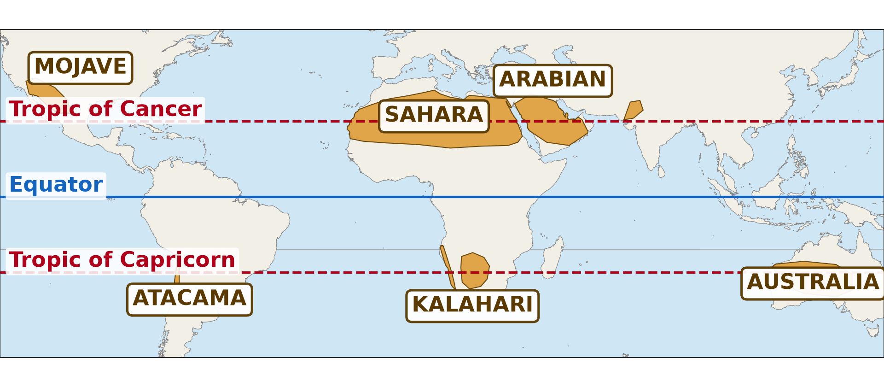
1. LOCATION
Activity 1
The hot deserts of the world.
Notes:
Activity 1. Look carefully at this diagram: the hot deserts of the world. Observe every detail before I ask the question.

Slide 20
1. LOCATION
Activity 1: Question 1
Which is the largest hot desert of Africa?
Notes:
Here is the question for Activity 1: Which is the largest hot desert of Africa? Take one minute to think and write your answer in your rough notebook.

Slide 21
1. LOCATION
Activity 1: Answer 1
The Sahara.
Notes:
Let us check the answer together. The Sahara.

Slide 22
1. LOCATION
Activity 1: Question 2
Which dry belt lies south of it?
Notes:
Here is the next question: Which dry belt lies south of it? Take one minute to think and write your answer in your rough notebook.

Slide 23
1. LOCATION
Activity 1: Answer 2
The Sahel.
Notes:
Let us check the answer together. The Sahel.

Slide 24
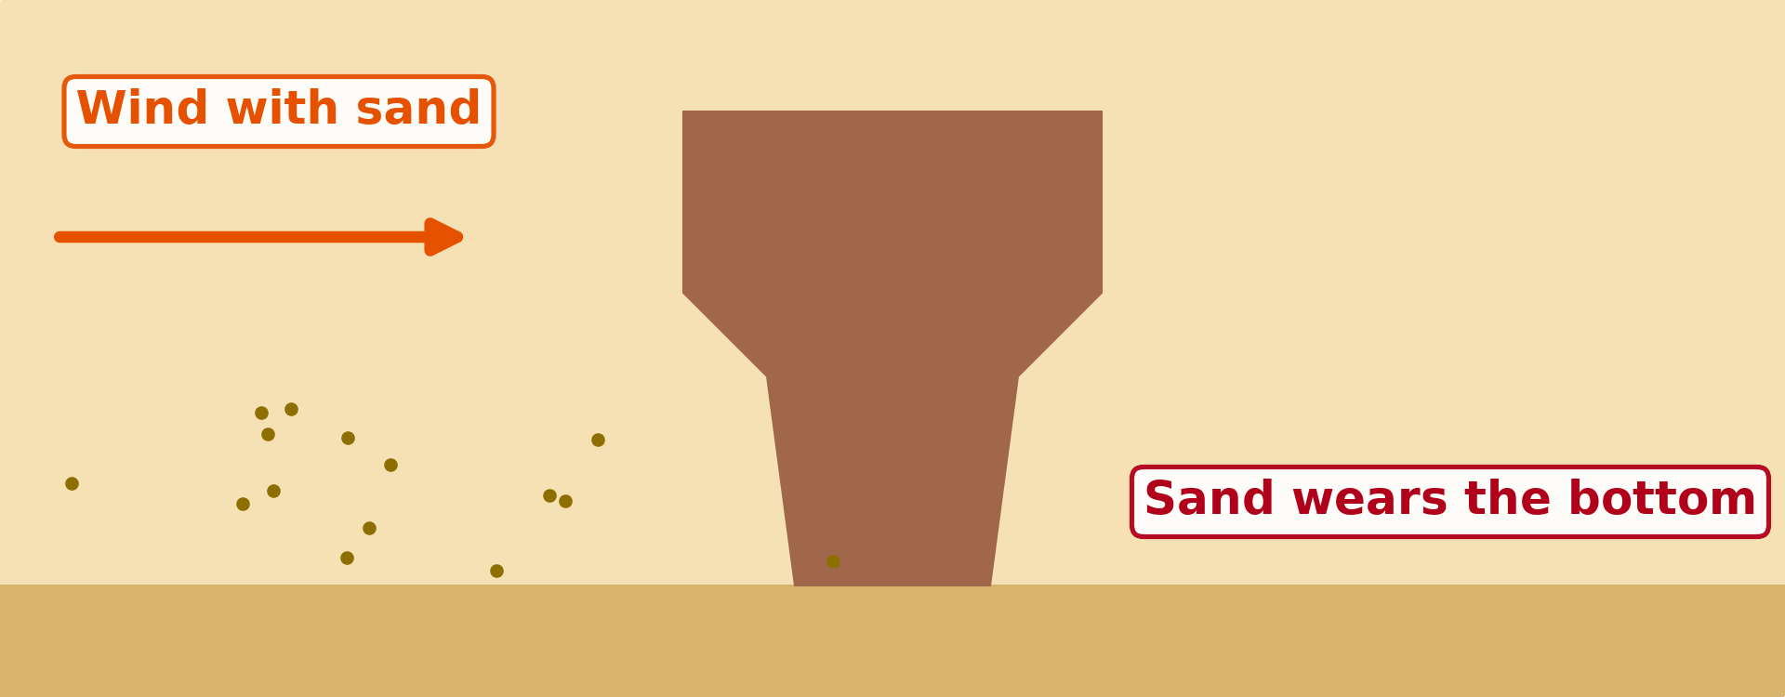
2. EROSIONAL PROCESSES
Activity 2
Animation: sand blown against a rock.
Notes:
Activity 2. Look carefully at this animation: animation: sand blown against a rock. Watch the animation to the end; it will play again.

Slide 25
2. EROSIONAL PROCESSES
Activity 2: Question
Why is the rock worn more at the bottom?
Notes:
Here is the question for Activity 2: Why is the rock worn more at the bottom? Take one minute to think and write your answer in your rough notebook.

Slide 26
2. EROSIONAL PROCESSES
Activity 2: Answer
The wind carries most of its sand near the ground.
Notes:
Let us check the answer together. The wind carries most of its sand near the ground.

Slide 27
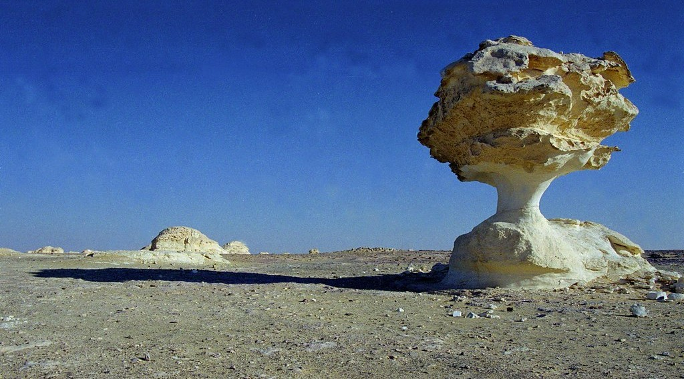
3. EROSIONAL FEATURES
Activity 3
A rock narrow at the bottom and wide at the top.
Notes:
Activity 3. Look carefully at this picture: a rock narrow at the bottom and wide at the top. Observe every detail before I ask the question.

Slide 28
3. EROSIONAL FEATURES
Activity 3: Question
What is this rock called?
Notes:
Here is the question for Activity 3: What is this rock called? Take one minute to think and write your answer in your rough notebook.

Slide 29
3. EROSIONAL FEATURES
Activity 3: Answer
A rock pedestal (mushroom rock).
Notes:
Let us check the answer together. A rock pedestal (mushroom rock).

Slide 30
BOARD SUMMARY
Board Summary
Topic: Denudation Processes, Landforms and Impacts on Man
Sub-topic: Hot Desert Landscapes: Wind Action and Human Adaptation
Lesson 27: Semi-Arid and Desert Landscapes
Notes:
Now we are going to copy the board summary. Write the title and the headings neatly in your notebooks. I will give you enough time for each slide, so do not rush.

Slide 31
BOARD SUMMARY
DEFINITIONS
The key terms of this lesson are defined as follows:
Hot desert: It is a hot region that receives less than 250 mm of rain per year.
Semi-arid region: It is a region that receives about 250 to 500 mm of rain per year.
Notes:
Let us copy the definitions. The key terms of this lesson are defined as follows. On this slide we have Hot desert and Semi-arid region. Write each point on a new line, with the key term first, and explain it in your own words when we revise. When you finish, we go to the next slide.

Slide 32
BOARD SUMMARY
DEFINITIONS (continued)
Wind erosion: It is the wearing away and removal of rock and soil by the wind.
Notes:
We continue with the definitions. On this slide we have Wind erosion. Write each point on a new line, with the key term first, and explain it in your own words when we revise.

Slide 33
BOARD SUMMARY
1. Location of Semi-arid Areas and Hot Deserts in Africa
Dry lands in Africa are located as follows:
The Sahara: It is the largest hot desert in the world and covers most of North Africa.
Illustration: hot deserts
Notes:
Let us copy Location of Semi-arid Areas and Hot Deserts in Africa. Dry lands in Africa are located as follows. Copy the point on The Sahara on the left, then draw the diagram on the right: hot deserts. Give it a title and label it clearly.

Slide 34
BOARD SUMMARY
1. Location of Semi-arid Areas and Hot Deserts in Africa
The Namib: It is a coastal desert in south-western Africa.
The Kalahari: It is a semi-desert in Southern Africa, mainly in Botswana.
The Sahel: It is a semi-arid belt south of the Sahara, from Senegal to Sudan, including the Far North of Cameroon.
Notes:
We continue with Location of Semi-arid Areas and Hot Deserts in Africa. On this slide we have The Namib, The Kalahari and The Sahel. Write each point on a new line, with the key term first, and explain it in your own words when we revise. When you finish, we go to the next slide.

Slide 35
BOARD SUMMARY
1. Location of Semi-arid Areas and Hot Deserts in Africa (continued)
The Horn of Africa: Parts of Somalia, Ethiopia and Kenya are semi-arid or desert.
Notes:
We continue with Location of Semi-arid Areas and Hot Deserts in Africa. On this slide we have The Horn of Africa. Write each point on a new line, with the key term first, and explain it in your own words when we revise.

Slide 36
BOARD SUMMARY
2. Main Erosional Processes of Wind
Wind erodes the land through the following processes:
Deflation: The wind lifts and removes loose sand and dust, leaving hollows and stony surfaces.
Notes:
Let us copy Main Erosional Processes of Wind. Wind erodes the land through the following processes. On this slide we have Deflation. Write each point on a new line, with the key term first, and explain it in your own words when we revise.

Slide 37
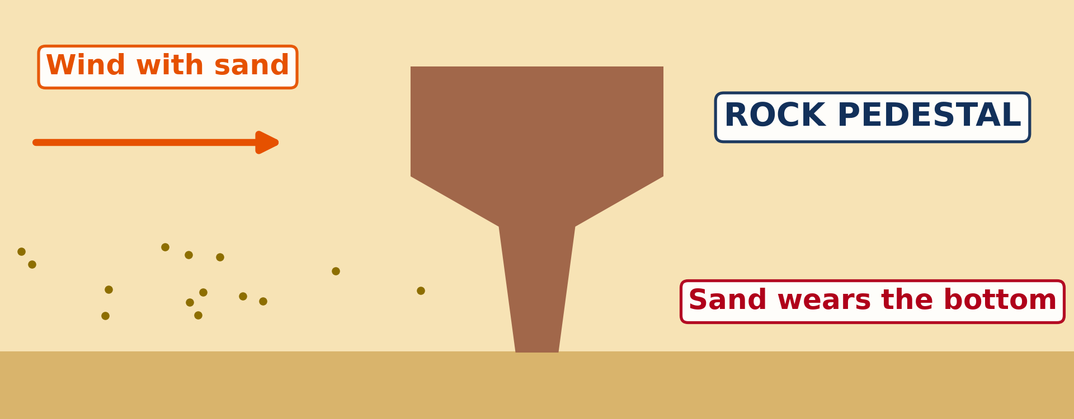
BOARD SUMMARY
2. Main Erosional Processes of Wind
Abrasion: Sand thrown by the wind near the ground wears and polishes rocks.
Illustration: abrasion
Notes:
Copy the point on Abrasion on the left, then draw the diagram on the right: abrasion. Give it a title and label it clearly.

Slide 38
BOARD SUMMARY
2. Main Erosional Processes of Wind
Attrition: Sand grains hit one another, become smaller and rounder, and turn into fine dust.
Notes:
We continue with Main Erosional Processes of Wind. On this slide we have Attrition. Write each point on a new line, with the key term first, and explain it in your own words when we revise.

Slide 39
BOARD SUMMARY
3. Erosional Features
Wind erosion forms the following features:
Rock pedestal: It is a mushroom-shaped rock worn at its base by abrasion.
Illustration: a rock pedestal
Notes:
Let us copy Erosional Features. Wind erosion forms the following features. Copy the point on Rock pedestal on the left, then draw the diagram on the right: a rock pedestal. Give it a title and label it clearly.

Slide 40
BOARD SUMMARY
3. Erosional Features
Zeugen: They are flat-topped ridges of hard rock resting on soft rock, separated by furrows.
Yardangs: They are long ridges of rock lying in the direction of the wind, with furrows between them.
Notes:
We continue with Erosional Features. On this slide we have Zeugen and Yardangs. Write each point on a new line, with the key term first, and explain it in your own words when we revise. When you finish, we go to the next slide.

Slide 41
BOARD SUMMARY
3. Erosional Features (continued)
Inselbergs: They are isolated, steep-sided hills rising from a flat plain.
Deflation hollows: They are depressions where the wind has removed the loose material.
Notes:
We continue with Erosional Features. On this slide we have Inselbergs and Deflation hollows. Write each point on a new line, with the key term first, and explain it in your own words when we revise.

Slide 42
FORMATIVE EVALUATION
Evaluation 1
What is abrasion?
Notes:
Now let us check what you have understood. Question 1: What is abrasion? Answer in your exercise book.

Slide 43
FORMATIVE EVALUATION
Expected Answer
The wearing of rocks by sand thrown by the wind.
Notes:
The expected answer is: the wearing of rocks by sand thrown by the wind. If you got it right, well done.

Slide 44
FORMATIVE EVALUATION
Evaluation 2
Why is a rock pedestal narrow at the bottom?
Notes:
Now let us check what you have understood. Question 2: Why is a rock pedestal narrow at the bottom? Answer in your exercise book.

Slide 45
FORMATIVE EVALUATION
Expected Answer
The wind throws most sand near the ground.
Notes:
The expected answer is: the wind throws most sand near the ground. If you got it right, well done.

Slide 46
REMEDIATION
Remediation
Fill in the blanks:
The removal of loose sand by wind is ______.
A mushroom-shaped rock is a rock ______.
A lonely hill on a flat plain is an ______.
Notes:
For those who need more practice, fill in the blanks in your exercise book. The answers are: number 1, deflation; number 2, pedestal; number 3, inselberg.

Slide 47
HOMEWORK
Homework
Name the two types of sand dunes.
Notes:
For your homework: Name the two types of sand dunes. We shall correct it at the beginning of our next lesson.

Slide 48
NEXT LESSON
Next Lesson
Our next lesson will be on:
Lesson 28: Depositional Features of Wind Action
Notes:
Our next lesson will be on Lesson 28: Depositional Features of Wind Action. Thank you for your attention, and see you next time.

Slide 49
BILINGUAL GAME
Bilingual Game (Jeu Bilingue)
English | Français
Desert | Le désert
Semi-arid | Semi-aride
Wind erosion | L'érosion éolienne
Deflation | La déflation
Abrasion | La corrasion
Rock pedestal | Le rocher-champignon
Inselberg | L'inselberg
Ridge | La crête
Notes:
Let us play the bilingual game. I say a word in English, and you give me the French word. Then we do the reverse.

Slide 50
LOGBOOK
Official Logbook (1/2)
Module / Topic | Denudation Processes, Landforms and Impacts on Man
Lesson Title | Lesson 27: Semi-Arid and Desert Landscapes
Expected Learning Outcomes | Locate the main hot deserts and the semi-arid Sahel on a map of Africa. Describe the three processes of wind erosion: deflation, abrasion and attrition. Explain the formation of rock pedestals, zeugen, yardangs and inselbergs.
Competence | Learners are able to locate the hot deserts of Africa on a map and recognise rocks and walls worn by the wind.
Notes:
I record this information in the official logbook of the class after the lesson.

Slide 51
LOGBOOK
Official Logbook (2/2)
Matter Taught | DEFINITIONS; Location of Semi-arid Areas and Hot Deserts in Africa; Main Erosional Processes of Wind; Erosional Features.
Evaluation | Formative evaluation and remediation exercise.
Homework | Name the two types of sand dunes.
Enrolment / Present / Absent | ____ / ____ / ____
Achievement | To be completed after the lesson.
Notes:
I complete the second page of the logbook: the matter taught, the evaluation, the homework and the attendance.

Slide 52
TEACHER'S NOTE
Teacher's Note
Timing: Homework correction, plan, objectives 4 min | Recall, situation, action 6 min | 3 activities 12 min | Board summary (copying) 15 min | Evaluation, remediation 5 min | Homework, next lesson 3 min | Logbook 5 min
Activity 2 is an animation (GIF): it plays automatically in slide-show mode.
Without the projector (Activity 1): use the atlas map of Africa.
Without the projector (Activity 2): blow sand against a stone.
Without the projector (Activity 3): draw a mushroom-shaped rock.
Notes:
This slide is for me, the teacher: it gives the timing of the lesson and what to do if the projector is not available.

Slide 53
REFERENCES
References
National Geography Syllabus (MINESEC), Form 3 — Denudation processes, landforms and impacts on man — Lesson 27.
Teacher's lesson notes, Lesson 27 (f4.docx).
Climate data for Garoua: Weather Spark; Mont Tinguelin: Wikipédia (fr).
Photo, Activity 3: “Stone Mushroom in White Desert. Qasr. Al-Farafra. Egypt. Free Stock Ph” by SkilledAdventurer, CC BY 2.0, via Flickr (https://www.flickr.com/photos/140589650@N06/26810236588)
Diagrams and animations: drawn for this lesson (Geography Department).
Notes:
These are the references and picture credits used to prepare this lesson.

