Slide 1
FORM 3
GEOGRAPHY
Lesson 34
Condensation
Notes:
Good morning, class, and welcome to our geography lesson. I am your geography teacher, Madam Che. Today we are starting Lesson 34: Condensation.

Slide 2
CLASS INFO
Class, Chapter and Duration
Class | Form 3
Chapter | Module 3: Weather and Climate — Adaptation to Climatic Excesses
Duration | 50 minutes
Notes:
This lesson is for Form 3. It belongs to Module 3: Weather and Climate — Adaptation to Climatic Excesses. We shall need 50 minutes to cover it.

Slide 3
IDENTIFICATION
Lesson Identification
Topic | The Earth-Atmosphere System
Sub-topic | Forms of Condensation
Lesson | Lesson 34: Condensation
Notions / Concepts | Drizzle, precipitation, hail, cloud, fog, dew, mist.
Syllabus focus | Meaning of condensation; forms of condensation.
Competence | Learners are able to explain the drops of water that appear on cold objects, grass and windows, and to drive or walk carefully in fog.
Notes:
Our topic is The Earth-Atmosphere System, and the sub-topic is Forms of Condensation. The key notions we shall use today are: drizzle, precipitation, hail, cloud, fog, dew, mist. At the end, you should be able to do this: learners are able to explain the drops of water that appear on cold objects, grass and windows, and to drive or walk carefully in fog.

Slide 4

HOMEWORK CORRECTION
Correction of the Homework
Question (Lesson 33: Weather Elements: Humidity, Wind, Pressure and Sunshine):
Define condensation.
Notes:
Before we start the new lesson, let us correct the homework I gave you at the end of Lesson 33: Weather Elements: Humidity, Wind, Pressure and Sunshine. The question was: Define condensation. Take out your exercise books.

Slide 5
HOMEWORK CORRECTION
Correction: Possible Answer
It is the change of water vapour into liquid water.
Notes:
Here is a good answer. It is the change of water vapour into liquid water. Compare it with your own answer and correct your work in red.

Slide 6
LESSON PLAN
Lesson Plan
Correction of the homework
Objectives and recall
Real-life situation and action to take
Learning activities
Board summary
Evaluation, remediation and homework
Notes:
Here is the plan of our lesson today. First, we shall correct the homework. Then we shall look at the objectives and recall what you already know. After that, we shall study a situation from real life and the action to take, and do the learning activities. Finally, we shall copy the board summary, do the evaluation and the remediation, and I will give you the homework.

Slide 7
OBJECTIVES
Objectives
By the end of this lesson, you should be able to:
Define condensation, saturation and dew point.
State the conditions necessary for condensation.
Notes:
Take your time to copy this part; we will continue together.

Slide 8
OBJECTIVES
Objectives (continued)
Describe the forms of condensation near the ground and in the atmosphere.
Notes:
By the end of this lesson, you should be able to do three things. Number 1: define condensation, saturation and dew point. Number 2: state the conditions necessary for condensation. Number 3: describe the forms of condensation near the ground and in the atmosphere.

Slide 9
PREVIOUS KNOWLEDGE
Previous Knowledge
Humidity is the amount of water vapour in the air.
It is measured with a hygrometer and given in percent.
Warm air can hold more water vapour than cold air.
Notes:
Let us first remember what you already know. Humidity is the amount of water vapour in the air. It is measured with a hygrometer and given in percent. Warm air can hold more water vapour than cold air. Keep this in mind, because we shall build on it today.

Slide 10
REAL-LIFE SITUATION
Situation in Real Life
On a hot afternoon, Eric takes a cold bottle out of the refrigerator. After a few minutes, drops of water cover the outside of the closed bottle. He asks: "Where do these drops come from, and is this how clouds and fog are formed?"
Notes:
Listen carefully to this situation from real life. On a hot afternoon, Eric takes a cold bottle out of the refrigerator. After a few minutes, drops of water cover the outside of the closed bottle. He asks: "Where do these drops come from, and is this how clouds and fog are formed?" Think about it, because I am going to ask you some questions.

Slide 11
REAL-LIFE SITUATION
Situation: Question 1
What is the problem in the situation?
Notes:
Question 1: What is the problem in the situation? Think for a moment, then raise your hand to answer.

Slide 12
REAL-LIFE SITUATION
Answer
Eric does not know where the drops come from and how clouds and fog form.
Notes:
Good. Eric does not know where the drops come from and how clouds and fog form.

Slide 13
REAL-LIFE SITUATION
Situation: Question 2
Is the bottle closed or open?
Notes:
Question 2: Is the bottle closed or open? Think for a moment, then raise your hand to answer.

Slide 14
REAL-LIFE SITUATION
Answer
It is closed.
Notes:
Good. It is closed.

Slide 15
REAL-LIFE SITUATION
Situation: Question 3
Where does the water come from?
Notes:
Question 3: Where does the water come from? Think for a moment, then raise your hand to answer.

Slide 16
REAL-LIFE SITUATION
Possible Answer
From the water vapour in the air, cooled by the cold bottle.
Notes:
Good. From the water vapour in the air, cooled by the cold bottle.

Slide 17
ACTION TO TAKE
Action to Take
Drive carefully in fog and mist.
Notes:
From this situation, the action we are working towards in this lesson is the following: drive carefully in fog and mist.

Slide 18
JUSTIFICATION
Justification of the Lesson
This lesson helps us to understand how clouds, fog and dew form.
Notes:
Why is this lesson important for you? This lesson helps us to understand how clouds, fog and dew form.

Slide 19

DEFINITIONS
Activity 1
A cold bottle with drops of water.
Notes:
Activity 1. Look carefully at this picture: a cold bottle with drops of water. Observe every detail before I ask the question.

Slide 20
DEFINITIONS
Activity 1: Question
What do we call the change of water vapour into drops of water?
Notes:
Here is the question for Activity 1: What do we call the change of water vapour into drops of water? Take one minute to think and write your answer in your rough notebook.

Slide 21
DEFINITIONS
Activity 1: Answer
Condensation.
Notes:
Let us check the answer together. Condensation.

Slide 22

1. FORMS OF CONDENSATION
Activity 2
A foggy morning.
Notes:
Activity 2. Look carefully at this picture: a foggy morning. Observe every detail before I ask the question.

Slide 23
1. FORMS OF CONDENSATION
Activity 2: Question
What is fog?
Notes:
Here is the question for Activity 2: What is fog? Take one minute to think and write your answer in your rough notebook.

Slide 24
1. FORMS OF CONDENSATION
Activity 2: Answer
A cloud at ground level.
Notes:
Let us check the answer together. A cloud at ground level.

Slide 25
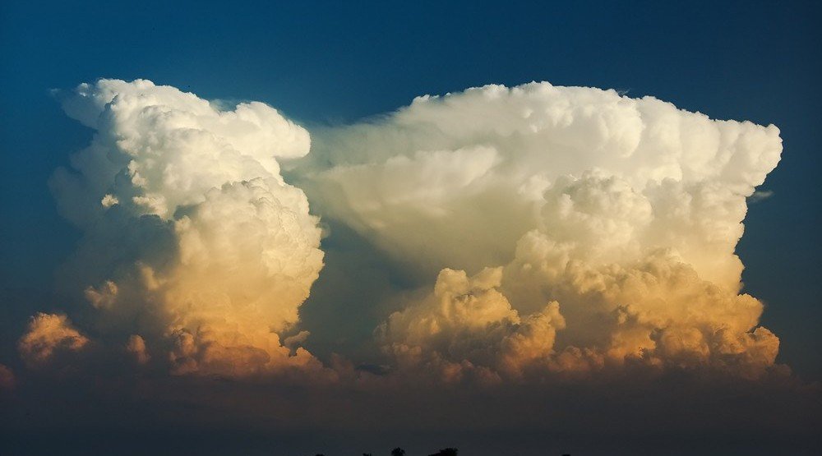
1. FORMS OF CONDENSATION
Activity 3
A huge storm cloud.
Notes:
Activity 3. Look carefully at this picture: a huge storm cloud. Observe every detail before I ask the question.

Slide 26
1. FORMS OF CONDENSATION
Activity 3: Question
This cloud brings heavy rain and thunder. What is it called?
Notes:
Here is the question for Activity 3: This cloud brings heavy rain and thunder. What is it called? Take one minute to think and write your answer in your rough notebook.

Slide 27
1. FORMS OF CONDENSATION
Activity 3: Answer
A cumulonimbus cloud.
Notes:
Let us check the answer together. A cumulonimbus cloud.

Slide 28
BOARD SUMMARY
Board Summary
Topic: The Earth-Atmosphere System
Sub-topic: Forms of Condensation
Lesson 34: Condensation
Notes:
Now we are going to copy the board summary. Write the title and the headings neatly in your notebooks. I will give you enough time for each slide, so do not rush.

Slide 29
BOARD SUMMARY
DEFINITIONS
The key terms of this lesson are defined as follows:
Condensation: It is the change of water vapour into liquid water when air cools.
Saturation: It is the state of air that holds all the water vapour it can at its temperature.
Notes:
Let us copy the definitions. The key terms of this lesson are defined as follows. On this slide we have Condensation and Saturation. Write each point on a new line, with the key term first, and explain it in your own words when we revise. When you finish, we go to the next slide.

Slide 30
BOARD SUMMARY
DEFINITIONS (continued)
Dew point: It is the temperature at which air becomes saturated and condensation starts.
Notes:
We continue with the definitions. On this slide we have Dew point. Write each point on a new line, with the key term first, and explain it in your own words when we revise.

Slide 31
BOARD SUMMARY
1. Meaning of Condensation
Condensation takes place under the following conditions:
Moist air: The air must contain water vapour.
Notes:
Let us copy Meaning of Condensation. Condensation takes place under the following conditions. On this slide we have Moist air. Write each point on a new line, with the key term first, and explain it in your own words when we revise.

Slide 32
BOARD SUMMARY
1. Meaning of Condensation
Cooling to the dew point: The air must cool until it is saturated, for example at night or when it rises.
Illustration: condensation on a cold bottle
Notes:
Copy the point on Cooling to the dew point on the left, then draw the diagram on the right: condensation on a cold bottle. Give it a title and label it clearly.

Slide 33
BOARD SUMMARY
1. Meaning of Condensation
Condensation nuclei: Tiny particles of dust, smoke or salt give the water vapour a surface to condense on.
Notes:
We continue with Meaning of Condensation. On this slide we have Condensation nuclei. Write each point on a new line, with the key term first, and explain it in your own words when we revise.

Slide 34

BOARD SUMMARY
2. Forms of Condensation
A) Near the Ground
Condensation near the ground takes the following forms:
Dew: It is drops of water formed on cold surfaces, such as grass, in the early morning.
Illustration: dew
Notes:
Let us copy Near the Ground. Condensation near the ground takes the following forms. Copy the point on Dew on the left, then draw the diagram on the right: dew. Give it a title and label it clearly.

Slide 35
BOARD SUMMARY
2. Forms of Condensation
A) Near the Ground
Frost: It is ice crystals formed when the dew point is below 0 °C.
Notes:
We continue with Near the Ground. On this slide we have Frost. Write each point on a new line, with the key term first, and explain it in your own words when we revise.

Slide 36
BOARD SUMMARY
2. Forms of Condensation
A) Near the Ground
Fog: It is a cloud at ground level in which we see less than 1 km.
Illustration: fog
Notes:
Copy the point on Fog on the left, then draw the diagram on the right: fog. Give it a title and label it clearly.

Slide 37
BOARD SUMMARY
2. Forms of Condensation
A) Near the Ground
Mist: It is a thin fog in which we can see more than 1 km.
Notes:
We continue with Near the Ground. On this slide we have Mist. Write each point on a new line, with the key term first, and explain it in your own words when we revise.

Slide 38
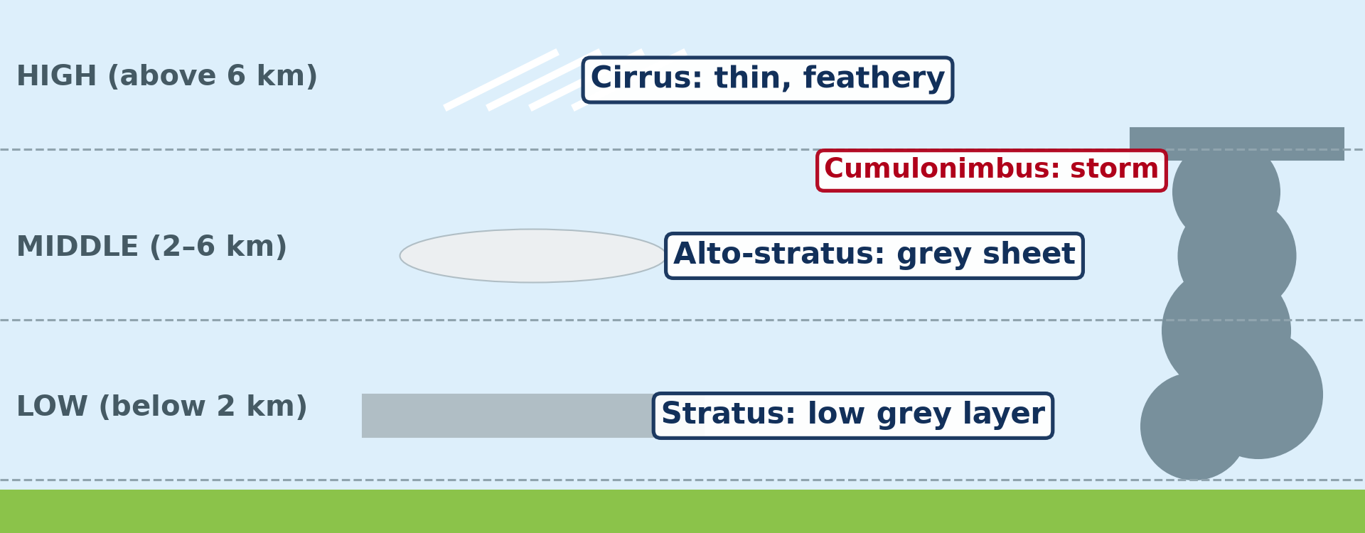
BOARD SUMMARY
2. Forms of Condensation
B) In the Atmosphere
Condensation in the atmosphere forms the following clouds:
Cirrus: They are high, thin, feathery clouds made of ice crystals.
Illustration: types of clouds
Notes:
Let us copy In the Atmosphere. Condensation in the atmosphere forms the following clouds. Copy the point on Cirrus on the left, then draw the diagram on the right: types of clouds. Give it a title and label it clearly.

Slide 39
BOARD SUMMARY
2. Forms of Condensation
B) In the Atmosphere
Stratus: They are low, grey layers of cloud that cover the sky.
Notes:
We continue with In the Atmosphere. On this slide we have Stratus. Write each point on a new line, with the key term first, and explain it in your own words when we revise.

Slide 40
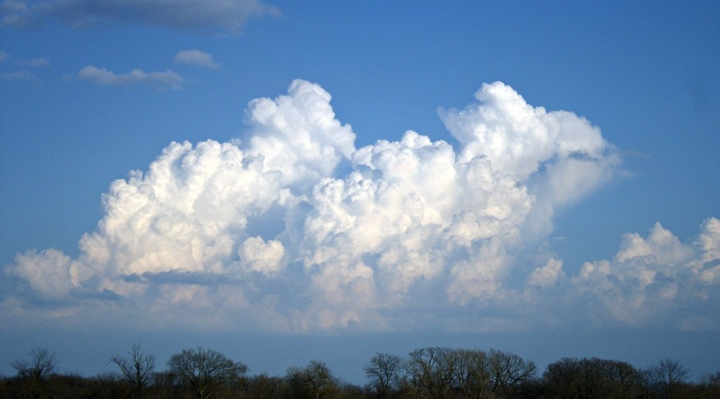
BOARD SUMMARY
2. Forms of Condensation
B) In the Atmosphere
Cumulus: They are white, puffy clouds with flat bases, seen on fine days.
Illustration: cumulus clouds
Notes:
Copy the point on Cumulus on the left, then draw the diagram on the right: cumulus clouds. Give it a title and label it clearly.

Slide 41
BOARD SUMMARY
2. Forms of Condensation
B) In the Atmosphere
Cumulonimbus: They are huge, tall storm clouds that bring heavy rain, thunder and hail.
Illustration: a cumulonimbus
Notes:
Copy the point on Cumulonimbus on the left, then draw the diagram on the right: a cumulonimbus. Give it a title and label it clearly.

Slide 42
FORMATIVE EVALUATION
Evaluation 1
What is condensation?
Notes:
Now let us check what you have understood. Question 1: What is condensation? Answer in your exercise book.

Slide 43
FORMATIVE EVALUATION
Expected Answer
The change of water vapour into water.
Notes:
The expected answer is: the change of water vapour into water. If you got it right, well done.

Slide 44
FORMATIVE EVALUATION
Evaluation 2
Which cloud brings thunderstorms?
Notes:
Now let us check what you have understood. Question 2: Which cloud brings thunderstorms? Answer in your exercise book.

Slide 45
FORMATIVE EVALUATION
Expected Answer
The cumulonimbus.
Notes:
The expected answer is: the cumulonimbus. If you got it right, well done.

Slide 46
REMEDIATION
Remediation
Fill in the blanks:
Water vapour becoming water is ______.
Drops on grass in the morning are ______.
A cloud at ground level is ______.
Notes:
For those who need more practice, fill in the blanks in your exercise book. The answers are: number 1, condensation; number 2, dew; number 3, fog.

Slide 47
HOMEWORK
Homework
Name the three types of rainfall.
Notes:
For your homework: Name the three types of rainfall. We shall correct it at the beginning of our next lesson.

Slide 48
NEXT LESSON
Next Lesson
Our next lesson will be on:
Lesson 35: Precipitation
Notes:
Our next lesson will be on Lesson 35: Precipitation. Thank you for your attention, and see you next time.

Slide 49
BILINGUAL GAME
Bilingual Game (Jeu Bilingue)
English | Français
Condensation | La condensation
Water vapour | La vapeur d'eau
Dew point | Le point de rosée
Dew | La rosée
Frost | Le givre
Fog | Le brouillard
Mist | La brume
Cloud | Le nuage
Notes:
Let us play the bilingual game. I say a word in English, and you give me the French word. Then we do the reverse.

Slide 50
LOGBOOK
Official Logbook (1/2)
Module / Topic | The Earth-Atmosphere System
Lesson Title | Lesson 34: Condensation
Expected Learning Outcomes | Define condensation, saturation and dew point. State the conditions necessary for condensation. Describe the forms of condensation near the ground and in the atmosphere.
Competence | Learners are able to explain the drops of water that appear on cold objects, grass and windows, and to drive or walk carefully in fog.
Notes:
I record this information in the official logbook of the class after the lesson.

Slide 51
LOGBOOK
Official Logbook (2/2)
Matter Taught | DEFINITIONS; Meaning of Condensation; Near the Ground; In the Atmosphere.
Evaluation | Formative evaluation and remediation exercise.
Homework | Name the three types of rainfall.
Enrolment / Present / Absent | ____ / ____ / ____
Achievement | To be completed after the lesson.
Notes:
I complete the second page of the logbook: the matter taught, the evaluation, the homework and the attendance.

Slide 52
TEACHER'S NOTE
Teacher's Note
Timing: Homework correction, plan, objectives 4 min | Recall, situation, action 6 min | 3 activities 12 min | Board summary (copying) 15 min | Evaluation, remediation 5 min | Homework, next lesson 3 min | Logbook 5 min
Without the projector (Activity 1): take a cold bottle out of a cooler.
Without the projector (Activity 2): describe a foggy morning in Ngaoundéré.
Without the projector (Activity 3): describe storm clouds in June.
Notes:
This slide is for me, the teacher: it gives the timing of the lesson and what to do if the projector is not available.

Slide 53
REFERENCES
References
National Geography Syllabus (MINESEC), Form 3 — Module 3: Weather and Climate.
Teacher's lesson notes (f4.docx), checked and corrected where necessary.
Photo, Activity 1: “water bottle” by Muffet, CC BY 2.0, via Flickr (https://www.flickr.com/photos/53133240@N00/542497582)
Photo, Activity 2: “Mist” by Art by MarkAC, CC BY-SA 2.0, via Flickr (https://www.flickr.com/photos/60580775@N08/40783321332)
Photo, Activity 3: “06172012 Sunday evening pulse storms/cumulonimbi” by StormRider93 | Into the Storm, CC BY-NC-ND 2.0, via Flickr (https://www.flickr.com/photos/65232104@N04/7395715628)
Photo, board summary (Dew): “Dew drops on grass” by Ervins Strauhmanis, CC BY 2.0, via Flickr (https://www.flickr.com/photos/76523360@N03/9537409567)
Photo, board summary (Cumulus): “Epic Cloud (Explored)” by Christina Ann VanMeter, CC BY-NC 2.0, via Flickr (https://www.flickr.com/photos/54129831@N02/6984912657)
Diagrams and animations: drawn for this lesson (Geography Department).
Notes:
These are the references and picture credits used to prepare this lesson.

