Slide 1
FORM 3
GEOGRAPHY
Lesson 38
Factors of Temperature
Notes:
Good morning, class, and welcome to our geography lesson. I am your geography teacher, Madam Che. Today we are starting Lesson 38: Factors of Temperature.

Slide 2
CLASS INFO
Class, Chapter and Duration
Class | Form 3
Chapter | Module 3: Weather and Climate — Adaptation to Climatic Excesses
Duration | 50 minutes
Notes:
This lesson is for Form 3. It belongs to Module 3: Weather and Climate — Adaptation to Climatic Excesses. We shall need 50 minutes to cover it.

Slide 3
IDENTIFICATION
Lesson Identification
Topic | The Earth-Atmosphere System
Sub-topic | Basic Notions of Climate
Lesson | Lesson 38: Factors of Temperature
Notions / Concepts | Weather and climate.
Syllabus focus | Factors of temperature: latitude, altitude, cloud cover, air masses, ocean currents, vegetation, human activities, etc.
Competence | Learners are able to explain why one place is hotter or cooler than another, and to choose shade, trees and building materials that reduce heat.
Notes:
Our topic is The Earth-Atmosphere System, and the sub-topic is Basic Notions of Climate. The key notions we shall use today are: weather and climate. At the end, you should be able to do this: learners are able to explain why one place is hotter or cooler than another, and to choose shade, trees and building materials that reduce heat.

Slide 4

HOMEWORK CORRECTION
Correction of the Homework
Question (Lesson 37: Local Winds):
Give two factors of temperature.
Notes:
Before we start the new lesson, let us correct the homework I gave you at the end of Lesson 37: Local Winds. The question was: Give two factors of temperature. Take out your exercise books.

Slide 5
HOMEWORK CORRECTION
Correction: Possible Answer
Latitude and altitude (also cloud cover, winds, ocean currents and vegetation).
Notes:
Here is a good answer. Latitude and altitude (also cloud cover, winds, ocean currents and vegetation). Compare it with your own answer and correct your work in red.

Slide 6
LESSON PLAN
Lesson Plan
Correction of the homework
Objectives and recall
Real-life situation and action to take
Learning activities
Board summary
Evaluation, remediation and homework
Notes:
Here is the plan of our lesson today. First, we shall correct the homework. Then we shall look at the objectives and recall what you already know. After that, we shall study a situation from real life and the action to take, and do the learning activities. Finally, we shall copy the board summary, do the evaluation and the remediation, and I will give you the homework.

Slide 7
OBJECTIVES
Objectives
By the end of this lesson, you should be able to:
Identify the main factors that affect temperature.
Explain how each factor makes a place hotter or cooler.
Notes:
Take your time to copy this part; we will continue together.

Slide 8
OBJECTIVES
Objectives (continued)
Use these factors to compare temperatures in Cameroon.
Notes:
By the end of this lesson, you should be able to do three things. Number 1: identify the main factors that affect temperature. Number 2: explain how each factor makes a place hotter or cooler. Number 3: use these factors to compare temperatures in Cameroon.

Slide 9
PREVIOUS KNOWLEDGE
Previous Knowledge
Local winds are caused by unequal heating of land and sea, or slopes and valleys.
Land heats and cools faster than water.
Temperature falls with height in the troposphere.
Notes:
Let us first remember what you already know. Local winds are caused by unequal heating of land and sea, or slopes and valleys. Land heats and cools faster than water. Temperature falls with height in the troposphere. Keep this in mind, because we shall build on it today.

Slide 10
REAL-LIFE SITUATION
Situation in Real Life
Fabrice travels from Douala to Dschang, only about 210 km away. In Douala it is 32 °C, but in Dschang, in the evening, he needs a sweater. He asks: "Why can two towns so close to each other have such different temperatures?"
Notes:
Listen carefully to this situation from real life. Fabrice travels from Douala to Dschang, only about 210 km away. In Douala it is 32 °C, but in Dschang, in the evening, he needs a sweater. He asks: "Why can two towns so close to each other have such different temperatures?" Think about it, because I am going to ask you some questions.

Slide 11
REAL-LIFE SITUATION
Situation: Question 1
What is the problem in the situation?
Notes:
Question 1: What is the problem in the situation? Think for a moment, then raise your hand to answer.

Slide 12
REAL-LIFE SITUATION
Answer
Fabrice does not know what makes temperatures different from place to place.
Notes:
Good. Fabrice does not know what makes temperatures different from place to place.

Slide 13
REAL-LIFE SITUATION
Situation: Question 2
Which town is hotter?
Notes:
Question 2: Which town is hotter? Think for a moment, then raise your hand to answer.

Slide 14
REAL-LIFE SITUATION
Answer
Douala.
Notes:
Good. Douala.

Slide 15
REAL-LIFE SITUATION
Situation: Question 3
What is different about Dschang?
Notes:
Question 3: What is different about Dschang? Think for a moment, then raise your hand to answer.

Slide 16
REAL-LIFE SITUATION
Possible Answer
It is much higher (about 1,400 m, in the Western Highlands).
Notes:
Good. It is much higher (about 1,400 m, in the Western Highlands).

Slide 17
ACTION TO TAKE
Action to Take
Plant trees to make our towns cooler.
Notes:
From this situation, the action we are working towards in this lesson is the following: plant trees to make our towns cooler.

Slide 18
JUSTIFICATION
Justification of the Lesson
This lesson helps us to know why temperatures change from place to place.
Notes:
Why is this lesson important for you? This lesson helps us to know why temperatures change from place to place.

Slide 19
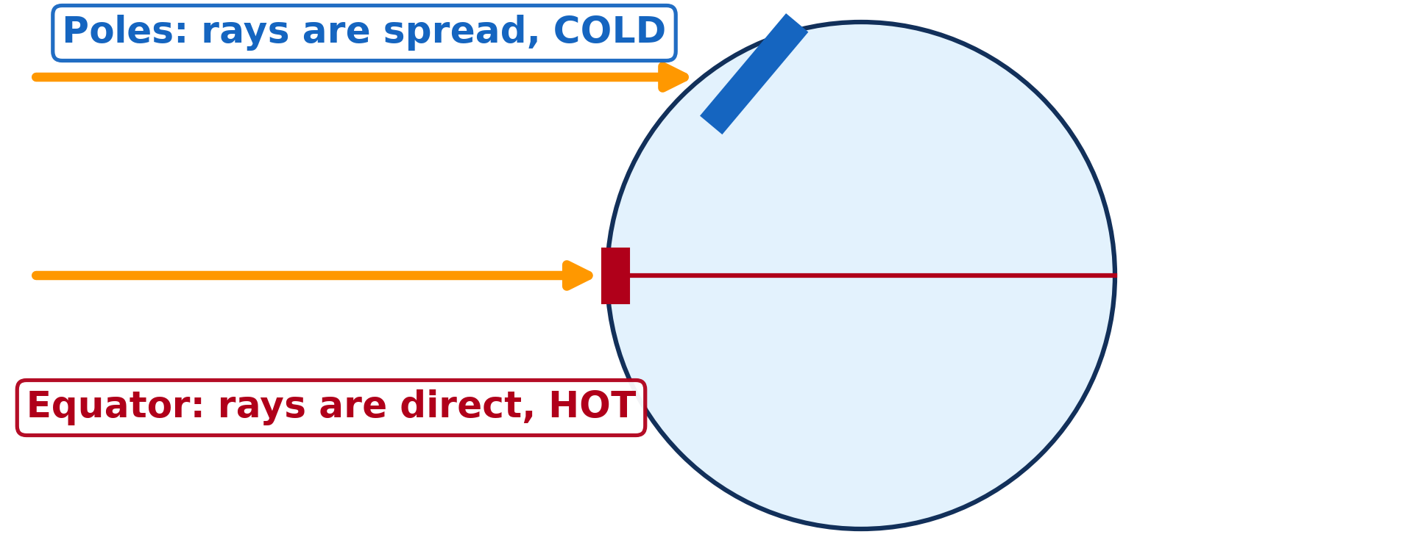
1. LATITUDE
Activity 1
The Sun's rays reach the Earth.
Notes:
Activity 1. Look carefully at this diagram: the Sun's rays reach the Earth. Observe every detail before I ask the question.

Slide 20
1. LATITUDE
Activity 1: Question
Why is it hotter near the Equator than near the poles?
Notes:
Here is the question for Activity 1: Why is it hotter near the Equator than near the poles? Take one minute to think and write your answer in your rough notebook.

Slide 21
1. LATITUDE
Activity 1: Answer
The Sun's rays are direct near the Equator and slanting near the poles.
Notes:
Let us check the answer together. The Sun's rays are direct near the Equator and slanting near the poles.

Slide 22
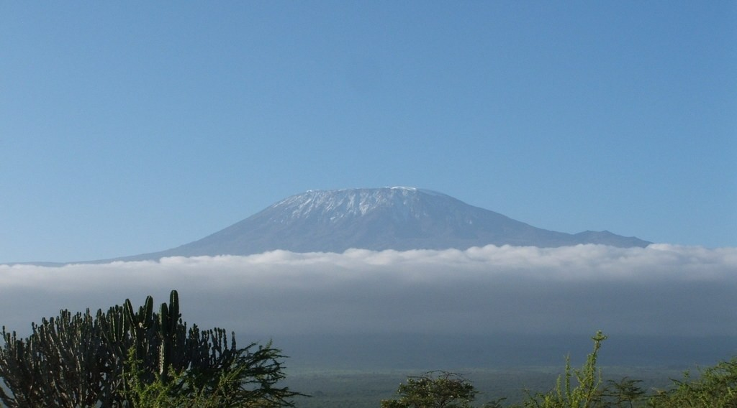
2. ALTITUDE
Activity 2
Snow on Mount Kilimanjaro.
Notes:
Activity 2. Look carefully at this picture: snow on Mount Kilimanjaro. Observe every detail before I ask the question.

Slide 23
2. ALTITUDE
Activity 2: Question
Why is there snow on a mountain near the Equator?
Notes:
Here is the question for Activity 2: Why is there snow on a mountain near the Equator? Take one minute to think and write your answer in your rough notebook.

Slide 24
2. ALTITUDE
Activity 2: Answer
It is very high, and temperature falls with height.
Notes:
Let us check the answer together. It is very high, and temperature falls with height.

Slide 25
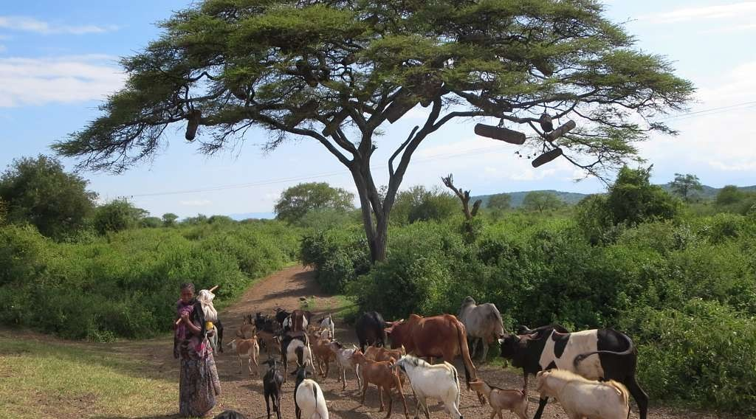
6. VEGETATION
Activity 3
Cattle under trees.
Notes:
Activity 3. Look carefully at this picture: cattle under trees. Observe every detail before I ask the question.

Slide 26
6. VEGETATION
Activity 3: Question
Why is it cooler under trees?
Notes:
Here is the question for Activity 3: Why is it cooler under trees? Take one minute to think and write your answer in your rough notebook.

Slide 27
6. VEGETATION
Activity 3: Answer
The leaves stop the Sun's rays and give shade.
Notes:
Let us check the answer together. The leaves stop the Sun's rays and give shade.

Slide 28
BOARD SUMMARY
Board Summary
Topic: The Earth-Atmosphere System
Sub-topic: Basic Notions of Climate
Lesson 38: Factors of Temperature
Notes:
Now we are going to copy the board summary. Write the title and the headings neatly in your notebooks. I will give you enough time for each slide, so do not rush.

Slide 29
BOARD SUMMARY
DEFINITIONS
The key terms of this lesson are defined as follows:
Factor of temperature: It is anything that makes a place hotter or cooler than another place.
Lapse rate: It is the fall of temperature with height, about 6.5 °C every 1,000 m.
Notes:
Let us copy the definitions. The key terms of this lesson are defined as follows. On this slide we have Factor of temperature and Lapse rate. Write each point on a new line, with the key term first, and explain it in your own words when we revise.

Slide 30
BOARD SUMMARY
Factors of Temperature
Temperature is affected by the following factors:
1. Latitude: Near the Equator the Sun's rays are direct and hot, while towards the poles they are slanting and spread over a larger area.
Illustration: the Sun's rays and latitude
Notes:
Let us copy Factors of Temperature. Temperature is affected by the following factors. Copy the point on 1. Latitude on the left, then draw the diagram on the right: the Sun's rays and latitude. Give it a title and label it clearly.

Slide 31
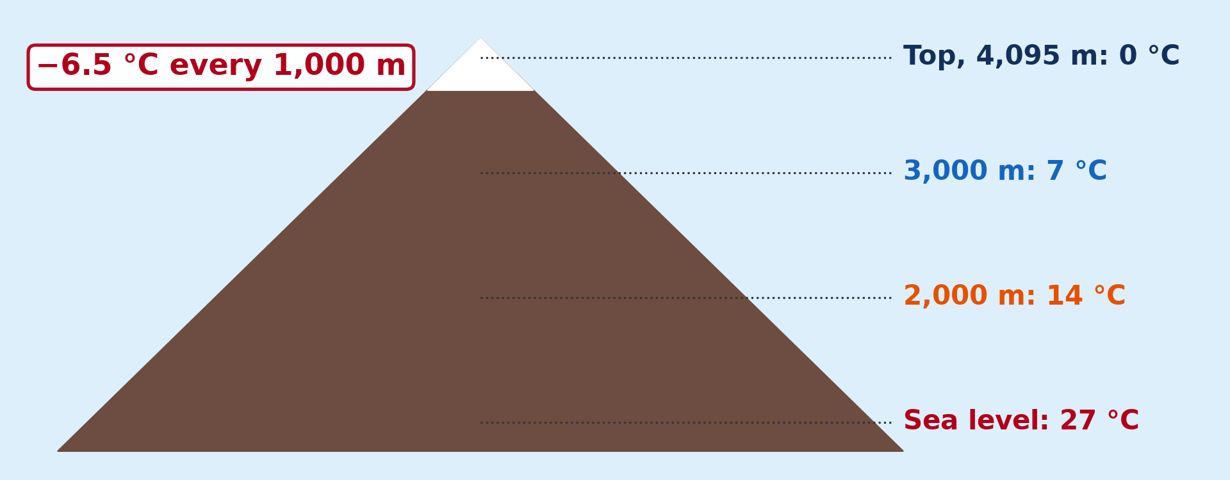
BOARD SUMMARY
Factors of Temperature
2. Altitude: Temperature falls by about 6.5 °C for every 1,000 m of height, so Dschang is cooler than Douala.
Illustration: temperature and altitude
Notes:
Copy the point on 2. Altitude on the left, then draw the diagram on the right: temperature and altitude. Give it a title and label it clearly.

Slide 32
BOARD SUMMARY
Factors of Temperature
3. Cloud cover: Clouds keep out the Sun by day and keep in the heat at night, so cloudy places have a small range.
4. Air masses and winds: Winds bring the temperature of the places they come from, like the dry, cool Harmattan nights.
Notes:
We continue with Factors of Temperature. On this slide we have 3. Cloud cover and 4. Air masses and winds. Write each point on a new line, with the key term first, and explain it in your own words when we revise.

Slide 33
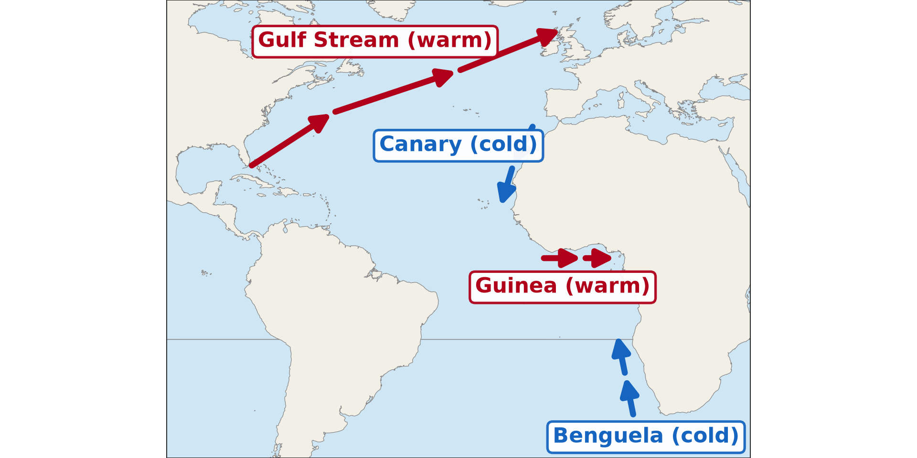
BOARD SUMMARY
Factors of Temperature
5. Ocean currents and distance from the sea: Warm currents warm coasts and cold currents cool them, while the sea keeps coastal towns like Douala mild.
Illustration: ocean currents
Notes:
Copy the point on 5. Ocean currents and distance from the sea on the left, then draw the diagram on the right: ocean currents. Give it a title and label it clearly.

Slide 34
BOARD SUMMARY
Factors of Temperature
6. Vegetation: Forests and trees shade the ground and cool the air.
7. Human activities: Towns with concrete, tar, factories and cars are hotter than the countryside.
Notes:
We continue with Factors of Temperature. On this slide we have 6. Vegetation and 7. Human activities. Write each point on a new line, with the key term first, and explain it in your own words when we revise.

Slide 35
FORMATIVE EVALUATION
Evaluation 1
Why is Dschang cooler than Douala?
Notes:
Now let us check what you have understood. Question 1: Why is Dschang cooler than Douala? Answer in your exercise book.

Slide 36
FORMATIVE EVALUATION
Expected Answer
It is higher (altitude).
Notes:
The expected answer is: it is higher (altitude). If you got it right, well done.

Slide 37
FORMATIVE EVALUATION
Evaluation 2
Why is Douala's temperature range small?
Notes:
Now let us check what you have understood. Question 2: Why is Douala's temperature range small? Answer in your exercise book.

Slide 38
FORMATIVE EVALUATION
Expected Answer
It is near the sea.
Notes:
The expected answer is: it is near the sea. If you got it right, well done.

Slide 39
REMEDIATION
Remediation
Fill in the blanks:
Temperature falls when ______ increases.
At the Equator, the sun rays are ______.
Places near the sea have a ______ temperature range.
Notes:
For those who need more practice, fill in the blanks in your exercise book. The answers are: number 1, altitude; number 2, direct; number 3, small.

Slide 40
HOMEWORK
Homework
Name the four main stages of the water cycle.
Notes:
For your homework: Name the four main stages of the water cycle. We shall correct it at the beginning of our next lesson.

Slide 41
NEXT LESSON
Next Lesson
Our next lesson will be on:
Lesson 39: The Hydrological Cycle
Notes:
Our next lesson will be on Lesson 39: The Hydrological Cycle. Thank you for your attention, and see you next time.

Slide 42
BILINGUAL GAME
Bilingual Game (Jeu Bilingue)
English | Français
Factor | Le facteur
Latitude | La latitude
Altitude | L'altitude
Cloud cover | La nébulosité
Air mass | La masse d'air
Ocean current | Le courant marin
Vegetation | La végétation
Heat island | L'îlot de chaleur
Notes:
Let us play the bilingual game. I say a word in English, and you give me the French word. Then we do the reverse.

Slide 43
LOGBOOK
Official Logbook (1/2)
Module / Topic | The Earth-Atmosphere System
Lesson Title | Lesson 38: Factors of Temperature
Expected Learning Outcomes | Identify the main factors that affect temperature. Explain how each factor makes a place hotter or cooler. Use these factors to compare temperatures in Cameroon.
Competence | Learners are able to explain why one place is hotter or cooler than another, and to choose shade, trees and building materials that reduce heat.
Notes:
I record this information in the official logbook of the class after the lesson.

Slide 44
LOGBOOK
Official Logbook (2/2)
Matter Taught | DEFINITIONS; Factors of Temperature.
Evaluation | Formative evaluation and remediation exercise.
Homework | Name the four main stages of the water cycle.
Enrolment / Present / Absent | ____ / ____ / ____
Achievement | To be completed after the lesson.
Notes:
I complete the second page of the logbook: the matter taught, the evaluation, the homework and the attendance.

Slide 45
TEACHER'S NOTE
Teacher's Note
Timing: Homework correction, plan, objectives 4 min | Recall, situation, action 6 min | 3 activities 12 min | Board summary (copying) 15 min | Evaluation, remediation 5 min | Homework, next lesson 3 min | Logbook 5 min
Without the projector (Activity 1): shine a torch straight and at an angle on paper.
Without the projector (Activity 2): compare Douala and Dschang.
Without the projector (Activity 3): compare the school yard and a shady place.
Notes:
This slide is for me, the teacher: it gives the timing of the lesson and what to do if the projector is not available.

Slide 46
REFERENCES
References
National Geography Syllabus (MINESEC), Form 3 — Module 3: Weather and Climate.
Teacher's lesson notes (f4.docx), checked and corrected where necessary.
Climate normals of Cameroonian towns (via Wikipedia climate tables: NOAA, WMO).
Photo, Activity 2: “Kilimanjaro” by ian 1602, CC BY-NC 2.0, via Flickr (https://www.flickr.com/photos/98181641@N00/2179855841)
Photo, Activity 3: “Acacia Tree” by D-Stanley, CC BY 2.0, via Flickr (https://www.flickr.com/photos/79721788@N00/11527335486)
Diagrams and animations: drawn for this lesson (Geography Department).
Notes:
These are the references and picture credits used to prepare this lesson.

