Slide 1
FORM 3
GEOGRAPHY
Lesson 41
Floods, Droughts and Desertification
Notes:
Good morning, class, and welcome to our geography lesson. I am your geography teacher, Madam Che. Today we are starting Lesson 41: Floods, Droughts and Desertification.

Slide 2
CLASS INFO
Class, Chapter and Duration
Class | Form 3
Chapter | Module 3: Weather and Climate — Adaptation to Climatic Excesses
Duration | 50 minutes
Notes:
This lesson is for Form 3. It belongs to Module 3: Weather and Climate — Adaptation to Climatic Excesses. We shall need 50 minutes to cover it.

Slide 3
IDENTIFICATION
Lesson Identification
Topic | Management of Climate and Hydrological Related Hazards
Sub-topic | Hydro-climatic Hazards
Lesson | Lesson 41: Floods, Droughts and Desertification
Notions / Concepts | Floods, droughts, desertification.
Syllabus focus | Meaning (definition and area of occurrence); causes; effects; adaptations and mitigations.
Competence | Learners are able to recognise the risks of floods and drought in their area and to take actions to protect their families, crops and land.
Notes:
Our topic is Management of Climate and Hydrological Related Hazards, and the sub-topic is Hydro-climatic Hazards. The key notions we shall use today are: floods, droughts, desertification. At the end, you should be able to do this: learners are able to recognise the risks of floods and drought in their area and to take actions to protect their families, crops and land.

Slide 4

HOMEWORK CORRECTION
Correction of the Homework
Question (Lesson 40: Global Warming):
Define desertification.
Notes:
Before we start the new lesson, let us correct the homework I gave you at the end of Lesson 40: Global Warming. The question was: Define desertification. Take out your exercise books.

Slide 5
HOMEWORK CORRECTION
Correction: Possible Answer
It is the lasting spread of desert conditions into dry lands.
Notes:
Here is a good answer. It is the lasting spread of desert conditions into dry lands. Compare it with your own answer and correct your work in red.

Slide 6
LESSON PLAN
Lesson Plan
Correction of the homework
Objectives and recall
Real-life situation and action to take
Learning activities
Board summary
Evaluation, remediation and homework
Notes:
Here is the plan of our lesson today. First, we shall correct the homework. Then we shall look at the objectives and recall what you already know. After that, we shall study a situation from real life and the action to take, and do the learning activities. Finally, we shall copy the board summary, do the evaluation and the remediation, and I will give you the homework.

Slide 7
OBJECTIVES
Objectives
By the end of this lesson, you should be able to:
Define floods, droughts and desertification and give their areas of occurrence.
Explain their causes.
Notes:
Take your time to copy this part; we will continue together.

Slide 8
OBJECTIVES
Objectives (continued)
Describe their effects.
Propose adaptation and mitigation measures.
Notes:
By the end of this lesson, you should be able to do four things. Number 1: define floods, droughts and desertification and give their areas of occurrence. Number 2: explain their causes. Number 3: describe their effects. Number 4: propose adaptation and mitigation measures.

Slide 9
PREVIOUS KNOWLEDGE
Previous Knowledge
Global warming is the long-term rise of the Earth's temperature.
It makes droughts and floods more frequent.
Mitigation reduces its causes; adaptation helps people to live with its effects.
Notes:
Let us first remember what you already know. Global warming is the long-term rise of the Earth's temperature. It makes droughts and floods more frequent. Mitigation reduces its causes; adaptation helps people to live with its effects. Keep this in mind, because we shall build on it today.

Slide 10
REAL-LIFE SITUATION
Situation in Real Life
In September 2012, floods destroyed villages along the Benue in northern Cameroon. Six months later, in the Far North, the rains stopped early, the crops dried up and sand covered some fields. A pupil asks: "How can the same region suffer from too much water and too little water, and what can people do?"
Notes:
Listen carefully to this situation from real life. In September 2012, floods destroyed villages along the Benue in northern Cameroon. Six months later, in the Far North, the rains stopped early, the crops dried up and sand covered some fields. A pupil asks: "How can the same region suffer from too much water and too little water, and what can people do?" Think about it, because I am going to ask you some questions.

Slide 11
REAL-LIFE SITUATION
Situation: Question 1
What is the problem in the situation?
Notes:
Question 1: What is the problem in the situation? Think for a moment, then raise your hand to answer.

Slide 12
REAL-LIFE SITUATION
Answer
The pupil does not understand how the region suffers both floods and droughts, and what can be done.
Notes:
Good. The pupil does not understand how the region suffers both floods and droughts, and what can be done.

Slide 13
REAL-LIFE SITUATION
Situation: Question 2
What happened along the Benue in 2012?
Notes:
Question 2: What happened along the Benue in 2012? Think for a moment, then raise your hand to answer.

Slide 14
REAL-LIFE SITUATION
Answer
Floods destroyed villages.
Notes:
Good. Floods destroyed villages.

Slide 15
REAL-LIFE SITUATION
Situation: Question 3
What happened in the Far North?
Notes:
Question 3: What happened in the Far North? Think for a moment, then raise your hand to answer.

Slide 16
REAL-LIFE SITUATION
Possible Answer
The rains stopped early and the crops dried up.
Notes:
Good. The rains stopped early and the crops dried up.

Slide 17
ACTION TO TAKE
Action to Take
Plant trees, avoid bush fires and prepare for floods and droughts.
Notes:
From this situation, the action we are working towards in this lesson is the following: plant trees, avoid bush fires and prepare for floods and droughts.

Slide 18
JUSTIFICATION
Justification of the Lesson
This lesson helps us to know floods, droughts and desertification.
Notes:
Why is this lesson important for you? This lesson helps us to know floods, droughts and desertification.

Slide 19
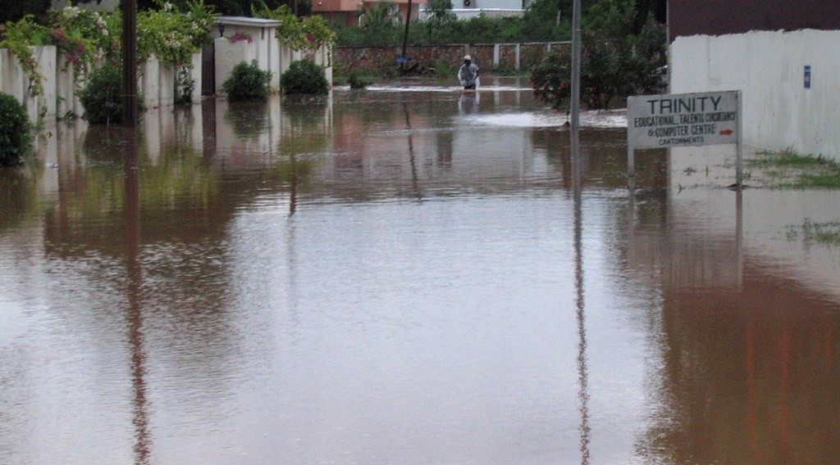
1. FLOODS
Activity 1
A flooded village.
Notes:
Activity 1. Look carefully at this picture: a flooded village. Observe every detail before I ask the question.

Slide 20
1. FLOODS
Activity 1: Question
Give one cause of the floods along the Benue.
Notes:
Here is the question for Activity 1: Give one cause of the floods along the Benue. Take one minute to think and write your answer in your rough notebook.

Slide 21
1. FLOODS
Activity 1: Answer
Heavy rain (or water released from the Lagdo Dam).
Notes:
Let us check the answer together. Heavy rain (or water released from the Lagdo Dam).

Slide 22
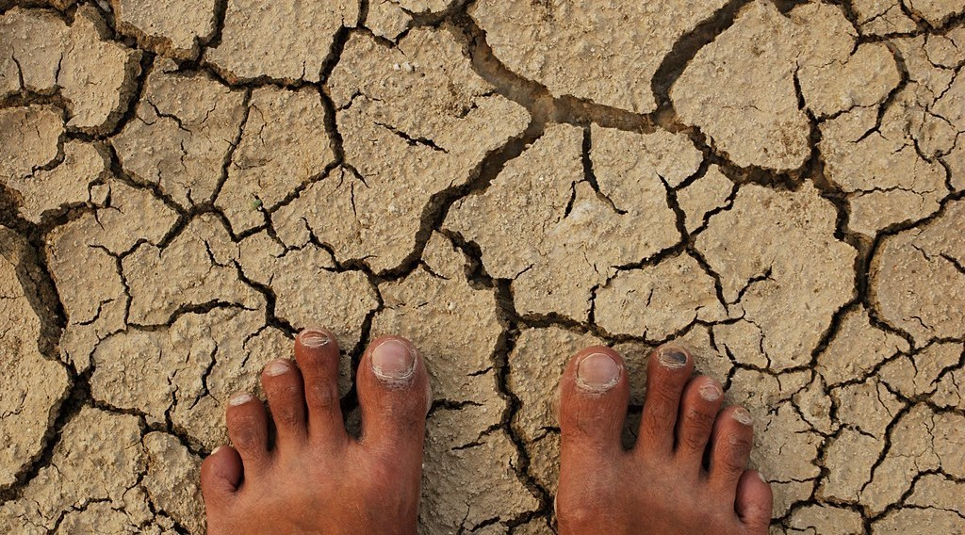
2. DROUGHTS
Activity 2
Dry, cracked land.
Notes:
Activity 2. Look carefully at this picture: dry, cracked land. Observe every detail before I ask the question.

Slide 23
2. DROUGHTS
Activity 2: Question
What is the difference between a drought and desertification?
Notes:
Here is the question for Activity 2: What is the difference between a drought and desertification? Take one minute to think and write your answer in your rough notebook.

Slide 24
2. DROUGHTS
Activity 2: Answer
A drought is a period without enough rain; desertification is the lasting spread of desert conditions.
Notes:
Let us check the answer together. A drought is a period without enough rain; desertification is the lasting spread of desert conditions.

Slide 25
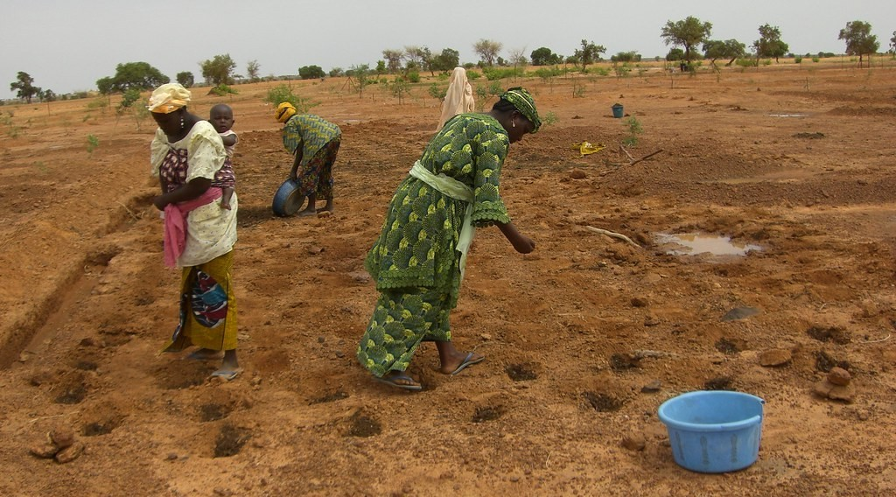
3. DESERTIFICATION
Activity 3
Planting pits in dry land.
Notes:
Activity 3. Look carefully at this picture: planting pits in dry land. Observe every detail before I ask the question.

Slide 26
3. DESERTIFICATION
Activity 3: Question
How do these pits help farmers in dry areas?
Notes:
Here is the question for Activity 3: How do these pits help farmers in dry areas? Take one minute to think and write your answer in your rough notebook.

Slide 27
3. DESERTIFICATION
Activity 3: Answer
They keep water and manure near the plants.
Notes:
Let us check the answer together. They keep water and manure near the plants.

Slide 28
BOARD SUMMARY
Board Summary
Topic: Management of Climate and Hydrological Related Hazards
Sub-topic: Hydro-climatic Hazards
Lesson 41: Floods, Droughts and Desertification
Notes:
Now we are going to copy the board summary. Write the title and the headings neatly in your notebooks. I will give you enough time for each slide, so do not rush.

Slide 29
BOARD SUMMARY
DEFINITIONS
The key terms of this lesson are defined as follows:
Flood: It is the covering by water of land that is usually dry.
Drought: It is a long period with much less rain than normal.
Notes:
Let us copy the definitions. The key terms of this lesson are defined as follows. On this slide we have Flood and Drought. Write each point on a new line, with the key term first, and explain it in your own words when we revise. When you finish, we go to the next slide.

Slide 30
BOARD SUMMARY
DEFINITIONS (continued)
Desertification: It is the lasting spread of desert conditions into dry lands.
Notes:
We continue with the definitions. On this slide we have Desertification. Write each point on a new line, with the key term first, and explain it in your own words when we revise.

Slide 31
BOARD SUMMARY
1. Floods
A) Areas of Occurrence
Floods occur in the following areas:
River valleys: Along the Benue, the Logone and the Chari.
Illustration: a flooded village
Notes:
Let us copy Areas of Occurrence. Floods occur in the following areas. Copy the point on River valleys on the left, then draw the diagram on the right: a flooded village. Give it a title and label it clearly.

Slide 32
BOARD SUMMARY
1. Floods
A) Areas of Occurrence
Towns: In low quarters of Douala, Yaoundé and many other towns.
Notes:
We continue with Areas of Occurrence. On this slide we have Towns. Write each point on a new line, with the key term first, and explain it in your own words when we revise.

Slide 33
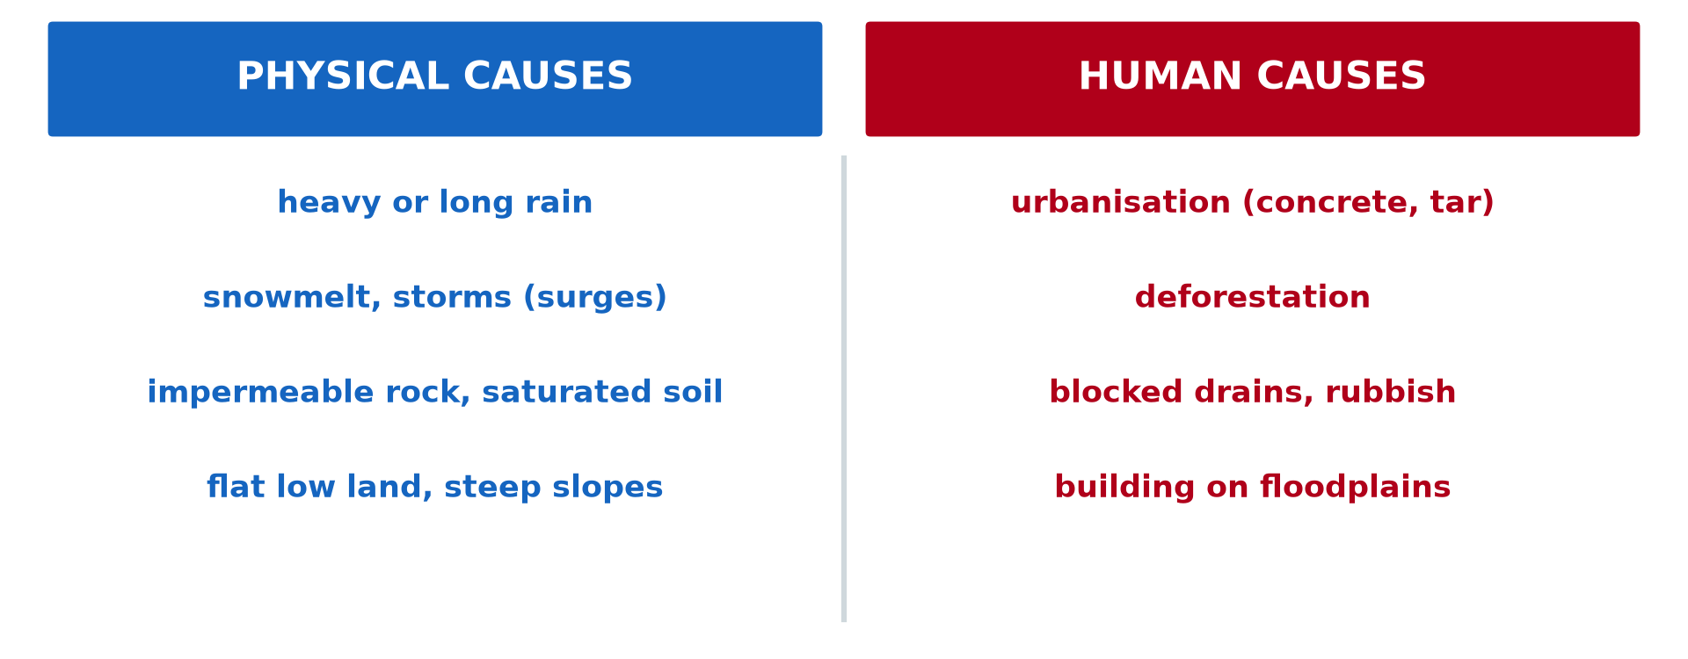
BOARD SUMMARY
1. Floods
B) Causes
Floods are caused by the following factors:
Heavy rain: Rivers overflow after long or very strong rains.
Illustration: causes of floods
Notes:
Let us copy Causes. Floods are caused by the following factors. Copy the point on Heavy rain on the left, then draw the diagram on the right: causes of floods. Give it a title and label it clearly.

Slide 34
BOARD SUMMARY
1. Floods
B) Causes
Water released from dams: Water released from the Lagdo Dam raises the Benue.
Blocked drains: Rubbish blocks gutters in towns.
Building on floodplains: Houses are built on low land near rivers.
Notes:
We continue with Causes. On this slide we have Water released from dams, Blocked drains and Building on floodplains. Write each point on a new line, with the key term first, and explain it in your own words when we revise.

Slide 35
BOARD SUMMARY
1. Floods
C) Effects
Floods have the following effects:
Destruction: Houses, crops and roads are destroyed.
Loss of life: People and animals drown.
Diseases: Cholera and malaria spread.
Notes:
Let us copy Effects. Floods have the following effects. On this slide we have Destruction, Loss of life and Diseases. Write each point on a new line, with the key term first, and explain it in your own words when we revise.

Slide 36
BOARD SUMMARY
1. Floods
D) Adaptation and Mitigation
Flood damage is reduced by the following measures:
Dykes: Walls of earth hold back the river.
Clean drains: Gutters are kept free of rubbish.
Notes:
Let us copy Adaptation and Mitigation. Flood damage is reduced by the following measures. On this slide we have Dykes and Clean drains. Write each point on a new line, with the key term first, and explain it in your own words when we revise. When you finish, we go to the next slide.

Slide 37
BOARD SUMMARY
1. Floods
D) Adaptation and Mitigation (continued)
Early warnings: People are warned before the water rises.
Building on high ground: Houses are built away from floodplains.
Notes:
We continue with Adaptation and Mitigation. On this slide we have Early warnings and Building on high ground. Write each point on a new line, with the key term first, and explain it in your own words when we revise.

Slide 38
BOARD SUMMARY
2. Droughts
A) Areas of Occurrence
Droughts occur in the following areas:
The Sahel: It includes the North and the Far North of Cameroon.
Illustration: dry land
Notes:
Let us copy Areas of Occurrence. Droughts occur in the following areas. Copy the point on The Sahel on the left, then draw the diagram on the right: dry land. Give it a title and label it clearly.

Slide 39
BOARD SUMMARY
2. Droughts
B) Causes
Droughts are caused by the following factors:
Low and irregular rainfall: Too little rain falls, or it stops too early.
Very high temperatures: Heat dries the soil and the plants.
Notes:
Let us copy Causes. Droughts are caused by the following factors. On this slide we have Low and irregular rainfall and Very high temperatures. Write each point on a new line, with the key term first, and explain it in your own words when we revise. When you finish, we go to the next slide.

Slide 40
BOARD SUMMARY
2. Droughts
B) Causes (continued)
A long dry season: No rain falls for many months.
Notes:
We continue with Causes. On this slide we have A long dry season. Write each point on a new line, with the key term first, and explain it in your own words when we revise.

Slide 41
BOARD SUMMARY
2. Droughts
C) Effects
Droughts have the following effects:
Crop failure: Crops dry up and harvests are poor.
Death of animals: Cattle and goats die of thirst and hunger.
Drying wells: Wells and rivers dry up.
Notes:
Let us copy Effects. Droughts have the following effects. On this slide we have Crop failure, Death of animals and Drying wells. Write each point on a new line, with the key term first, and explain it in your own words when we revise. When you finish, we go to the next slide.

Slide 42
BOARD SUMMARY
2. Droughts
C) Effects (continued)
Hunger and migration: People suffer hunger and leave their villages.
Notes:
We continue with Effects. On this slide we have Hunger and migration. Write each point on a new line, with the key term first, and explain it in your own words when we revise.

Slide 43
BOARD SUMMARY
2. Droughts
D) Adaptation and Mitigation
The effects of droughts are reduced by the following measures:
Irrigation: Crops are watered from rivers and wells.
Water storage: Rainwater is kept in tanks and ponds.
Notes:
Let us copy Adaptation and Mitigation. The effects of droughts are reduced by the following measures. On this slide we have Irrigation and Water storage. Write each point on a new line, with the key term first, and explain it in your own words when we revise. When you finish, we go to the next slide.

Slide 44
BOARD SUMMARY
2. Droughts
D) Adaptation and Mitigation (continued)
Drought-resistant crops: Farmers grow millet and sorghum.
Food reserves: Grain is stored for bad years.
Notes:
We continue with Adaptation and Mitigation. On this slide we have Drought-resistant crops and Food reserves. Write each point on a new line, with the key term first, and explain it in your own words when we revise.

Slide 45
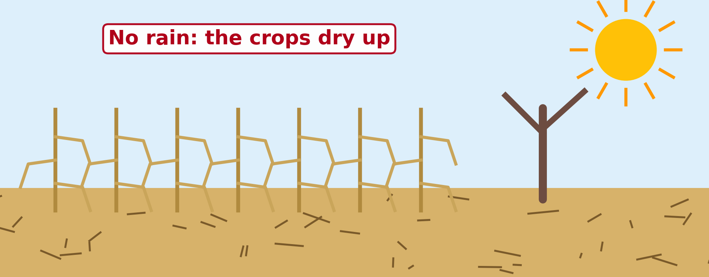
BOARD SUMMARY
3. Desertification
A) Areas of Occurrence
Desertification occurs in the following areas:
The Sahel: It includes the Far North of Cameroon around Lake Chad.
Illustration: crops dried by drought
Notes:
Let us copy Areas of Occurrence. Desertification occurs in the following areas. Copy the point on The Sahel on the left, then draw the diagram on the right: crops dried by drought. Give it a title and label it clearly.

Slide 46
BOARD SUMMARY
3. Desertification
B) Causes
Desertification is caused by the following factors:
Overgrazing: Too many animals eat all the grass.
Cutting trees: Trees are cut for firewood.
Bush fires: Fires destroy the plant cover.
Notes:
Let us copy Causes. Desertification is caused by the following factors. On this slide we have Overgrazing, Cutting trees and Bush fires. Write each point on a new line, with the key term first, and explain it in your own words when we revise. When you finish, we go to the next slide.

Slide 47
BOARD SUMMARY
3. Desertification
B) Causes (continued)
Repeated droughts: Many dry years kill the vegetation.
Notes:
We continue with Causes. On this slide we have Repeated droughts. Write each point on a new line, with the key term first, and explain it in your own words when we revise.

Slide 48
BOARD SUMMARY
3. Desertification
C) Effects
Desertification has the following effects:
Poor soils: Soils lose their fertility.
Moving sand: Sand covers fields and roads.
Water shortage: Water becomes scarce.
Migration: People leave the area.
Notes:
Let us copy Effects. Desertification has the following effects. On this slide we have Poor soils, Moving sand, Water shortage and Migration. Write each point on a new line, with the key term first, and explain it in your own words when we revise.

Slide 49
BOARD SUMMARY
3. Desertification
D) Adaptation and Mitigation
Desertification is stopped by the following measures:
Tree planting: Operation Sahel Vert and the Great Green Wall plant trees.
Notes:
Let us copy Adaptation and Mitigation. Desertification is stopped by the following measures. On this slide we have Tree planting. Write each point on a new line, with the key term first, and explain it in your own words when we revise.

Slide 50
BOARD SUMMARY
3. Desertification
D) Adaptation and Mitigation
Zaï pits: Small pits keep water and manure near the plants.
Illustration: zaï planting pits
Notes:
Copy the point on Zaï pits on the left, then draw the diagram on the right: zaï planting pits. Give it a title and label it clearly.

Slide 51
BOARD SUMMARY
3. Desertification
D) Adaptation and Mitigation
Stone lines: Lines of stones slow down runoff.
Control of grazing: The number of animals is limited.
Notes:
We continue with Adaptation and Mitigation. On this slide we have Stone lines and Control of grazing. Write each point on a new line, with the key term first, and explain it in your own words when we revise.

Slide 52
FORMATIVE EVALUATION
Evaluation 1
What is desertification?
Notes:
Now let us check what you have understood. Question 1: What is desertification? Answer in your exercise book.

Slide 53
FORMATIVE EVALUATION
Expected Answer
The spread of the desert.
Notes:
The expected answer is: the spread of the desert. If you got it right, well done.

Slide 54
FORMATIVE EVALUATION
Evaluation 2
Give one way to fight desertification.
Notes:
Now let us check what you have understood. Question 2: Give one way to fight desertification. Answer in your exercise book.

Slide 55
FORMATIVE EVALUATION
Expected Answer
Plant trees (or stop overgrazing).
Notes:
The expected answer is: plant trees (or stop overgrazing). If you got it right, well done.

Slide 56
REMEDIATION
Remediation
Fill in the blanks:
A long period without enough rain is a ______.
The spread of the desert is ______.
In 2012, water from the ______ Dam flooded villages.
Notes:
For those who need more practice, fill in the blanks in your exercise book. The answers are: number 1, drought; number 2, desertification; number 3, Lagdo.

Slide 57
HOMEWORK
Homework
Give two causes of water scarcity.
Notes:
For your homework: Give two causes of water scarcity. We shall correct it at the beginning of our next lesson.

Slide 58
NEXT LESSON
Next Lesson
Our next lesson will be on:
Lesson 42: Water Scarcity
Notes:
Our next lesson will be on Lesson 42: Water Scarcity. Thank you for your attention, and see you next time.

Slide 59
BILINGUAL GAME
Bilingual Game (Jeu Bilingue)
English | Français
Flood | L'inondation
Drought | La sécheresse
Desertification | La désertification
Floodplain | La plaine d'inondation
Dyke | La digue
Famine | La famine
Overgrazing | Le surpâturage
Early warning | L'alerte précoce
Notes:
Let us play the bilingual game. I say a word in English, and you give me the French word. Then we do the reverse.

Slide 60
LOGBOOK
Official Logbook (1/2)
Module / Topic | Management of Climate and Hydrological Related Hazards
Lesson Title | Lesson 41: Floods, Droughts and Desertification
Expected Learning Outcomes | Define floods, droughts and desertification and give their areas of occurrence. Explain their causes. Describe their effects. Propose adaptation and mitigation measures.
Competence | Learners are able to recognise the risks of floods and drought in their area and to take actions to protect their families, crops and land.
Notes:
I record this information in the official logbook of the class after the lesson.

Slide 61
LOGBOOK
Official Logbook (2/2)
Matter Taught | DEFINITIONS; Areas of Occurrence; Causes; Effects; Adaptation and Mitigation.
Evaluation | Formative evaluation and remediation exercise.
Homework | Give two causes of water scarcity.
Enrolment / Present / Absent | ____ / ____ / ____
Achievement | To be completed after the lesson.
Notes:
I complete the second page of the logbook: the matter taught, the evaluation, the homework and the attendance.

Slide 62
TEACHER'S NOTE
Teacher's Note
Timing: Homework correction, plan, objectives 4 min | Recall, situation, action 6 min | 3 activities 12 min | Board summary (copying) 15 min | Evaluation, remediation 5 min | Homework, next lesson 3 min | Logbook 5 min
Without the projector (Activity 1): describe the flood of 2012.
Without the projector (Activity 2): compare a dry year and a spreading desert.
Without the projector (Activity 3): describe the zaï method.
Notes:
This slide is for me, the teacher: it gives the timing of the lesson and what to do if the projector is not available.

Slide 63
REFERENCES
References
National Geography Syllabus (MINESEC), Form 3 — Module 3: Weather and Climate.
Teacher's lesson notes (f4.docx), checked and corrected where necessary.
MINEPDED: Opération Sahel Vert; African Union: Great Green Wall.
Photo, Activity 1: “Flood in Accra” by Stig Nygaard, CC BY 2.0, via Flickr (https://www.flickr.com/photos/10259776@N00/181742000)
Photo, Activity 2: “Imagine a world without trees” by aloshbennett, CC BY 2.0, via Flickr (https://www.flickr.com/photos/13203757@N00/3480223314)
Photo, Activity 3: “Women sowing okra in zai holes” by abossuet, CC BY-NC 2.0, via Flickr (https://www.flickr.com/photos/30450178@N07/7175750825)
Diagrams and animations: drawn for this lesson (Geography Department).
Notes:
These are the references and picture credits used to prepare this lesson.

